Slide 1
SS8H1 b.
What impact did European contact have on Native American cultures; including Spanish missions along the barrier islands and settlement of Hernando DeSoto?

Slide 2
SS8H1 c.
Explain reasons for European exploration & settlement of North America, with emphasis on the interests of the French, Spanish, and British in the southeastern area.

Slide 3
ESSENTIAL QUESTION FOR YOUR JOURNAL
What impact did European contact have on the Native Americans in the New World?
Why did European countries (such as France, Spain, and Great Britain) explore and create colonies in North America? (3 G’s! GOD, GOLD, GLORY)
Notes:
3
This is an essential question for this section of the chapter.

Slide 4
Hernando DeSoto
In 1540, Spanish explorer Hernando DeSoto, with approximately 600 men, marched north from Tampa, Florida into southwest Georgia (near today’s Albany) in search of Gold.
DeSoto’s metal weapons, plated armor, war dogs, and horses overwhelmed the Native Americans; thousands of Georgia’s Native Americans died, many from diseases (such as Small Pox) brought by the Spaniards. DeSoto also brought pigs to the New World. These pigs were not used for food but were used for protection from reptiles.
Notes:
4

Slide 5
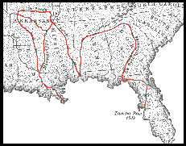

Slide 6
Spanish Missions
Mission – Definition: A religious church or station established in a foreign land to allow missionaries to spread their religion.
In 1566, Spain established missions on Georgia’s Cumberland Island and St. Catherine’s Island, called Santa Catalina. During the same century, posts were established at Sapelo and St. Simon’s Island.
The Spanish missionaries called the region Guale (pronounced “Wallie”) after the Guale Indians.
The missions were used by the Spanish to convert the Native Americans to Catholicism but also served as a trading post; Native Americans used the missions to integrate themselves into the European world.
Notes:
6

Slide 7
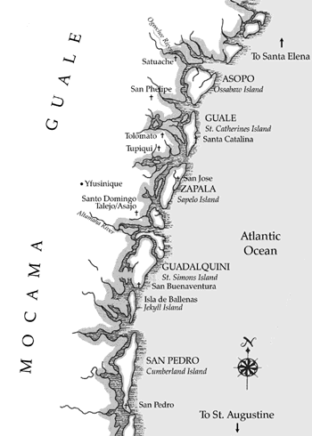

Slide 8
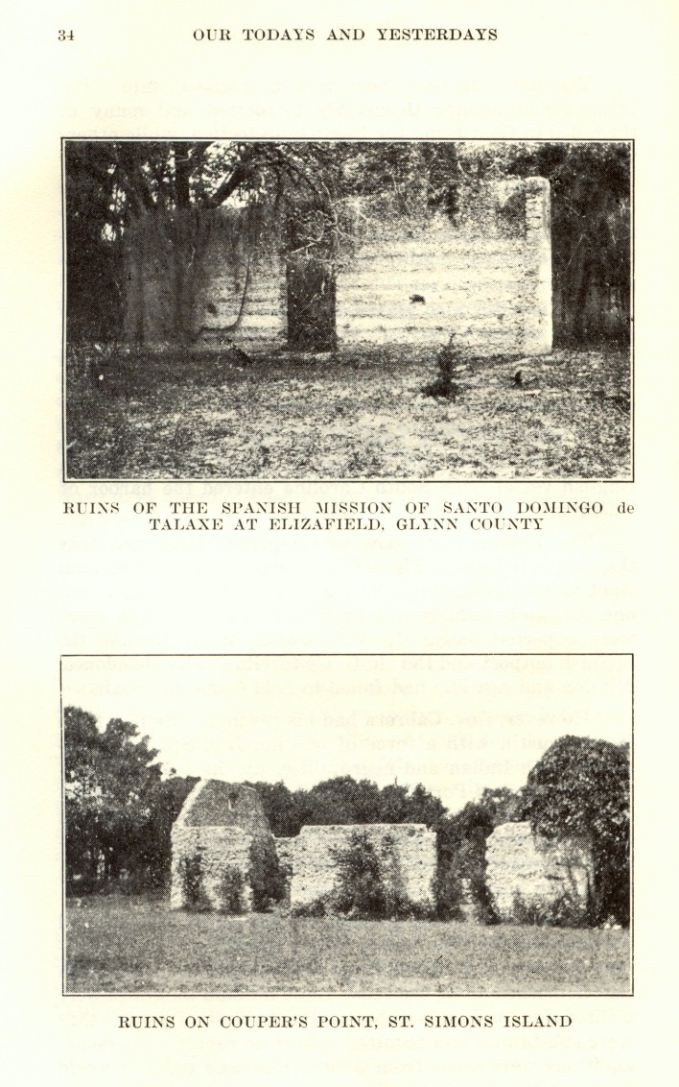

Slide 9
New World-Old World Exchanges
Both the New World (North and South America) and the Old World (Europe) benefited from exploration.
Brought to New World
Brought to Old World
Agricultural Products – Rye, radishes, beets, sugar cane, rice, peaches, and wheat all came from Europe to the New World.
Animals – Horses, chickens, pigs, oxen, sheep, goats, and cattle all came from Europe to the New World. Many of these animals had negative impacts as they destroyed the ground cover and led to the extinction of some native animals.
Agricultural Products – Corn, white potatoes, yams (sweet potatoes), peanuts, and pumpkins all came from the New World and were taken to Europe.
Animals – Turkeys were brought from the New World and taken to Europe.
Notes:
9

Slide 10
Reasons for European Exploration: French (France)
France began sending explorers to North America in 1562 in search of gold.
French explorers created a colony in South Carolina (Charlesfort in 1562) and Florida (Fort Caroline in 1564) but these were later taken over by the Spainsh.
Notes:
10

Slide 11
Reasons for European Exploration: Spanish (Spain)
Spain began sending explorers to the New World for God, glory, and gold.
Spain hoped to convert the Native Americans to Catholicism/Christianity (God), gain more power through the expansion of the Spanish Empire (glory), and discover new riches (gold).
Juan Ponce de Leon came to Florida as early as 1513; Hernando DeSoto was the first Spanish explorer to lead an expedition through Georgia.
Notes:
11

Slide 12
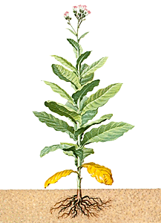
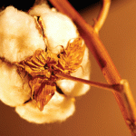
Reasons for European Exploration: British (Great Britain)
Great Britain (England) began sending explorers to the New World in the 1580’s in search of exotic foods, wealth (gold), and mercantilism.
Mercantilism – Economic system based on the belief that a country could increase its wealth by exporting more than they import.
The British wanted to create colonies that would help produce raw materials (cotton, tobacco, forest products, etc.) that could be imported into Great Britain. British companies would then refine these products and sell the finished product back to the colonies at a higher rate.
Notes:
12

Slide 13
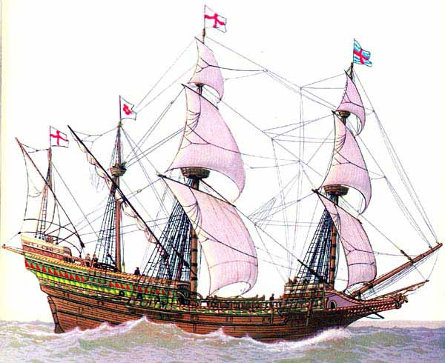
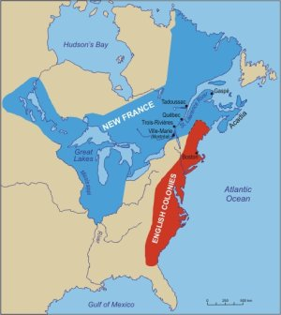
After the defeat of the Spanish Armada…
1600:
English began permanent settlements along the Atlantic coast
English
=
World dominant power

Slide 14
English Colonies
Why did they begin?
Religious refuge
Economic Gains
Bring Christianity to Natives
New Start
Mercantilism: Trade policy where England should export more than it imported.

Slide 15
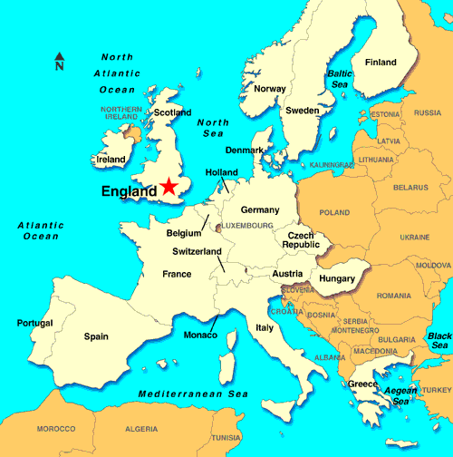
ENGLAND
Before mercantilism had to buy…
Cotton
Forest Products
Tobacco
Some Foods
After mercantilism
Colonies would produce raw materials and ship them to England. Then , finished goods would be made.

