Slide 1
Altmetrics:
Where are we and where
are we going?

Slide 2
Every researcher is a communicator
Within academia
Within society
Presentations and seminars
Funding and ethics applications
Academic books
Journal articles and posters
Term papers and essays
Meetings and conferences
Correspondence
Speaking at public events
Books for general audiences
Press
Social media
Blogs
How can we measure both
academic and societal research impact?

Slide 3
New perspectives of impact
Journal Impact Factor
Citation counts
Download counts
Page views
Mentions in news reports
Mentions in social media
Mentions in blogs
Reference manager readers
… etc.
ACADEMIC IMPACT
SOCIETAL IMPACT
+
Traditional metrics
Alternative metrics
“altmetrics”
Traditional metrics
More article-centric, as opposed to journal-centric.
Notes:
Focus has been shifting to metrics at the article level. Why should the value of a work be judged the journal it has been published in?

Slide 4
What are “altmetrics”?
“alternative metrics”
new ways of measuring different, non-traditional forms of impact.
“alternative to only using citations”, not “alternative to citations”.
complementary to traditional citation-based analysis.
Article-level metrics have come to refer to any metrics (e.g., including altmetrics) that surround a scholarly article.

Slide 5
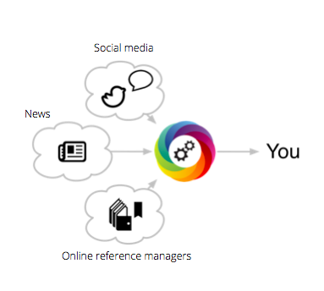
An article-centric approach
We measure online attention surrounding journal articles (and datasets).
We collect and deliver article-level metrics to journal publishers.

Slide 6
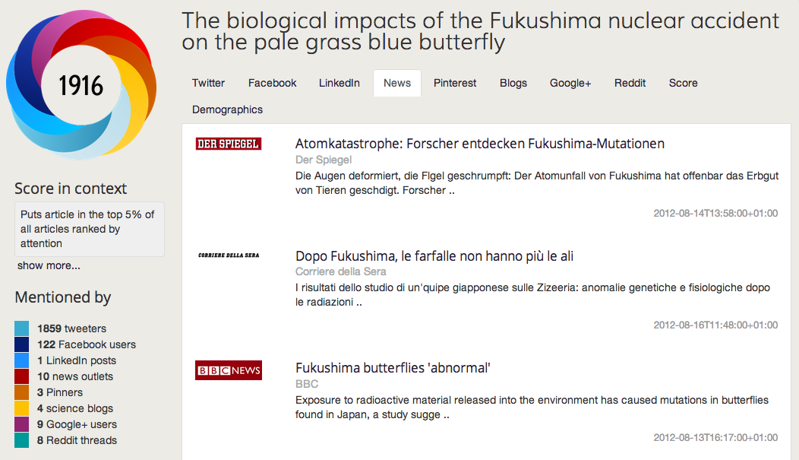
Altmetric Data: Details Pages
1
See all the conversations and mentions.
2
Monitor mentions in the mainstream news.
3
Estimate the amount of attention.
See article-level metrics and a score of attention below.
1
3
2

Slide 7
Use the conversations behind the metrics to…
1
Get an immediate sense of uptake.
2
Highlight broad engagement and impact.
3
Demonstrate non-traditional impact amongst non-academics.

Slide 8
The numbers…
X
Don’t represent the quality of research.
X
Don’t indicate the quality of individual researchers.
X
Don’t tell the whole story – look for qualitative data as well!

Slide 9
Altmetric currently receive ~3.3 million calls to the API each day.
Mentions for over 2 million articles.
1 mention every 7 seconds
Serving ~300k donuts a per day.
Article-level metrics are worth paying attention to.
Altmetric internal data, 2014

Slide 10
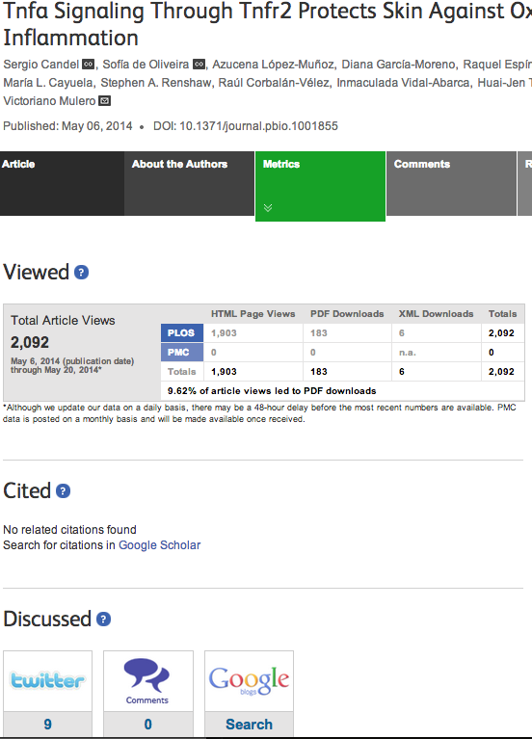
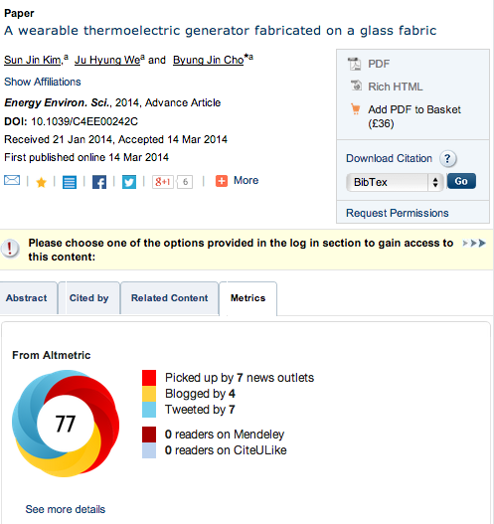
Publisher implementations

Slide 11
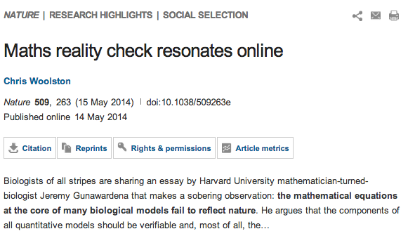
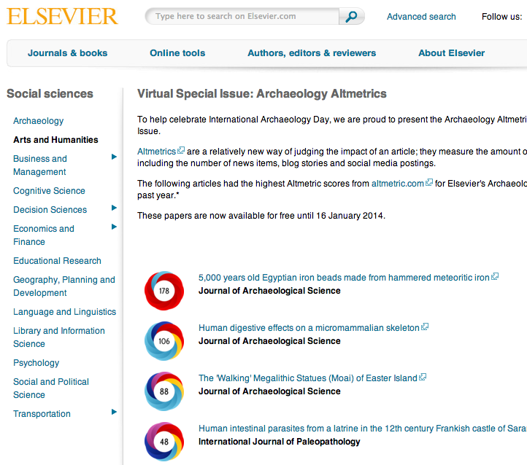
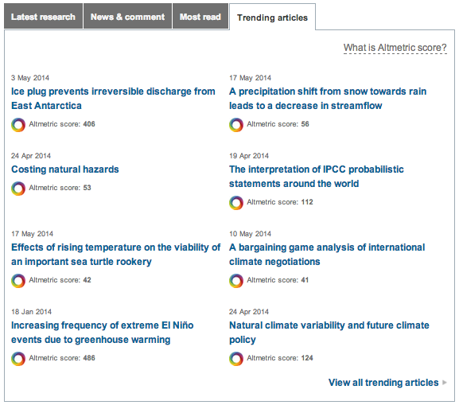
Publishers: marketing
Donuts can be easily embedded into email campaigns or journal homepages.

Slide 12
Feedback
65%
felt the
metrics
were useful
77%
agreed or strongly agreed that altmetrics enhanced the value of the journal article
50%
agreed that they were more likely to submit a paper to a journal that supports altmetrics
“Looking forward to the day I can put altmetric measures on my cv and have everyone who reads it know what they mean! I am a fan.”
— Britt Koskella (@bkoskella) July 2, 2013
Wiley survey, 2014
http://exchanges.wiley.com/blog/2014/03/19/wiley-introduces-altmetrics-to-its-open-access-journals/

Slide 13
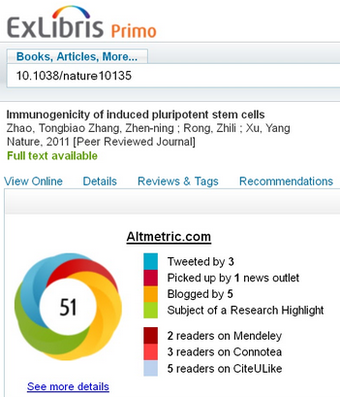
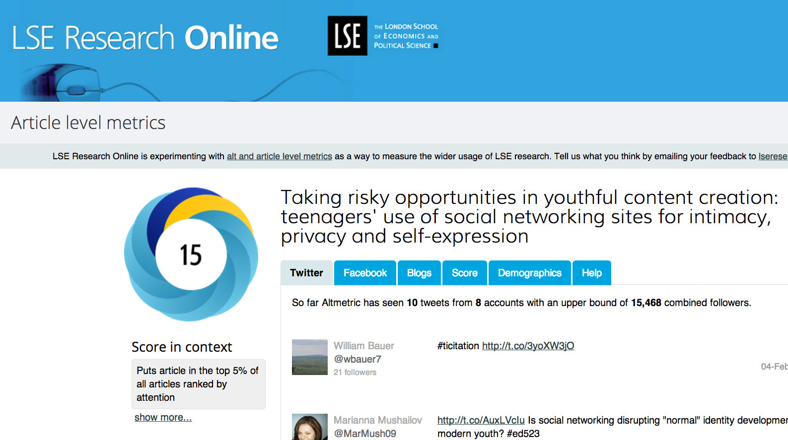
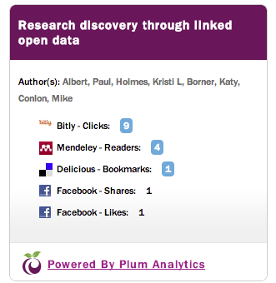
Institutions
Repositories
Library discovery platforms
Staff web pages

Slide 14
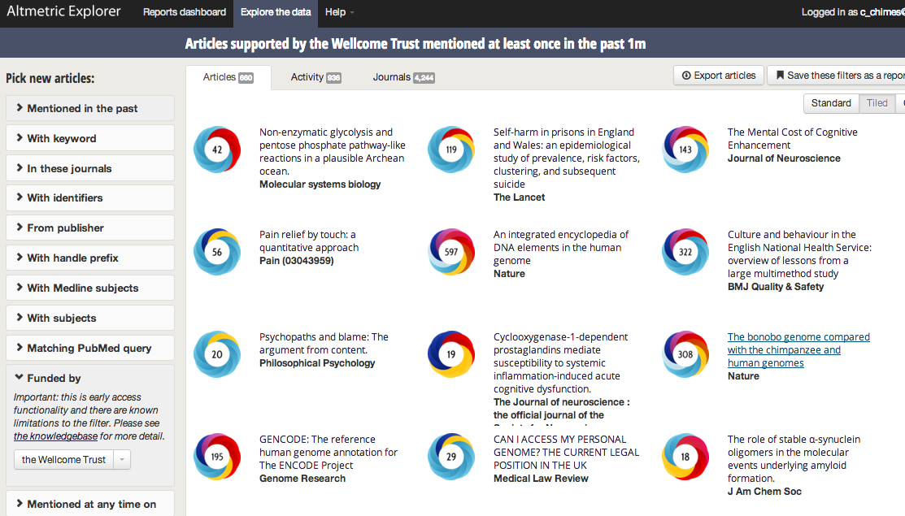
Funders

Slide 15
Altmetrics research
*Web of Science, May 2014
*Google adwords, May 2014

Slide 16
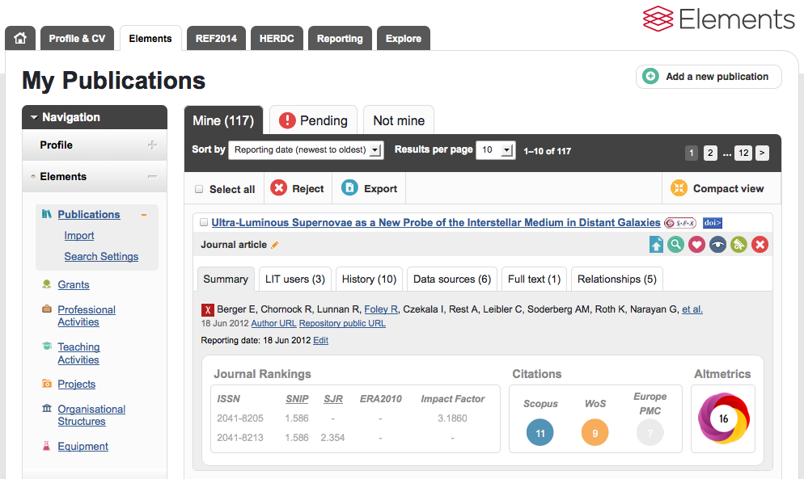
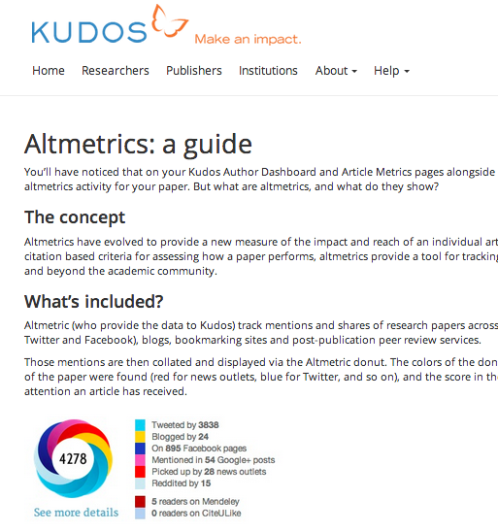
Other applications

Slide 17
What next?
Sources that show real life applications
Policy docs
Patents
Integration into workflows
Research administrators
Communications officers
Librarians
Researchers

Slide 18
Thanks for listening!
E-mail: info@altmetric.com
Twitter: @altmetric
Website: altmetric.com

