Slide 1
Age of Exploration Simulation
Find the GOLD!

Slide 2
You have been chosen….
Today you and your team of explorers will represent your country in a quest for treasure!!!!
Somewhere in the room is treasure and it is your job to find it.
Once you find it, it is your decision on whether to keep it or bring it back to your country…. YOU DECIDE!!!

Slide 3
Simulation Reality
Teacher ate the chocolate.
Now that our quest is done…

Slide 4
Simulation Reality
Teacher ate the chocolate.
Spain discovers gold in the new world.

Slide 5
Simulation Reality
Teacher ate the chocolate.
You were put into groups representing countries.
Spain discovers gold in the new world.

Slide 6
Simulation Reality
Teacher ate the chocolate.
You were put into groups representing countries.
Spain discovers gold in the new world.
European countries compete for Claims (resources).

Slide 7
Simulation Reality
Teacher ate the chocolate.
You were put into groups representing countries.
1 Chocolate bar was hidden.
Spain discovers gold in the new world.
European countries compete for Claims (resources).

Slide 8
Simulation Reality
Teacher ate the chocolate.
You were put into groups representing countries.
1 Chocolate bar was hidden.
Spain discovers gold in the new world.
European countries compete for Claims (resources).
Gold was rare (hidden).

Slide 9
Simulation Reality
Teacher ate the chocolate.
You were put into groups representing countries.
1 Chocolate bar was hidden.
Students search for candy.
Spain discovers gold in the new world.
European countries compete for Claims (resources).
Gold was rare (hidden).

Slide 10
Simulation Reality
Teacher ate the chocolate.
You were put into groups representing countries.
1 Chocolate bar was hidden.
Students search for candy.
Spain discovers gold in the new world.
European countries compete for Claims (resources).
Gold was rare (hidden).
Explorers sent to new world.

Slide 11
Simulation Reality
Teacher ate the chocolate.
You were put into groups representing countries.
1 Chocolate bar was hidden.
Students search for candy.
1 group finds candy.
Spain discovers gold in the new world.
European countries compete for Claims (resources).
Gold was rare (hidden).
Explorers sent to new world.

Slide 12
Simulation Reality
Teacher ate the chocolate.
You were put into groups representing countries.
1 Chocolate bar was hidden.
Students search for candy.
1 group finds candy.
Spain discovers gold in the new world.
European countries compete for Claims (resources).
Gold was rare (hidden).
Explorers sent to new world.
Successful countries find gold.

Slide 13
Simulation Reality
Teacher ate the chocolate.
You were put into groups representing countries.
1 Chocolate bar was hidden.
Students search for candy.
1 group finds candy.
Other students are jealous and angry.
Spain discovers gold in the new world.
European countries compete for Claims (resources).
Gold was rare (hidden).
Explorers sent to new world.
Successful countries find gold.
Other countries are jealous and angry.

Slide 14
Age of Exploration
Wealth & Power: money through trade w/Asia (spices, sugar, silk)
Religious Aims: Drive Muslims from lands, convert
Renaissance Spirit: curiosity, desire for adventure, fame (Marco Polo)
Technology: sailing ships propelled by rowers, more accurate maps, cannons, guns, astrolabe

Slide 15
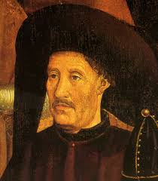
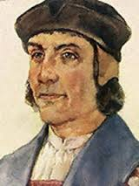
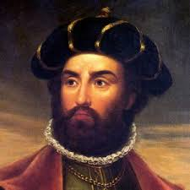
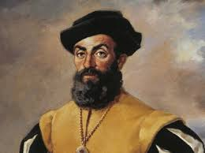
Portuguese Exploration
Prince Henry the Navigator: never sailed; built naval station, collected expert info., advanced sea knowledge
Bartholomeu Dias: sailed around Cape of Good Hope (southern tip of Africa)
Vasco da Gama: reached India around Africa
Ferdinand Magellan: Sailed around the world

Slide 16
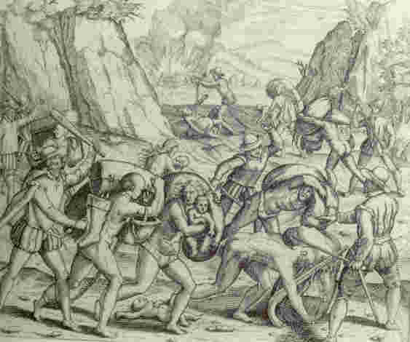
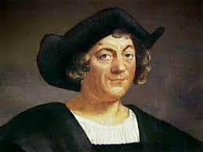
Spanish Exploration
Christopher Columbus: reached the Caribbean (west Indies); opened up European colonization; encomienda system

Slide 17
Chinese Exploration

