Slide 1
Bell Ringer
What is the difference between a temporary and a permanent magnet?
Test TOMORROW! Study, study, study!
Temporary magnet loses magnetism when not near a permanent magnet

Slide 2
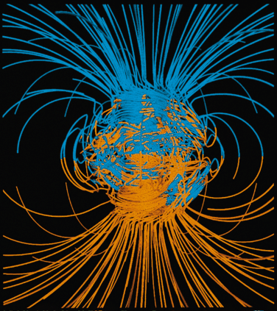
Electromagnetism

Slide 3
Currents and Magnets
Sometimes, great scientific discoveries are made by accident
In 1820, a physics teacher happened to have a compass near an electric current he was showing his class
The electric current moved the needle of the compass

Slide 4
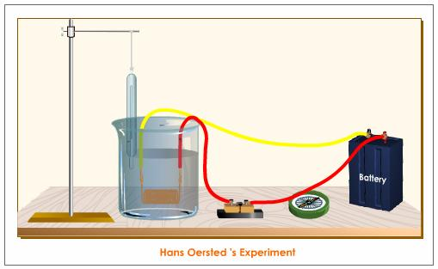
Currents and Magnets
Electric current produces a magnetic field around the wires
As the electric current increases, so does the strength of the magnetic field

Slide 5
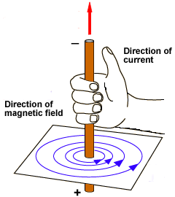
Currents and Magnets
The direction of the field changes with the direction of the current
Right hand rule: If your right thumb points in the direction the current is flowing, your fingers curl in the direction of the magnetic field lines

Slide 6
Electromagnets
Solenoid – wire wrapped into a cylindrical coil
Electromagnet – a temporary magnet that is made by wrapping a current-carrying wire coil (solenoid) around an iron core

Slide 7
Electromagnets
Wires wrapped around a highly magnetic core will produce a stronger magnet
The more wires wrapped around the core, the stronger the magnet
The higher the voltage, the stronger the magnet

Slide 8
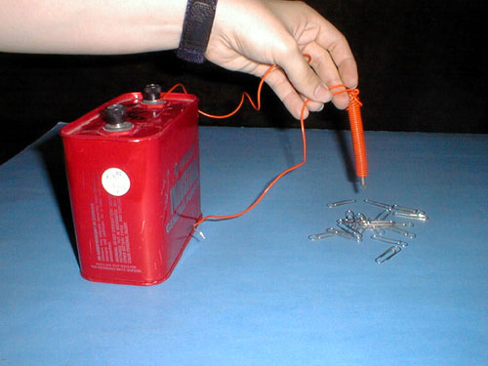
Electromagnets
Electromagnets are temporary magnets
Their magnetism goes away when the electric current is removed or turned off

Slide 9
Electromagnets
Similar properties to other magnets – dipoles, magnetic field lines, etc.
Difference – Able to convert electrical energy into mechanical energy as it moves towards or away from other magnets

Slide 10
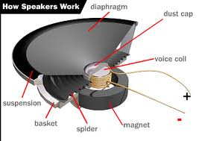
Electromagnets
Magnetic forces (attraction and repulsion) from a permanent magnet can make an electromagnet
This is how speakers make sound

Slide 11
Electromagnets
New uses for electromagnets are currently being explored, such as using them for transportation
http://videos.howstuffworks.com/discovery/29341-extreme-engineering-maglev-train-video.htm

Slide 12
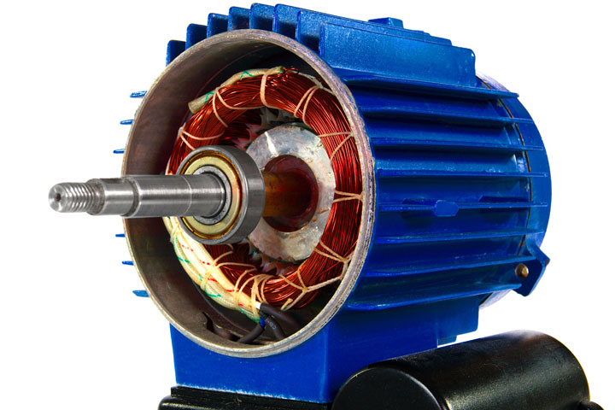
Motors and Generators
Electric motor – converts electrical energy into mechanical energy
Used in every appliance where something moves
Energy source – a battery or other external power source

Slide 13
Motors and Generators
Electric generator – converts mechanical energy into electrical energy
Energy source – moving the coil in and out of the magnetic field (either manually by turning a handle or automatically by an engine)

Slide 14
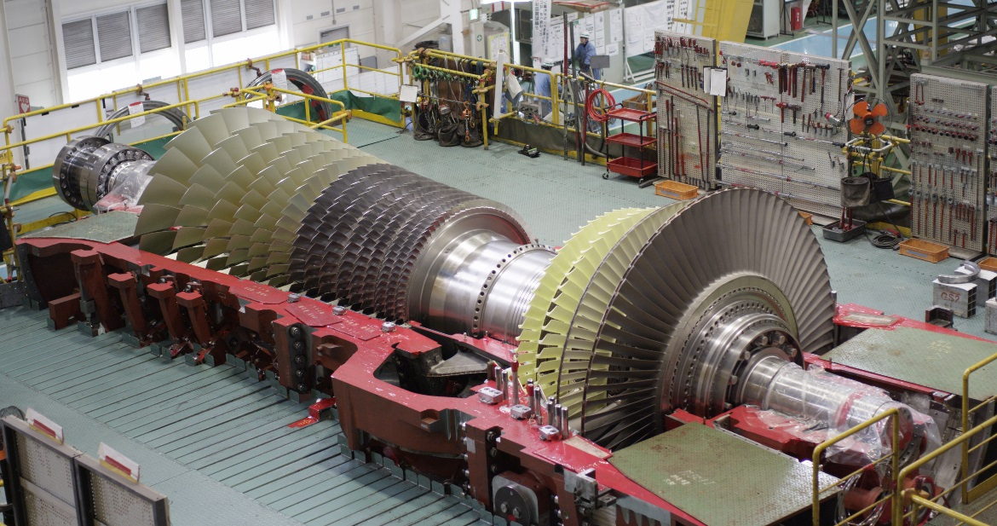
Motors and Generators
Power plant generators are connected to turbines, large wheels that rotate
The turbines’ mechanical energy changes into electrical energy that is sent to businesses, schools, and houses

Slide 15
Motors and Generators
This electrical energy is alternating current (AC), which reverses the direction of the current in a regular pattern
Battery-operated appliances use direct current (DC), which always flows in one direction

Slide 16
Review
electrical
Electric Motor – turns _________ energy into ___________ energy
Electric Generator – turns ___________ energy into __________ energy
mechanical
mechanical
electrical

Slide 18
Electricity WS
If you did this WS, you’re getting it back. Look over it, ask questions, read comments!
If you have not done this WS, you need to work on it. You will sit away from your peers since they are getting their WS back.
Electricity WS, Take 2
Optional
Earn back points on the ones you missed
I recommend doing the whole WS
Turn in tomorrow with your original
Study Guide – helps you study the non-math concepts. Hold onto until tomorrow.

Slide 20
Bluff
I will ask questions from this unit.
Members of your team will stand up if they know the answer. If you don’t know the answer, you may still choose to stand up. You are “bluffing.” This bluff could either cause your team to earn or lose points.
A member from the opposing team will call on one of the standing people.
Correct answers will earn the team 1 pt for every person standing
Incorrect answers will earn the team 1 pt for every person standing
Whoever was called on gets to choose the person from the opposing team to answer the next question.

Slide 21
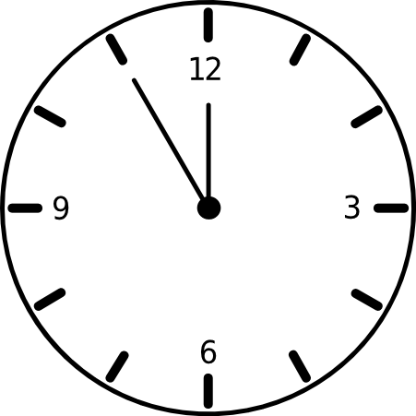
Bell Ringer
Is this arrow clockwise or counterclockwise?
Counterclockwise (goes the opposite direction a clock usually goes)
Turn in Review WS.
Electricity WSs… listen to directions

Slide 22
Bellringer
Current is flowing to the left. Describe what direction the magnetic field is flowing.
Up and over
Current is flowing straight up. Describe the direction of the magnetic field.
Counterclockwise

Slide 23
Bellringer
Convert 83 W to kilowatts
Convert 1234.5 W to kilowatts

Slide 24
I = current, measured in amperes
V = ____________, measured in __________
R = ____________, measured in __________
P = ____________, measured in __________
OR measured in _____________ when using E=Pt
E = electrical energy, measured in _________
t = ____________, measured in ___________
voltage
volts
resistance
ohms
power
watts
kilowatts
kilowatt hours
time
hours

Slide 25
Spend the next 5 minutes looking over material for the test.
Make sure you feel comfortable with calculations on the Electricity WS.
Write clearly, show your work, and include units. Turn in to the front basket when done. Find something quiet to do afterwards. No electronics.
Suggestions: Review WS, Electricity WS, or love/break-up letter if you haven’t turned any of these in

