Slide 1
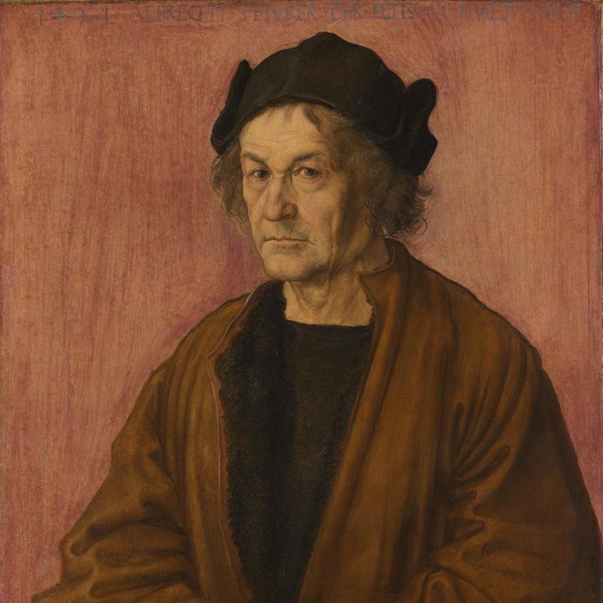
Notes:
Staring into the face of this man unnerving

Slide 2
Notes:
Map recorded with ruthless accuracy and intensity, a truthfulness absent from Ital or French. Otto Dix

Slide 3
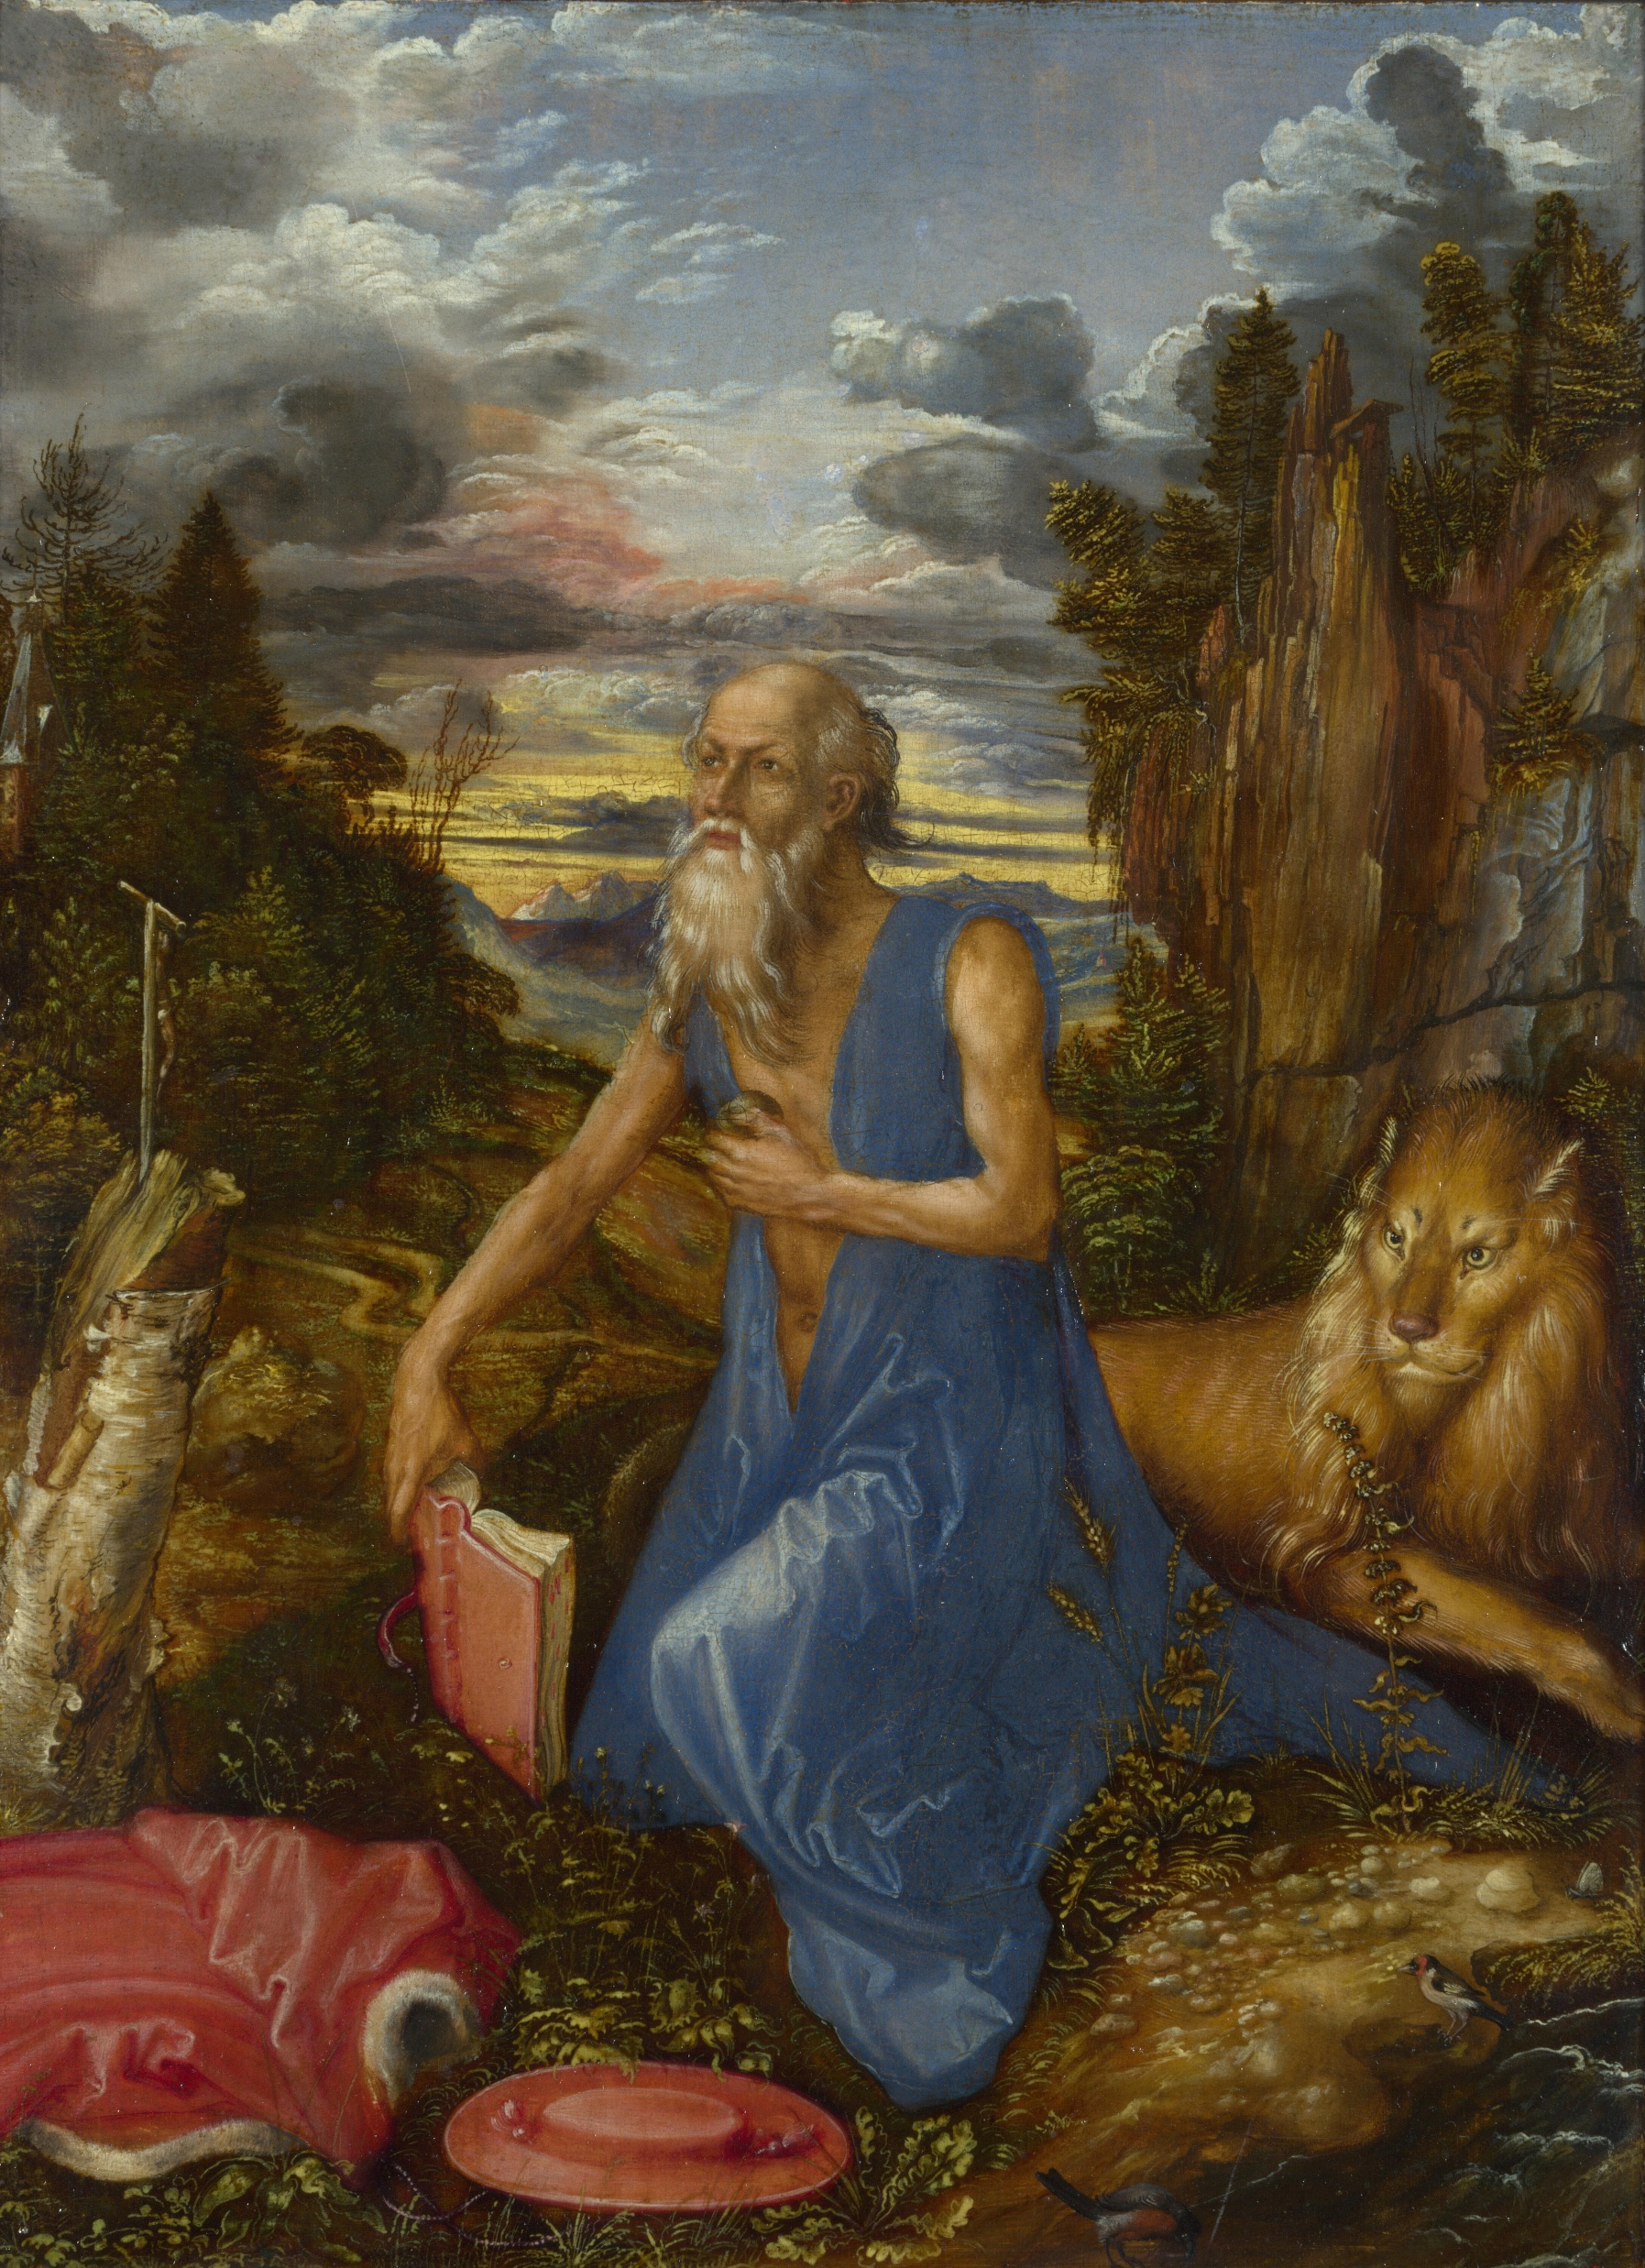

Slide 4
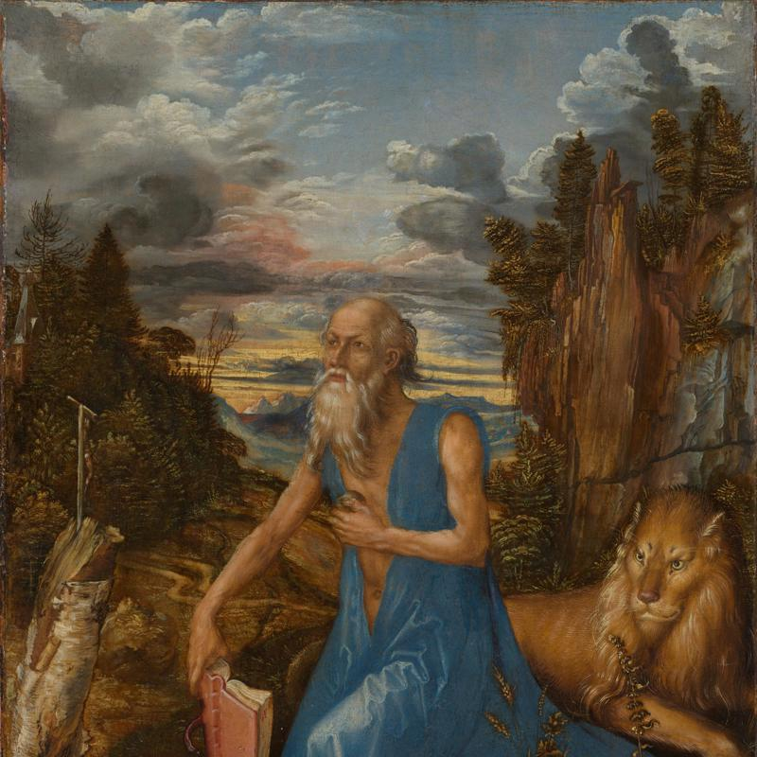

Slide 5
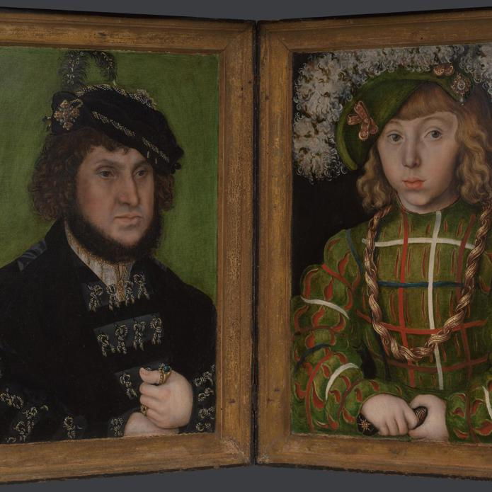

Slide 6
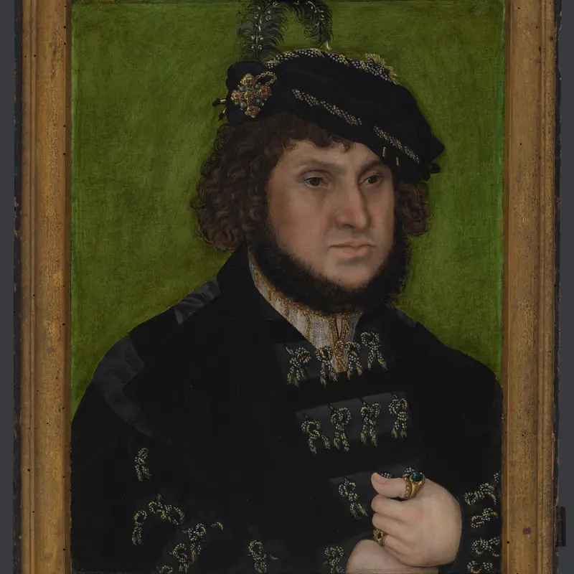
Notes:
Ally and patron of Luther. Helped to est Lutheran church in Saxony

Slide 7
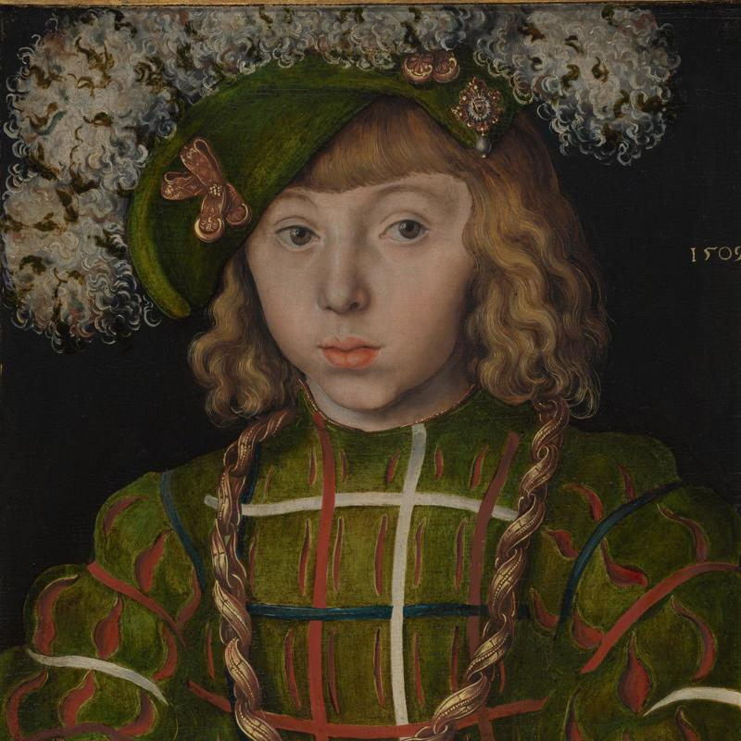
Notes:
Johann the Steadfast 1525-32 , Johann Friedrich the Magnanius son of 1509

Slide 8
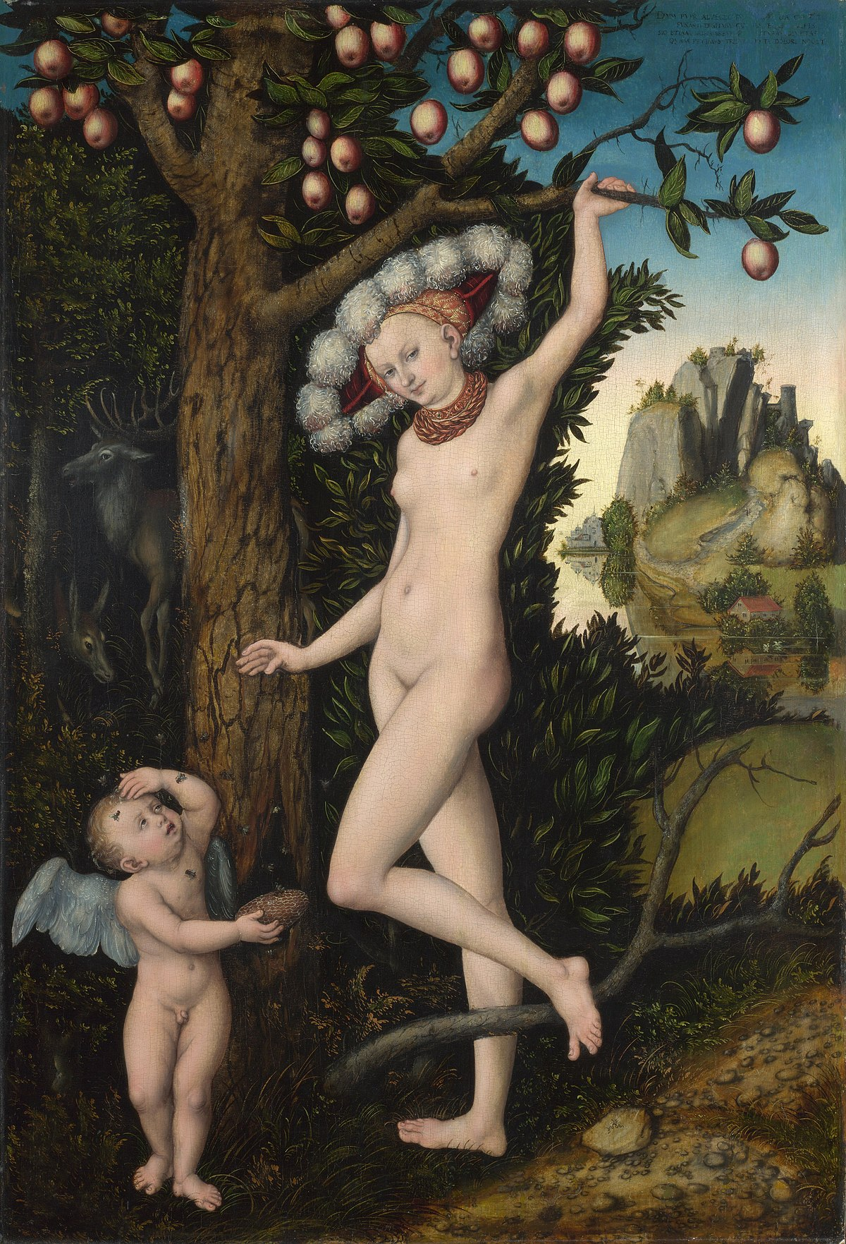

Slide 9
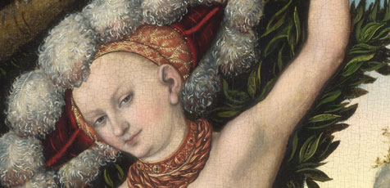

Slide 10
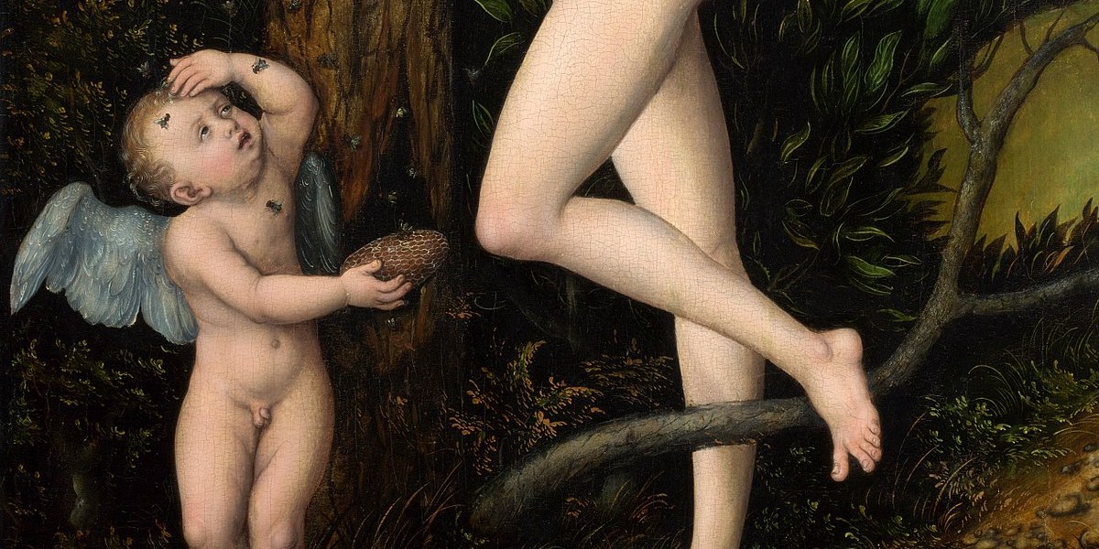

Slide 11
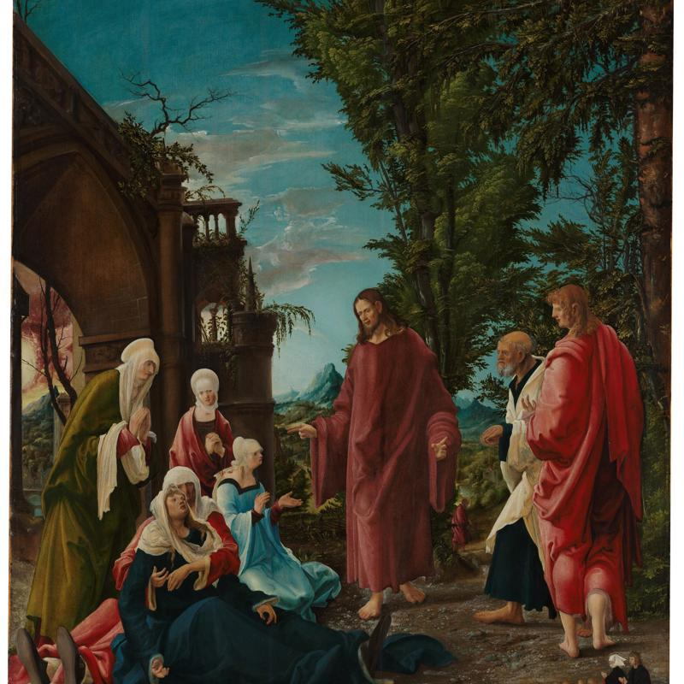
Notes:
Albrecht Altdorfer c 1515-20

Slide 12
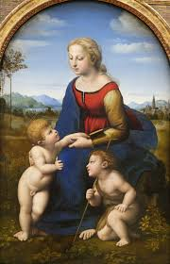
Notes:
Albrecht Altdorfer c 1515-20

Slide 13
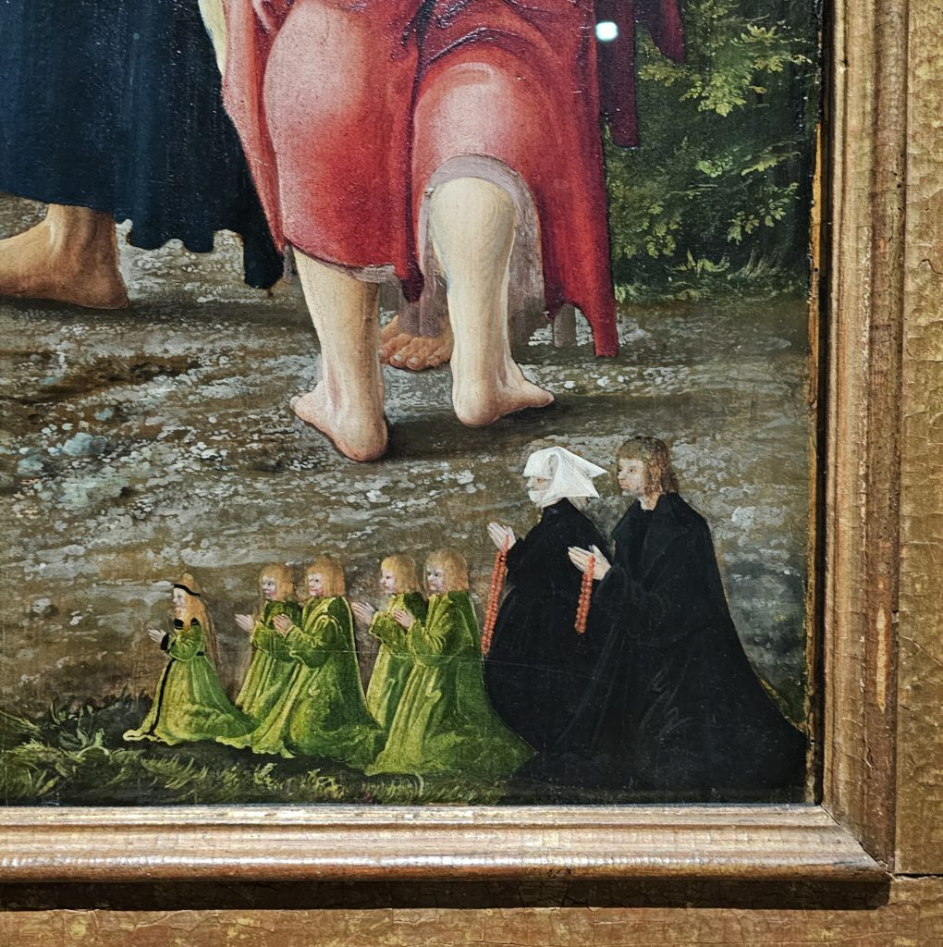

Slide 14
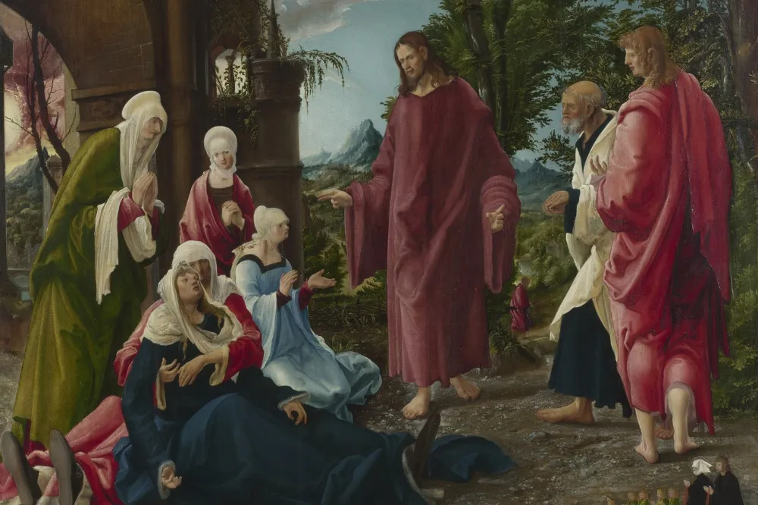

Slide 15
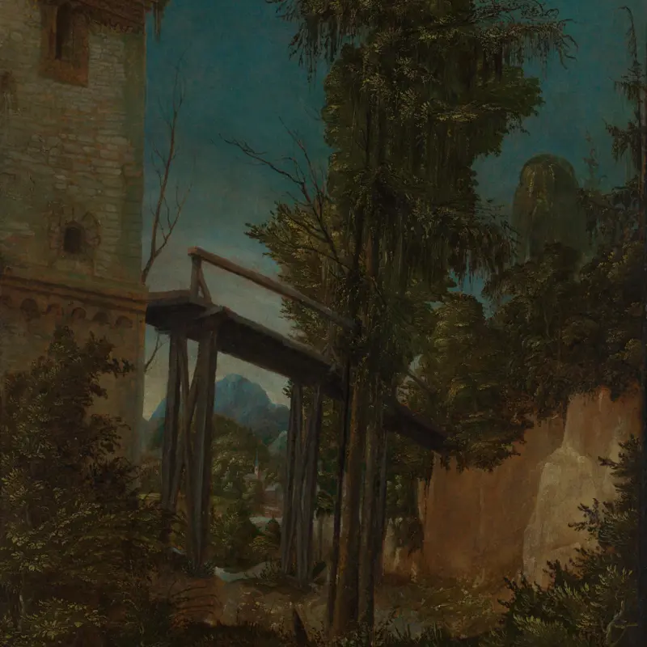

Slide 16
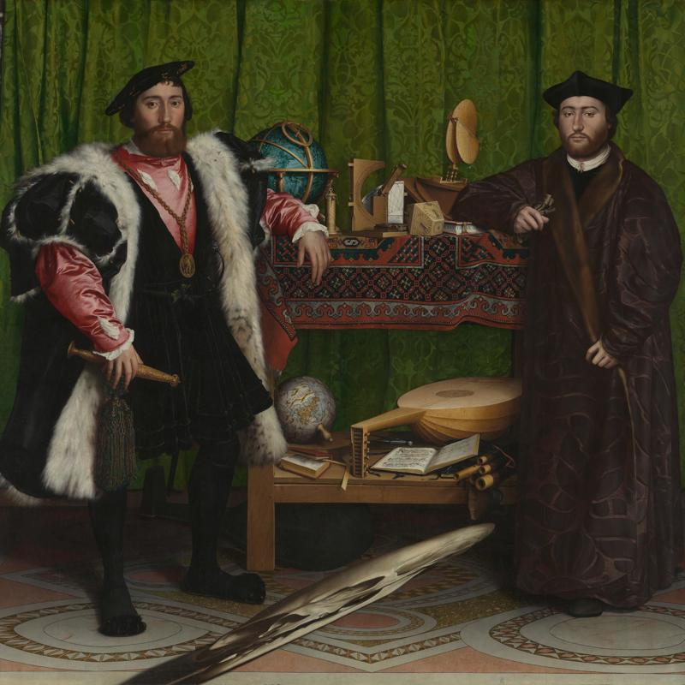

Slide 17
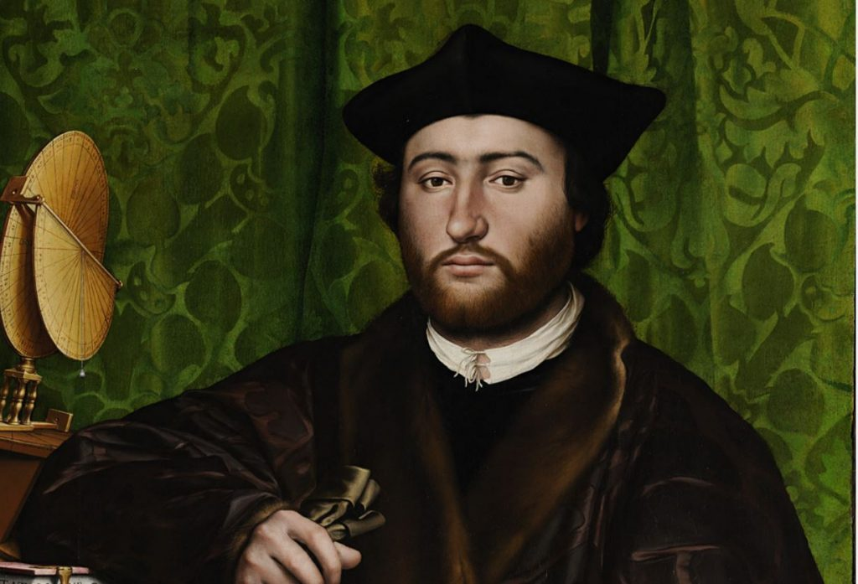

Slide 18
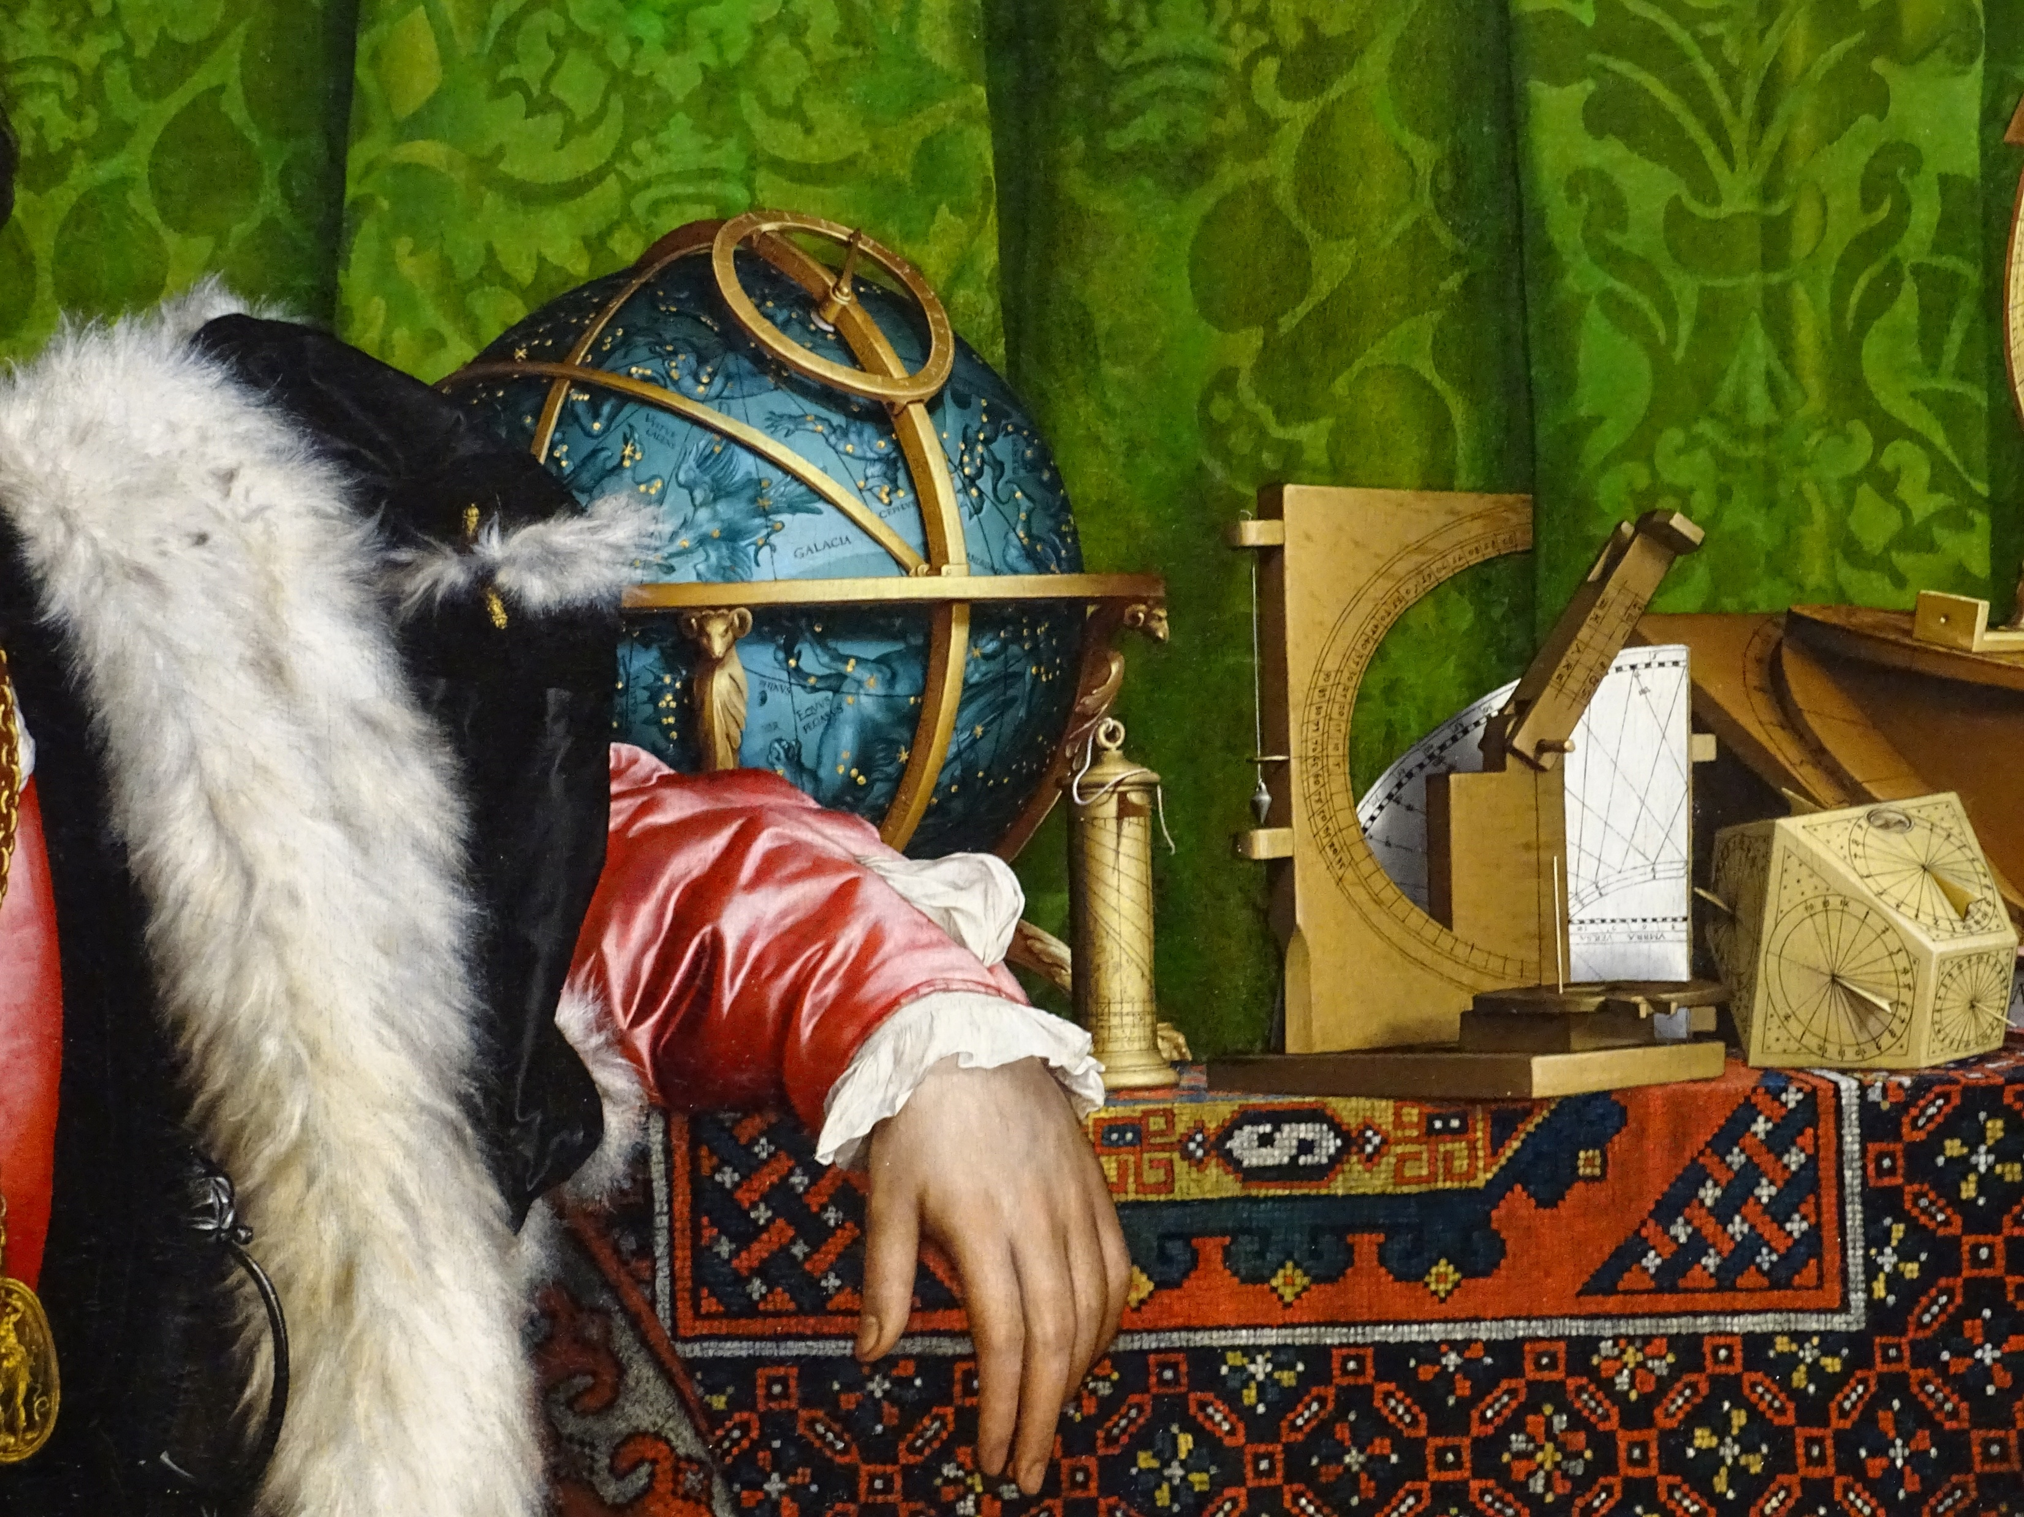

Slide 19
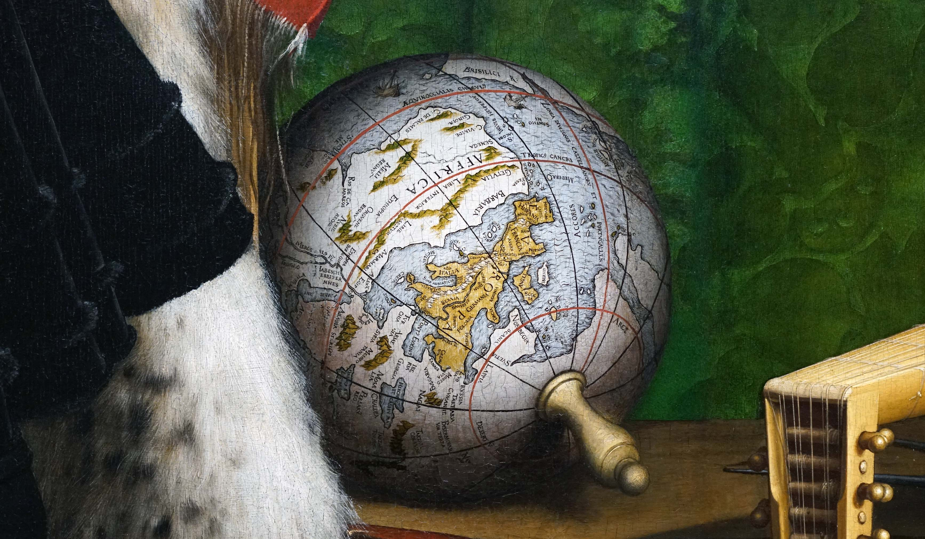

Slide 20
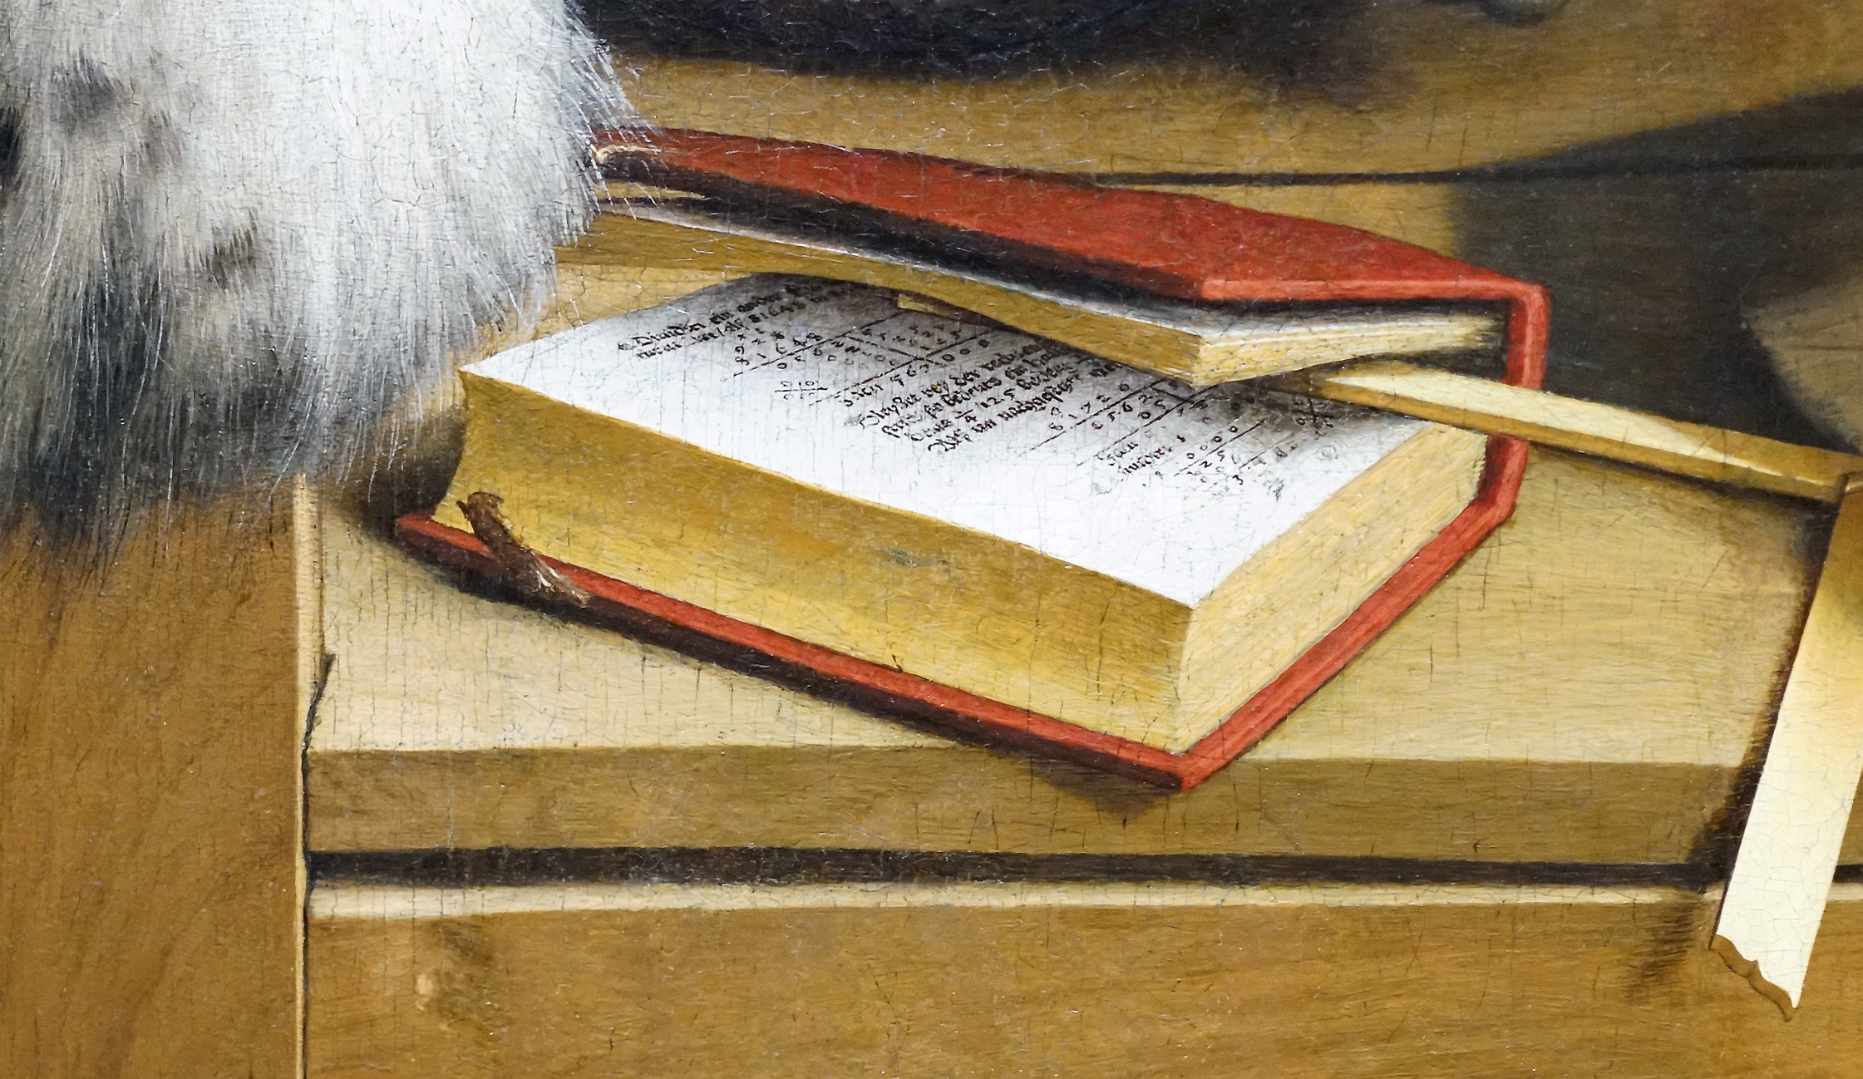

Slide 21
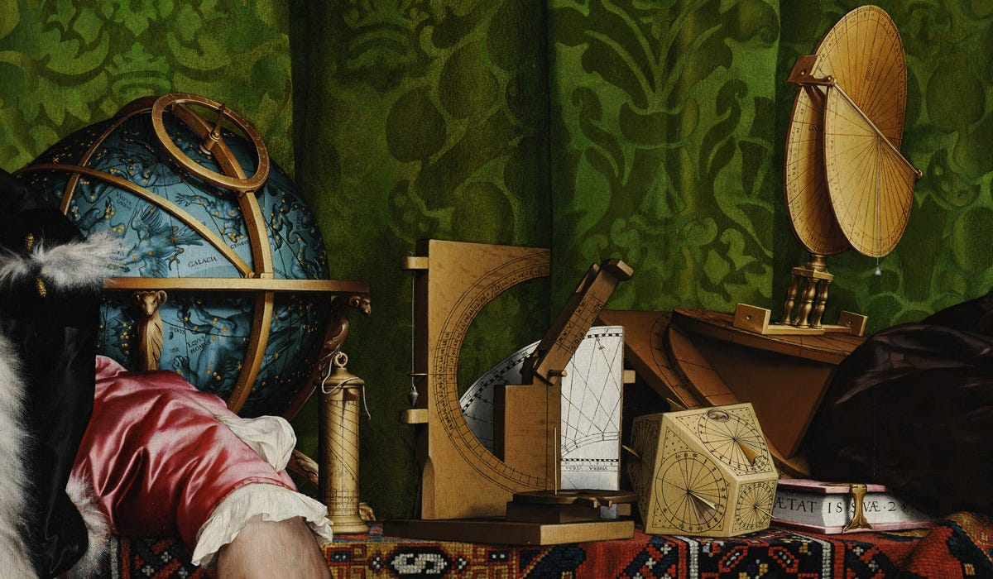

Slide 22
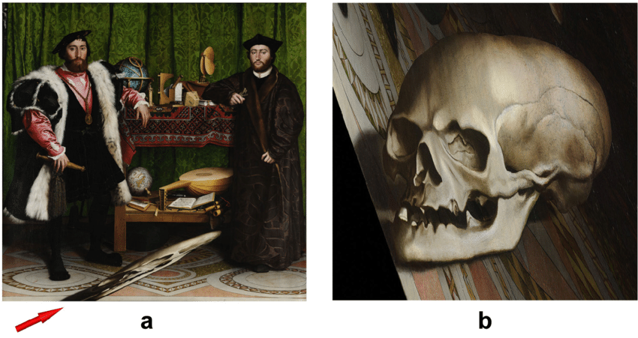
Notes:
Anamorphic distorted projectio

Slide 23
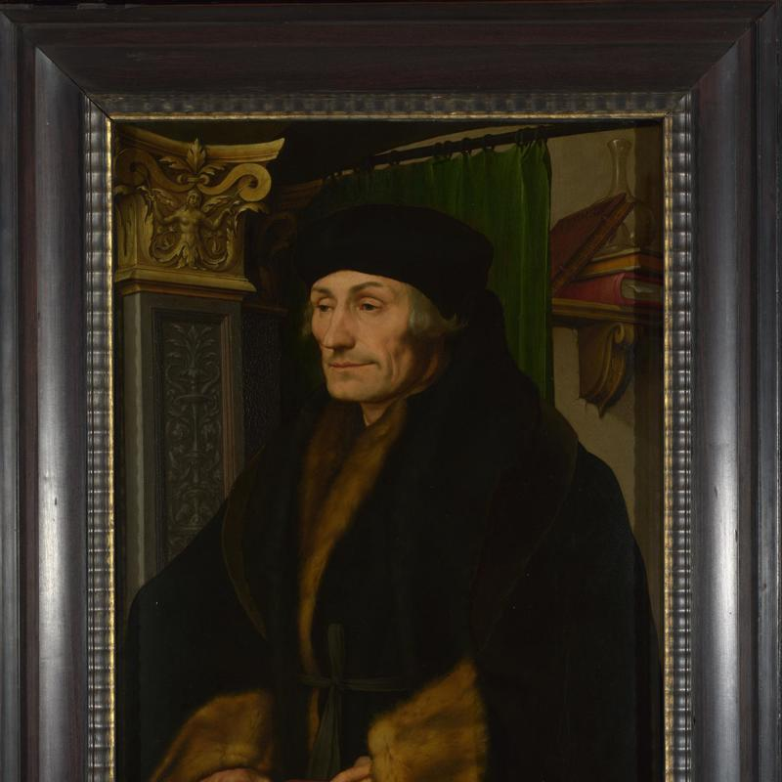

Slide 24
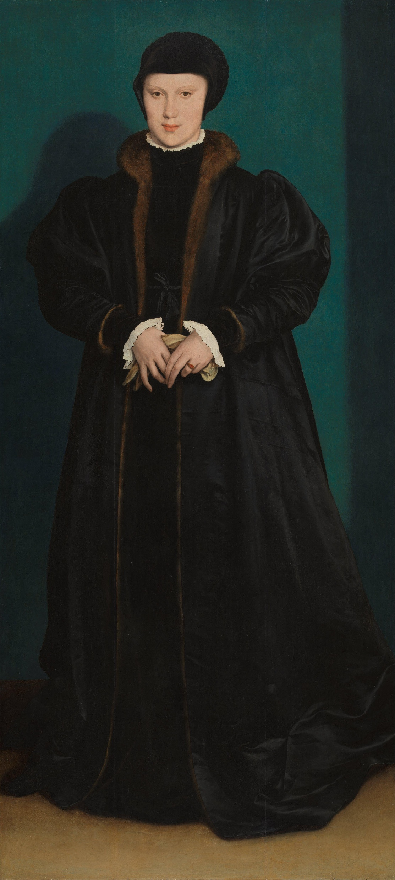

Slide 25
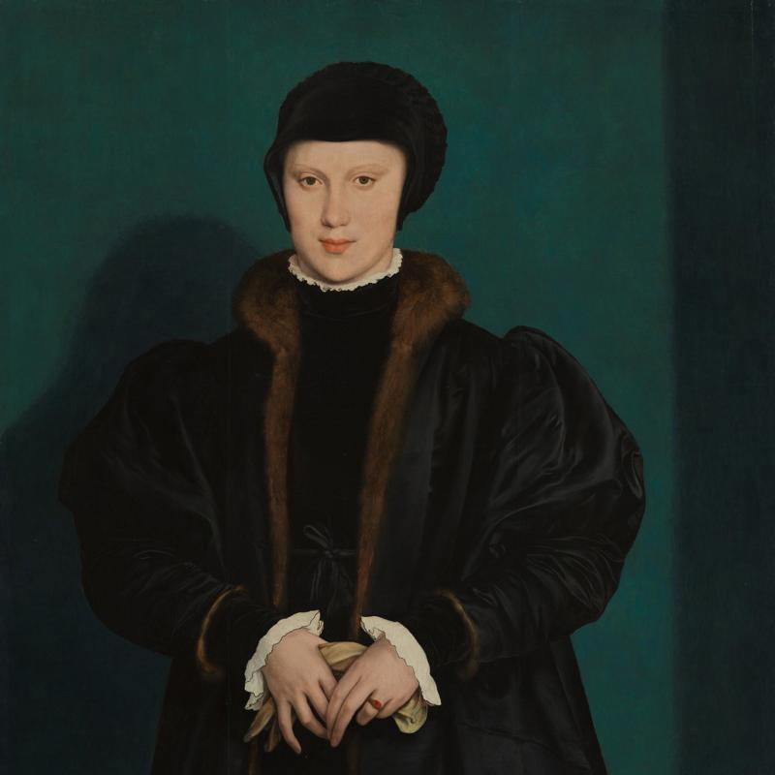

Slide 26
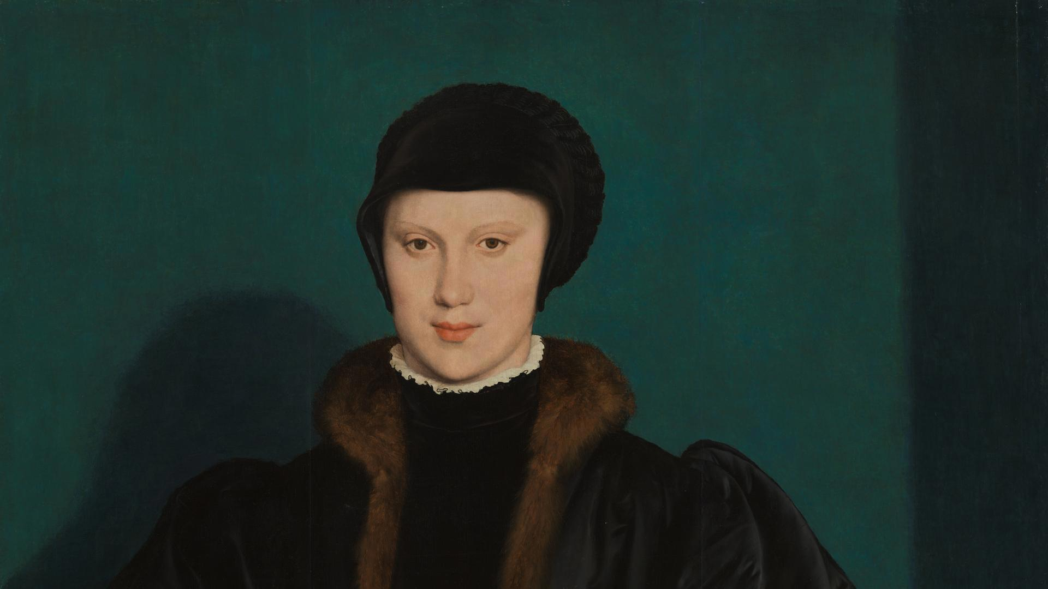

Slide 27
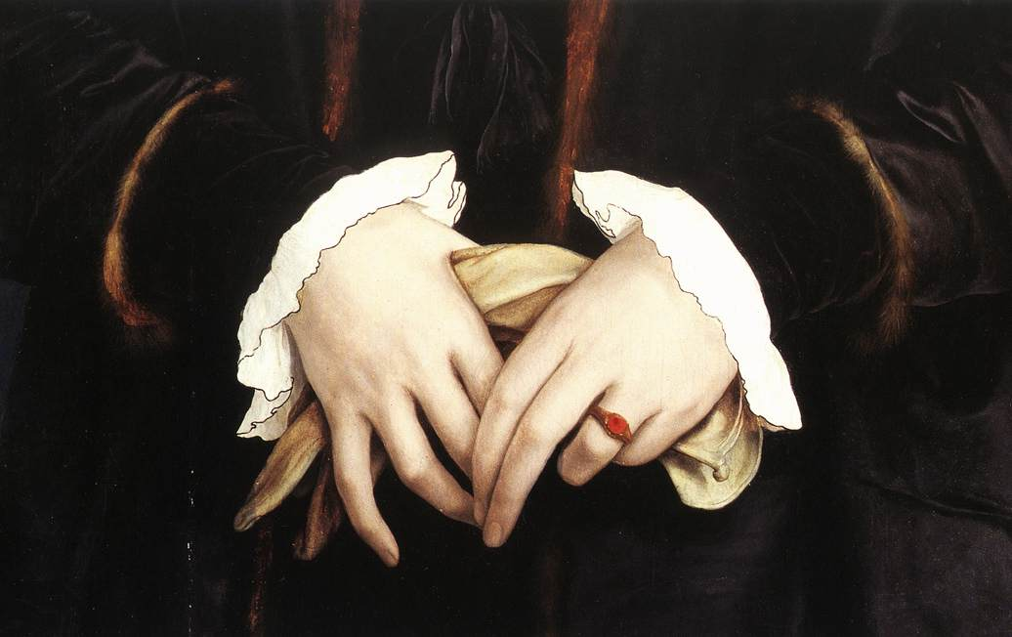

Slide 28
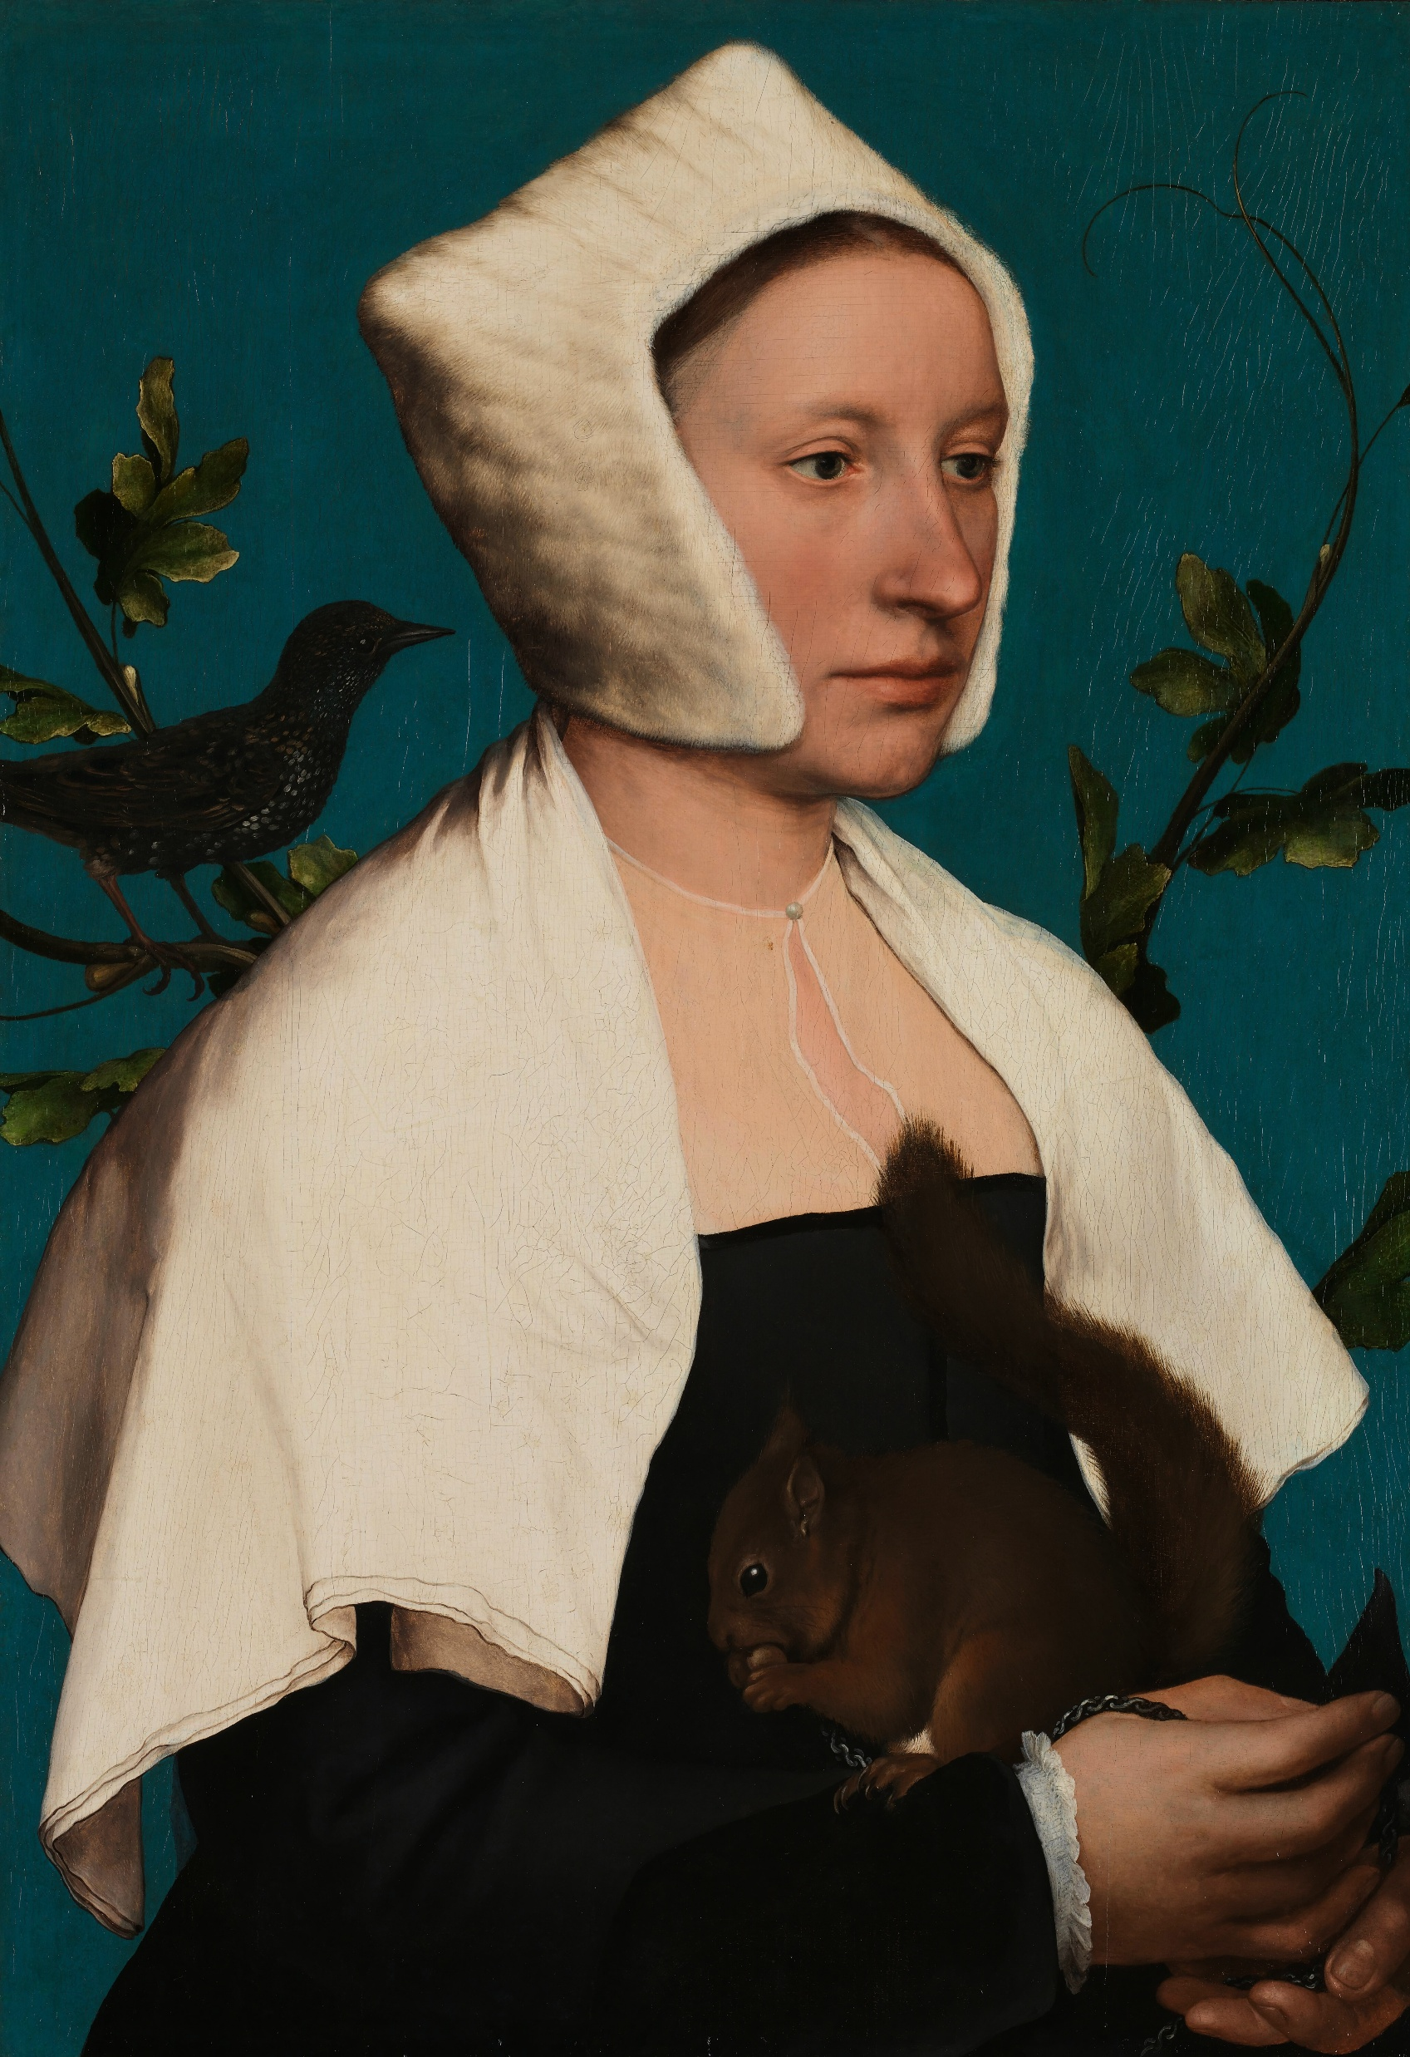

Slide 29
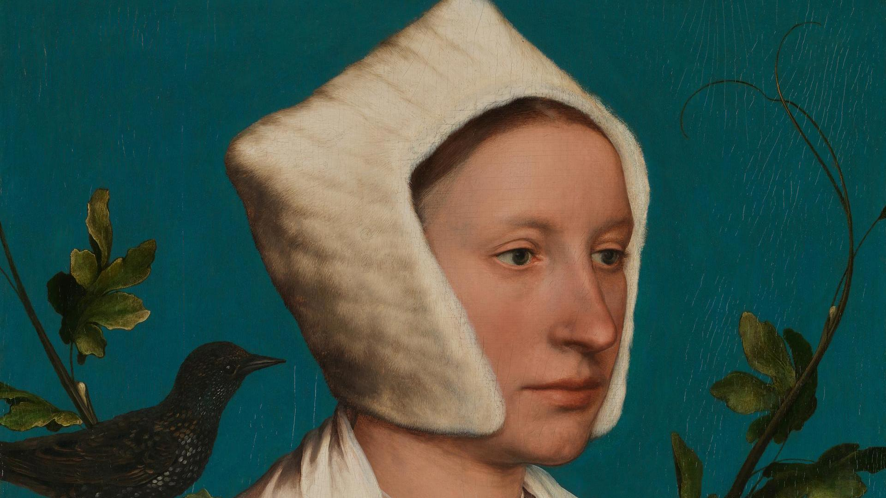

Slide 30
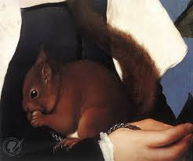

Slide 31
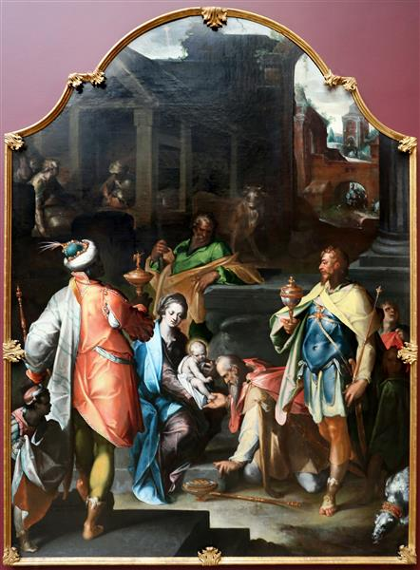

Slide 32
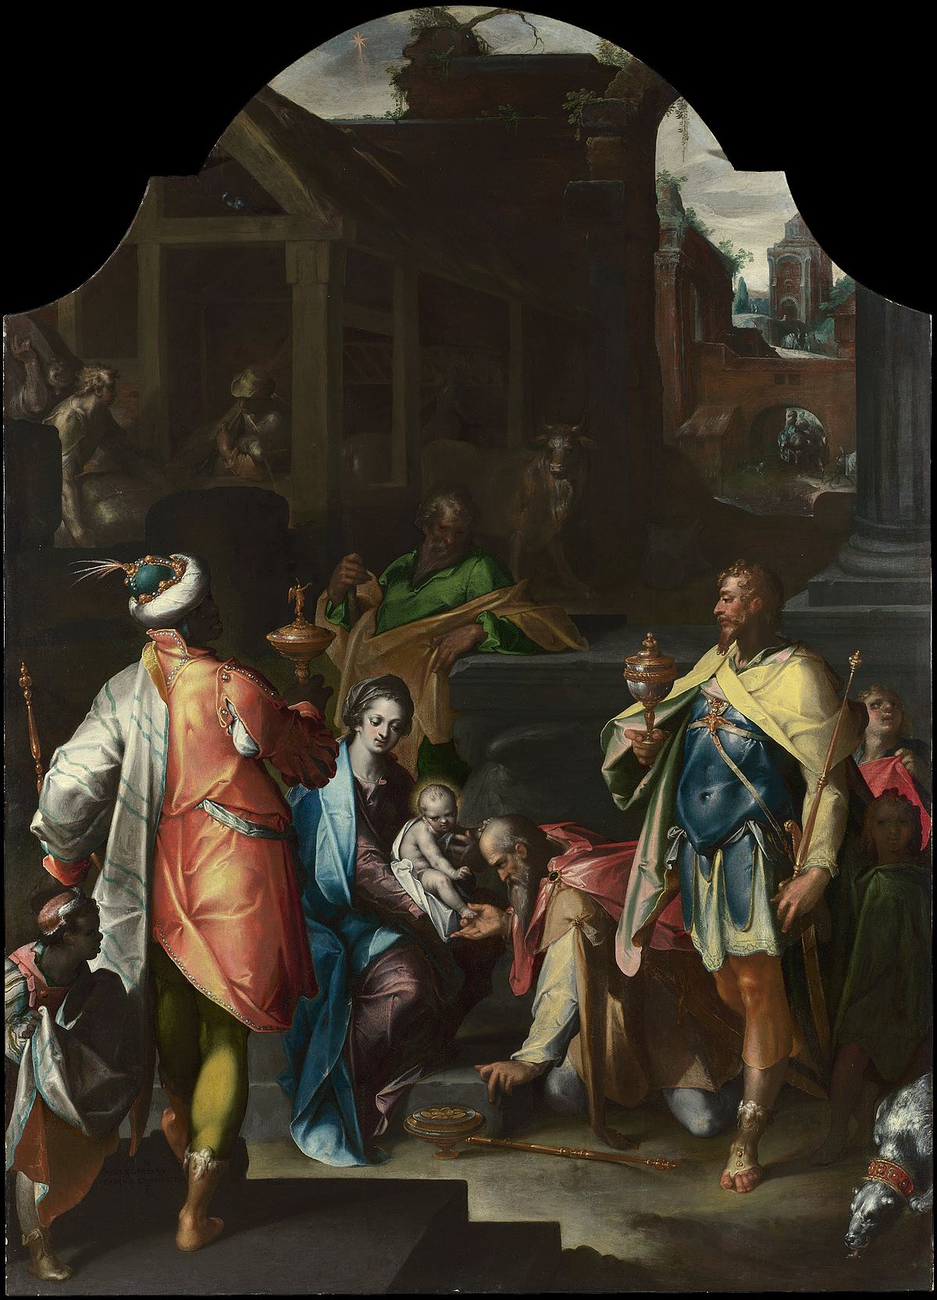

Slide 33
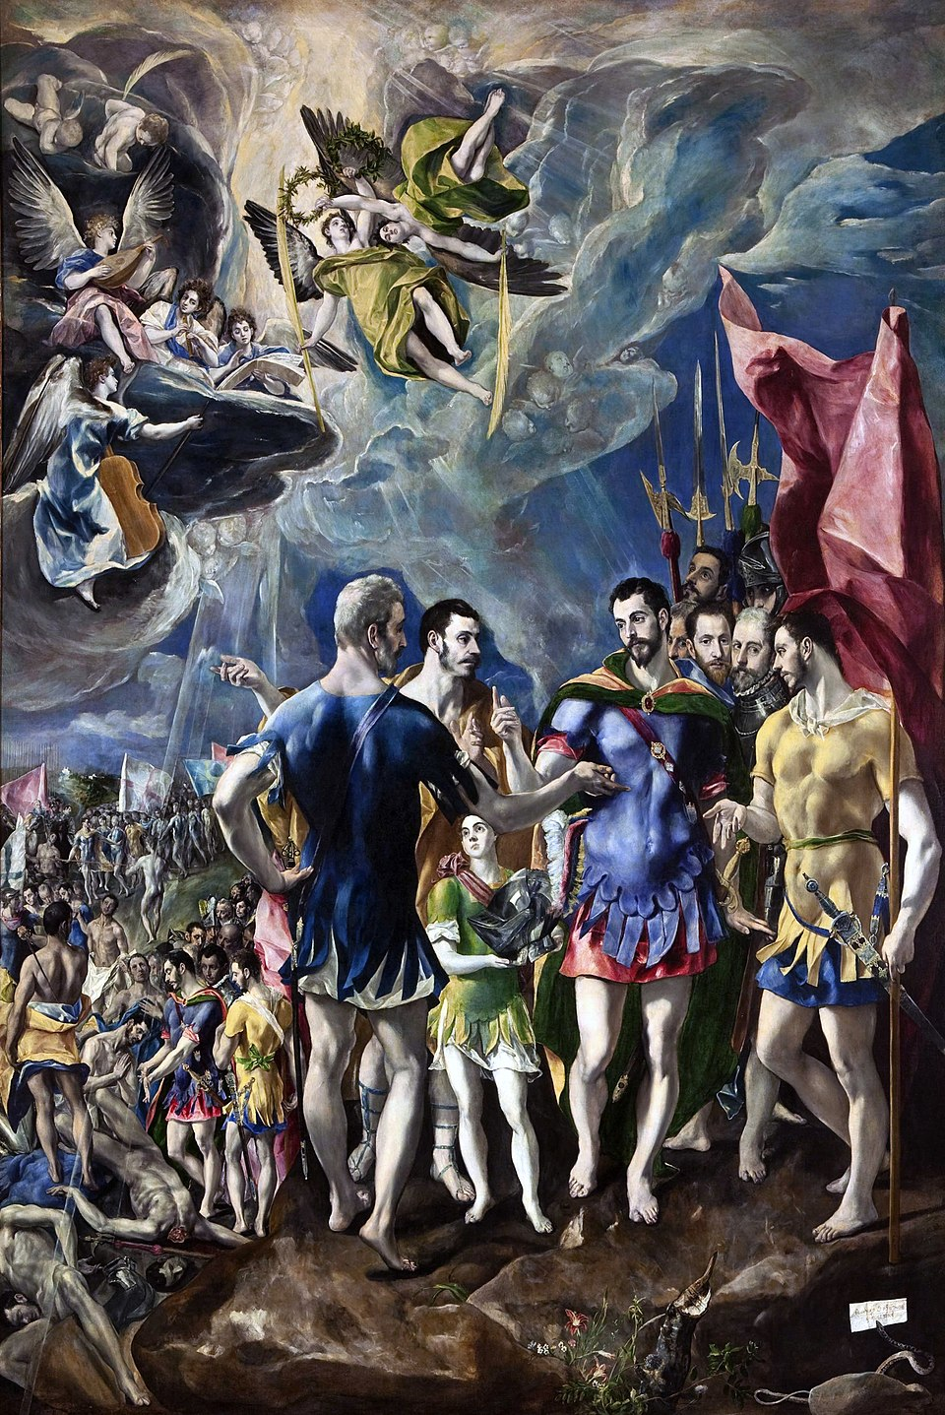

Slide 34
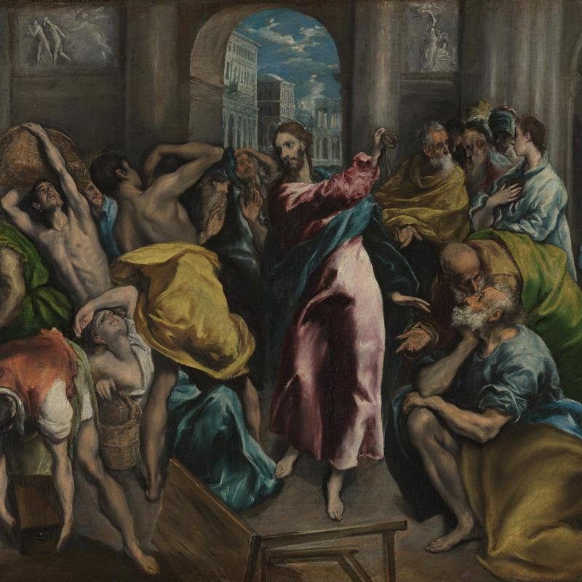

Slide 35
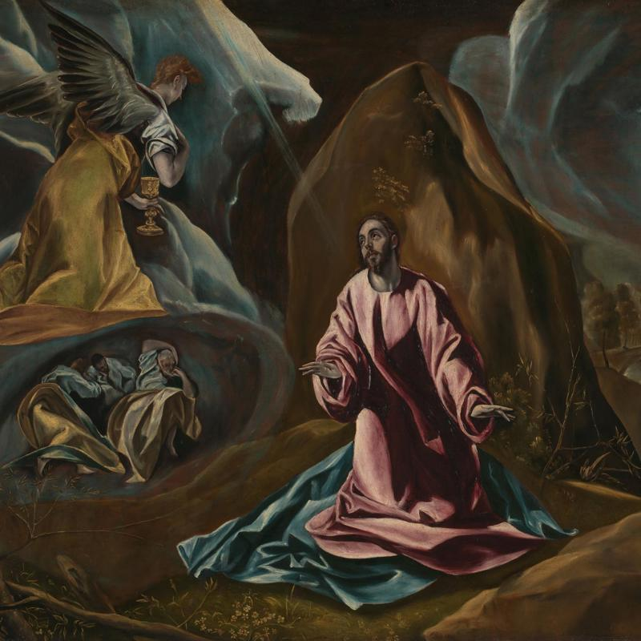

Slide 36
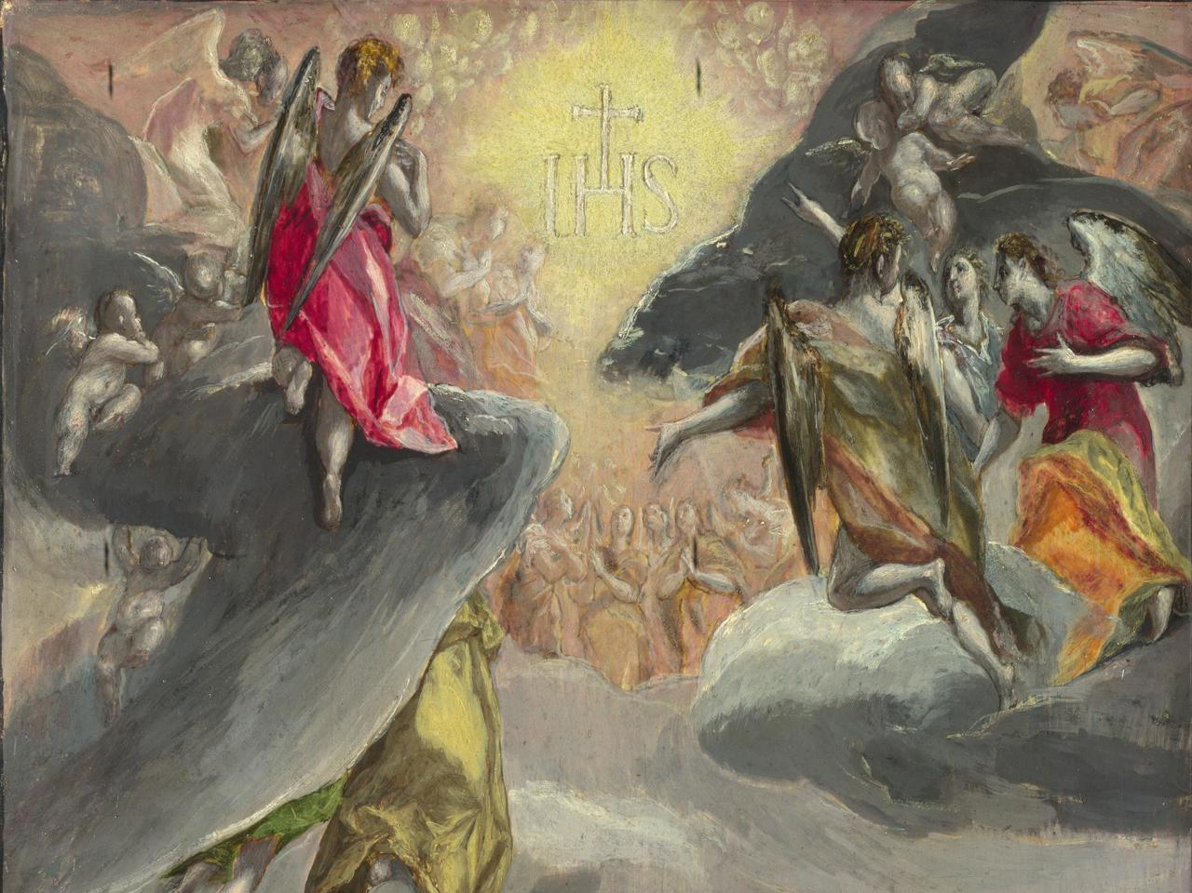

Slide 37
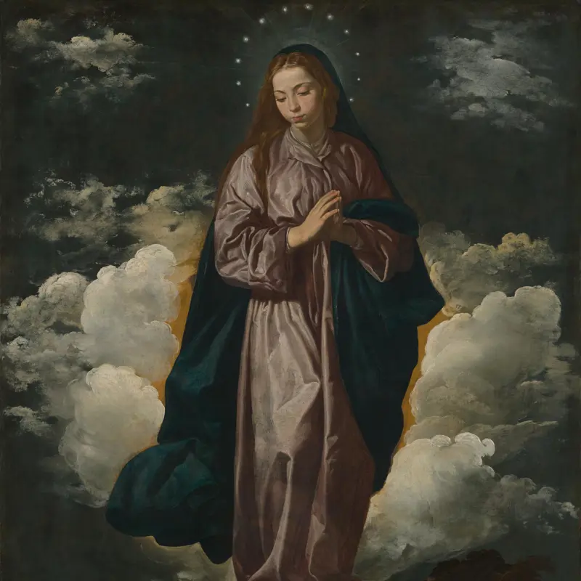

Slide 38
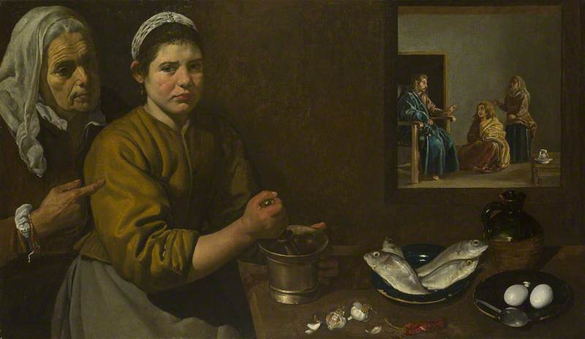

Slide 40
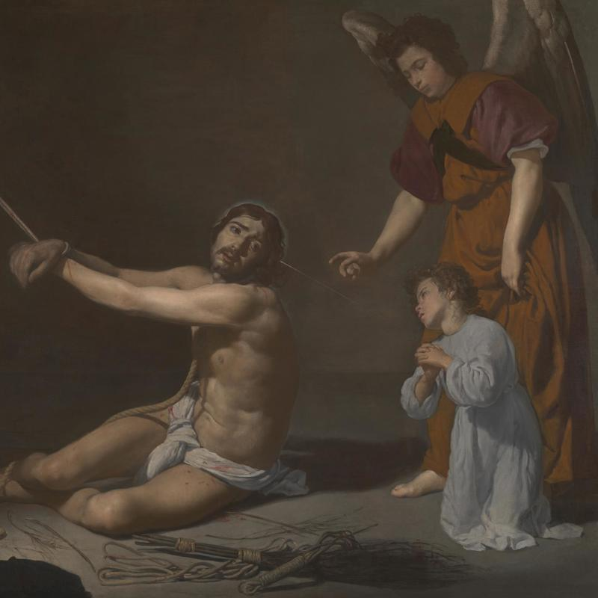

Slide 41
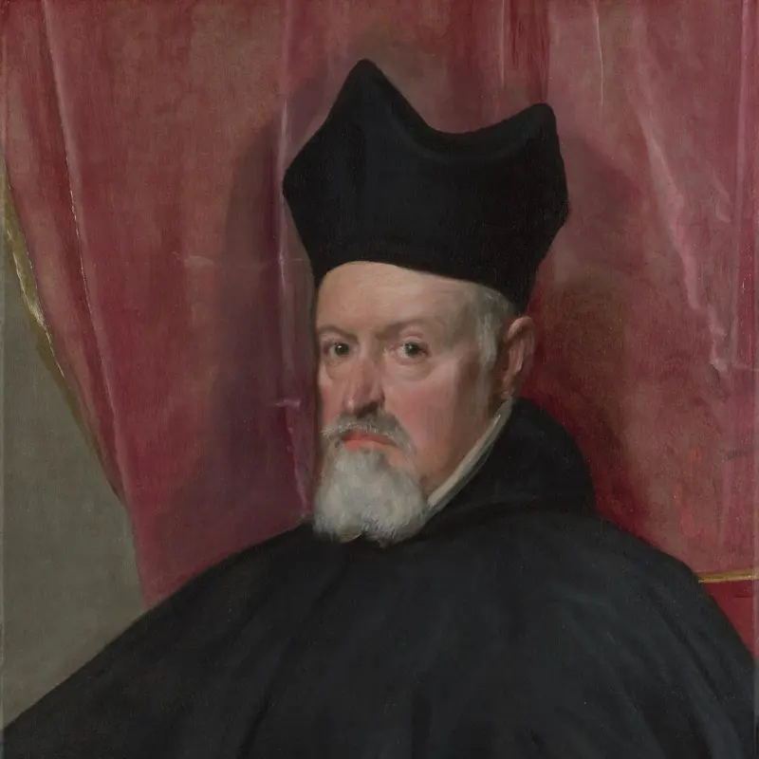

Slide 42
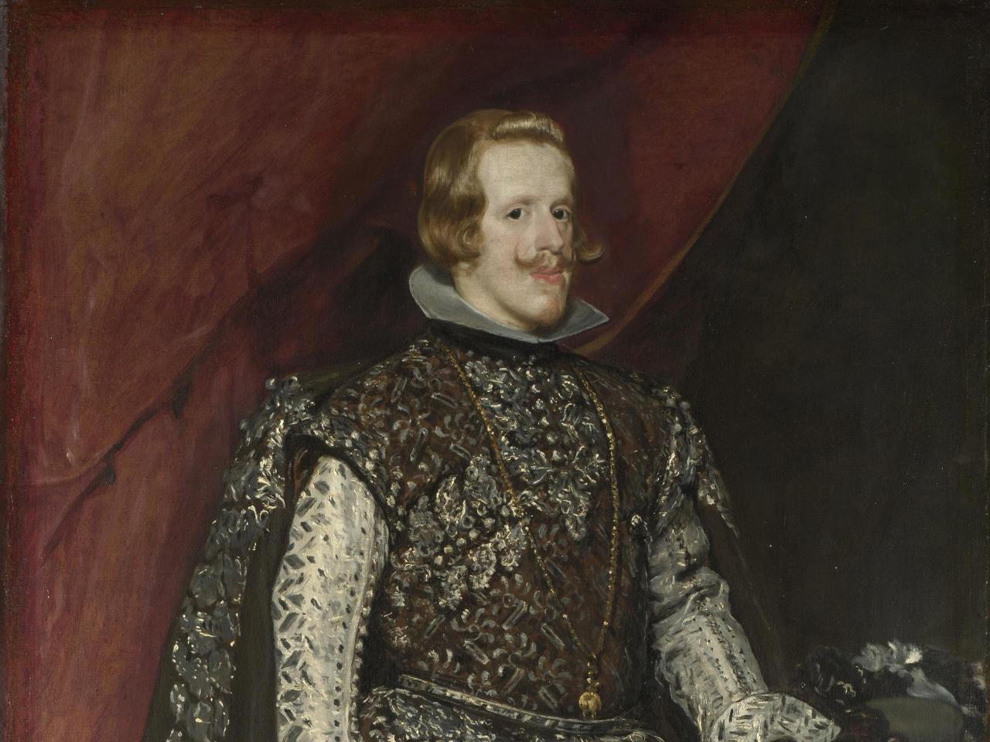

Slide 43
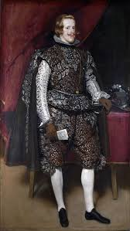

Slide 44
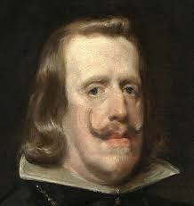

Slide 45
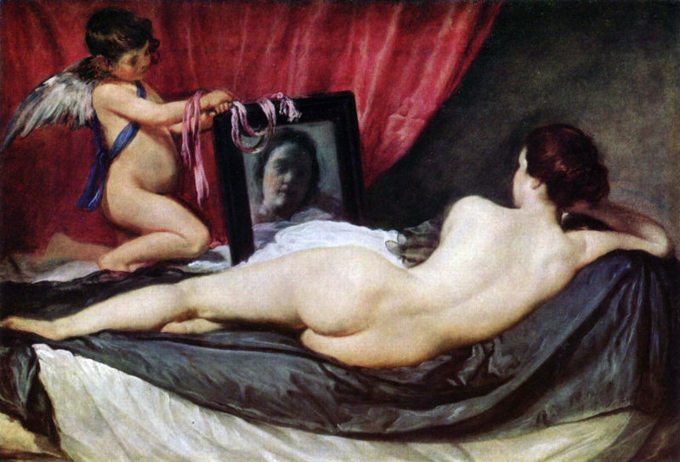
Notes:
Rokeby Venus

Slide 46
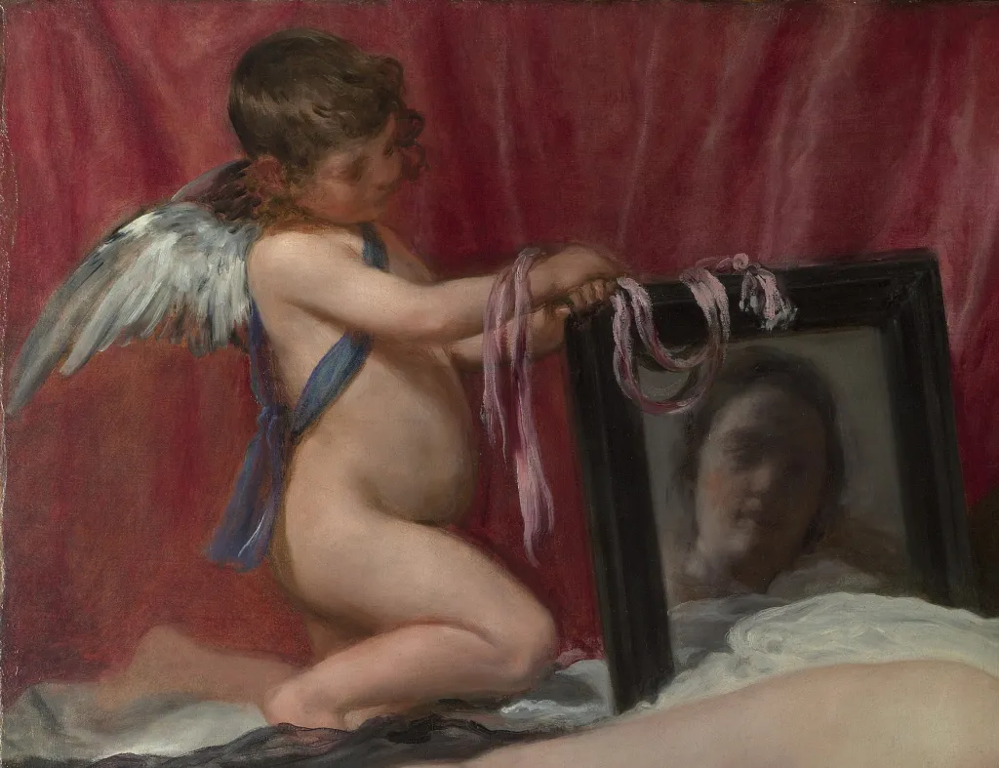

Slide 47
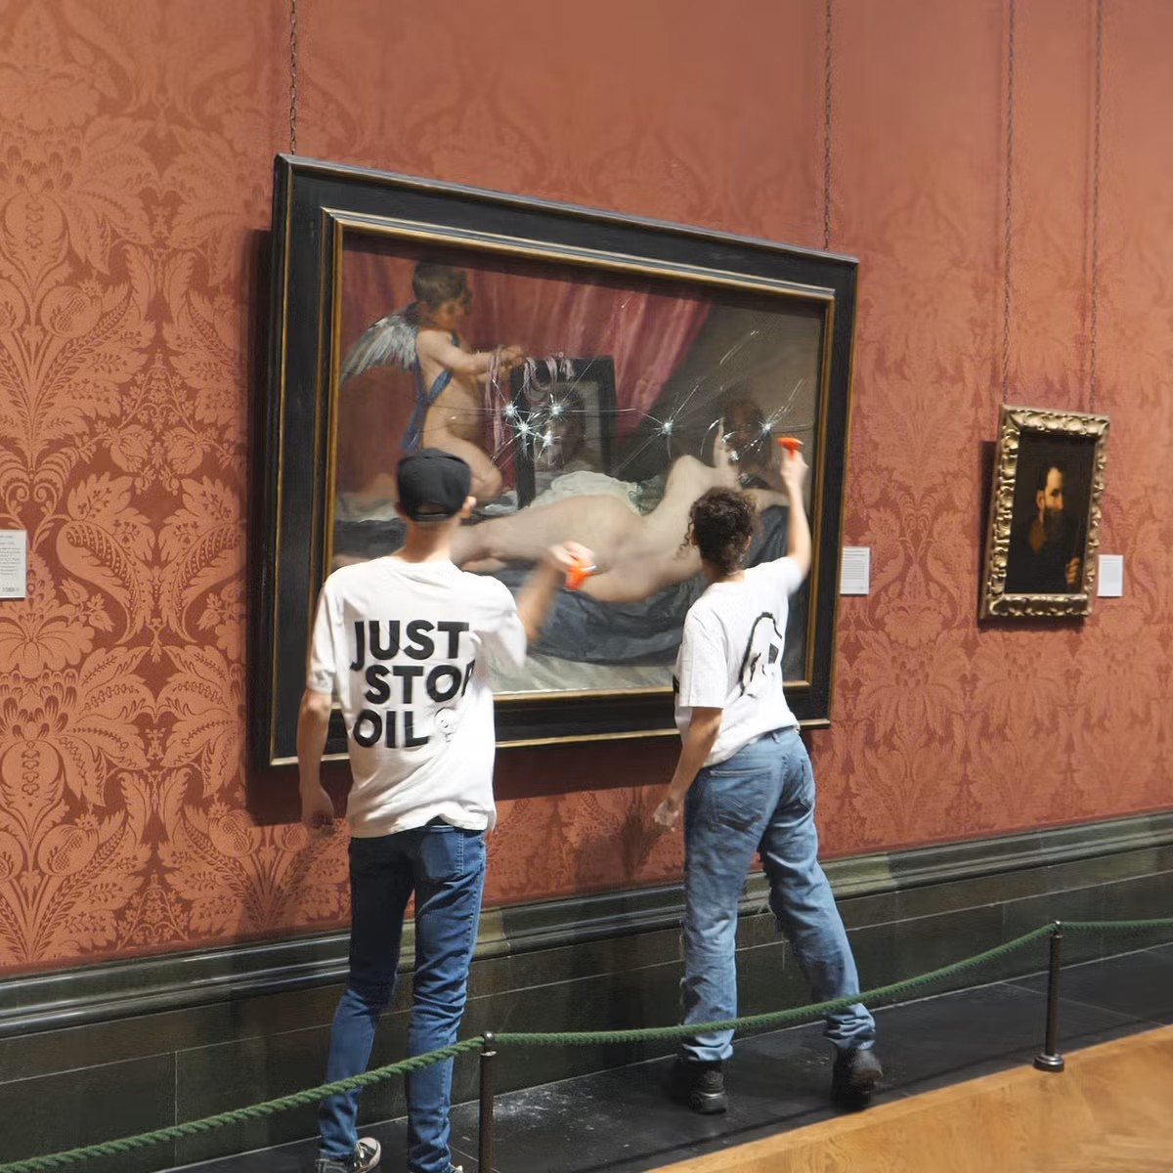

Slide 48
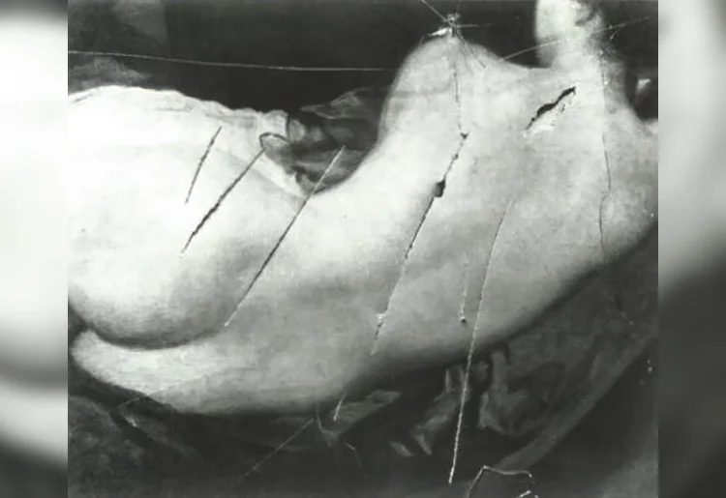

Slide 49
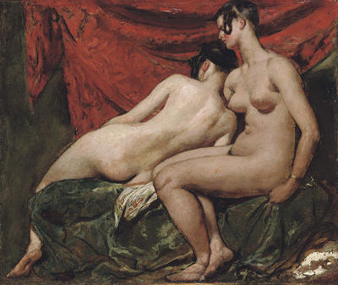
Notes:
Rokeby Venus

Slide 50
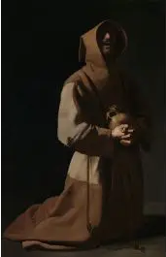
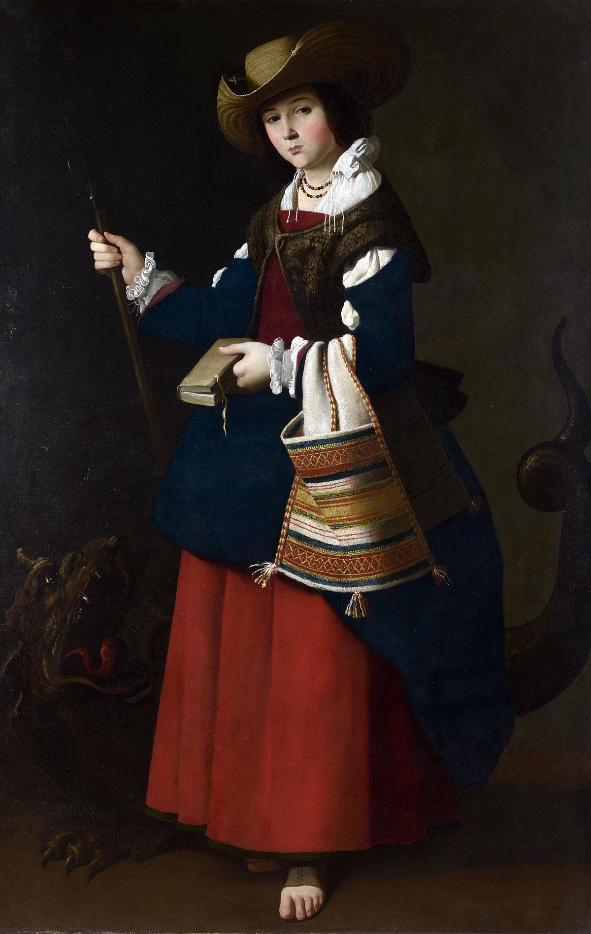

Slide 51
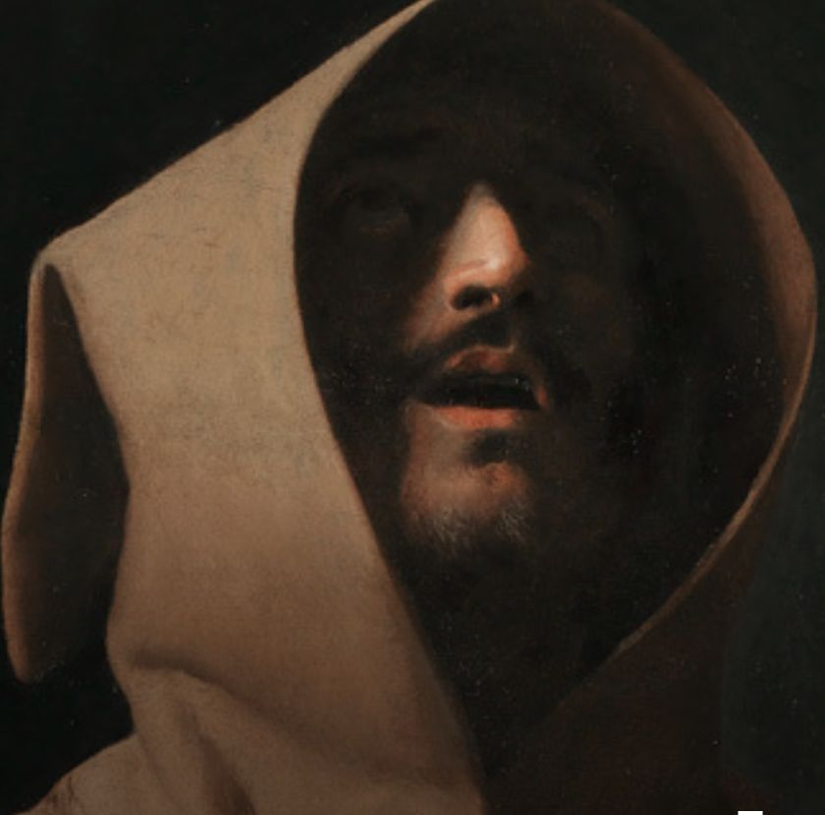

Slide 52


Slide 54


Slide 55


Slide 56


Slide 57


Slide 58


Slide 59


Slide 60


Slide 61


Slide 62


Slide 63


Slide 64


Slide 65


Slide 66


Slide 67


Slide 68


Slide 70


Slide 71

Notes:
Julius Schnorr von Carolsfeld

Slide 72


Slide 73


Slide 74


Slide 75


Slide 76


Slide 77

Notes:
Kobke

Slide 78


Slide 79


Slide 80


Slide 81

Notes:
Max Pechstein recent acquis. Red and green terrible passions

Slide 82


Slide 83


Slide 84


Slide 85


Slide 86


