Slide 1
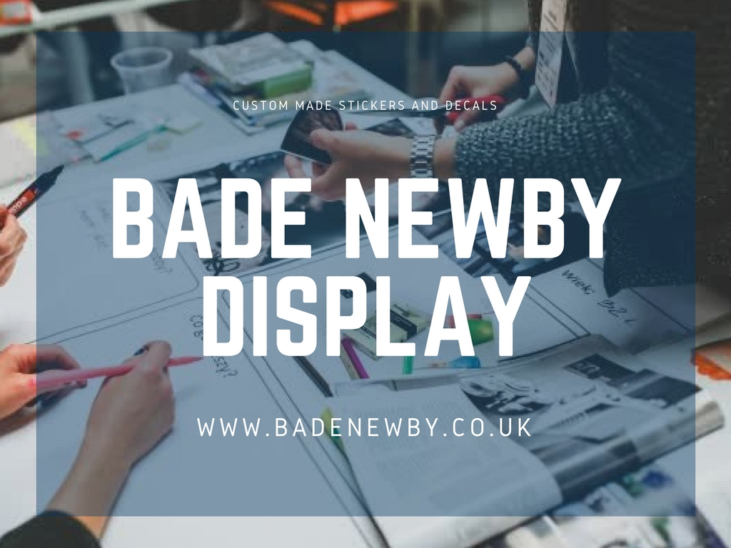

Slide 2
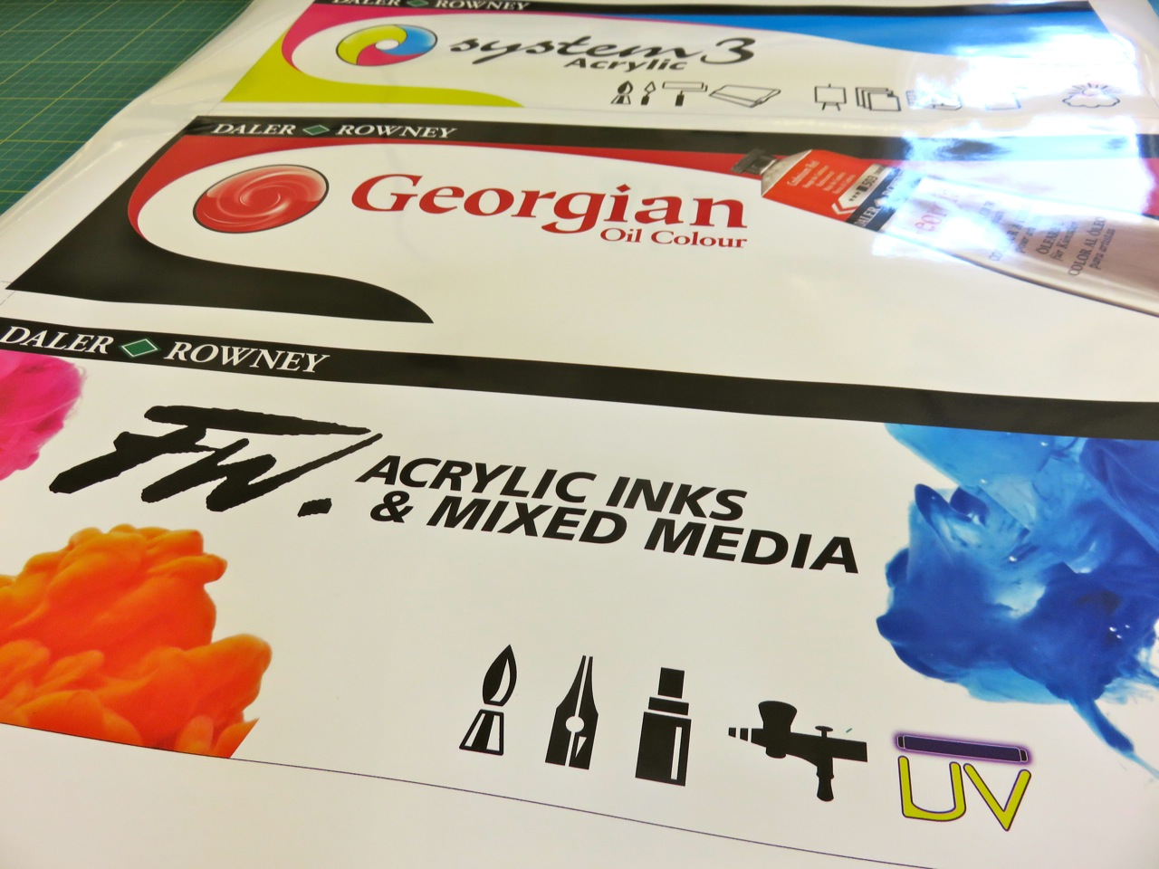
Bade Newby is a most reputed brand in the screen printing industry that prints only high resolution stickers for commercial and residential purposes. We have a huge collection of sticker designs within different types, sizes, colors that help businesses to promote their products and services widely in order to get new and buying customers to their shop. Our stickers range is window stickers, vinyl stickers, parking permit stickers, car window stickers, self cling stickers and many more.

Slide 3
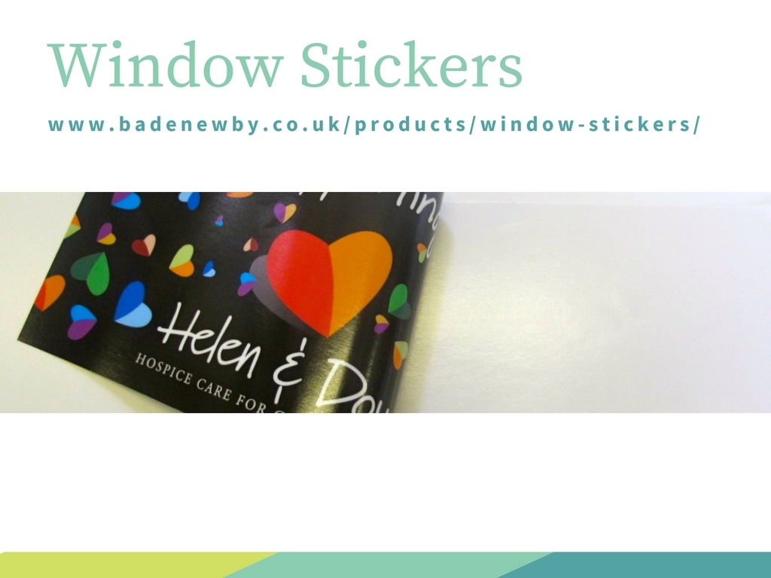
Window Stickers are the best way to showcase your latest products and offers through the shop window. Our all the stickers are waterproof and weatherproof that help to show your products for a long time.

Slide 4
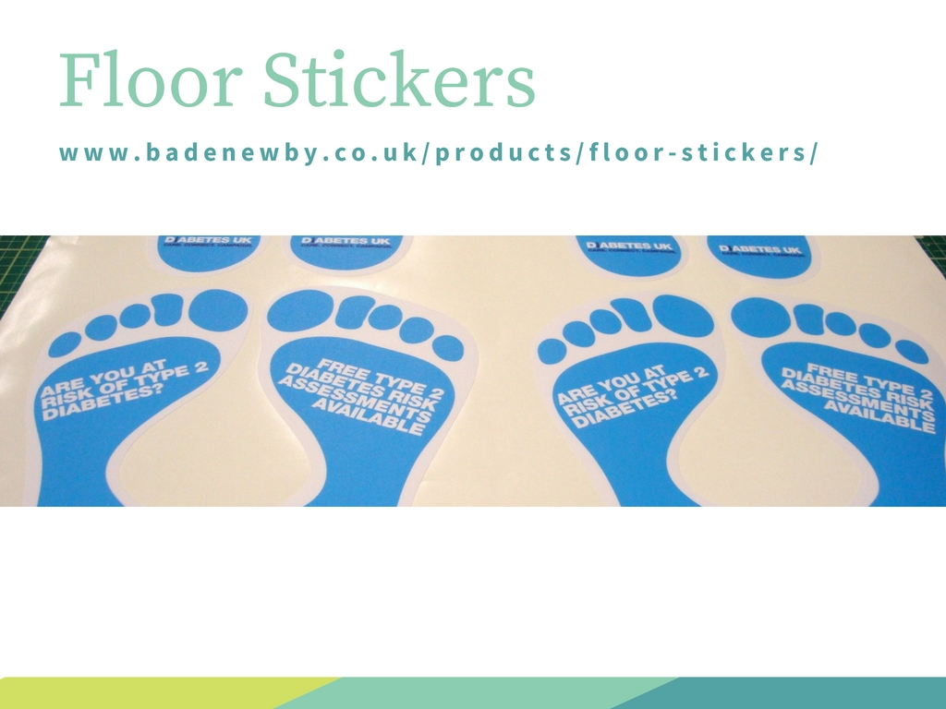
Our Floor stickers are one of the best selling products as they are widely used by local shops to direct their potential customers to the shop easily and also help to make more awareness of their companies brand. We have the latest print technology to print floor stickers in 1441dpi resolution with the large size of the sticker.

Slide 5
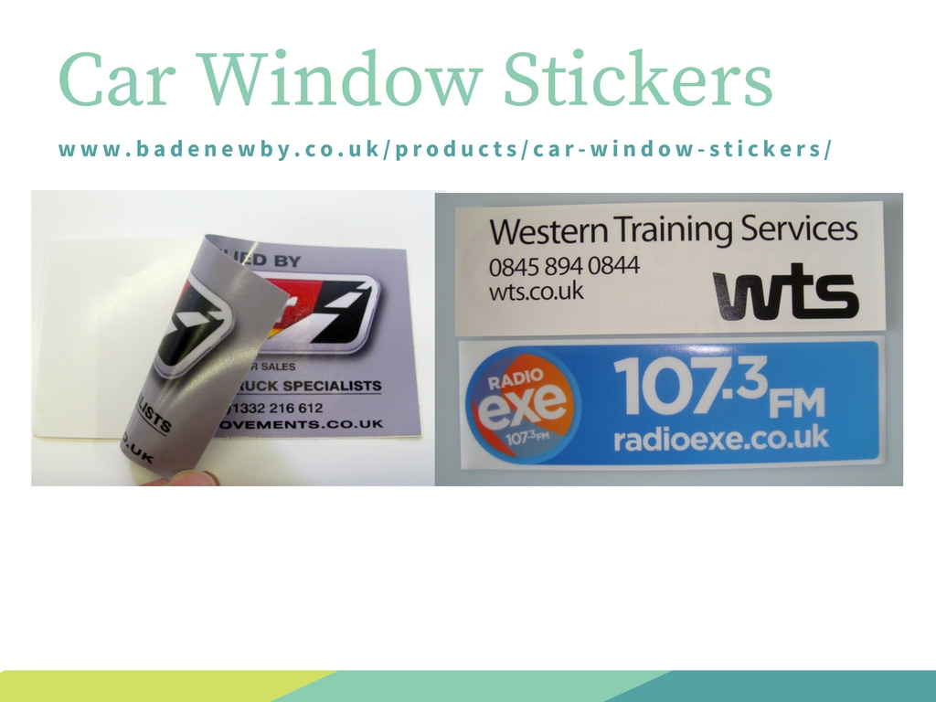
Car Window Stickers are also helping to make brand awareness and grab the more eyeballs to the attractive stickers. With the use of car window stickers, you can paste your car window stickers on your vehicles window in the back, front and sides.

Slide 6
