Slide 1
Golden Key GINsystem and Website Training

Slide 2
What is the GINsystem?
A members-only internal communication system for Golden Key chapters
Features:
Announcements
Calendar
Attendance Check Ins
Files
Emails
Text messages
Questions
Learn Faces
Who’s in my Classes
Contacts List
Chapter Wall
Points Management
Study Hours Tracking

Slide 3
The GINsystem
Benefits:
Cut down chapter time
Reduce officer headaches
Increase chapter communication
Efficient chapter management
No more paper “Go Green!”
Efficient officer transitions
Centralized calendar
Access to phone and email list, files anonymous voting
…and so much more!

Slide 4
How do I log into my GINsystem?
All members of Golden Key will log into their GINsystem using their Golden Key Username and Password from their chapter website

Slide 5
How do I add new users to the GINsystem?
All users add themselves!
Login with their Golden Key username and password
Accept terms of use
Verify and Save profile information

Slide 6
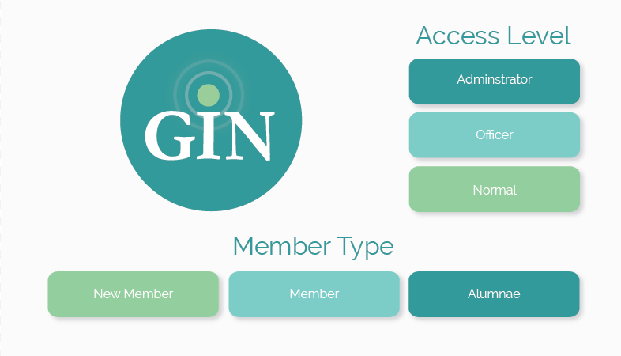
Member Types and Access Levels

Slide 7
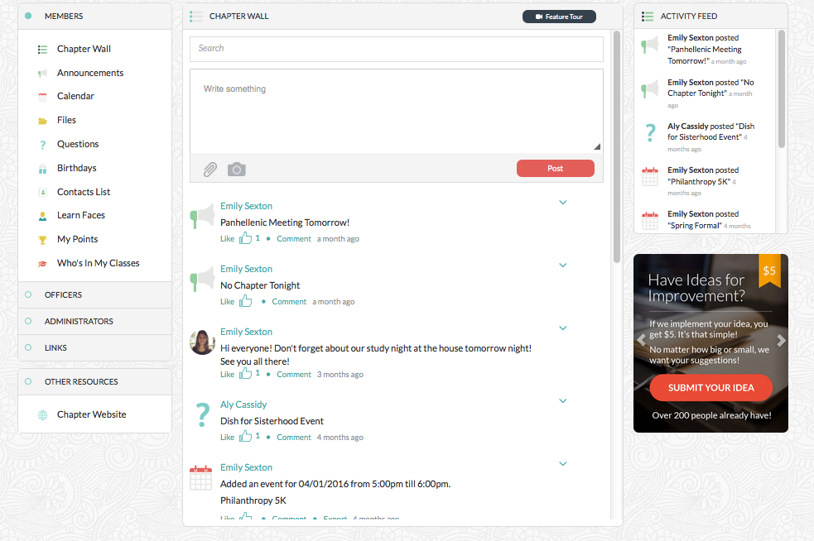
Home Page
Notes:
Add HQ tab on homepage

Slide 8
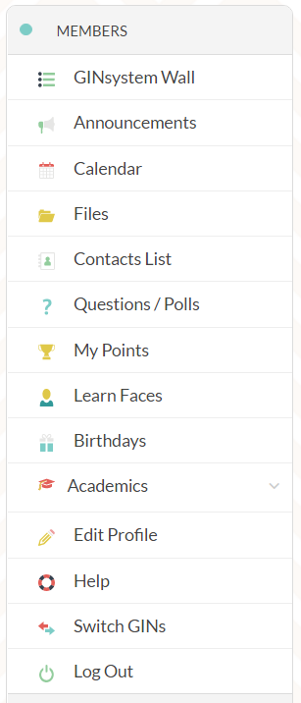
Member Menu
Members are able to view all information in the GINsystem that is intended for their member type

Slide 9
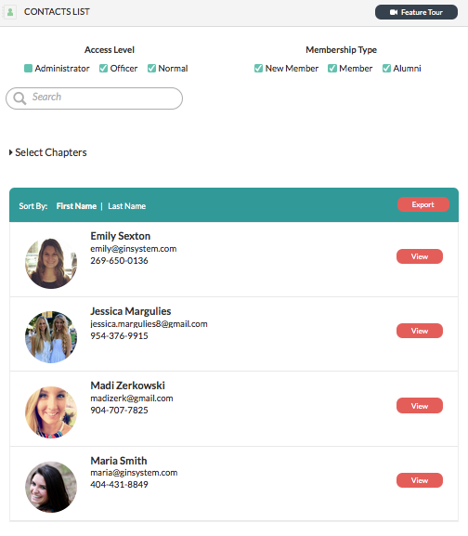
Contact List

Slide 10
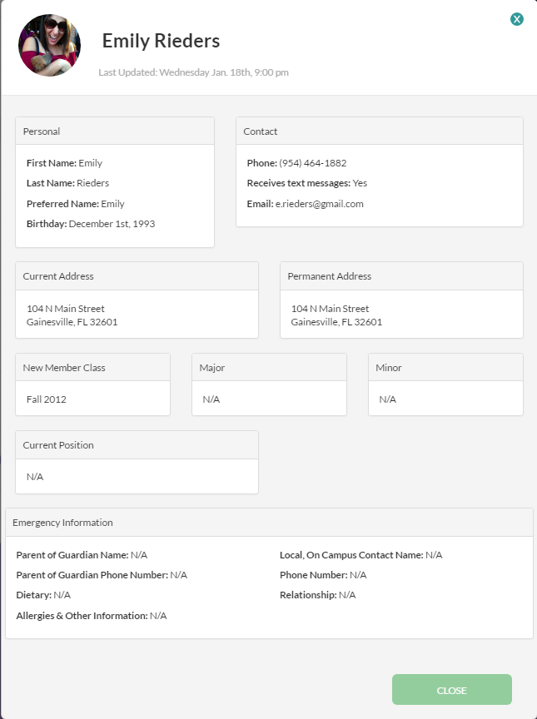
Contact List
Emergency Contact Information

Slide 11
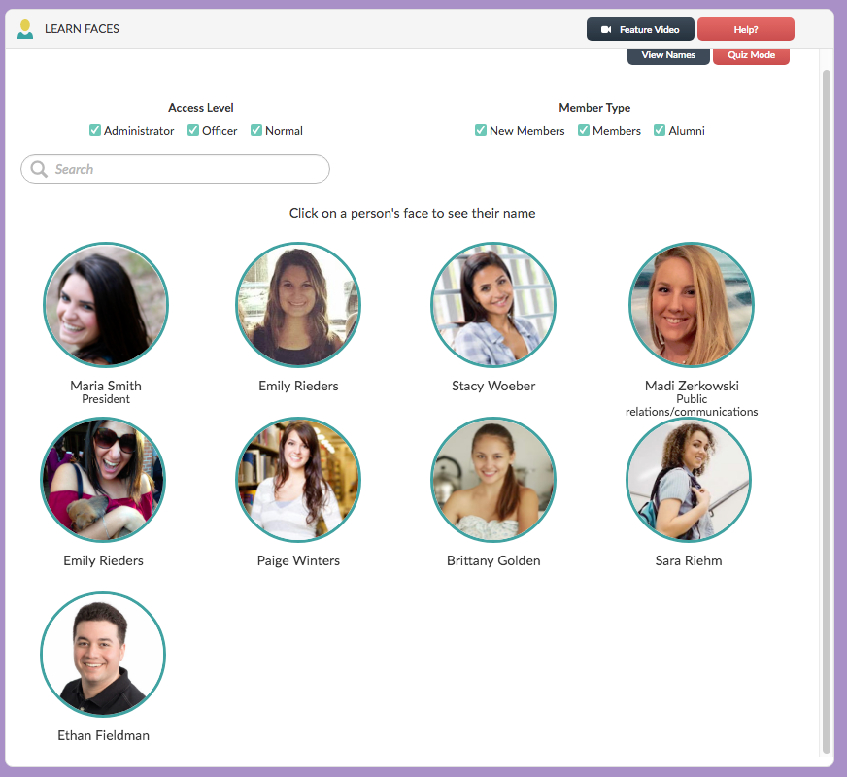
Learn Faces

Slide 12
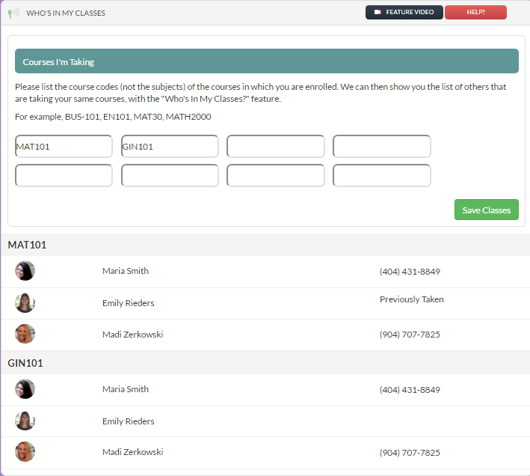
Academics Tab:
Who’s in my Classes?
Set up study groups with members of your chapter!

Slide 13
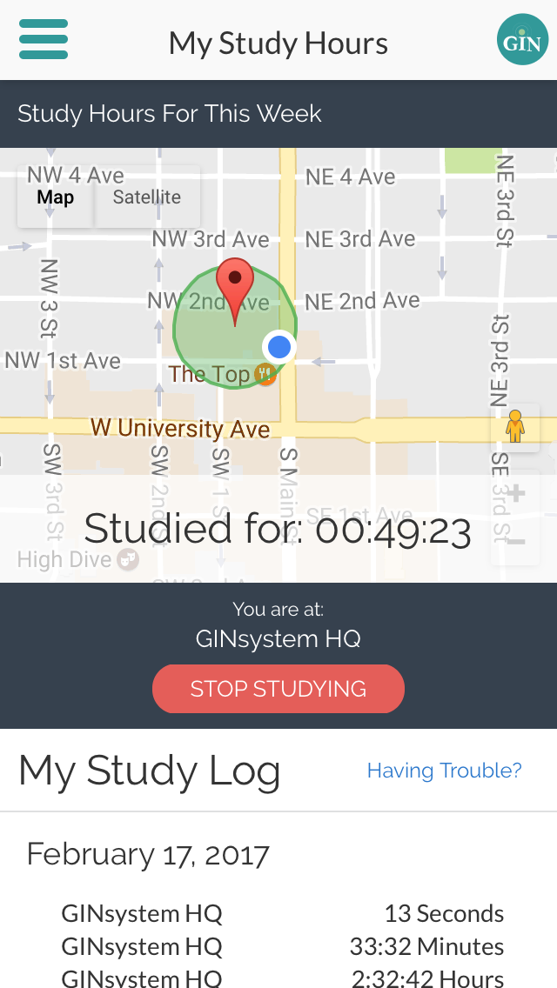
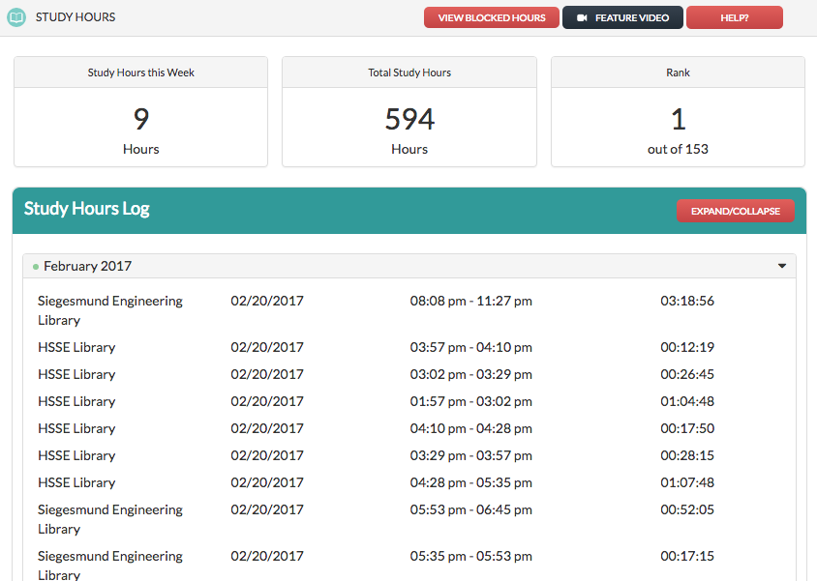
Academics Tab: My Study Hours

Slide 14
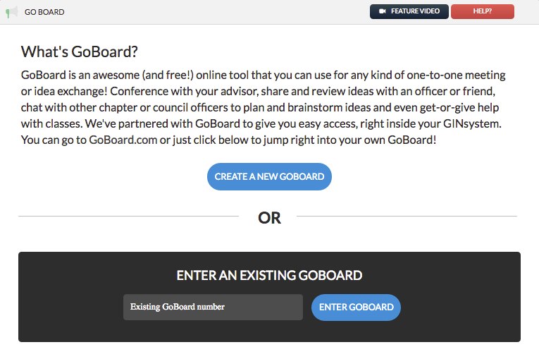
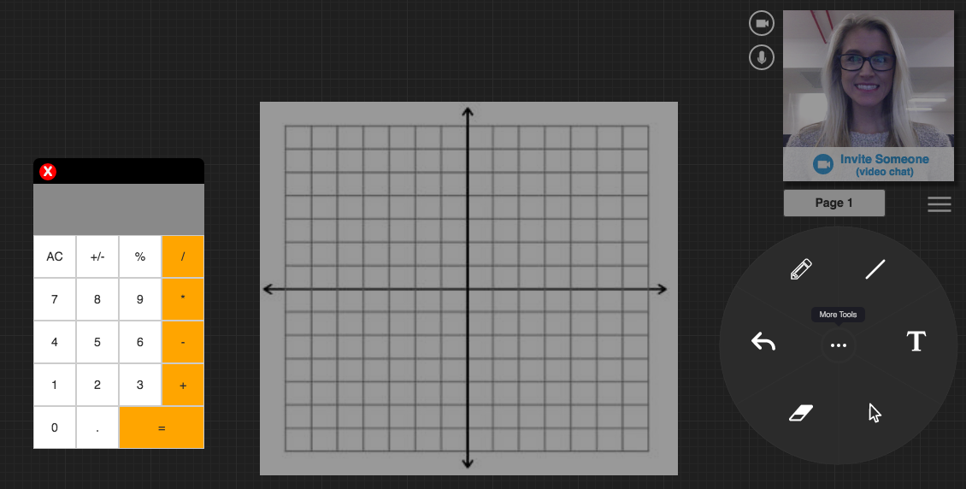
Academics Tab: Go Board

Slide 15
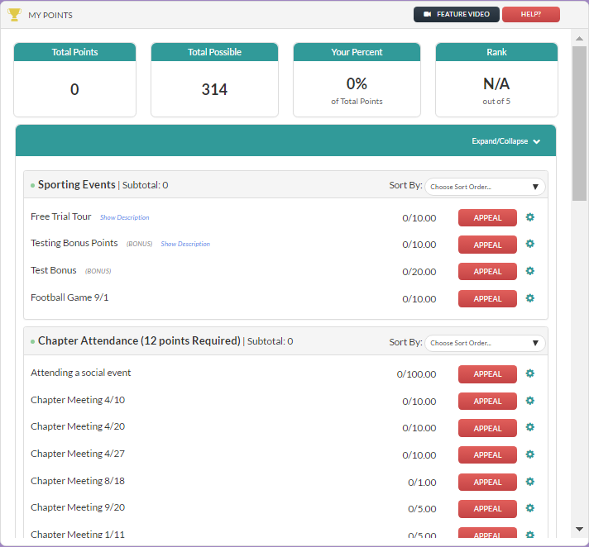
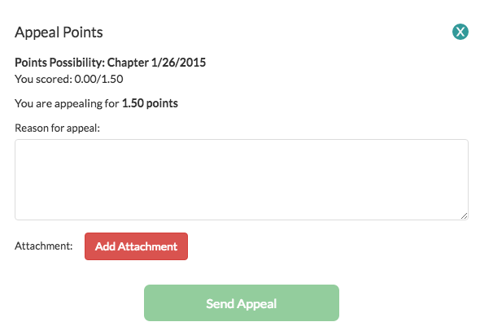
My Points
Users can appeal and keep track of their points and ranking within the chapter

Slide 16
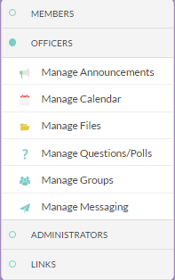
Officer Menu
Officers can manage all GINsystem communications from the officer menu
Note- Administrators have access to all these features as well.

Slide 17
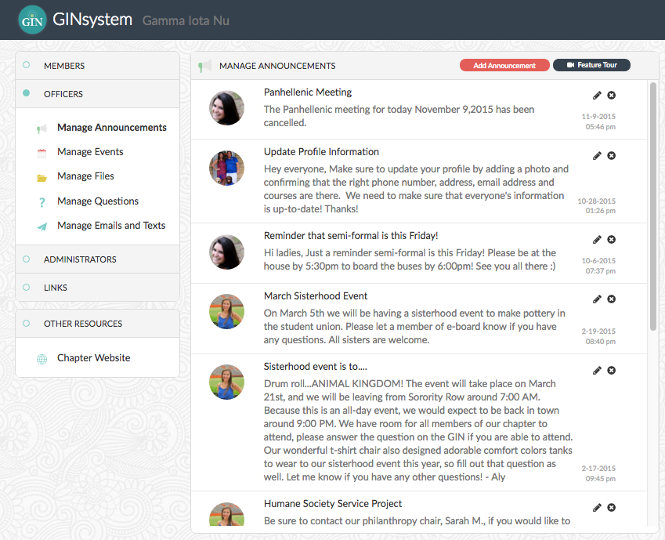
Announcements

Slide 18
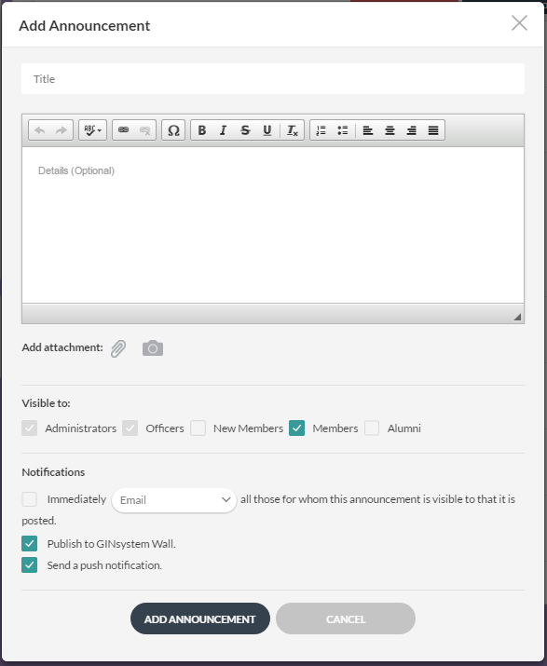
Add Announcements
Send push notifications

Slide 19
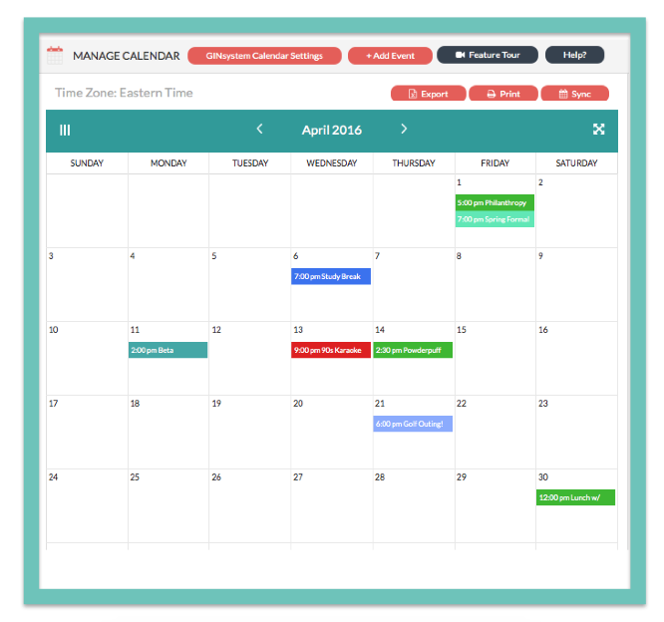
Calendar: Month View

Slide 20
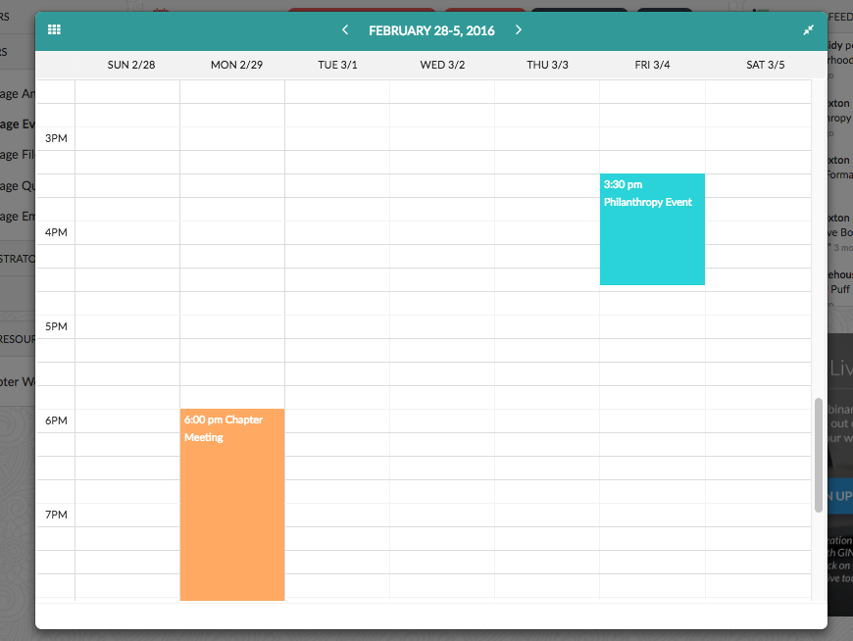
Week View Calendar

Slide 21
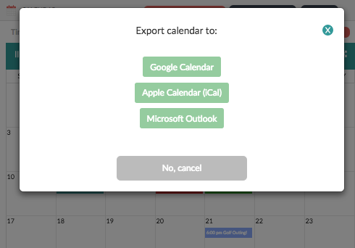
Calendar

Slide 22
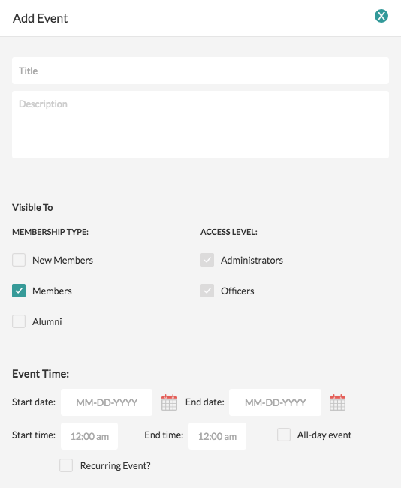
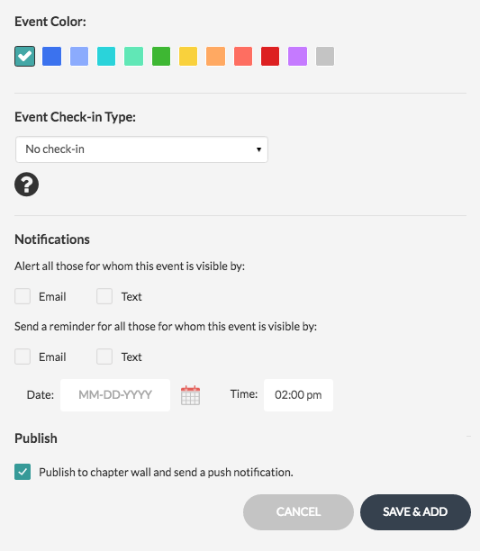
Manage Calendar

Slide 23
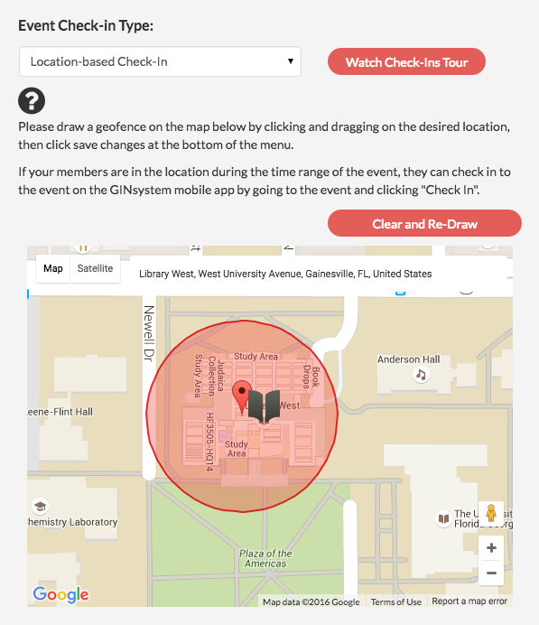
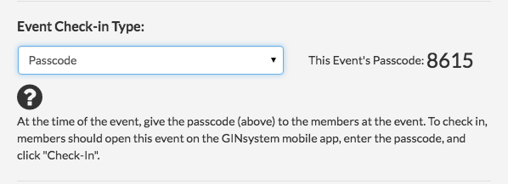
Manage Calendar

Slide 24
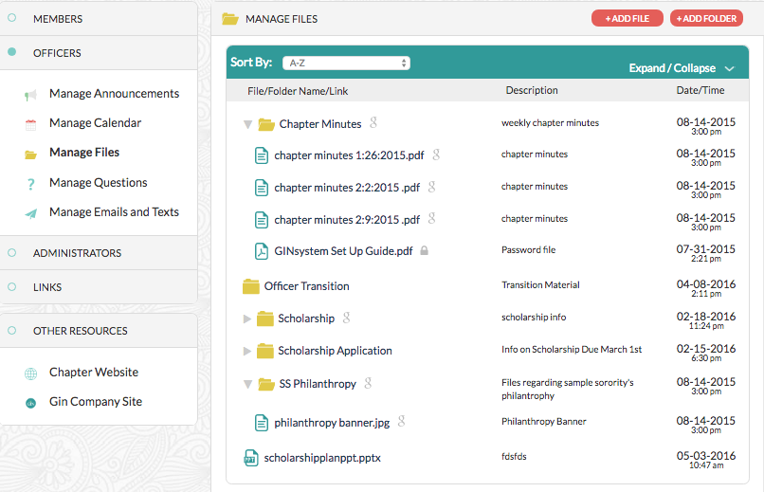
Manage Files

Slide 25
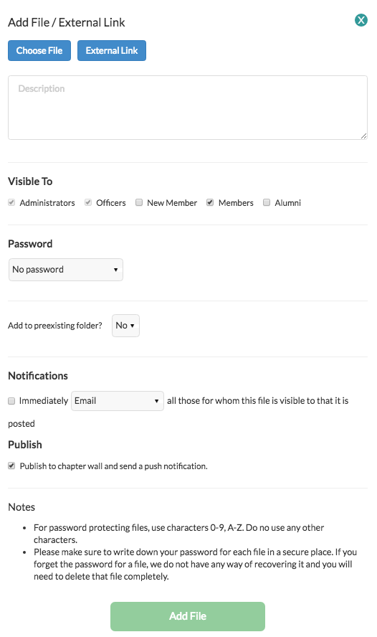
Add a Files

Slide 26
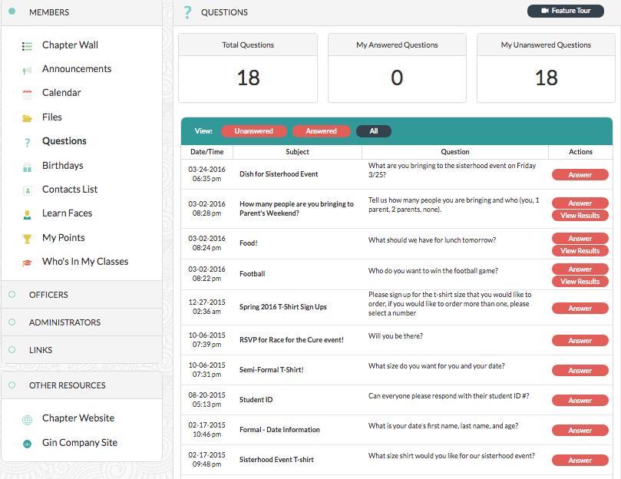
Answering Questions and Polls
(Member Menu)

Slide 27
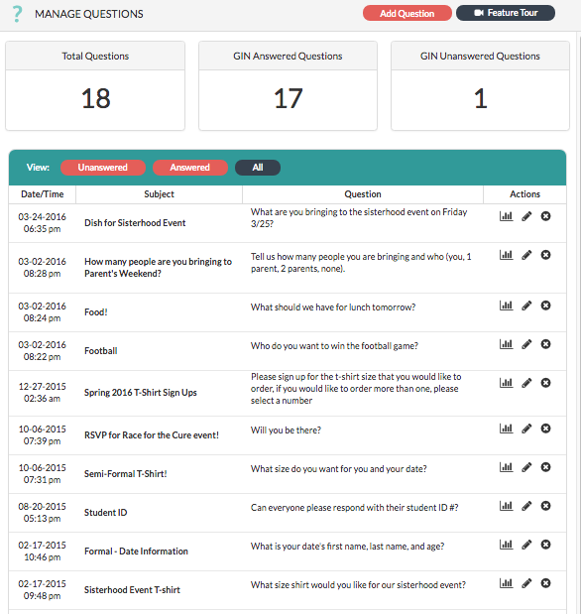
Manage Questions
(Officer Menu)

Slide 28
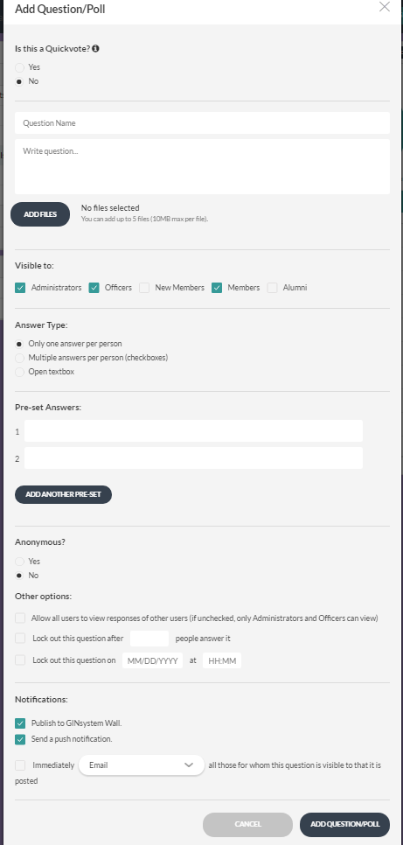
Add a Question/Poll

Slide 29
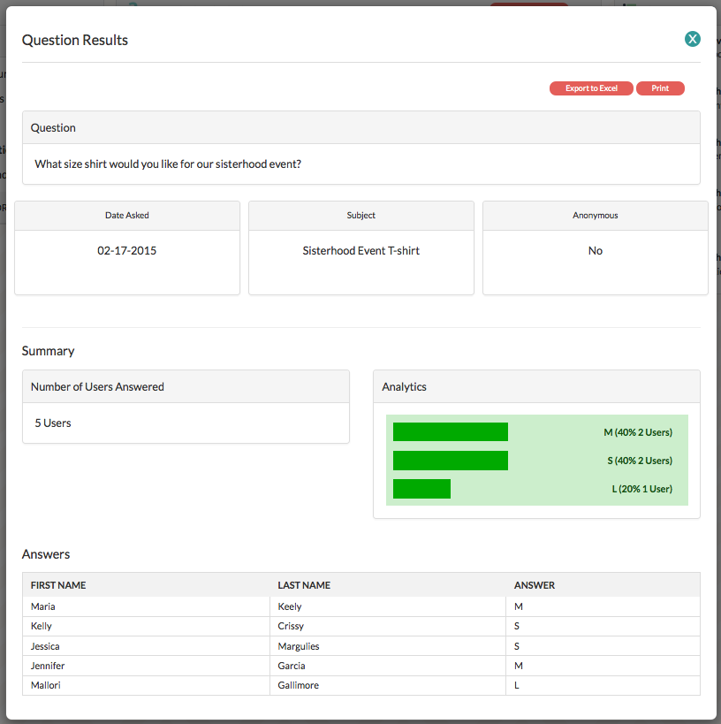
View Results

Slide 30
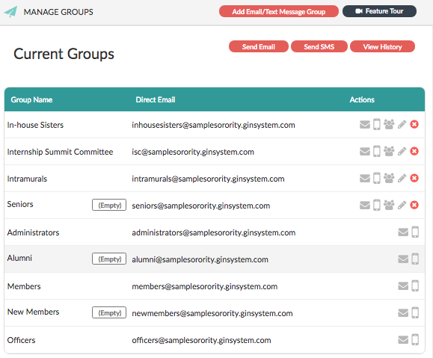
Group Emails and Texts

Slide 31
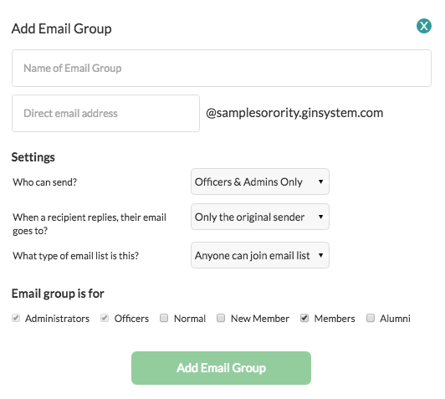
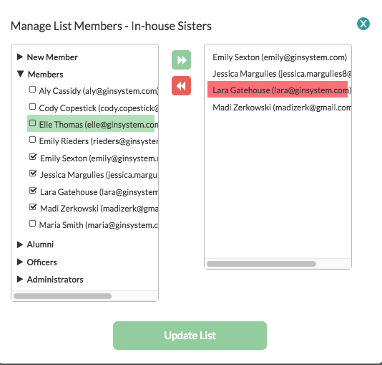
Create Email and Text Groups
It’s easy to add new groups and add and update members in groups

Slide 32
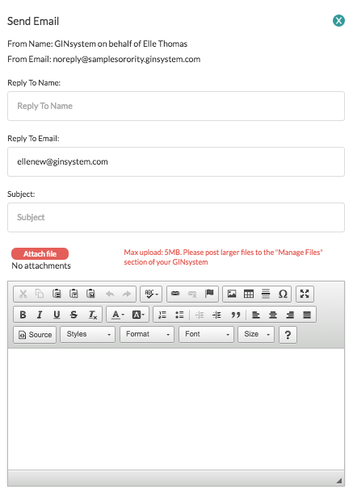
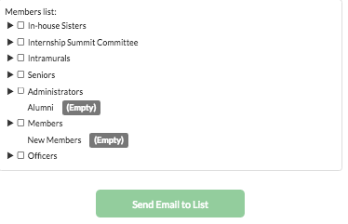
Send an Email

Slide 33
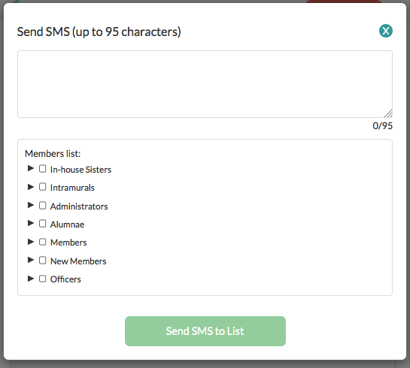
Send a Text Message

Slide 34
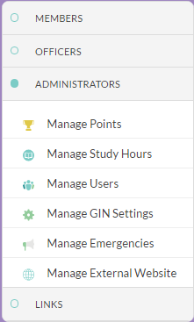
Administrator Menu
Administrators can manage all officer functions as well as study hours, manage users, and external websites

Slide 35
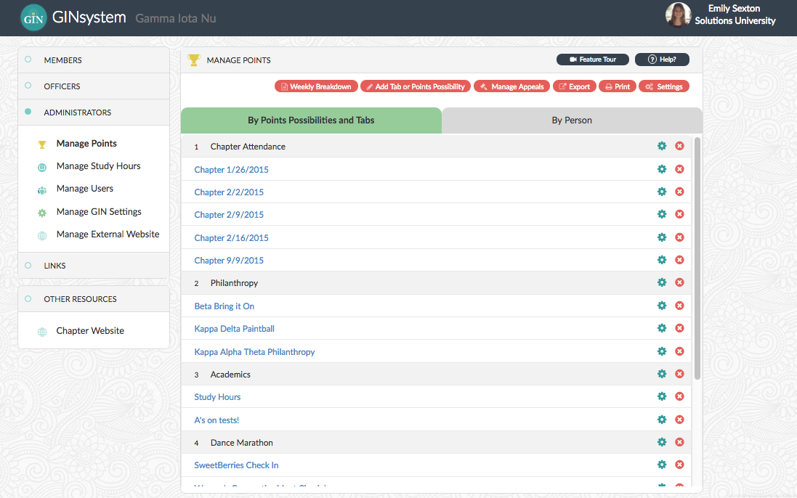
Manage Points

Slide 36
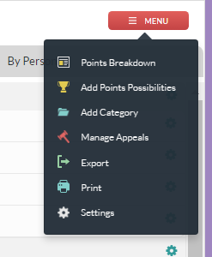
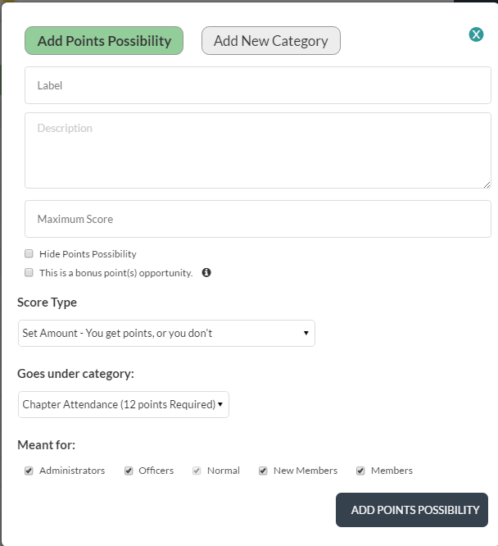
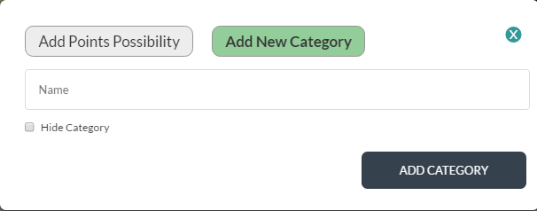
Add Points Possibilities and Categories

Slide 37
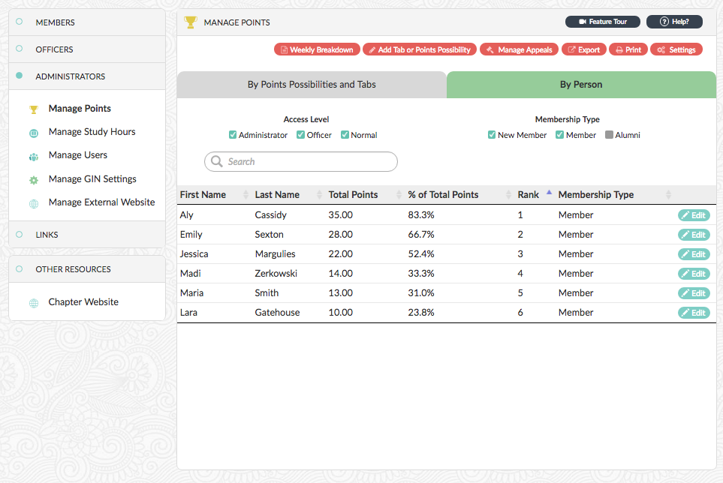
Manage Points By Person

Slide 38
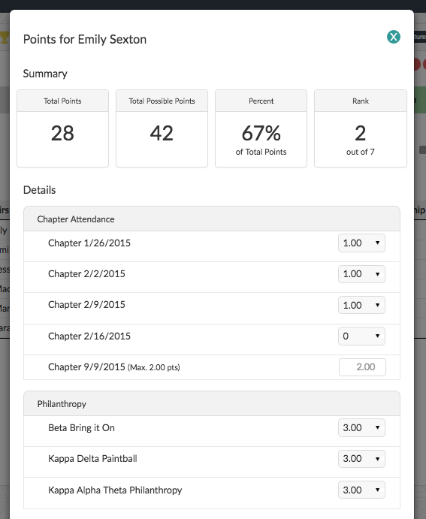
Edit Points Per Person

Slide 39
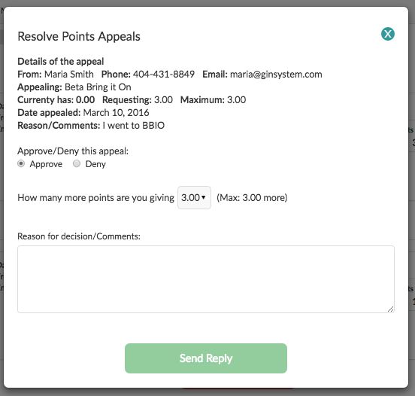
Manage Appeals

Slide 40
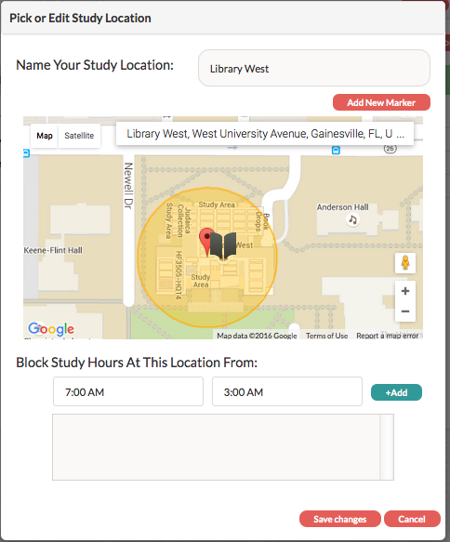
Manage Study Hours
Add study locations throughout your campus for members to track their studying

Slide 41
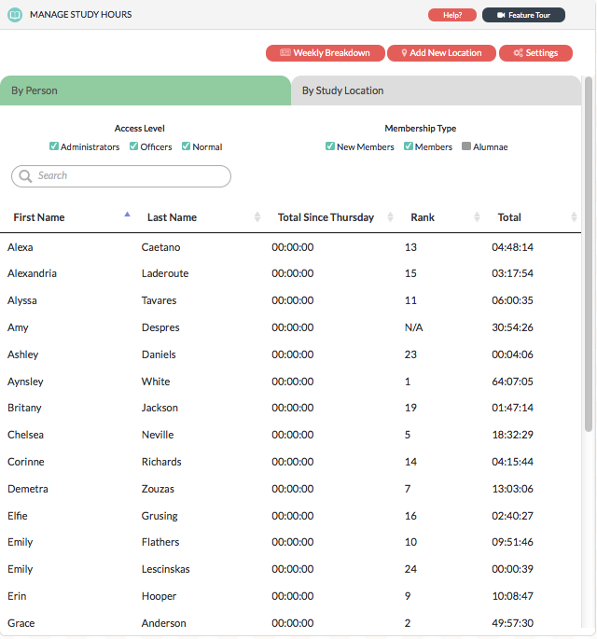
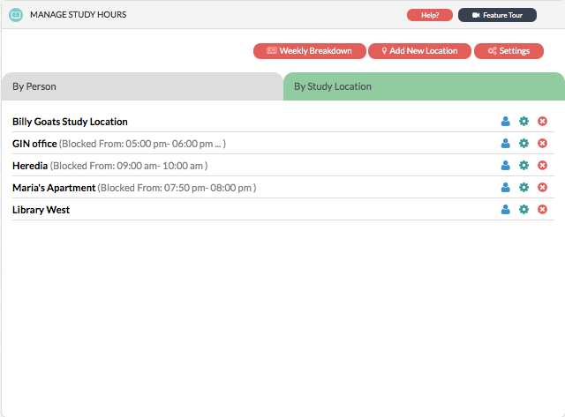
Manage Study Hours
View the number of hours studied by person and by study location

Slide 42
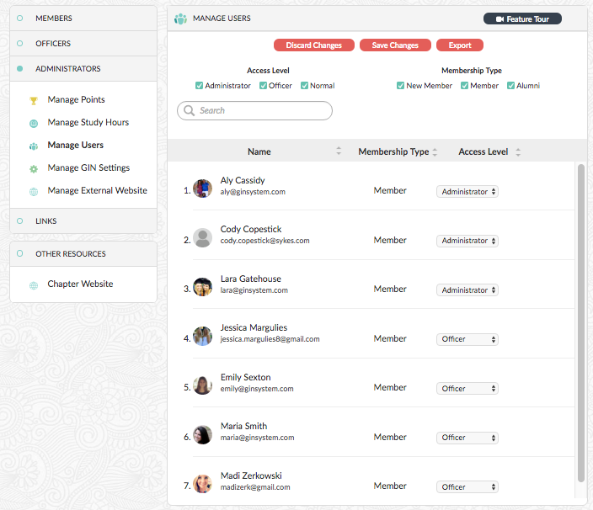
Manage Users

Slide 43
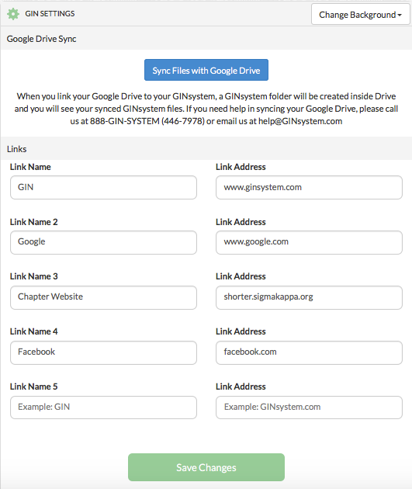
Manage Settings

Slide 44
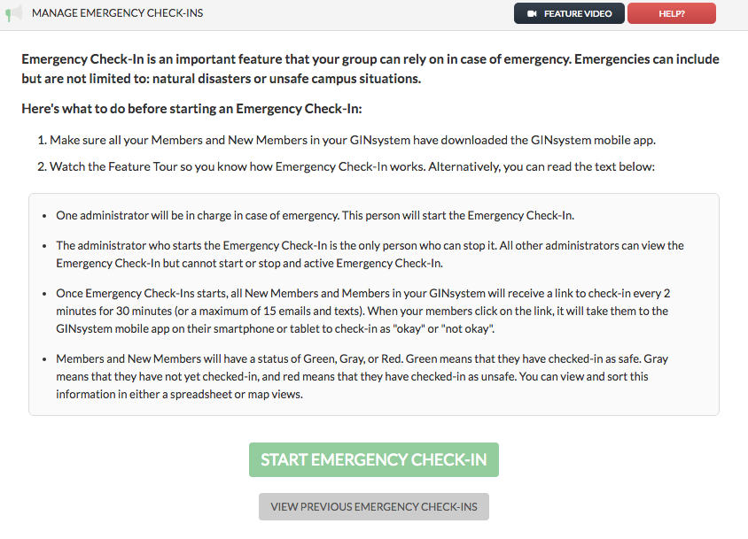
Manage Emergency Check-In

Slide 45
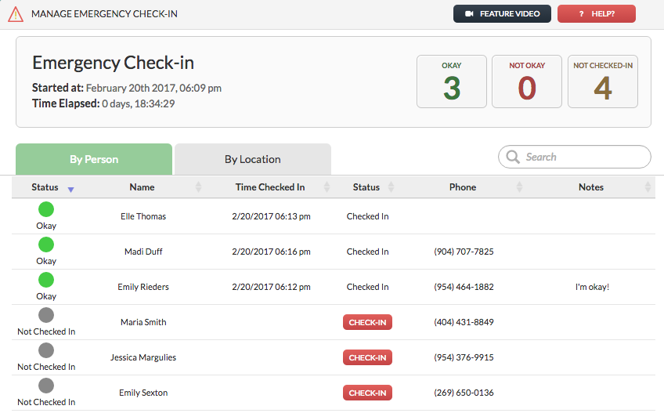
Manage Emergency Check-In: By Person

Slide 46
Manage Emergency Check-In: By Location

Slide 47
Manage Emergency Check-In: Mobile Application
v

Slide 48
Emergency Check-In: (Member Menu)
v

Slide 49
Mobile Applications
Manage all officer functions from on the go! Members can also view all GIN communications, and answer questions

Slide 50
Chapter Websites
3 Custom Designs
Golden Key Branding
P.A.R
Let’s take a look…

Slide 54
How do I edit my website?

Slide 58
Edit Slide
Crop Slide
Move Slide
Delete Slide

Slide 59
Photo Editor

Slide 62
Homepage Photo

Slide 63
Interior Page Slideshow

Slide 64
Chapter News

Slide 65
Chapter News Option 1 - Twitter

Slide 66
Chapter News Option 2 – Non-Twitter

Slide 67
Social Media

Slide 68
Locked Content

Slide 69
Partially Locked Content

Slide 70
Add New Pages

Slide 72
Chapter Officers

Slide 73
Chapter Officers Three Layouts

Slide 74
Photo Gallery

Slide 75
Photo Albums

Slide 76
Training Resources
GINsystem.com/goldenkey
Notes:
Fix this screenshot

Slide 77
Questions?
Contact us!
888-GIN-SYSTEM
(446-7978)
Chat M-F 10 AM-6 PM EST
at GINsystem.com
Theta@GINsystem.com

Slide 78
Case Study #1
Sister Sally has struggled with academics for some time. The sorority’s obligation is to provide Sally with the tools to succeed. What tools on the GINsystem can help to improve Sally’s academic performance?

Slide 79
How GIN helps Sister Sally
Tutor Matching Service – Find an online tutor directly from GIN
Study Hours Tracking – Track hours studied so that administrators can help work with her and know how much she is studying
Who’s In My Classes – Find a sister in your class that can help you study

Slide 80
Case Study #2
Gamma Iota Nu chapter is ordering T-shirts for the upcoming philanthropy event. The previous T-shirt chair lost the piece of paper with everyone’s T-shirt size. This lead to members grabbing whatever shirt they thought would be best and members not receiving what they actually ordered. How can the GINsystem help to stream line this process so there is less headache?

Slide 81
How GIN helps Gamma Iota Nu
Questions Feature- View everyone’s answers and export the results directly to Excel for apparel provider
Files Section – Add the T-Shirt Proofs into the Files section so members can reference the files at any time

Slide 82
Case Study #3
Alumnae Sister Ashley want to be able to help their local chapter during their recruitment process. How can the chapter best communicate their needs to local alumnae members?

Slide 83
How GIN helps Alumnae Sister Ashley
Calendar Feature- Chapters can share recruitment events with alumnae and alumnae can export events or sync the GIN calendar
Announcements– Chapter Officers can send announcements to alumnae to inform their alumnae members about events or their need for recruitment help

