Slide 1
Dante’s Project Examples

Slide 2
Option a
He created an Inferno based on Harry Potter. 9 created levels with Harry Potter characters in each level. These are close up pictures until the last where you can see he created levels as a 3D creation.

Slide 3
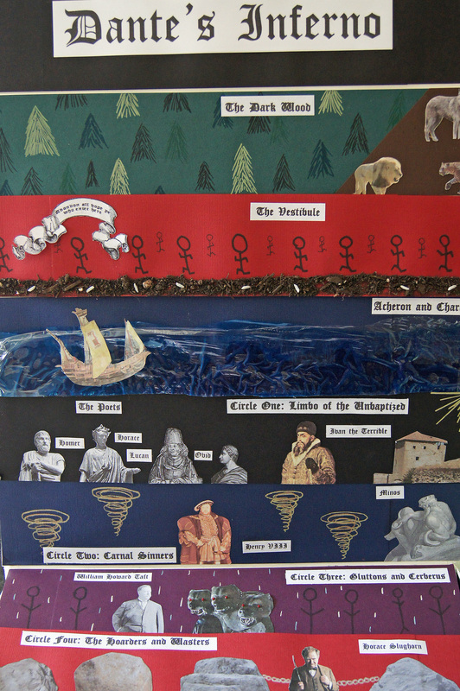

Slide 4
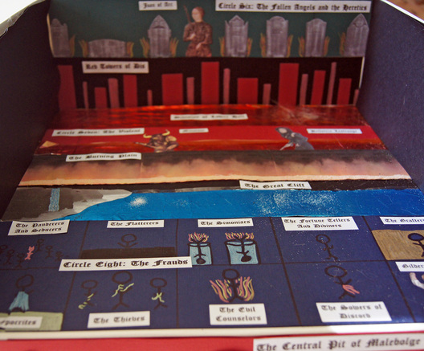

Slide 5
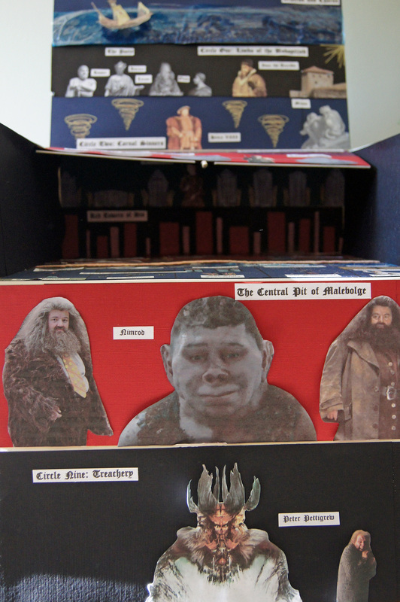

Slide 6
Option b
https://www.youtube.com/watch?v=Fr4wmvRmQ20

Slide 7
Option e
This is an example of cake 1. She created a layer cake. On the cake it says, “Abandon All Hope Ye Who Enter Here”

Slide 8
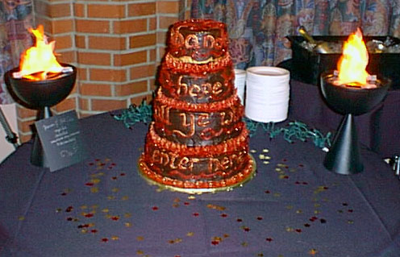

Slide 9
Option E
This is an example of cake 2. She focused on a level she created. It was for all the people who abused sweets and were obese. They are forced to eat sweets 24/7.

Slide 10
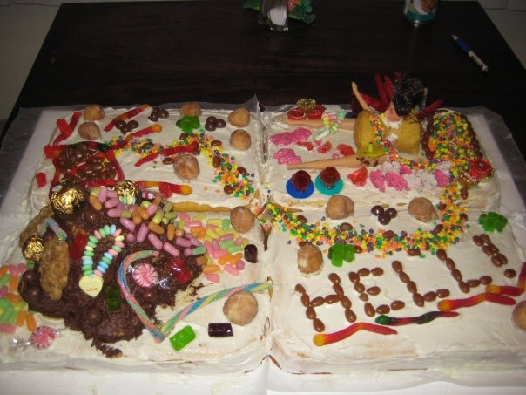

Slide 11
Etc.
More ideas for presentation:

Slide 12
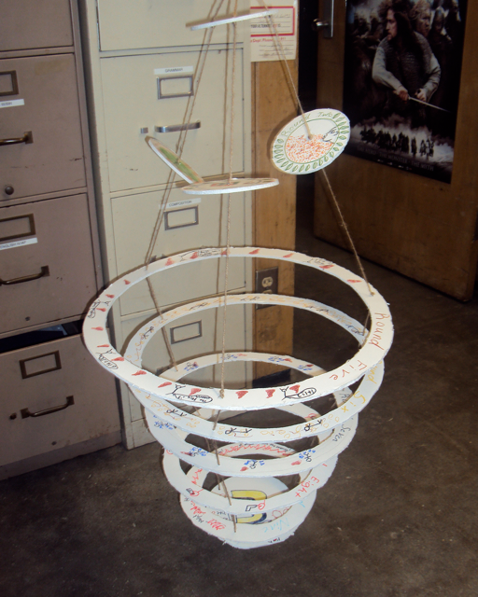

Slide 13
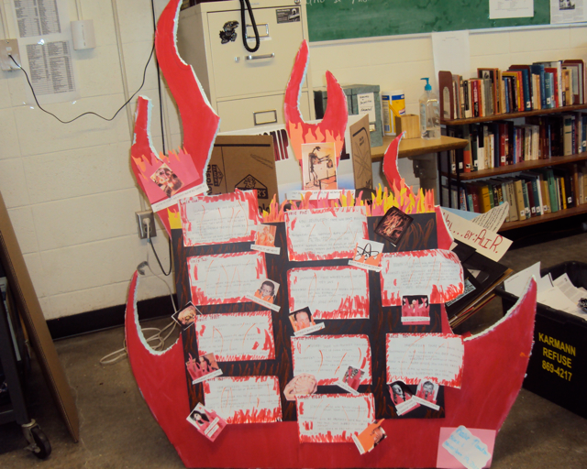

Slide 14
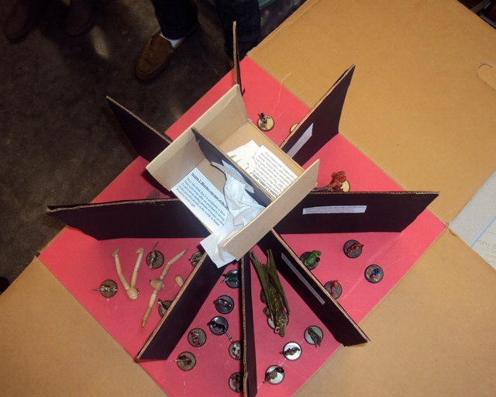

Slide 15
