Slide 1
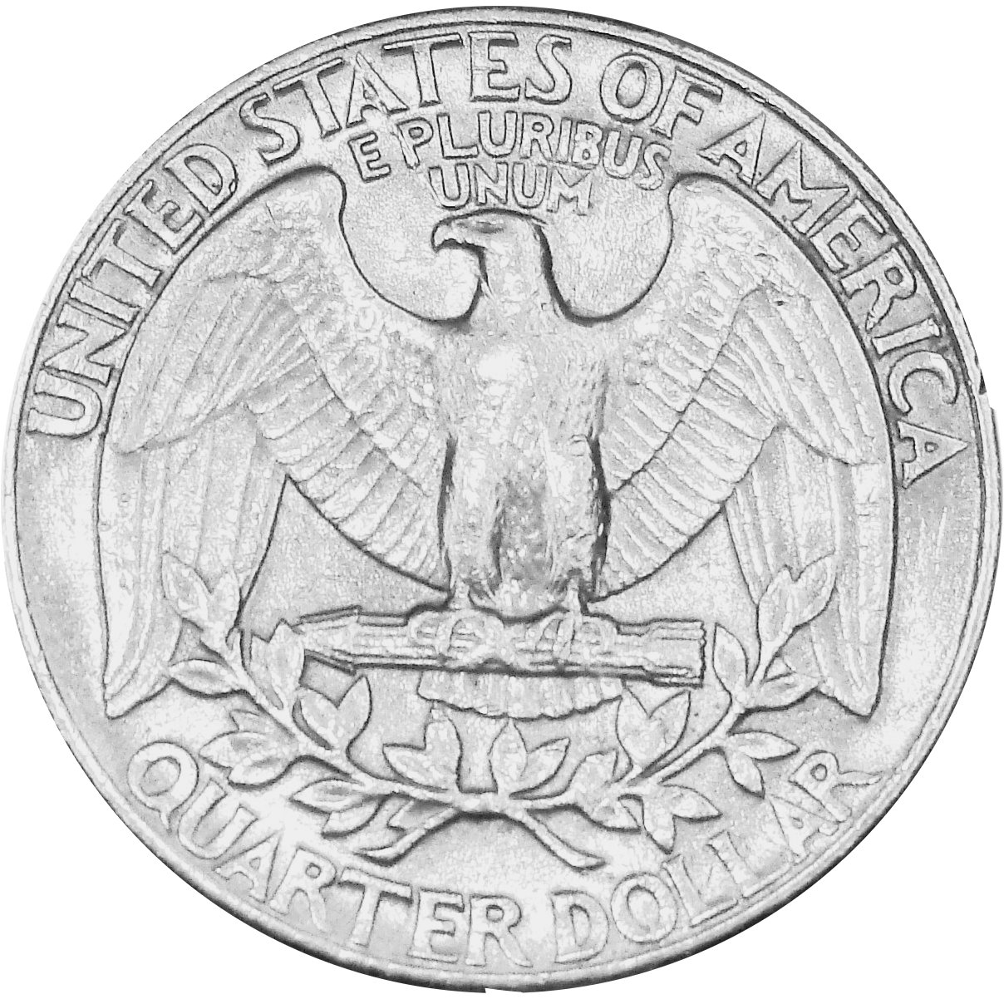
How Much is a Quarter?

Slide 2
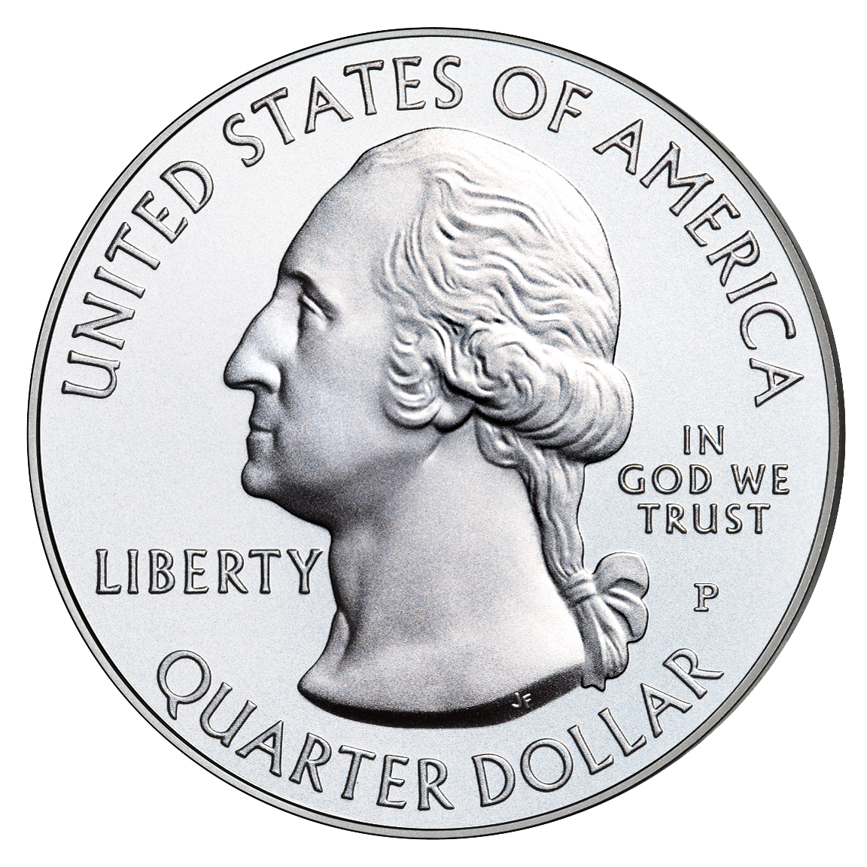
This is a quarter. A quarter is worth 25 cents.
25 ¢
The quarter is the biggest coin.

Slide 3
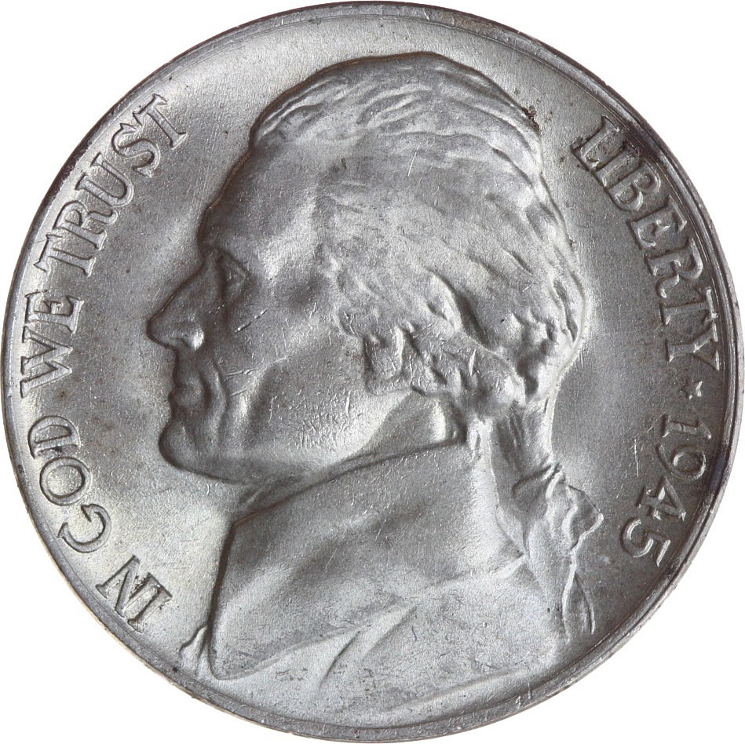
A quarter is the same as 5 nickels.
=

Slide 4
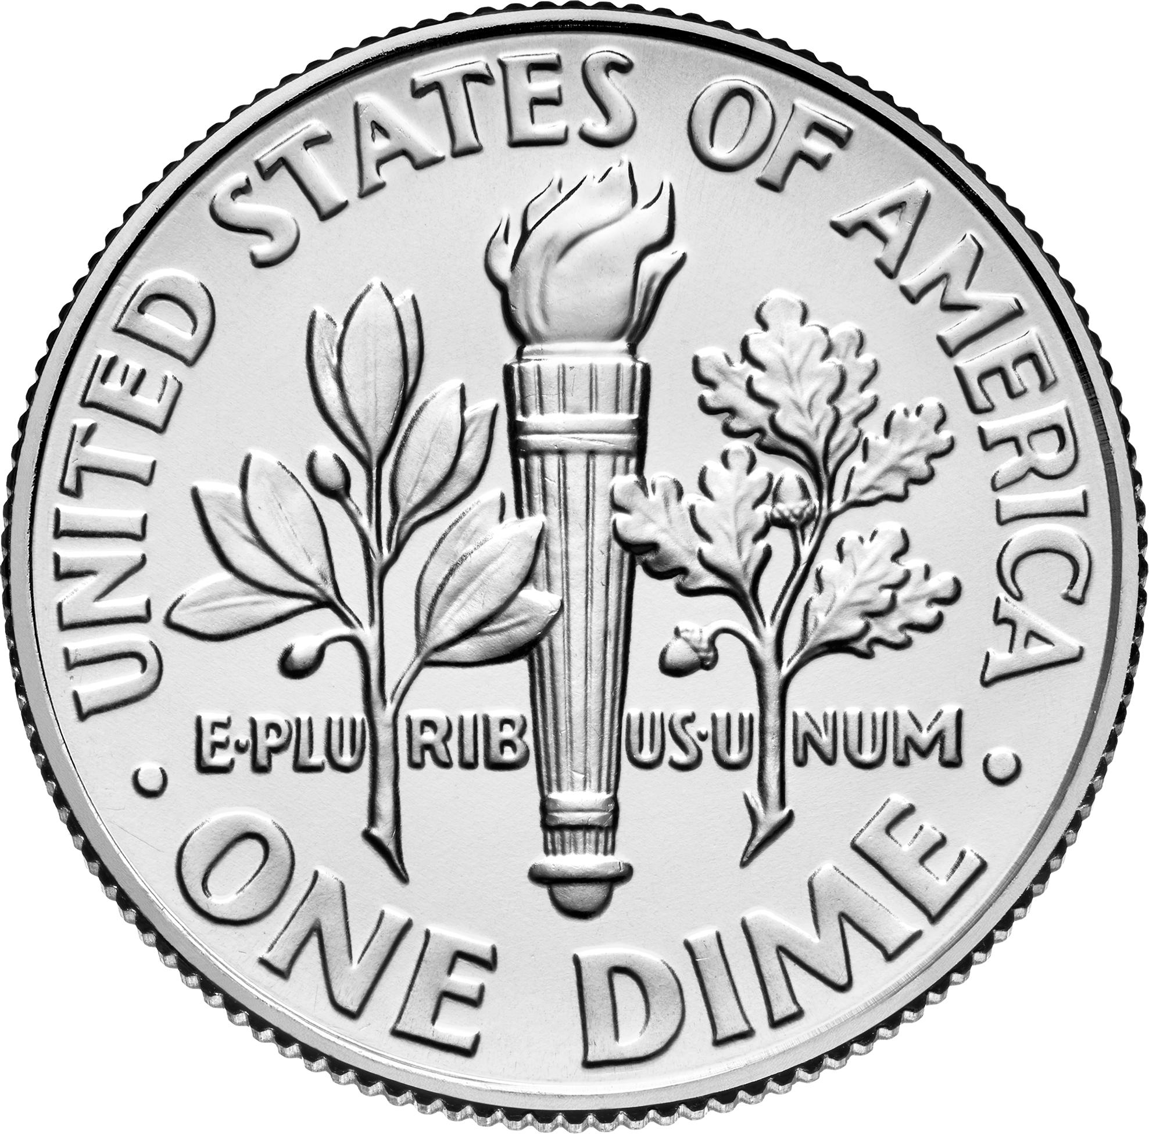
A quarter is the same as 2 dimes and 1 nickel.
=

Slide 5
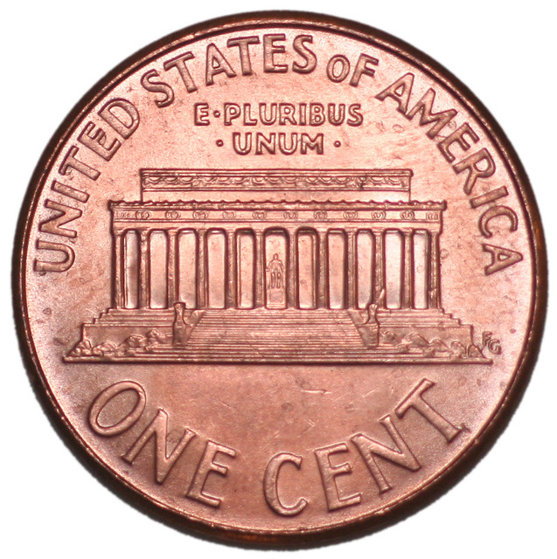
A quarter is the same as 25 pennies.
=

Slide 6
How many? How much is this?

Slide 7
50 ¢

Slide 8
How many? How much is this?

Slide 9
100 ¢ or $1.00

Slide 10
How many? How much is this?

Slide 11
75 ¢

Slide 12
How many? How much is this?

Slide 13
$1.25

Slide 14
How many? How much is this?

Slide 15
$1.50

Slide 16
How many? How much is this?

Slide 17
$2.00

Slide 18
How many? How much is this?

Slide 19
$1.75

Slide 20
Review: How much is a quarter worth?

