Slide 1
Introduction to
ELECTRICAL CIRCUIT DIAGRAMS
SciencePoint

Slide 2
ELECTRICALCIRCUITS
SERIES
A series circuit is a circuit where there is only one path from the source through all of the loads and back to the source. This means that all of the current in the circuit must flow through all of the loads.
Teacher Guide
Click on the light switch to turn the globe on and off.
Click on page to display text.
Hide Teacher Guide
Show Teacher Guide

Slide 3
DIFFERENCES BETWEEN SERIES & PARALLEL CIRCUITS
Teacher Guide
Click on the light switches to turn the globes on and off.
Note the relative brightness of globes.
Click on an illuminated globe to “break” it. Note the effect.
Click red arrow to reset (repair globes).
Click elsewhere to proceed to next slide.
⬅
Hide Teacher Guide
Show Teacher Guide

Slide 4
DIFFERENCES BETWEEN SERIES & PARALLEL CIRCUITS
SERIES
PARALLEL
Teacher Guide
Click to display textboxes.
If one globe burns out
or is removed, all globes
will stop working.
If one globe burns out
or is removed, all other globes will continue working.
The voltage is shared between each globe, resulting in reduced
brightness.
Each globe receives the full voltage of the source, resulting in all globes burning at the same brightness regardless of the number of globes.
Serial circuits are cheap and easy to construct.
Parallel circuits require more effort to construct.
Hide Teacher Guide
Show Teacher Guide

Slide 5
PREDICT WHAT WILL HAPPEN WHEN THE SWITCH IS ON
Teacher Guide
Click on the light switches to turn the globe on.
Nothing should happen.
Discuss short circuits.
This is called a SHORT circuit
Hide Teacher Guide
Show Teacher Guide

Slide 6
PREDICT WHAT WILL HAPPEN WHEN THE SWITCH IS OFF
Teacher Guide
Click on the light switches to turn the globe off.
Nothing should happen.
This is also called a SHORT circuit but instead, the light stays on.
Hide Teacher Guide
Show Teacher Guide

Slide 7
WHERE WOULD YOU FIND THIS
CIRCUIT?
Teacher Guide
Click on the light switches to turn the globes on and off.
Discuss household lighting circuits.
Click elsewhere to proceed to next slide.
This is a common circuit. Lighting in a house consists of a parallel circuit with individual switches for each light.
~
Hide Teacher Guide
Show Teacher Guide

Slide 8
WHERE WOULD YOU FIND THIS
CIRCUIT?
Teacher Guide
Click on the light switches to turn the globes on and off.
Safety switch will override all other switches.
This is a SAFETY circuit.
Individual globes (or machines) can be switch on and off by their own switches, but a safety switch can shut off all devices at once.
~
Hide Teacher Guide
Show Teacher Guide

Slide 9
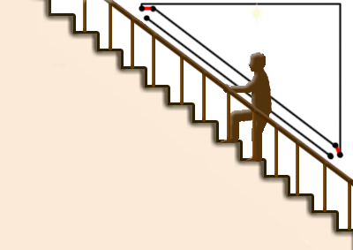
WHERE WOULD YOU FIND THIS CIRCUIT?
1
2
Teacher Guide
Click on the AC power source symbol to cycle through switching scenarios.
Click on slide to display image of staircase.
Discuss 2-way switches.
This is a TWO-WAY circuit.
The light is controlled by two switches. These are often found at staircases, where the light can be switch on or off at the top or bottom of the stairs.
1
2
~
~
~
~
Hide Teacher Guide
Show Teacher Guide

Slide 10
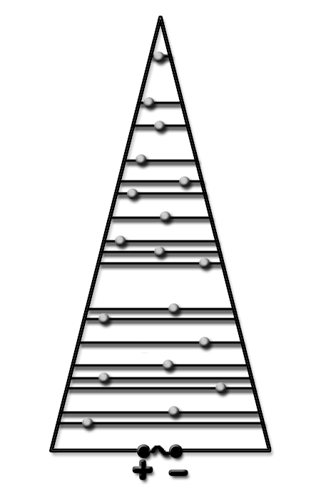
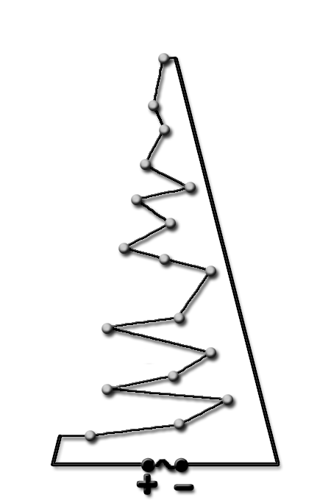
CHRISTMAS TREE LIGHTS SERIES OR PARALLEL CIRCUITS?
Teacher Guide
Click to fade Christmas tree to reveal series circuit.
Click to show parallel circuit.
Series
Parallel
Hide Teacher Guide
Show Teacher Guide

Slide 11
CHRISTMAS TREE LIGHTS SERIES
If one globe burns out, all lights will go out. The circuit is no longer closed.
Teacher Guide
Click on slide to “break” a globe.
Note all globes do not work.
Hide Teacher Guide
Show Teacher Guide

Slide 12
CHRISTMAS TREE LIGHTS PARALLEL
Teacher Guide
Repeatedly click on the slide to break globes.
Note all other globes remain working.
Repeat until all globes are off.
If one globe burns out, all other lights will remain on. The circuit is still closed.
Hide Teacher Guide
Show Teacher Guide

Slide 13
ABOUT
This and other quality resources can be found on
SciencePoint
Released by SciencePoint under
Attribution - NonCommercial - Share Alike CC BY-NC-SA
This licence lets others distribute, remix and build upon the work, but only if it is for non-commercial purposes, they credit the original creator/s (and any other nominated parties) and they license their derivative works under the same terms.

