Slide 1
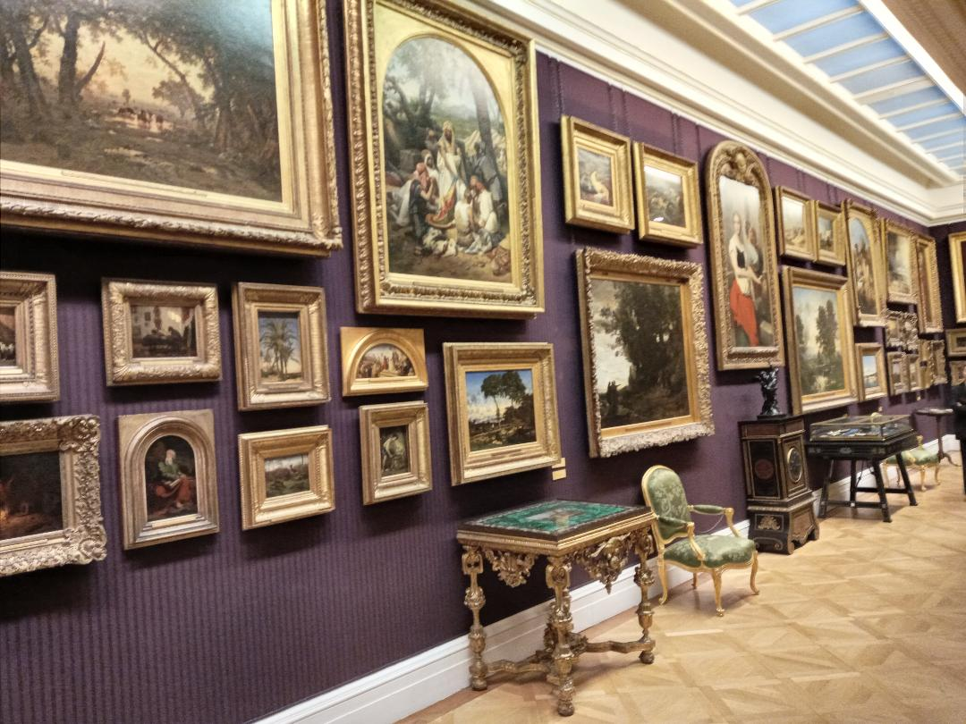

Slide 2
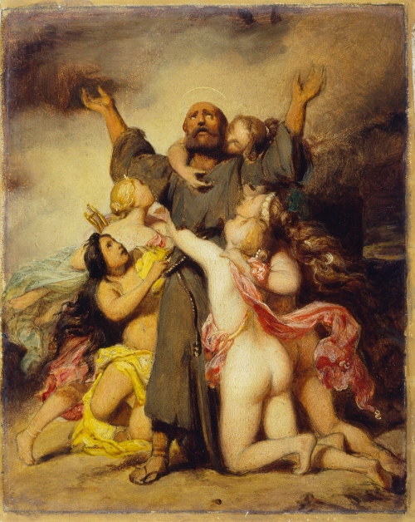
Notes:
Delaroche

Slide 3
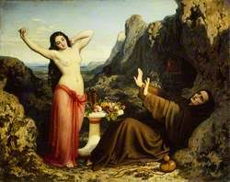
Notes:
Domenique Papety. Temptation of St Hilarion

Slide 4
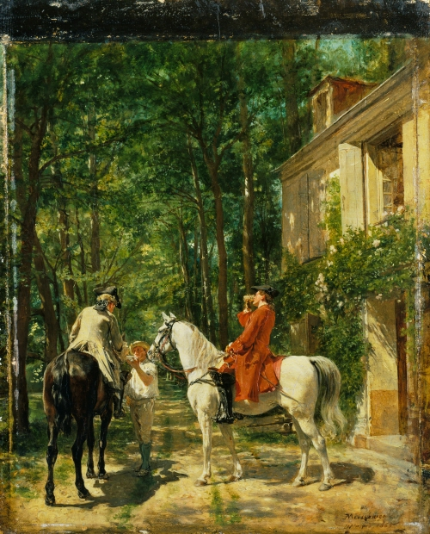

Slide 5
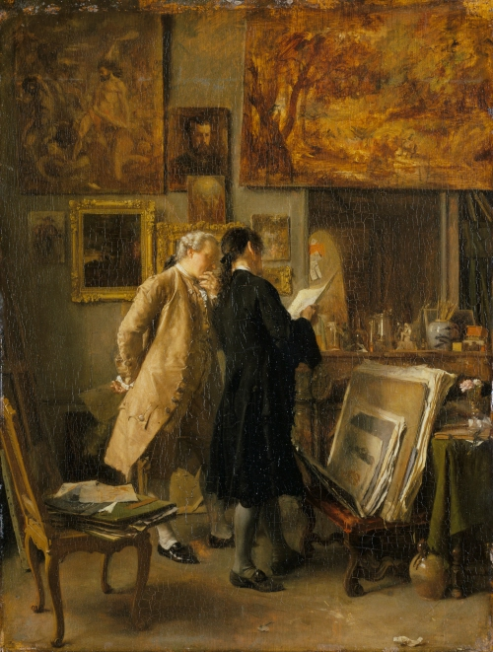

Slide 6
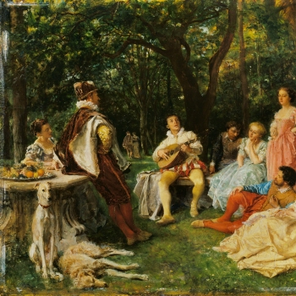

Slide 7
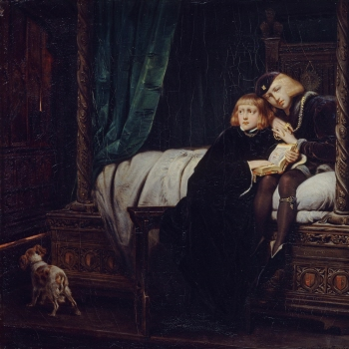

Slide 8
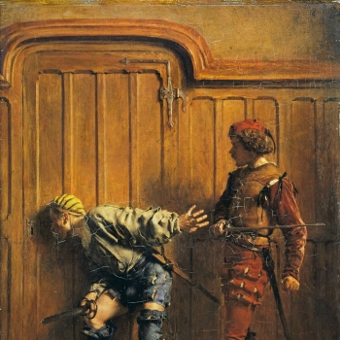

Slide 9
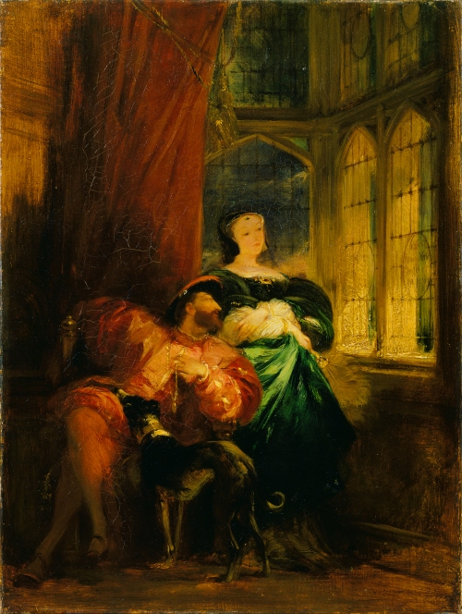

Slide 10
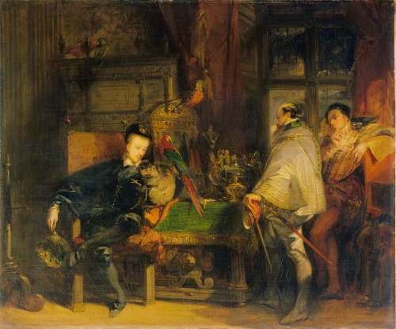
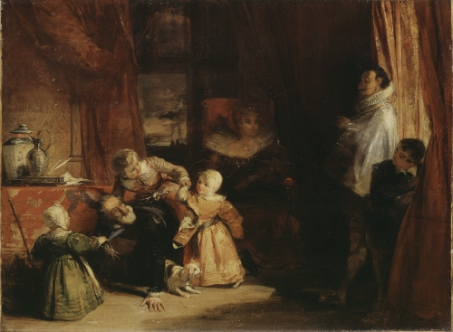

Slide 11
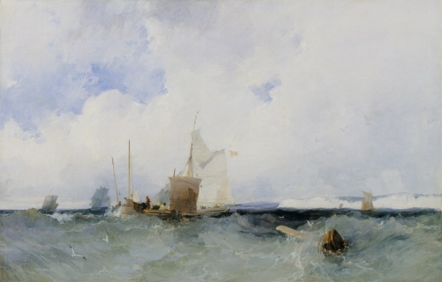

Slide 12
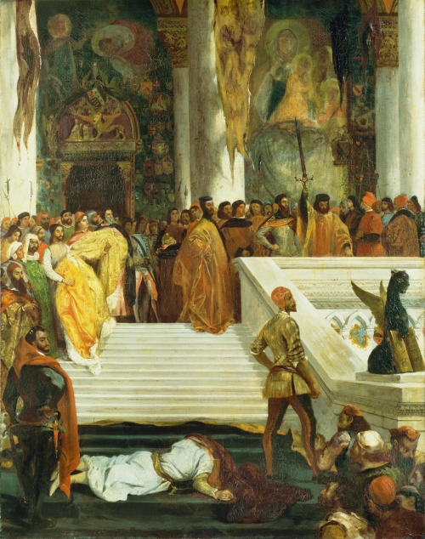

Slide 13
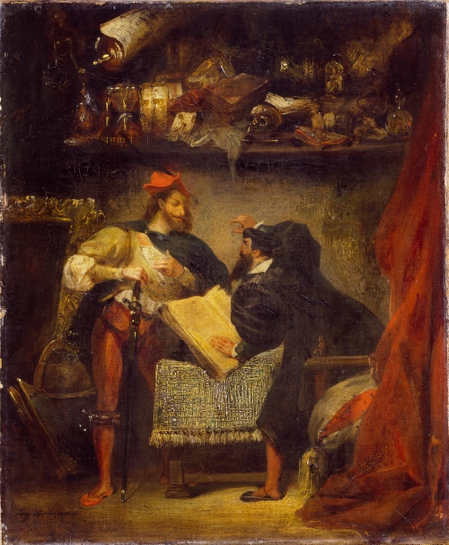

Slide 14
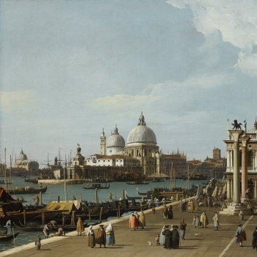
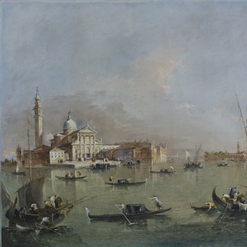

Slide 15
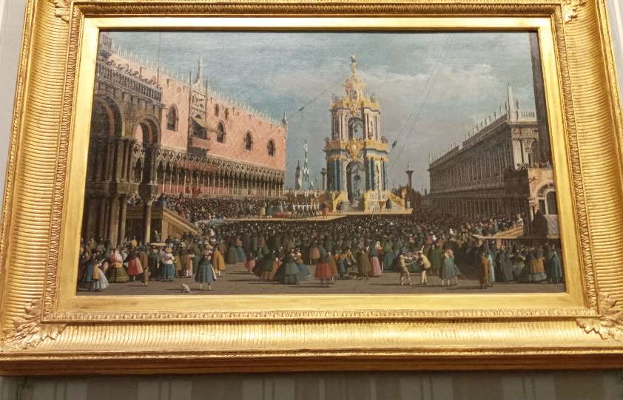
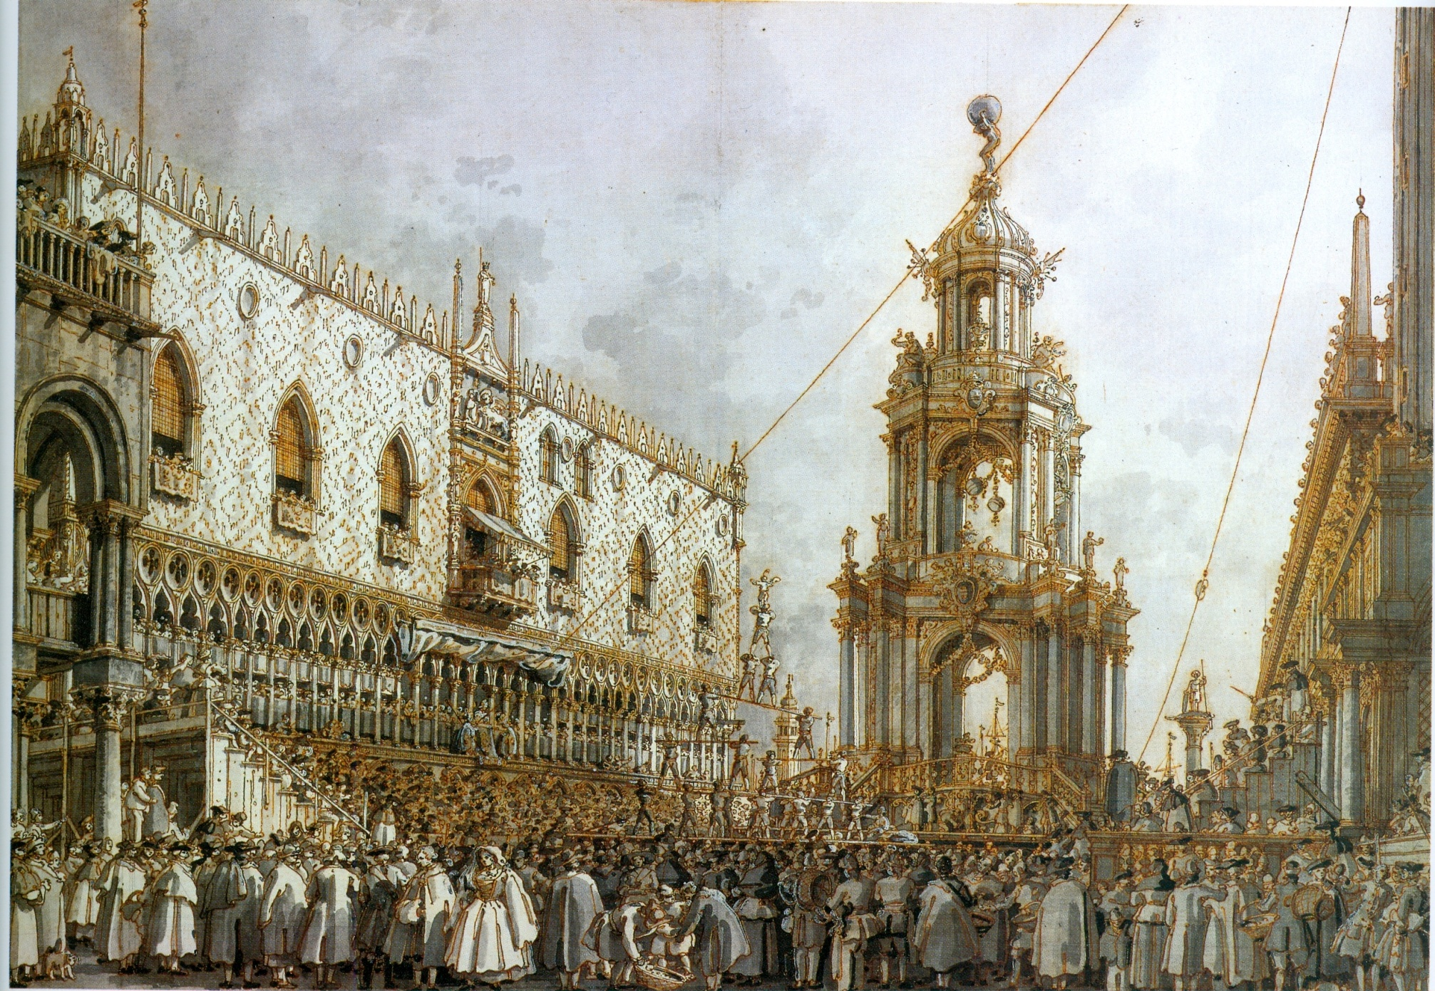
Notes:
Wolfgang Ratjen

Slide 16
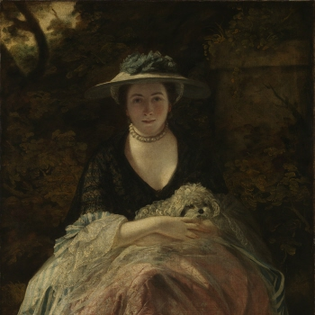
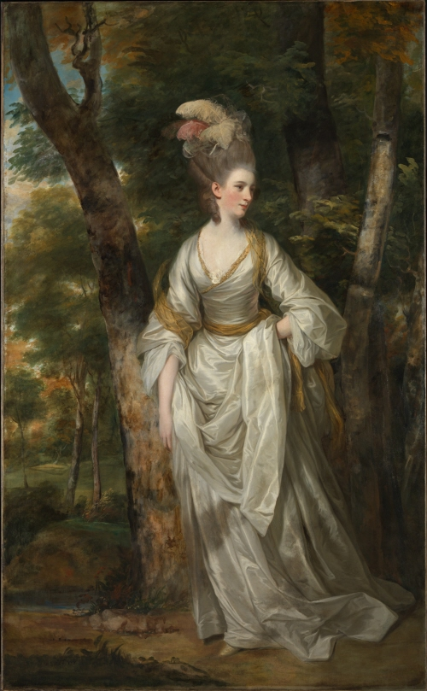

Slide 17
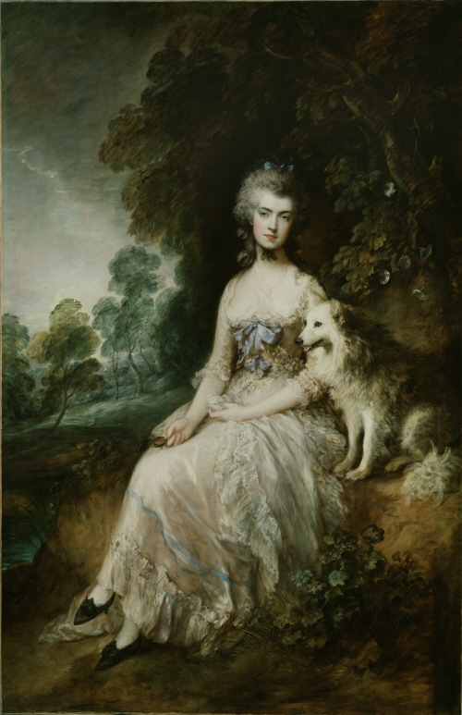
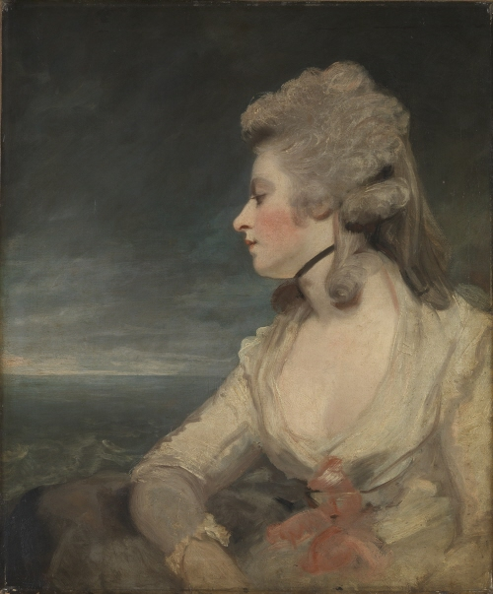

Slide 18
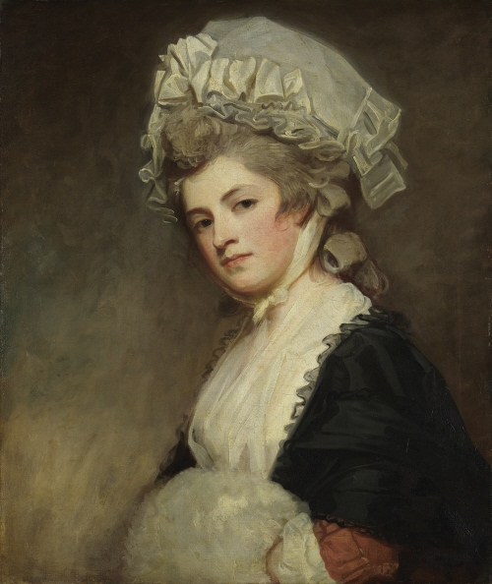
Notes:
Romney

Slide 19
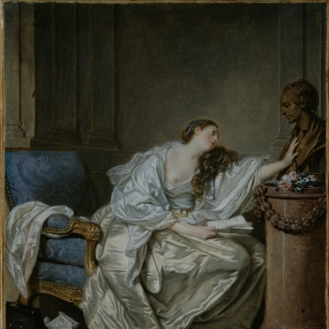
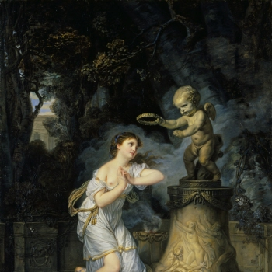
Notes:
Jean Baptiste Greuze

Slide 20
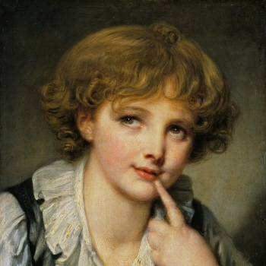

Slide 21
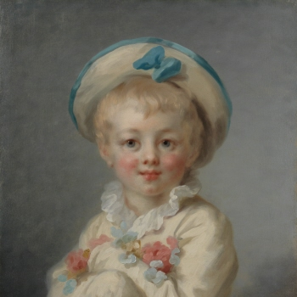
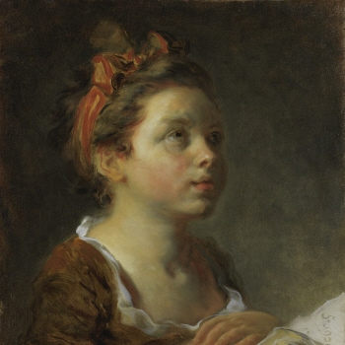

Slide 22
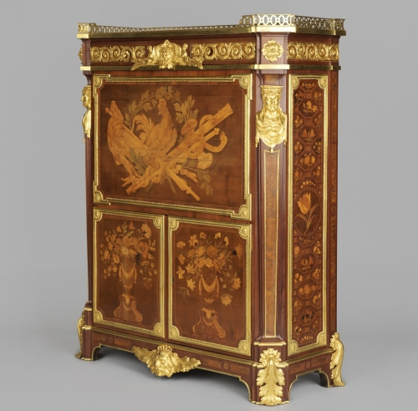
Notes:
Jean henri Riesener. Study

Slide 23
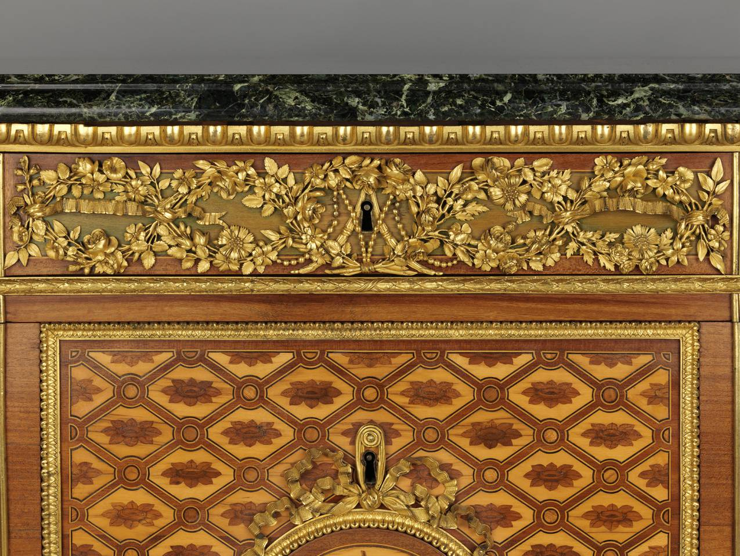
Notes:
M A

Slide 24
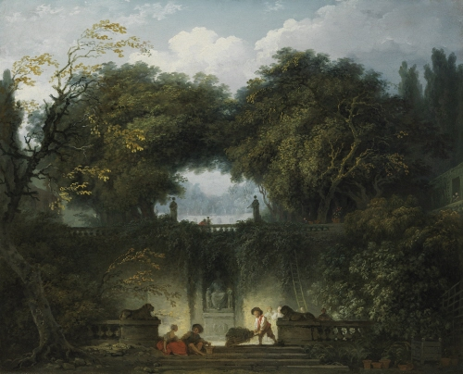

Slide 25
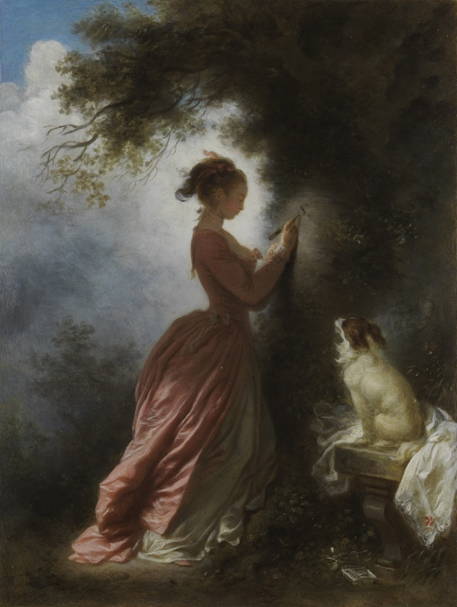

Slide 26
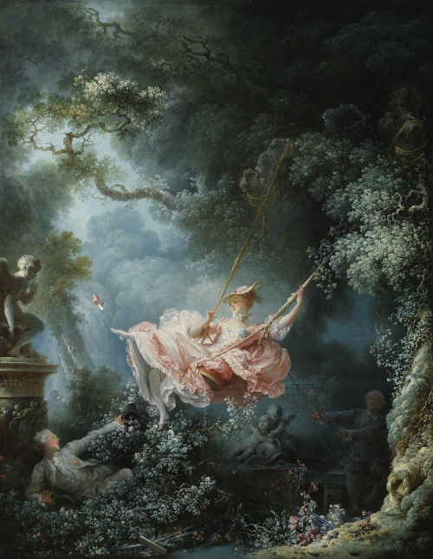

Slide 27
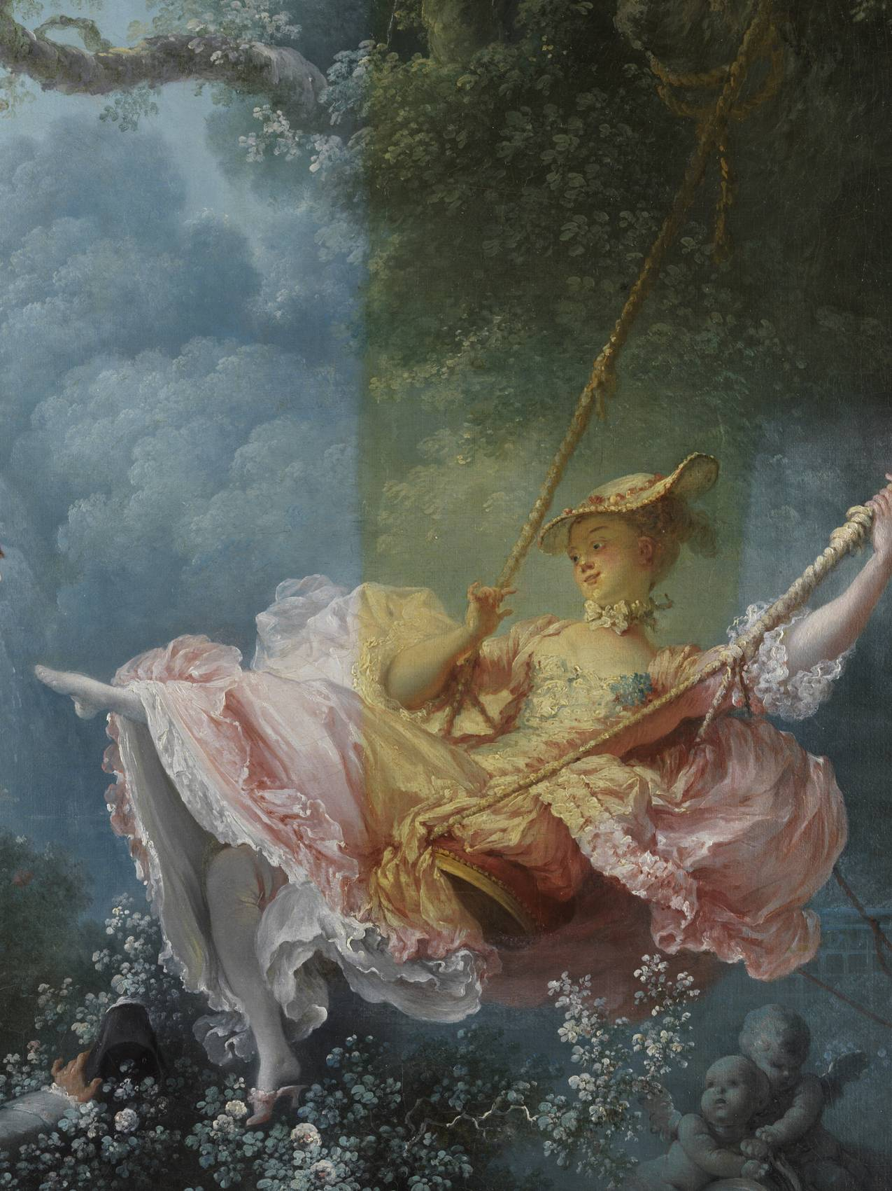

Slide 28
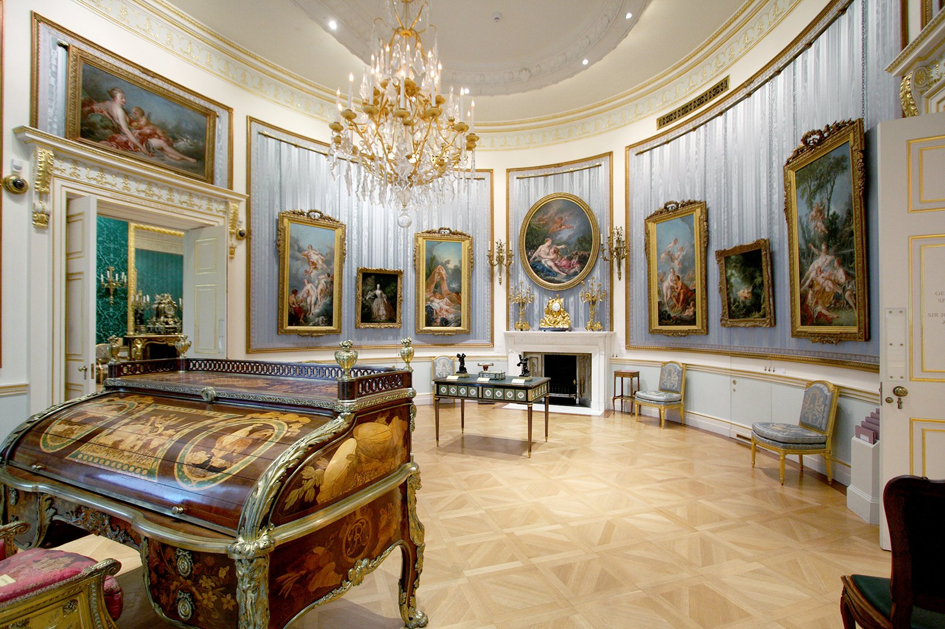
Notes:
Bureau du Compte d’Orsay (Stanislav

Slide 29
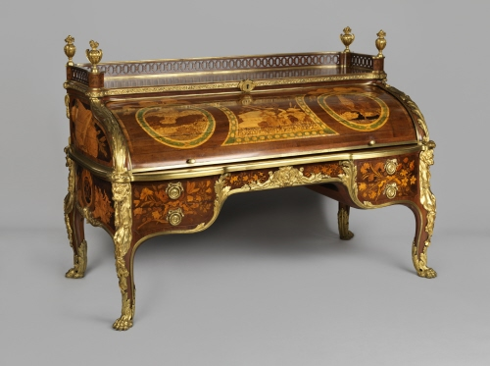

Slide 30
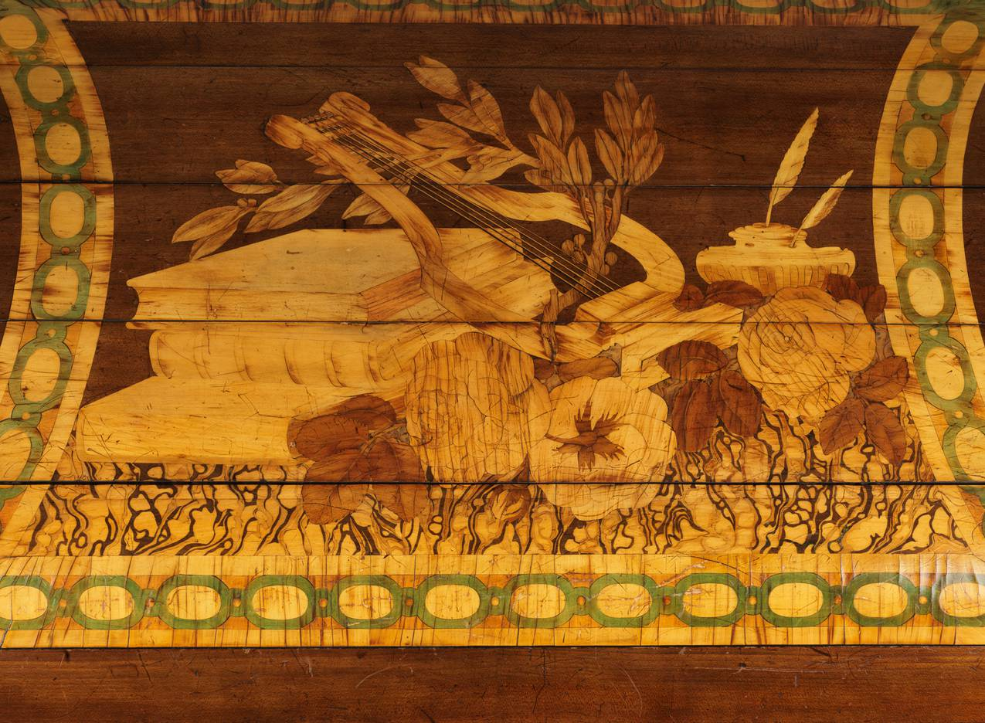

Slide 31
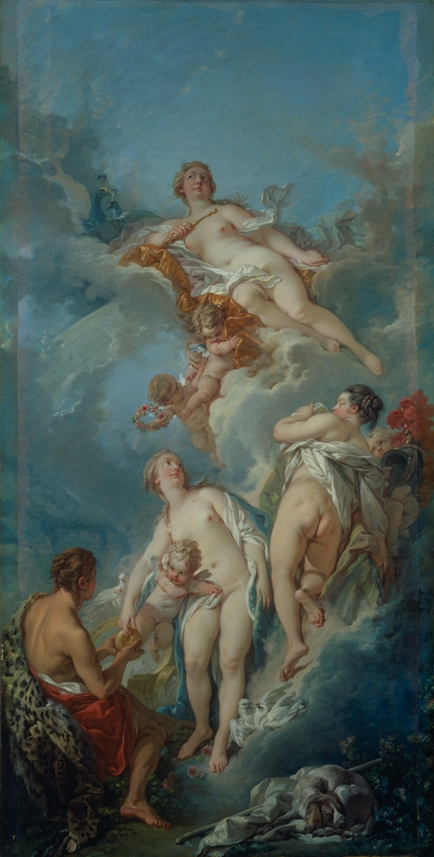
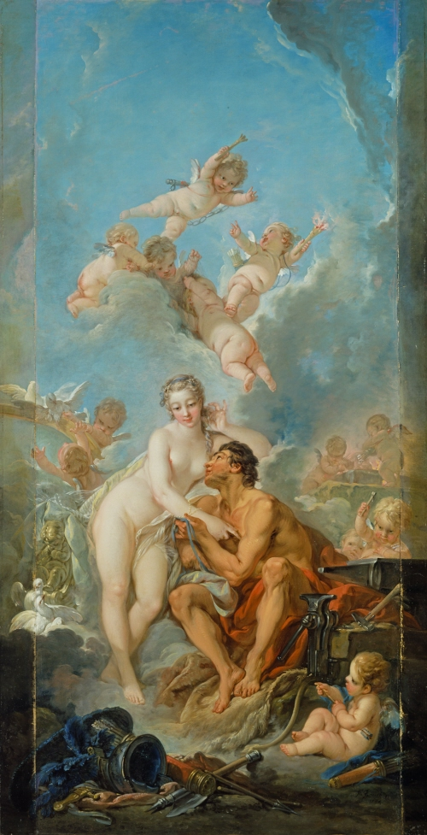
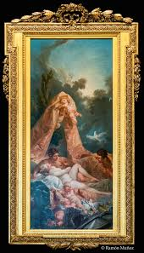

Slide 32
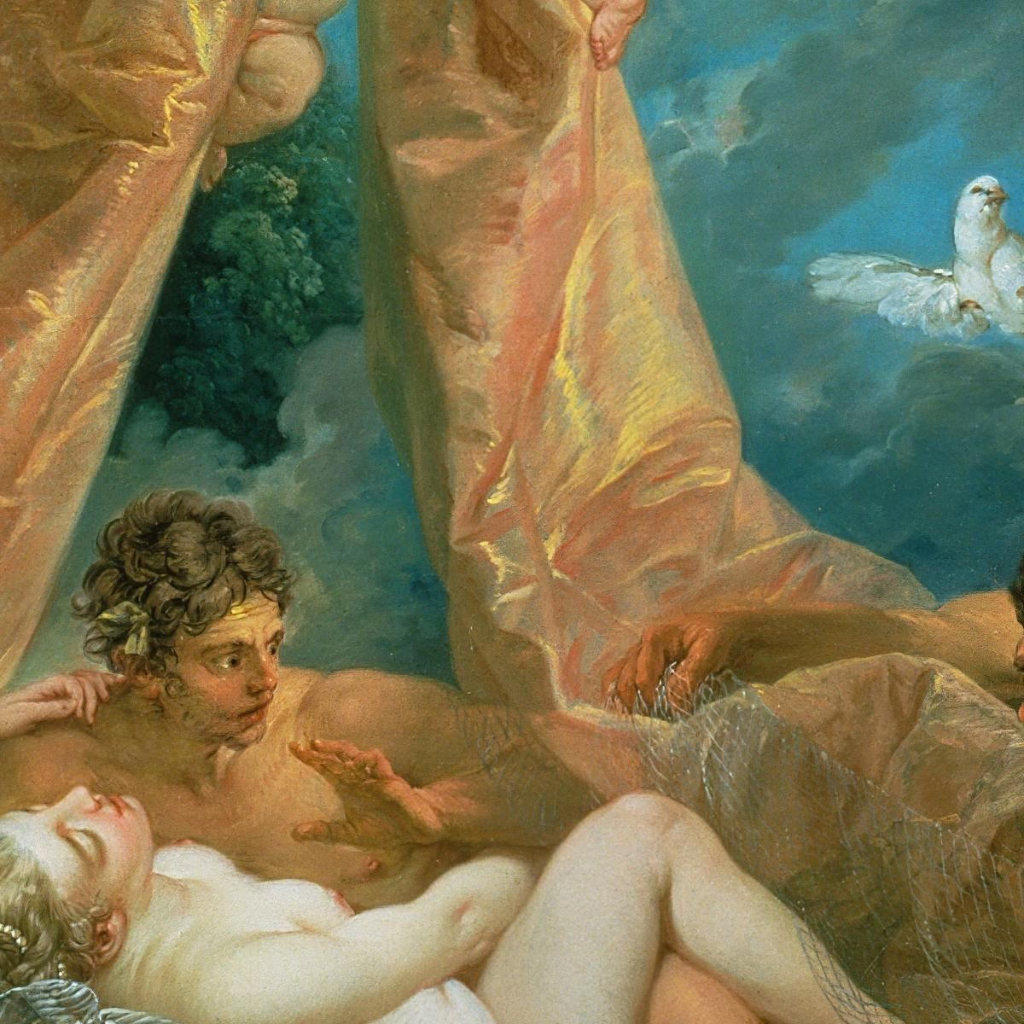

Slide 33
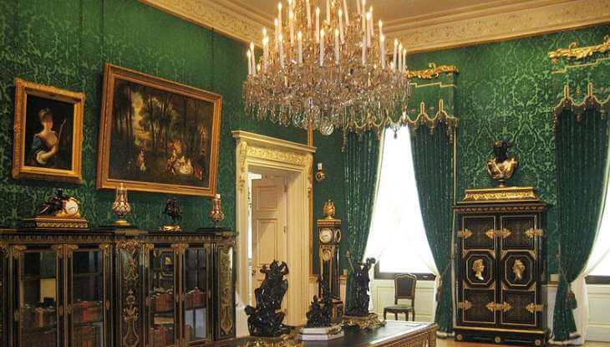

Slide 34
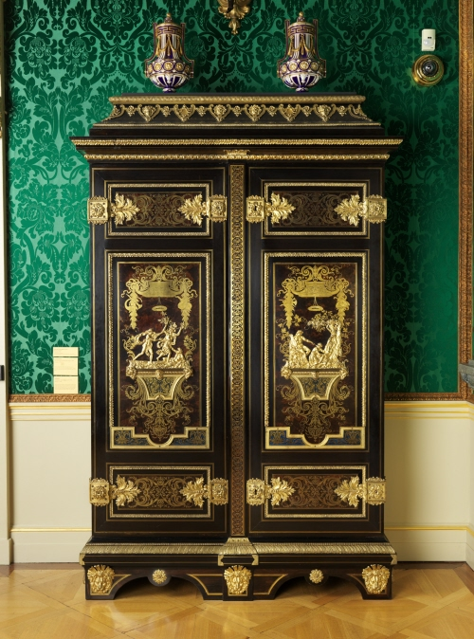
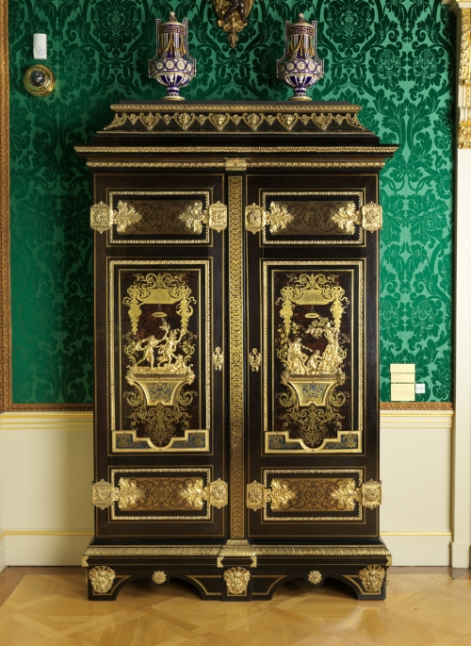

Slide 35
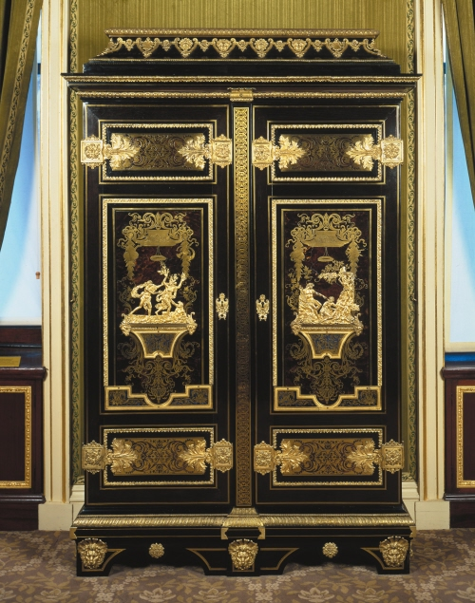

Slide 37
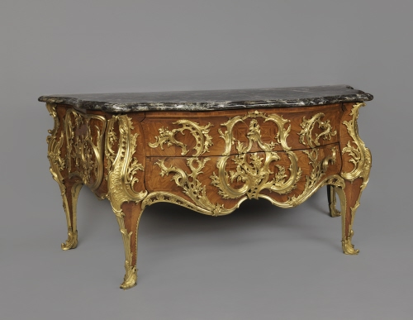
Notes:
Gaudreaus 1739 andtoine Robert

Slide 38
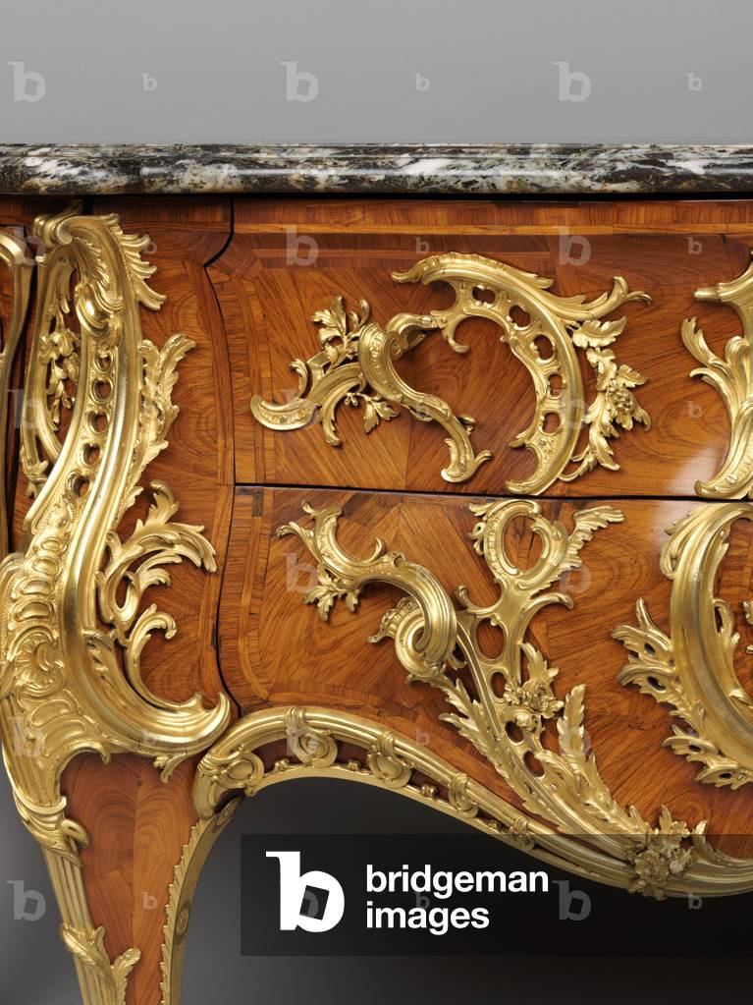

Slide 39
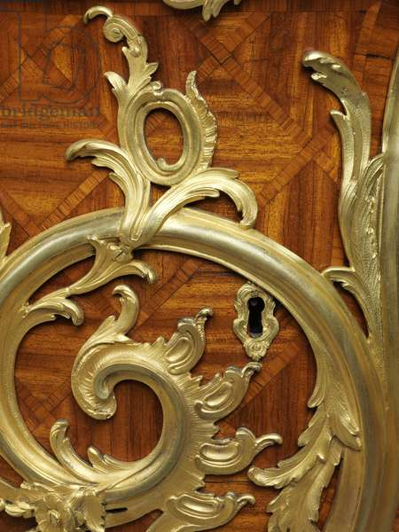

Slide 40
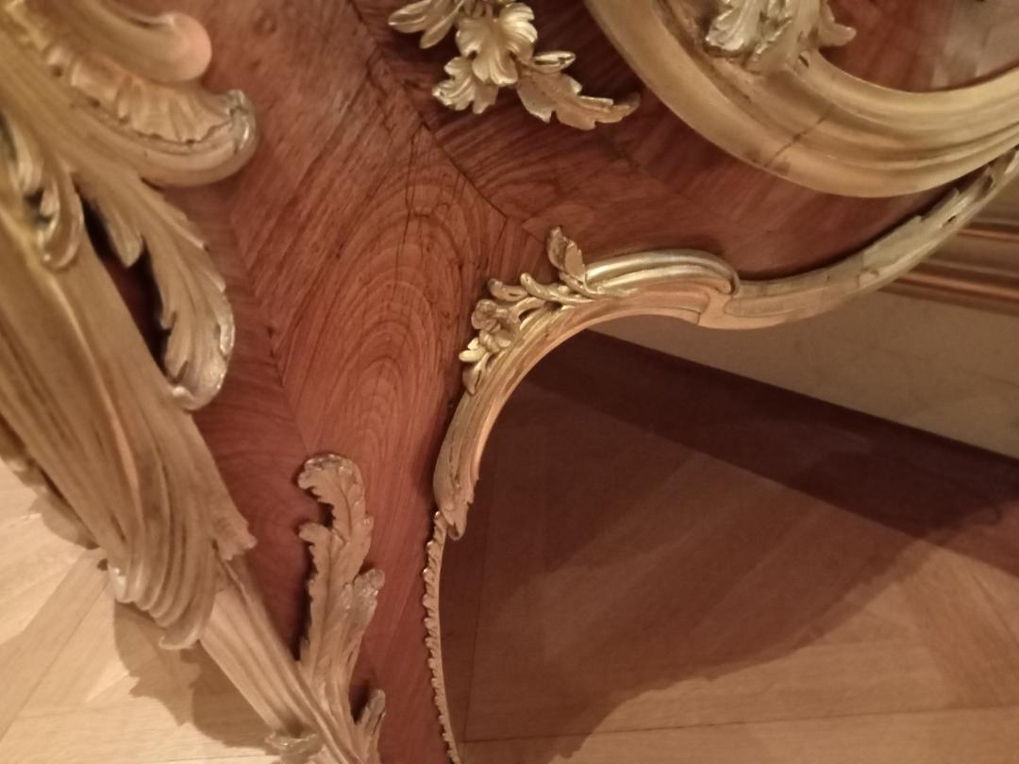

Slide 41
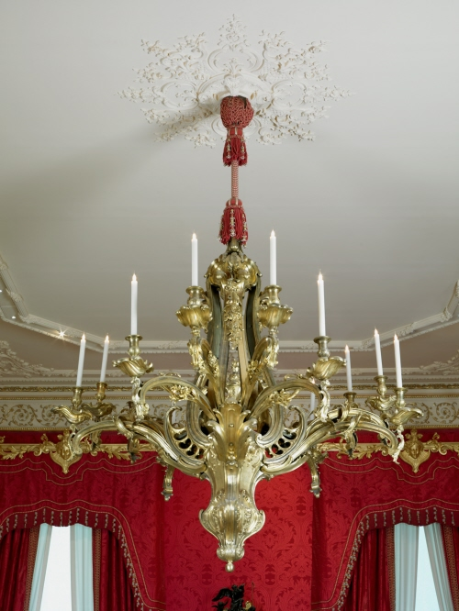

Slide 42


Slide 43


Slide 44


Slide 45


Slide 46

Notes:
Vincenso Foppa the young Cicero reading c 1464 fresco

Slide 47


Notes:
Crivelli St Roch

Slide 48


Notes:
Rock crystal enamel

Slide 49


Slide 50

Notes:
Adam Dircjsz boxwood 1500-30

Slide 51

Notes:
1830-50 cup and cover

Slide 52



Slide 53

Notes:
16th c and 19th

Slide 54

Notes:
Fake 19th C

Slide 55


Slide 56


Slide 57

Notes:
Alborello

Slide 58

Notes:
Iznik

Slide 59

Notes:
Bernard Palissy

Slide 60

Notes:
Cloisonne 1855 summer Palace incense burners

Slide 61


Slide 62



Slide 63

Notes:
Maiolica.

Slide 64

Notes:
Lustre. Metal oxides

Slide 65
Notes:
Istoriato

Slide 66


Slide 67


Notes:
Cosimo de Medici and Lorenzo the Magnificent

Slide 68


Slide 69


Slide 71


Slide 72


Slide 73


Slide 75


Slide 76


Slide 77


Slide 78


Slide 79


Slide 80


Slide 81


Slide 82



Slide 83


Slide 84


Slide 86



Slide 87


Slide 89


Slide 90


Slide 92


Slide 93


Slide 94


Slide 95


Slide 96



Slide 97



Slide 101


Slide 102


Slide 103


Slide 104


Slide 105


Slide 106


Slide 107


Slide 108


Slide 109

Notes:
Fait par caffieri

Slide 111


Slide 112


Slide 113


Slide 114


Slide 115


Slide 116


Slide 118


Slide 119


Slide 120


Slide 121


Slide 122


Slide 123


Slide 124


Slide 125


Slide 126


Slide 127


Slide 128


