Slide 1

Waves
Objective: I will understand the difference between mechanical waves and electromagnetic waves.

Slide 2
The Power of Waves
Where does the energy that powers your school come from? It may be from oil, gas, or coal. You may have heard of using the sun or wind as energy sources. But did you know that ocean waves could be used as an energy source too? Mechanical systems placed in the ocean or near the shore transform the energy from waves into electricity. Unlike oil, gas, or coal, the energy from ocean waves will not run out.
Although wave energy technology is still very new, many scientists are optimistic about its possible use around the world.
What do you think? Pros/Cons?

Slide 3


What is a wave?
A wave is a moving disturbance that transfers energy through matter or space.

Slide 4


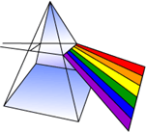
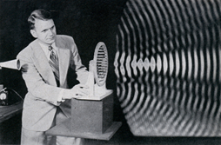
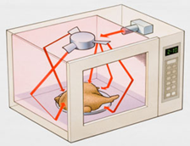
Examples of waves
Water waves light waves
Sound waves microwaves

Slide 5

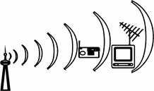

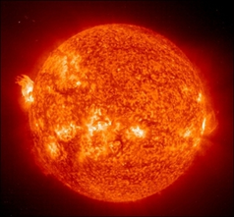
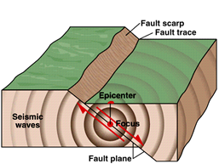
Radio waves X ray waves
Ultraviolet waves seismic waves

Slide 6


All of these waves can be put into 2 categories:
Waves that do not require a medium
Waves that require a medium

Slide 7

So what’s a medium?
Most waves need something to travel through. For example, sound waves can travel through air, water, and even solid materials. Water waves travel along the surface of the water. A wave can even travel along an object, such as a rope.
A medium is something through which a wave travels. (solid, liquid, or gas!)
BUT some waves can travel with no medium at all. They can travel through the vacuum of space!
Does light require a medium?

Slide 8

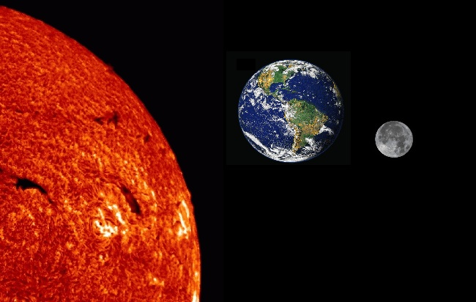
Well, where does light come from?
If it can travel through NOTHINGNESS, then it doesn’t need a medium

Slide 9


Back to our 2 groups
Electromagnetic waves can transfer energy through a medium OR through empty space (a vacuum). They do NOT need a medium to travel through.
Ex. Radio waves, light waves, infrared waves, ultraviolet waves, x-rays, gamma rays
Mechanical Waves are waves that DO require a medium in order to transfer energy.
Ex. Sound waves, water waves, seismic waves

Slide 10
Review
What is a medium?
Do electromagnetic waves require a medium?
Give an example of an electromagnetic wave.
Do mechanical waves require a medium?
Give an example of a mechanical wave.

Slide 11
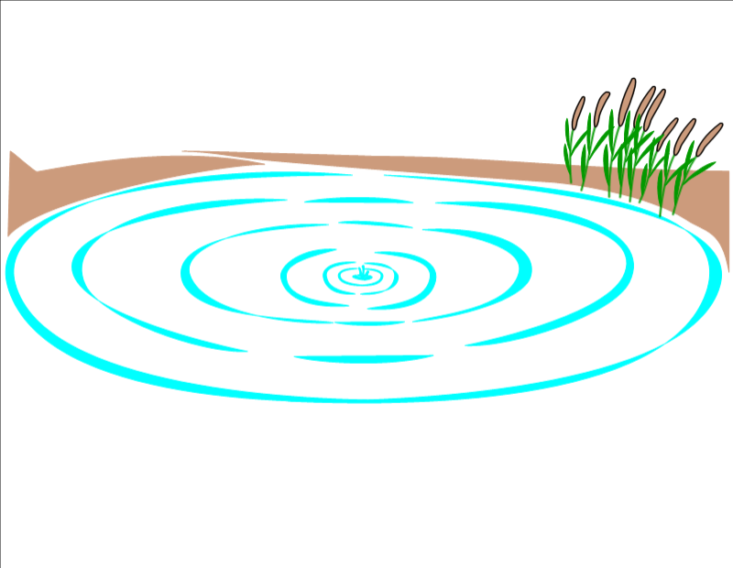

Mechanical Waves form when a source of energy causes a medium to vibrate.
Vibration: the wave results when the rocks energy causes the medium to vibrate.
Energy Source:
Rock dropped in the water
Medium: the water

Slide 12


Slide 13
An electromagnetic wave is made up of vibrating electric and magnetic fields that move through space or some medium at the speed of light.
An electromagnetic wave can begin with the movement of charged particles, all of which have electric fields around them. As the particles change speed or direction, they vibrate, creating a magnetic field. The vibrations result in an electromagnetic wave.
*They do not require a medium such as air, so they can transfer energy through a vacuum, or empty space!

Slide 14

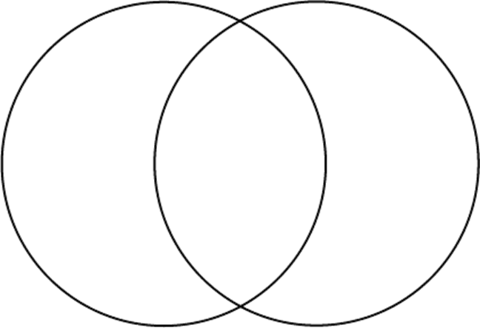
Mechanical wave Electromagnetic wave

Slide 15

PART TWO
Transverse and Longitudinal Waves
Objective: I will be able to differentiate between transverse and longitudinal waves.

Slide 16
We have learned that mechanical waves are things like sound waves, water waves, and seismic waves. We know that they require a medium to travel through.
There are TWO types of mechanical waves...

Slide 17

Two main types of mechanical waves:
1. Transverse waves
2. Longitudinal waves (compression)
Waves move through mediums in different ways. Depending on how they move, they are either transverse or longitudinal (compression).

Slide 18

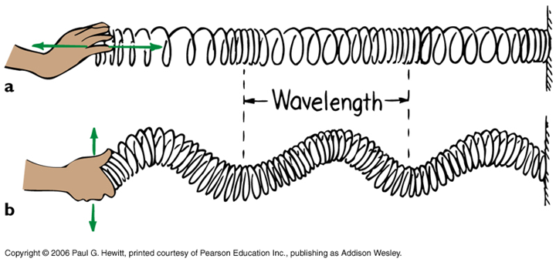
2 different ways to create a wave:

Slide 19

Now lets see these two wave types in action
http://www.acs.psu.edu/drussell/demos/waves/wavemotion.html
http://www.acs.psu.edu/drussell/demos/waves/wavemotion.html

Slide 20
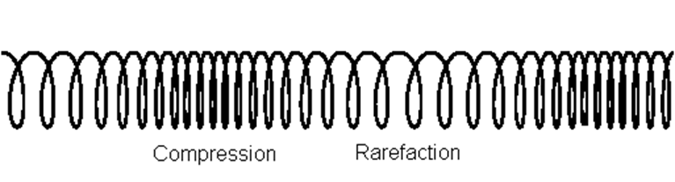
Longitudinal Waves
In a longitudinal, or compression wave, the particles of the medium vibrate in the same direction as (or parallel to) the direction that the wave is travelling.

Slide 21
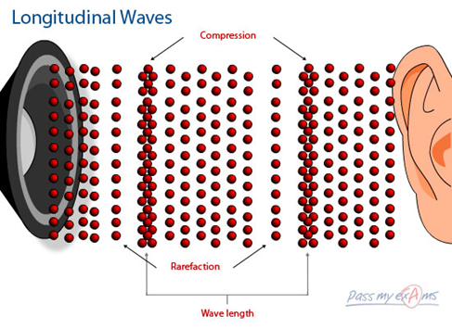
Longitudinal waves (where particles move parallel to the direction of the wave) are something you experience every day in the form of SOUND!

Slide 22
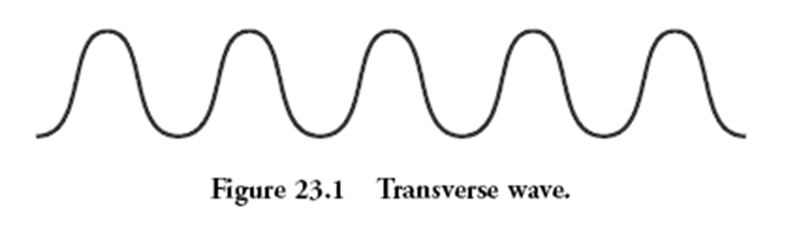
Transverse Waves
When you make a wave on a rope, the wave moves from one end of the rope to the other. However, the rope itself moves up and down or from side to side, at right angles in the direction in which the wave travels. A wave that vibrates the medium at right angles, or perpendicular to the direction in which the wave travels, is called a transverse wave.

Slide 23
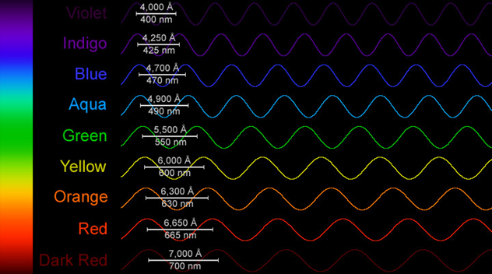
Transverse waves (where the particles move perpendicular to the direction of the wave) are also all around you in the form of LIGHT!

Slide 24
Review
In a ___________ wave the particles of the medium vibrate PARALLEL to the direction the wave is travelling.
In a ___________ wave the particles of the medium vibrate PERPENDICULAR to the direction the wave is travelling.
Sound is an example of a ________ wave.
Light is an example of a ________ wave.

Slide 25
Transverse Wave Longitudinal Wave

Slide 26

Sound Waves
Sound waves are one wave that we will go in more detail with. They are a type of mechanical wave, along with seismic waves and water waves.

Slide 27
A sound wave begins with a vibration. These vibrations disturb nearby air particles.
Like other mechanical waves, sound waves carry energy through a medium without moving the particles of the medium along. Each particle vibrates, and when the vibration reaches your ears, you hear a sound.
Sound can travel through air, solids, and liquids!

Slide 28
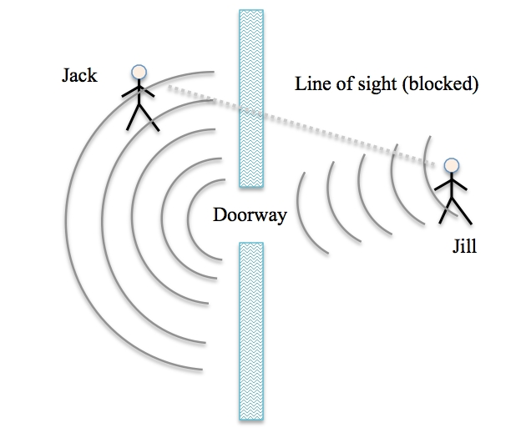
Diffraction of Sound Waves:
Sound waves do not always travel in straight lines. Sound waves can diffract, or bend, around the edges of an opening such as a doorway.

Slide 29
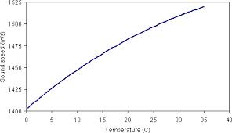
1. Temperature-
In a given liquid or gas, sound travels more slowly at lower temperatures than at higher temperatures. Why? At lower temperatures, the particles of a medium move more slowly. It is more difficult for the particles to move and they return to their original positions more slowly.
High temps=High Frequency

Slide 30
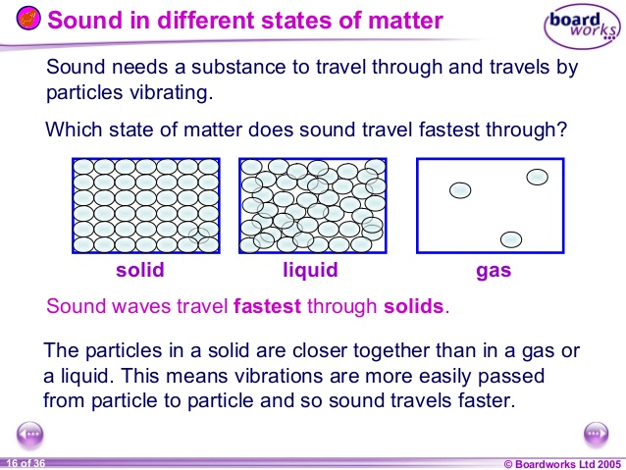
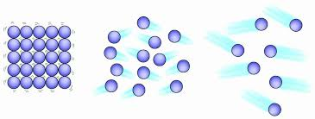
2. Type of Material
Sound travels more quickly in solids.
The particles are more condensed in a solid, meaning the wave has more particles to vibrate off of.

Slide 31

Part 3: Wave Parts
Objective: I will be able to identify the main parts of a wave.
Waves may vary greatly. For example, waves can be long or short. They can carry a little energy or a lot of energy. They can be transverse or longitudinal. However, all waves have common properties: amplitude, wavelength, frequency, and speed.

Slide 32


Wavelength
The distance between one point on a wave and the exact same point on the next wave

Slide 33
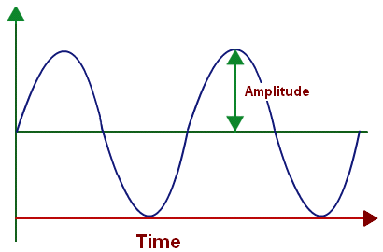
Amplitude
Amplitude is the maximum distance the medium vibrates from the rest position. High waves have more energy than low waves. The more energy a wave has, the greater its amplitude.

Slide 34

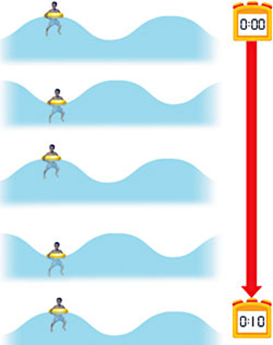

Frequency
The number of waves produced in a given amount of time.
High frequency: lots of waves pass by a point every second
Low frequency: fewer waves pass by a point every second

Slide 35

Crest and trough
The highest/lowest point of a transverse wave
crest
trough

Slide 36

Compression and rarefaction
The squished up or spread out parts of a longitudinal wave

Slide 37
Review
Draw a transverse wave and label
Wavelength
Amplitude
Crest
Trough

Slide 38

Review, continued
2. Draw a longitudinal wave and label
Wavelenth
Compression
rarefaction

Slide 40

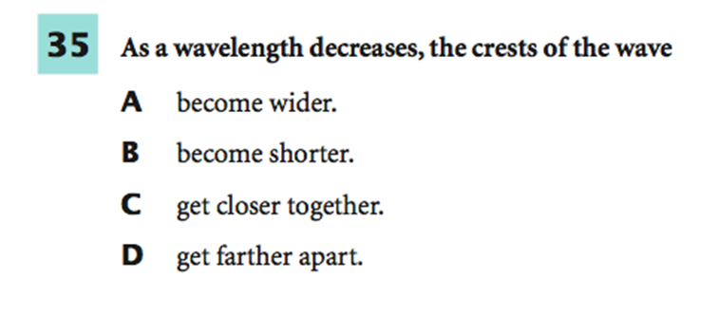
Practice

Slide 41

Part 4: Wave Relationships
I understand how parts of waves relate to each other, and to energy.

Slide 42
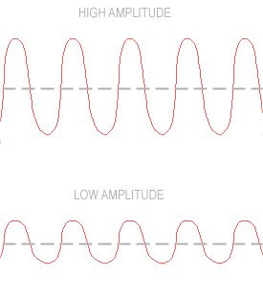
High amplitude means:
1. Louder sounds (if the wave is a sound wave)
2. More energy!
Low amplitude means:
1. Softer sounds (if the wave is a sound wave)
2. Less energy

Slide 43
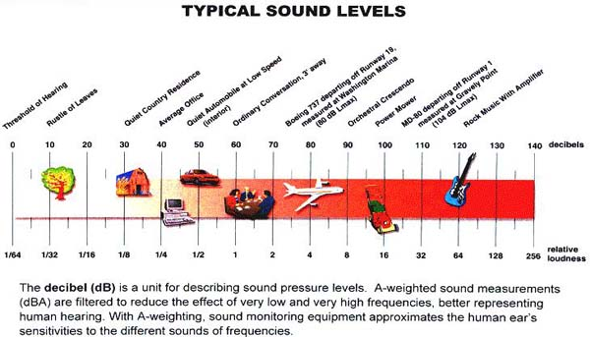
Measuring Loudness:
Loudness is measured in a unit called a decibel (dB).
Sounds louder than 100 dB can cause damage to your ears, especially for long periods of time.

Slide 44
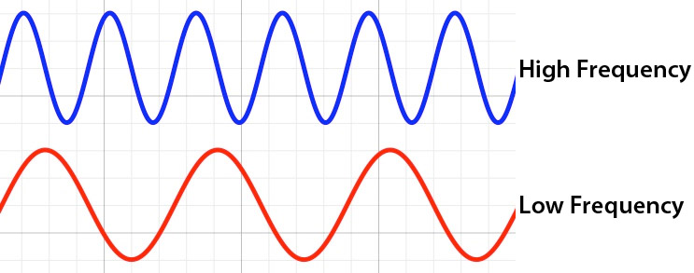
High frequency means:
1. High pitch (if it is a sound wave)
2. Short wavelengths
3. Lots of energy
Low frequency means:
1. Low pitch (if it is a sound wave)
2. Long wavelengths
3. Low energy

Slide 45
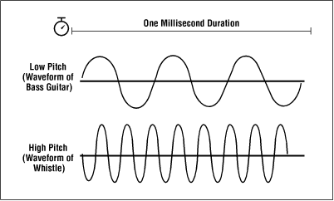
Pitch:
When your vocal chords stretch, they vibrate more quickly as air rushed by them. When they are relaxed, they vibrate less quickly.
The more quickly they vibrate, the higher pitch they produce. The more slowly they vibrate, the lower pitch they produce.

Slide 46
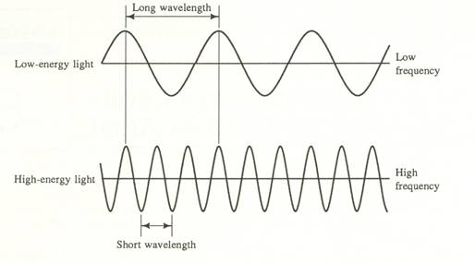
Long wavelength means:
1. Low energy 2. Low frequency
Short wavelength means:
1. High energy 2. High frequency

Slide 47
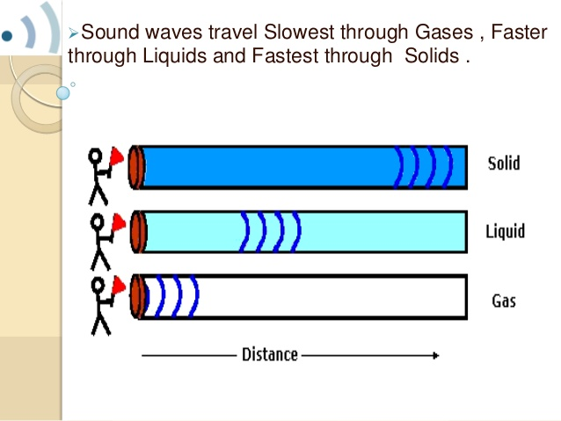
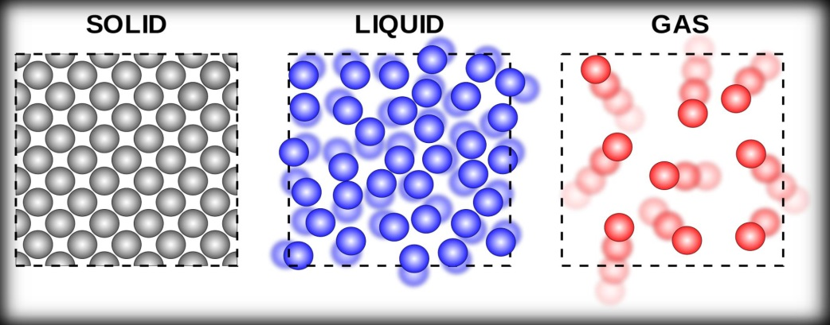
Do the mediums matter??? YES!
In mechanical waves, they travel fastest through solids, then liquids, and slowest through gases.
However, in electromagnetic waves, because they do not need a medium to travel, they prefer to not have all those particles in their way! They travel the fastest through gases, then liquids, and the slowest through solids.

Slide 48
Part 5: Practice Questions/Assessment

Slide 49
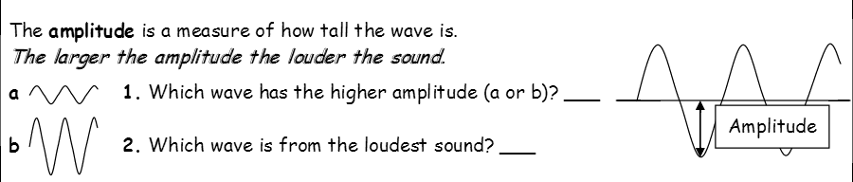
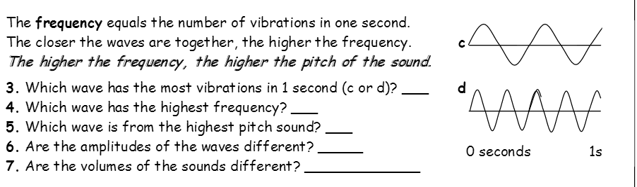

Slide 50
B
D
D
D
No
No

Slide 51
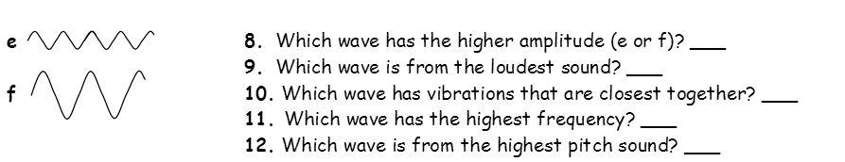
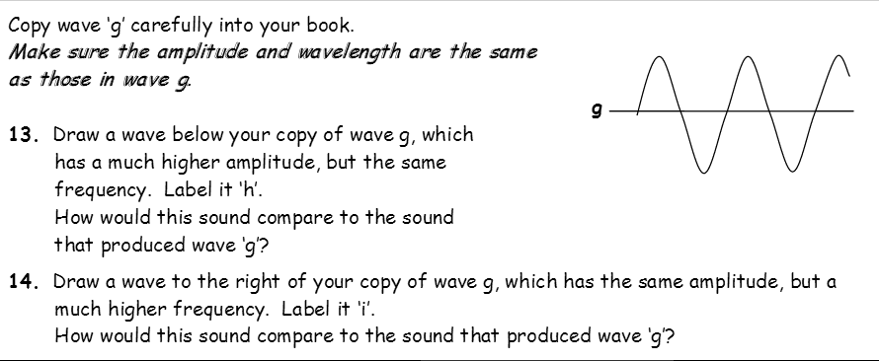

Slide 52

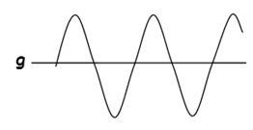



F
F
E
E
E
H
It would be louder
It would have a higher pitch
I

Slide 53
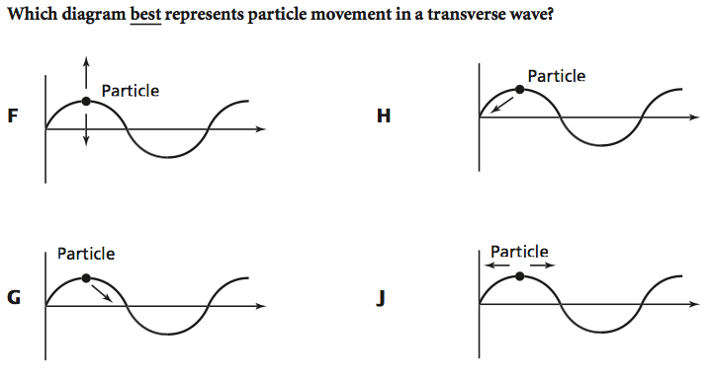
Practice

Slide 54
Practice

Slide 55

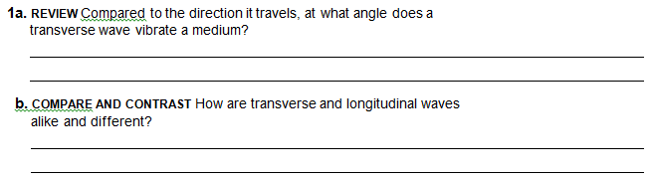


Slide 56
a source of energy causes a medium to vibrate
perpendicular
They both are moving disturbances that transfer energy. They are both types of mechanical waves. They are different because in longitudinal waves, the particles moves parallel to the wave. In transverse, the particles move perpendicular to the wave.
Sound, water, and seismic

Slide 57
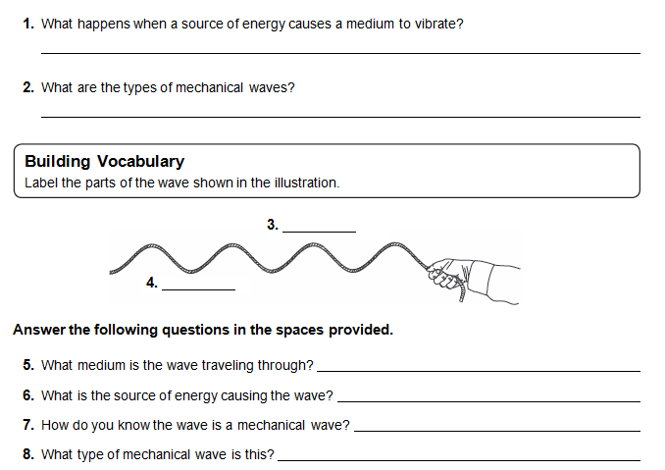

Slide 58
A wave
Transverse and longitudinal (compression)
Crest
Trough
A rope
His hand
It is traveling through a medium
Transverse

Slide 59
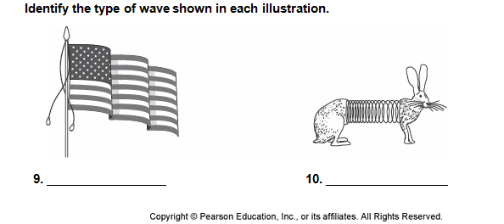
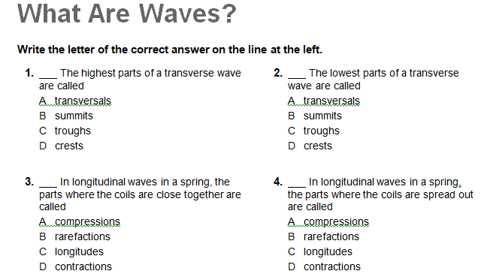

Slide 60
Transverse
Longitudinal

Slide 61
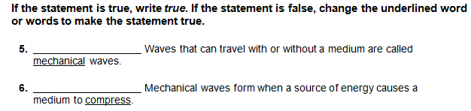


Slide 62
False, electromagnetic
False, vibrate
False, perpendicular

Slide 63
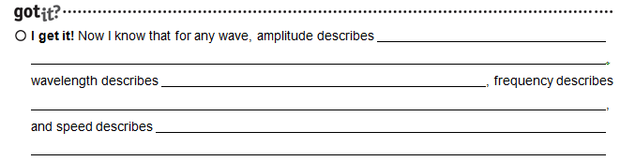


Slide 64
the distance away from the resting point
the distance from one part of the wave to the very same part on the next wave
how many waves pass by in a given second
the distance traveled in a given amount of time
frequency, amplitude, wavelength, and speed

Slide 65
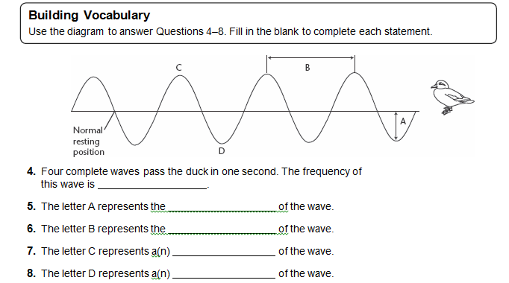

Slide 66
Amplitude
Wavelength
Crest
Trough

Slide 67
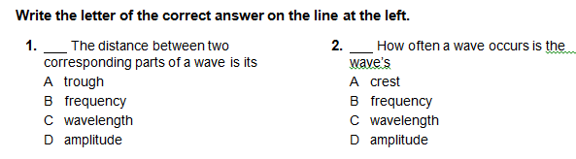
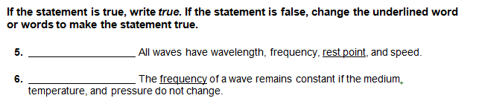


Slide 68
False, amplitude
True
Sound can travel through solid matter, and it does not have to travel in a straight line.

Slide 69
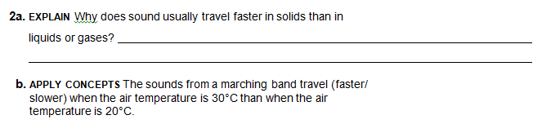

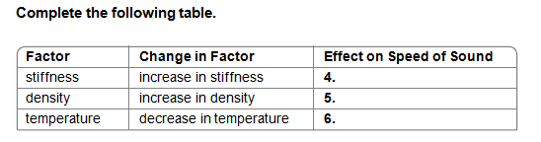

Slide 70
There are more particles for the wave to bounce off of
the state of matter of the medium it is flowing through, and temperature
No, it can travel around an object.
Travel best/fastest in solids
Travel slower in cold temps

Slide 71
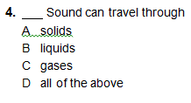


Slide 72
True
the frequency of the wave

Slide 73

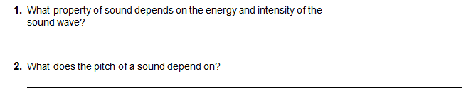
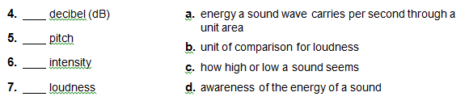

Slide 74
Pitch is determined by frequency, loudness is determined by amplitude. High frequency and amplitudes mean high pitched loud sounds, and visa versa.
Loudness
Frequency
B
C
A
D

Slide 75
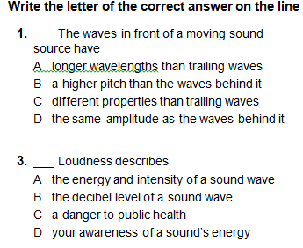
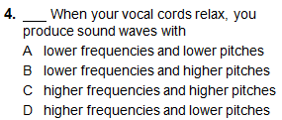


Slide 76
True: less energy means low amplitude which means soft sound

Slide 77
Name:
Waves
Matching
___1. Crest
___2. Wave
___3. Trough
___4. Wavelength
___5. Amplitude
a) moving disturbance that transfers energy through matter or space.
b) highest point of a wave
c) distance between identical points on a wave
d) distance between the resting point and crest/trough
e) lowest point of a wave
Fill in the Blanks
6. _______ __________ requires some sort of solid, liquid, or gas medium through which to pass
7. In a ______________ wave, the motion of the particles is a parallel motion
8. ____________ waves, like light, depend on the vibration of electric and magnetic fields to carry energy, and they require no medium
9. Regions where particles bunch together in a longitudinal wave are called ______
10. Waves with high amplitude and high frequency also have high ___________

Slide 78
Name: Key
Waves
Matching
___1. Crest
___2. Wave
___3. Trough
___4. Wavelength
___5. Amplitude
a) moving disturbance that transfers energy through matter or space.
b) highest point of a wave
c) distance between identical points on a wave
d) distance between the resting point and crest/trough
e) lowest point of a wave
Fill in the Blanks
6. Mechanical wave requires some sort of solid, liquid, or gas medium through which to pass
7. In a longitudinal (compression) wave, the motion of the particles is a parallel motion
8. Electromagnetic waves, like light, depend on the vibration of electric and magnetic fields to carry energy, and they require no medium
9. Regions where particles bunch together in a longitudinal wave are called compressions
10. Waves with high amplitude and high frequency also have high energy

Slide 79



- Seismic P waves
- Seismic S waves
High amplitude = loud sound, high energy
High frequency = high pitch, short wavelength, high energy
Large wavelength = low energy, low frequency

Slide 80

Thank you for your purchase!
Your feedback is welcomed!
SnazzyScience

