Slide 1
Negotiation for Physicians: Introduction
Robert A Felberg MD
CEO Physicians Advocates LLC
www.mdavocates.com

Slide 2
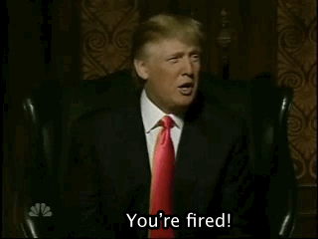
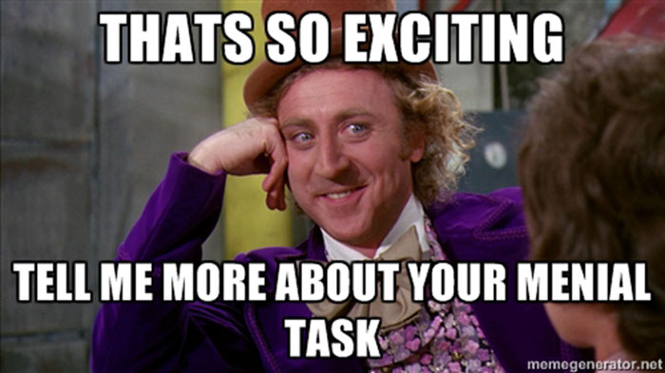
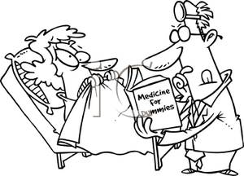
Common Physician Negotiation Myths
You should be scared to negotiate
Organizations will be offended if I attempt to negotiate
The improvements made in negotiation are so tiny that it’s not worth the effort
One good strategy is to take a lower salary now with the understanding that it will be revisited
Physicians are poor at negotiating (and all other financial matters…)

Slide 3
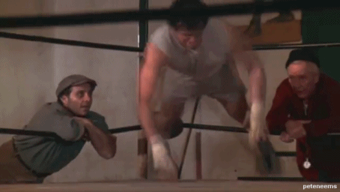
Becoming an Expert Physician Negotiator
“In business, as in life, you don’t get what you deserve. You get what you negotiate.” -Karass”
Negotiation Definition:
“neg” – not
“otium” - leisure
“Without Leisure”
Most people despise negotiation and will avoid it even at the risk of losing personal benefit.

Slide 4
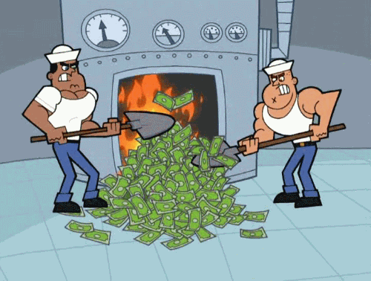
The Risks of Not Learning How to Negotiate
You will leave money on the table
Anecdotally, there is usually $15,000-$30,000 annually available for negotiation
This base salary difference compounds yearly!
Example: baseline 100k, +5k, +10k, +15k, +30k with 5% annual raise
Salary isn’t the only item up for negotiation
There are several items that are open to bargain, but only if you open negotiation on the items
CME, call schedule, support staff, moving expenses, etc
“Unfairness” and all it’s negative connotations
Negotiating a bad deal that is later discovered leads to strong dissatisfaction, career halts, harmful practice and location relocations, and “burn-out”

Slide 5
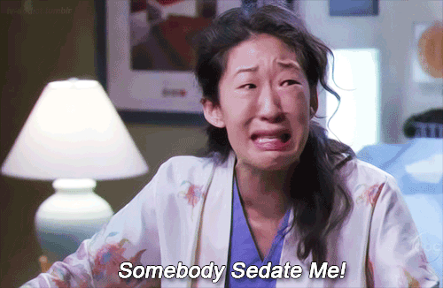
The Great News: Doctors are Natural Negotiators
We are accustomed to performance in front of others
We are excellent communicators
We can think quickly “on our feet”
We are familiar with “risk/benefit” calculations
Some disadvantages
We are trained to prefer agreement over conflict
We are naturally prone to sacrifice our own needs for others
We are not familiar with finances
Pay special attention to the next speaker!
We are scared of legal talk
We are brought up in a hierarchal social group, naturally deferring to the leaders

Slide 6
Introduction to this Presentation
Case based scenarios
Each will touch on a negotiation topic
We’re all friends here!
Please be willing to commit and shout your answers.
This isn’t oral boards and I’m not your Examiner
Let’s have FUN!
There is a booklet for notes
Please, don't look at the next cases or the discussion.
This is a small taste of Negotiation for Physicians
Don’t based your future success on a dinner talk
Don’t be like the “empowered” patient who consulted “Dr. Google” when you go into the next important negotiation!

