Slide 1
Kappa Alumnae GINsystem Online Tour

Slide 2
What We Will Cover
The GINsystem (members-only)
Training Resources Available

Slide 3
What is the GINsystem?
A members-only internal communication system for Kappa chapters and alumnae associations
Features:
Announcements
Calendar
Files
Questions/Polls
Messaging Groups
Emails
Text messages
Learn Faces
Academics Tab
Contacts List
GINsystem Wall
Points Management
Study Hours Tracking
Emergency Check-In

Slide 4
The GINsystem
Benefits:
Cut down chapter time
Reduce officer headaches
Increase chapter communication
Efficient chapter management
No more paper “Go Green!”
Efficient officer transitions
Centralized calendar
Access to contacts list, files, anonymous voting,
…and so much more!

Slide 5
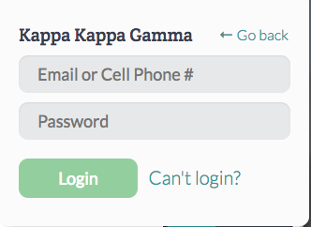
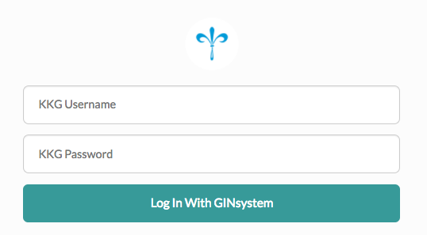
How Do I Log In to my GINsystem?
You will log in using your Kappa username and password. If you do not know your username or password, you can retrieve it from Kappa.org/members.
FAQ:
Q: Can new members access the GINsystem?
A: Yes! New members first have to set up their accounts with your organization then they will be able to log onto the GINsystem.

Slide 6
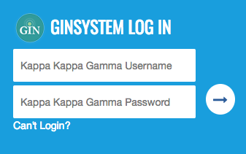
Where do I go to log into my GINsystem?
The External Website
The GINsystem Website
Mobile App

Slide 7
How do I add new users to the GINsystem?
All users add themselves!
Login with their Kappa username and password
Accept terms of use
Verify and Save profile information

Slide 8
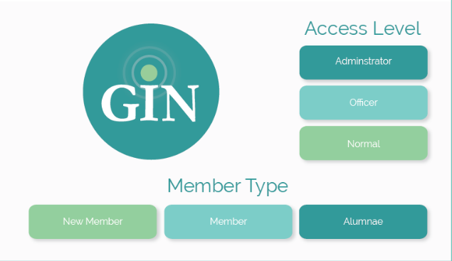
Member Types and Access Levels

Slide 9
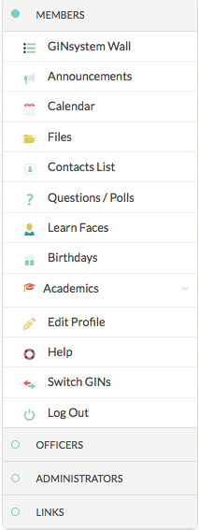
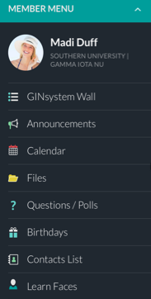
Member Menu

Slide 10
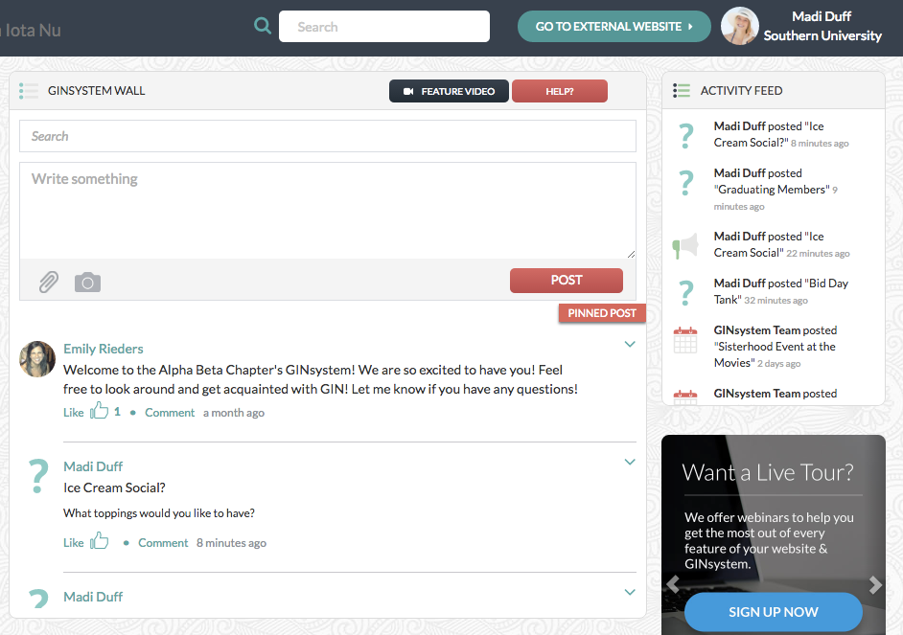
The GINsystem

Slide 11
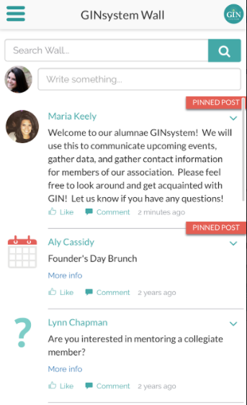
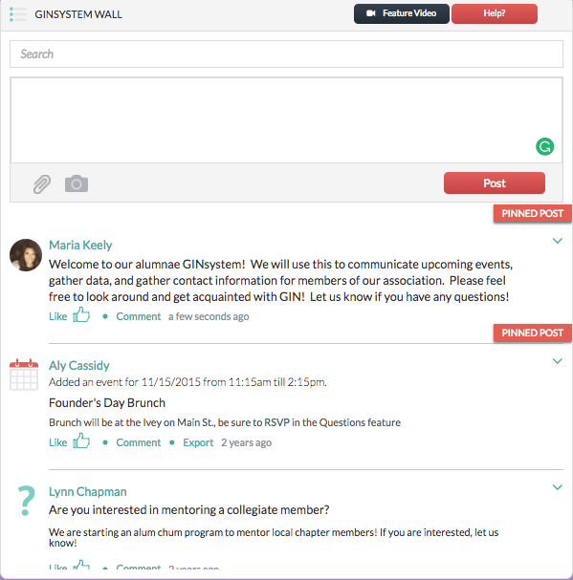
GINsystem Wall

Slide 12
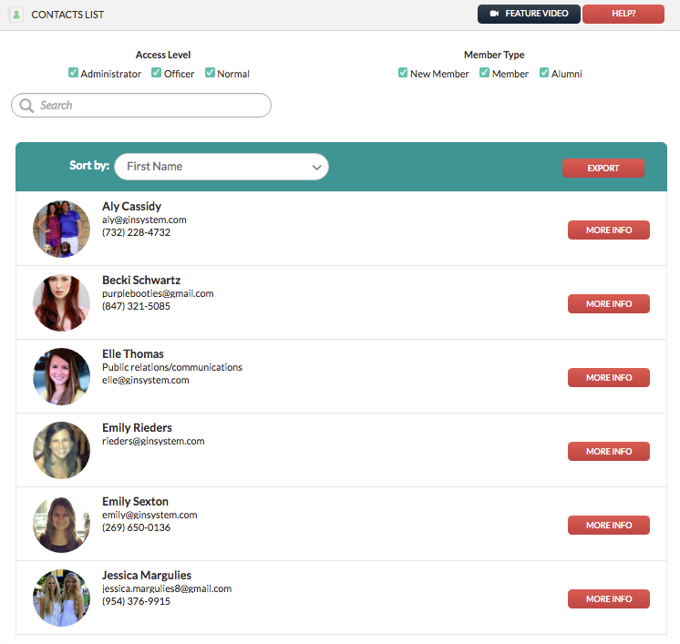
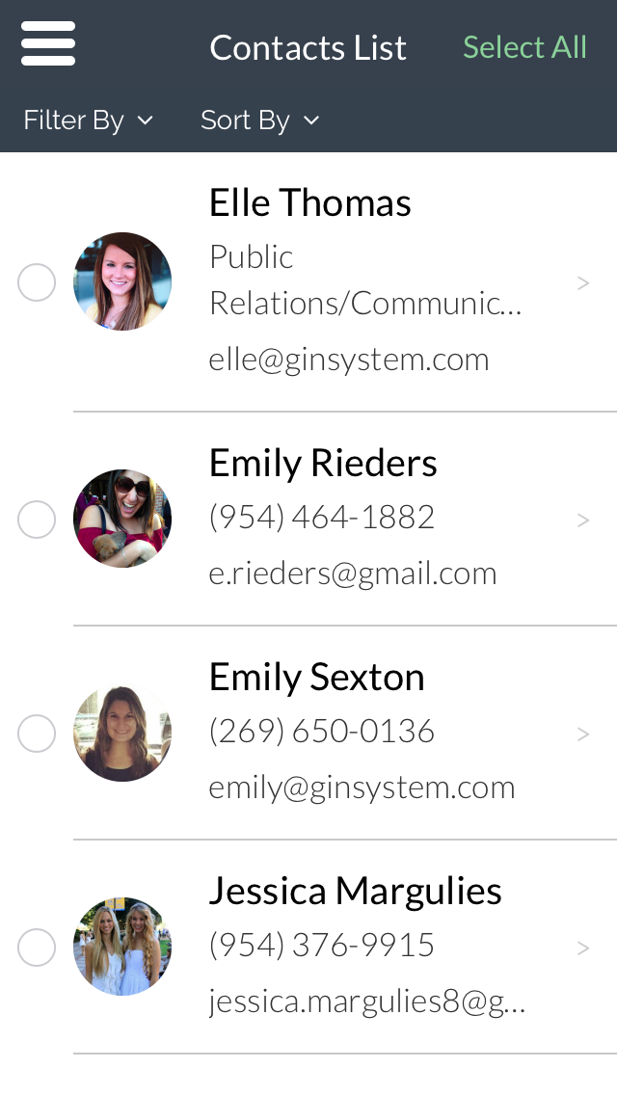
Contacts List

Slide 13
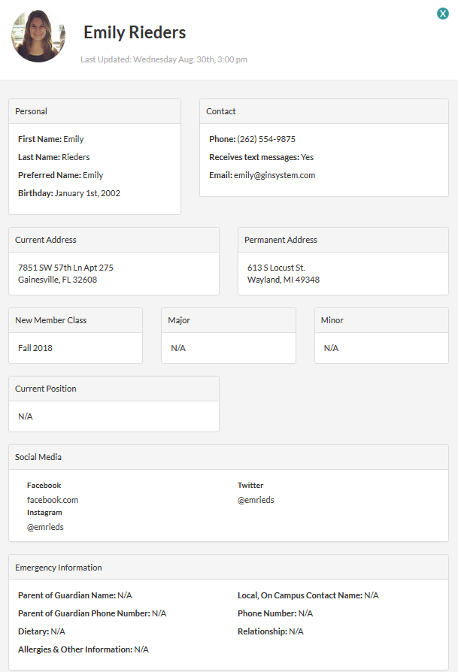
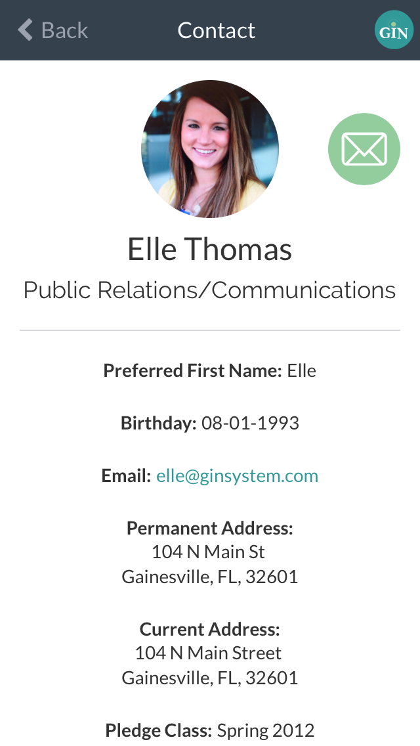
Contacts List

Slide 14
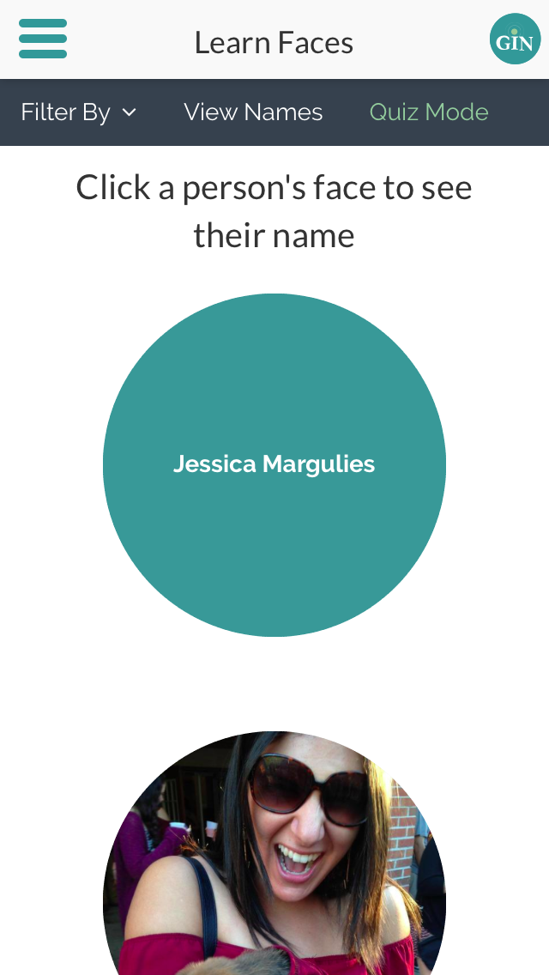
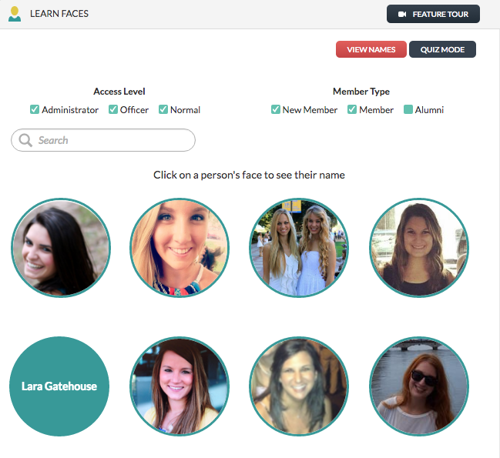
Learn Faces

Slide 15
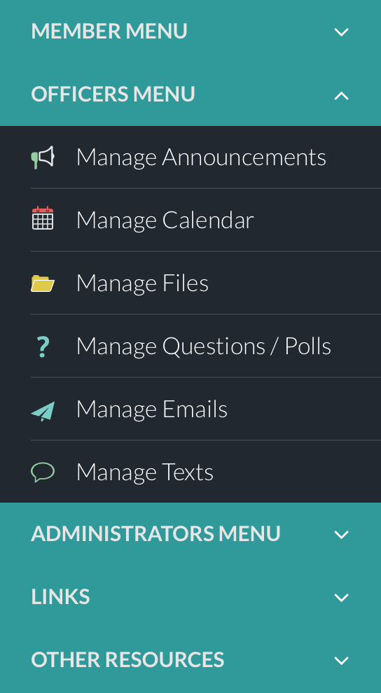
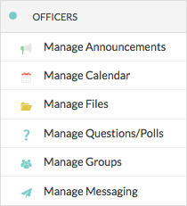
Officer Menu

Slide 16
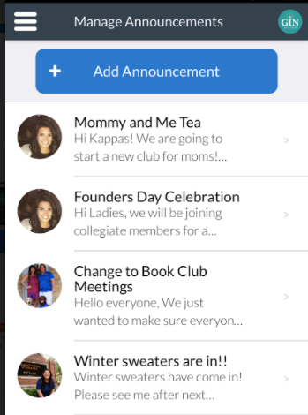
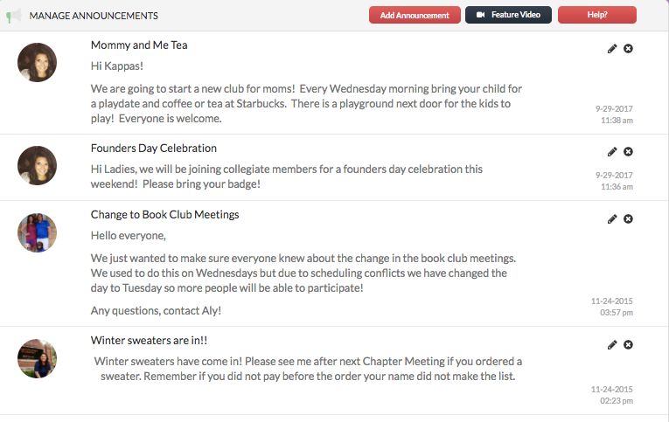
Manage Announcements

Slide 17
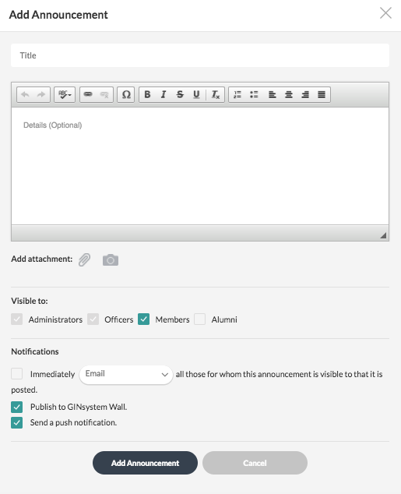
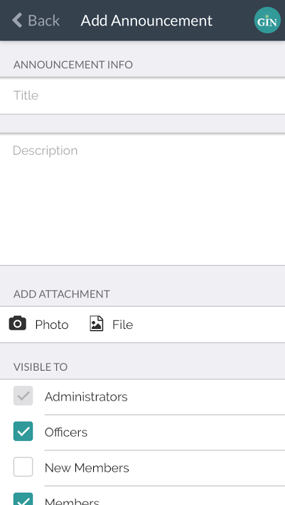
Add Announcement

Slide 18
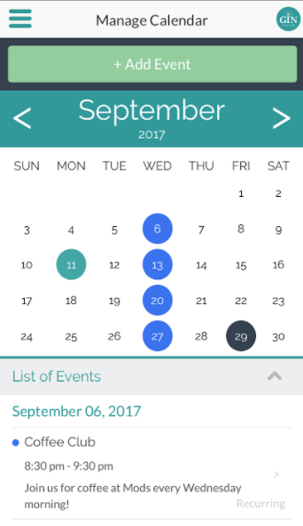
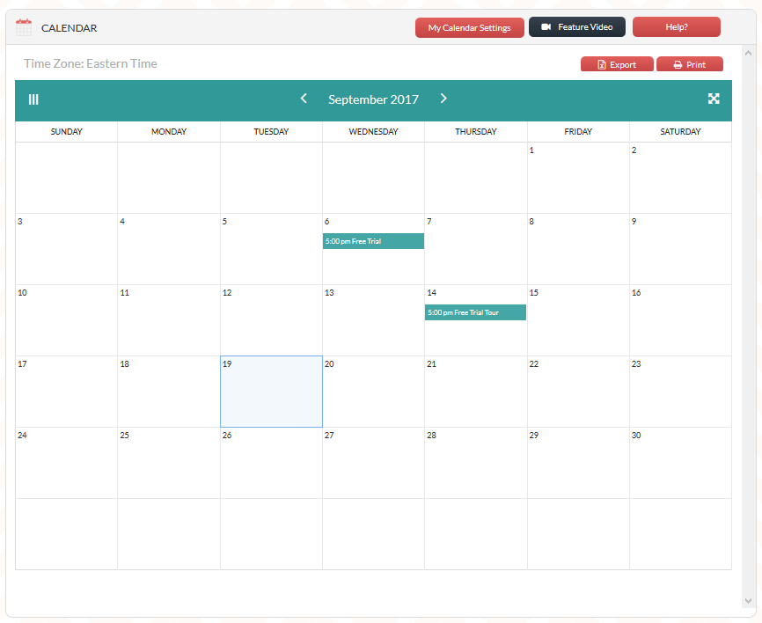
Calendar: Month View

Slide 19
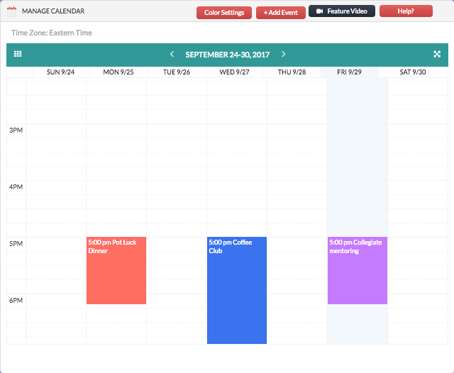
Calendar: Week View

Slide 20
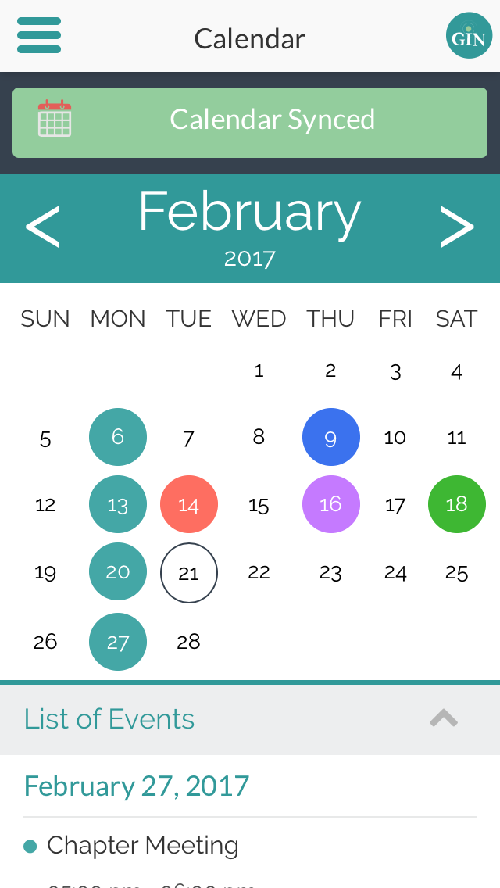
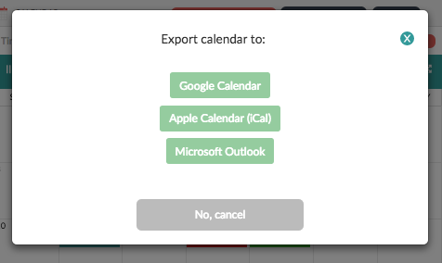
Calendar: Export or Sync

Slide 21
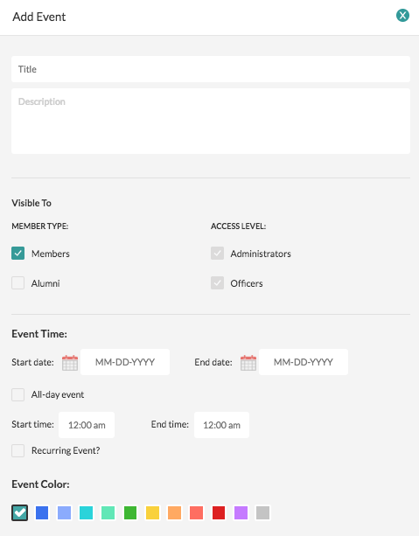
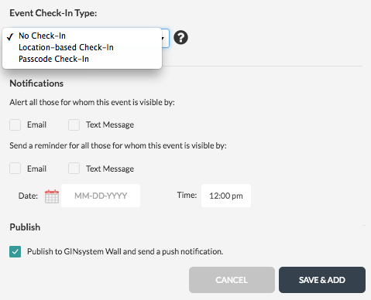
Add Event

Slide 22
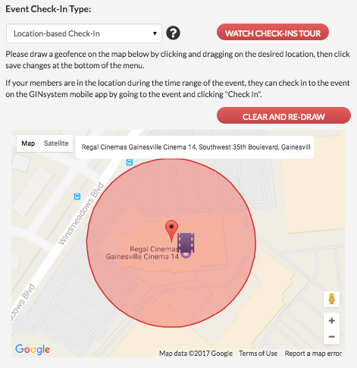
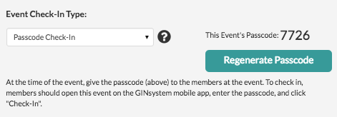
Manage Calendar:
Check-In

Slide 23
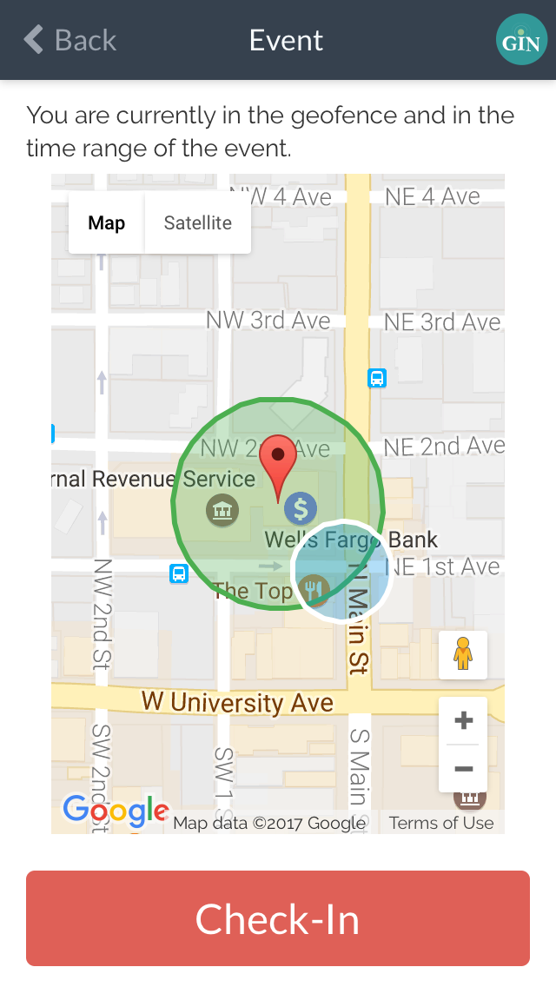
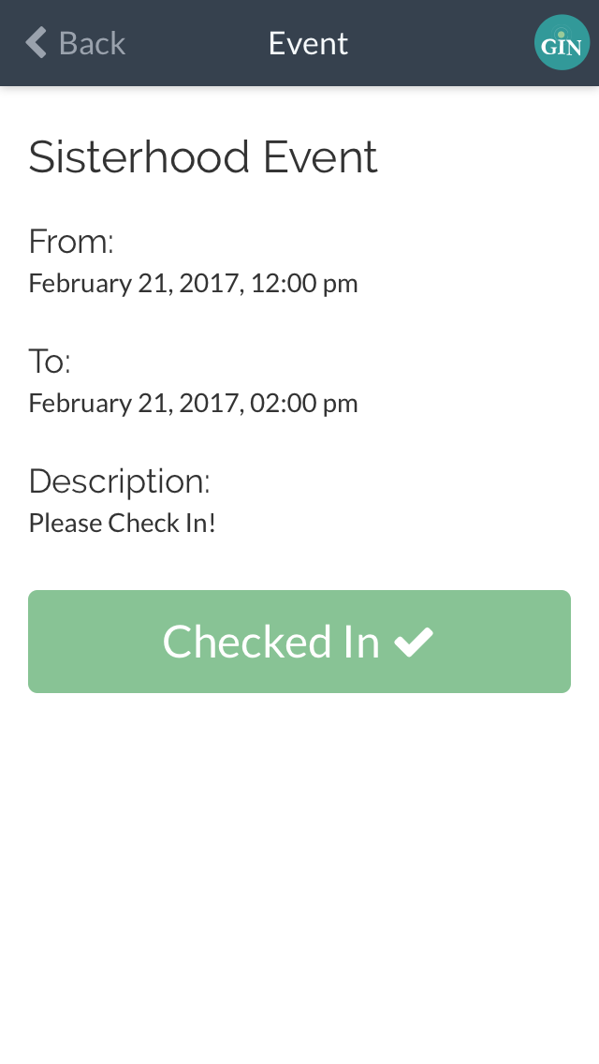
Check-In on Mobile
(Member Menu)

Slide 24
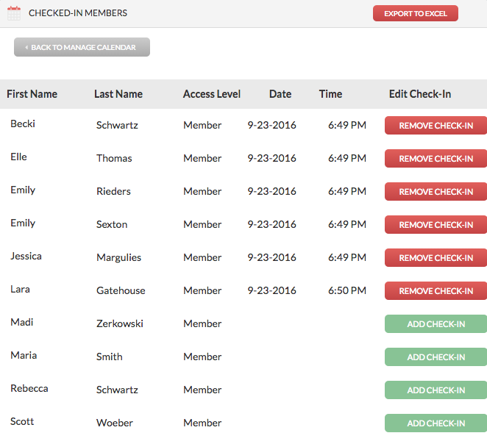
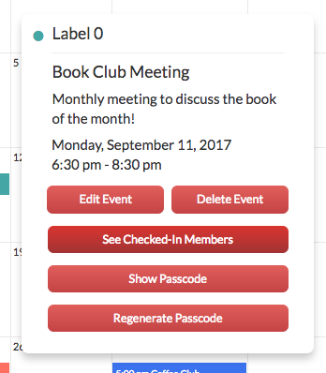
Manage Calendar:
Check-In

Slide 25
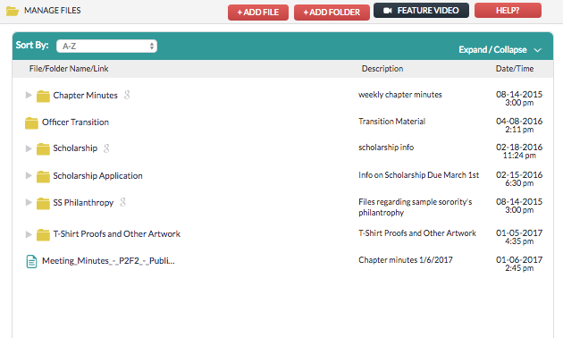
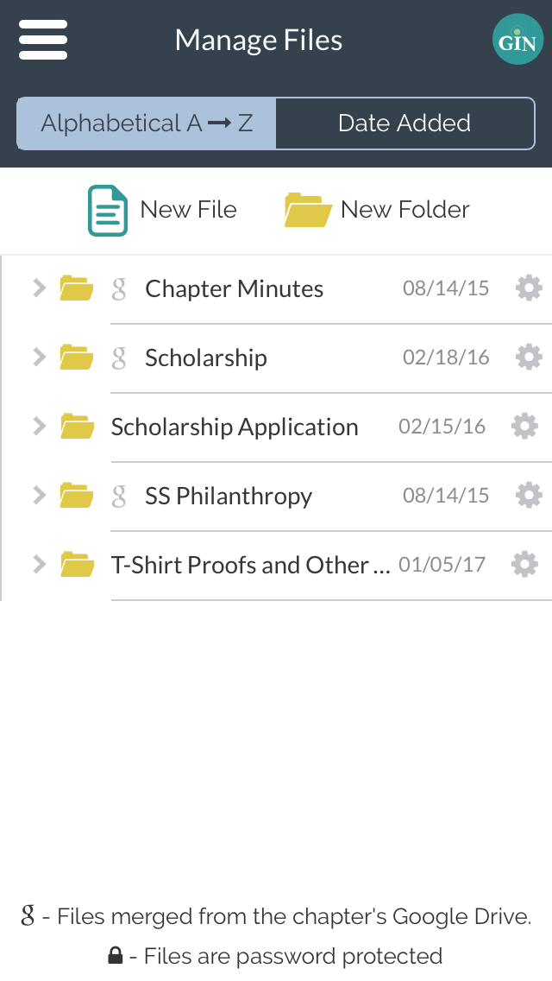
Manage Files

Slide 26
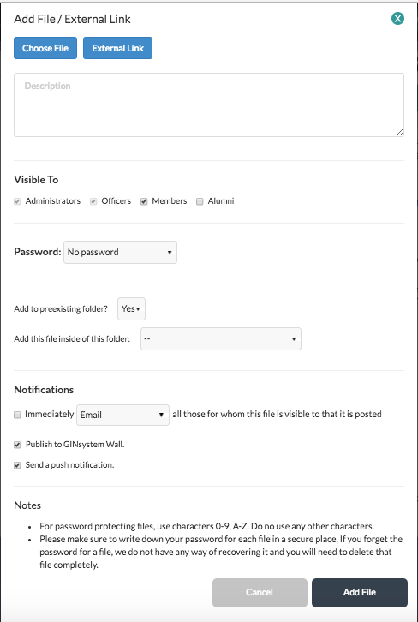
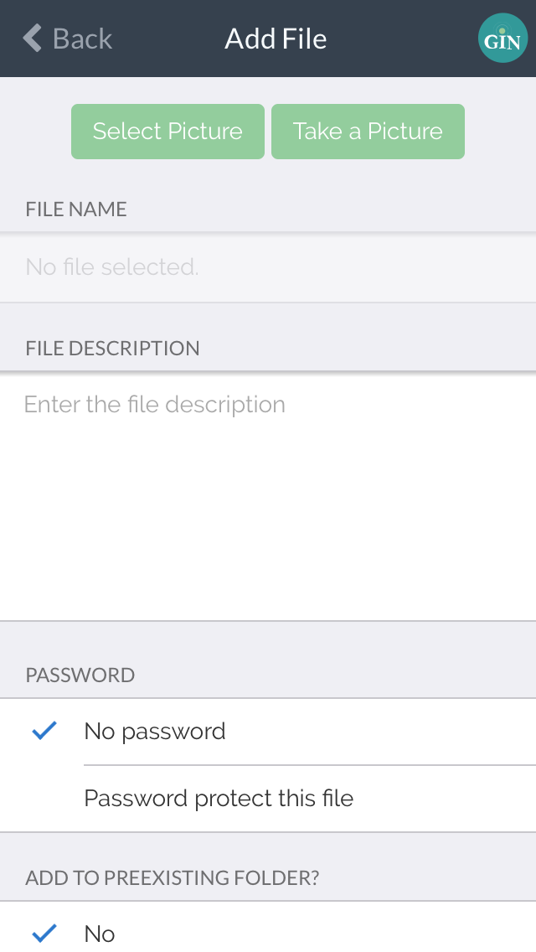
Add a File

Slide 27
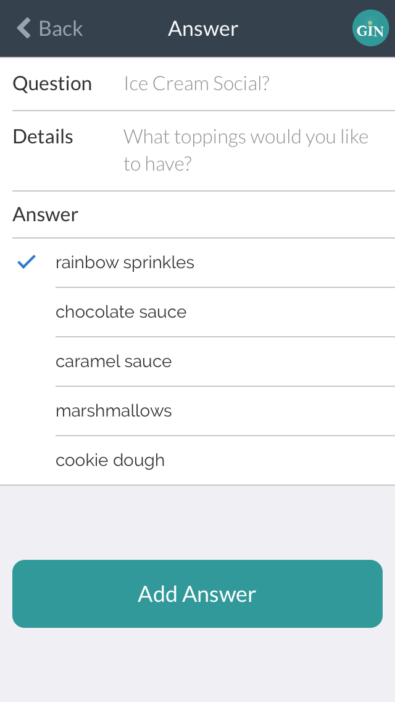
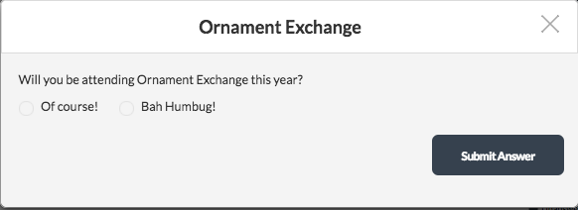
Answering Questions/Polls
(Member Menu)

Slide 28
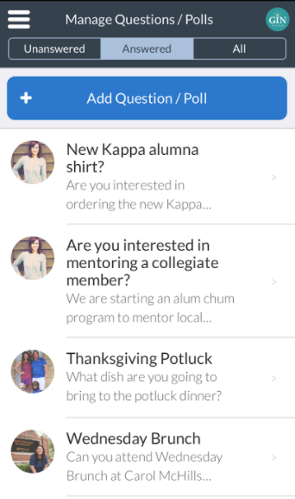
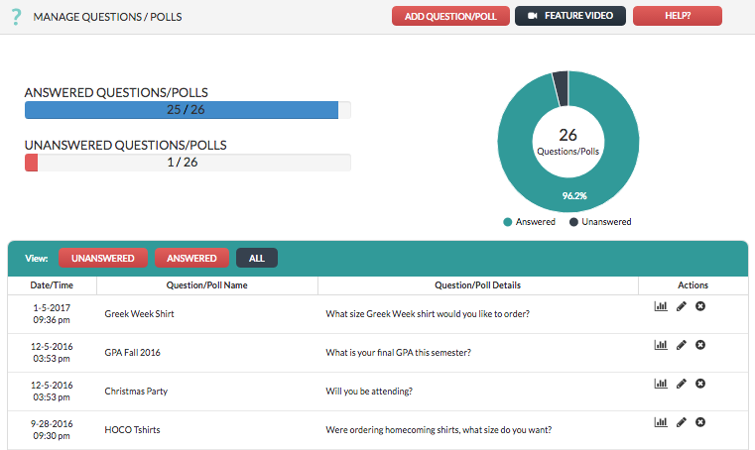
Manage Questions/Polls
(Officer Menu)

Slide 29
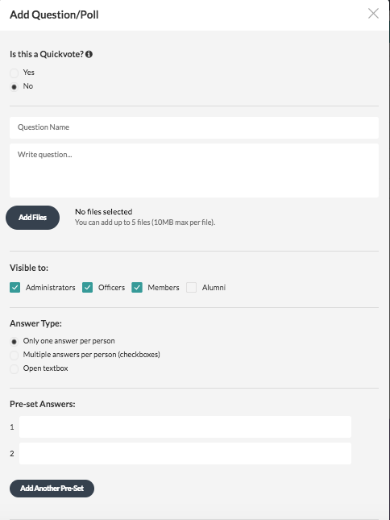
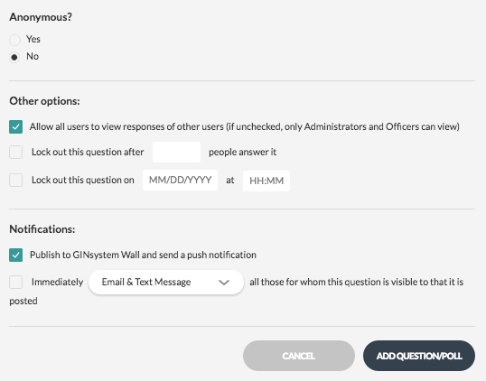
Add a Question/Poll

Slide 30
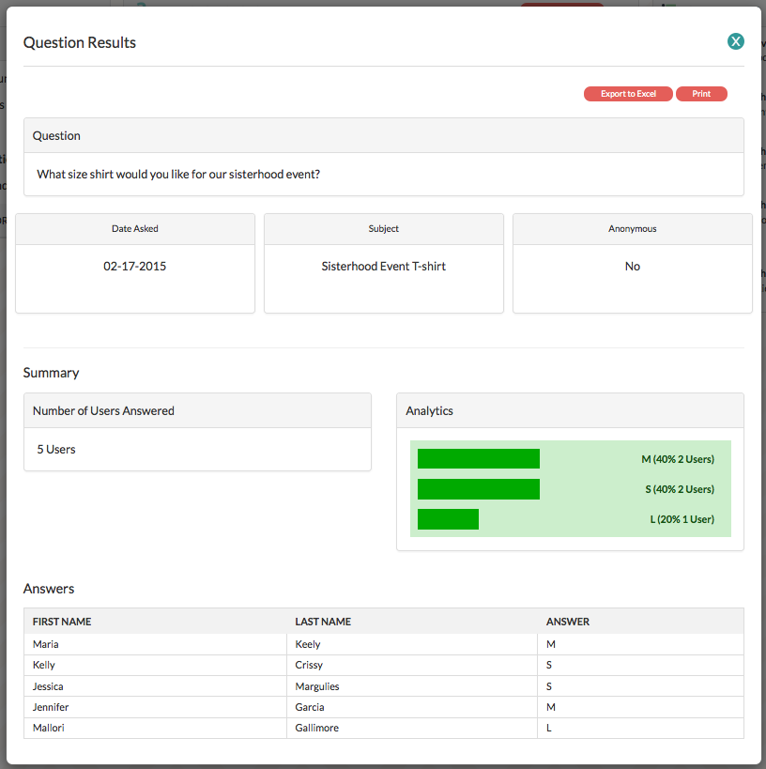
View Results

Slide 31
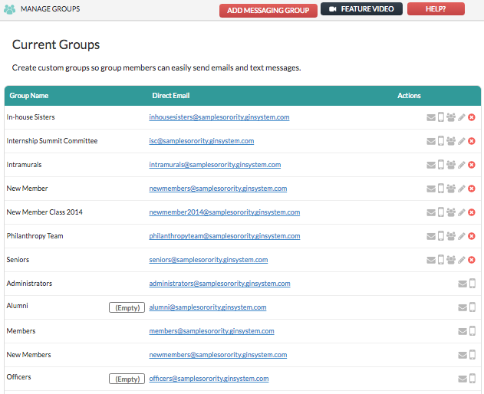
Manage Groups

Slide 32
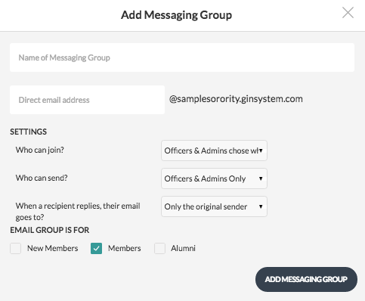
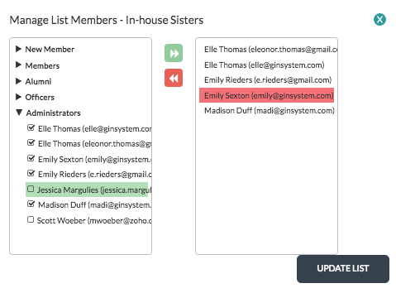
Add Messaging Group

Slide 33
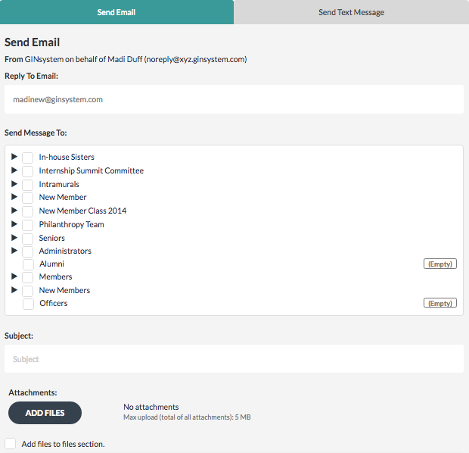
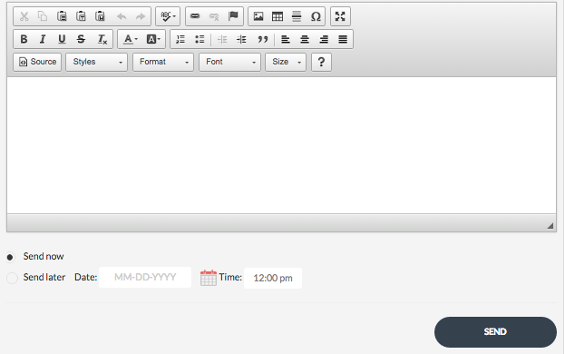
Send an Email

Slide 34
Send a Text Message

Slide 35
Send Emails and Texts on the Mobile App

Slide 36
Administrator Menu

Slide 37
Manage Users

Slide 38
Manage Users: Mute Communication

Slide 39
Manage GIN Settings

Slide 40
Manage Emergency Check-In

Slide 41
Manage Emergency Check-In: By Person

Slide 42
Manage Emergency Check-In: By Location

Slide 43
Manage Emergency Check-In: Mobile Application
v

Slide 44
Emergency Check-In: (Member Menu)
v

Slide 45
Mobile Applications

Slide 46
Questions?
Contact us!
(888)-GIN-SYSTEM
(446-7978)
Chat M - F 10 AM - 6 PM ET at GINsystem.com
Help@GINsystem.com

