Slide 1
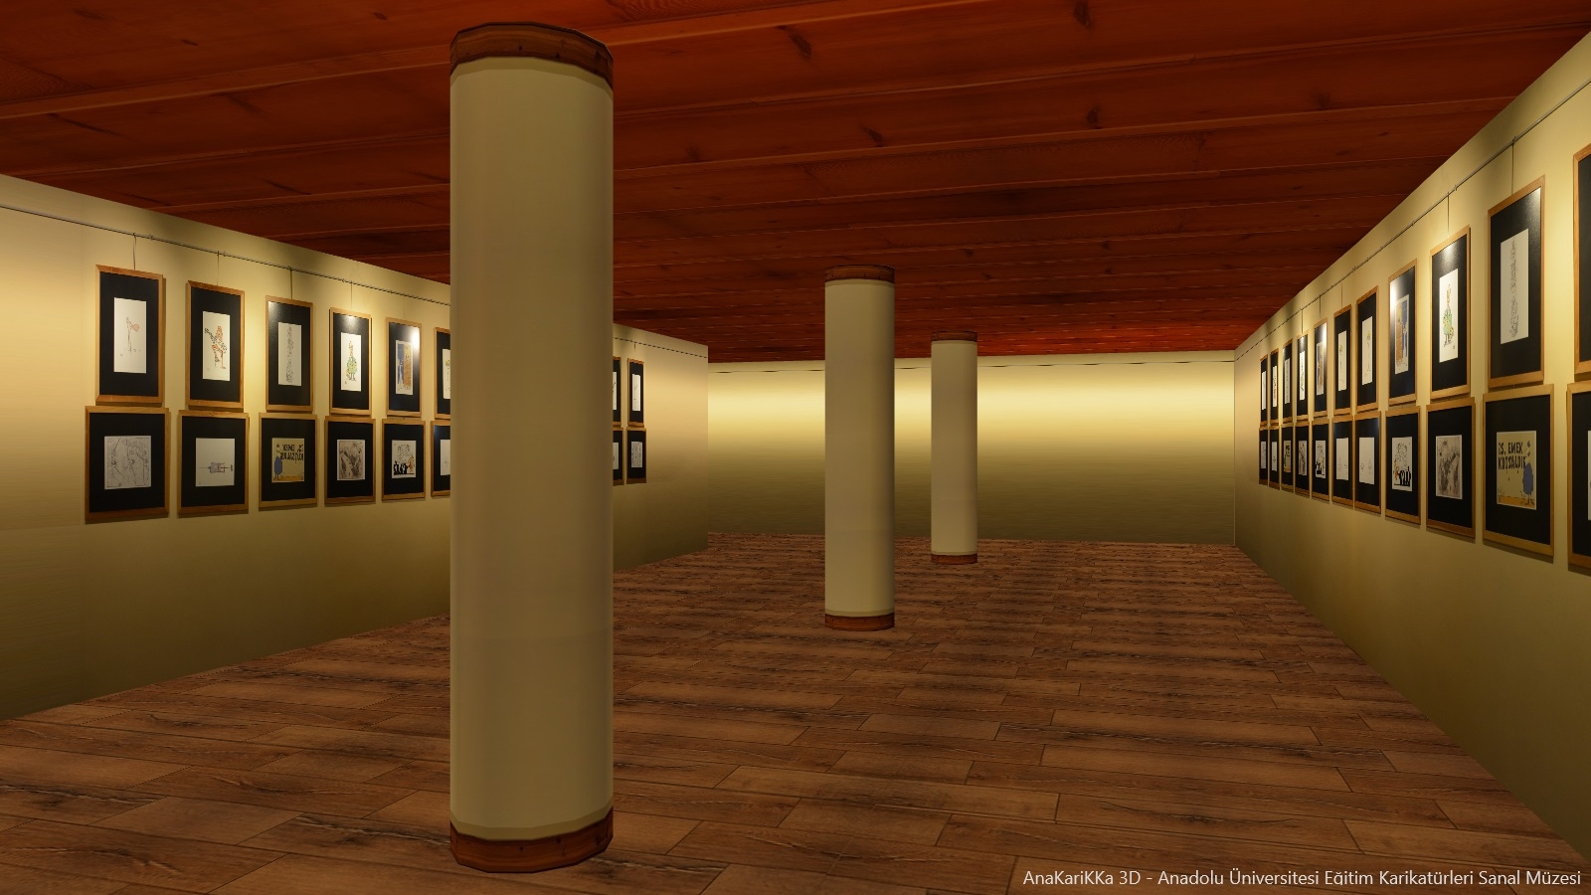
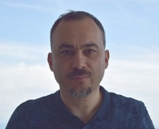
Dr. Yılmaz Yörü
Embarcadero MVP

Slide 2
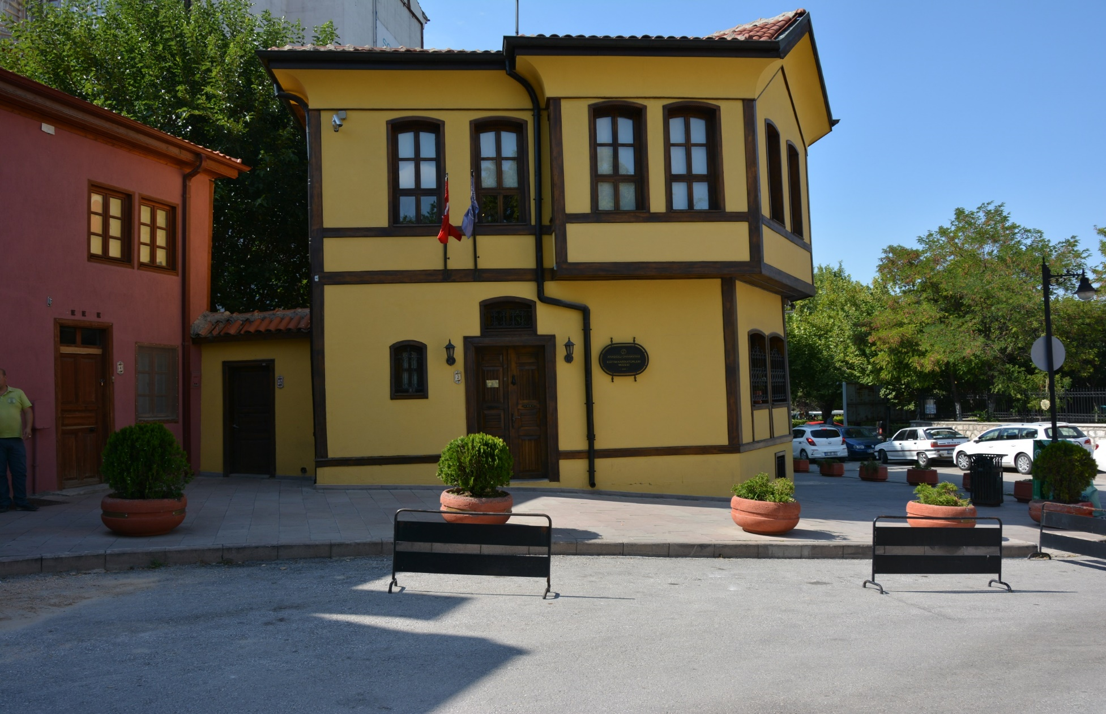
http://www.ekm.anadolu.edu.tr/
Educational Caricature Art Museum of Anadolu University, Eskisehir, TURKEY

Slide 3
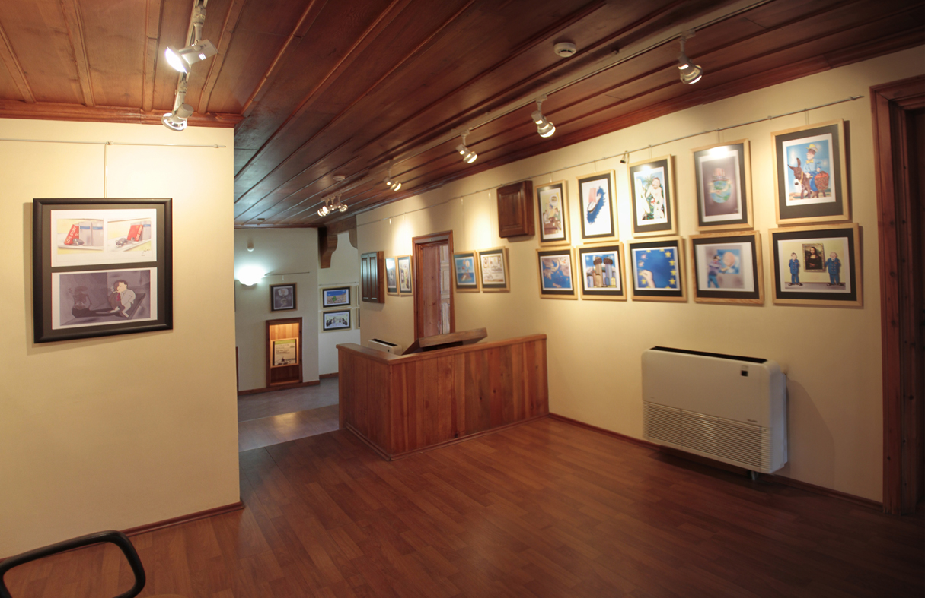
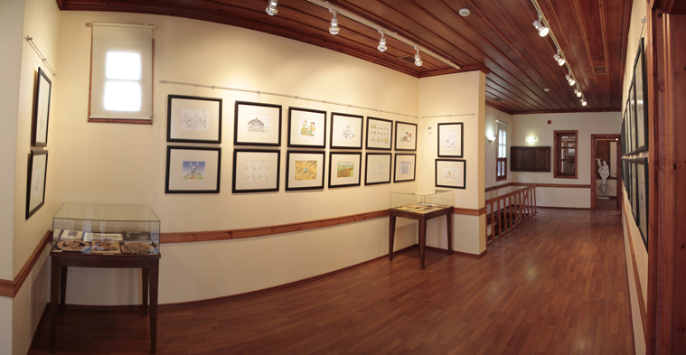
Educational Caricature Art Museum of Anadolu University, Eskisehir, TURKEY

Slide 4
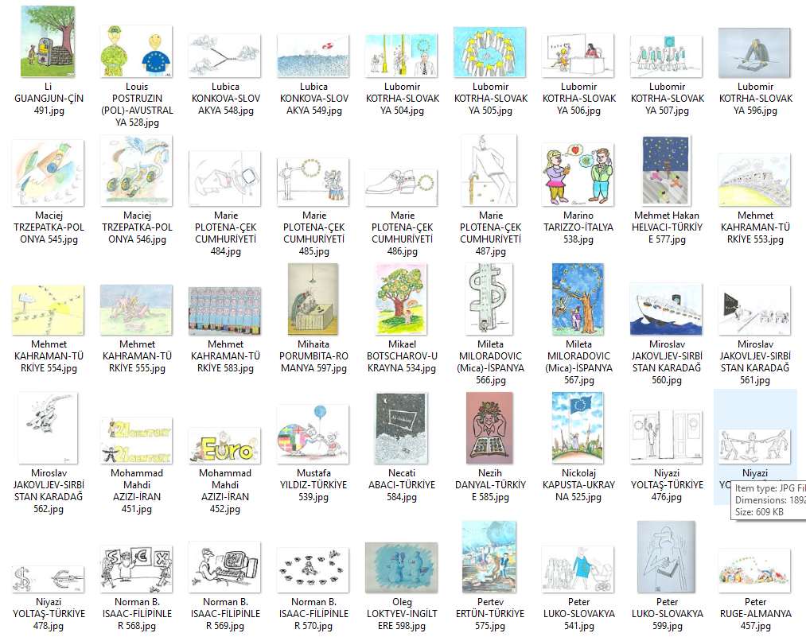
+ More than 12000 caricatures
Anadolu University Scientific Research Project
Project Manager: Prof.Dr. Mesut Kurulgan
Lecturers: Halime Yörü, Hayriye Cetintaş, Dilek Meriç
+ Project Management,
+ Art Scanning
+ Art Interpretation
+ Art Control
+ Data Input
+ Database Server
…
R&D Project
Esenja Company
+ 3D Design
+ UI Design
+ Software Development
+ Database Development
…

Slide 5
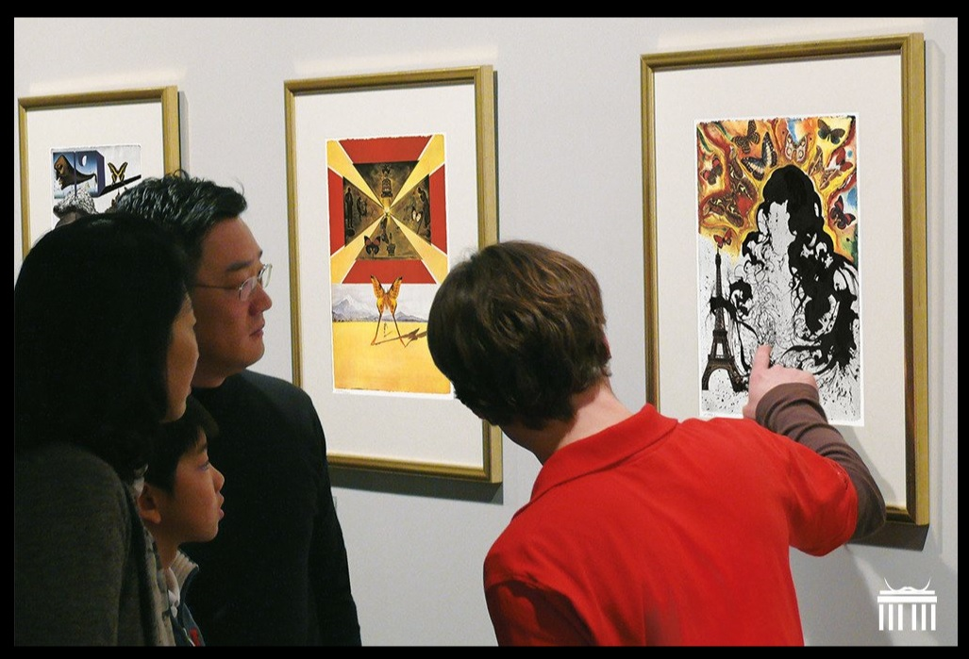
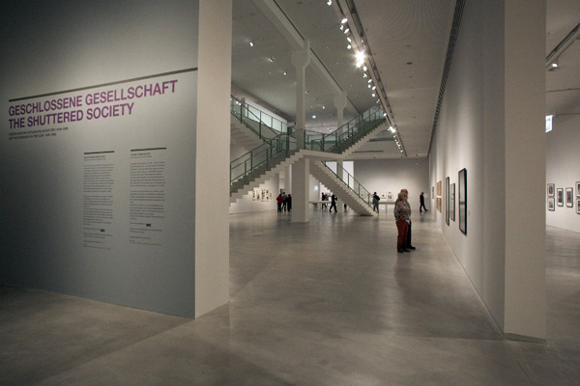
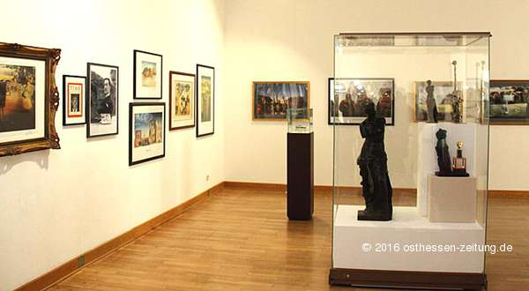
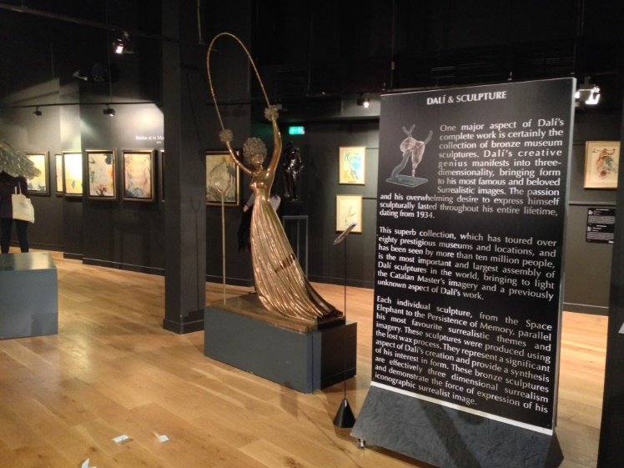
SOME MUSEUM EXAMPLES

Slide 6
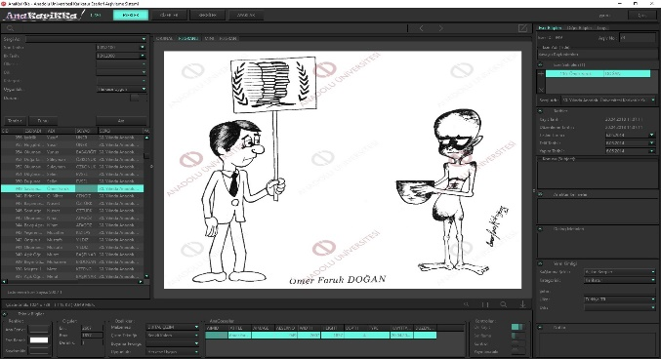
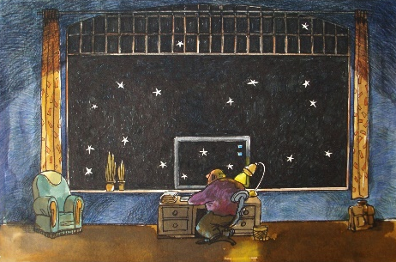
DEVELOPED SOFTWARE SYSTEM
Exhibition
Artist
Title
Digital Image
AnaKarikka (Technical)
InterBase
MySQL
SQLite
Oracle
MSSQL
..
Server
AnaKarikka (Experts, Manager, Admin)
AnaKarikka 3D (Visitors)

Slide 7
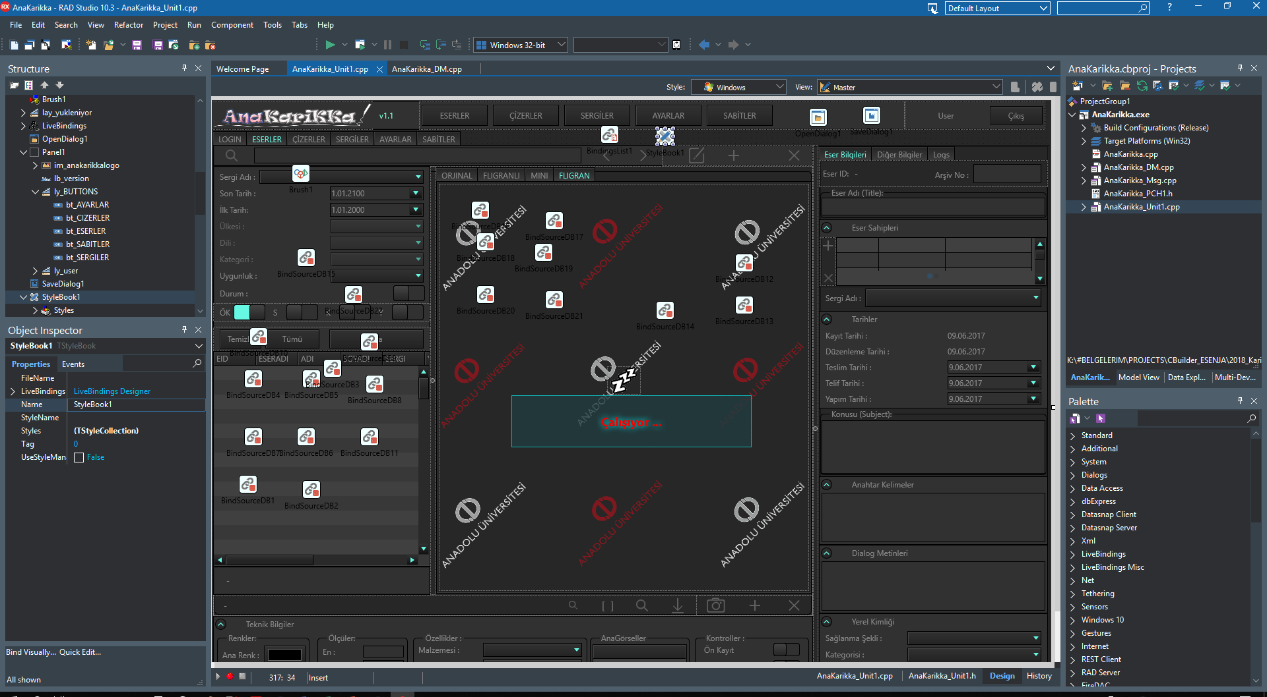
ANAKARIKKA SOFTWARE

Slide 8
How TO WATERMARK
im_fligran (alpha watermark)
im_fligranli
(orginal image)

Slide 9
How TO SETUP MYSQL SERVER FOR THE HI-QUALITY IMAGES
1. SETUP INI FOR THE MEDIUM BLOB IMAGE PACKAGES
C:\ProgramData\MySQL\MySQL Server 5.7\my.ini
wait_timeout=28800
interactive_timeout = 28800
max_allowed_packet=16M
2. USE A SEPARETE TABLE FOR IMAGES, INDEX PARAMETERS USED BY WHERE … LIKE … ON … COMMANDS
select * from imagetable where depth=…
inner join on paramx=...

Slide 10
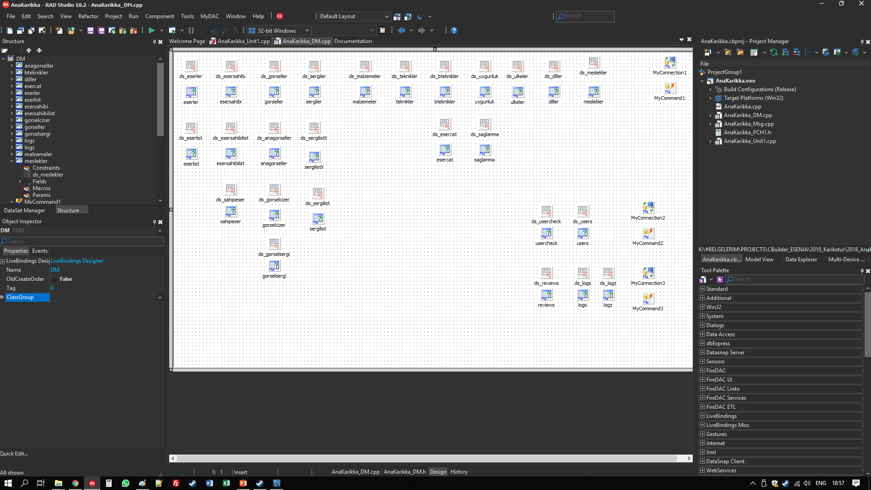
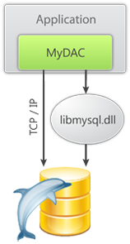
How TO SETUP DATA MODULE

Slide 11
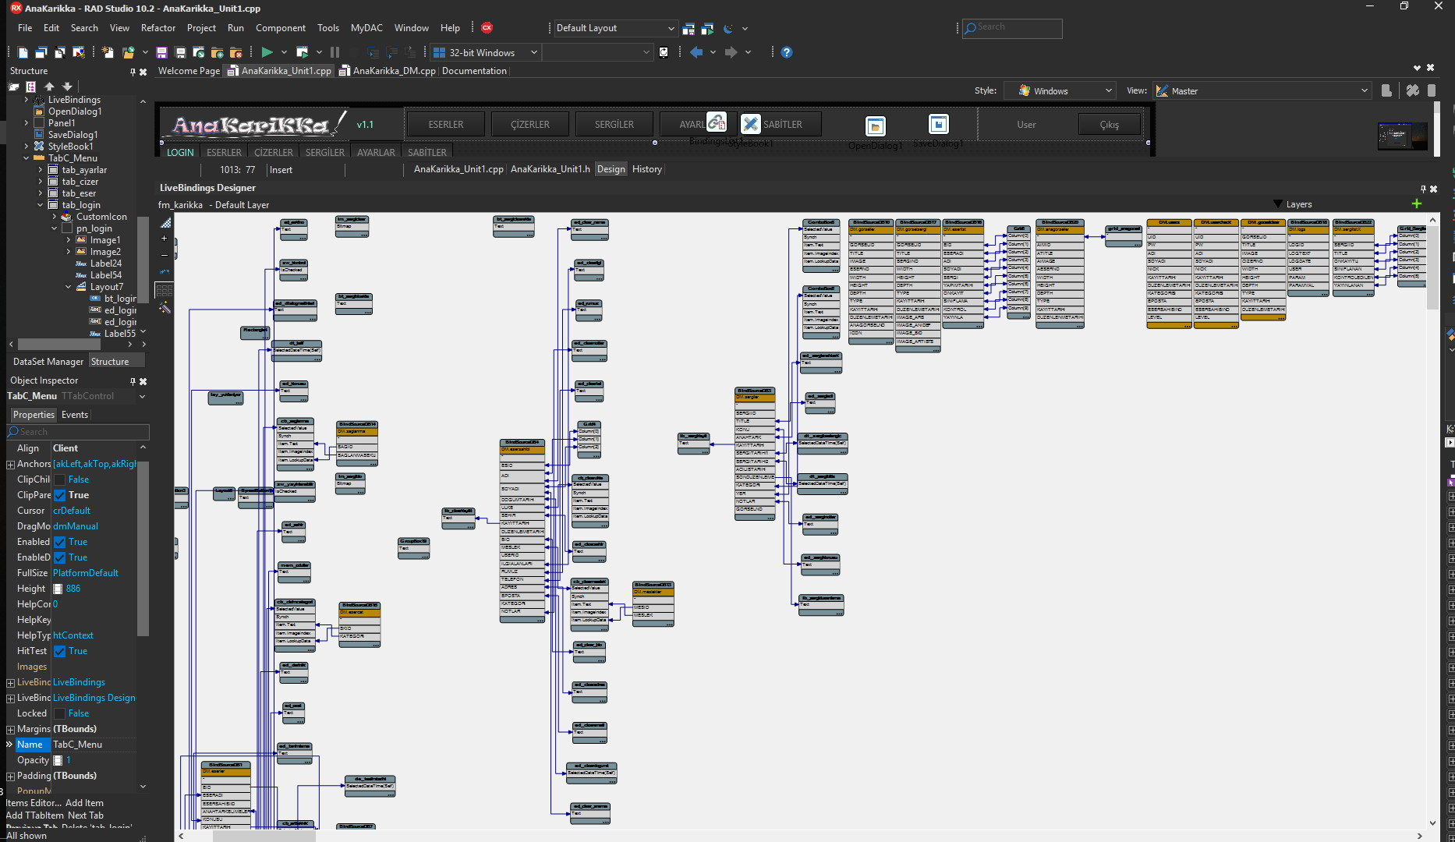
How TO SETUP VISUAL BINDINGS

Slide 12
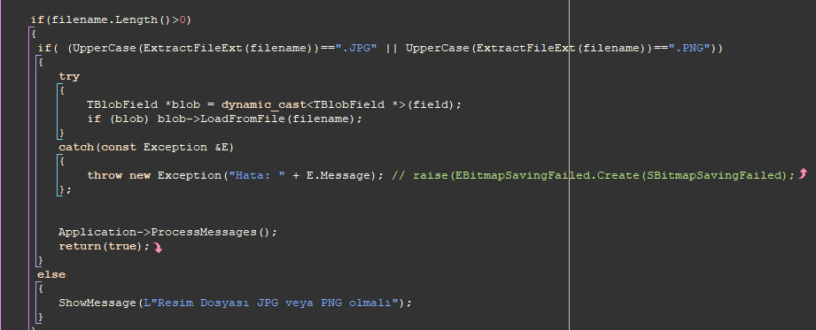
How TO UPLOAD FROM DATABASE

Slide 13
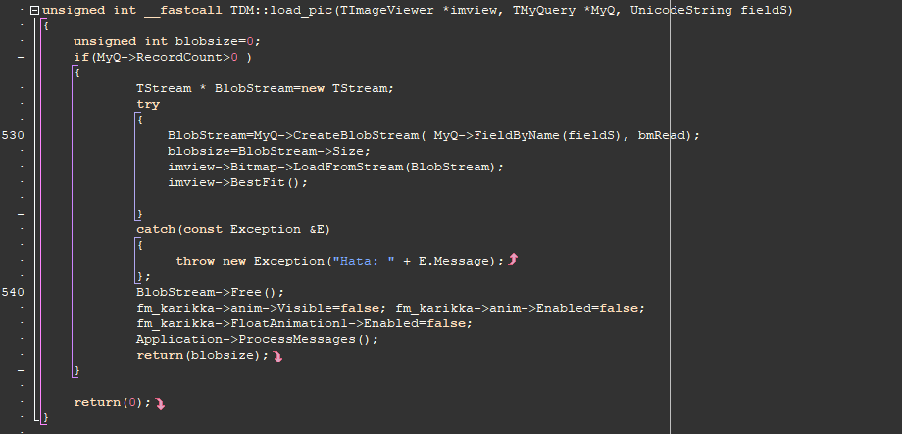
How TO DOWNLOAD FROM DATABASE

Slide 14
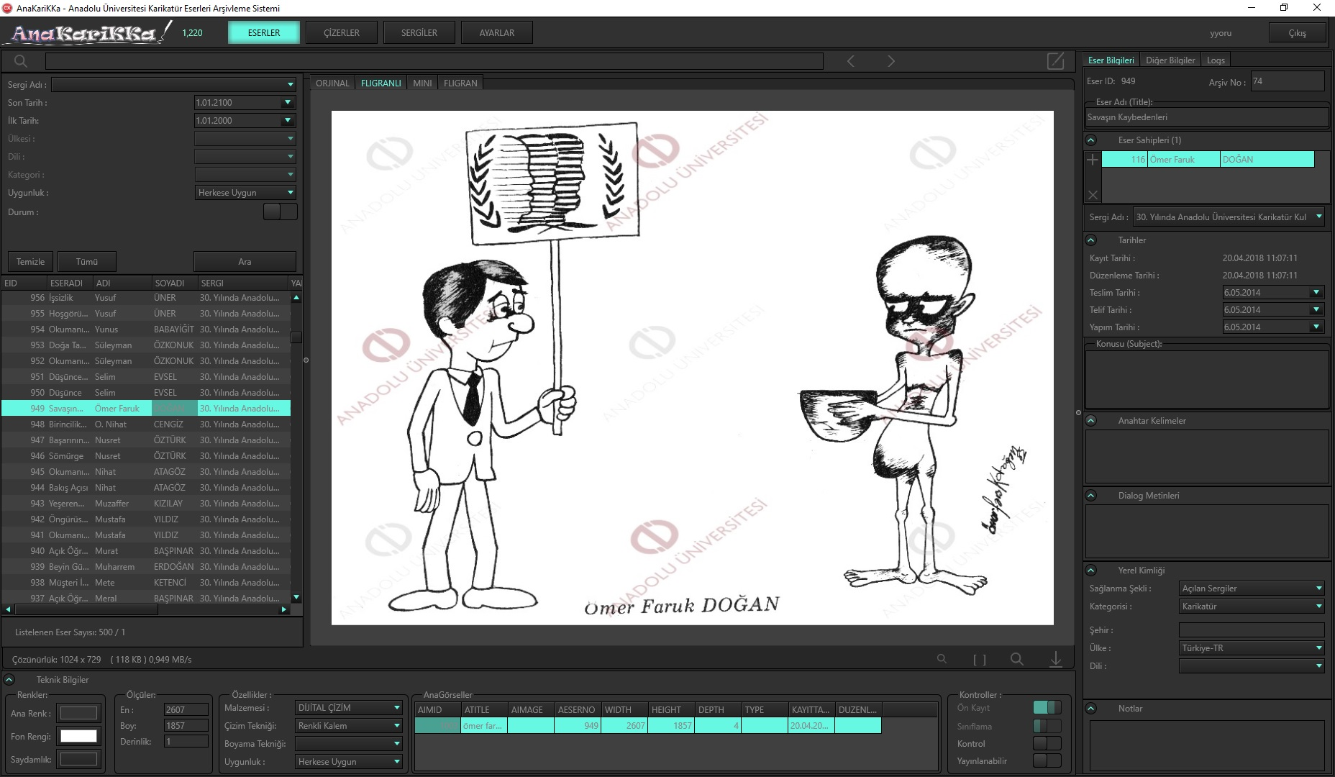
AnaKarikka - Anadolu University Achieving System for the Caricature Arts

Slide 15
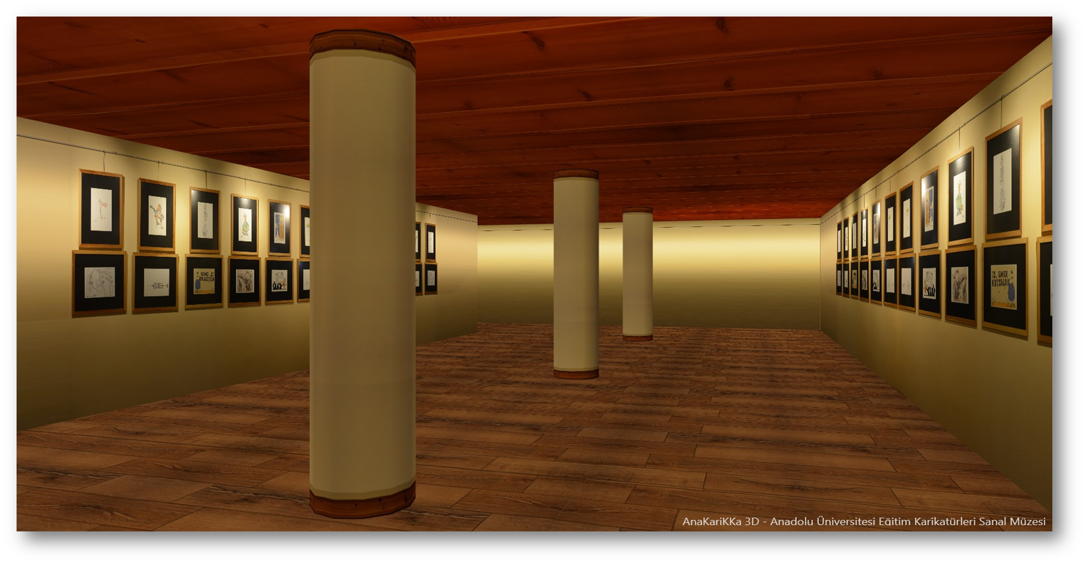
ANAKARIKKA 3D

Slide 16
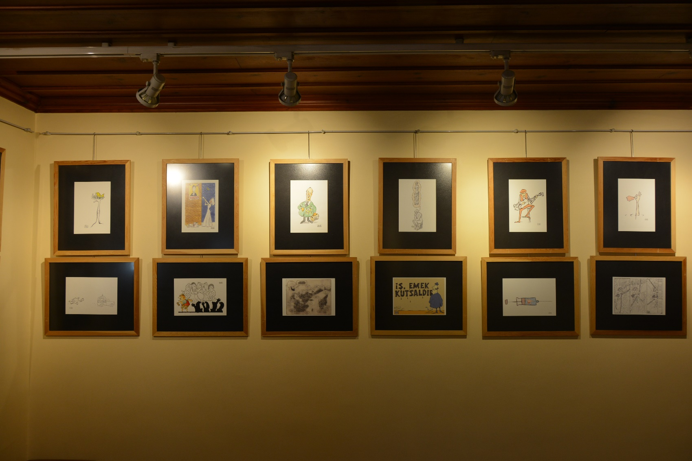
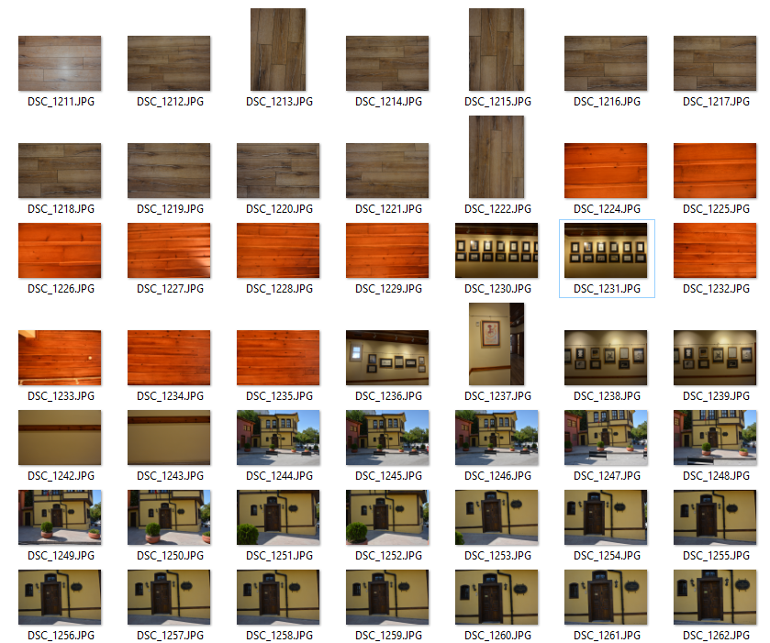
OBTAINING TEXTURES FROM REAL LIFE

Slide 17
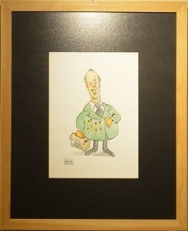
TEXTURE EDITING
Orginal Frame
Frame
Ceiling
Floor
Wall

Slide 18
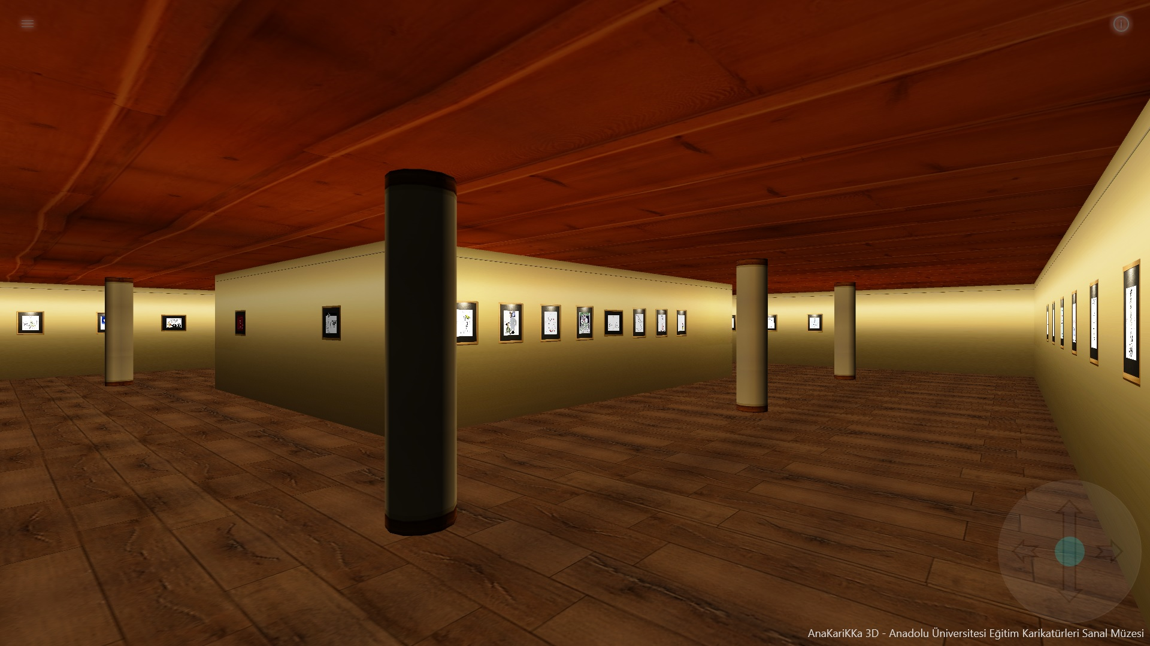
AnaKarikka 3D – Anadolu University Educational Caricature Virtual Museum

Slide 19
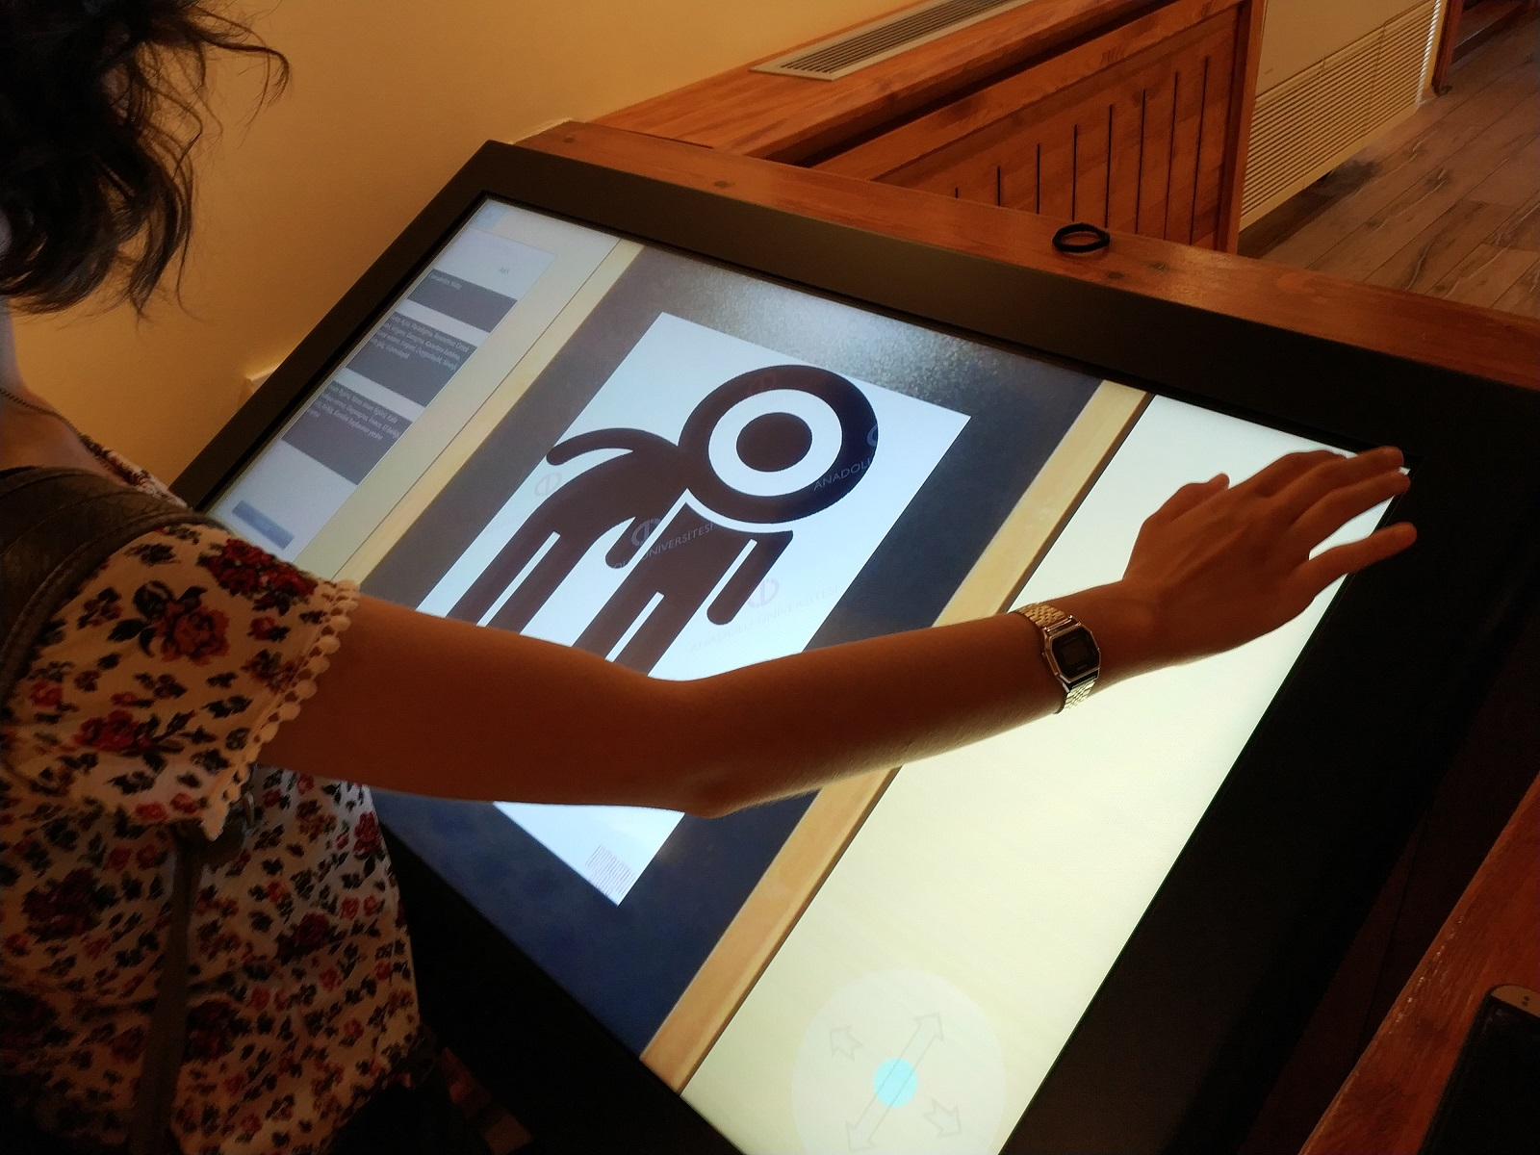
AnaKarikka 3D - Anadolu University Educational Caricature Virtual Museum of Anadolu University

Slide 20
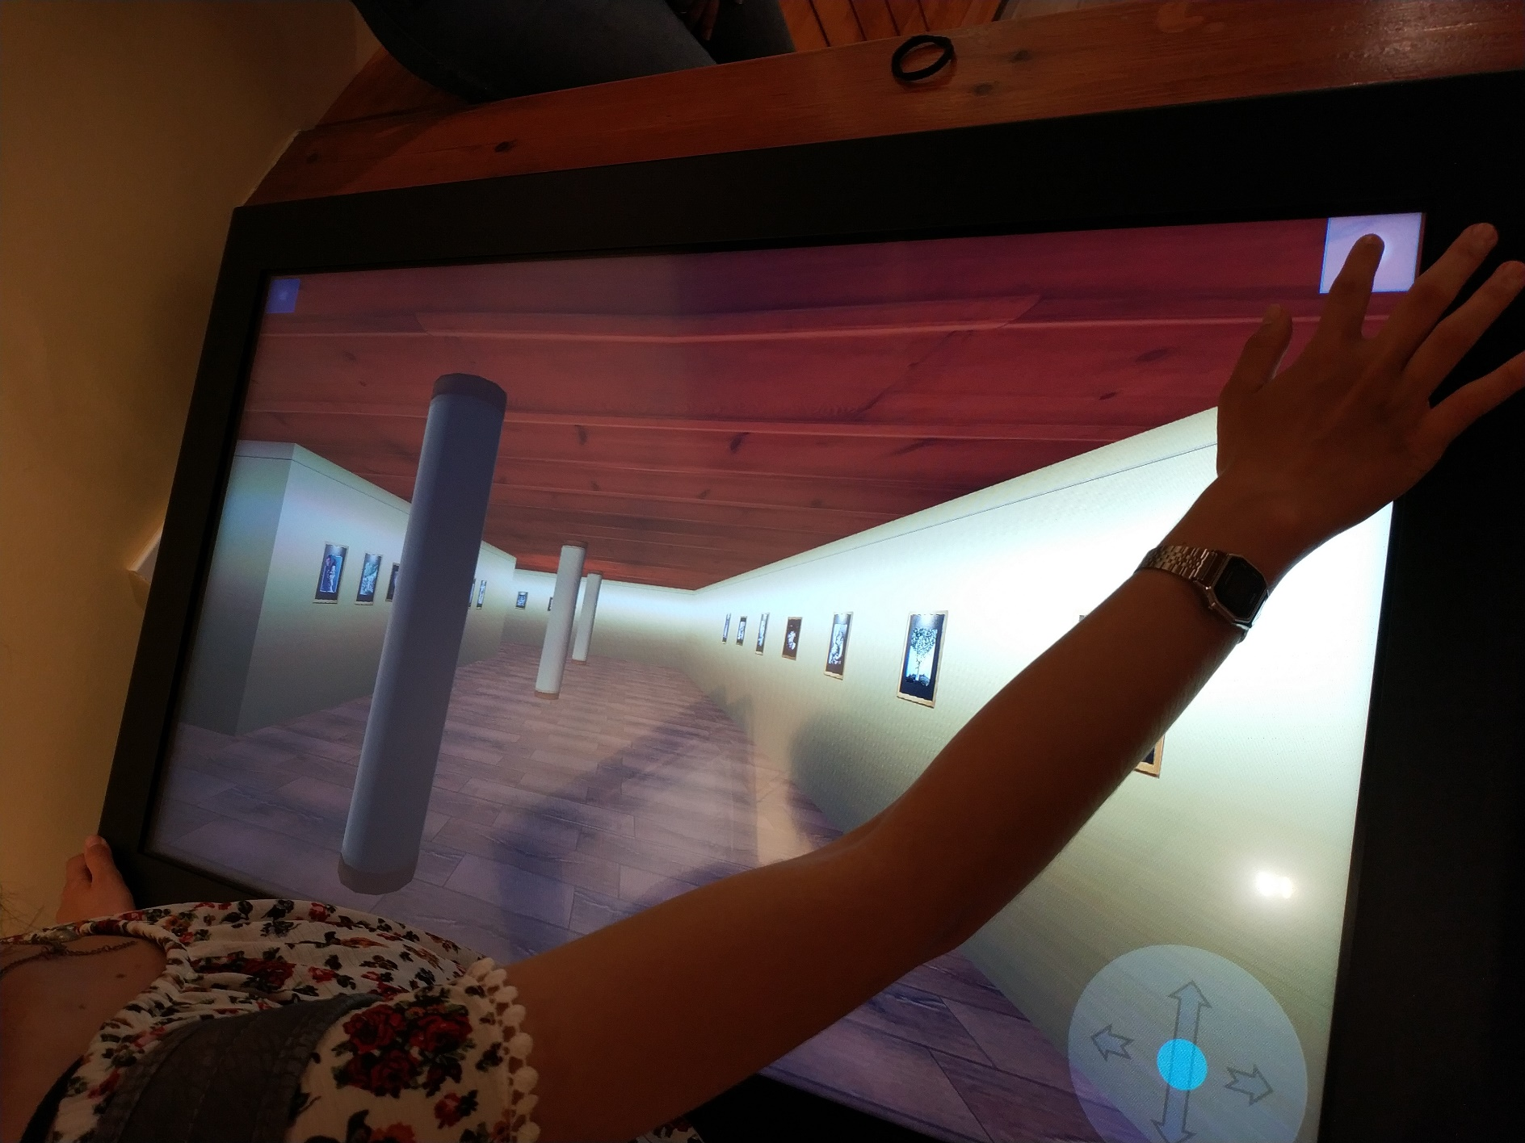
AnaKarikka 3D - Anadolu University Virtual Educational Caricature Museum Software

Slide 21
Thank You
Q & A
Yilmaz Yoru
yilmazyoru@esenja.com

