Slide 1
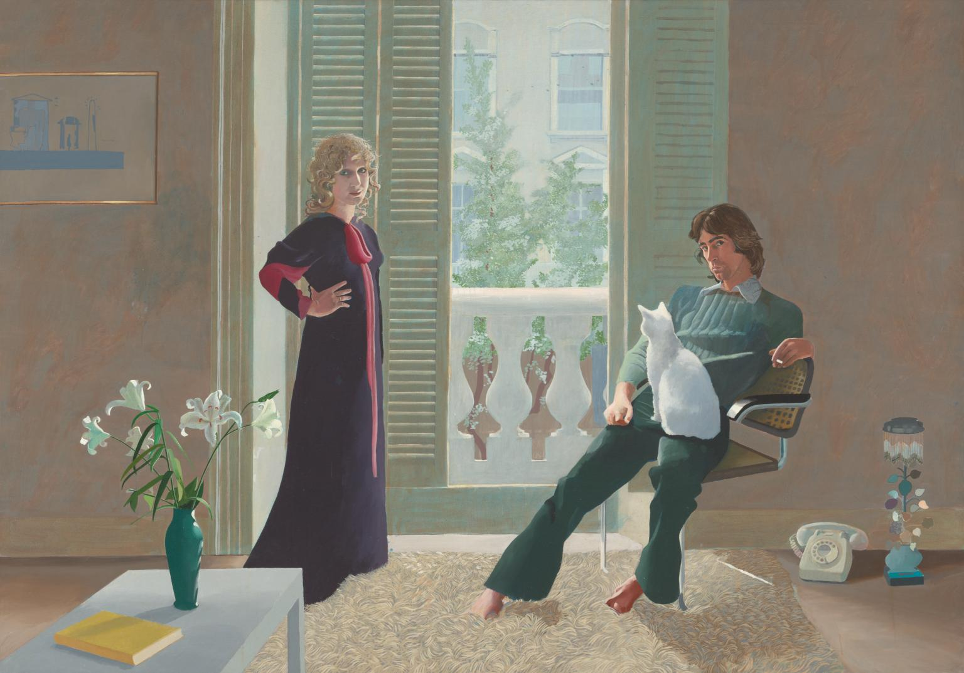
Notes:
Ossie Clark and Celia bertwhistle 1971

Slide 2
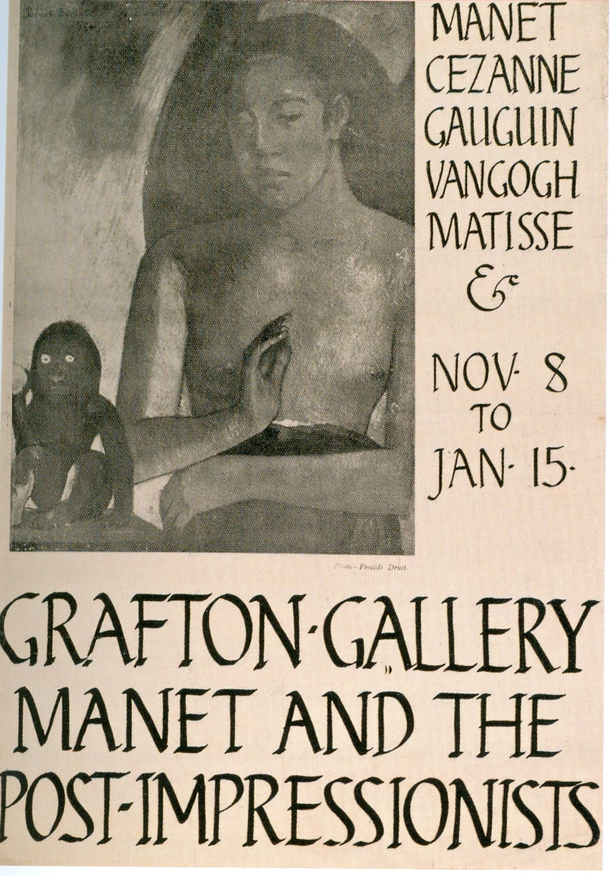
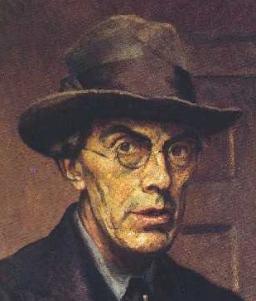
Notes:
1910-11

Slide 3
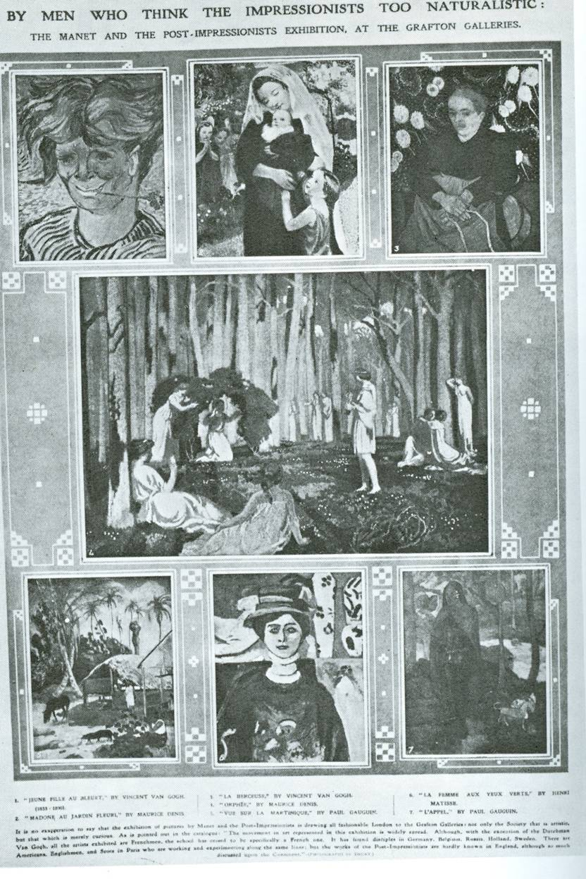
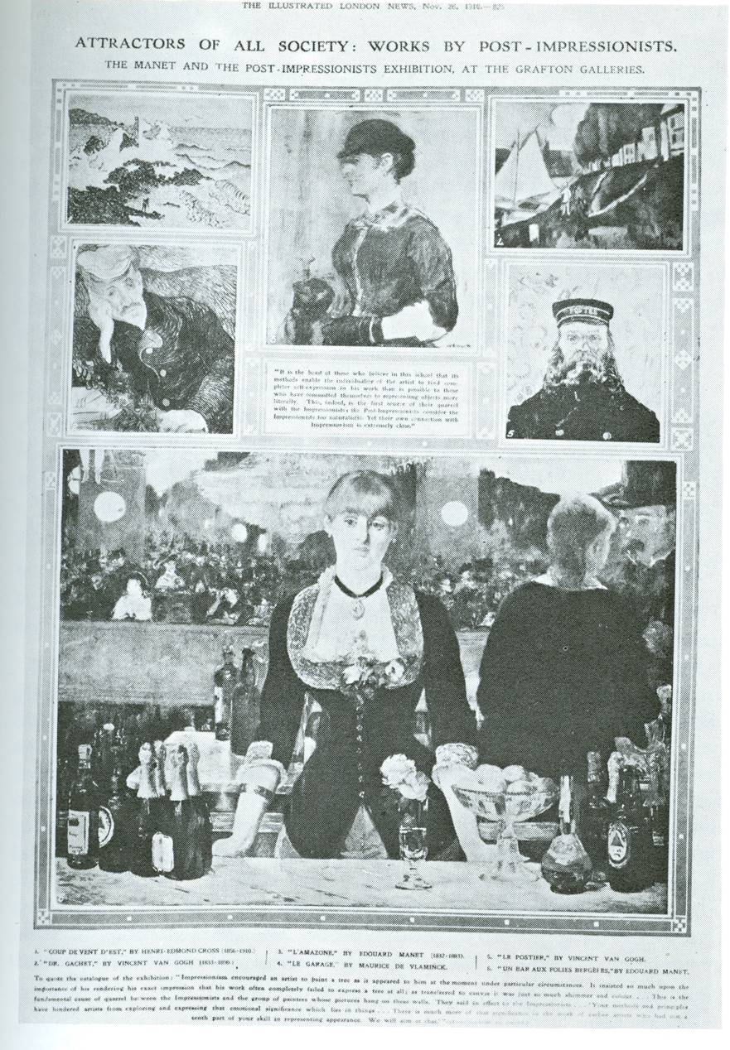

Slide 4
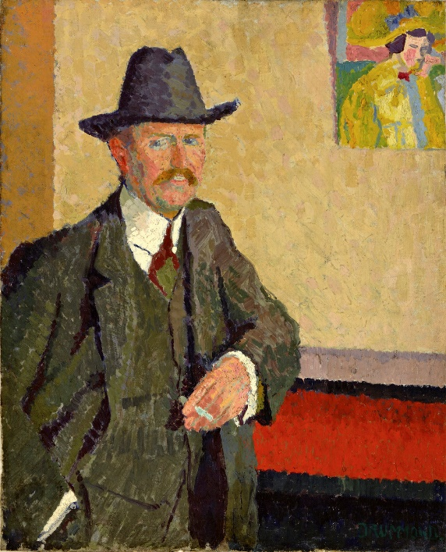
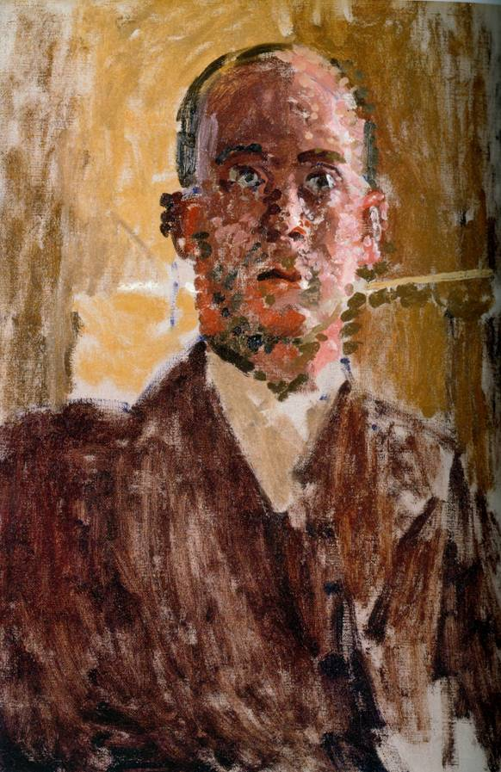
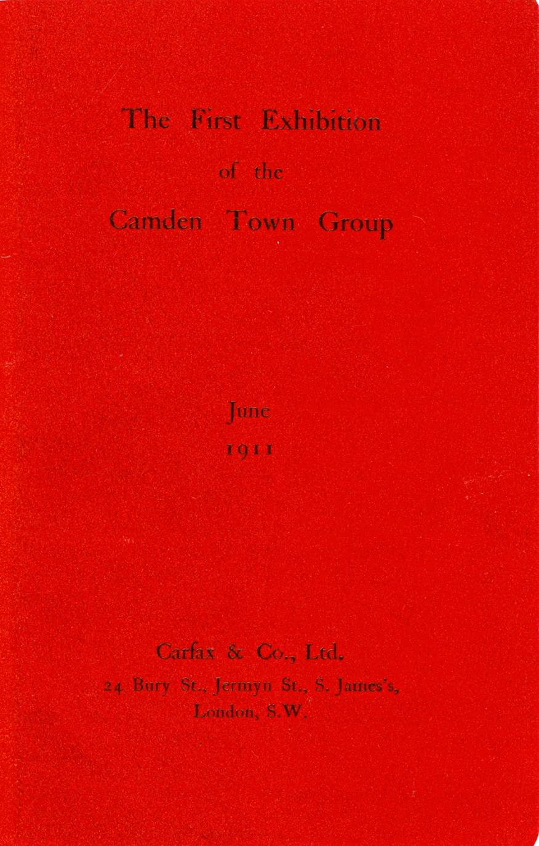
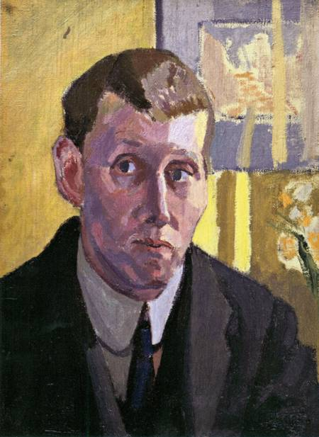
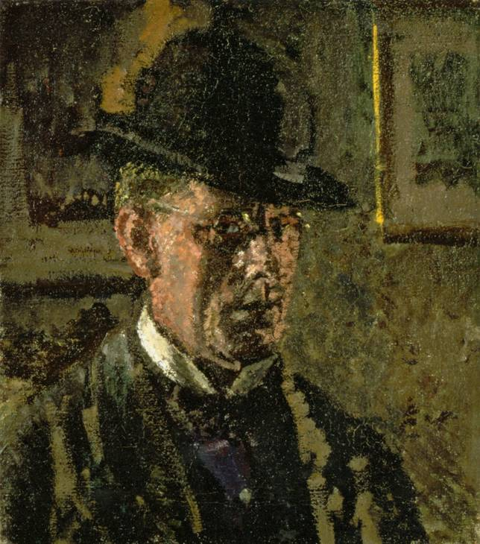
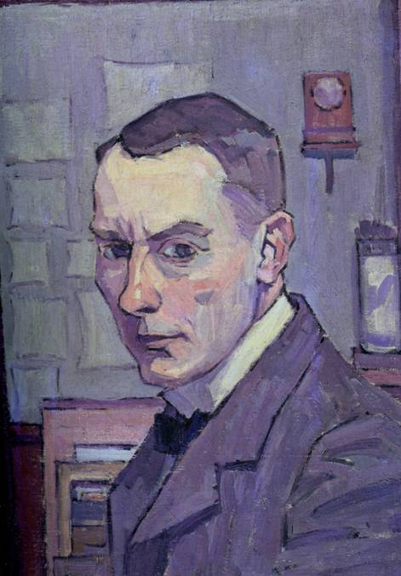
Notes:
Top L Charles Ginner by Malcolm Drummond. Top M Sickert. Top R Harold Gilman/ bottm L Spencer Gore. Bottom R Robert Bevan

Slide 5
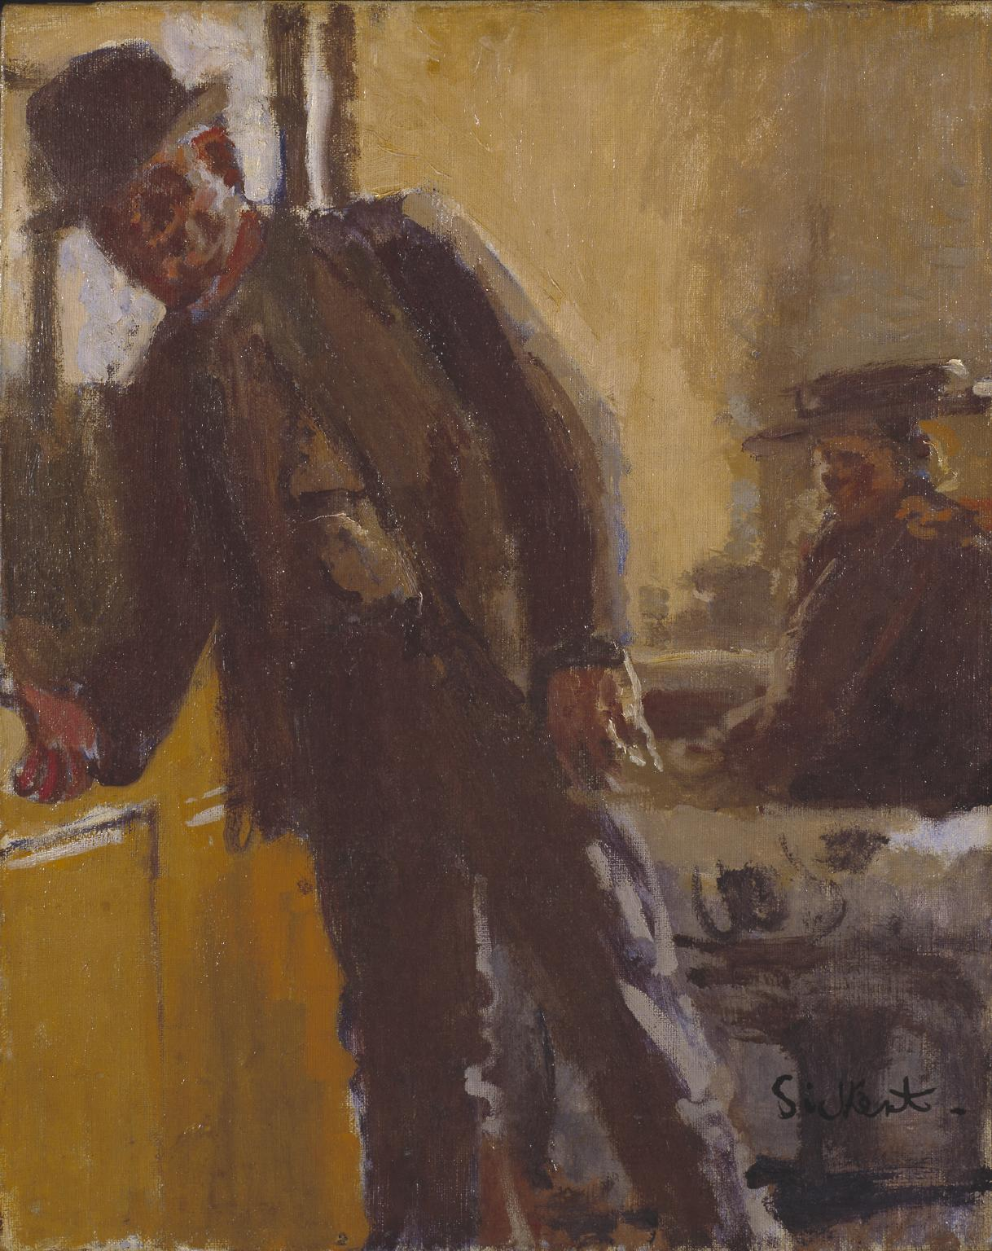

Slide 6
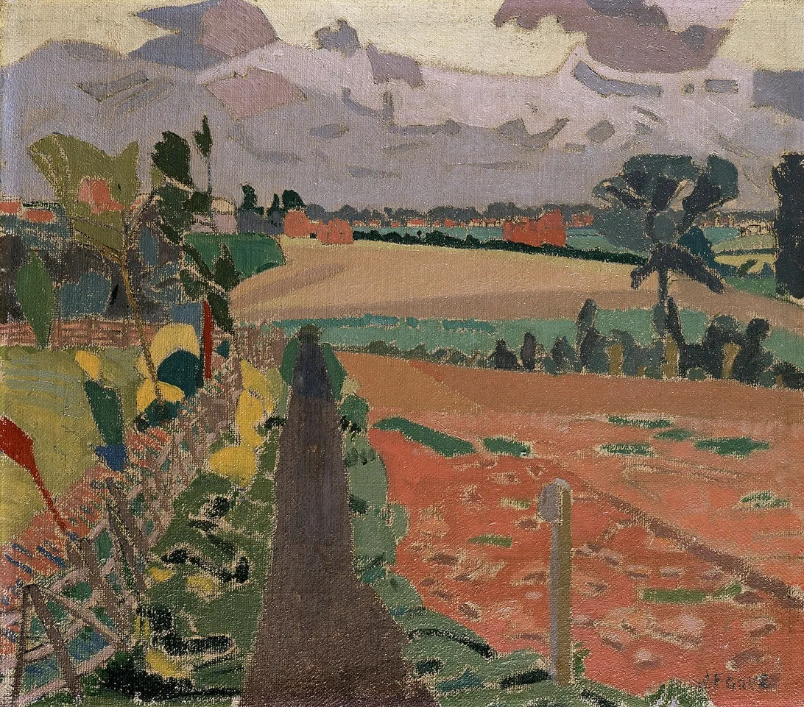
Notes:
Spencer Gore the Cinder path. Letchworth garden city 1912 included in 2nd Post Imp show

Slide 7
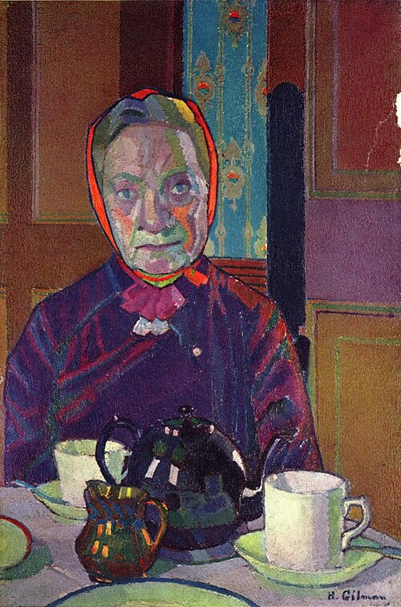
Notes:
Harold Gilman Mrs Mounter at the breakfast table 1916-17

Slide 8

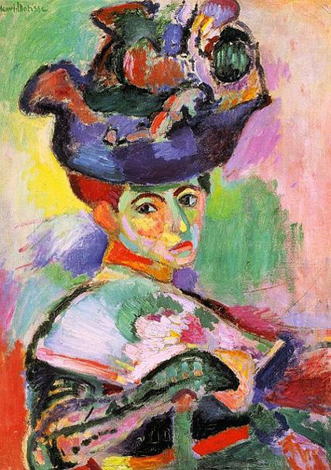
Notes:
Harold Gilman

Slide 9
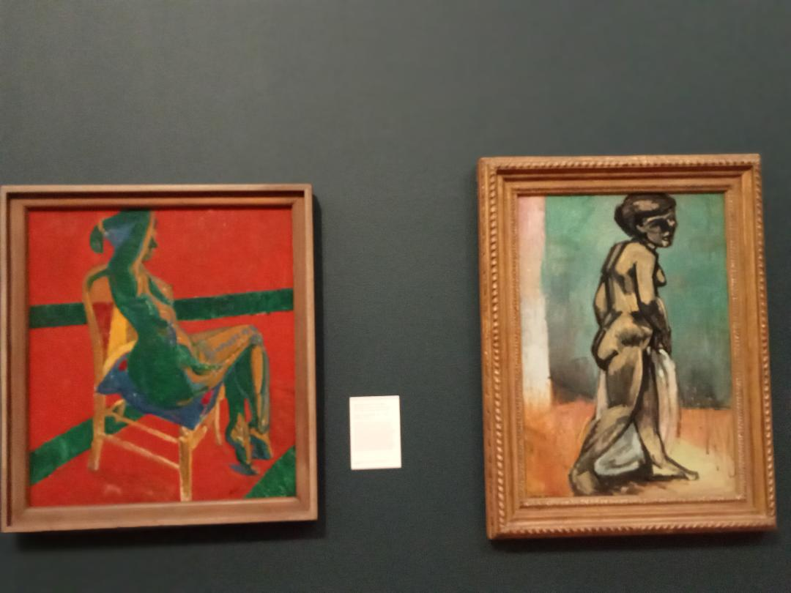
Notes:
Matthew Smith Nude Fitzroy st no 1

Slide 10
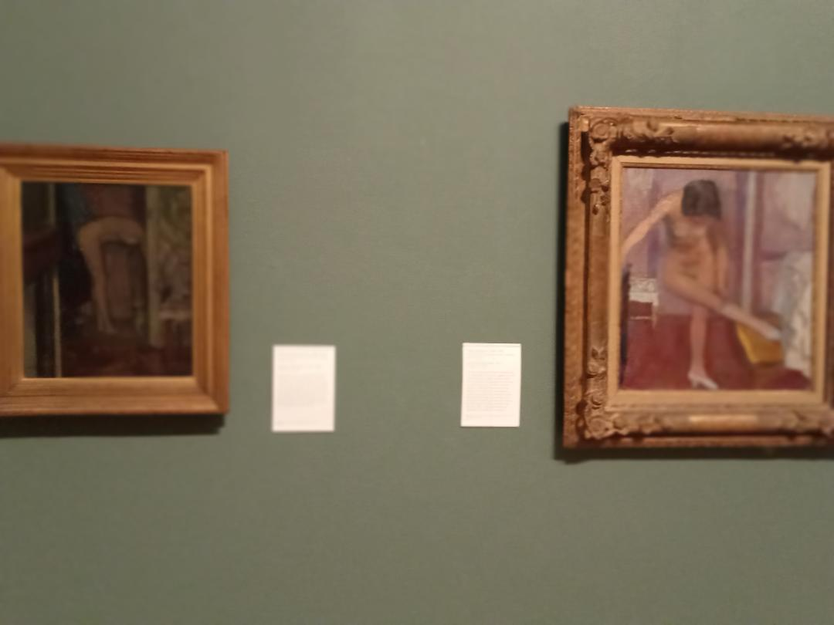

Slide 11
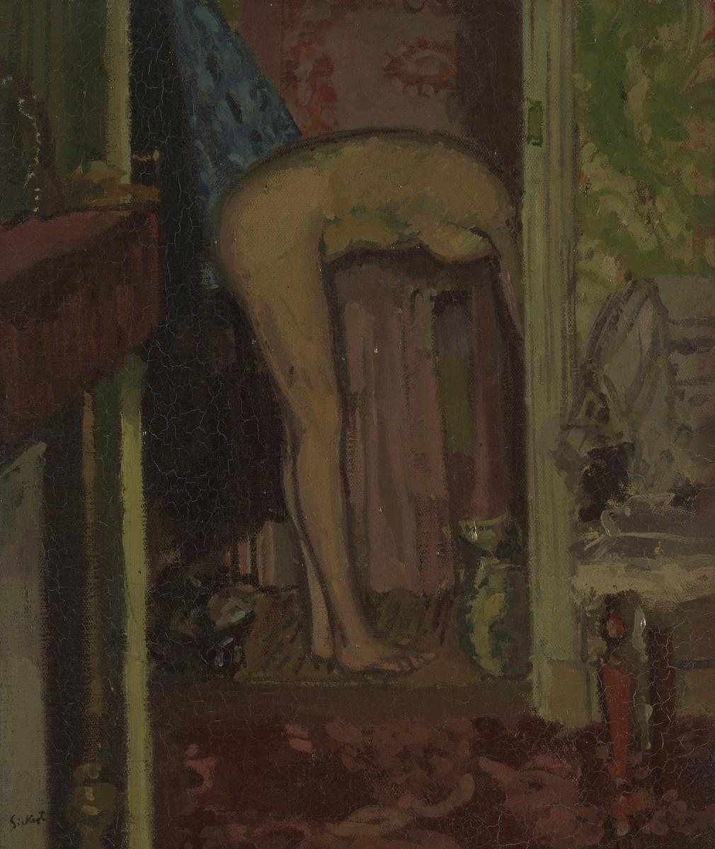
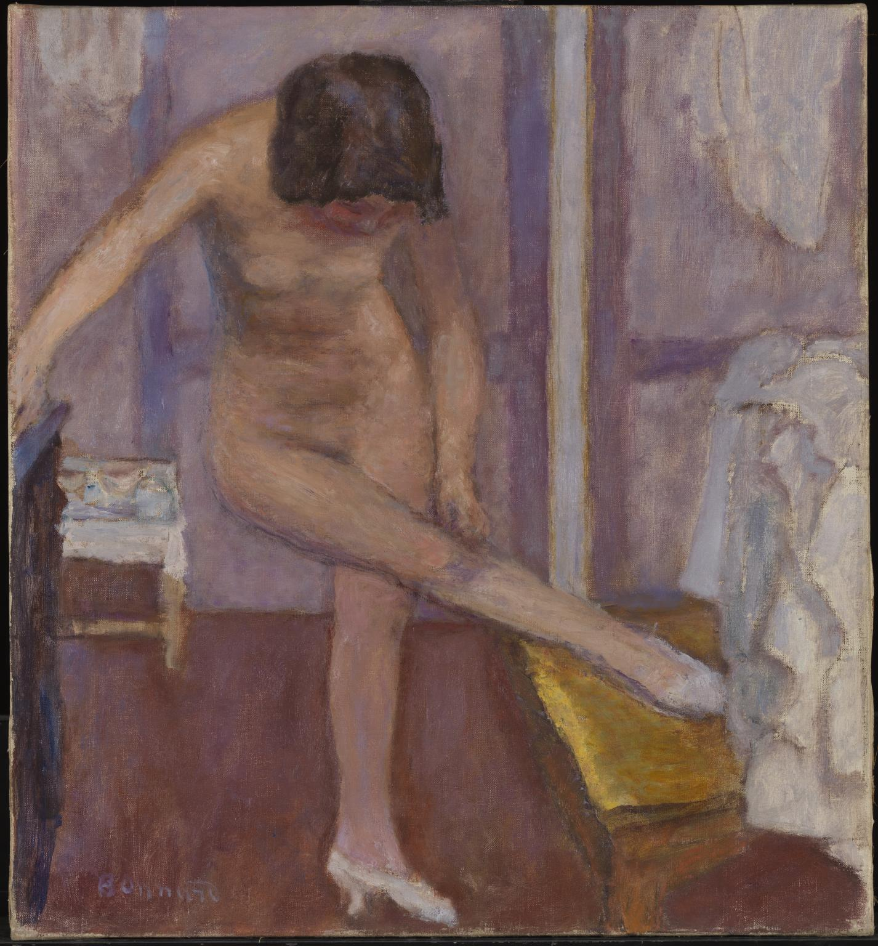

Slide 12
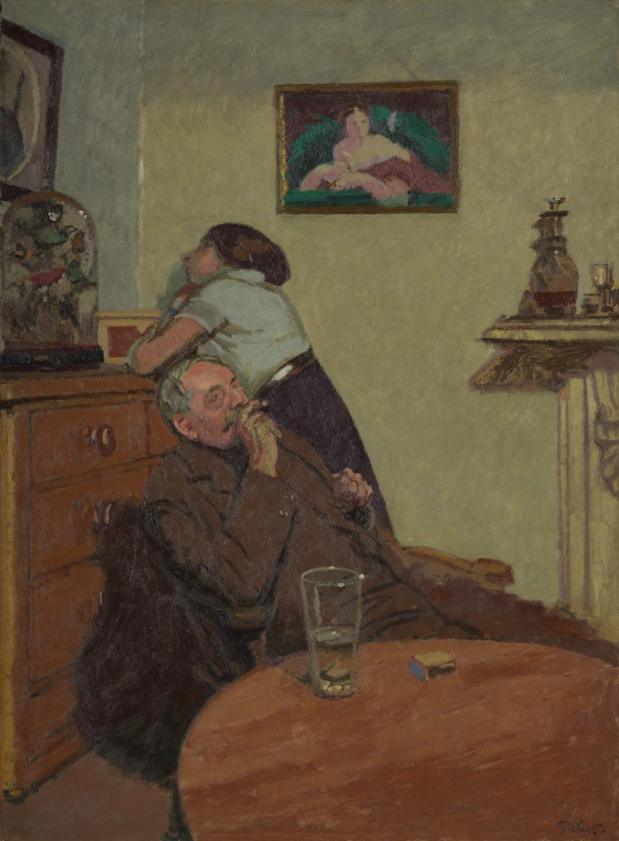
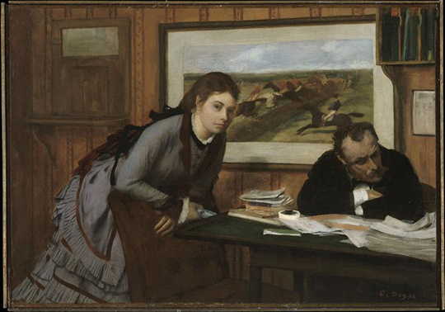
Notes:
Bouderie. Ennui

Slide 13
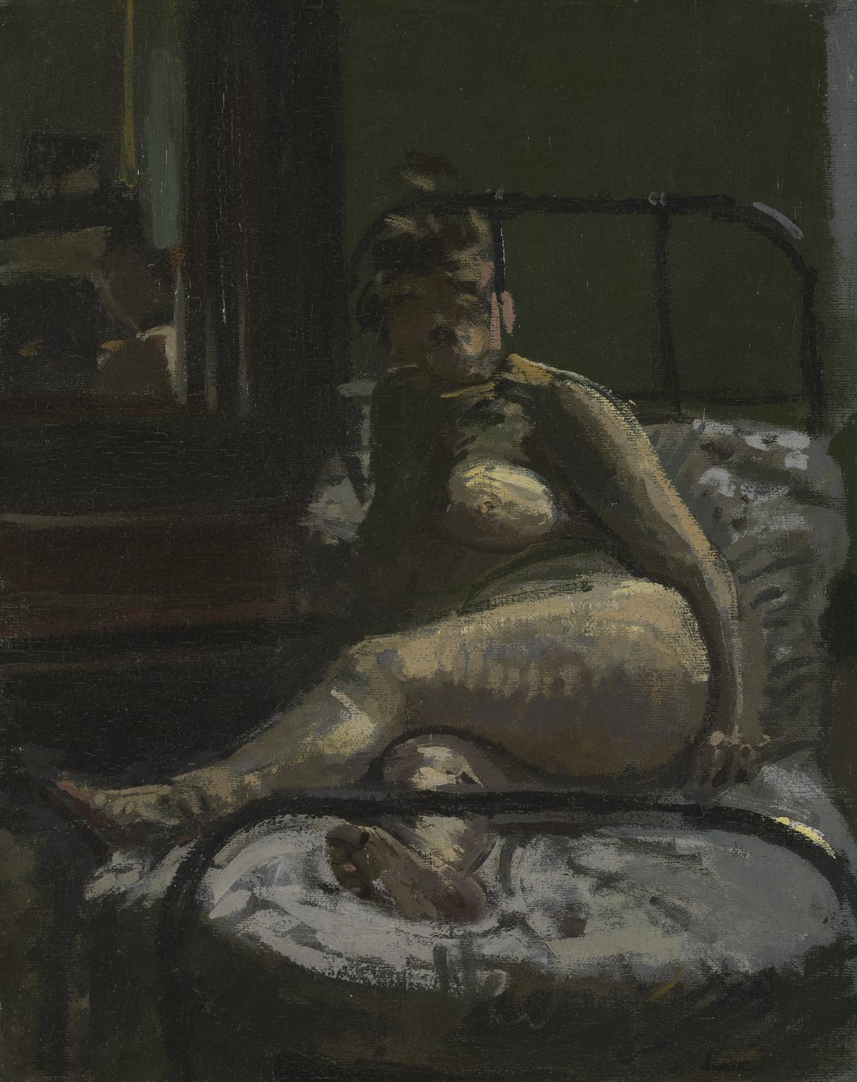
Notes:
La Hollandaise 1906

Slide 14
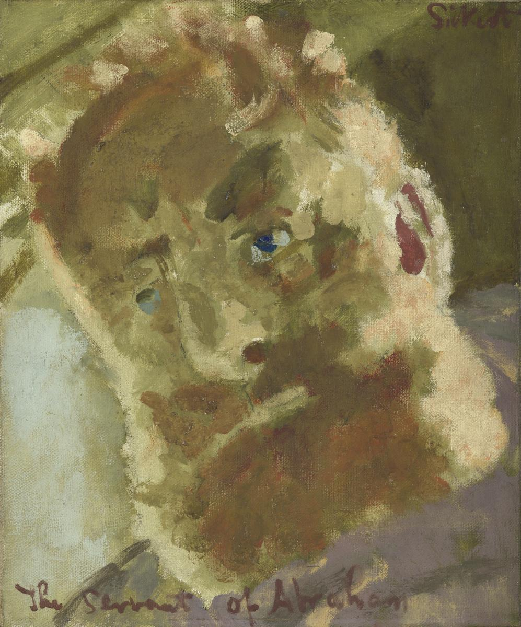
Notes:
Servant of Abraham 1929

Slide 15
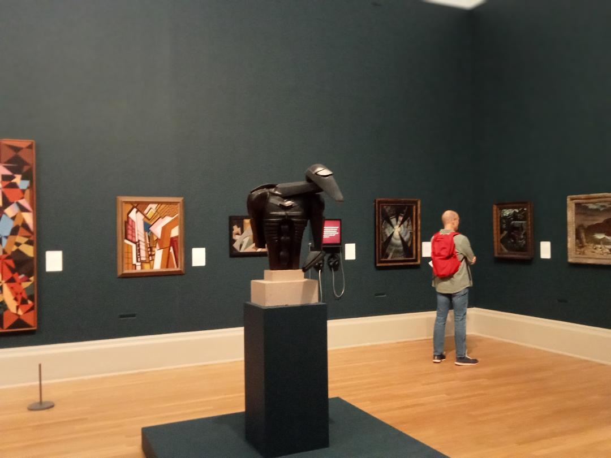

Slide 16
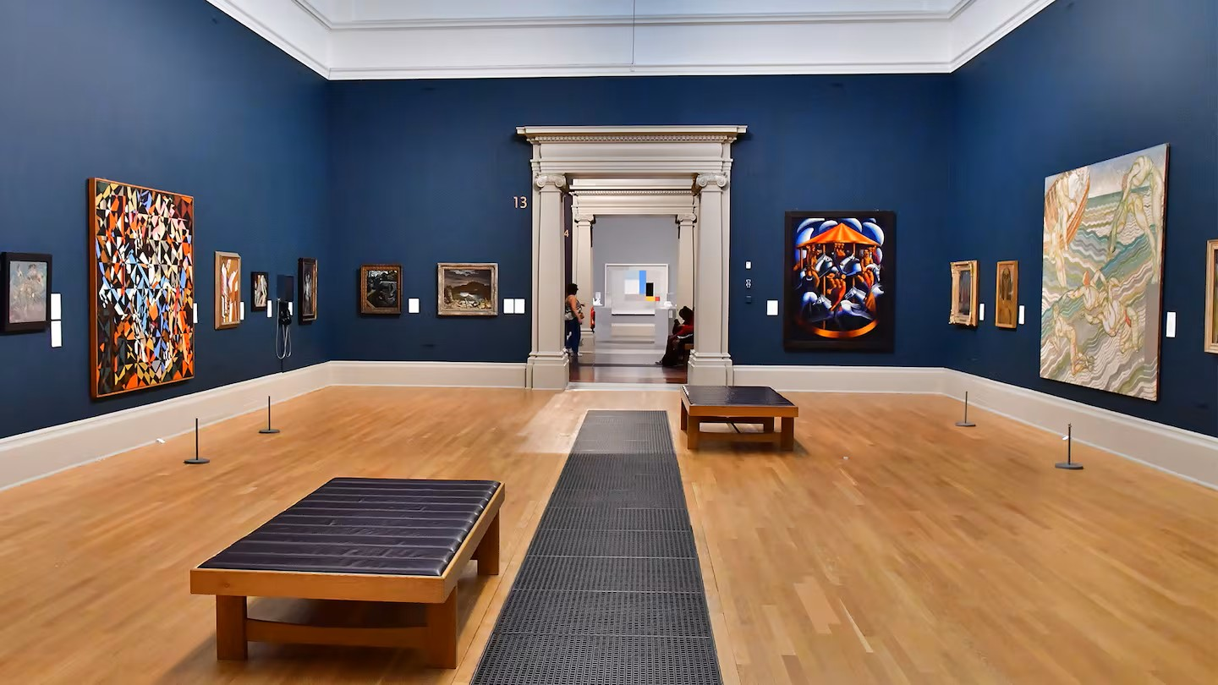

Slide 17
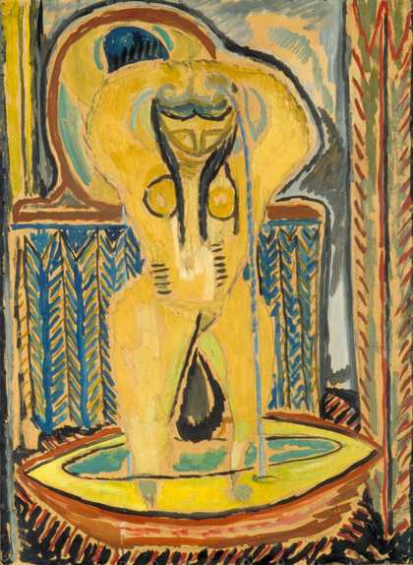
Notes:
Duncan Grant Tub 1913

Slide 18
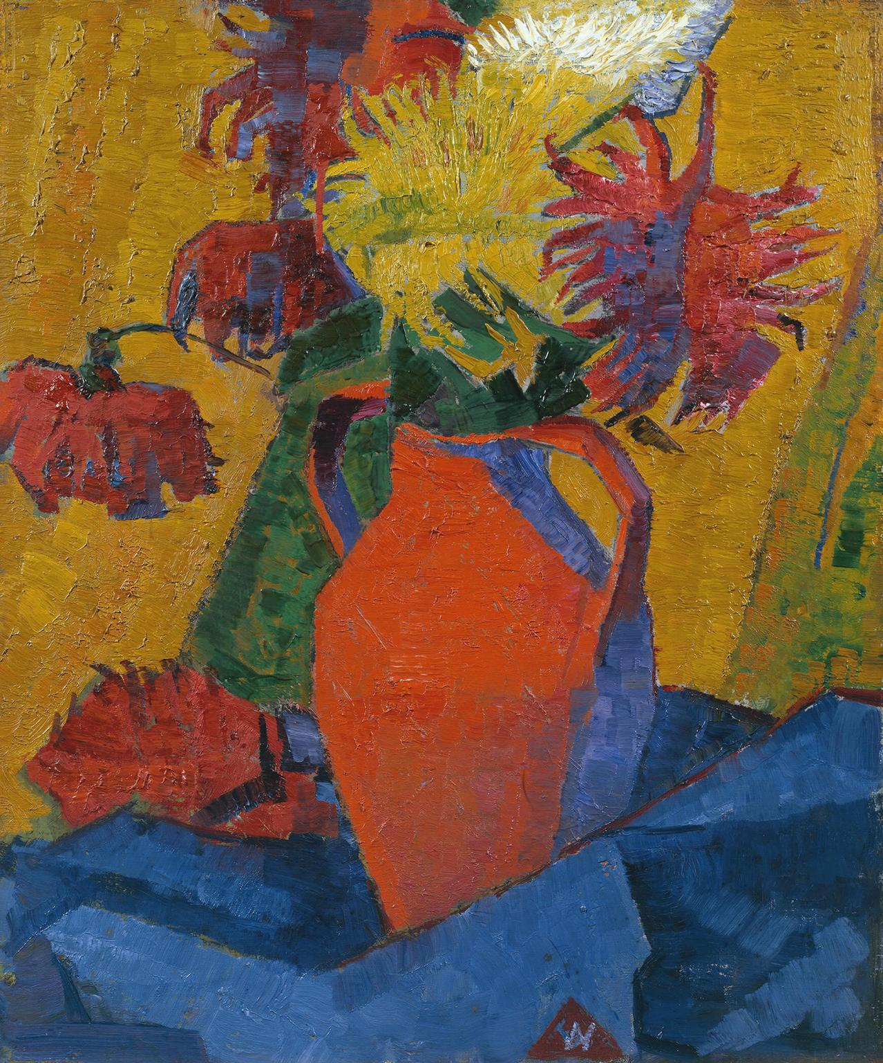
Notes:
Alfred Wolmark

Slide 19
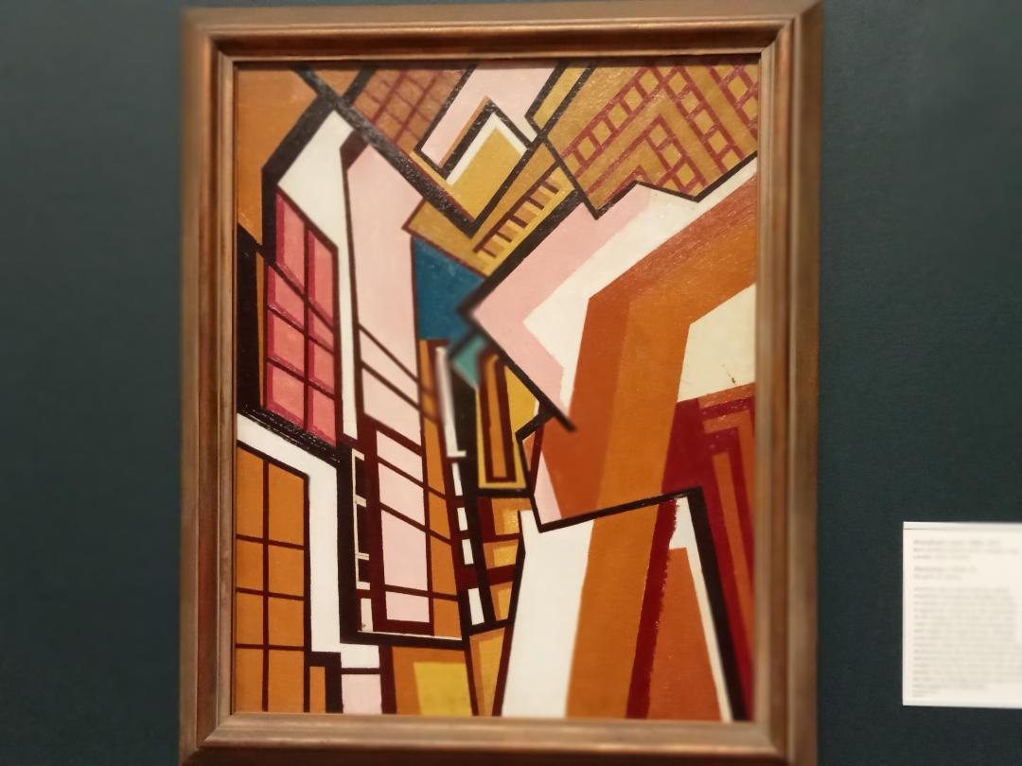
Notes:
Wyndham Lewis 1914-5 workshop later supporter of Hitler

Slide 20
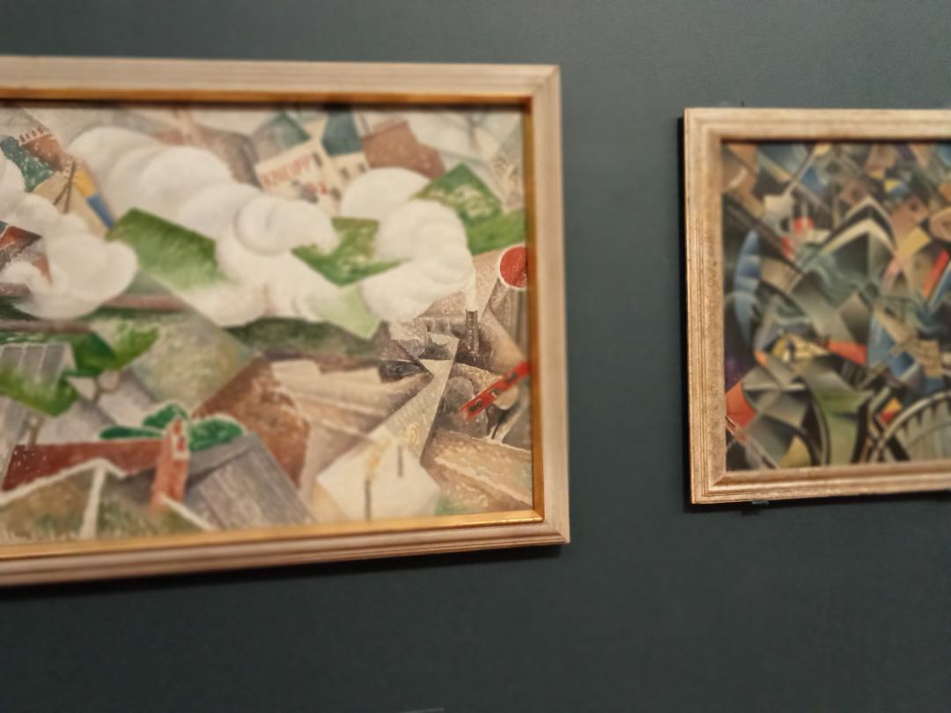

Slide 21
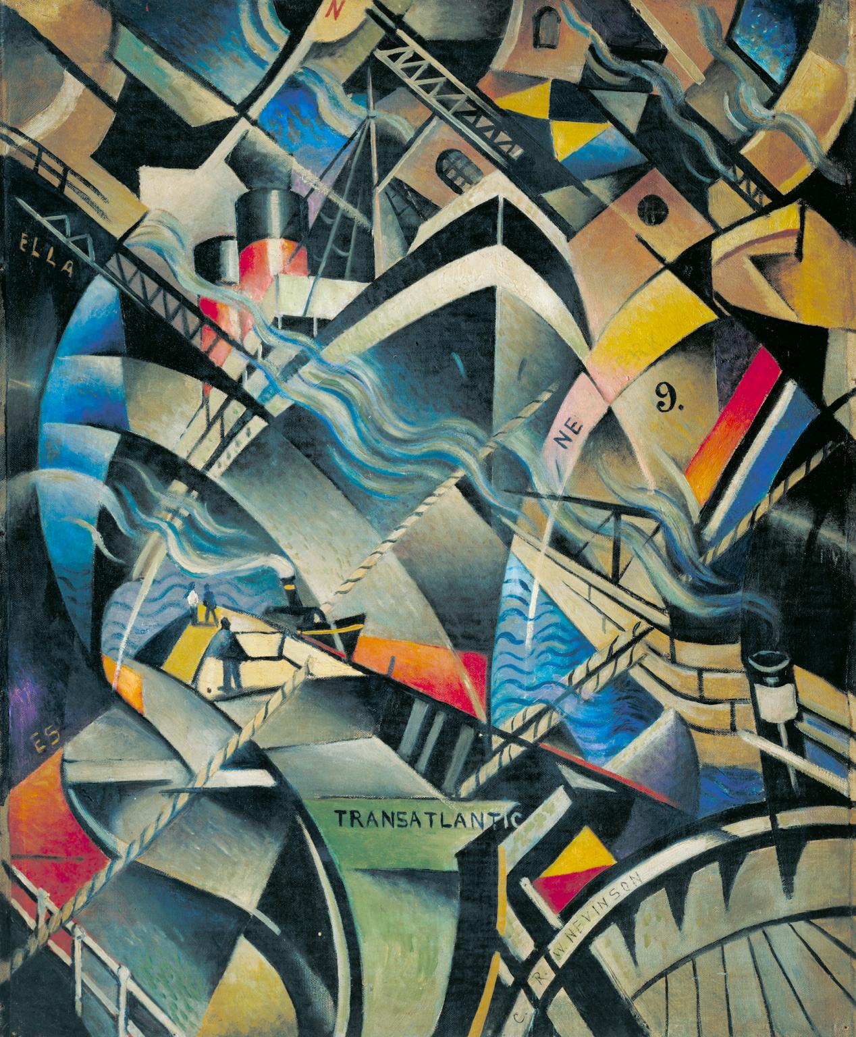
Notes:
Christopher Nevinson The Arrival 1913

Slide 22
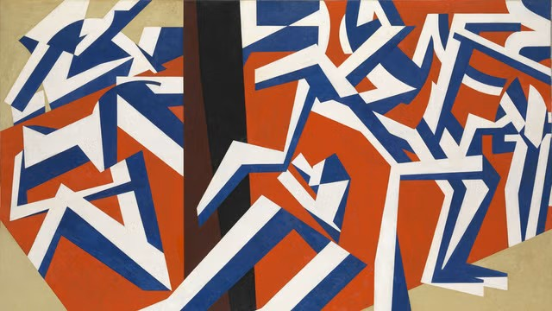
Notes:
David Bomberg the mud bath 1914. 19th C Jewish artists marginal

Slide 23
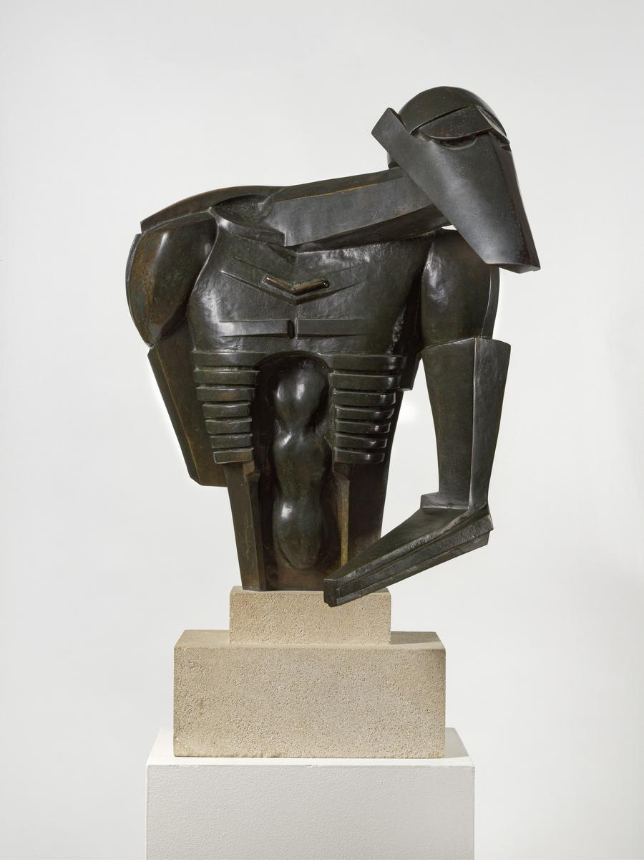
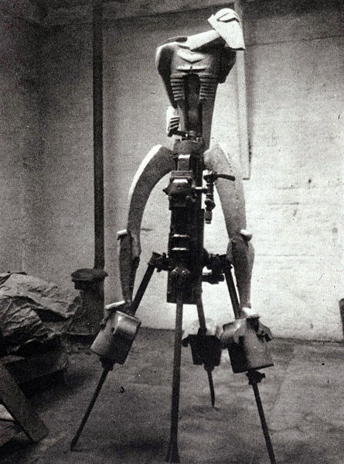
Notes:
Epstein Rock drill 1913

Slide 24
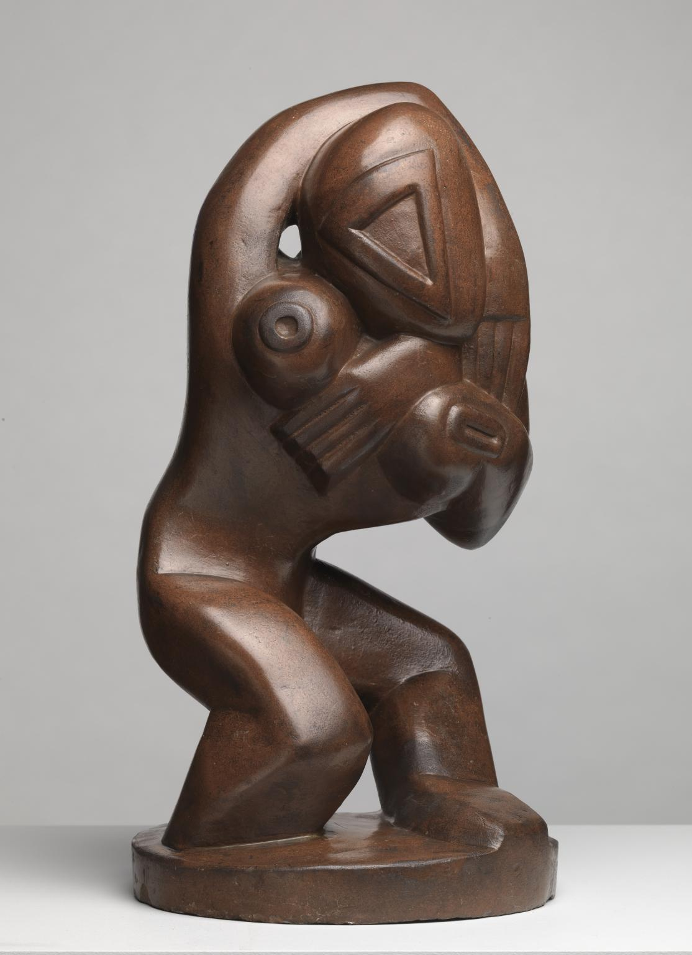
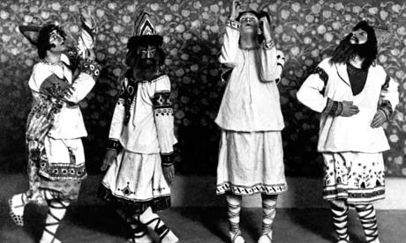
Notes:
Henri Gaudier Brzeska 1913 Same yr as Rite of Spring

Slide 25
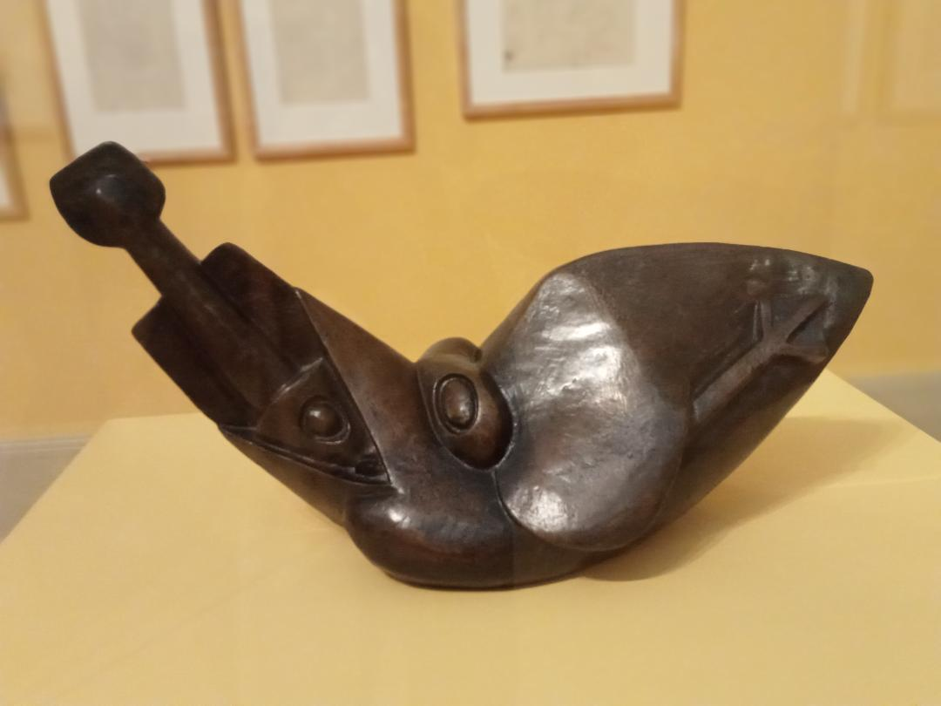
Notes:
Bird swallowing fish 1913-4

Slide 26
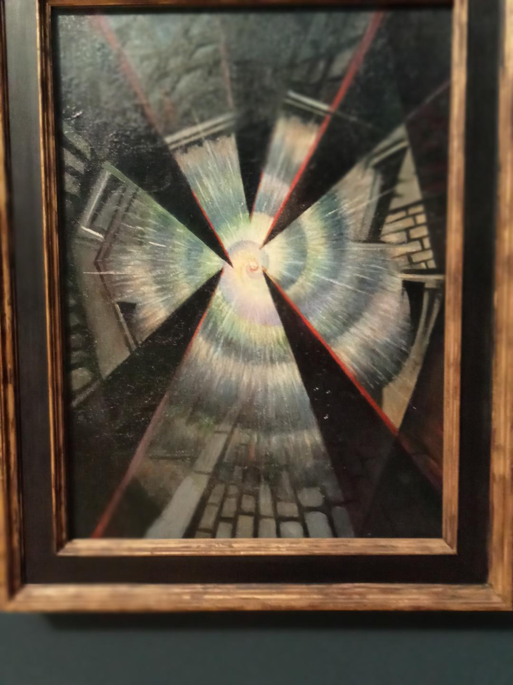
Notes:
Nevinson exploding shell 1916

Slide 27
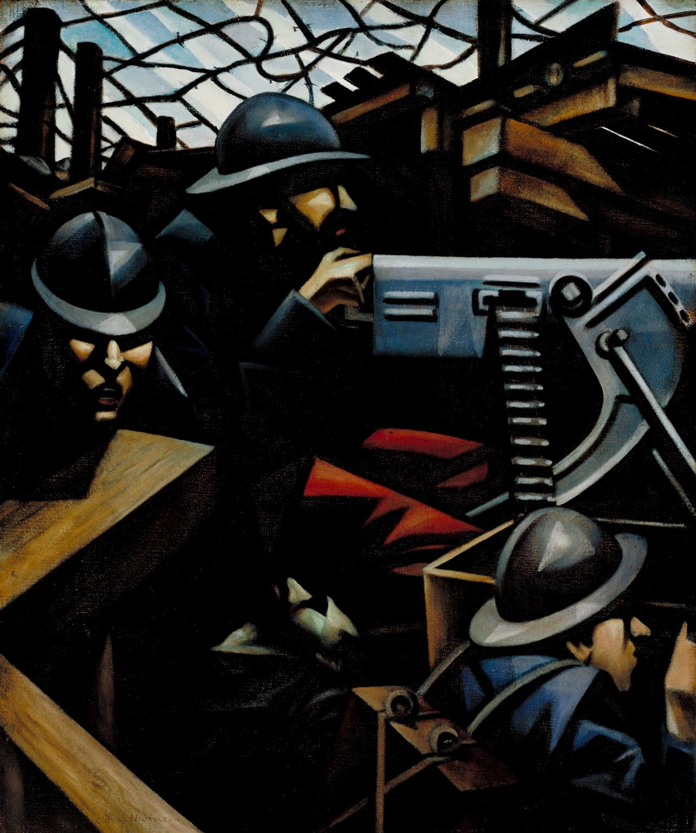
Notes:
La Mitrailleuse 1915

Slide 28
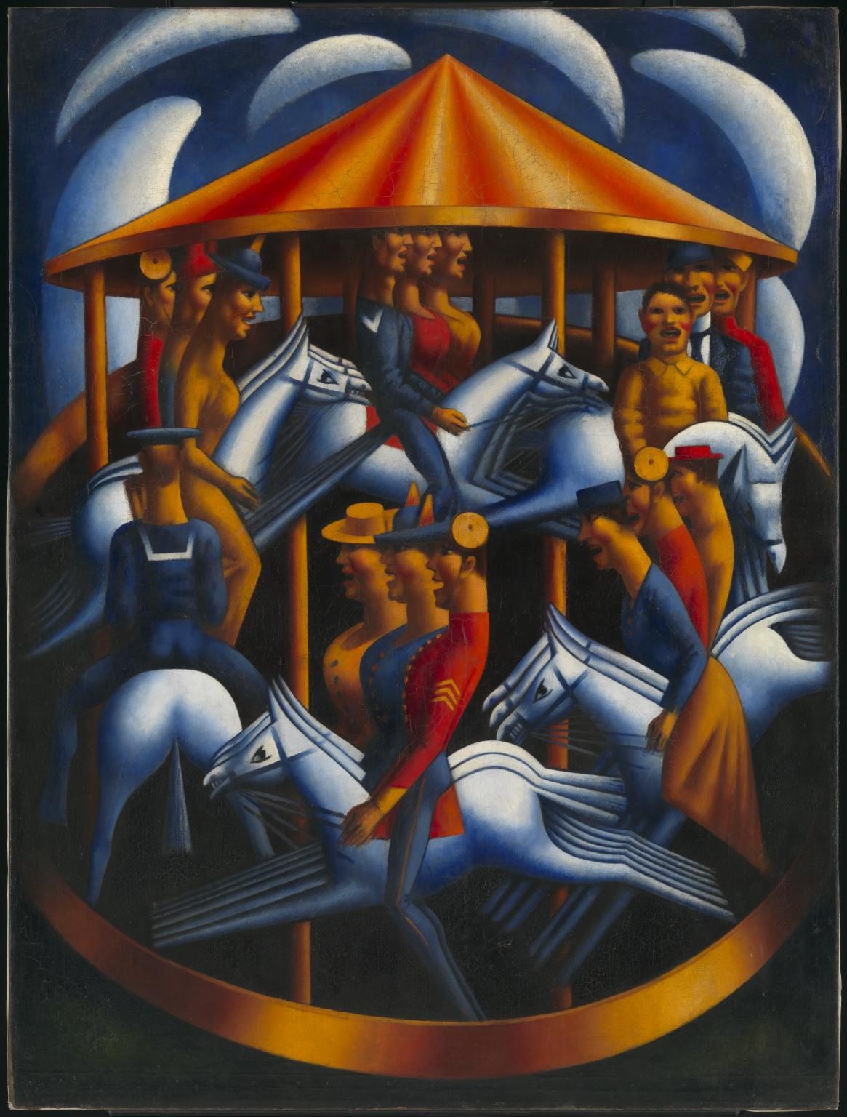

Slide 29
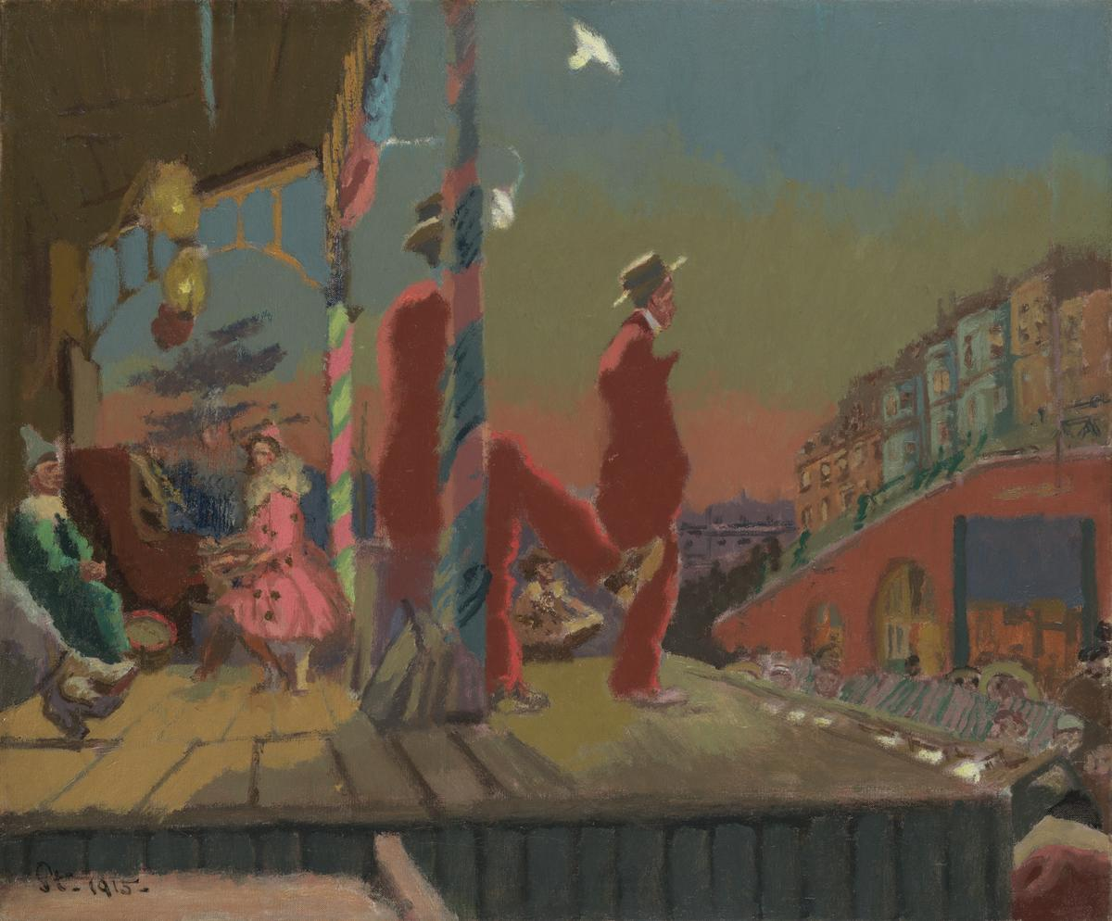
Notes:
Brighton Pierrots 1915 empty seats

Slide 30
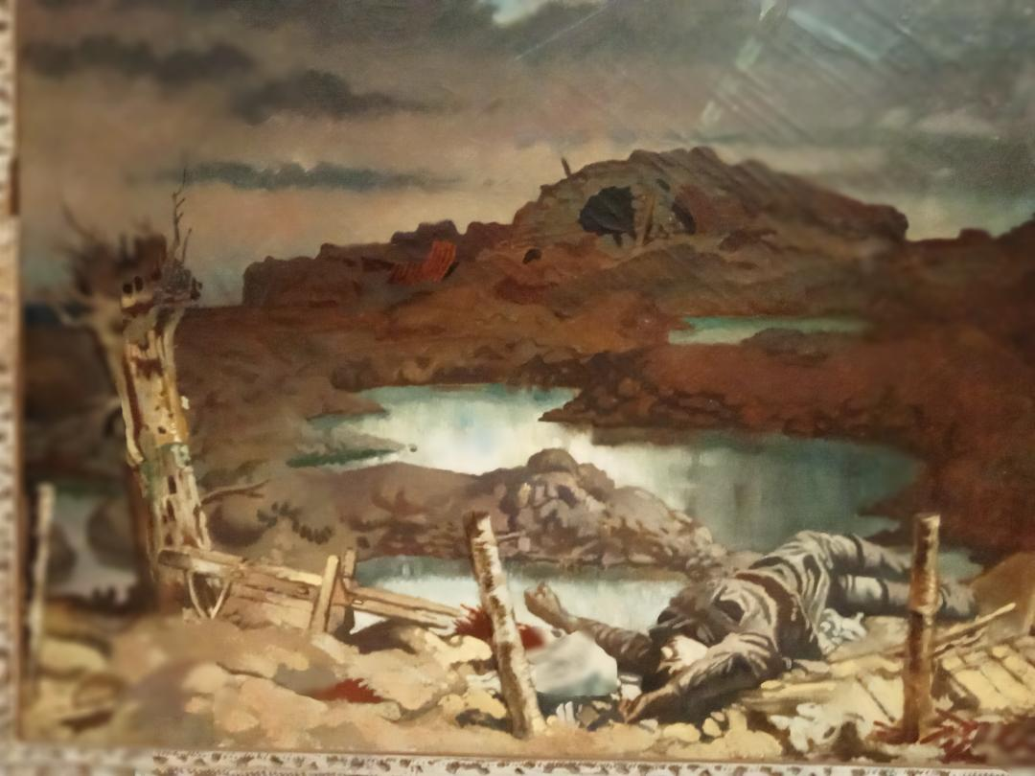
Notes:
Orpen 1918 Zonnebeke battle of Passchendaele

Slide 31
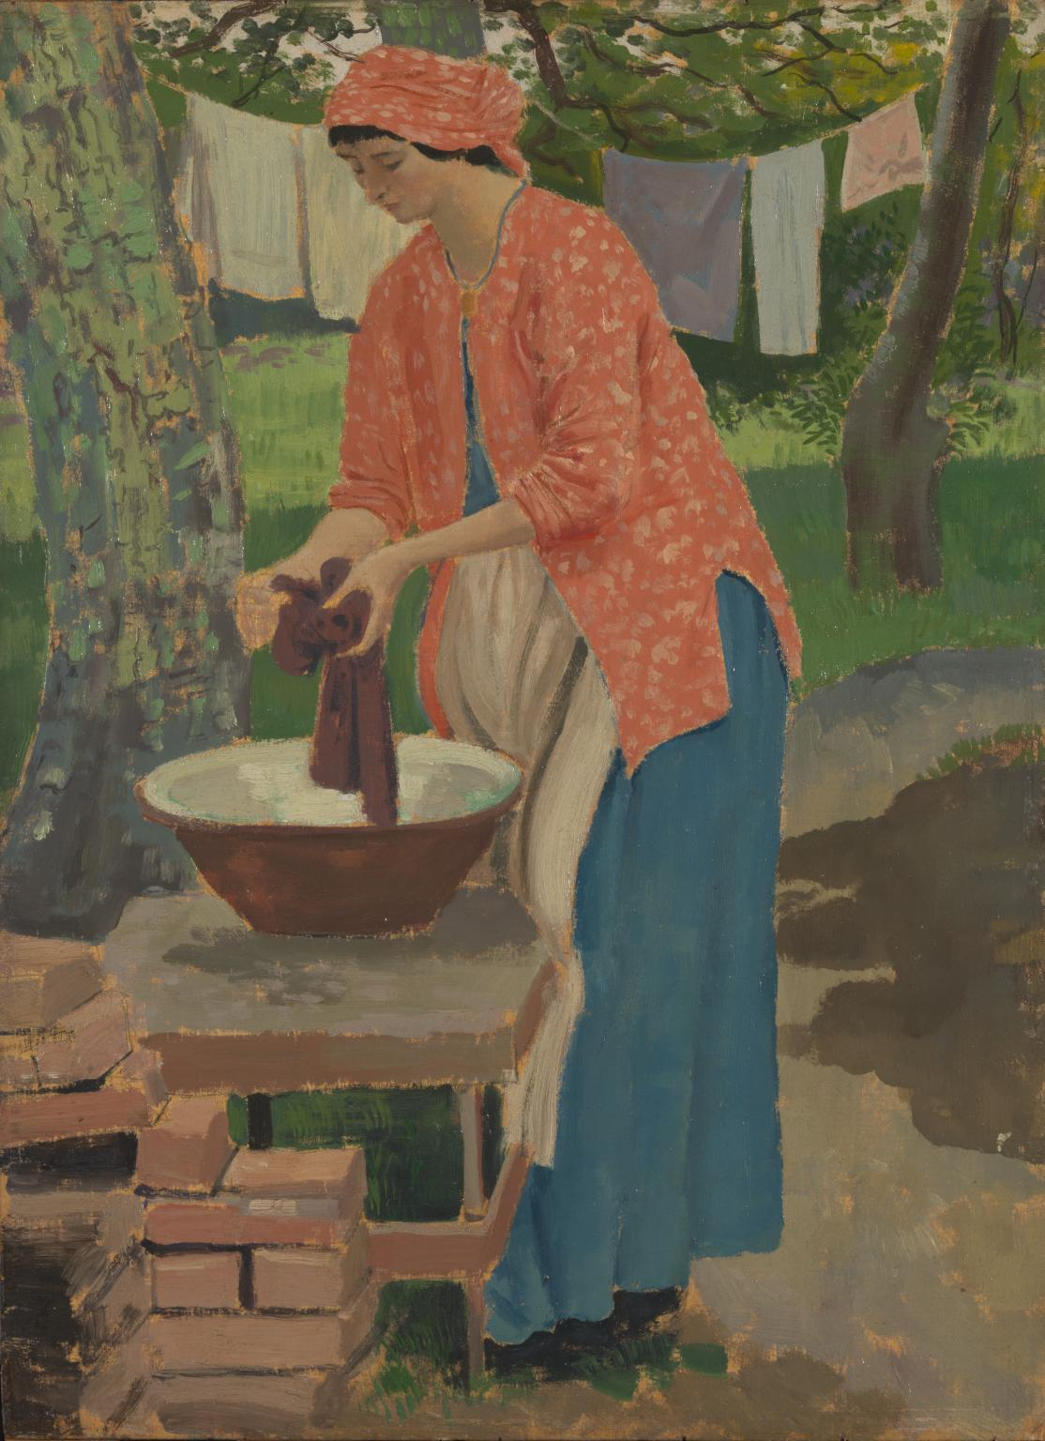
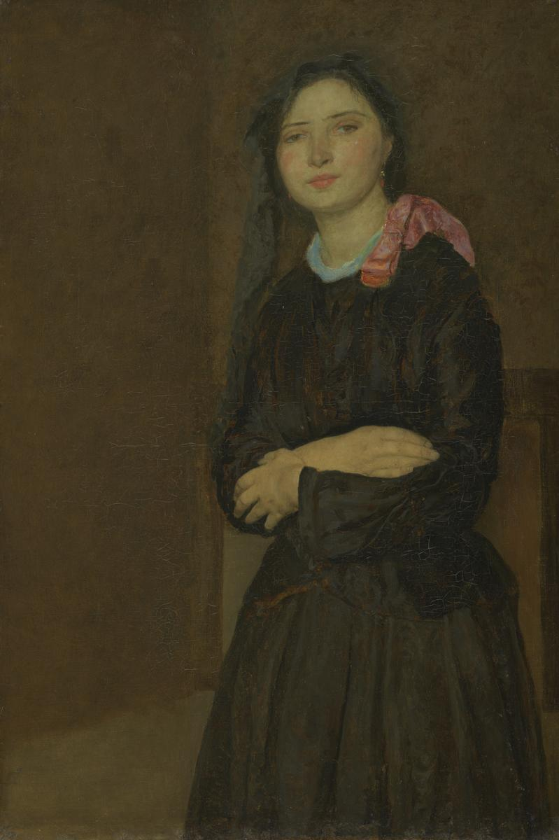

Slide 32
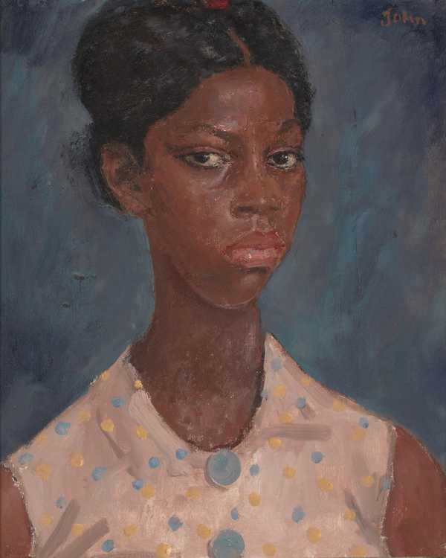
Notes:
Augustus John Jamaican girl 1937. didn’t bother to note names. Truculant and suspicious expression

Slide 33
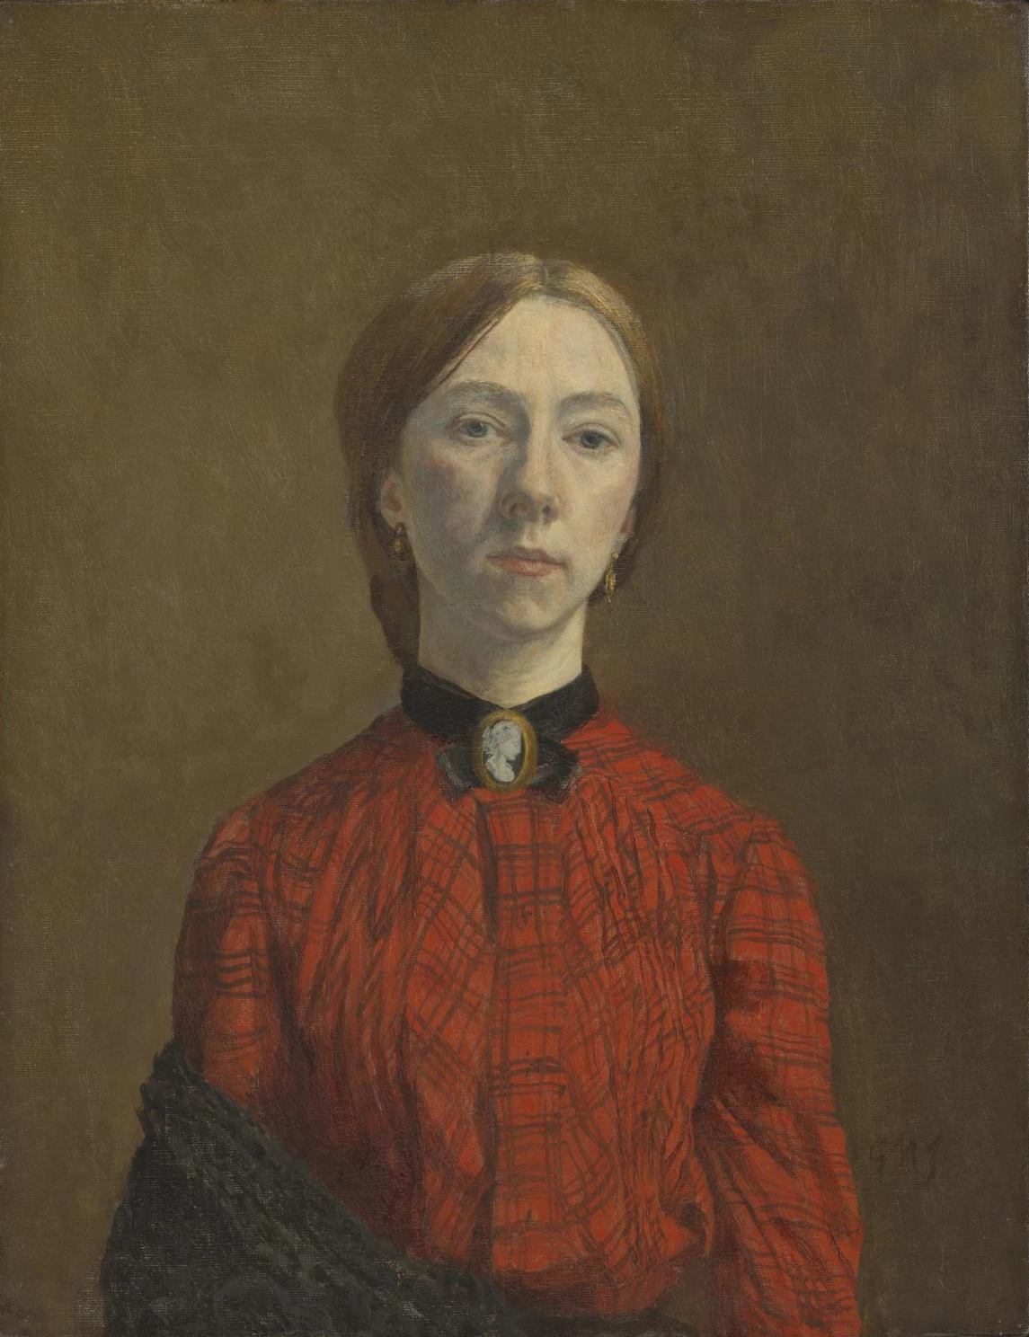

Slide 34
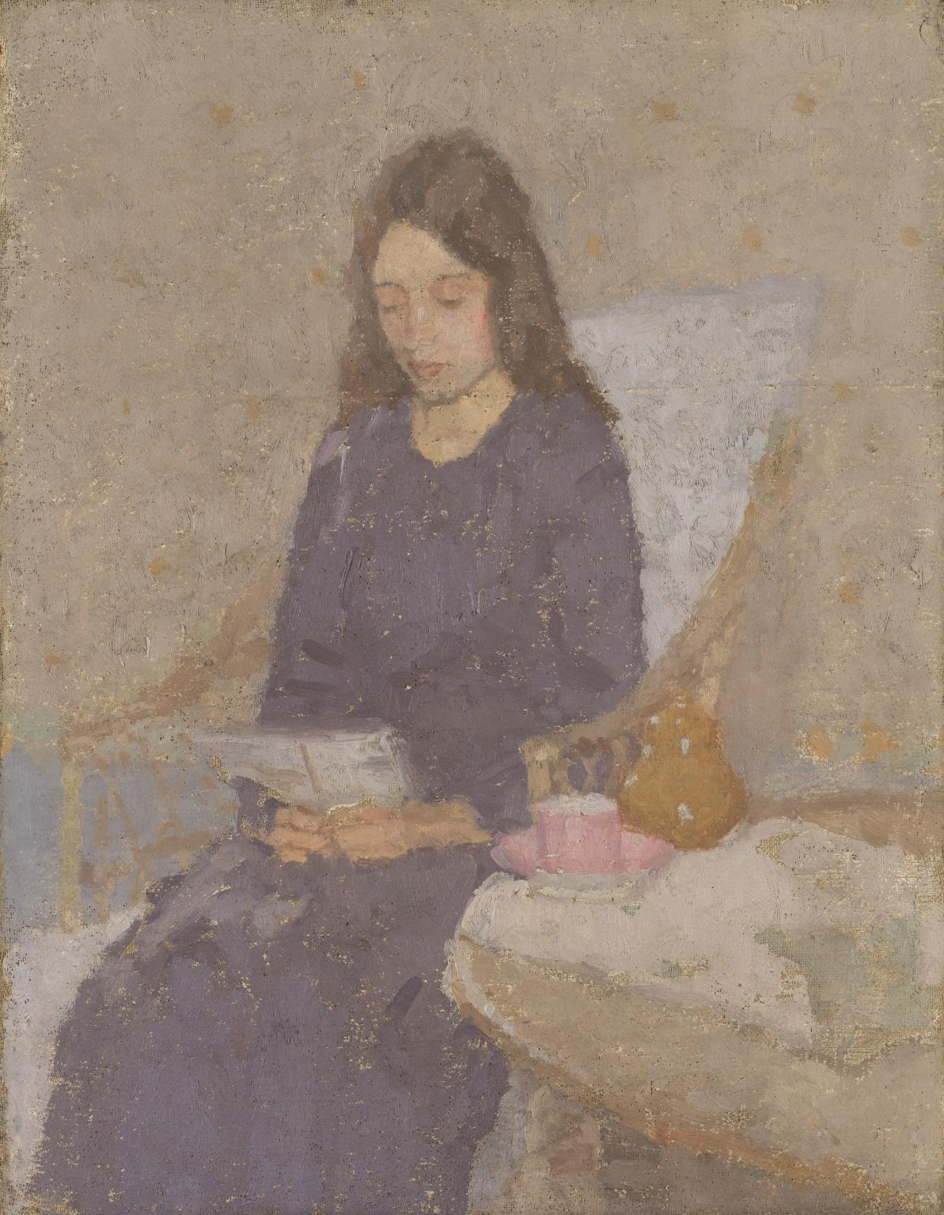

Slide 35
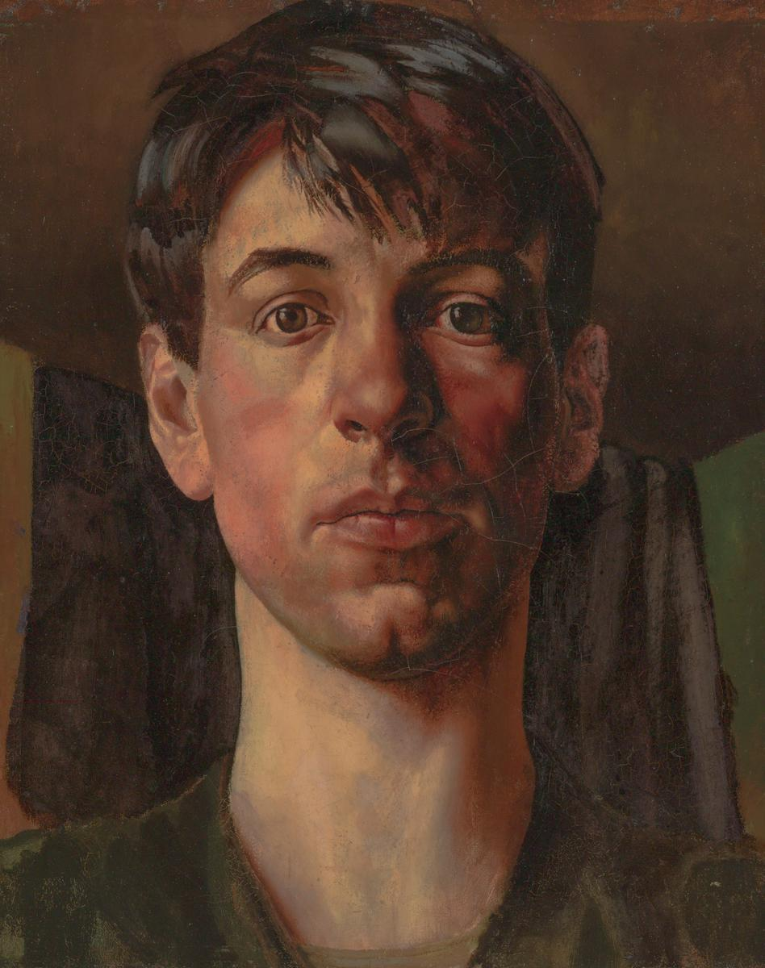

Slide 36
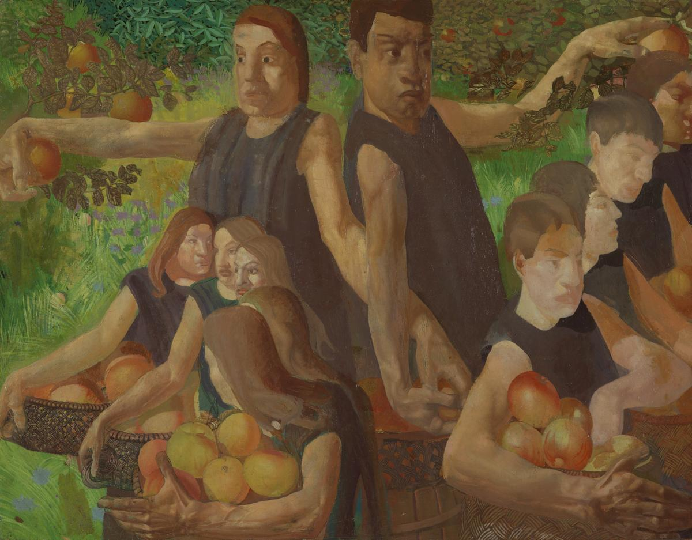

Slide 37
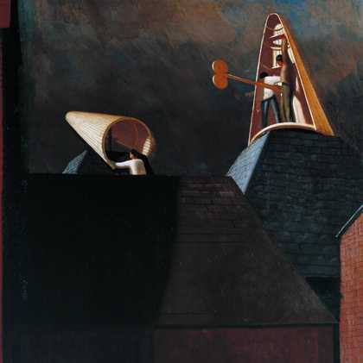

Slide 38
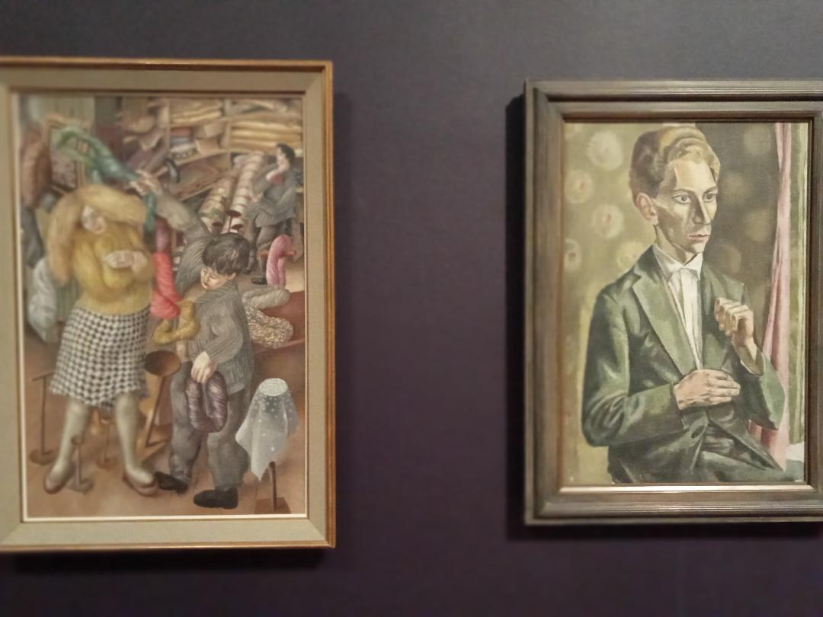

Slide 39

Notes:
Spencer wool shop 1939

Slide 40

Notes:
Infl of Max Beckman. Left day after Anschluss. Jewish on mother;s side

Slide 41

Notes:
Sexual love key to divine love. Church House scheme. Nave and side chapels

Slide 42


Slide 43


Slide 44


Notes:
Meredith Frampton Portrait of a young woman 1935

Slide 45


Slide 46

Notes:
Christopher Wood Zebra and parachute 1930

Slide 47

Notes:
Reuben Mednikoff December 31 1937 orthodox fam from Vitebsk

Slide 48

Notes:
Ithell Colquhoun Scylla 1933 sea scape or her own bdy

Slide 49

Notes:
Eileen Agar autobiography of an embryo 1933-4

Slide 50

Notes:
Paul Nash equivalents for the megaliths 1935

Slide 51

Notes:
Totes Meer 1940-41

Slide 52


Slide 53

Notes:
Ben Nicholson June 1937

Slide 54

Notes:
Barbara Hepworth 3 forms 1935

Slide 55


Slide 56


Slide 57


Slide 58


Slide 59


Slide 60

Notes:
Bacon 1972 figs taken from Muybridge, George Dyer suicide 1971 wrestling

Slide 61


Slide 62

Notes:
Moore Mother and Child 1953 menacing

Slide 63

Notes:
Moore woman 1957 inspired by pre historic emphasing fertility

Slide 64

Notes:
Antony Caro

Slide 65



Slide 66


Slide 67


Slide 68


Slide 69

Notes:
Bigger splash 1967 painted very slow delib acrylic

Slide 70

Notes:
Chris Ofili No woman no cry 1998

Slide 71


Slide 72


Slide 73

Notes:
Saatchi.

Slide 74


Notes:
Hans Haacke Institutional critique, cance Saatchi llation of show at Guggenheim Slum landlords sponsors

Slide 80


Slide 81


Slide 83


Slide 84


Slide 85

Notes:
Ginner Café Royal 1911

Slide 86


Slide 87


Slide 88


Slide 89


Slide 90


Slide 91


Slide 92


Slide 93


Slide 94


Slide 95


Slide 96


Slide 97


Slide 98


Slide 99


Slide 100


Slide 101


Slide 102


Slide 103


Slide 104


Slide 105


Slide 106


Slide 107


Slide 108


Slide 109


Slide 110


Slide 111


Slide 113


Slide 114


Slide 115


Slide 116


Slide 117


Slide 118


