Slide 1
Intelligent Customer Support Bot_

Slide 2
What Is YoAssist?
A customer support module, making Business-Client communication possible without a need of
Sales Representative

Slide 3
How It Works?
It works similar to live chat, with only difference of no sales executive handling clients.
It would hunt best suitable answers from prefix directory that seem as real as by a human.

Slide 4
Features
Intuitive interface that speaks multiple languages
FAQ like or dislike
Leave comment feature
Add or edit FAQs
Related FAQs section
Smart FAQ script for fast reply
7. CSV Upload feature
8. Automatic Reply on Comment
9. Domain specific script
10. Category & tags add/edit
11. Script to display FAQ box
12. Google analytics report

Slide 5
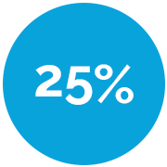
Why YoAssist
Engage audience through engaging answers. YoAssist makes them feel attended, involved, and lets them contribute, which in turn increases participation.
With YoAssist on can experience up to:
Reduction
in contact center volume
Uplift
in conversion

Slide 6
How It’s Useful To A Business?
To automates a standard workflow for customers’ query resolution
To provide outclass customer service
Flawless Integration, full control, no compromises
All data remains on your server
No Subscription, no running expenses
To reduce expense of hiring an in-house customer representative

Slide 7
Why Is It Required?
Help those who need it
Get in touch with people on your website and point them in the right direction.
See how good you’re at customer service
Answer like or dislike feature lets you constantly improve the quality of your support.
Cases resolved on the spot
8 out of 10 times cases are resolved by YoAssist.

Slide 8
It does the heavy lifting email can’t handle
Get rid of long queues and surprise customers with instant answers.
Make customers checkout
Stop losing customers by guiding them as soon as difficulties arise.
Bring more revenue
Chat-Bots leads bring in additional $65000 of business each month.
Available 24x7
Make your virtual customer representative available round-the-clock.

Slide 9
Chatbots Can Reduce Cost of Customer Care by up to 29%
Business Insider Intelligence suggests that significant savings can be achieved in customer service when Chatbots (and other tech) are deployed.
“Chatbots have the potential to help businesses significantly cut labor costs. While complete automation of the customer service workforce is not feasible, automating customer management and sales positions in the US where possible through Chatbots and other automation technologies would result in considerable saving,” BI Intelligence.

Slide 10
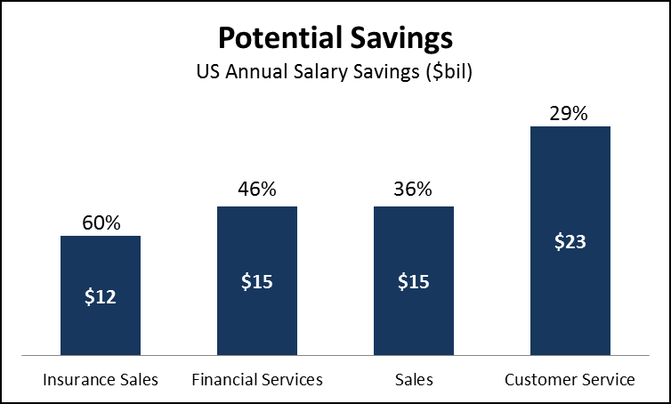
A potential savings of $23 billion can be achieved in the U.S. as Chatbots have the potential to automate 29% more of the tasks done by customer support staff today.

Slide 11
The Industries YoAssist is Beneficial For?
It’s benefits are not limited to a specific industry or field, but YoAssist brings great benefits for sectors including:
E-commerce
Product Development
Publication
Software Design & Development
Healthcare Industry
Educational Platforms
Skilled professionals
8. Training Institutes
9. Communication
10. Beauty & Skincare
11. Automobile
12. Movers & Packers
13. Travel Industry
14. Comfort Solution Providers
The list never ends…

Slide 12
Details Required For New Customers’ Account Creation
Customer Name
Professional Email
Website URL
Password
Contact Number

Slide 13
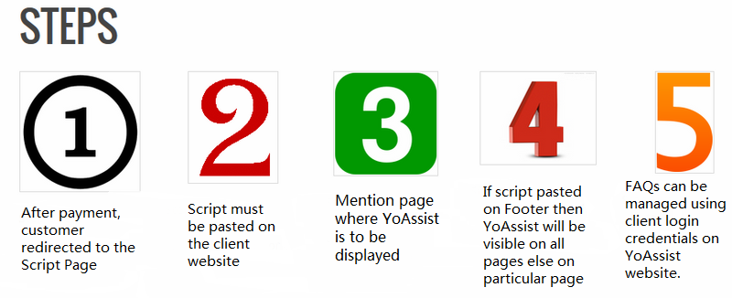
Steps For Usage & Maintenance
After payment process, customer gets redirected to the ‘Script Page’.
Script must be pasted on the client’s website.
Mention page where YoAssist is to be displayed
If script is pasted on Footer then the YoAssist will be visible on all pages else on particular page
FAQs can be managed edited or deleted using client login credentials on ‘YoAssist’ website.

Slide 14
How It’s Better Than competitors?
NanoRep
http://nanorep.com/
Pandora Bots
http://www.pandorabots.com/
Customizable
Speech Interface
Deploy in any application
Multi-lingual
Programed to remember user details
Free
YoAssist
Multiple languages
FAQ like or dislike
Leave comment feature
Add or edit FAQs
Related FAQs section
Smart FAQ script for fast reply
CSV Upload feature
Automatic Reply on Comment
Domain specific script
Category & tags add/edit
Script to display FAQ box
Google analytics report
Customer self service
NLP technology
Knowledge management
Analytics about common queries
Admin dashboard
Multi-lingual
Smart channeling
Agent self service

Slide 15
Marketing Strategy, For Better Presence
Social Media Optimization
Blog Submission
Classified Ads
Video Sharing
Social Bookmarking
Email Campaign
Telemarketing
Pay-per-Click Ads
Article Submission
Business Listing
Question/Answer
Image Sharing
Visit Here:
http://yoassist.com/

