Slide 1
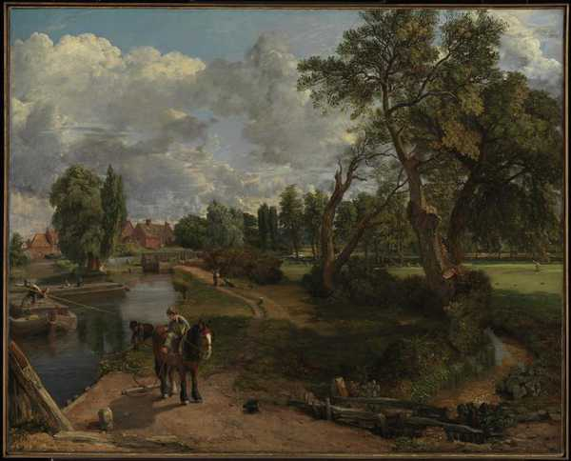
Notes:
Flatford Mill 1817

Slide 2
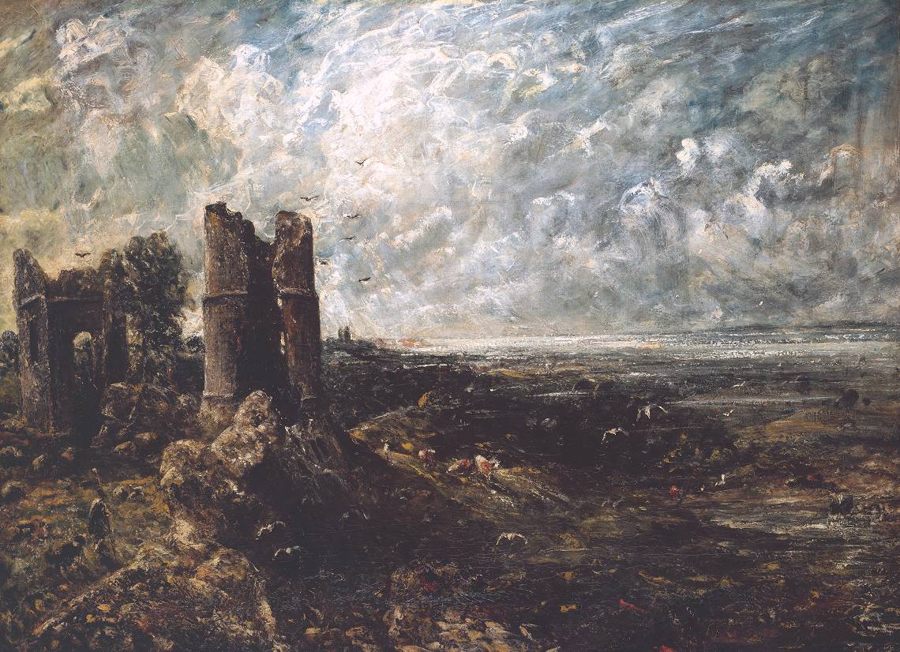
Notes:
Hadleigh Castle 1828

Slide 3
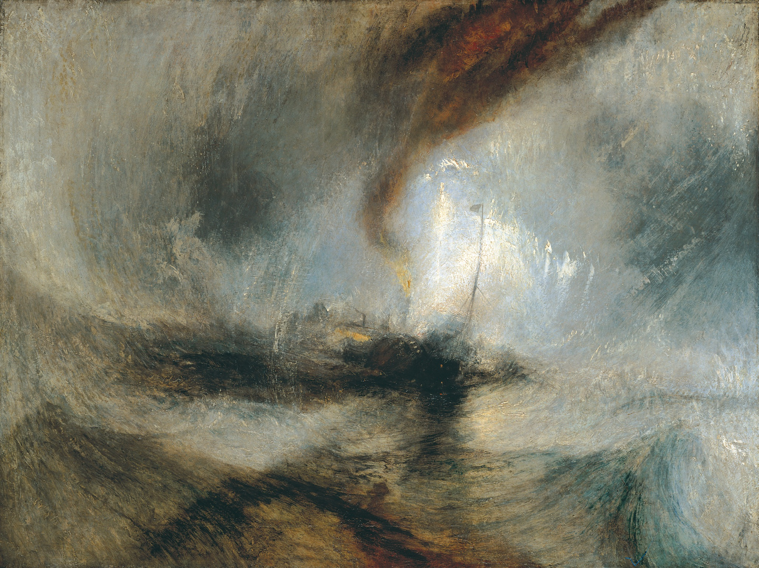

Slide 4
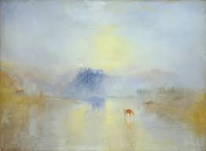
Notes:
Norham Castle sunrise 1845

Slide 5
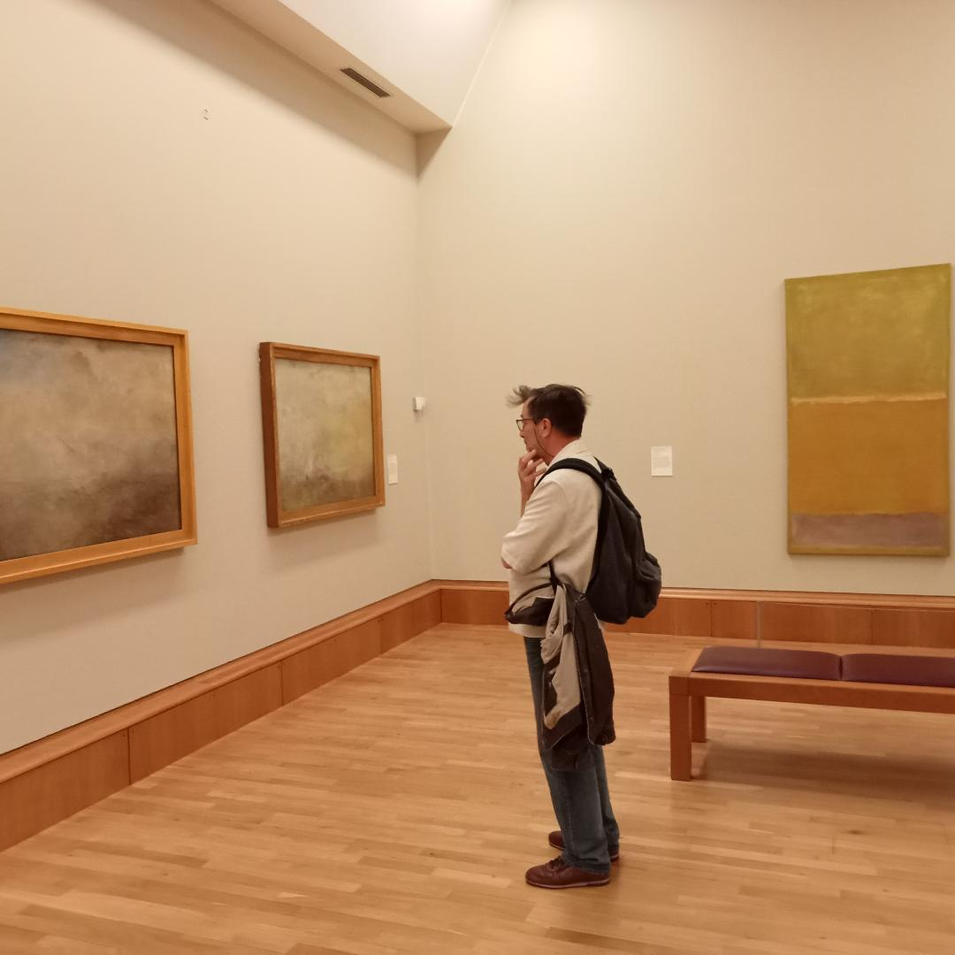

Slide 6
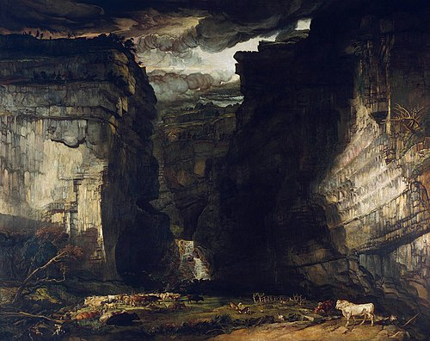

Slide 7
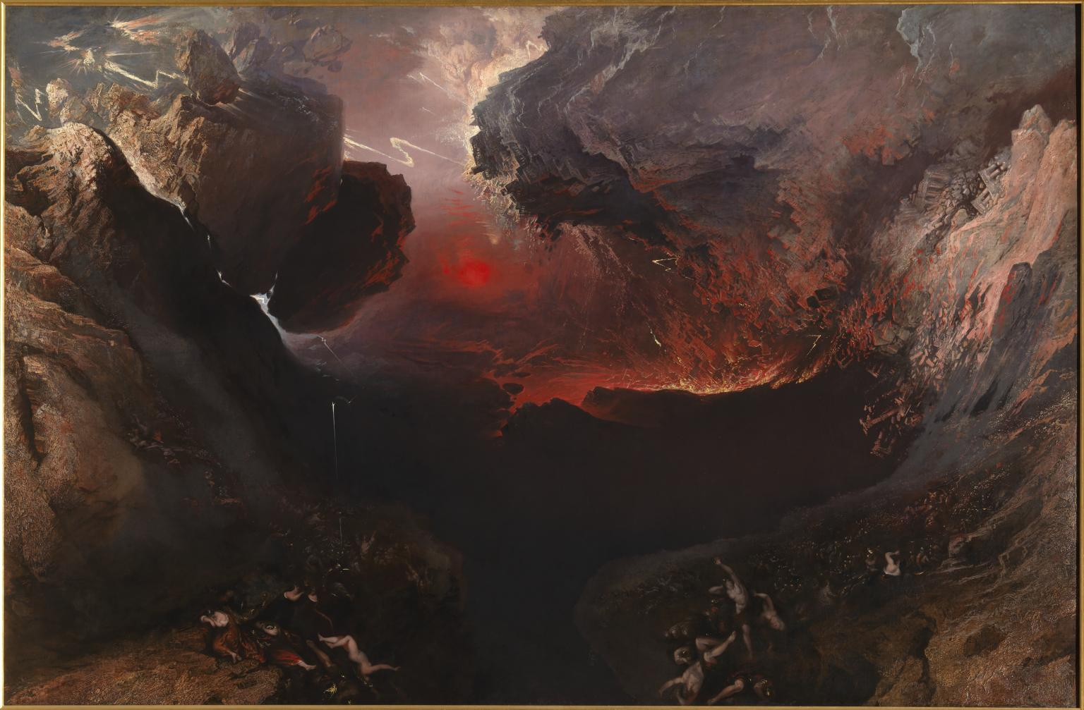

Slide 8
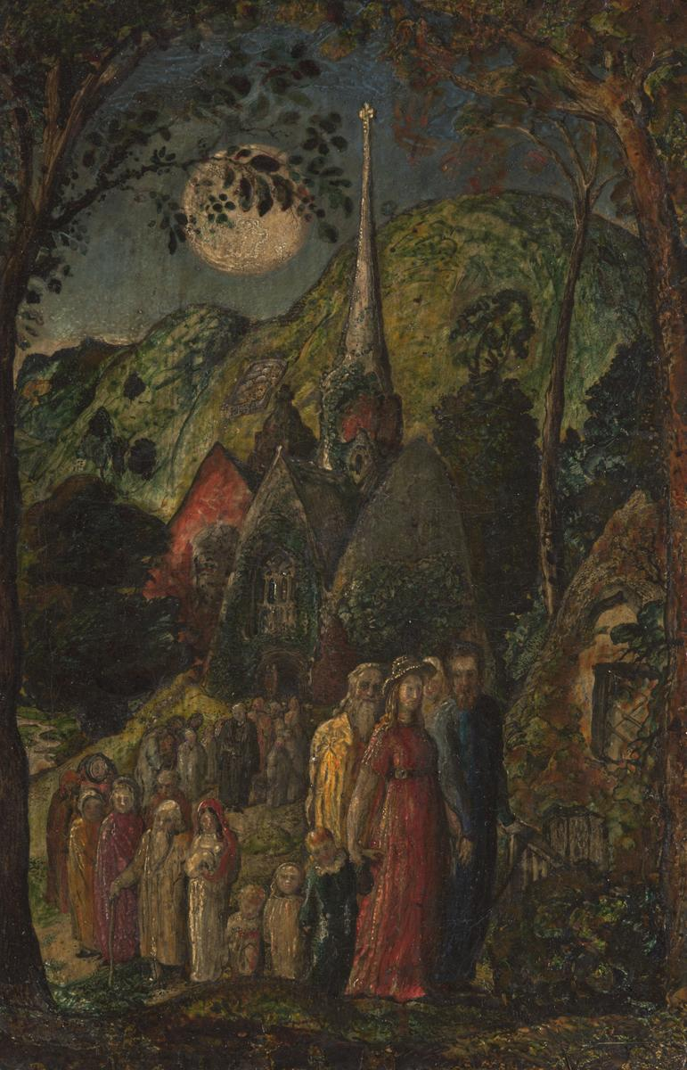

Slide 9
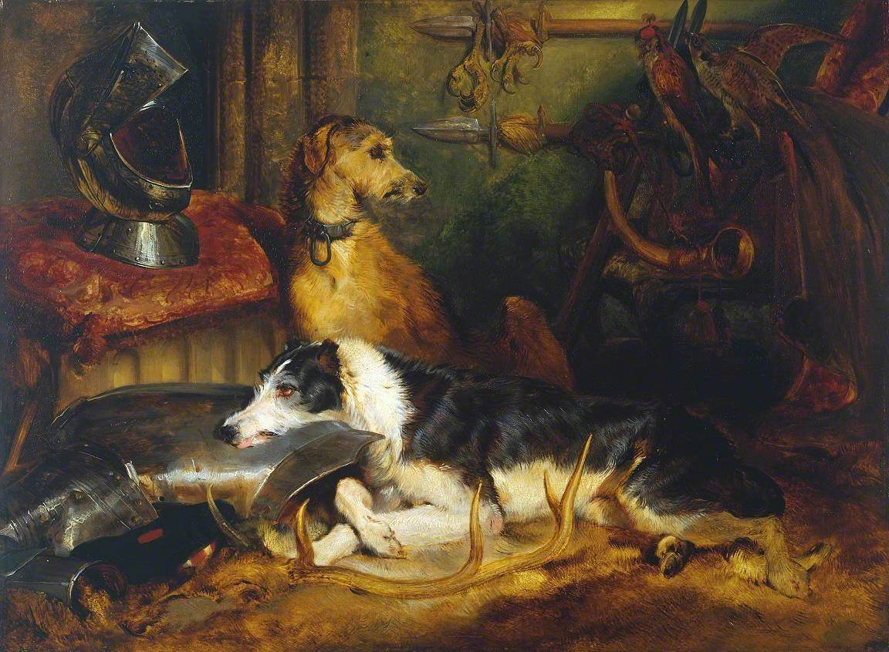

Slide 10
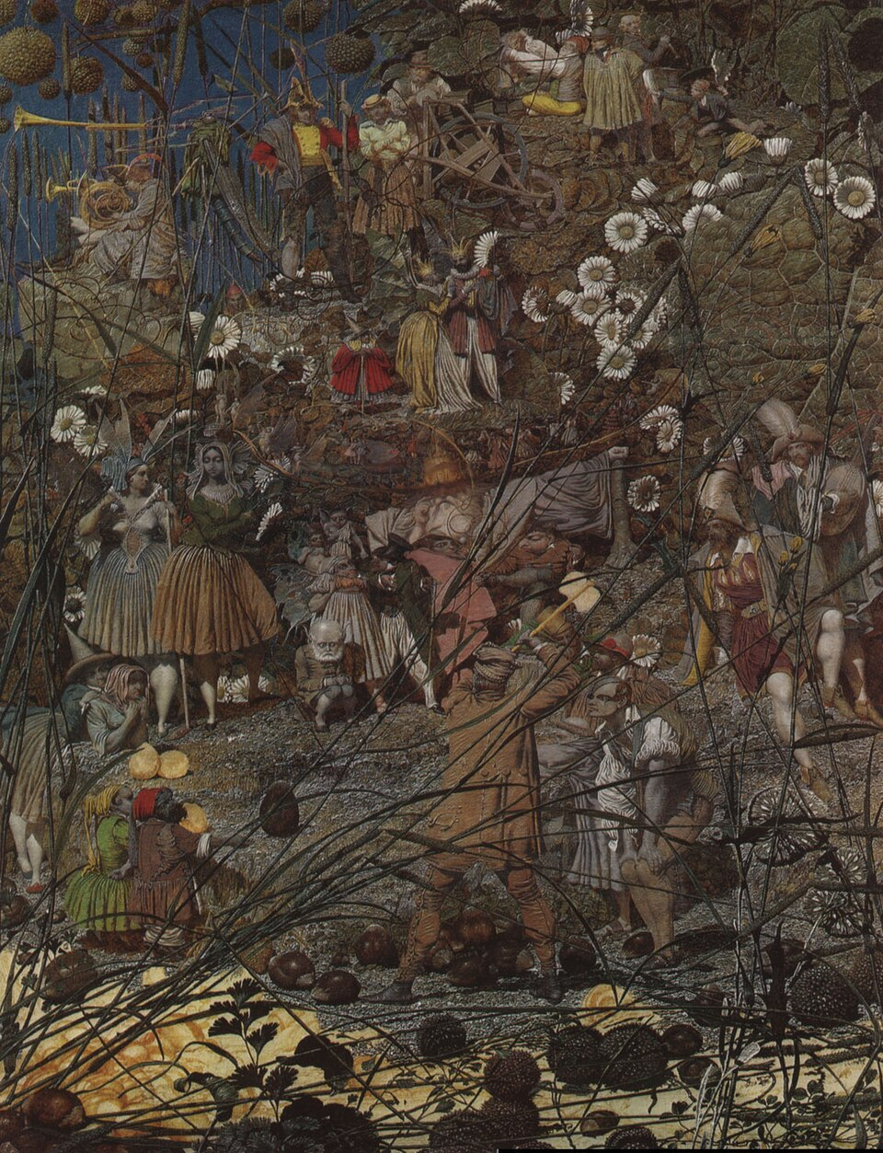

Slide 11
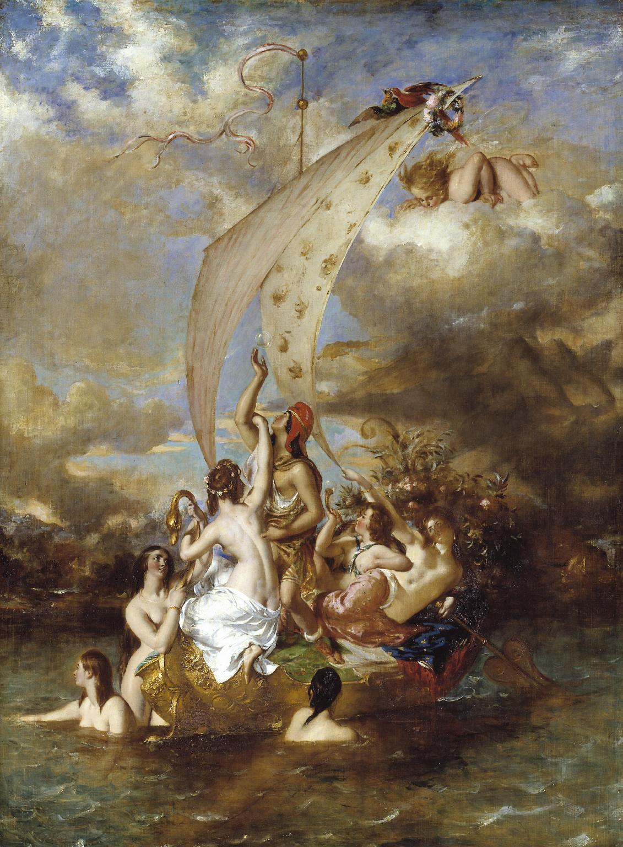

Slide 12
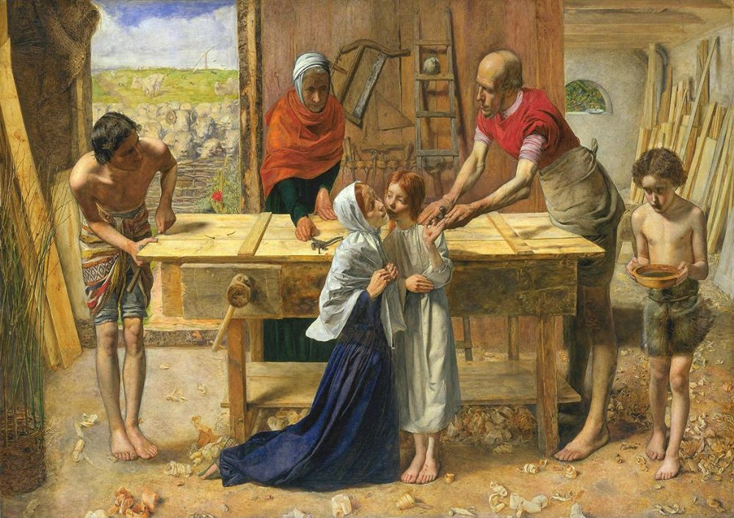
Notes:
Millais. Christ in the house of his parents (Carpenter’s shop) 1849-50

Slide 13
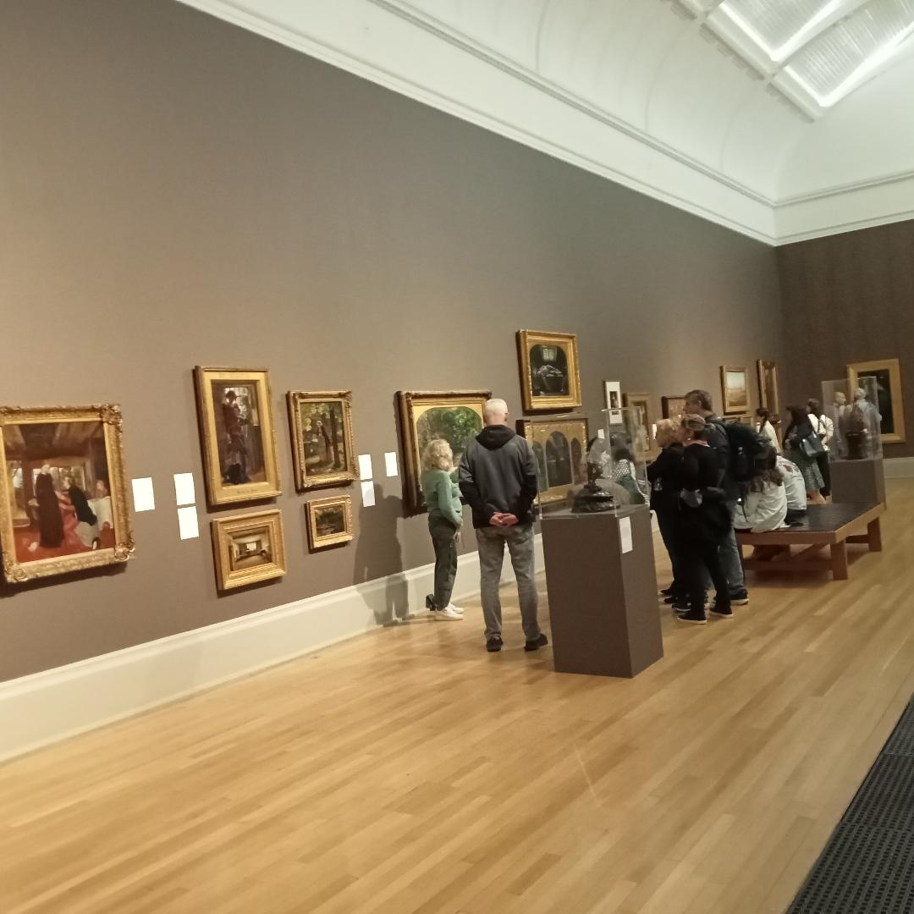

Slide 14
Notes:
Millais. Christ in the house of his parents (Carpenter’s shop) 1849-50

Slide 15
Notes:
Millais. Christ in the house of his parents (Carpenter’s shop) 1849-50

Slide 16
Notes:
Millais. Christ in the house of his parents (Carpenter’s shop) 1849-50

Slide 17
Notes:
Millais. Christ in the house of his parents (Carpenter’s shop) 1849-50

Slide 18
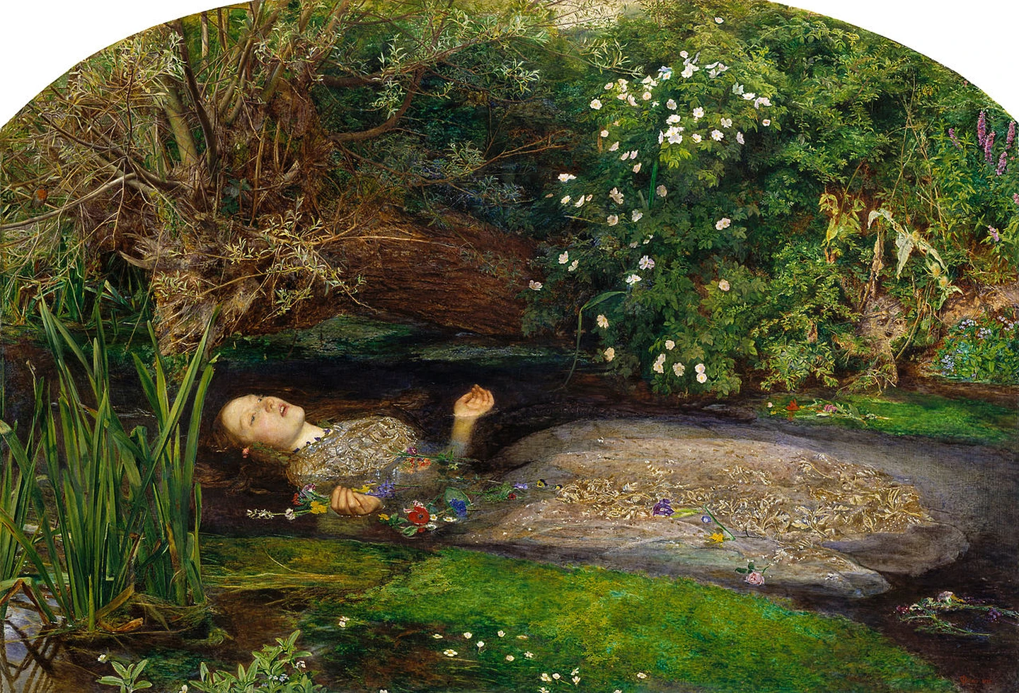
Notes:
Millais ophelia 1851-2

Slide 19
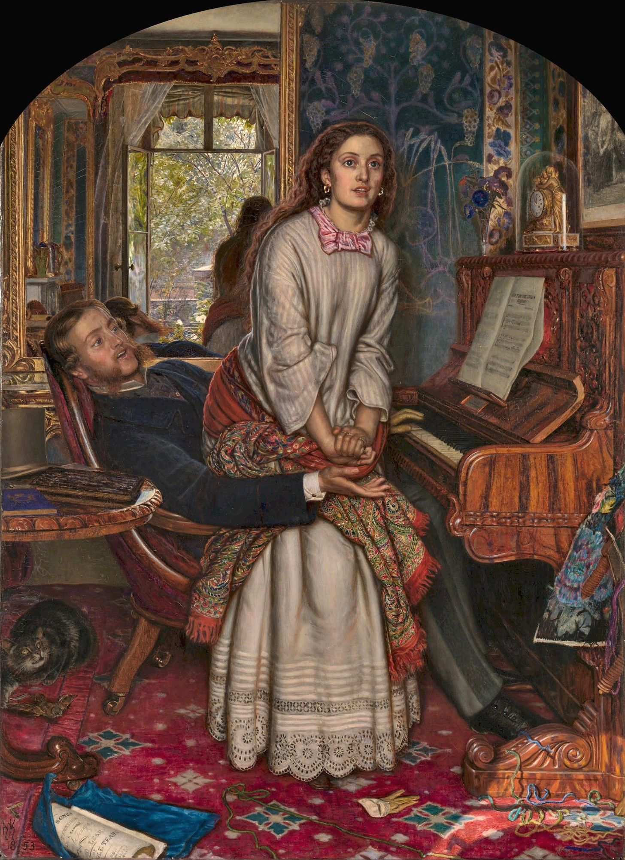

Slide 20
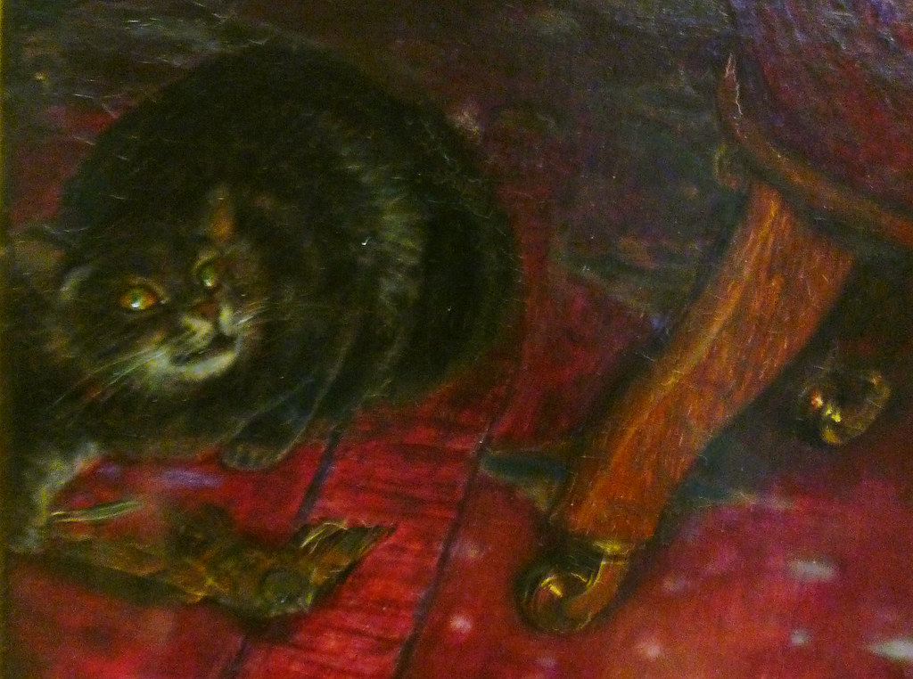

Slide 21
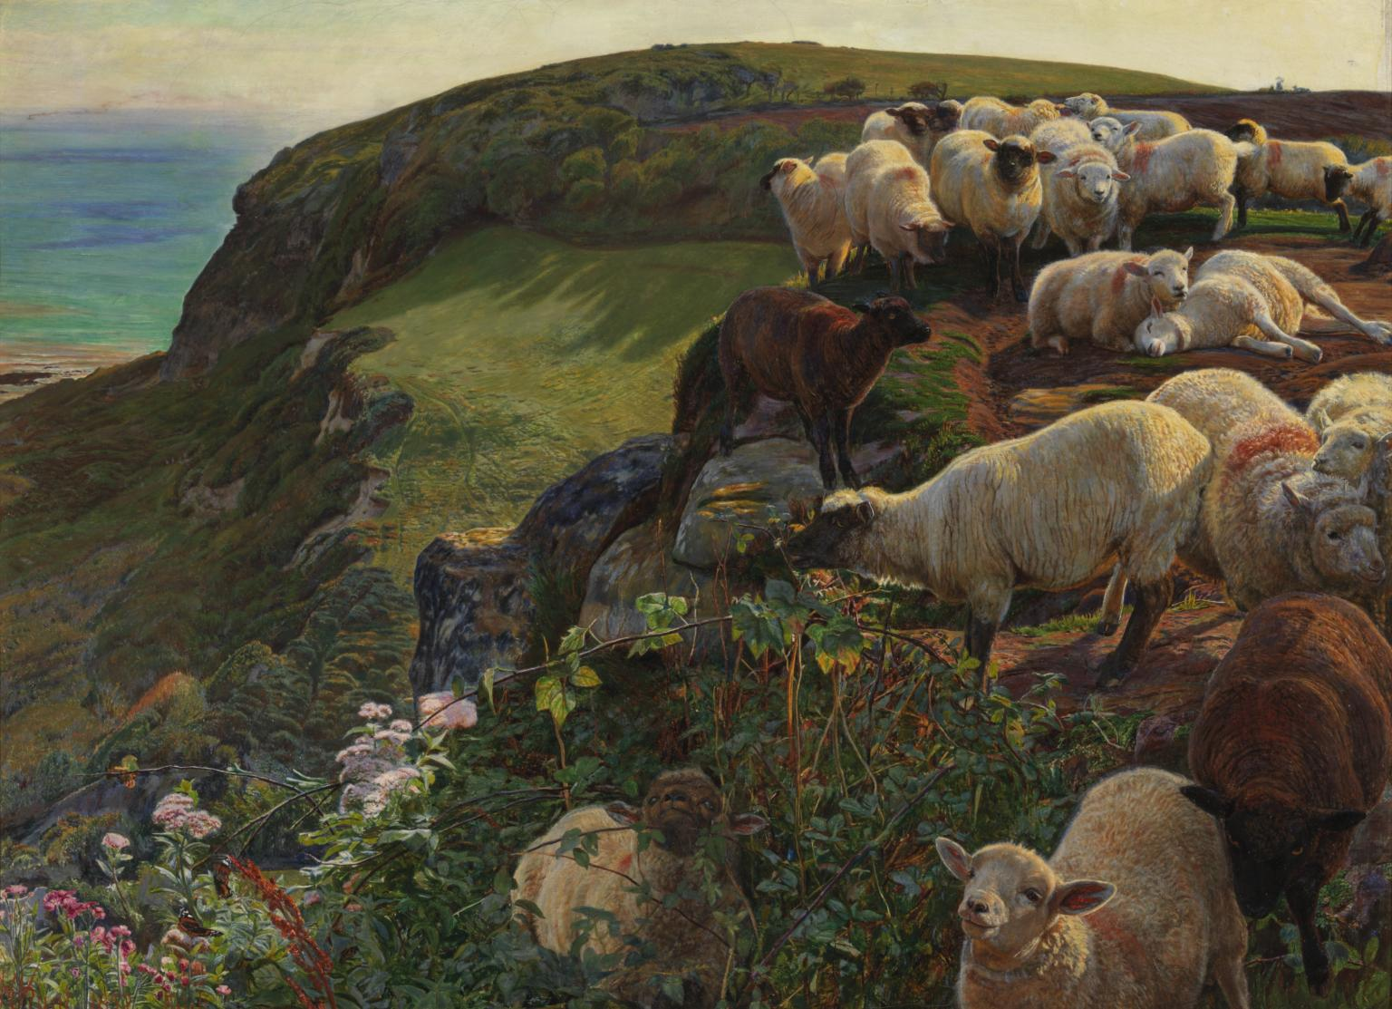

Slide 23
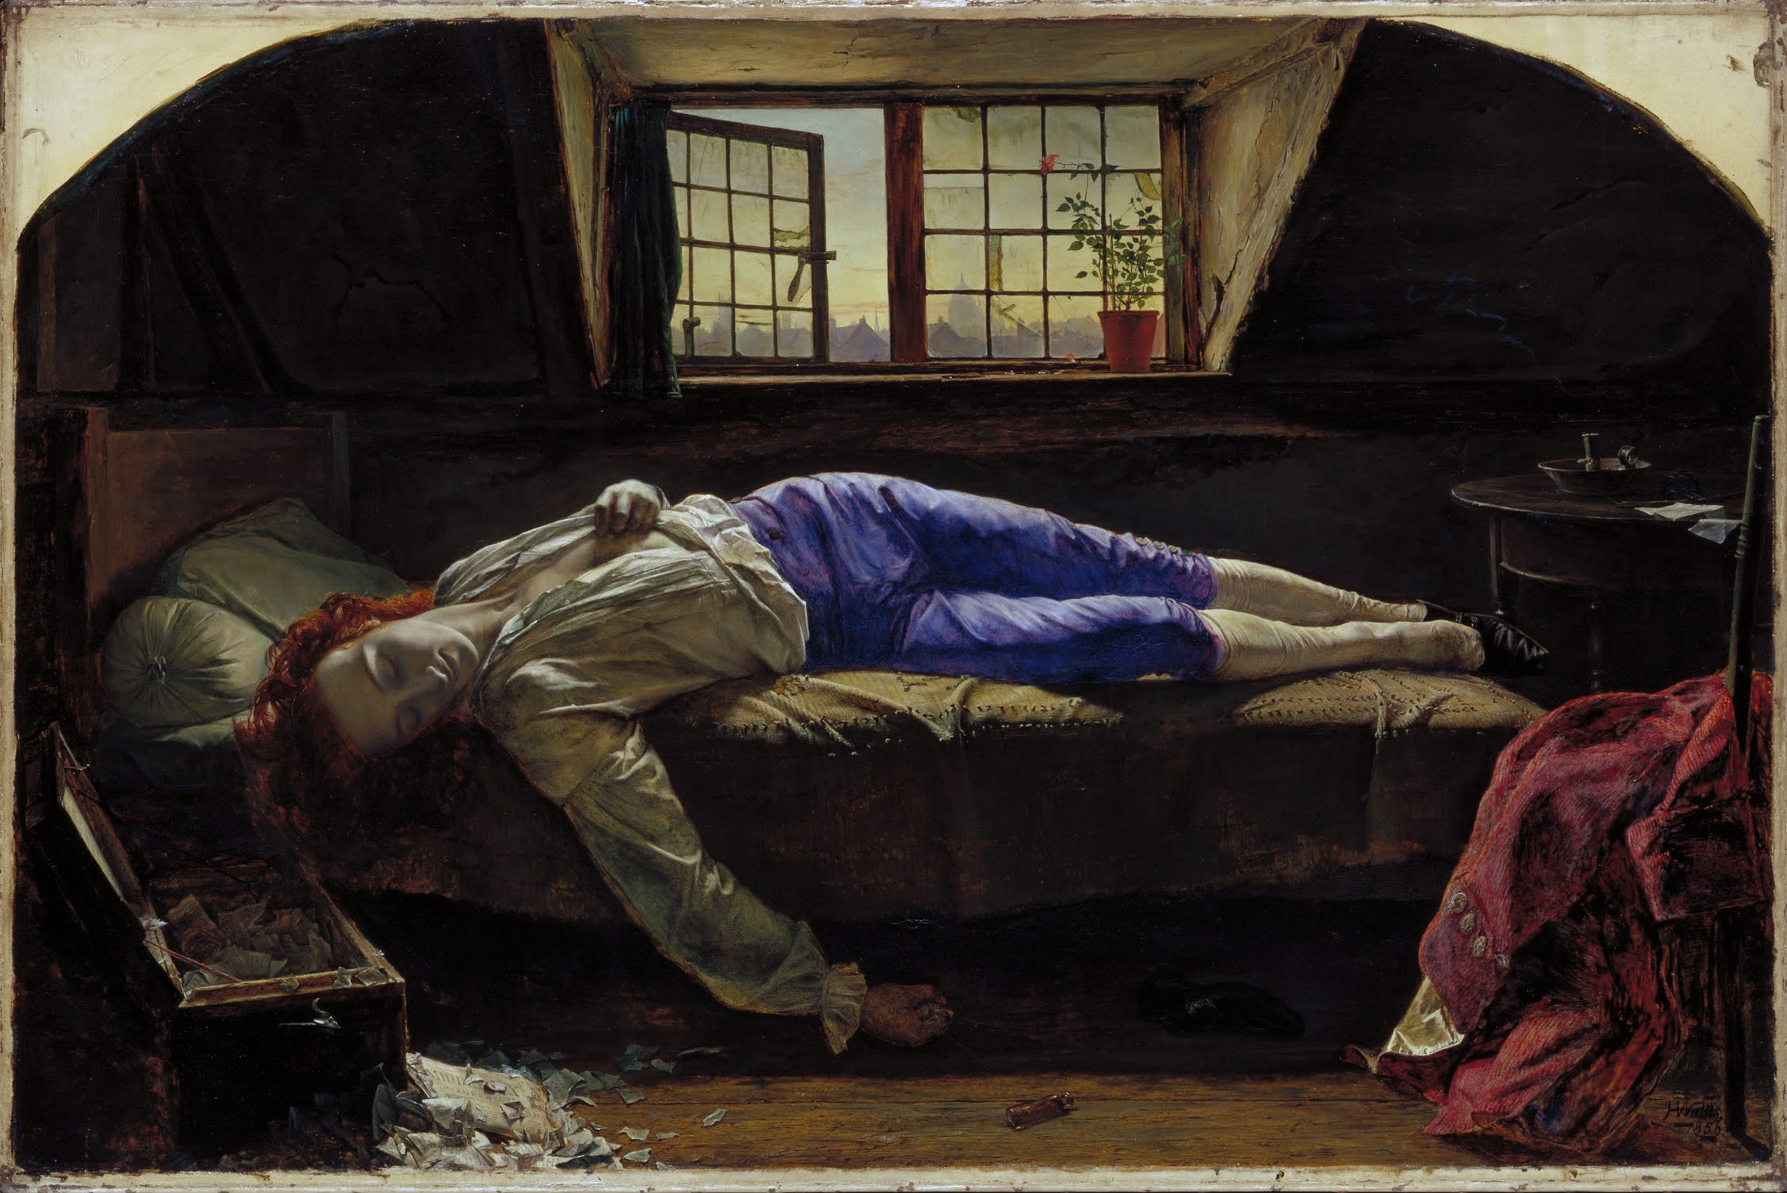

Slide 24
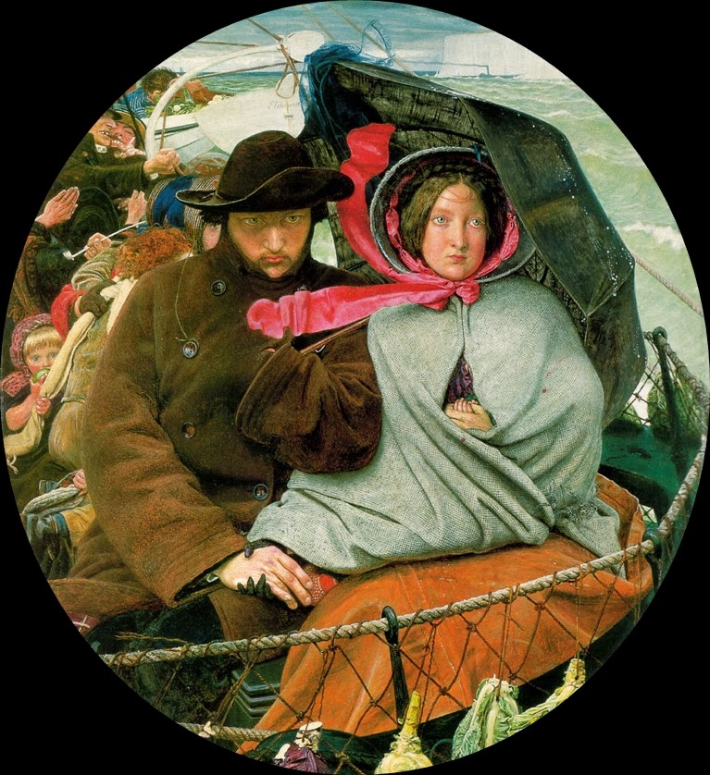
Notes:
Ford Madox Brown. The last of england. 1855 Thos Woolner

Slide 25
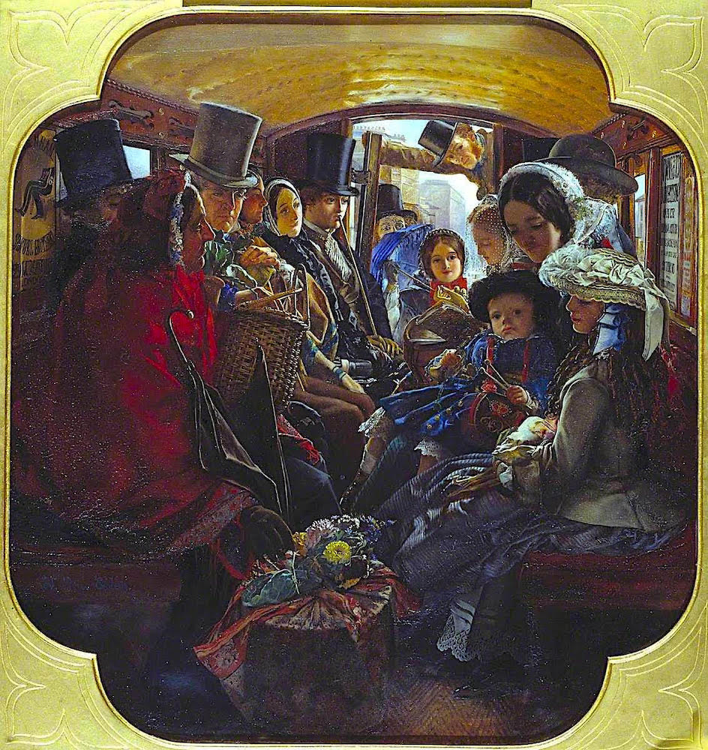
Notes:
William Maw Egley Omnibus life in London 1859

Slide 26
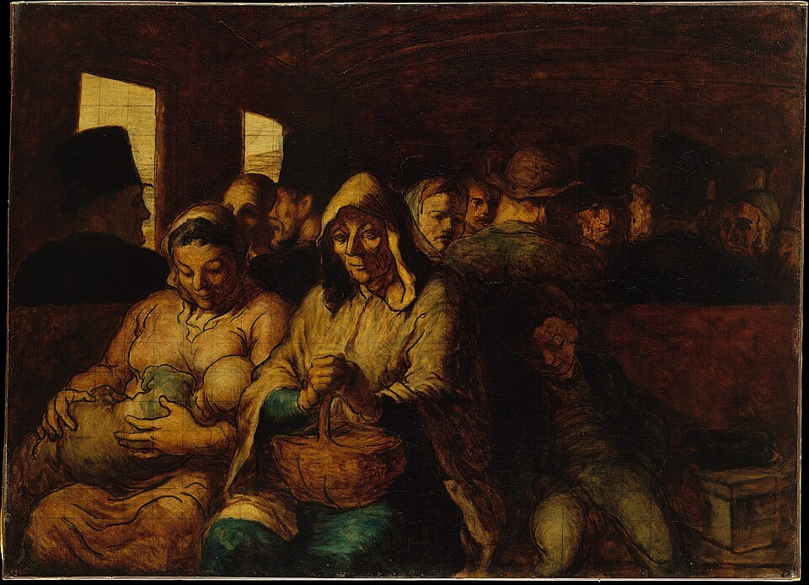
Notes:
William Maw Egley Omnibus life in London 1859

Slide 27
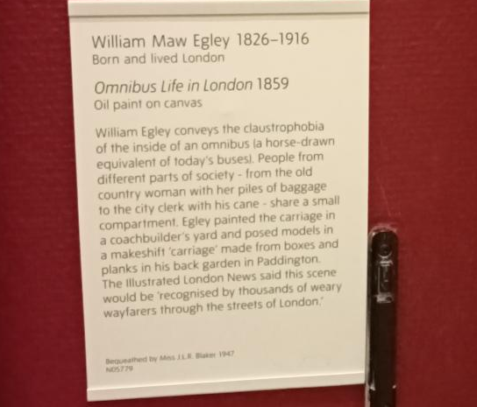

Slide 28
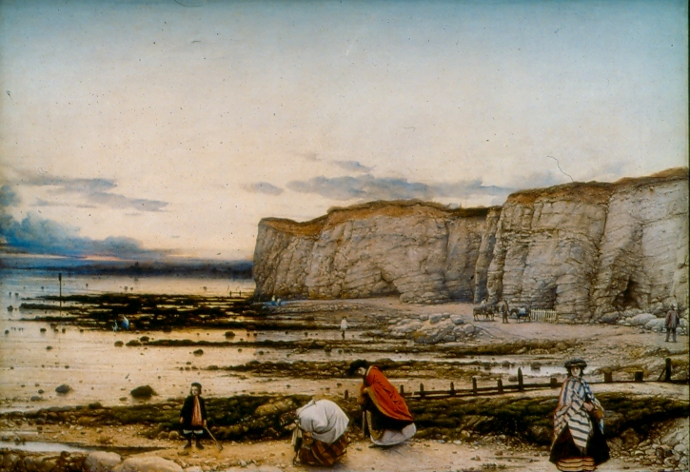
Notes:
William Dyce pegwell Bay

Slide 29
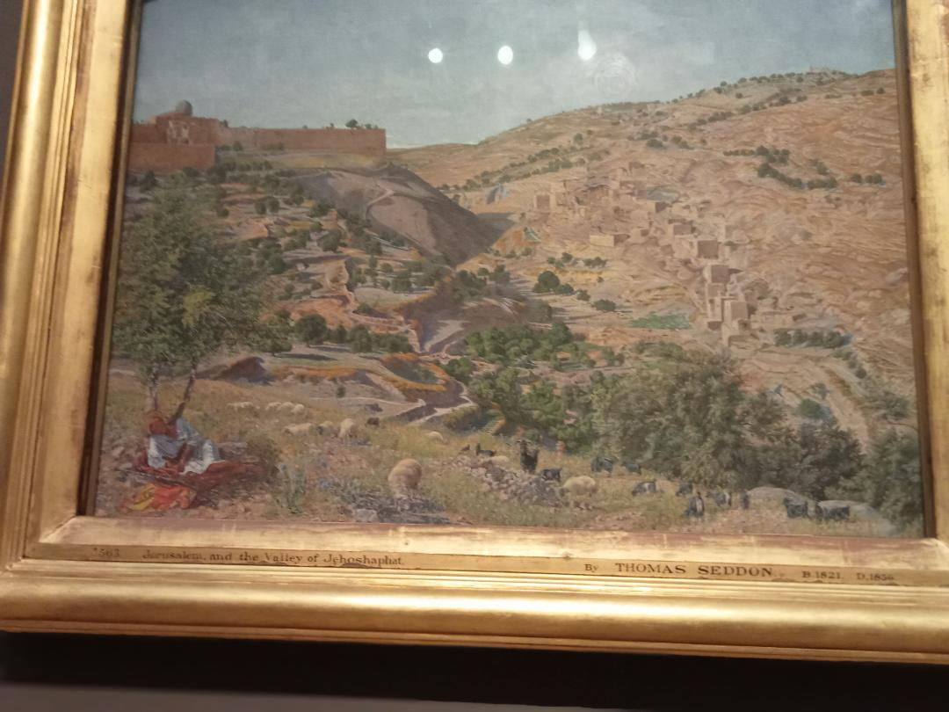
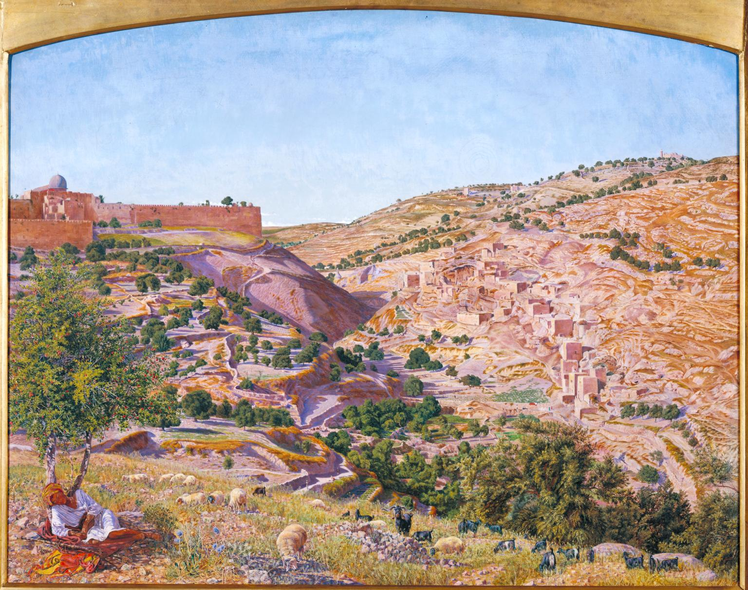
Notes:
Thomas Seddon 1854-5 died of dysentery in Cairo

Slide 30
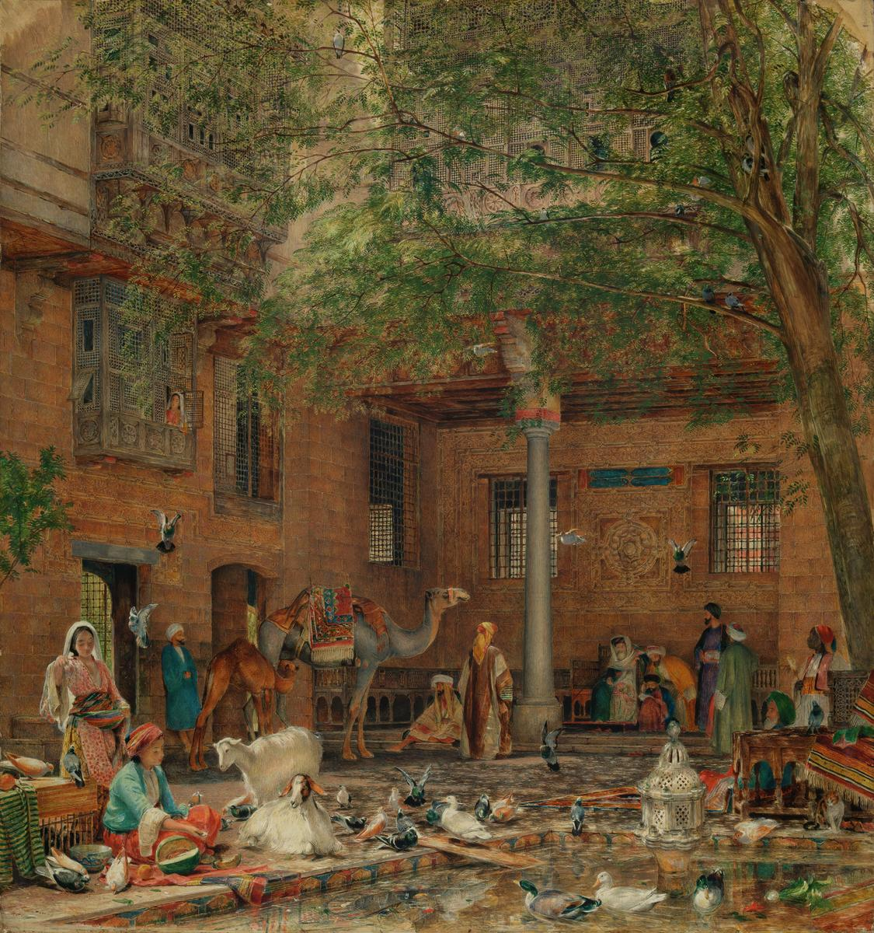

Slide 31
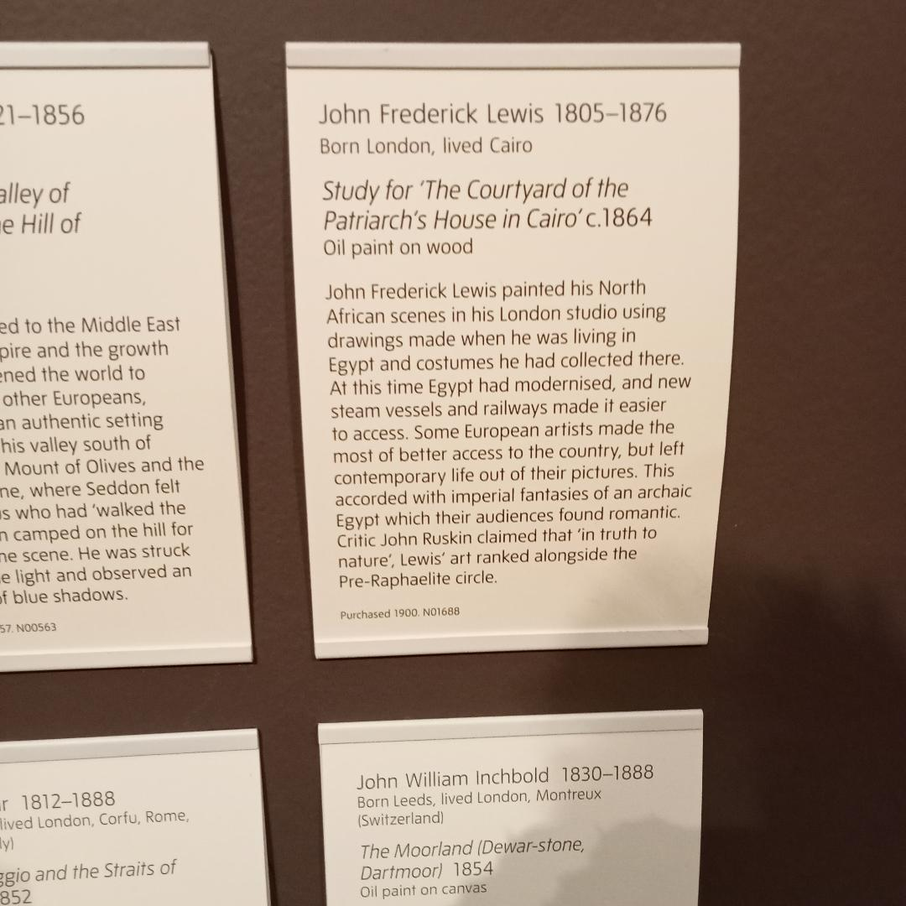

Slide 32
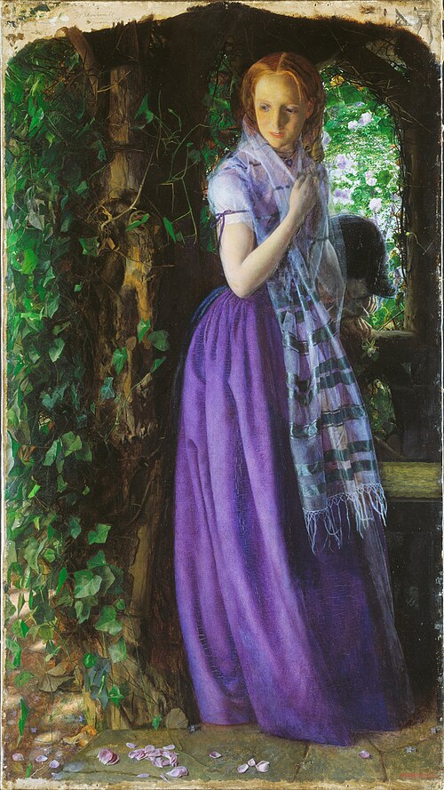
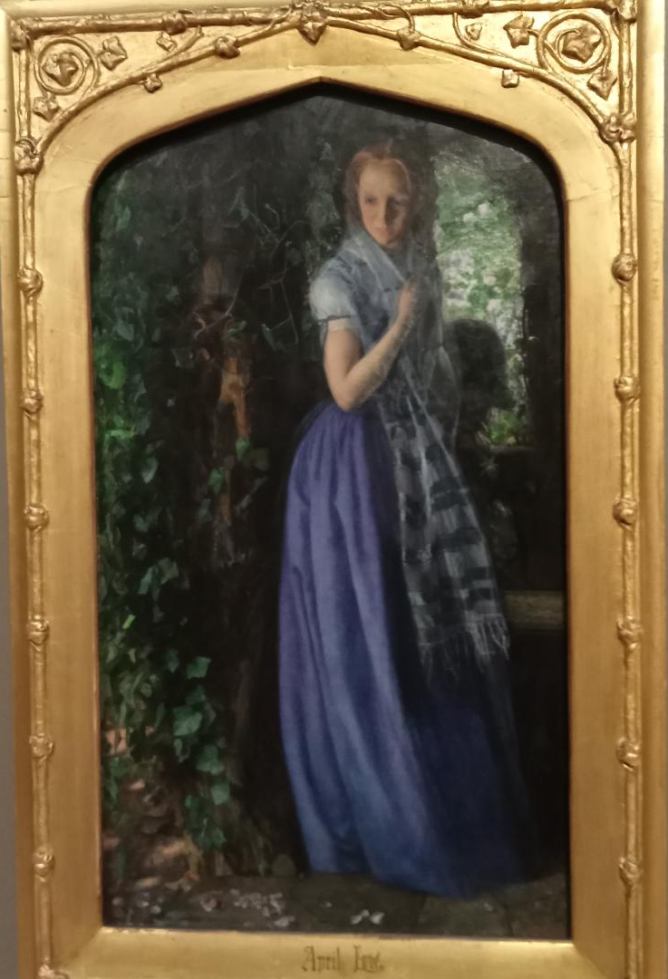

Slide 33
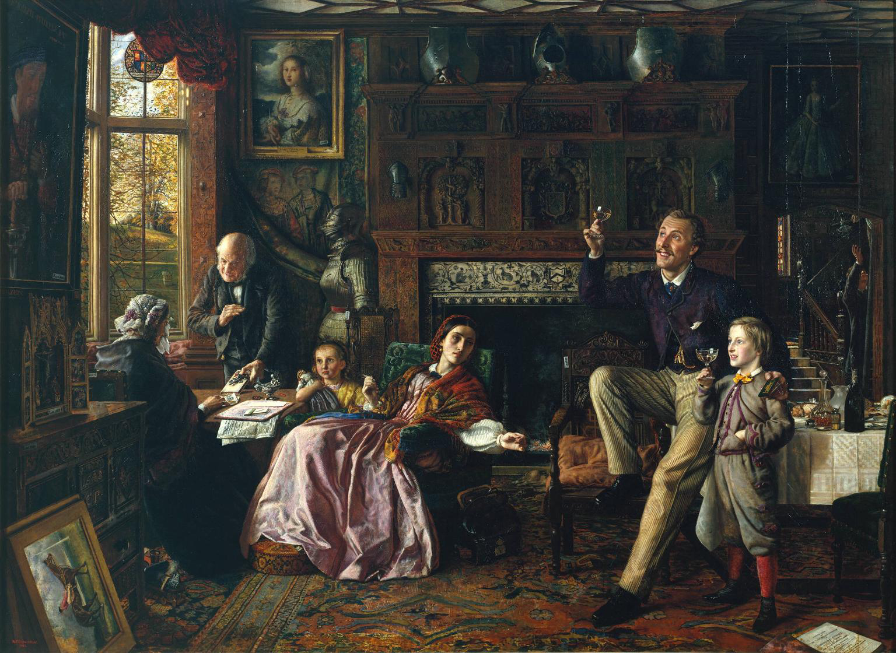
Notes:
1862 Robert Braithwaite Martineau

Slide 34
Notes:
1862 Robert Braithwaite Martineau

Slide 35
Notes:
1862 Robert Braithwaite Martineau

Slide 36
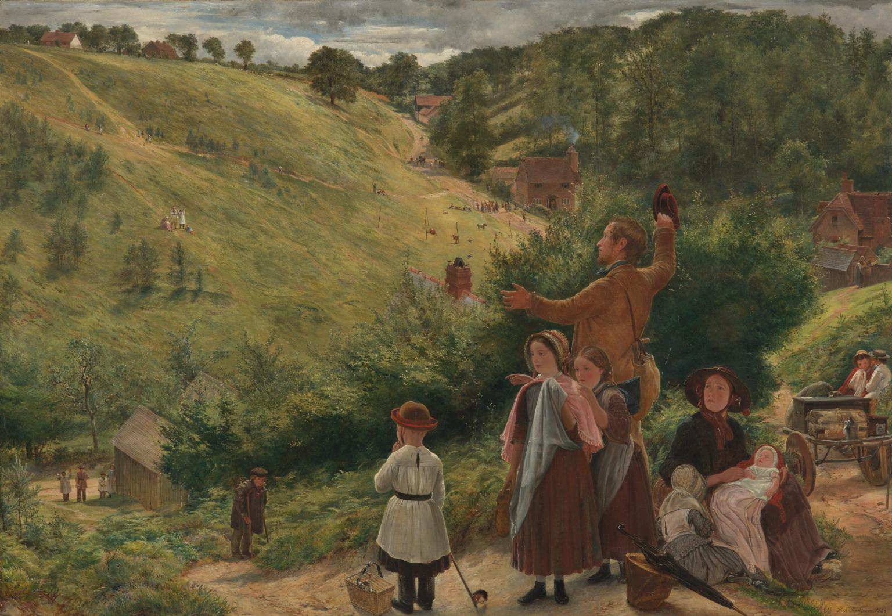
Notes:
Richard Redgrave. The immigrants last sight of home 1858

Slide 37
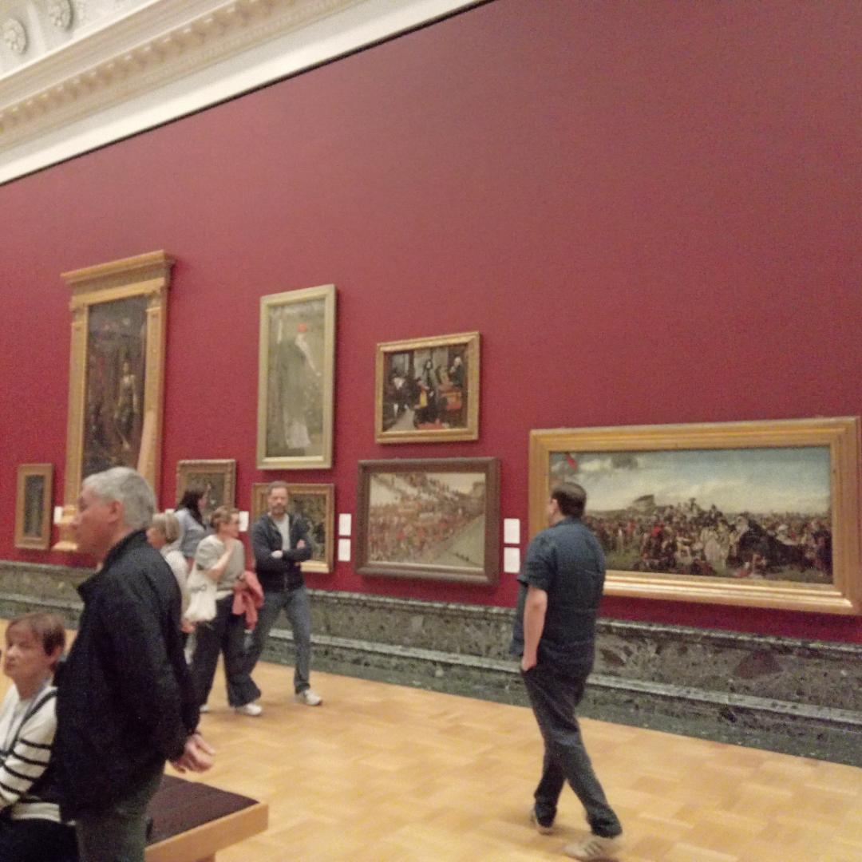

Slide 38
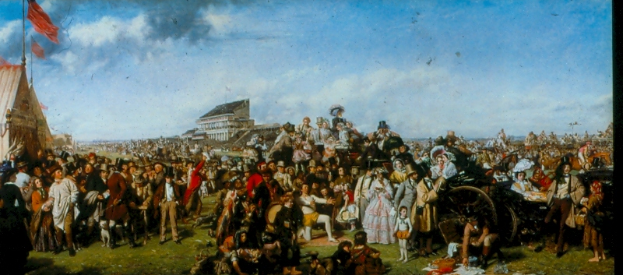

Slide 39
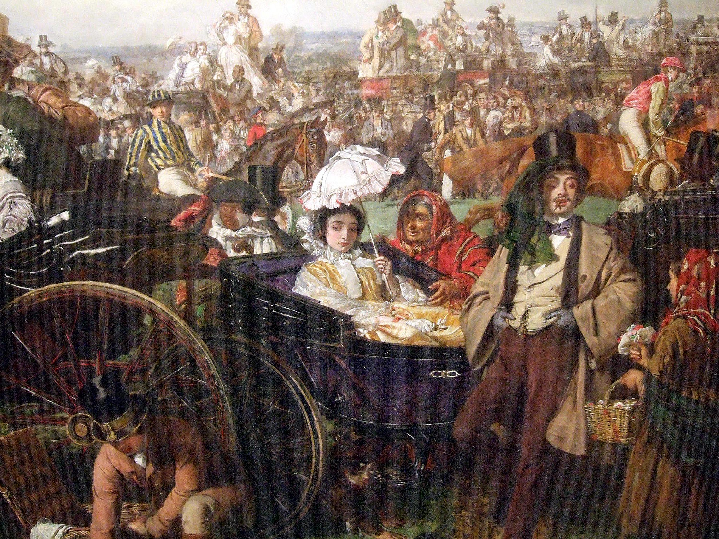

Slide 40
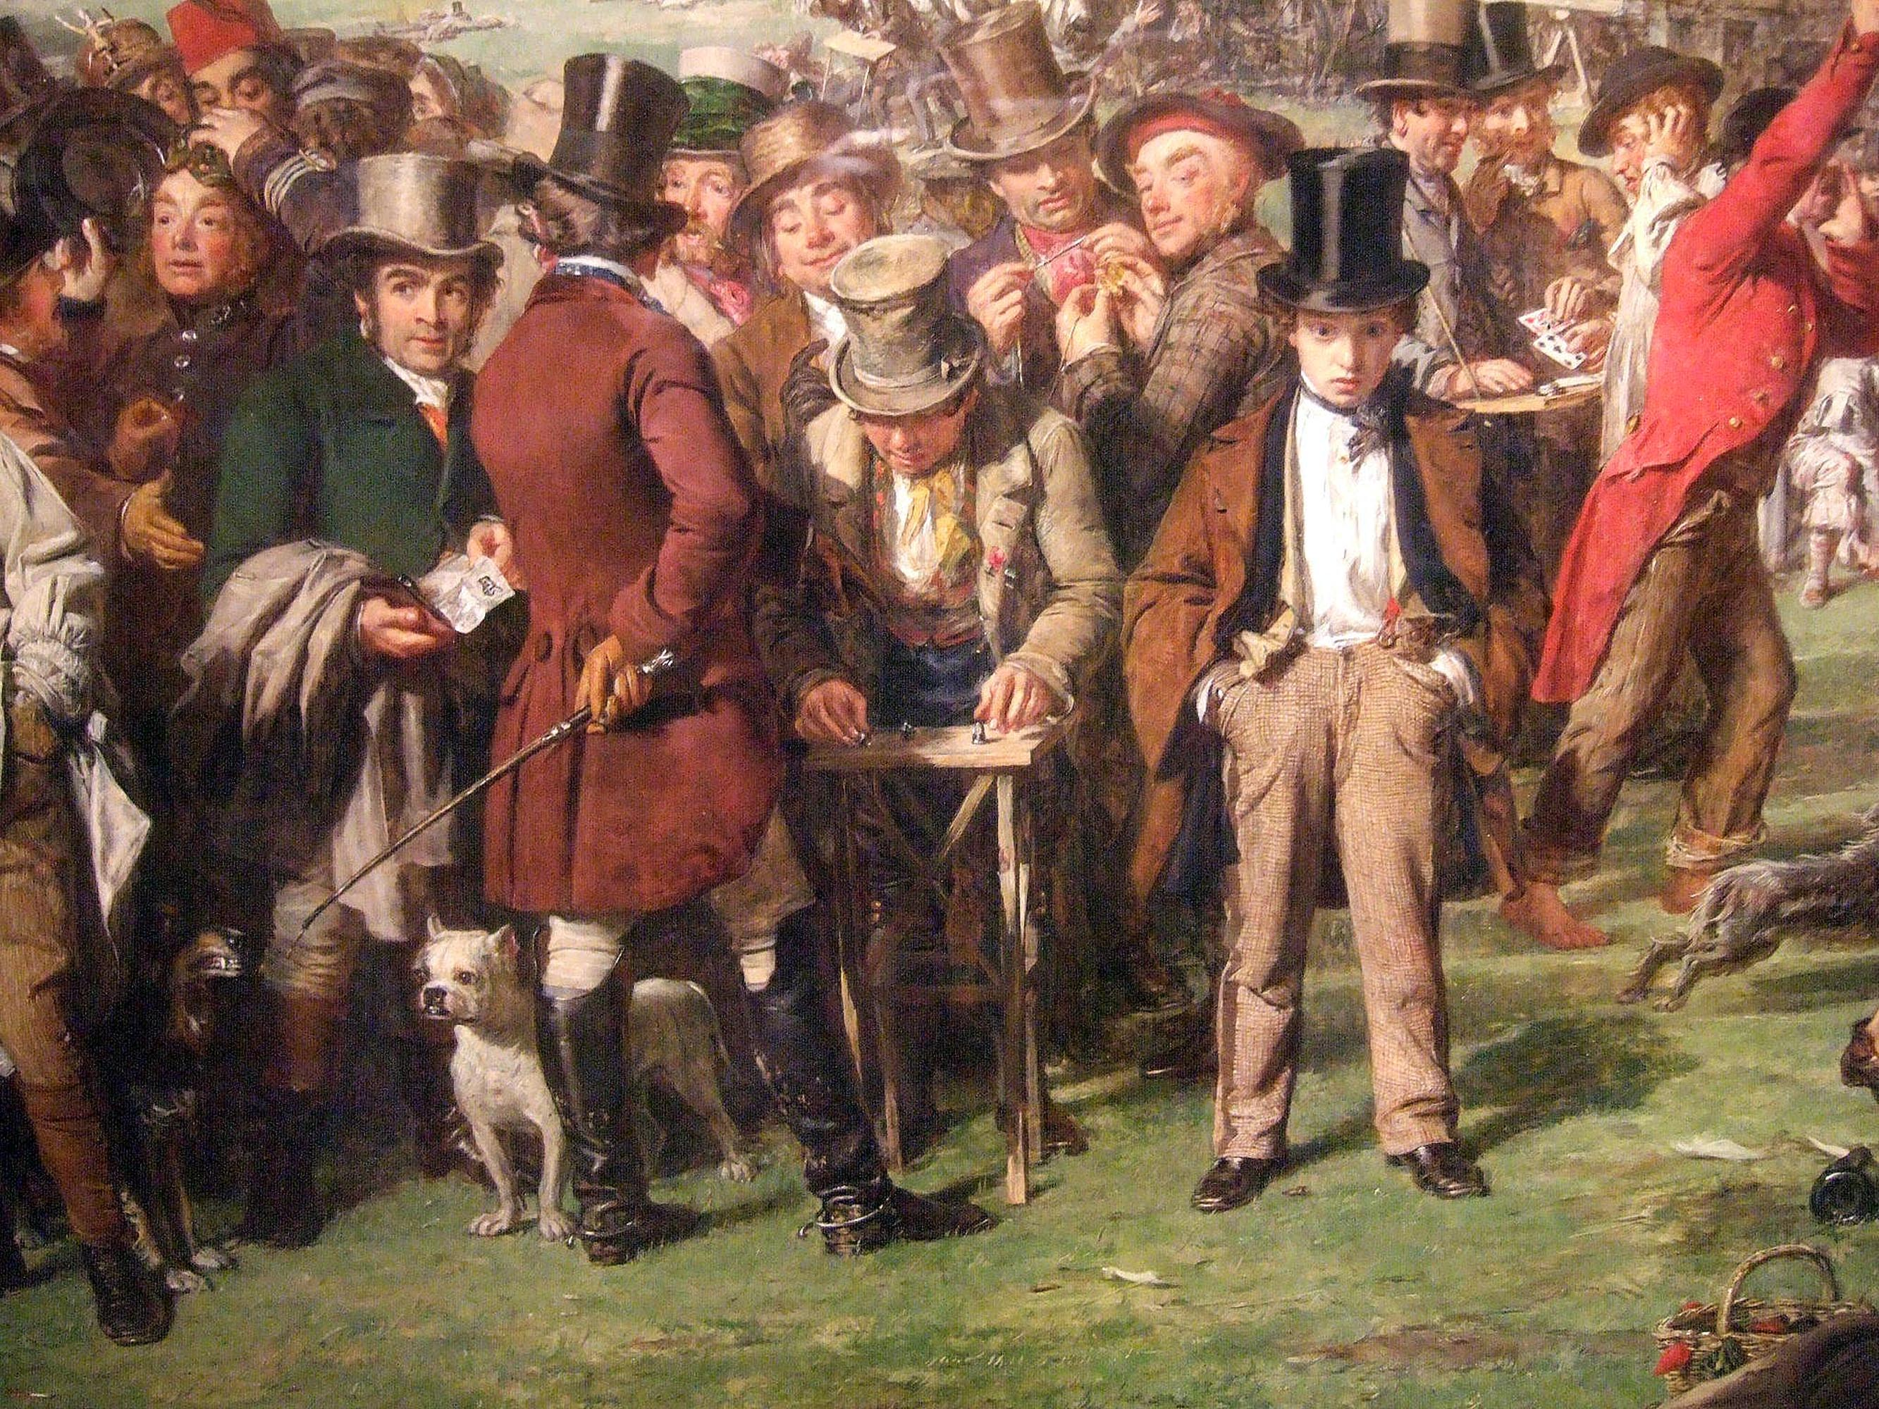

Slide 41
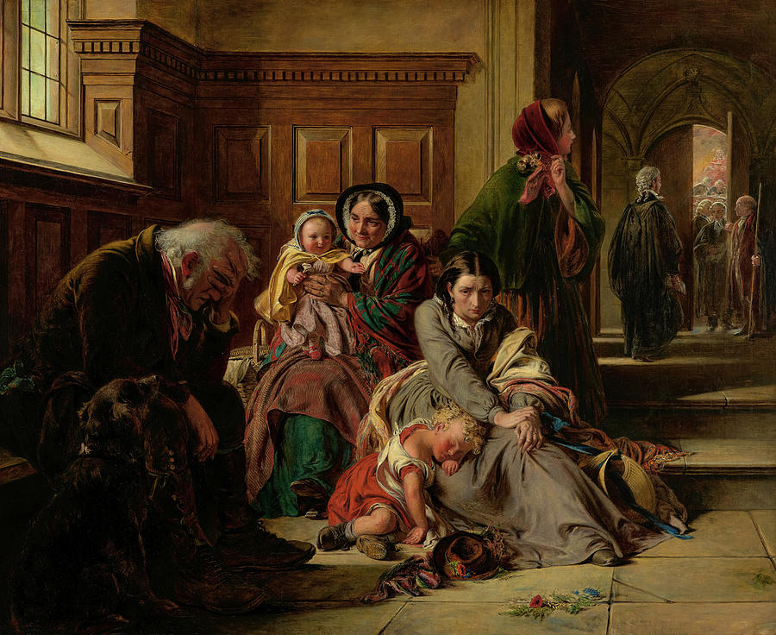
Notes:
Abraham SolomonAwaiting the Verdict 1857

Slide 42
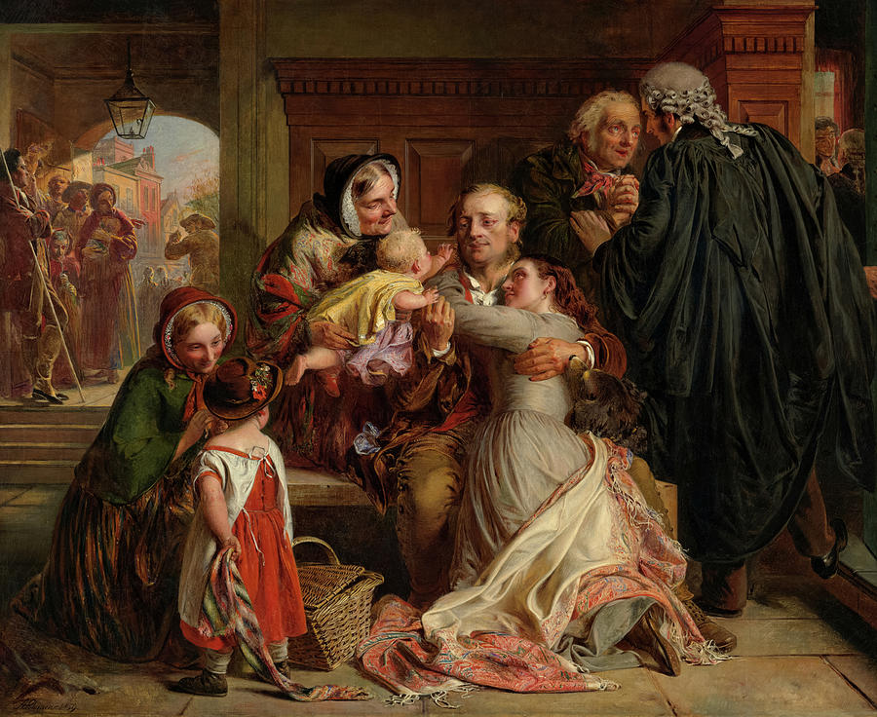
Notes:
1859

Slide 43
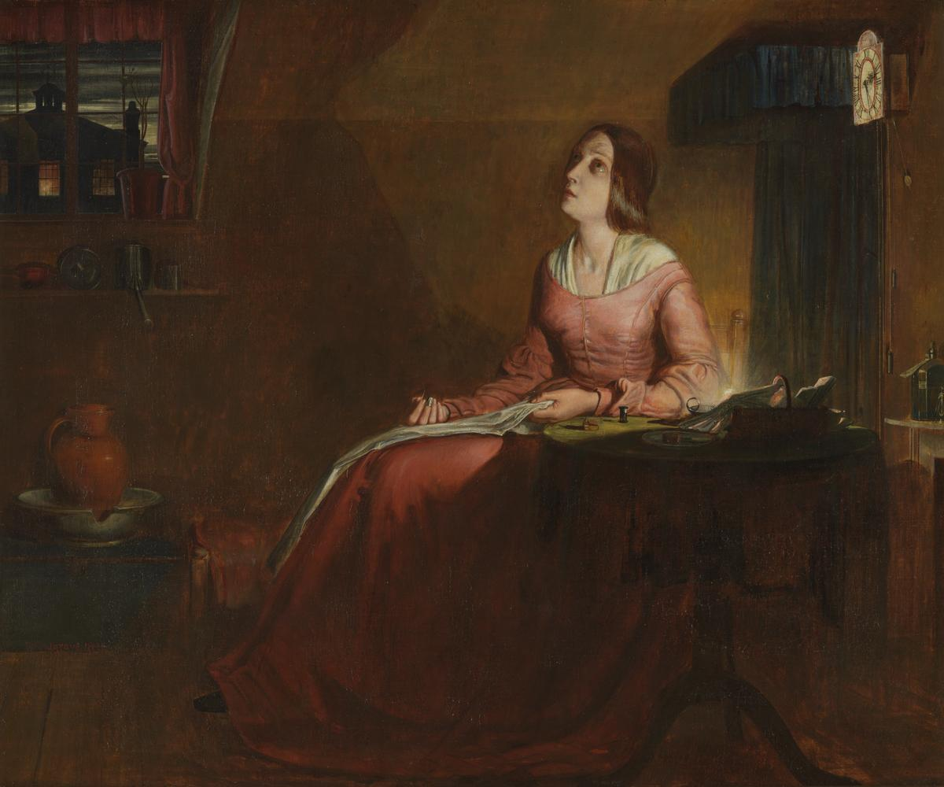
Notes:
Clock 10 past five

Slide 44
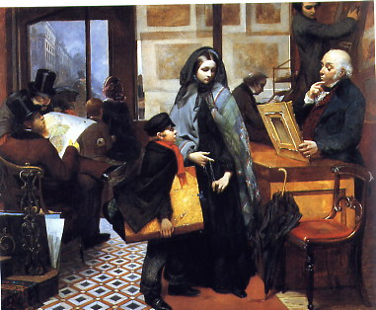
Notes:
Emily Mary Osborn. Nameless and friendless 1857

Slide 45
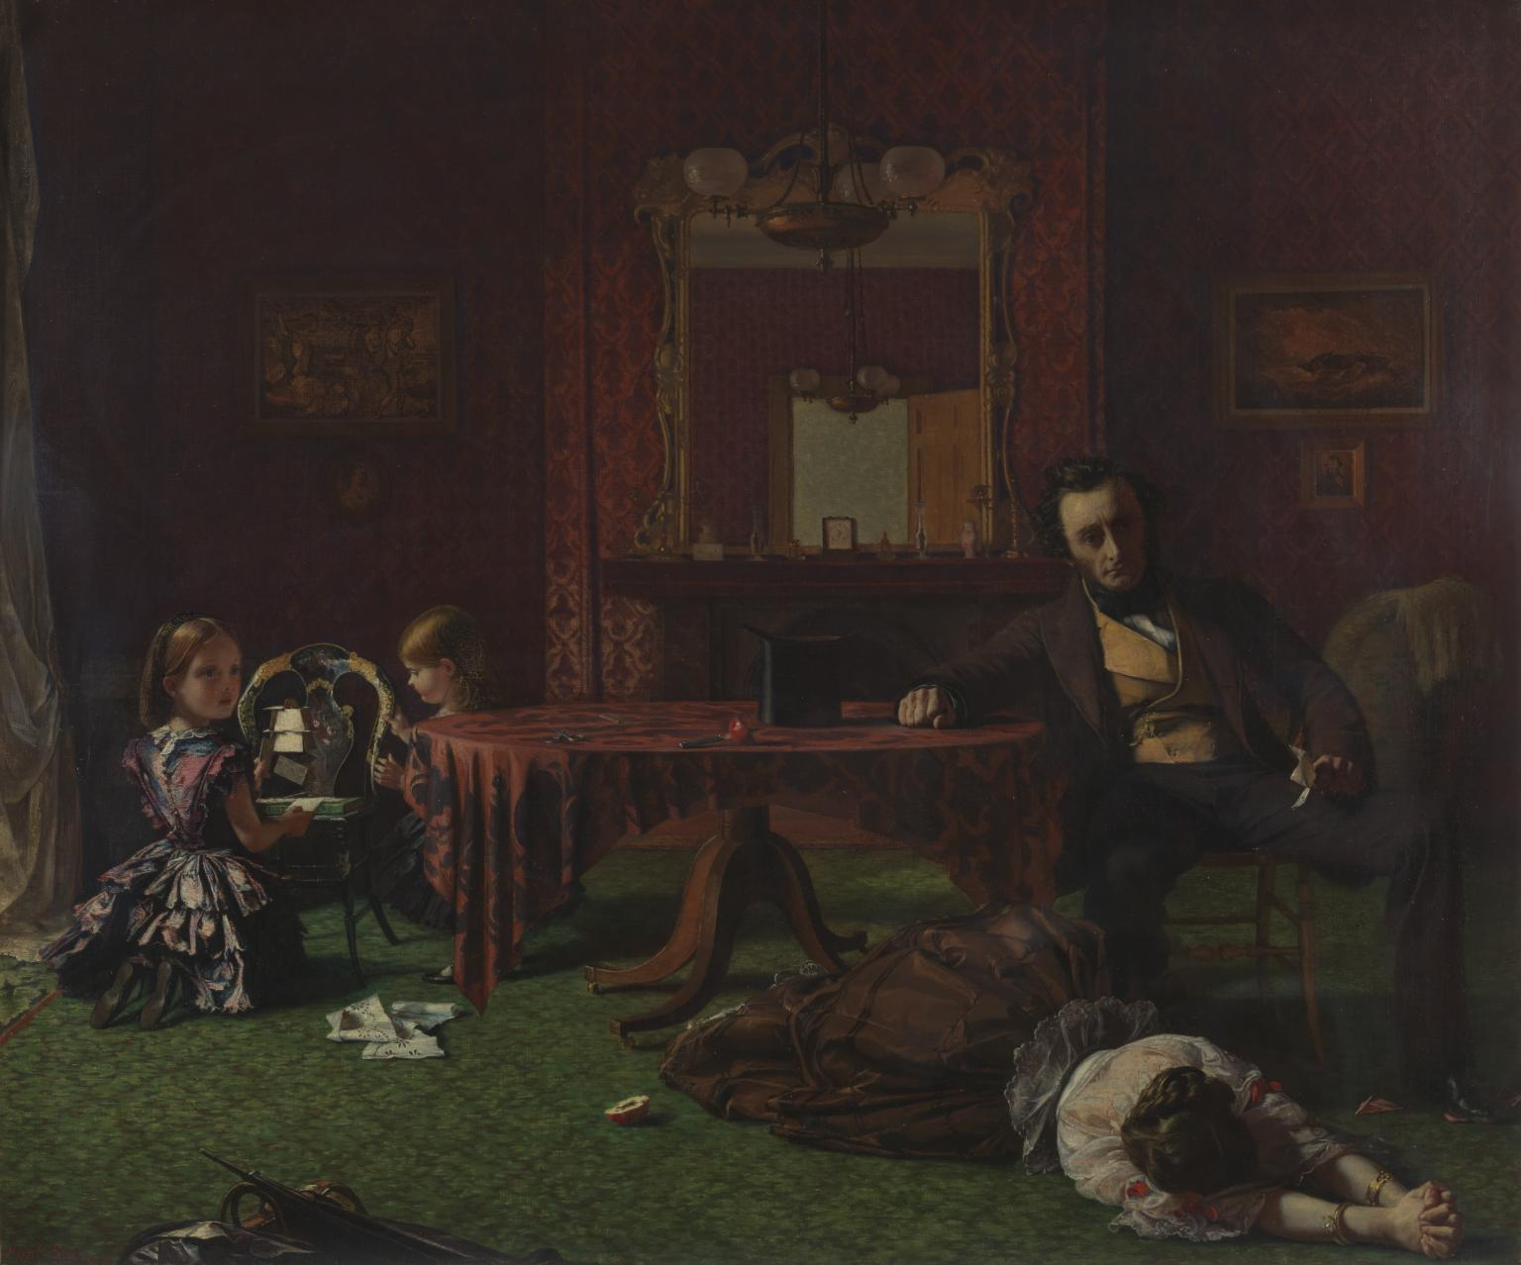

Slide 46
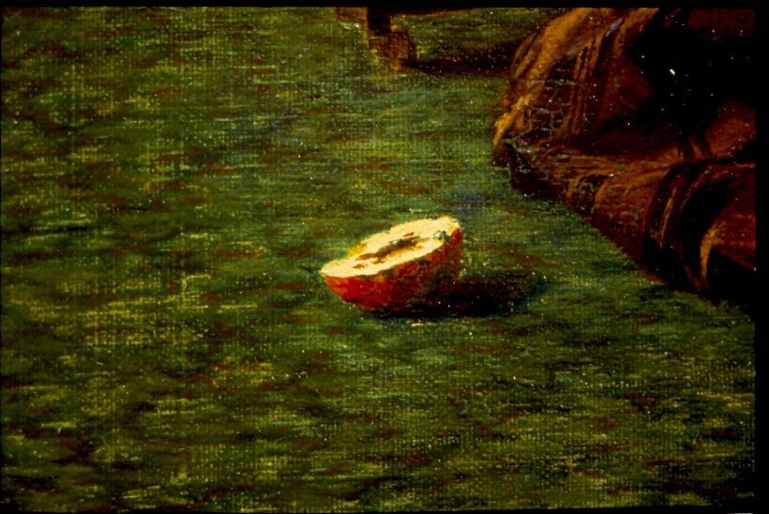

Slide 47
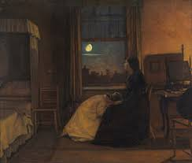
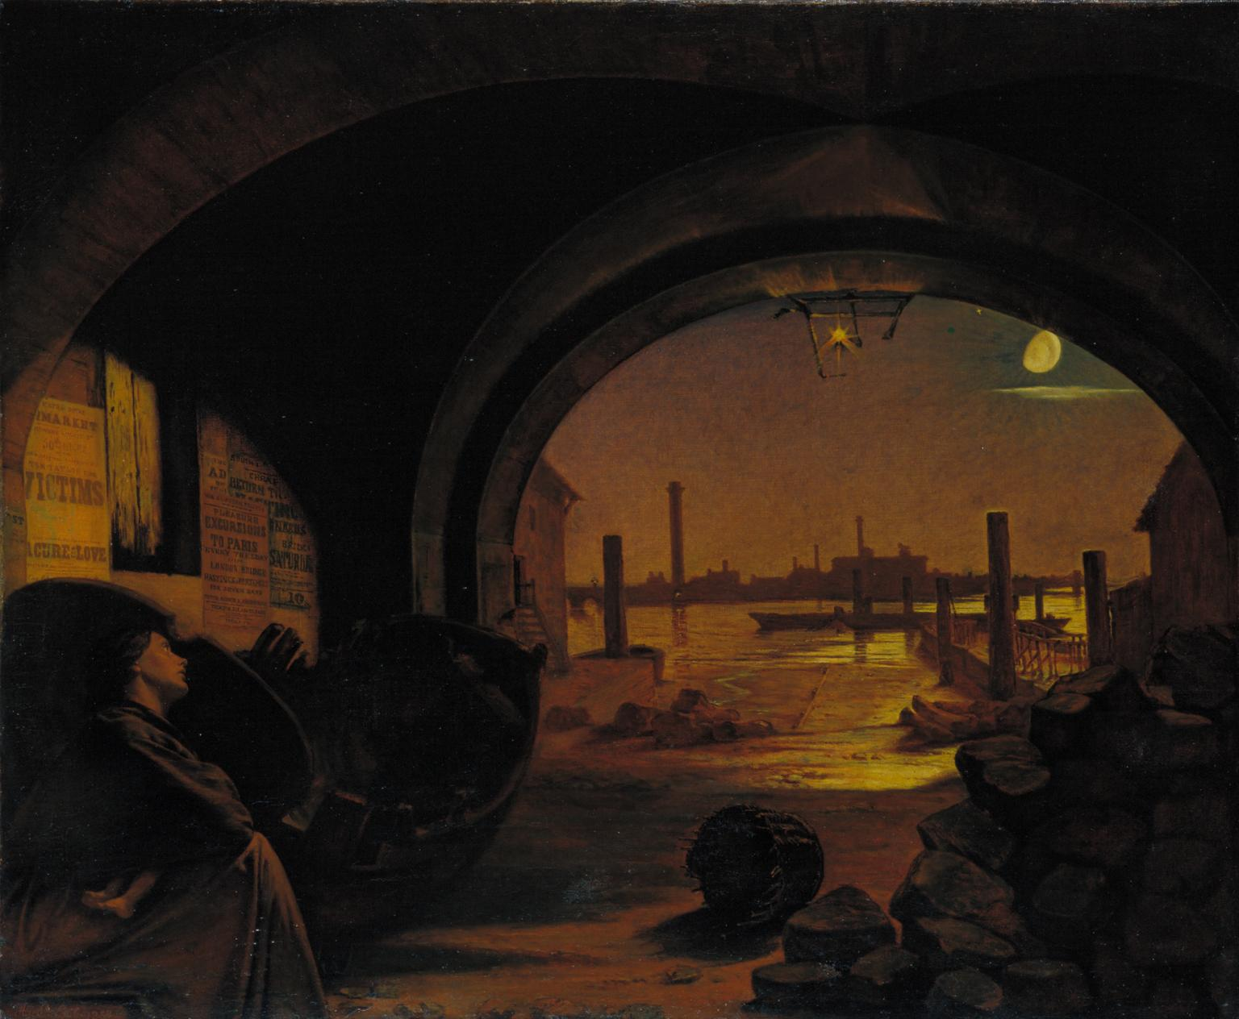

Slide 48
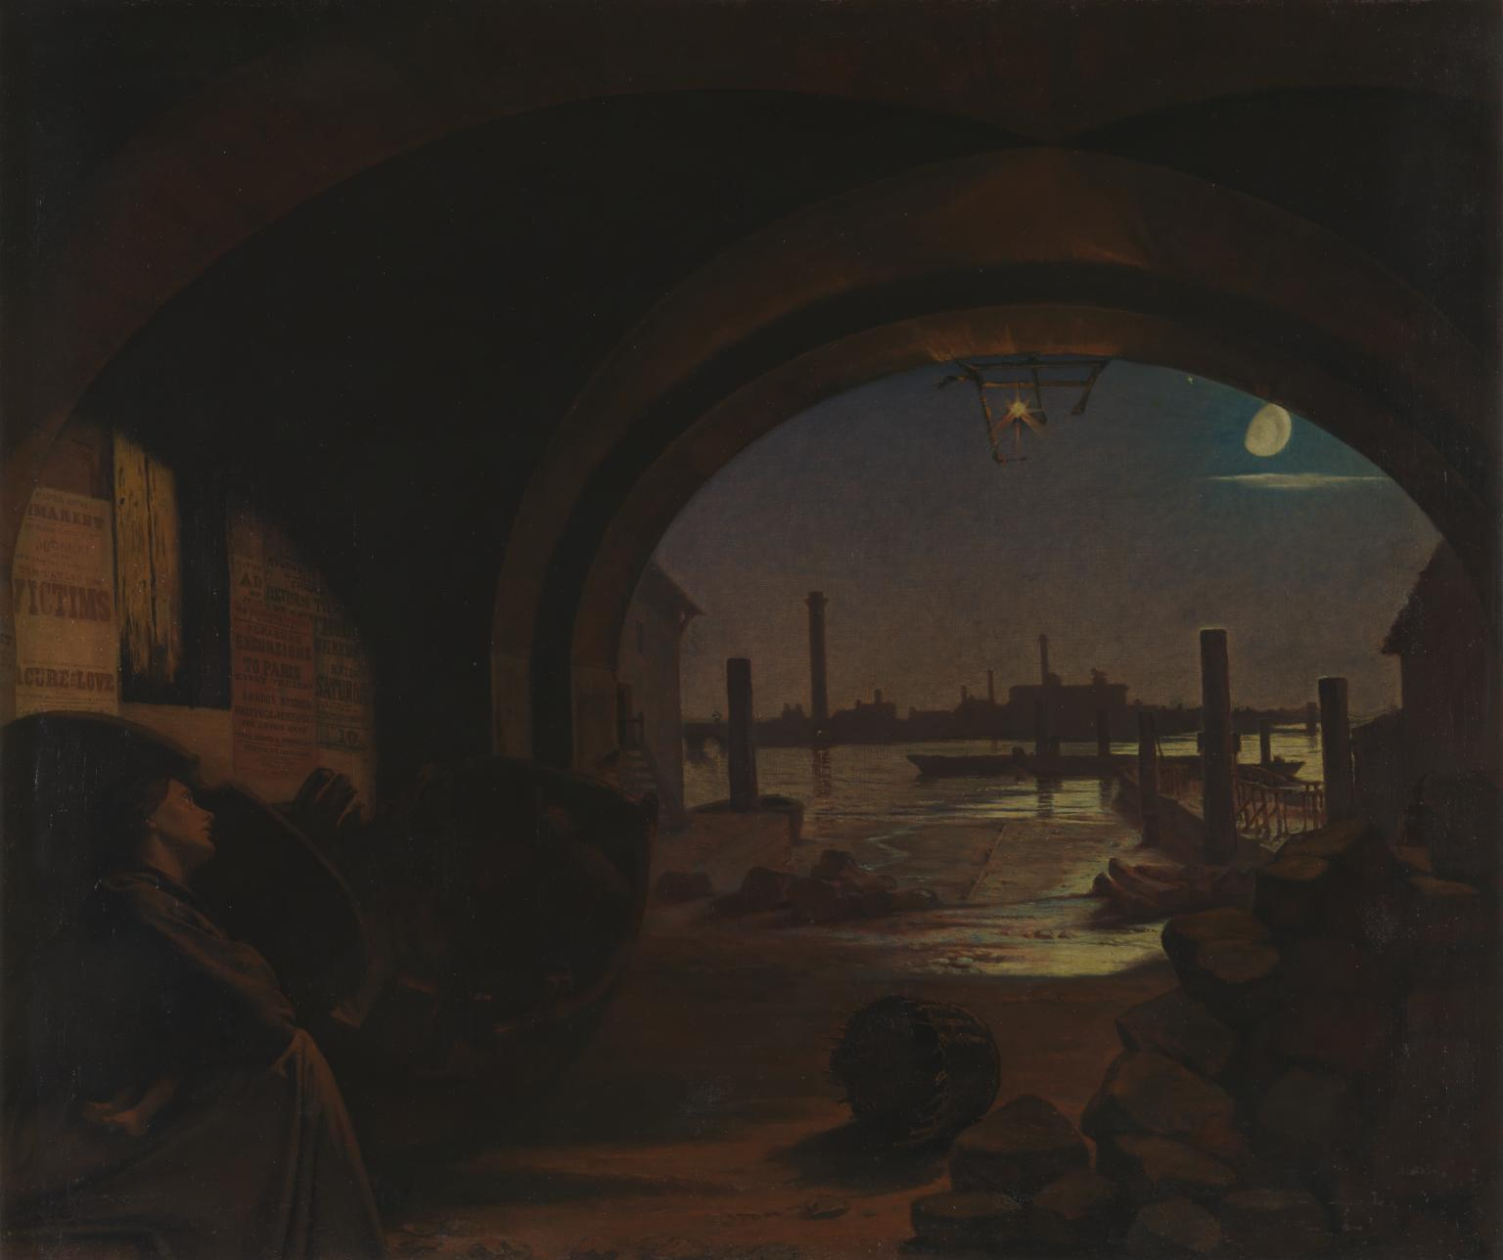
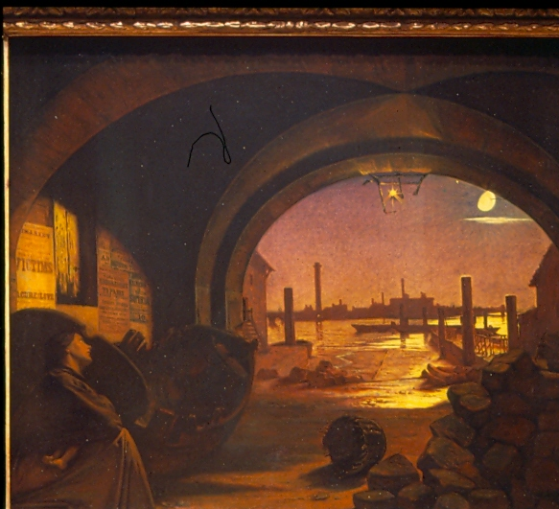

Slide 50
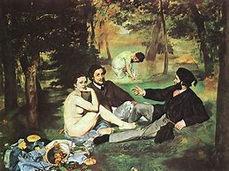
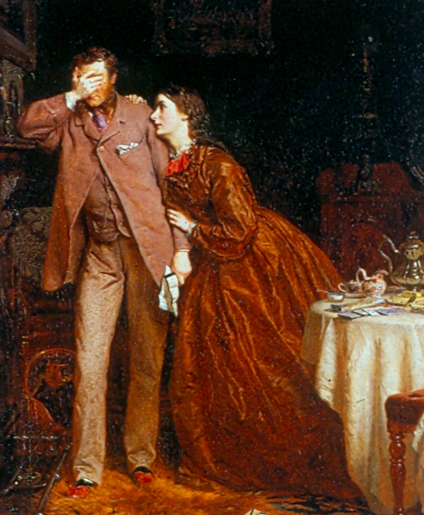
Notes:
George Elgar Hicks Womans mission companion of manhood

Slide 51
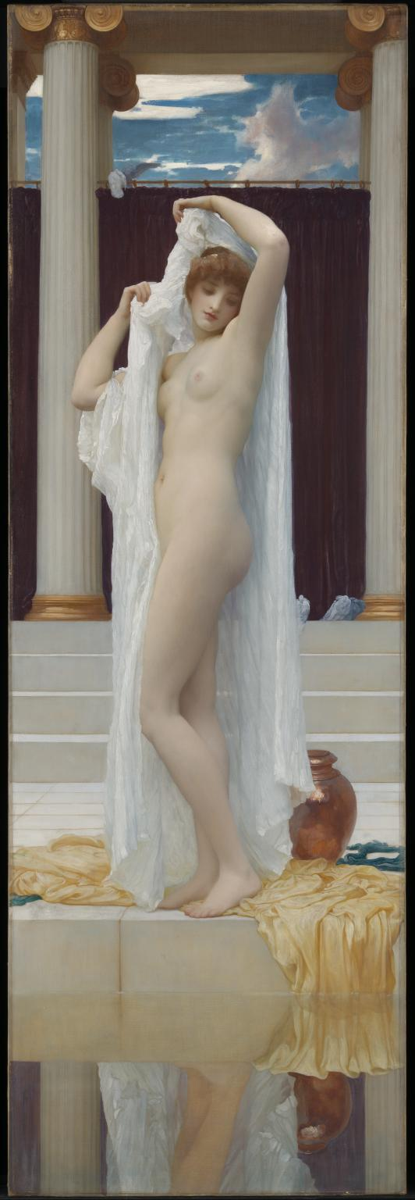
Notes:
So frigid and idealized bath of Pysche 1890

Slide 52
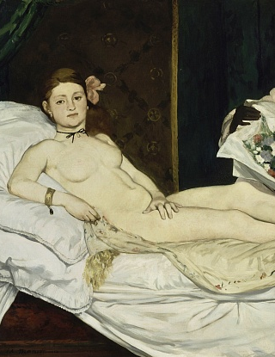

Slide 53
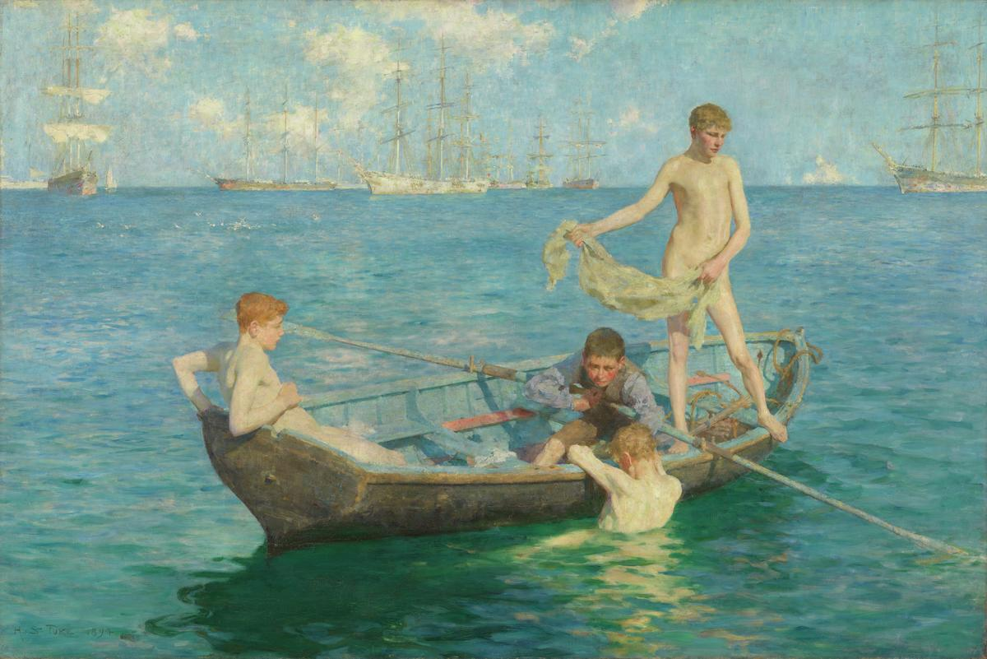
Notes:
Henry Scott Tuke. August Blue 1893-4

Slide 54


Slide 55

Notes:
Alma Tadema A favourite custom 1909

Slide 56


Notes:
Alma Tadema

Slide 57

Notes:
Symph in White no 2 1864

Slide 58


Slide 59


Slide 60

Notes:
The Girlhood of mary virgin 1848-49

Slide 61

Notes:
Ecce ancilla domini! 1849-50 (annunciation.

Slide 62

Notes:
William Morris. Guinevere or La Belle iseult. 1858

Slide 63

Notes:
Beata Beatrix c1862-70

Slide 64



Slide 66


Notes:
Cophetua. 1884

Slide 67


Slide 68


Slide 69


Slide 70

Notes:
Tissot HMS Calcutta 1876

Slide 71

Notes:
George Clausen Winter work 1883=4 cf Bastien-Lepage

Slide 72

Notes:
Waterhouse Lady of Shalott

Slide 73


Slide 74


Slide 75


Notes:
Ellen TerryIsabella stewart Grdner

Slide 76

Notes:
Asher Wertheimer

Slide 77


Notes:
Ena, Betty and Ena

Slide 78

Notes:
Sickert Minnie Cunningham 1892

Slide 79


Slide 81


Slide 82


Slide 83


Slide 84


Slide 85

Notes:
John Frederick Lewis

Slide 86


Slide 87


Slide 88


Slide 90


Slide 91


Slide 96


Slide 105


Notes:
Both created in reign

Slide 134


Notes:
Waiting 1854

Slide 136


Slide 137


Slide 138

Notes:
w. Graham Robertson 1894 aged 28

Slide 139


Slide 140


Slide 141


Slide 142

Notes:
Awakening conscience. 1852. king Cophetua. 1884

Slide 143


Slide 144


Notes:
DGR Proserpine 1877 Aurea Catena.c 1868

Slide 145



