Slide 1
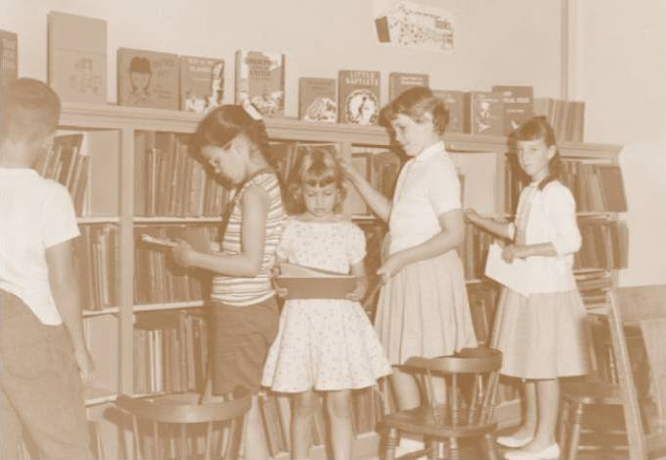
This is one way to learn about fish

Slide 2
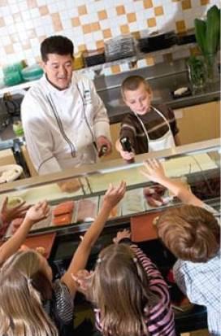
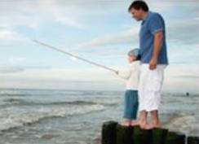
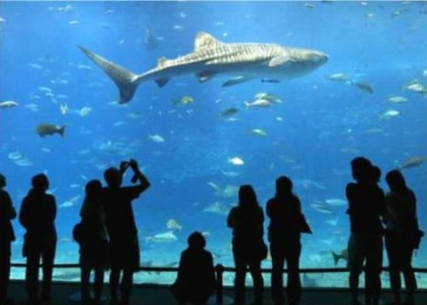
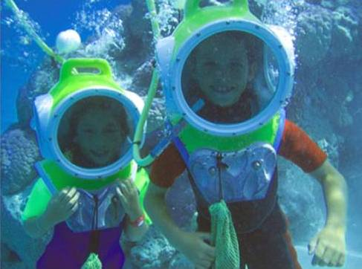
These kids are also learning about fish!

Slide 3
Which students
will remember more?

Slide 4
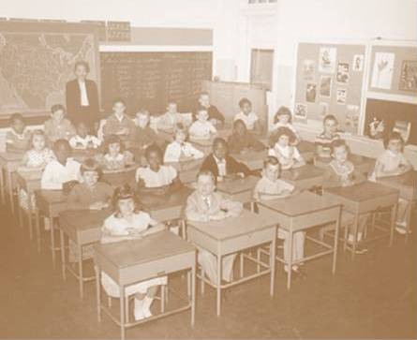
These children are learning history…sorta

Slide 5
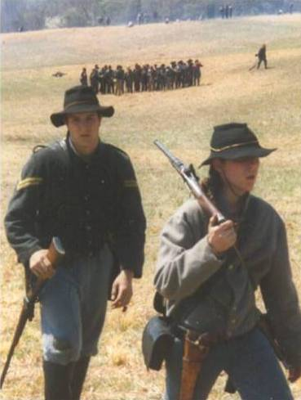
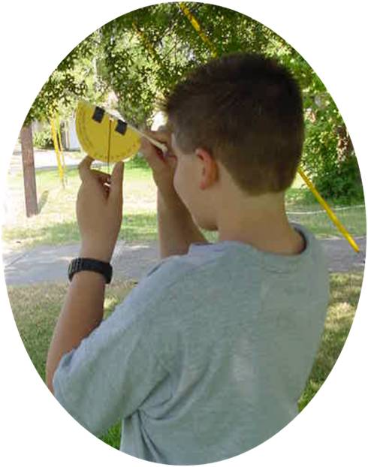
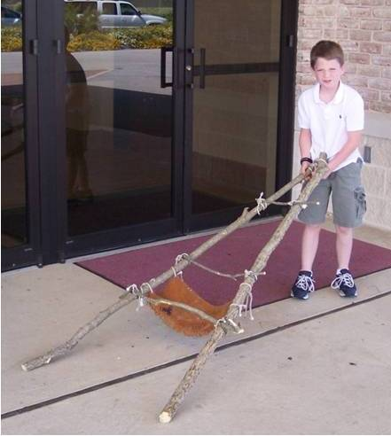
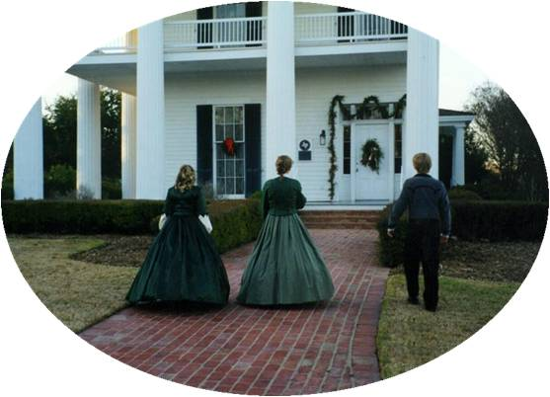
These kids are also learning about history!

Slide 6
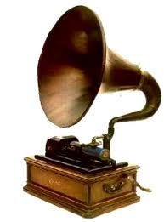
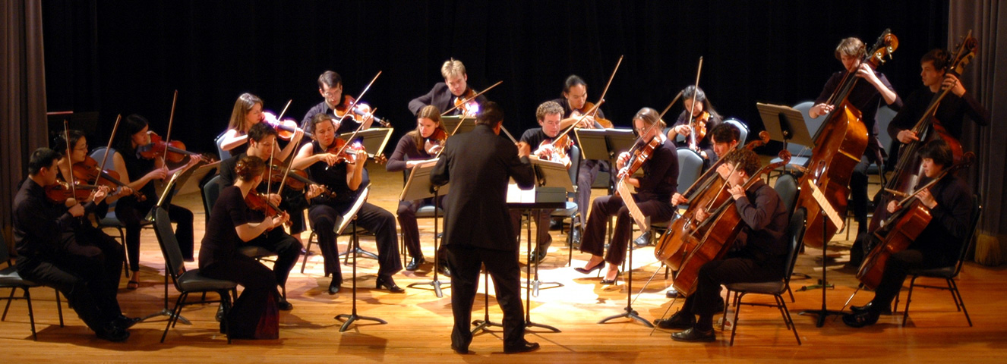
Is THIS... or THIS...
more likely to inspire THIS?

Slide 7
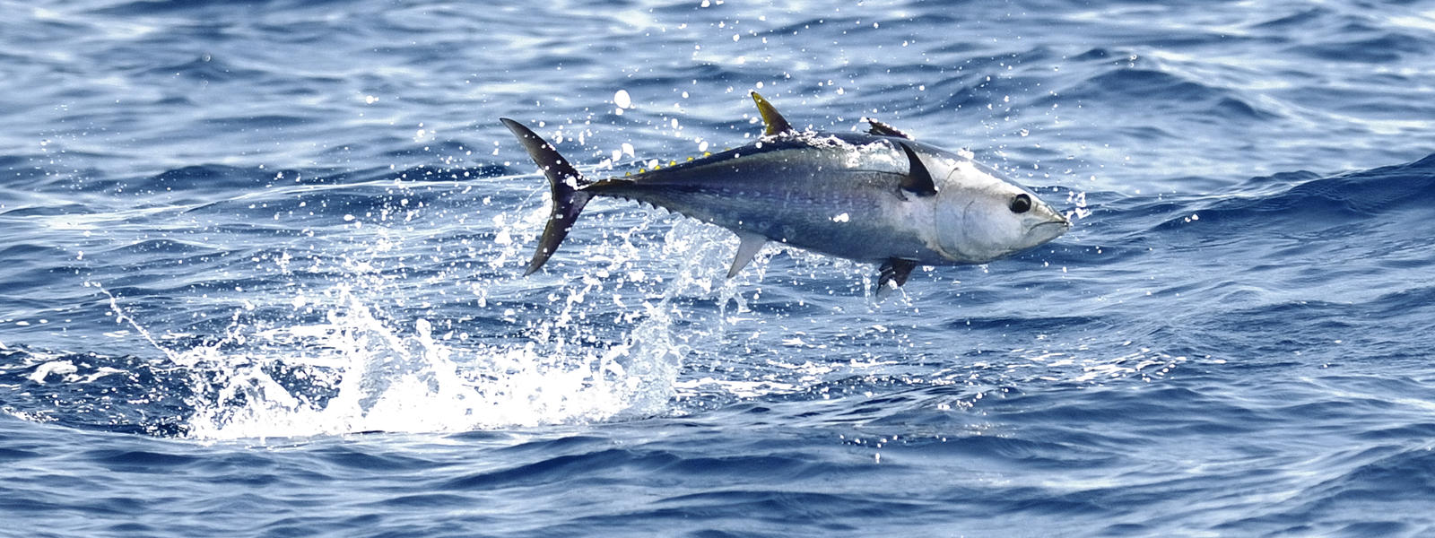
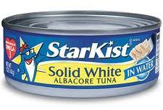
Do our methods take this…
And reduce it to this?

Slide 8
Studies show that we remember only:
10% of what we read
20% of what we hear
30% of what we see
50% of material presented in a passive manner…
But when learning is ACTIVE–when we
experience something for ourselves,
join in a discussion,
enact a simulation or dramatic presentation
share with others what we’ve learned
retention jumps to 70%-90%!

Slide 9
When learning loses appeal, it also loses effectiveness.

Slide 10
To launch students on the adventure
of learning
as a lifestyle
for a lifetime
We must teach in ways that are
Meaningful,
Memorable,
and FUN!

