Slide 1
The Eight Parts of Speech
Elements of Writing
Freshman Level
Notes:
This presentation demonstrates the new capabilities of PowerPoint and it is best viewed in Slide Show. These slides are designed to give you great ideas for the presentations you’ll create in PowerPoint 2010!
For more sample templates, click the File tab, and then on the New tab, click Sample Templates.

Slide 2
Diagnostic Pretest: Identifying Parts of Speech, page 464-5
DIRECTIONS: Identify the part of speech of each underlined word in the following paragraph.
Example: Everyone (1) has favorite summer (2) places.
1. verb
2. noun

Slide 3
noun verb adjective adverb pronoun conjunction preposition interjection
For (1) me, no (2) spot is (3) better than the beach. On (4) hot, sunny days, when the sand (5) burns my feet, I am always (6) careful (7) about putting on (8) sunscreen. I like to run (9) through the foaming surf and later relax under a beach umbrella. Most of the time, I (10) enjoy being with friends, (11) but sometimes I prefer to be by (12) myself. (GO TO THE NEXT SLIDE)

Slide 4
noun verb adjective adverb pronoun conjunction preposition interjection
With only (13) strangers around me, I (14) feel free to think my (15) own thoughts. I wander (16) slowly along the waterline, poking through all the interesting things (17) that the sea has washed up. Once I accidentally stepped on a (18) jellyfish and couldn’t help but yell (19) “Ouch!” when it stung my foot. Since then, I’ve learned to be (20) more careful about where I step.

Slide 5
And now for the answers
1
Diagnostic Pretest pages 464-5

Slide 6
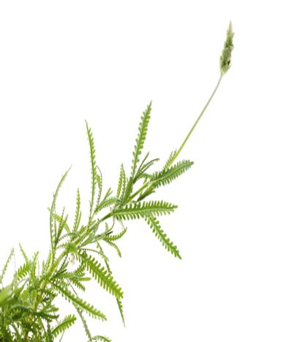
Diagnostic Pretest page 464-5
Pronoun 11. Conjunction
Noun 12. Pronoun
Adjective 13. Noun
Adjective 14. Verb
Verb 15. Adjective
Adjective 16. Adverb
Preposition 17. Pronoun
Noun 18. Noun
Preposition 19. Interjection
Verb 20. Adverb
Organize with Sections

Slide 7
The Noun page 465
A noun is a word used to name a person, place, thing, or idea.
PERSONS: Sharon, Captain Brown, hairstylist, swimmers
PLACES: Iowa, district, Mars, Antarctica, library
THINGS: okra, Great Pyramid, toothpicks, U.S.S. Enterprise, merry-go-round
IDEAS: peach, truth, justice, excellence, honesty

Slide 8
Common and Proper Nouns pages 465-6
A proper noun names a particular person, place, thing, or idea and is always capitalized. A common noun names any one of a group of persons, places, things, or ideas and is not generally capitalized.

Slide 9
Common Proper Nouns
Nouns
scientist……......Marie Curie, Charles Drew
woman…………….Rita Moreno, Maria
city……………………Cairo, St. Louis, Paris
building……………World Trade Center
continent……………..North America, Africa
mountain……………..Mount Everest
day……………………Monday, Labor Day
Comparing Common and Proper Nouns

Slide 10
Concrete Nouns Abstract Nouns
cloud freedom
tulip joy
thunder beauty
silk kindness
yogurt
Comparing Common and Proper Nouns

Slide 11
Exercise 1, page 466
(1) Many useful and amusing new words came into our language during World War II. (2) Now these words are familiar to most Americans. (3) One of these odd words is gremlin. (4) During the war, fliers were often troubled by mysterious mechanical malfunctions. (5) Not knowing what caused these problems, they joked that gremlins—small, mischievous creatures—were in the aircraft.

Slide 12
Exercise 1, page 466
(1) Many useful and amusing new words came into our language during World War II. (2) Now these words are familiar to most Americans. (3) One of these odd words is gremlin. (4) During the war, fliers were often troubled by mysterious mechanical malfunctions. (5) Not knowing what caused these problems, they joked that gremlins—small, mischievous creatures—were in the aircraft.

Slide 13
Exercise 1, page 466
(6) These gremlins could be helpful as well as harmful. (7) Many fliers claimed they had miraculously escaped danger only because the gremlins had come to their rescue. (8) Artists drew the imps as little men with beards and top hats who played all over the planes.

Slide 14
Exercise 1, page 466
(6) These gremlins could be helpful as well as harmful. (7) Many fliers claimed they had miraculously escaped danger only because the gremlins had come to their rescue. (8) Artists drew the imps as little men with beards and top hats who played all over the planes.

Slide 15
Exercise 2, page 467
Identify each of the following nouns as a common or proper noun. Correct capitalization when necessary.

Slide 16
Exercise 2, page 467
1. Man
1. man common noun

Slide 17
Exercise 2, page 467
2. Month
2. Month
common noun

Slide 18
Exercise 2, page 467
3. vietnam
1. Vietnam
proper noun

Slide 19
Exercise 2, page 467
4. singer
4. singer
common noun

Slide 20
Exercise 2, page 467
5. athena
5. Athena
proper noun

Slide 21
Exercise 2, page 467
6. City
6. city
common noun

Slide 22
Exercise 2, page 467
7. Gumbo
7. gumbo
common noun

Slide 23
Exercise 2, page 467
8. movie
8. movie
common noun

Slide 24
Exercise 2, page 467
9. Virginia
9. Virginia
proper noun

Slide 25
Exercise 2, page 467
10. Ocean
10. ocean
common noun

Slide 26
Exercise 2, page 467
11. Mount hood
11. Mount Hood
proper noun

Slide 27
Exercise 2, page 467
12. Australia
12. Australia
proper noun

Slide 28
Exercise 2, page 467
13. DeTroit
13. Detroit
proper noun

Slide 29
Exercise 2, page 467
14. street
14. street
common noun

Slide 30
Exercise 2, page 467
15. Alice walker
15. Alice Walker
proper noun

Slide 31
Exercise 2, page 467
16. airport
16. airport
common noun

Slide 32
Exercise 2, page 467
17. Cousin
17. cousin
common noun

Slide 33
Exercise 2, page 467
18. automobile
18. automobile
common noun

Slide 34
Exercise 2, page 467
19. Blues
19. blues
common noun

Slide 35
Exercise 2, page 467
20. Christopher columbus
20. Christopher Columbus
proper noun

Slide 36
Compound Nouns
A compound noun consists of two or more words used together as a single noun. The parts of a compound noun may be written as one word, as two words, or as a hyphenated word.
Elements of Writing page 467

Slide 37

Note: If you are not sure how to write a compound noun, look in a dictionary.
ONE WORD firefighter, Iceland, newspaper
TWO OR MORE WORDS prime minister, Red River Dam, fire drill
HYPHENATED WORD sister-in-law, Stratford-on-Avon, push-up

Slide 38
Exercise 3, pages 467-8
Identifying Compound Nouns
Each of the following sentences contains at least one compound noun. Identify the compound noun(s) in each sentence.
Example: 1. My cousin John is a political scientist.

Slide 39

Board Races!
Get Ready For…

Slide 40
Exercise 3, pages 467-8
I use a word processor or a typewriter in class.
We went swimming in the Gulf of Mexico.
My brother-in-law lives in Council Bluffs, Iowa.
My Old English sheepdog is still a puppy.
Benjamin Banneker’s almanac gave exact times for sunrises and sunsets.

Slide 41
Exercise 3, pages 467-8
I use a word processor or a typewriter in class.
We went swimming in the Gulf of Mexico.
My brother-in-law lives in Council Bluffs, Iowa.
My Old English sheepdog is still a puppy.
Benjamin Banneker’s almanac gave exact times for sunrises and sunsets.

Slide 42
Exercise 3, pages 467-8
We used to play hide-and-seek in the old barn.
Sitting Bull was the war chief who masterminded the Sioux victory at the Battle of the Little Bighorn.
Meet me at the bowling alley near the post office.
The fountain pen is not as popular as the ballpoint.
Luis Valdez is a playwright, actor, and director.

Slide 43
Exercise 3, pages 467-8
We used to play hide-and-seek in the old barn.
Sitting Bull was the war chief who masterminded the Sioux victory at the Battle of the Little Bighorn.
Meet me at the bowling alley near the post office.
The fountain pen is not as popular as the ballpoint.
Luis Valdez is a playwright, actor, and director.

Slide 44
Exercise 4, page 468 --Find all twenty nouns.
(1) Businesses sometimes use gigantic objects to advertise their products. (2) A stand that sells fruit might look like an enormous orange, complete with doors and windows. (3) Hug dogs, dinosaurs, and figures of Paul Bunyan are formed with cement or fiberglass to help sell chain saws, trucks, or souvenirs. (4) This old hotel in New Jersey was built to look like an elephant!

Slide 45
Exercise 4, page 468
(1) Businesses sometimes use gigantic objects to advertise their products. (2) A stand that sells fruit might look like an enormous orange, complete with doors and windows. (3) Hug dogs, dinosaurs, and figures of Paul Bunyan are formed with cement or fiberglass to help sell chain saws, trucks, or souvenirs. (4) This old hotel in New Jersey was built to look like an elephant!

Slide 46
Exercise 5, page 469
The teacher shall time you as you work in small groups. Identify as many nouns as you can from the pictures on page 469.
Share your answers with the class.
Which group found the most nouns?

Slide 47
The Pronoun, page 469
A pronoun is a word used in place of one or more nouns or pronouns.
Where is Lian? She said she would be here on time. (The pronouns she takes the place of the proper noun Lian twice in the second sentence.)
Our teacher and Mr. Barnes said they would go to the meeting. (The pronoun they takes the place of two nouns: teacher and Mr. Barnes.)

Slide 48
Antecedents page 469-70
A pronoun usually refers to a noun that comes before it. This noun, called an antecedent, gives the pronoun its meaning.
Example:
Thomas closed his book and put it down.
                antecedent pronoun

Slide 49
Antecedents page 469-70
A pronoun usually refers to a noun that comes before it. This noun, called an antecedent, gives the pronoun its meaning.
Example:
The coach showed the players how they
should throw the ball.
pronoun
antecedent

Slide 50
Exercise Six, page 470
(1) Since many people told the same story, the historian believed it. (2) Supposedly, a young boy and girl with bright green skin had been found wandering in the fields. (3) They spoke a foreign language and wore clothing made of an unknown material. (4) At first, the two children would eat only green beans, but after they learned to eat bread, their skin gradually lost its greenness.

Slide 51
Exercise Six, page 470 PRONOUN ANSWERS
(1) Since many people told the same story, the historian believed it.

Slide 52
Exercise Six, page 470 PRONOUN ANSWERS
(1) Since many people told the same story, the historian believed it. (2) Supposedly, a young boy and girl with bright green skin had been found wandering in the fields. (3) They spoke a foreign language and wore clothing made of an unknown material. (4) At first, the two children would eat only green beans, but after they learned to eat bread, their skin gradually lost its greenness.

Slide 53
Exercise Six, page 470
(5) After learning English, the girl said she and her brother had come from a land called Saint Martin. (6) This story sounds like science fiction, doesn’t it? (7) Perhaps the villagers invented it to amuse their friends and fool historians.

Slide 54
Exercise Six, page 470 PRONOUN ANSWES
(5) After learning English, the girl said she and her brother had come from a land called Saint Martin. (6) This story sounds like science fiction, doesn’t it? (7) Perhaps the villagers invented it to amuse their friends and fool historians.

Slide 55
Personal Pronouns
FIRST PERSON SINGULAR:
I, my, mine, me
FIRST PERSON PLURAL:
we, our, ours, us

Slide 56
Personal Pronouns
SECOND PERSON SINGULAR:
you, your, yours
SECOND PERSON PLURAL:
you, your, yours

Slide 57
Personal Pronouns
SECOND PERSON SINGULAR:
you, your, yours
SECOND PERSON PLURAL:
you, your, yours

Slide 58
Personal Pronouns
THIRD PERSON SINGULAR:
he, his him, she, her, hers, it, its
THIRD PERSON PLURAL:
they, their, theirs, them

Slide 59
Other Commonly Used Pronouns
REFLEXIVE AND INTENSIVE PRONOUNS (used to refer to or to emphasize a noun or another pronoun):
myself ourselves
yourself yourselves
himself, herself, itself themselves

Slide 60
Other Commonly Used Pronouns
RELATIVE PRONOUNS (used to introduce adjective and noun clauses)
who whom that
which whose

Slide 61
Other Commonly Used Pronouns
INTERROGATIVE PRONOUNS (used to begin questions)
who…? whom…? which…? whose…?
what…?

Slide 62
Other Commonly Used Pronouns
DEMONSTRATIVE PRONOUNS (used to point out a specific person, place, thing, or idea)
this that these those

Slide 63
Other Commonly Used Pronouns
INDEFINITE PRONOUNS (used to refer to people, places, things, or ideas in general; frequently used without antecedents)
all each more one
another either most other
any everybody much several
anybody everyone neither some
anyone everything nobody somebody
anything few none someone
both many no one

Slide 64
Exercise Seven, page 471
(1) The tea ceremony at Hideko’s house was more like some I have seen in the movies than the one shown here. (2) Hideko said that in Japan people have special rooms for their tea ceremonies, but we used her family’s living room. (3) Hideko told me that the purpose of the tea ceremony, accustomed which dates back hundreds of years, is to create a peaceful mood. (4) In the ceremony, everyone sits quietly and watches the tea being made.

Slide 65
Exercise Seven, page 471
(1) The tea ceremony at Hideko’s house was more like some I have seen in the movies than the one shown here. (2) Hideko said that in Japan people have special rooms for their tea ceremonies, but we used her family’s living room. (3) Hideko told me that the purpose of the tea ceremony, accustomed which dates back hundreds of years, is to create a peaceful mood. (4) In the ceremony, everyone sits quietly and watches the tea being made.

Slide 66
Exercise Seven, page 471-2
(5) Hideko’s mother was our tea master, the person who conducts the ceremony and prepares the tea. (6) Before entering the room for the ceremony, we took our shoes off. (7) During the ceremony each of us kneeled on straw mats. (8) Hideko’s mother served us sweet cakes called Kashi (KAH-shee). (9) Then she prepared the tea and served it in bowls that had been in their family for generations. (10) afterwards, Hideko gave me a poster to remember the ceremony.

Slide 67
Exercise Seven, page 471
(5) Hideko’s mother was our tea master, the person who conducts the ceremony and prepares the tea. (6) Before entering the room for the ceremony, we took our shoes off. (7) During the ceremony each of us kneeled on straw mats. (8) Hideko’s mother served us sweet cakes called Kashi (KAH-shee). (9) Then she prepared the tea and served it in bowls that had been in their family for generations. (10) afterwards, Hideko gave me a poster to remember the ceremony.

Slide 68
Why did Janet take her dog to the vet?
They should start migrating soon.
The English villagers told him.
Susie quit biting her nails.
Vic took an umbrella with him.
What three items would you be tempted to buy?
Why did Janet take her dog to the vet?
They should start migrating soon.
The English villagers told him.
Susie quit biting her nails.
Vic took an umbrella with him.
What three items would you be tempted to buy?

Slide 69
Why did Janet take her dog to the vet?
They should start migrating soon.
The English villagers told him.
Susie quit biting her nails.
Vic took an umbrella with him.
What three items would you be tempted to buy?
Why did Janet take her dog to the vet?
They should start migrating soon.
The English villagers told him.
Susie quit biting her nails.
Vic took an umbrella with him.
What three items would you be tempted to buy?

Slide 70
The Adjective
An adjective is a word used to modify a noun or a pronoun.
To modify a word means to describe the word or to make its meaning more definite. An adjective modifies a noun or a pronoun by telling what kind, which one, or how many.

Slide 71
What Kind? Adjectives
gray sky
old shoes
clever dog
low price
Which One? Adjectives
that girl
next day
either way
last chance

Slide 72
How Many? Adjectives
five fingers
many rivers
fewer hours
some problems

Slide 73
Pronoun or Adjective?
Pronoun
I like that.
Either will do.
Sheila bought some.
Adjective
I like that shirt.
Either car will do.
Sheila bought some books.

Slide 74
Nouns Used as Adjectives?
Common Nouns
cheese
snow
winter
Common Nouns Used as Adjectives
cheese sandwich
snow sculpture
winter sale

Slide 75
Nouns Used as Adjectives?
Common Nouns
cheese
snow
winter
Common Nouns Used as Adjectives
cheese sandwich
snow sculpture
winter sale

Slide 76
Nouns Used as Adjectives?
Proper Nouns
Sioux
Texas
Picasso
Common Nouns Used as Adjectives
Sioux tradition
Texas coast
Picasso painting

Slide 77
Exercise 8, page--Identify nouns used as adjectives.
I love anything that has to do with (1) baseball. I save the money I make mowing the (2) golf course, and then I go to the (3) card (4) store. The (5) store owner sold me a terrific (6) Don Mattingly (7) card today. It came in its own (8) plastic case. I’ll display my new card with my other favorites in a special (9) glass (10) case on the wall in my room.

Slide 78
Exercise 8, page--Identify nouns used as adjectives.
baseball=noun
golf course=adjective
card store=adjective
card store=noun
store owner=adjective

Slide 79
Why did Janet take her dog to that vet?
They should start migrating soon.
The English villagers told him.
Susie quit biting her long nails.
Vic took a blue umbrella with him.
What three items would you be tempted to buy?
Why did Janet take her dog to that vet?
They should start migrating soon.
The English villagers told him.
Susie quit biting her long nails.
Vic took a blue umbrella with him.
What three items would you be tempted to buy?

Slide 80
Why did Janet take her dog to that vet?
They should start migrating soon.
The English villagers told him.
Susie quit biting her long nails.
Vic took a blue
umbrella with him.
What three items would you be tempted to buy?
Why did Janet take her dog to that vet?
They should start migrating soon.
The English villagers told him.
Susie quit biting her long nails.
Vic took a blue umbrella with him.
What three items would you be tempted to buy?

Slide 81
Exercise 8, page--Identify nouns used as adjectives.
6. Don Mattingly card=adjective
7. Don Mattingly card=noun
plastic case=adjective
glass case=adjective
glass case=noun

Slide 82
An Article is an Adjective
The most frequently used adjectives are articles: a, an, the.
A and an are indefinite articles. They indicate that the noun refers to one of a general group.
EXAMPLES: A girl won
An elephant escaped
This is an honor

Slide 83
An Article is an Adjective
The is a definite article. It indicates that a noun refers to someone or something in particular.
EXAMPLES: The girl won
The elephant escaped
The honor goes to her.

Slide 84
Adjectives in Sentences
An adjective usually comes before the noun or pronoun it modifies.
DIRECTIONS: Draw arrows from the adjective to the words they modify.
Examples:
Ms. Farrell tells all students that good workers will be give special privileges.
A sweating, exhausted runner crossed the line

Slide 85
Adjectives in Sentences
An adjective usually comes before the noun or pronoun it modifies.
DIRECTIONS: Draw arrows from the adjective to the words they modify.
Examples:
Ms. Farrell tells all students that good→workers will be give special→privileges.
A sweating, exhausted→runner crossed the line

Slide 86
Adjectives in Sentences
In some cases, adjectives follow the word they modify.
DIRECTIONS: Draw arrows from the adjective to the words they modify.
Example: A dog, old and overweight, snored in the sun.

Slide 87
Adjectives in Sentences
In some cases, adjectives follow the word they modify.
DIRECTIONS: Draw arrows from the adjective to the words they modify.
Example: A dog, old and overweight, snored in the sun.

Slide 88
Adjectives in Sentences
Other words may separate an adjective from the noun or pronoun it modifies.
DIRECTIONS: Draw arrows from the adjective to the words they modify.
Examples:
Beverly was worried.
She felt nervous about the play.

Slide 89
Adjectives in Sentences
Other words may separate an adjective from the noun or pronoun it modifies.
DIRECTIONS: Draw arrows from the adjective to the words they modify.
Examples:
Beverly was worried.
She felt nervous about the play.

Slide 90
Revising Sentences by Using Appropriate Adjectives, Exercise 9, page 475
DIRECTIONS: Add adjectives to make two entirely different sentences from each of the following five sentences.
Examples:
1. The waiter showed the woman to a table in the corner.
1. The kindly waiter showed the shy woman to a pleasant table in the sunny corner.

Slide 91
Exercise 9, page 475
The blossoms on the trees filled he air with a scent.
As the clouds gathered in the sky, the captain spoke to the crew.
At the end of the hall were stairs that led to a room.
Jerome’s car had an engine and wheels.
The singers and comedians gave a performance for the audience.

Slide 92
Exercise 9, page 475,
Student Awesome Revisions
The blossoms on the trees filled he air with a scent.
1. The sparkling blossoms on the oak trees filled the air with a beautiful scent.
2. As the clouds gathered in the sky, the captain spoke to the crew.
2. As the ominous clouds gathered in the dark, blue sky, the captain barked orders to his frantic crew.

Slide 93
Exercise 9, page 475,
Student Awesome Revisions
3. At the end of the hall were stairs that led to a room.
3. At the end of the long hall, were stairs leading to the dead child’s room.
4. Jerome’s car had an engine and wheels.
4. Jerome’s beat up car with worn out wheels, at least had an engine.

Slide 94
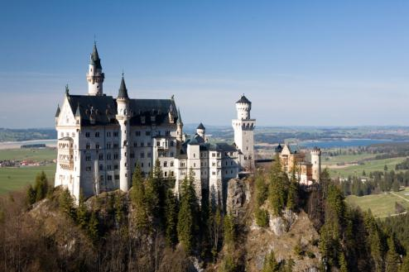
Exercise 10, page 475
Using Adjectives in a Descriptive Paragraph
Inside this castle are hundreds of rooms—a throne room, banquet halls, dungeons, and so on. Write a paragraph that describes a room in the castle as it might have looked when a king or queen lived there. In the paragraph, use adjectives that clearly describe the room. Underline the
adjectives you use and be
prepared to identify the noun that each adjective modifies.

Slide 95
Exercise 10, page 475
Using Adjectives in a Descriptive Paragraph
Far, far away there was once a beautiful castle nestled deep in the woods. Magnificent splendor draped the outer walls, yet buried within the belly of this majestic beast, death and a fate worse than death hungered for its next repast. One of its most spacious rooms, bore chains, whips, spikes, and shrill screams for mercy.

Slide 96
Review A, page 477
Identifying Nouns, Pronouns, and Adjectives
(1) This article tells about Shakespeare’s life. (2) Shakespeare, perhaps the most famous playwright of all time, was born in Stratford-on-Avon in 1564. (3) He was baptized in the small church at Stratford shortly after his birth. (4) In 1616, he was buried in the same church. (5) If you visit his grave, you can find an inscription placing a curse on anyone who moves his bones. (6) Out of respect for his wish or because of fear of his curse, nobody has disturbed the grave.

Slide 97
Review A, page 477
Identifying Nouns, Pronouns, and Adjectives
(7) As a result, his body has never been moved to Westminster Abby, where many other famous English writers are buried. (8) Visitors to Stratford can also see the house in which Shakespeare was born. (9) At one time tourists could visit the large house that Shakespeare bought for himself and his family. (10) This was where they lived when he retired from the London theater.

Slide 98
Review A, page 477
Identifying Nouns, Pronouns, and Adjectives
This article tells about Shakespeare’s life.
adjective noun
Shakespeare, perhaps the most famous
noun adjective
playwright of all time, was born in Stratford-on-Avon in
1564.
(3) He was baptized in the small church at Stratford
adjective
shortly after his birth.

Slide 99
Review A, page 477
Identifying Nouns, Pronouns, and Adjectives
(4) In 1616, he was buried in the same church.
pronoun adjective
(5) If you visit his grave, you can find an inscription
placing a curse on anyone who moves his bones.
pronoun
(6) Out of respect for his wish or because of fear of his curse, nobody has disturbed the grave.
pronoun

Slide 100
Review A, page 477
Identifying Nouns, Pronouns, and Adjectives
(7) As a result, his body has never been moved to Westminster Abby, where many other famous English
adj. adj.
writers are buried. (8) Visitors to Stratford can also
noun
see the house in which Shakespeare was born.
(9) At one time tourists could visit the large house
adjective
that Shakespeare bought for himself and his family.
pronoun

Slide 101
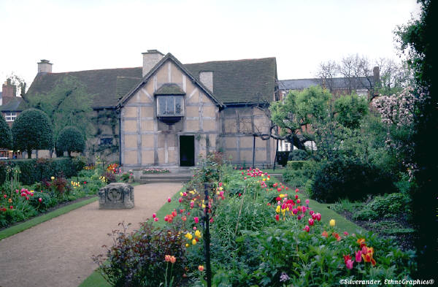
Review A, page 477
Identifying Nouns, Pronouns, and Adjectives
(10) This was where they lived when he retired from
adjective
the London theater.
noun

Slide 102
The Verb
A verb is a word used to express an action or a state of being.
Action Verbs: express physical or mental activity.
Examples of Action Verbs:
PHYSICAL: come, go, inquire, proceed
MENTAL: believe, know, remember, understand

Slide 103
Exercise 11, page 477—Writing Action Verbs
DIRECTIONS: Write twenty action verbs, not including those listed previously. Include and underline at least five verbs that express actions that cannot be seen.

Slide 104
Exercise 11, page 477—Writing Action Verbs
A minimum of five students should write example sentences on the board for whole-group analysis.

Slide 105
Transitive and Intransitive Verbs
A transitive verb is an action verb that expresses an action directed toward a person or thing named in the sentence.
EXAMPLES:
Neil rang the bell. (The action of the verb rang is directed toward bell.)
Juanita mailed the package. (The action of mailed is directed toward the package.)

Slide 106
Transitive and Intransitive Verbs page 478
An intransitive verb expresses action (or tells something about the subject) without passing the action from a doer to a receiver.
EXAMPLES:
Last Saturday we stayed inside.
The children laughed.

Slide 107
A Verb May Be Transitive in One Sentence and Intransitive in Another
DIRECTIONS: Mark as (T) transitive or (I) intransitive.
____ We stayed inside.
____ We painted the inside.
____ Marcie studied her notes.
____ Marcie wrote late into the night.
____ Marcie studied very late.

Slide 108
A Verb May Be Transitive in One Sentence and Intransitive in Another
DIRECTIONS: Mark as (T) transitive or (I) intransitive.
I We stayed inside.
T We painted the inside.
T Marcie studied her notes.
I Marcie wrote late into the night.
I Marcie studied very late.

Slide 109
Linking Verbs
A Linking verb is a verb that connects the subject to a word that identifies or describes it. The most commonly used linking verbs are forms of the verb be.

Slide 110
Linking Verbs are Forms of the Verb BE
be shall be should be
being will be would be
am has been can be
is have been could be
are had been should have been
was shall have been would have been
were will have been could have been

Slide 111
Other Frequently Used Linking Verbs
appear feel look seem sound
taste become remain smell stay
turn

Slide 112
Exercise 13, page 481—Underline the linking verbs.
He felt foolish when his car ran out of gas.
Suddenly, it turned very dark, and the wind began to blow.
We had waited so long for dinner that anything would have tasted wonderful.
The plot of that fantasy novel seems awfully childish to me now.
Kevin and I stayed best friends throughout middle school.

Slide 113
Exercise 13, page 481—Underline the linking verbs.
He felt foolish when his car ran out of gas.
Suddenly, it turned very dark, and the wind began to blow.
We had waited so long for dinner that anything would have tasted wonderful.
The plot of that fantasy novel seems awfully childish to me now.
Kevin and I stayed best friends throughout middle school.

Slide 114
Exercise 13, page 481—Now, circle all other verbs.
He felt foolish when his car ran out of gas.
Suddenly, it turned very dark, and the wind began to blow.
We had waited so long for dinner that anything would have tasted wonderful.
The plot of that fantasy novel seems awfully childish to me now.
Kevin and I stayed best friends throughout middle school.

Slide 115
Exercise 13, page 481—Now, circle all other verbs.
He felt foolish when his car ran out of gas.
Suddenly, it turned very dark, and the wind began to blow.
We had waited so long for dinner that anything would have tasted wonderful.
The plot of that fantasy novel seems awfully childish to me now.
Kevin and I stayed best friends throughout middle school.

Slide 116
Exercise 13, page 481—Underline the linking verbs.
I am happy that you won the chess match.
If the coach had let me play, this game would have been my first one with the Tigers.
My father thinks that you should become a lawyer.
After practicing hard, Stef’s band sounded great in the concert.
For a confusing moment, Dr. Kostas thought the planet’s rings appeared smaller.

Slide 117
Exercise 13, page 481—Underline the linking verbs.
I am happy that you won the chess match.
If the coach had let me play, this game would have been my first one with the Tigers.
My father thinks that you should become a lawyer.
After practicing hard, Stef’s band sounded great in the concert.
For a confusing moment, Dr. Kostas thought the planet’s rings appeared smaller.

Slide 118
Exercise 13, page 481—Now find all the verbs.
I am happy that you won the chess match.
If the coach had let me play, this game would have been my first one with the Tigers.
My father thinks that you should become a lawyer.
After practicing hard, Stef’s band sounded great in the concert.
For a confusing moment, Dr. Kostas thought the planet’s rings appeared smaller.

Slide 119
Exercise 13, page 481—Now adjective, noun, pronoun review
6. I am happy that you won the chess match.
7. If the coach had let me play, this game would have been my first one with the Tigers.
8. My father thinks that you should become a lawyer.
9. After practicing hard, Stef’s band sounded great in the concert.

Slide 120
I am happy that you won the chess match.
P P A A N
If the coach had let me play, this game would have
A N P A N
been my first one with the Tigers.
P A N A N
My father thinks that you should become a lawyer.
P N P A N
After practicing hard, Stef’s band sounded great in
    A N
the concert.
N

Slide 121
Exercise 14, page Writing appropriate linking verbs
That building ___ the new public library.
The care ____ funny.
The moose ____ huge.
I ____ very nervous about the driving test.
Her garden ____ dried and brown in the drought.
Let’s hope the evening ___ cool.
We can eat the raspberries when they ____ red.

Slide 122
Exercise 14, page Writing appropriate linking verbs (Suggested Answers)
That building is the new public library.
The care sounds funny.
The moose is huge.
I felt very nervous about the driving test.
Her garden became dried and brown in the drought.
Let’s hope the evening will be cool.
We can eat the raspberries when they turn red.

Slide 123
Exercise 14, page Writing appropriate linking verbs
Burt ____ grouchy early in the morning.
The soup ____ to salty.
The puppy _____ healthy and playful.
(Suggested Answers)
Burt would be grouchy early in the morning.
The soup tasted to salty.
The puppy appears healthy and playful.

Slide 124
Verb Phrases: A verb phrase consists of a main verb preceded by at least one helping verb (also called an auxiliary verb). Besides all forms of the verb be, helping verbs include…
has shall may could do
have will should might did
had can would must does

Slide 125
Verb Phrases: Notice how helping verbs work together with main verbs to make a complete verb phrase…
EXAMPLES:
may become might have remained
had seemed must have thought should move
shall be going could jump does sing

Slide 126
Verb Phrases: Sometimes the parts of a verb phrase are interrupted by other parts of speech…
EXAMPLES:
She had always been thinking of her future.
We could never have moved the car alone.
Did you hear the Rev. Jesse Jackson’s speech?
Has my sister played her new song for you?

Slide 127

Note: The word not is ALWAYS an adverb. It is never part of a helping verb, even when it is joined to a verb as the contraction—n’t.

Slide 128
Exercise 16, Identifying Helping Verbs page 483
Fortunately, he didn’t need surgery.
His physical therapist has designed an exercise program for him.
Before exercising, he must spend at least five minutes warming up.
Does he walk indoors on a treadmill or outdoors on a track?
He will be using a back-extension machine.

Slide 129
Exercise 16, Identifying Helping Verbs page 483
Fortunately, he didn’t need surgery.
His physical therapist has designed an exercise program for him.
Before exercising, he must spend at least five minutes warming up.
Does he walk indoors on a treadmill or outdoors on a track?
He will be using a back-extension machine.

Slide 130
Exercise 16, Identifying Helping Verbs page 483
In his exercise program at home, he will be using a gymnastic ball.
The doctor is always reminding my brother about proper techniques for lifting.
When lifting heavy objects, my brother must wear a back brace.
Should he try acupuncture or massage therapy?
Without physical therapy, he might not have healed as quickly and as completely.

Slide 131
Exercise 16, Identifying Helping Verbs page 483
In his exercise program at home, he will be using a gymnastic ball.
The doctor is always reminding my brother about proper techniques for lifting.
When lifting heavy objects, my brother must wear a back brace.
Should he try acupuncture or massage therapy?
Without physical therapy, he might not have healed as quickly and as completely.

Slide 132


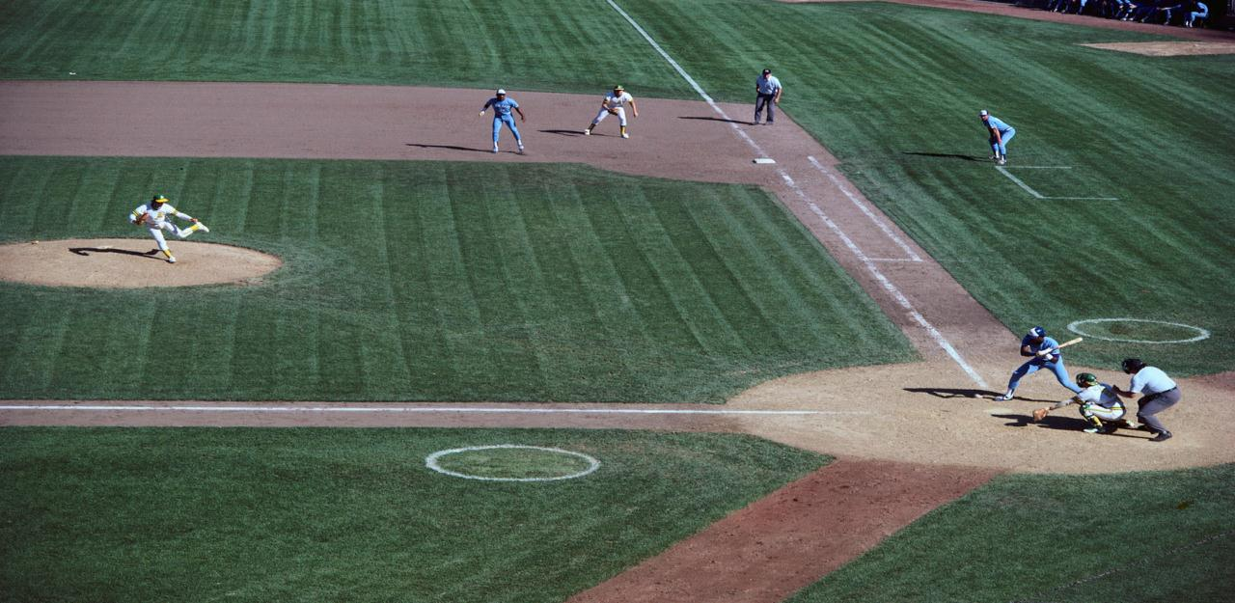
Choose the correct base or…You’re Out!

Slide 133
Noun Baseman
Adjective Baseman
Pitchers
Pronoun Baseman
Verb Baseman

Slide 134
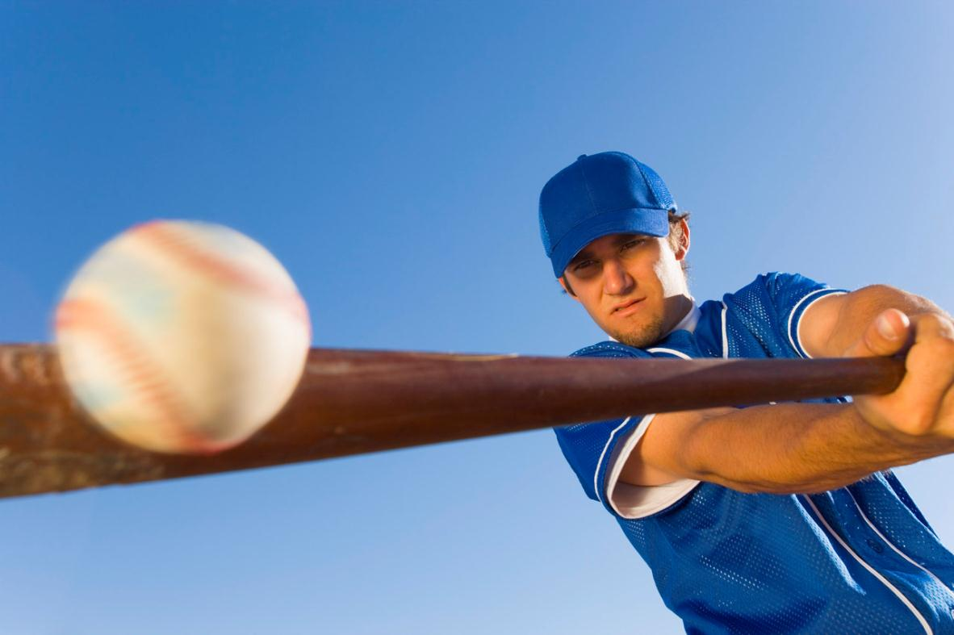

Slide 135
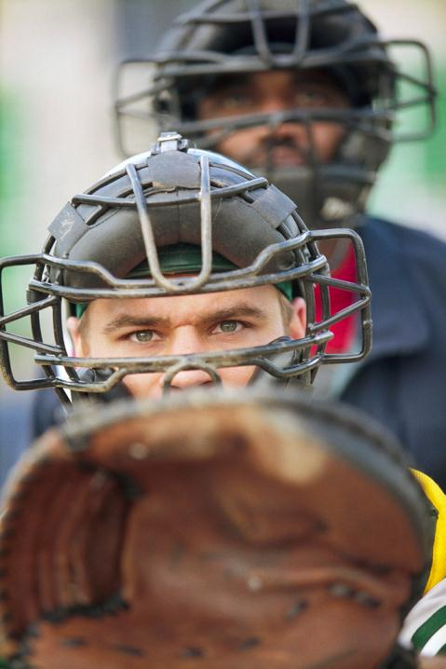
Let’s Play Ball!
many
  adjective
useful
adjective
3. amusing
  adjective
4. new
  adjective
words
  noun

Slide 136
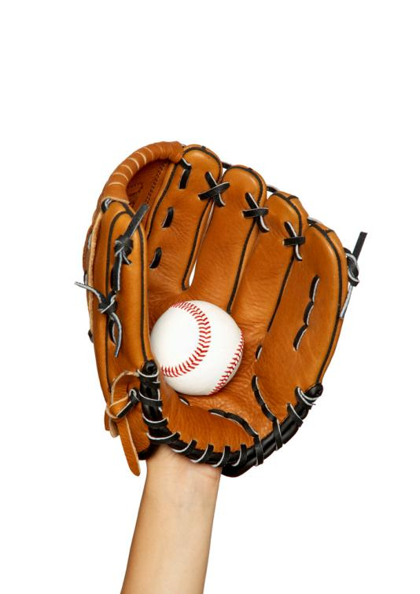
Let’s Play Ball!
me
  pronoun
burning
verb
3. been
  verb
4. my
  pronoun
enjoy
  verb

Slide 137
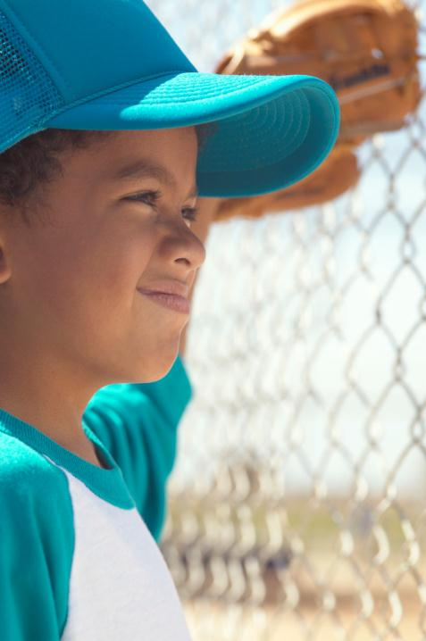
Let’s Play Ball!
putting
  verb
tiger
noun
3. awesome
  adjective
4. you
  pronoun
Millennium Tiger
  adjective

Slide 138
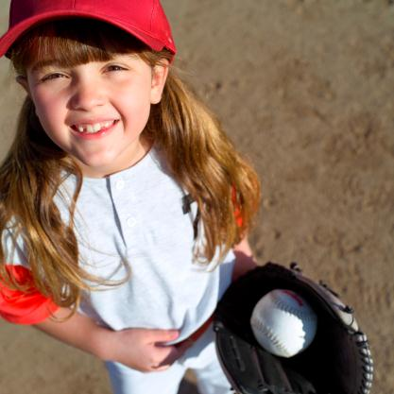
Let’s Play Ball!
run
  verb
runner
noun
3. running shoes
  adjective
4. baseball
  noun
baseball bat
  adjective

Slide 139
Students should now prepare to demonstrate mastery of nouns, pronouns, and adjectives. See unit test.

Slide 140
The Adverb
A adverb is a word used to modify a verb, and adjective or another adverb.

Slide 141
Where? When?
We lived there. May we go tomorrow?
Please step up. Water the plant weekly.
I have the ticket here. We’ll see you later.
How? To What Extent?
She quickly agreed. I am completely happy.
The rain fell softly. He hardly moved.
Drive carefully. Did she hesitate slightly?

Slide 142
Where? When?
We lived there. May we go tomorrow?
Please step up. Water the plant weekly.
I have the ticket here. We’ll see you later.
How? To What Extent?
She quickly agreed. I am completely happy.
The rain fell softly. He hardly moved.
Drive carefully. Did she hesitate slightly?

Slide 143
Exercise 19 page 486
The soldiers must travel (how).
You will probably sleep well (when).
They whispered (how) to Mr. Baldwin.
Tonya took a deep breath and dived (where).
Did you study (to what extent)?

Slide 144
Exercise 19 page 486
The soldiers must travel quietly (how).
You will probably sleep well tonight (when).
They whispered softly (how) to Mr. Baldwin.
Tonya took a deep breath and dived in (where).
Did you study much (to what extent)?

Slide 145
Exercise 19 page 486
Handle the baby kittens (how).
My uncle Hans is (when) in a bad mood.
Your taxi should be (where) soon.
I could (to what extent) taste the tangy pizza.
(When), you should paste the pictures on the poster.

Slide 146
Exercise 19 page 486
Handle the baby kittens carefully (how).
My uncle Hans is never (when) in a bad mood.
Your taxi should be here (where) soon.
I could almost (to what extent) taste the tangy pizza.
(When) First, you should paste the pictures on the poster.

Slide 147
Adverbs Modifying Adjectives
Examples:
Beth did an exceptionally fine job. (The adverb exceptionally modifies the adjective fine, telling how fine.)
Slightly cooler temperatures are forecast for this Sunday. (The adverb slightly modifies the adjective cooler, telling how cool.)

Slide 148
Adverbs that Frequently Modify Adjectives, page 486
completely
dangerously
definitely
dreadfully
entirely
especially extremely
largely
mainly
mostly
quite
rather surprisingly terribly unusually

Slide 149
Exercise 20, page 487
Identify ten adverbs that modify adjectives.
1. If you are ever really lost in the woods at night, knowing how to find the north Star may be extremely important. 2. Here is one method that is often useful. 3. First, find the constellation Ursa Major, which many people call the Big Dipper. 4. this constellation is especially easy to find. 5. It consists of seven rather bright stars in the northern sky that are arranged in the shape of a large dipper.

Slide 150
Exercise 20, page 487 adverbs adjectives
1. If you are ever really lost in the woods at night, knowing how to find the north Star may be extremely important. 2. Here is one method that is often useful. 3. First, find the constellation Ursa Major, which many people call the Big Dipper. 4. this constellation is especially easy to find. 5. It consists of seven rather bright stars in the northern sky that are arranged in the shape of a large dipper.

Slide 151
Exercise 20, page 487
Identify ten adverbs that modify adjectives.
6. Do not confuse it with the Little Dipper, which is somewhat smaller. 7. After you have found the Big Dipper, you must be very careful to sight along the two stars that form the front of the dipper bowl. 8. They are two points on an almost straight line that leads to Polaris, the North Star. 9. This method for getting your bearings is completely reliable—except when the clouds are so dense that you cannot see the stars.

Slide 152
Exercise 20, page 487
Identify ten adverbs that modify adjectives.
6. Do not confuse it with the Little Dipper, which is somewhat smaller. 7. After you have found the Big Dipper, you must be very careful to sight along the two stars that form the front of the dipper bowl. 8. They are two points on an almost straight line that leads to Polaris, the North Star. 9. This method for getting your bearings is completely reliable—except when the clouds are so dense that you cannot see the stars.

Slide 153


Let’s Play FLICKO
Create a game board (see next slide), then point at the correct answer before your partner does.
One point per each correct point (pun intended)

Slide 154


Noun 4. Verb
Adjective 5. Adverb
Pronoun 6. Article

Slide 155
She moved her hand gracefully.
pronoun
2. She moved her hand gracefully.
pronoun
3. She moved her hand gracefully.
adverb
She moved her hand gracefully.
  verb
She moved her hand gracefully.
  noun

Slide 156
First you should paste the pictures on the poster.
adverb modifying how you should paste
2. First you should paste the pictures on the poster.
noun
3. First you should paste the pictures on the poster.
article (a type of adjective)
First you should paste the pictures on the poster.
verb
First you should paste the pictures on the poster.
pronoun

Slide 157
The compass I had bought was incredibly cheap.
article (a type of adjective)
2. The compass I had bought was incredibly cheap.
pronoun
3. The compass I had bought was incredibly cheap.
verb (a form of he verb be)
4. The compass I had bought was incredibly cheap.
adjective
5. The compass I had bought was incredibly cheap.
adverb modifying the adjective cheap

Slide 158
Adverbs Modifying Other Adverbs
Examples:
Calvin was almost never there. (The adverb almost modifies the adverb never, telling to what extent.)
We’ll meet shortly afterward. (The adverb shortly modifies the adverb afterward, telling to what extent.)
She slept too late. (The adverb too modifies the adverb late, telling to what extent.)

Slide 159
Exercise 22, page 488
DIRECTIONS: Identify all the adverbs that modify other adverbs in the following sentences. After each, give the adverb it modifies.
EXAMPLE:
Brian is so terribly shy that he blushes when people speak to him.
so, terribly

Slide 160
Exercise 22, page 488 adverbs modifying other adverbs
The cat leapt to the windowsill quite agilely.
The books were stacked rather haphazardly.
Corrie knew she’d have to get up incredibly early to watch the eclipse.
The tornado almost completely destroyed the barn.
The famous diamond was more heavily guarded than any other exhibit at the museum.

Slide 161
Exercise 22, page 488 adverbs modifying other adverbs
The cat leapt to the windowsill quite agilely.
The books were stacked rather haphazardly.
Corrie knew she’d have to get up incredibly early to watch the eclipse.
The tornado almost completely destroyed the barn.
The famous diamond was more heavily guarded than any other exhibit at the museum.

Slide 162
Exercise 22, page 488 adverbs modifying other adverbs
The cat leapt to the windowsill quite agilely.
The books were stacked rather haphazardly.
Corrie knew she’d have to get up incredibly early to watch the eclipse.
The tornado almost completely destroyed the barn.
The famous diamond was more heavily guarded than any other exhibit at the museum.

Slide 163
Exercise 22, page 488
My brother is nearly always finished with his paper route before I am finished with mine.
She registered too late to be eligible for the first sweepstakes drawing.
In the final four minutes of the game, Isiah Thomas shot extremely accurately.
Usually it seems that each month goes more rapidly than the month before.
They walked onto the stage most calmly, as if they felt completely relaxed.

Slide 164
Exercise 22, page 488
My brother is nearly always finished with his paper route before I am finished with mine.
She registered too late to be eligible for the first sweepstakes drawing.
In the final four minutes of the game, Isiah Thomas shot extremely accurately.
Usually it seems that each month goes more rapidly than the month before.
They walked onto the stage most calmly, as if they felt completely relaxed.

Slide 165
Exercise 22, page 488
My brother is nearly always finished with his paper route before I am finished with mine.
She registered too late to be eligible for the first sweepstakes drawing.
In the final four minutes of the game, Isiah Thomas shot extremely accurately.
Usually it seems that each month goes more rapidly than the month before.
They walked onto the stage most calmly, as if they felt completely relaxed.

Slide 166
Exercise 23, page 489—identify all adverbs
1. Successful movie scripts, or screenplays, are written according to a very rigid formula. 2. The main character and the story idea must grab an audience’s interest quickly. 3. Almost exactly twenty-five minutes into the movie comes a “plot point.” 4. This is a surprising event that swings the story around in another direction. 5. Most of the action and conflict occurs in the next hour of the movie.

Slide 167
Exercise 23, page 489—identify all adverbs
1. Successful movie scripts, or screenplays, are written according to a very rigid formula. 2. The main character and the story idea must grab an audience’s interest quickly. 3. Almost exactly twenty-five minutes into the movie comes a “plot point.” 4. This is a surprising event that swings the story around in another direction. 5. Most of the action and conflict occurs in the next hour of the movie…no adverb in 5

Slide 168
Exercise 23, page 489—identify all adverbs
6. Then comes another plot point, about eighty-five minutes into the movie. 7. Finally we learn what happens to the characters. 8. The last time I went to a movie I really liked, I checked my watch. 9. It was quite interesting to find that the movie’s timing matched this formula.

Slide 169
Exercise 23, page 489—identify all adverbs
6. Then comes another plot point, about eighty-five minutes into the movie. 7. Finally we learn what happens to the characters. 8. The last time I went to a movie I really liked, I checked my watch. 9. It was quite interesting to find that the movie’s timing matched this formula.

Slide 170
Exercise 24, page 489-90—revise sentences by using appropriate adverbs
Angelo promised me that he would try to meet the train.
My coat was torn during the long hike, and Barbara lent me her poncho.
Engineering degrees are popular with students because job opportunities are so good.
The Wallaces are settled into a new house, which they built themselves.
When the baseball season begins, I will be attending games every day.

Slide 171
Exercise 24, page 489-90—revise sentences by using appropriate adverbs
Angelo promised me that he definitely would try to meet the train.
My coat was badly torn during the long hike, and Barbara lent me her poncho.
Engineering degrees are particularly popular with students because job opportunities are so good.
The Wallaces are comfortably settled into a new house, which they built themselves.
When the baseball season begins, I will be happily attending games every day.

Slide 172
Exercise 24, page 489-90—revise sentences by using appropriate adverbs
Ronald dribbled to his left and threw the ball into a crowd of defenders.
Visits to national monuments and parks remind us that our country has an exciting history.
We returned the book to Marcella, but she had planned her report without it.
Georgia O’Keefe displayed her paintings and received the admiration of a large audience.
The recipe calls for two eggs, but I did not have time to buy any at the store.

Slide 173
Exercise 24, page 489-90—revise sentences by using appropriate adverbs
Ronald hastily dribbled to his left and threw the ball into a crowd of defenders.
Visits to national monuments and parks remind us that our country has an especially exciting history.
We returned the book to Marcella, but she already had planned her report without it.
Georgia O’Keefe displayed her paintings and later received the admiration of a large audience.
The recipe calls for two eggs, but I certainly did not have time to buy any at the store.

Slide 174
Good vs. Well
Good is an adjective which modifies a noun.
Well is an adverb which modifies a verb.
Exception: Well is sometimes used to mean healthy, so pay attention to the content of the sentence.
  Example: I am well; I’m not sick anymore.

Slide 175
Practice Good vs. Bad
Interactive Quiz
http://www.eflnet.com/grammar/goodwell1.php

Slide 176


Let’s Play…
Flicko
  Point at the appropriate response before your partner does to earn a point.

Slide 177
Good Well

Slide 178
Good or Well?
I usually do (good, well) on that kind of test.
I can skate (good, well).
How (good, well) do you know him?
Sam did a (good, well) job on her assignment.
Sam did (good, well) on her assignment.
Sam did (good, well).
Driving with your eyes open is a (good, well) idea.
The idea was expressed (good, well) in the article.

Slide 179
Good or Well?
I usually do (good, well) on that kind of test.
I can skate (good, well).
How (good, well) do you know him?
Sam did a (good, well) job on her assignment.
Sam did (good, well) on her assignment.
Sam did (good, well).
Driving with your eyes open is a (good, well) idea.
The idea was expressed (good, well) in the article.

Slide 180
Good or Well?
I’ll feel better if I get a (good, well) night’s sleep.
Your snoring made it impossible for me to sleep (good, well).
I really believe that tuna fish is a (good, well) breakfast food.
I’m still afraid of your (good, well) trained grizzly bear.
How (good, well) do you run on a hot day?
Dig deep to have a (good, well) well.
Have you been a (good, well) or a bad example to your younger friends?

Slide 181
Good or Well?
I’ll feel better if I get a (good, well) night’s sleep.
Your snoring made it impossible for me to sleep (good, well).
I really believe that tuna fish is a (good, well) breakfast food.
I’m still afraid of your (good, well) trained grizzly bear.
How (good, well) do you run on a hot day?
Dig deep to have a (good, well) well.
Have you been a (good, well) or a bad example to your younger friends?

Slide 182
Good or Well?
You think that Desmond has behaved badly, but I think he has behaved (good, well).
I hope you have a (good, well) excuse!
Please chew your food (good, well).
The doctor took a (good, well) deserved vacation.
Why would you quit when you’re doing so (good, well).
Melody is a (good, well) singing partner.
He is being (good, well).
He is acting (good, well).

Slide 183
Good or Well?
You think that Desmond has behaved badly, but I think he has behaved (good, well).
I hope you have a (good, well) excuse!
Please chew your food (good, well).
The doctor took a (good, well) deserved vacation.
Why would you quit when you’re doing so (good, well).
Melody is a (good, well) singing partner.
He is being (good, well).
He is acting (good, well).

Slide 184
Review B, page 490—identifying nouns, pronouns, adjectives, verbs, and adverbs
(1) My best friend’s mother just came back from visiting her family in Brazil. (2) She showed us these pictures she took in Brasilia, the capital, and told us about it. (3) It was amazing to learn that this area had been jungle until construction began in the 1950s. (4) At first, few people lived in Brasilia because it was so isolated. (5) However, over the years hundreds of thousands of people have moved there.

Slide 185
Review B, page 490—identifying nouns, pronouns, adjectives, verbs, and adverbs
best=adjective
came=verb
(2) she=pronoun
capital=noun
(3) amazing=adjective
that=pronoun
(4) so=adverb
isolated=adjective
(5) years=noun
have=verb
there=adverb

Slide 186
Review B, page 490—identifying nouns, pronouns, adjectives, verbs, and adverbs
(6) Several other Brazilian cities also lie within one hundred miles of Brasilia. (7) Several good highways connect Brasilia with other major cities. (8) Residents enjoy the wide streets and open spaces that are shown in these pictures. (9) One of Brasilia’s most striking features is its bold architecture. (10) Aren’t the government buildings at the Plaza of the Three Powers fantastic?

Slide 187
Review B, page 490—identifying nouns, pronouns, adjectives, verbs, and adverbs
(6) also=adverb
miles=noun
(7) connect=verb
(8) that=pronoun
shown=verb
(9) one=pronoun
most=adverb
(10) buildings=noun
fantastic=adjective

Slide 188
Choose the correct base or…You’re Out!

Slide 189
Noun Baseman
Adjective Baseman
Adverb
Pitchers
Pronoun Baseman
Verb Baseman

Slide 190
My best friend’s mother just came back from visiting her family in Brazil.
verb
She showed us these pictures she took in Brasilia, the capital, and told us about it.
pronoun
It was amazing to learn that this area had been jungle until construction began in the 1950s.
pronoun
At first, few people lived in Brasilia because it was so isolated.
proper noun

Slide 191
Switch all pitchers for verb basemen (in thirty seconds or less!)

Slide 192
However, over the years hundreds of thousands of people have moved there.
article (adjective)
Successful movie scripts, or screenplays, are written according to a very rigid formula.
adjective
The main character and the story idea must grab an audience’s interest quickly.
adverb
Mrs. Purtell is my favorite teacher!
pronoun

Slide 193
Almost exactly twenty-five minutes into the movie comes a “plot point.”
adverb
This is a surprising event that swings the story around in another direction.
verb
Most of the action and conflict occurs in the
next hour of the movie.
verb
12. The dolphin swam in the ocean.
preposition (the next part of speech)

Slide 194
Switch all pitchers for pronoun basemen (in thirty seconds or less!)

Slide 195
I usually do (good, well) on that kind of test.
well=adverb modifying the verb do
I can skate (good, well).
well=adverb modifying the verb skate
How (good, well) do you know him?
well=adverb modifying the verb know
Sam did a (good, well) job on her assignment.
good=adjective modifying the noun job
Sam did (good, well) on her assignment.
well=adverb modifying the verb did
Sam did (good, well).
well=adverb modifying the verb did

Slide 196
Driving with your eyes open is a (good, well) idea.
good=adjective modifying the noun idea
The idea was expressed (good, well) in the article.
well=adverb modifying the verb expressed
Point of view is the type of narration used in a story.
noun
Mood is the dominant emotion of a story.
adjective
11. Swiftly the boy sprinted; he was so fast.
verb=a form of the verb be
They’re over there with their pets.
pronoun

Slide 197
The Preposition
A preposition is a word used to show the relationship of a noun or a pronoun to some other word in the sentence.
Helper Sentence:
The dolphin swam in the wave.

Slide 198
The Preposition
Helper Sentence:
The dolphin swam on the wave.
The dolphin swam at the wave.
The dolphin swam under the wave.
The dolphin swam around the wave.
The dolphin swam amid the wave.
The dolphin swam through the wave.
The dolphin swam from the wave.

Slide 199
Commonly Used Prepositions pages 491-2
aboard
about
above
across
after
against
along
among
around
as
at
before
behind
below
beneath
beside
besides
between
beyond
but (meaning except)
by
concerning
down
during
except
for
from
in
inside
into

Slide 200
Commonly Used Preposition (continued)
like
near
of
off
on
out
over
past
since
through
throughout
till
to
toward
under
underneath
until
up
upon
with
within
without

Slide 201
The Preposition
Note: Many words in the preceding list can also be adverbs. To be sure that a word is a preposition, ask whether the word relates a noun or a pronoun following it to a word that comes before it. Compare the following sentences:
Welcome aboard. (adverb)
Welcome aboard our boat. (preposition)

Slide 202
Compound Prepositions page 492
according to
as of
aside from
because of
by means of
in addition to
in front of
in place of
in spite of
instead of
next to
on account of
out of
owing to
prior to

Slide 203
Exercise 25, page 492
(1) Lobsters are large shellfish that live ____ the sea. (2) The people who fish ____ these creatures are hardy and independent. (3) Using small, specially built boats and a number ____ cratelike traps made ____ wood, they go to work. (4) Lobster fishing ____ the United States has been practiced only ____ the last century; before that time people thought lobster was not good to eat.

Slide 204
Exercise 25, page 492
(1) Lobsters are large shellfish that live under the sea. (2) The people who fish for these creatures are hardy and independent. (3) Using small, specially built boats and a number of cratelike traps made from wood, they go to work. (4) Lobster fishing throughout the United States has been practiced only within the last century; before that time people thought lobster was not good to eat.

Slide 205
Exercise 25, page 492
(5) For centuries, farmers used the plentiful lobsters as fertilizer ___ their gardens.

Slide 206
Exercise 25, page 492
(5) For centuries, farmers used the plentiful lobsters as fertilizer for their gardens.

Slide 207
(6) To catch lobsters, the fishers first lower traps ____ chucks ____ bait ____ the sea. (7) Then the fishers mark the location ____ colorful floats that identify the owners. (8) If the fishers are lucky, the lobster enters the trap ____ the part called the kitchen, tries to escape ____ another opening called the shark’s mouth, and then is trapped ____ the section called the parlor. (9) Fishers call a lobster ____ only one claw a cull; one ____ any claws is called a pistol or a buffalo. (10) By law, undersized lobsters must be returned ____ the sea.

Slide 208
(6) To catch lobsters, the fishers first lower traps with chucks of bait into the sea. (7) Then the fishers mark the location with colorful floats that identify the owners. (8) If the fishers are lucky, the lobster enters the trap through the part called the kitchen, tries to escape by means of another opening called the shark’s mouth, and then is trapped inside the section called the parlor. (9) Fishers call a lobster with only one claw a cull; one without any claws is called a pistol or a buffalo. (10) By law, undersized lobsters must be returned to the sea.

Slide 209
Kinesthetic Learning with Prepositions
Create actions which illustrate the following:
The Function of the Preposition: That a preposition shows a relationship between a noun/pronoun to some other word in the sentence.
  *The airplane flew through the cloud (use your own example)
Act out several examples of prepositions.
Be creative.

Slide 210
Acting with Prepositions: Use any of the following…
Use charades
Pictionary
Create a skit with actors
Pantomime
Be creative!

Slide 211
The Prepositional Phrase, page 533
A prepositional phrase is a group of words beginning with a preposition and ending with a noun or a pronoun.
EXAMPLES:
to the pool
at the Jackson’s house
instead of them

Slide 212
Composing Sentences with Prepositions
Compose five original sentences using prepositions.
  Circle the prepositions

Slide 213
Composing Sentences with Prepositions—Student Sample Sentences
I like to go to the mall.
1. I like to go to the mall. (to is part of the verb)
I like to go to the mall.
2. I like to go to the mall. (to is the preposition, to the mall is the prepositional phrase)
3. I can wait until the holiday.
4. The final exams are on the table.

Slide 214
The Prepositional Phrase, page 533
The noun or pronoun that ends a prepositional phrase is the object of the preposition that begins the phrase.
EXAMPLES:
Every weekend, Pedro works in his parents’ store (Store is the object of the preposition in).

Slide 215
The Prepositional Phrase, page 533
The noun or pronoun that ends a prepositional phrase is the object of the preposition that begins the phrase.
EXAMPLES:
Are you going with them? (Them is the object of the preposition with.)
Kyoko called to Nancy and me. (Both Nancy and me are objects of the preposition to.)

Slide 216
Exercise 2, page 534--Identifying prepositions and their objects.
(1) Last Tuesday, My Spanish class went on a field trip to Juarez, Mexico, across the Rio Grande from El Paso, Texas, where we live. (2) Senora Ayala, our teacher, wanted us to practice speaking and reading Spanish outside the classroom. (3) Everyone was supposed to speak only Spanish during the trip. (4) We first went to the Museo de Arte e Historia and saw colorful displays of art and crafts as well as many archaeological exhibits. (5) J.D., Leo, Yolanda, and I looked around the museum and read the information about each exhibit.

Slide 217
Exercise 2, page 534--Identifying prepositions and their objects.
(1) Last Tuesday, My Spanish class went on a field trip to Juarez, Mexico, across the Rio Grande from El Paso, Texas, where we live. (2) Senora Ayala, our teacher, wanted us to practice speaking and reading Spanish outside the classroom. (3) Everyone was supposed to speak only Spanish during the trip. (4) We first went to the Museo de Arte e Historia and saw colorful displays of art and crafts as well as many archaeological exhibits. (5) J.D., Leo, Yolanda, and I looked around the museum and read the information about each exhibit.

Slide 218
Composing Sentences using Prepositions
Compose five original sentences properly using different prepositions.
Circle the preposition.
Draw an arrow to the object of the preposition.
The dolphin swam out of the wave.

Slide 219
Watch out for infinitive forms of verbs using to:
  To watch
  To bake
  To run
  To bring
  To study
  To tell

Slide 220
Student Sentence Samples...CORRECT OR INCORRECT?
I walked to the park.
to=preposition
I need to eat before finals.
to eat=infinitive verb
The answers were in my head.
in=preposition
4. I needed to study more.
to study=infinitive verb

Slide 221
The Conjunction page 493
A conjunction is a word used to join words or groups of words.
Coordinating conjunctions always connect items of the same kind. Sometimes they join single words, or they may join groups of words.
Coordinating Conjunctions (FAN BOYS)
for and not but
or yet so

Slide 222
The Conjunction page 493
Examples:
streets and sidewalks (two nouns)
on land or at see (two prepositional phrases)
Judy wrote down her number, but she lost it. (two complete ideas)
Coordinating Conjunctions (FAN BOYS)
for and not but
or yet so

Slide 223
Correlative Conjunctions pages 493-4
Correlative Conjunctions
both…and not only…but also
either…or neither…nor
whether…or
Correlative conjunctions also connect items of the same kind. However, unlike coordinating conjunctions, correlatives are always used in pairs.
EXAMPLES:
Both Jim Thorpe and Roberto Clemente were outstanding athletes. (two proper nouns)
We want to go not only to Ontario but also to Quebec. (two prepositional phrases)

Slide 224
Exercise 26, page 494—Identifying and Classifying Conjunctions
(1) When we bought our new house, my mother wanted to hire movers, but my father said we could do the moving more efficiently. (2) He said that doing the job ourselves would be not only much faster but also far less expensive than having movers do it. (3) Neither my mom nor I was enthusiastic, but at last Dad convinced us. (4) Luckily, Uncle Waldo and my cousin Fred volunteered to help, for they thought it was a great idea.

Slide 225
Exercise 26, page 494—Identifying and Classifying Conjunctions
(1) When we bought our new house, my mother wanted to hire movers, but my father said we could do the moving more efficiently. (2) He said that doing the job ourselves would be not only much faster but also far less expensive than having movers do it. (3) Neither my mom nor I was enthusiastic, but at last Dad convinced us. (4) Luckily, Uncle Waldo and my cousin Fred volunteered to help, for they thought it was a great idea.

Slide 226
Exercise 26, page 494
(5) Both Uncle Waldo and Fred lifted weights, and they loved to show off their muscles. (6) On the day of the move, Dad rented a truck, but it wasn’t large enough, and we had to make several trips. (7) At the new house, we could get the sofa through neither the back door nor the front doors, and Uncle Waldo strained his back trying to loosen the sofa from the door frame. (8) On the second load, either Fred or my father lost his grip, and the refrigerator fell on Dad’s foot.

Slide 227
Exercise 26, page 494
(5) Both Uncle Waldo and Fred lifted weights, and they loved to show off their muscles. (6) On the day of the move, Dad rented a truck, but it wasn’t large enough, and we had to make several trips. (7) At the new house, we could get the sofa through neither the back door nor the front doors, and Uncle Waldo strained his back trying to loosen the sofa from the door frame. (8) On the second load, either Fred or my father lost his grip, and the refrigerator fell on Dad’s foot.

Slide 228
Exercise 26, pages 494-5
(9) His enthusiasm was somewhat dimmed, yet he said his foot didn’t hurt much and told us we were doing a wonderful job. (10) Whether we saved money or not after paying both Uncle Waldo’s and Dad’s doctor bills and having the doorway widened is something we still don’t discuss in our family.

Slide 229
Exercise 26, pages 494-5
(9) His enthusiasm was somewhat dimmed, yet he said his foot didn’t hurt much and told us we were doing a wonderful job. (10) Whether we saved money or not after paying both Uncle Waldo’s and Dad’s doctor bills and having the doorway widened is something we still don’t discuss in our family.

Slide 230
Exercise 27—Using Conjunctions, pages 495
If you were at a summer camp, how would you spend your day? Write five sentences about what you would and would not do. In each sentence, use a coordinating conjunction or a pair of correlative conjunctions.
Activities: nature hike, computer seminar, aerobics, volleyball, art class, swimming, sailing classes, crafts, water-skiing, scuba diving, video games, movie, campfire songs, storytelling

Slide 231
The Interjection
An interjection is a word used to express emotion. It has no grammatical relation to the rest of the sentence.
Since it is unrelated to other words in the sentence, it is set off from the rest of the sentence by an exclamation point or by a comma or commas.
EXAMPLES:
Hey! Be careful of that wire!
There’s a skunk somewhere, ugh!

Slide 232
The Interjection
Find the interjection.
Hey! Be careful of that wire!
There’s a skunk somewhere, ugh!
I like that outfit, but, wow, it’s really expensive.
Well, I guess that’s that.
Ouch! I stubbed my toe on that table leg.
Sean, your room is a mess, and, phew, what’s that smell?

Slide 233
The Interjection
Find the interjection.
Hey! Be careful of that wire!
There’s a skunk somewhere, ugh!
I like that outfit, but, wow, it’s really expensive.
Well, I guess that’s that.
Ouch! I stubbed my toe on that table leg.
Sean, your room is a mess, and, phew, what’s that smell?

Slide 234
A List of Common Interjections
A: aha, ahem, ahh, ahoy, alas, arg, aw
B: bam, bingo, blah, boo, bravo, brrr
C: cheers, congratulations
D: dang, drat, darn, duh
E: eek, eh, encore, eureka
F: fiddlesticks
G: gadzooks, gee, gee whiz, golly, goodbye, goodness, good grief, gosh
H: ha-ha, hallelujah, hello, hey, hmm, holy buckets, holy cow,
holy smokes, hot dog, huh?, humph, hurray
O: oh, oh dear, oh my, oh well, ooops, ouch, ow
P: phew, phooey, pooh, pow
R: rats
S: shh, shoo
T: thanks, there, tut-tut
U: uh-huh, uh-oh, ugh
W: wahoo, well, whoa, whoops, wow
Y: yeah, yes, yikes, yippee, yo, yuck

Slide 235
Exercise 28—Using Interjections, page 496

Slide 236
(1) “____ how was the concert?” asked Michelle. “Tell me all about it.” Jason shook his head. “The opening act was terrible.
(2) _____ It seemed like they played forever!”
“But how was the rest of the show? (3) ____ Give me some details, Jason!”
“The drummer was fantastic. (4) ____ He acted like a wild man. He was all over the drums! But the best part was Stevie’s twenty-minute guitar solo. (5) ____ he really let loose.”

Slide 237
(1) “Well, how was the concert?” asked Michelle. “Tell me all about it.” Jason shook his head. “The opening act was terrible.
(2) Ugh! It seemed like they played forever!”
“But how was the rest of the show? (3) Come on! Give me some details, Jason!”
“The drummer was fantastic. (4) Wow! He acted like a wild man. He was all over the drums! But the best part was Stevie’s twenty-minute guitar solo. (5) Man, he really let loose.”

Slide 238
The Interjection Narrative
Compose a five-sentence narrative using interjections. Experiment with using interjections at the beginning, middle, and end of the sentences.
EXAMPLES:
Hey! Be careful of that wire!
There’s a skunk somewhere, ugh!
I like that outfit, but, wow, it’s really expensive.
Hey, Sean. What the, phew, what’s that smell?

Slide 239
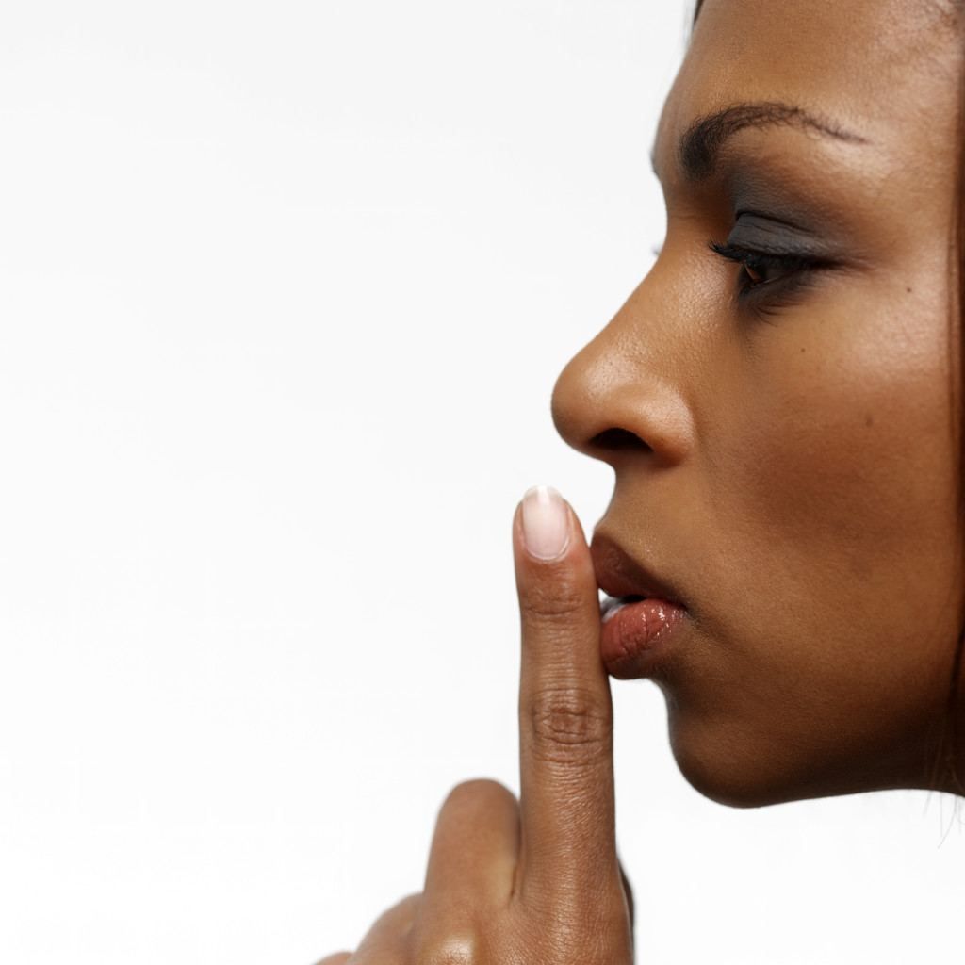
The Interjection Narrative
Shh! Silent Sustained Writing!
Share with a shoulder partner
Then, be prepared to share with the entire class.

Slide 240
A List of Common Interjections
A: aha, ahem, ahh, ahoy, alas, arg, aw
B: bam, bingo, blah, boo, bravo, brrr
C: cheers, congratulations
D: dang, drat, darn, duh
E: eek, eh, encore, eureka
F: fiddlesticks
G: gadzooks, gee, gee whiz, golly, goodbye, goodness, good grief, gosh
H: ha-ha, hallelujah, hello, hey, hmm, holy buckets, holy cow,
holy smokes, hot dog, huh?, humph, hurray
O: oh, oh dear, oh my, oh well, ooops, ouch, ow
P: phew, phooey, pooh, pow
R: rats
S: shh, shoo
T: thanks, there, tut-tut
U: uh-huh, uh-oh, ugh
W: wahoo, well, whoa, whoops, wow
Y: yeah, yes, yikes, yippee, yo, yuck

Slide 241
Determining Parts of Speech
Rule 14i A Word’s use determines its part of speech.
The same word may be used as different parts of speech. For instance, to figure out what part of speech down is in each of the following sentences, read the entire sentence. What you are doing is studying the word’s context—the way the word is used in the sentence. From the context, you can identify the part of speech that down is in each of the following sentences.

Slide 242
Determining Parts of Speech
Rule 14i A Word’s use determines its part of speech.
The fine feathers of young birds are called down.
noun
2. She wore a down vest.
adjective
Do you think the tackle with down the runner before reaching the end zone?
verb

Slide 243
Let’s Play…
Flicko
  Point at the appropriate response before your partner does to earn a point.

Slide 244
noun no pronouns verb
adjective no articles adverb
preposition conjunction interjection

Slide 245
Her poster fell down.
adverb
My cousin lives down the street.
preposition
You did well on the test.
adverb
The bucket and rope fell in the well.
noun
The girl had cat eyes.
adjective

Slide 246
Did the pond ice over?
verb
An ice storm struck.
adjective modifying storm
Ice covered the wall.
noun
The light flashed on.
adverb modifying flashed
We rode on the subway.
preposition

Slide 247
The went to the park.
noun
We can park the car here.
verb
They waited by the park entrance.
adjective modifying entrance
Well, I think I did well on the exam.
interjection
Man! That was a hard test.
interjection

Slide 248
Summary of Parts of Speech page 499
Part of Speech Use Examples
NOUN names Lydia reads novels.
PRONOUN takes the place of a noun You and they saw it.
ADJECTIVE modifies a noun or pronoun I got a new bike.
We were hungry.
VERB shows action or a state of We swam and surfed.
being She was a candidate.
ADVERB modifies a verb, adjective, They are here.
or another adverb We were quite surprised.
You worked very quickly.
CONTINUE TO NEXT SLIDE

Slide 249
Summary of Parts of Speech page 499
Part of Speech Use Examples
PREPOSITION relates a noun or Some of the cats the
pronoun to another store window had bows word on their necks.
CONJUNCTION joins words or group Whitney or Jan will sing
(FAN BOYS) words We plan to hike and to camp.
INTERJECTION expresses emotion Hey! Hooray!
Well, here we are.

