Slide 1
Lima Bean Dissection
Foss 5, part 1
Notes:
Do after students have finished the dissection.

Slide 2
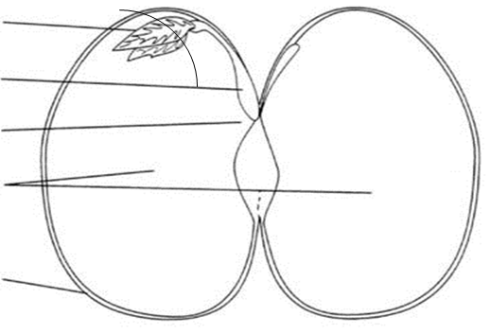
Parts of a Seed
Cotyledon
Seed Coat – the tough, almost airtight layer on the outside of the seed.
Seed Coat
Cotyledon – the two large, white ear shaped parts of the seed. Seeds that separate in two halves are called dicots. Lima beans are dicots. Seeds that have only one cotyledon are monocots. (seed leaf in greek)
The cotyledon is composed of endosperm, a starch material that supplies food to the plant as it starts to grow.

Slide 3
Parts of a Seed
Embryo
Epicotyl
Hypocotyl
Embryo – the baby plant. The embryo may have tiny developing leaves and a stem and root that can been seen with a hand lens.
Radicle
Cotyledon
Seed Coat
The embryo is alive, but has been in a state of suspended development waiting for the right conditions to resume growing.
Embryos are made of 3 parts
Epicotyl (leaves)
Hypocotyl (stem)
Radicle (roots)

Slide 4
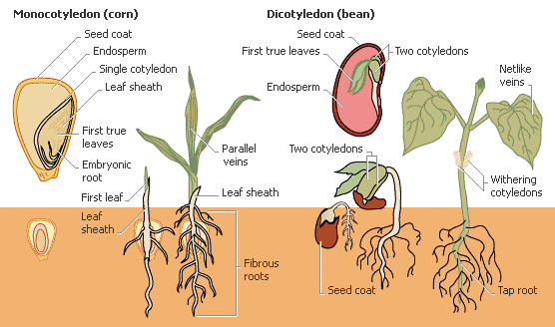
Germinate
The beginning of development of a seed after a period of dormancy or rest.

Slide 5
Parts of a Seed
Seeds consists of three main parts: (1) the seed coat, (2) the embryo, and (3) the endosperm. The seed coat, or outer skin, protects the embryo, which contains all the parts needed to form a new plant. The endosperm nourishes the embryo until it can make its own food. The endosperm of a monocot contains one cotyledon, and that of a dicot has two cotyledons.

Slide 6
Seed Coat

Slide 7
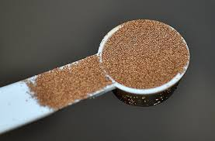
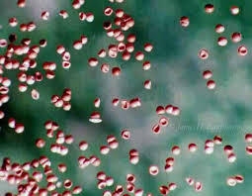
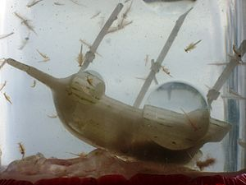
Sea Monkeys (Shrimp Brine Eggs)

