Slide 1
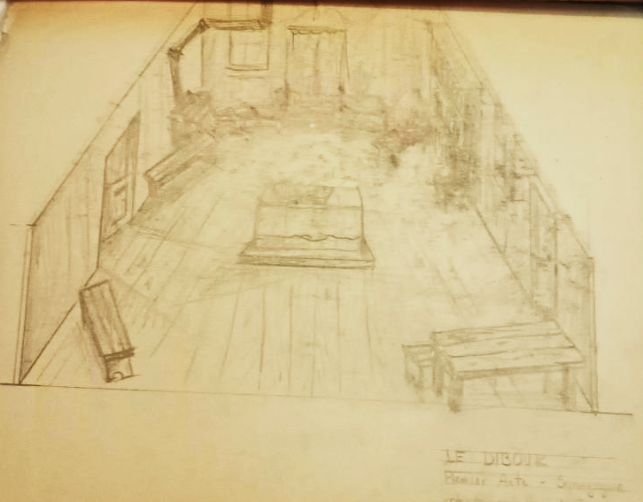

Slide 2
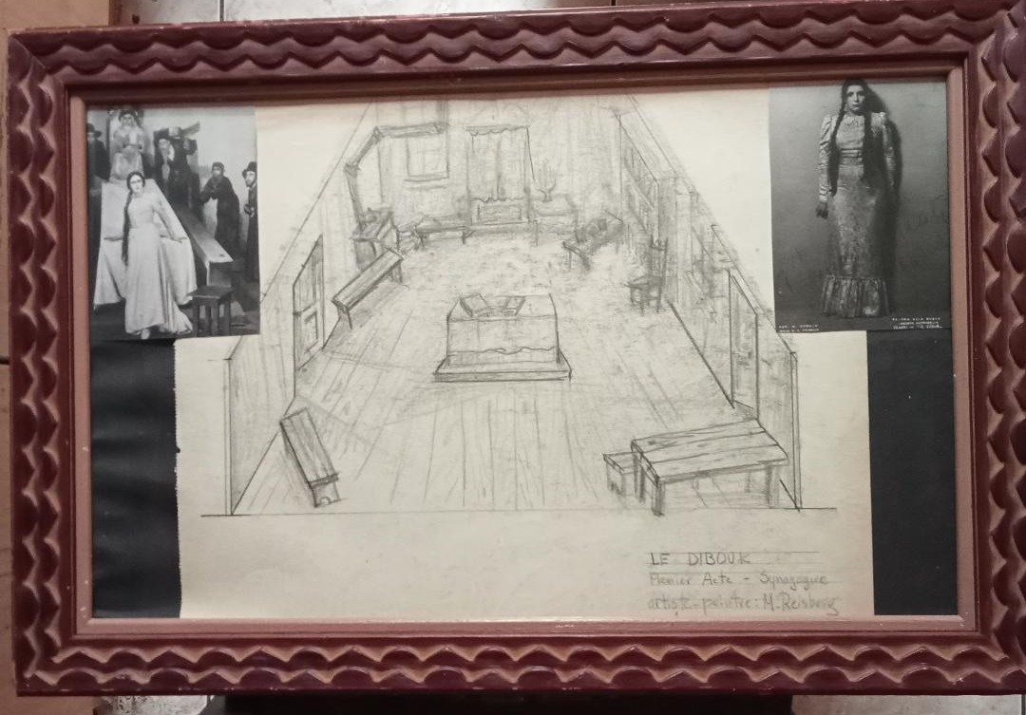
Notes:
1928 Th des Ch Elysees. Gaston Baty avant garde th director

Slide 3
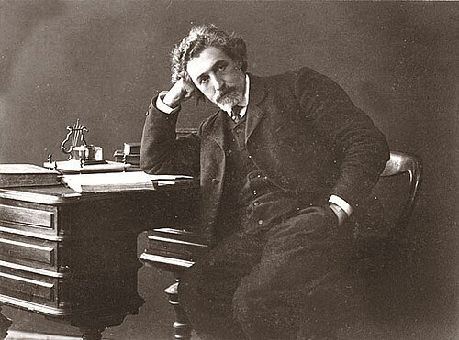
Notes:
Shlomo An-ski left wing. Ethnographic studies. Folklore wrote play in rus. Trans to Yiddish. Warsaw after death. 1920. 1922 Habima Moscow in Hebrew

Slide 4
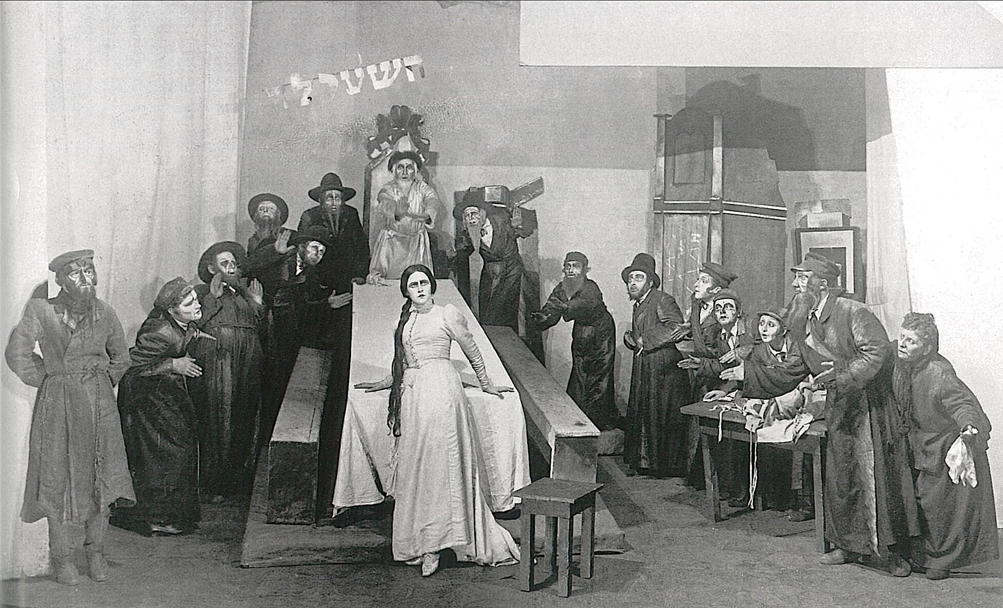
Notes:
Habima 1922. 1926 toured world

Slide 5
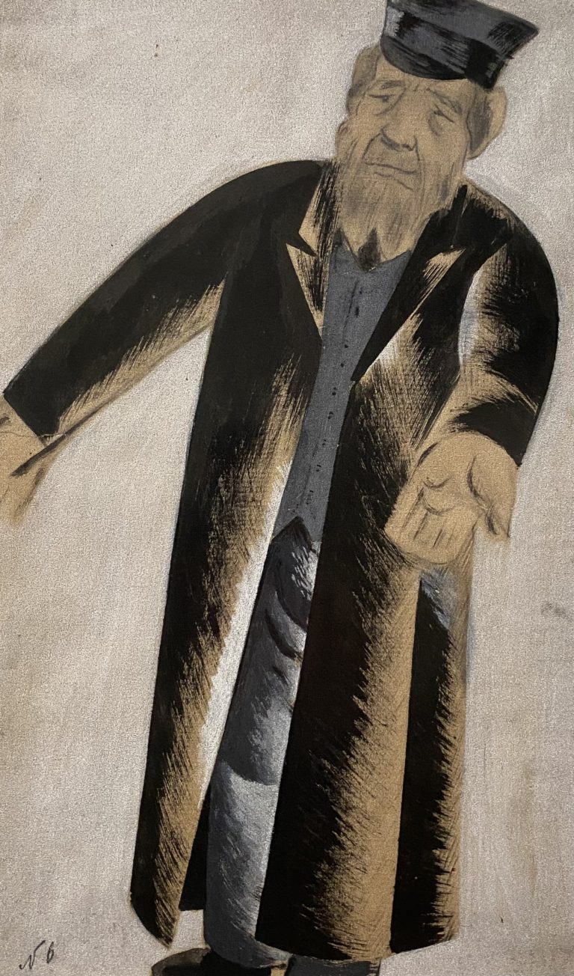
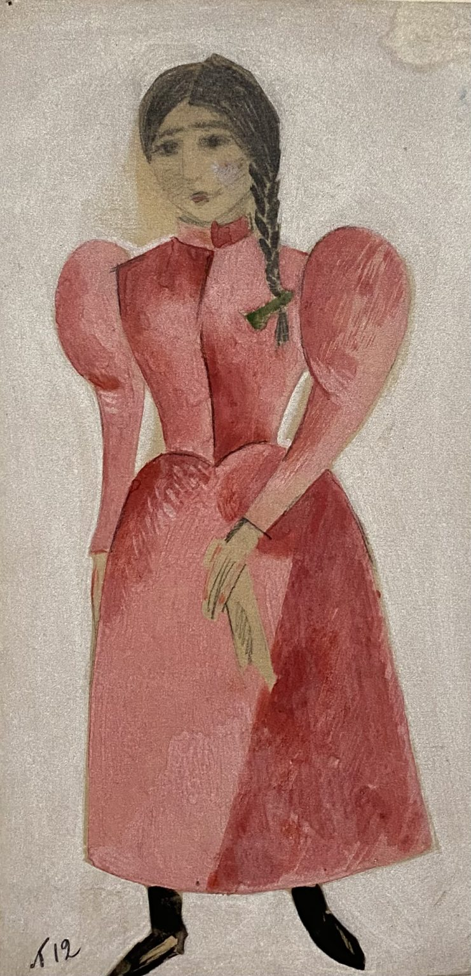
Notes:
Nathan Altman designs for Habima

Slide 6
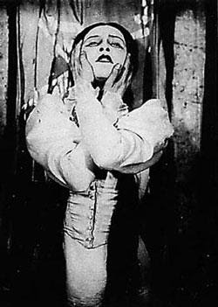
Notes:
Hanna Rovina Leah, 1928 immigrated to Palestine with Habima.

Slide 7
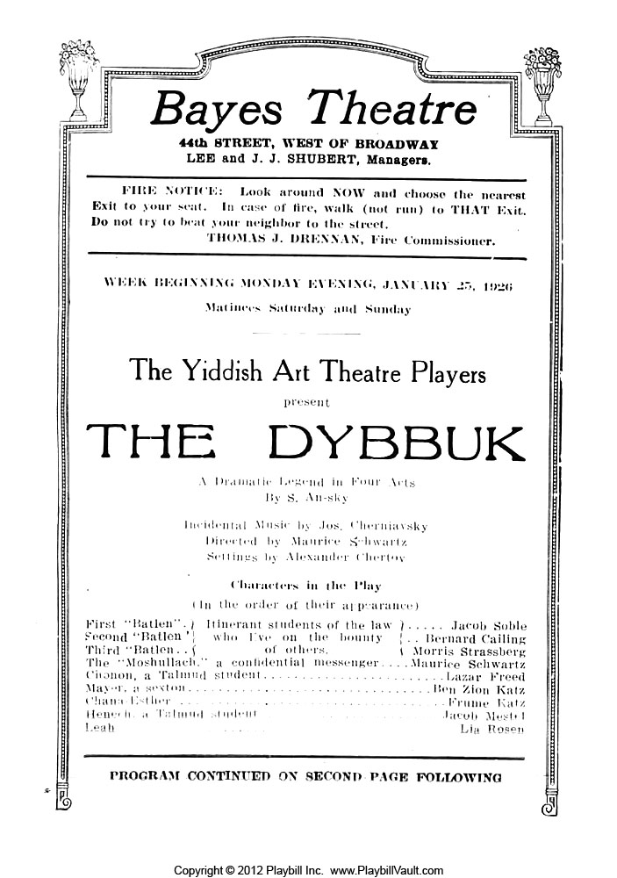

Slide 8
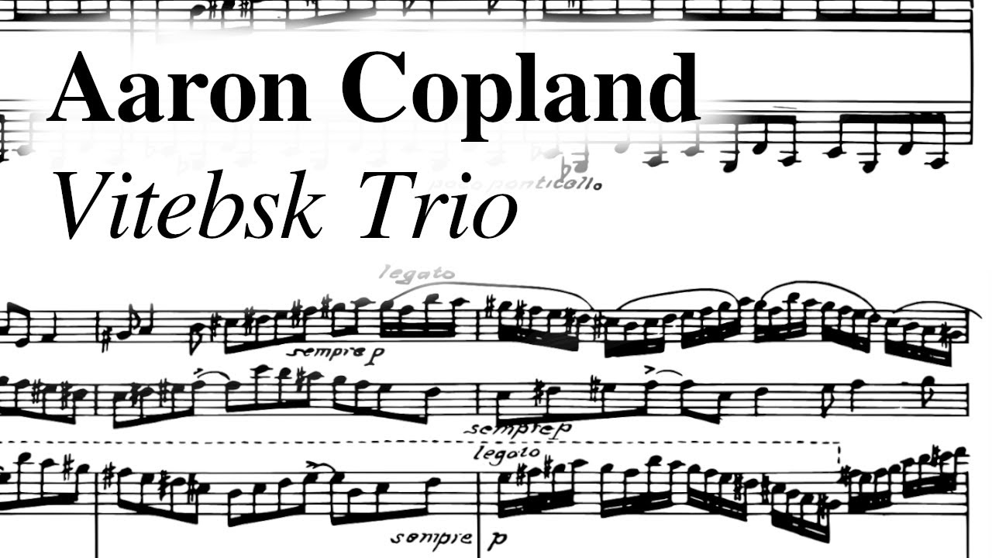
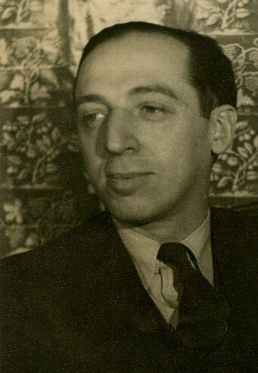

Slide 9
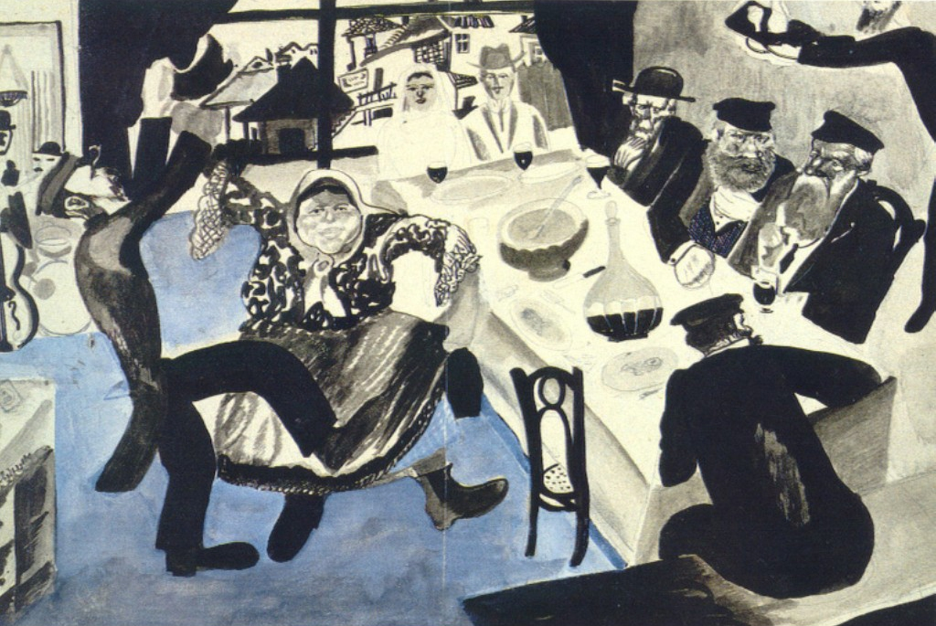
Notes:
Chagall Jewish wedding 1912

Slide 10
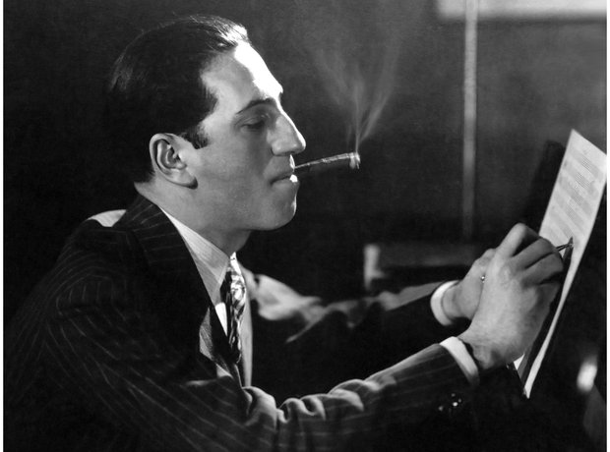

Slide 11
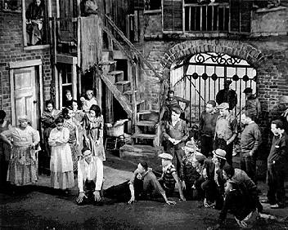

Slide 12
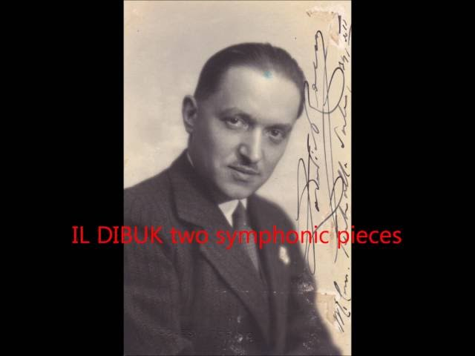
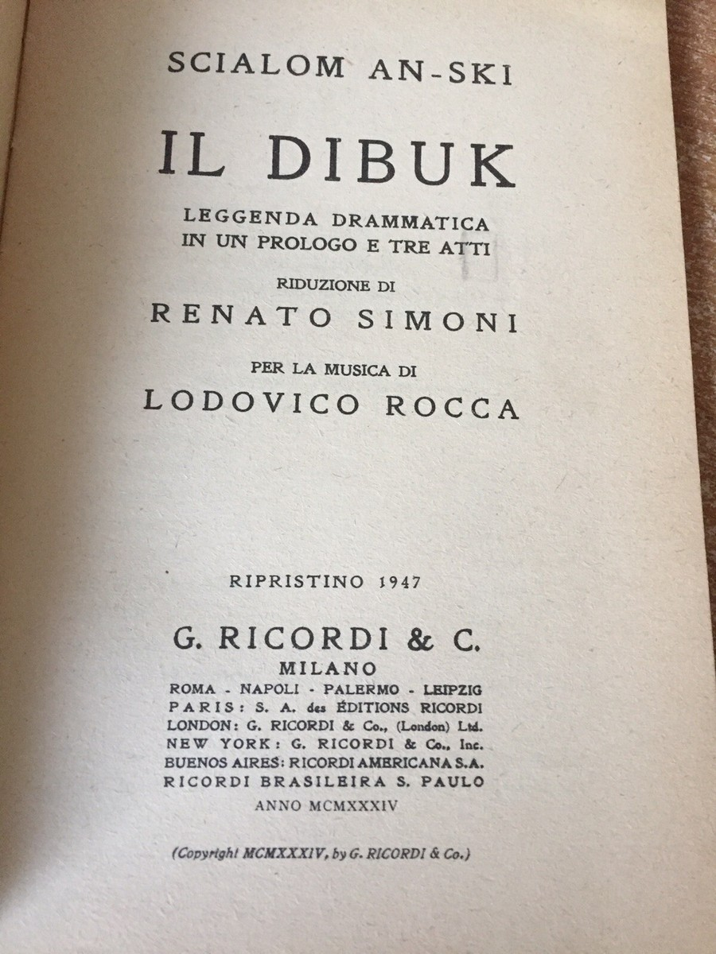

Slide 13
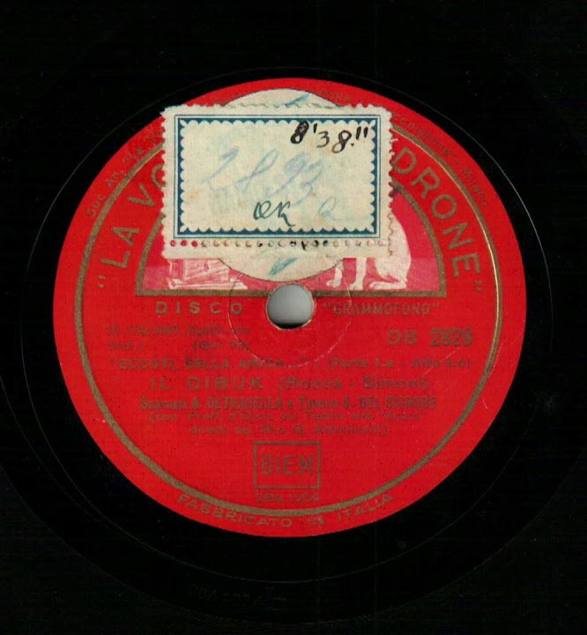
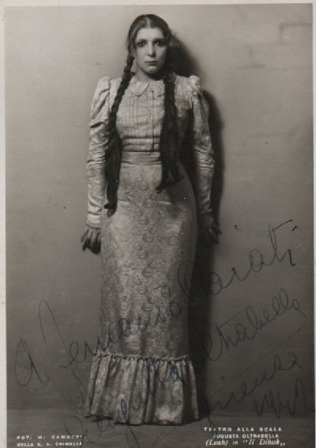

Slide 14
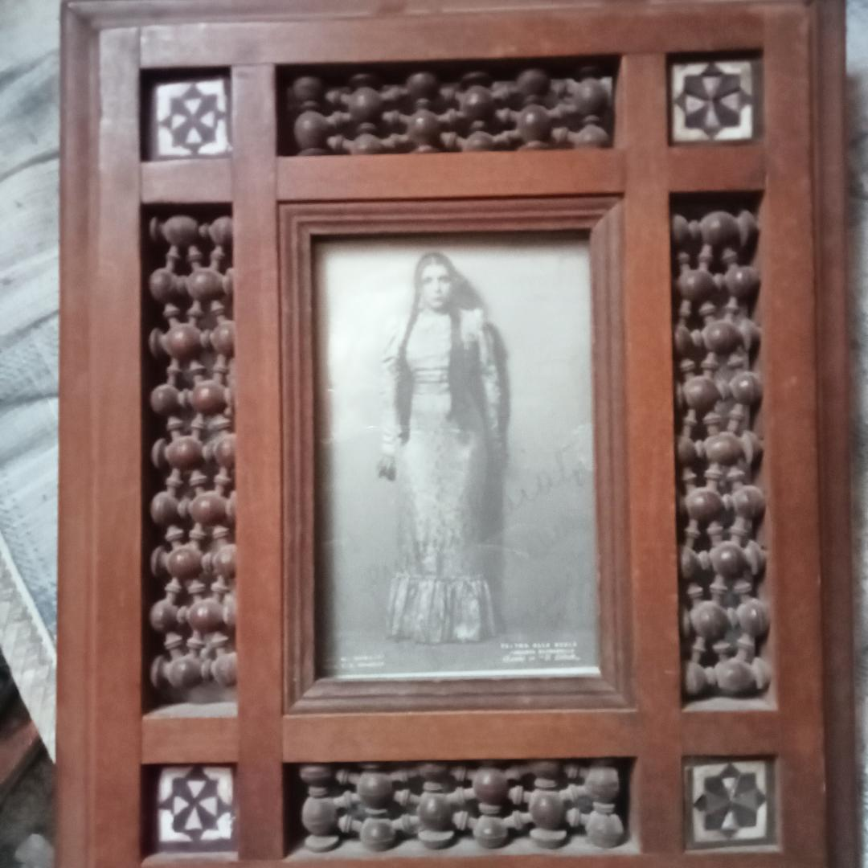

Slide 15
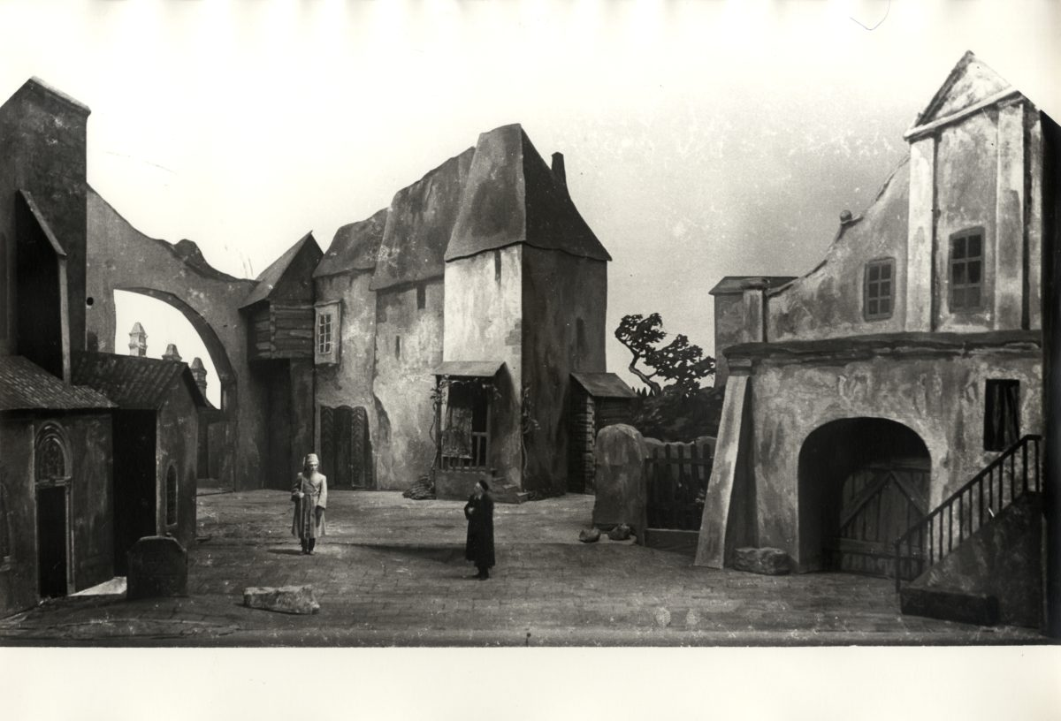

Slide 16
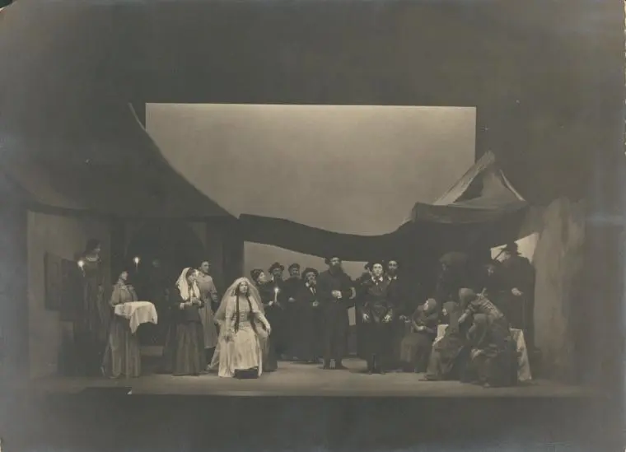

Slide 17
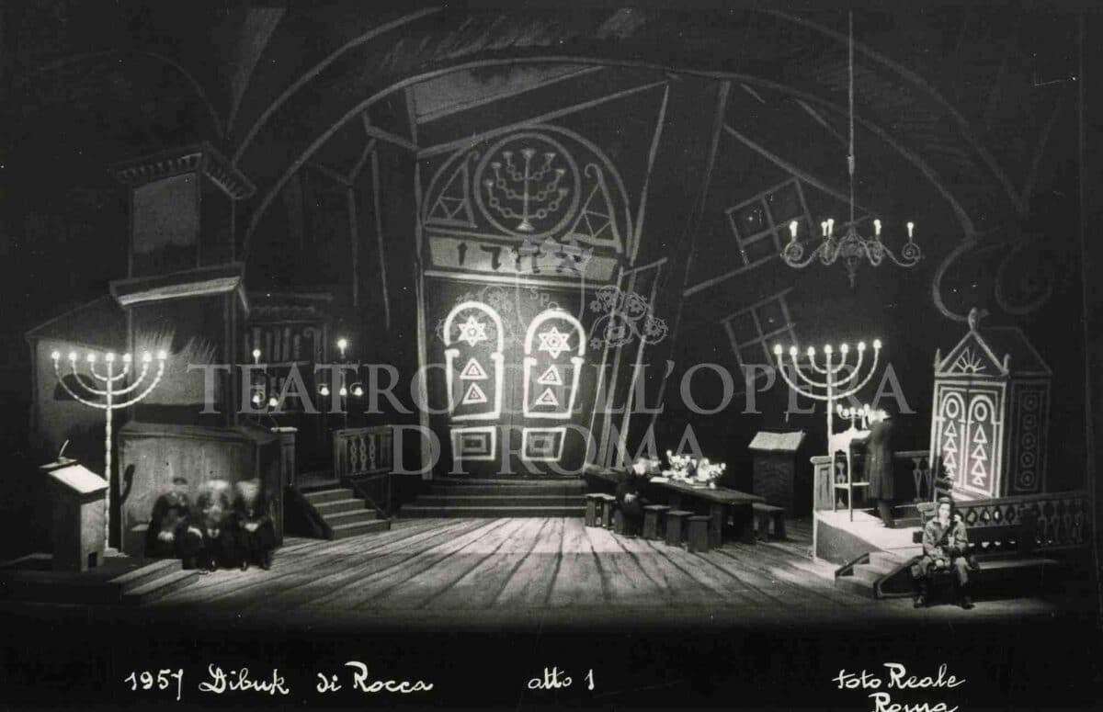

Slide 18
Notes:
Appointed director of Turin conserve 1940

Slide 19
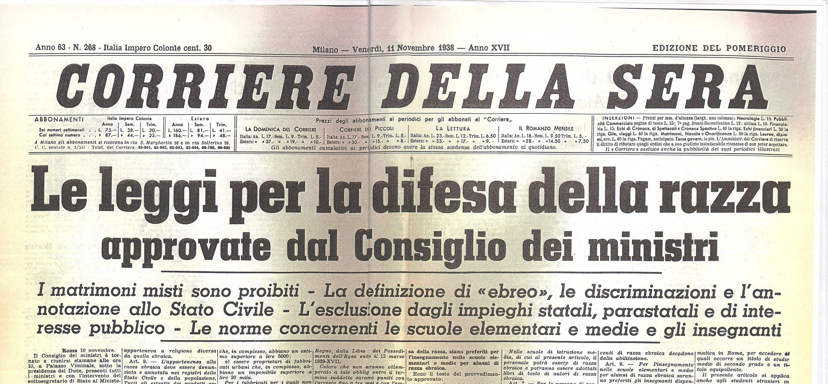

Slide 20
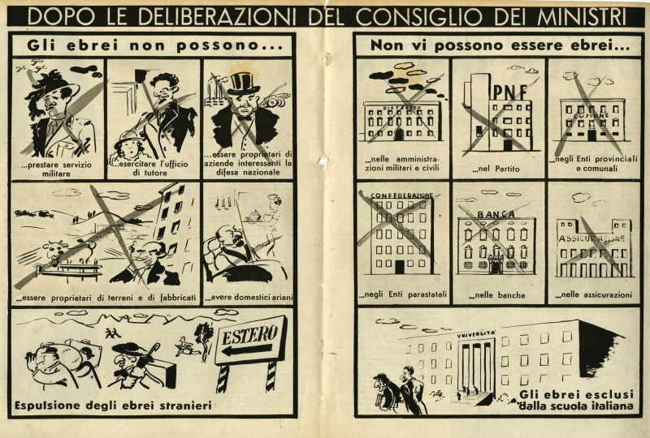

Slide 21
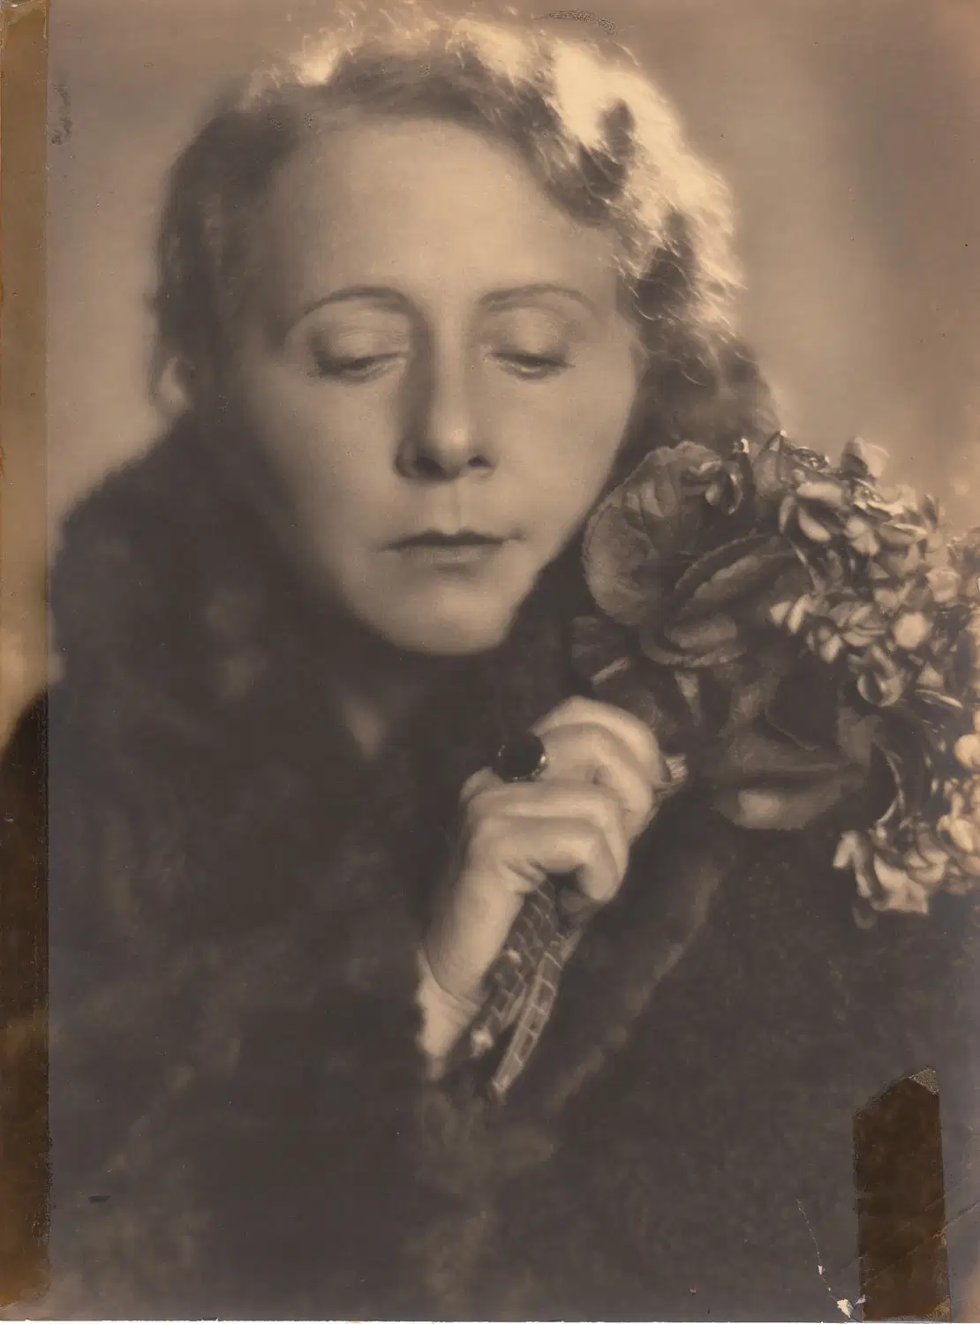
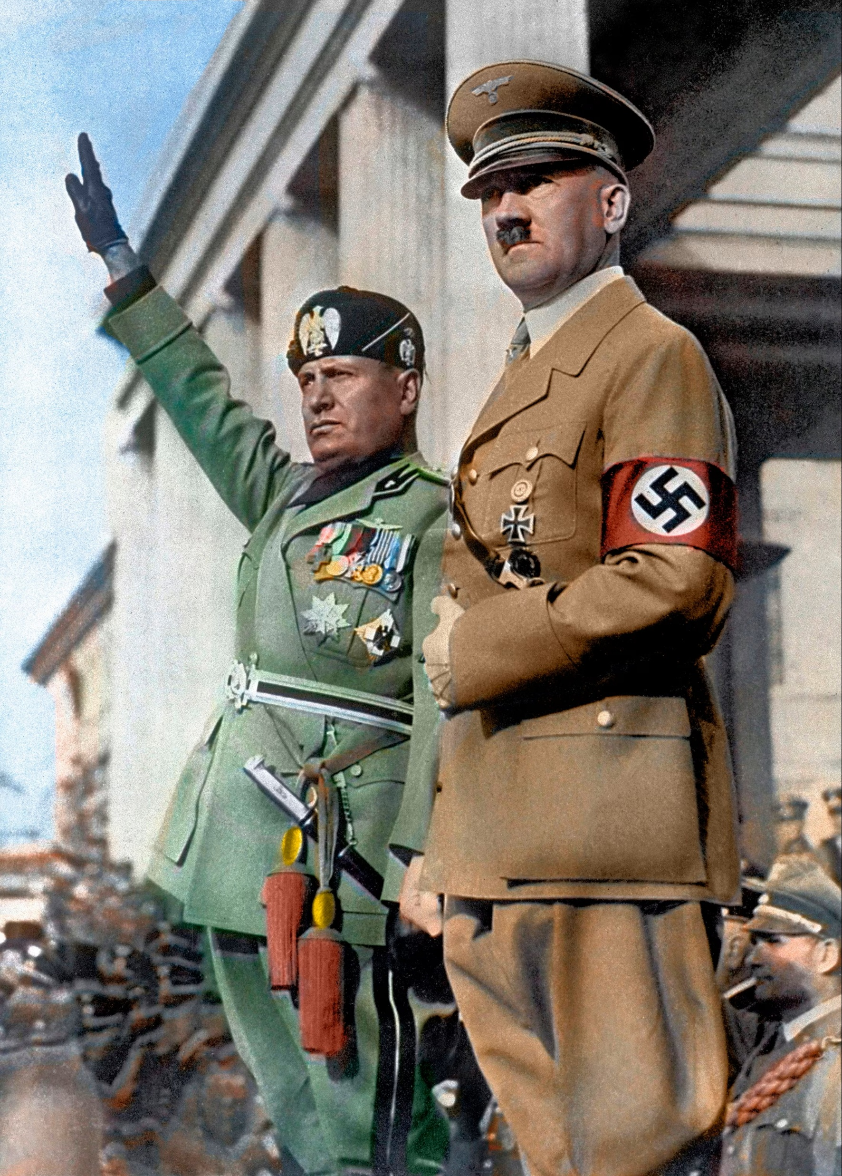
Notes:
Margherita Sarfatti

Slide 22
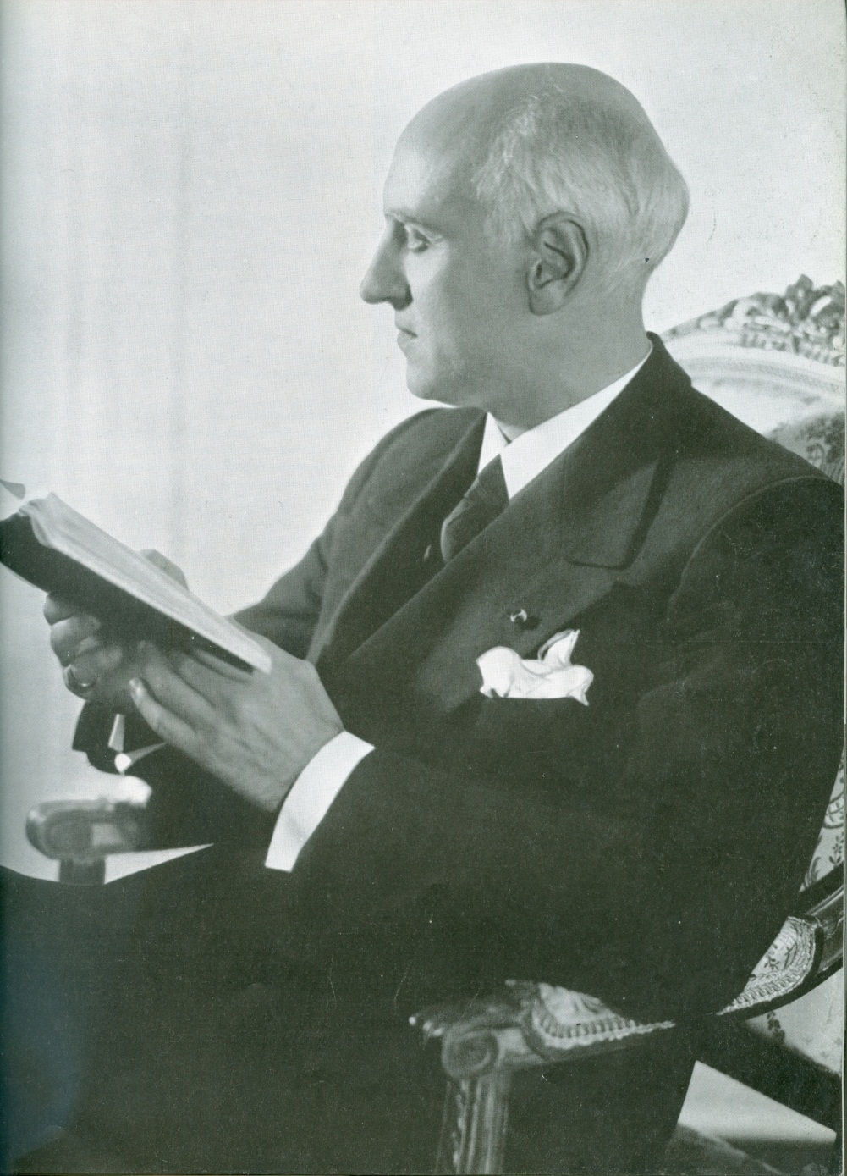
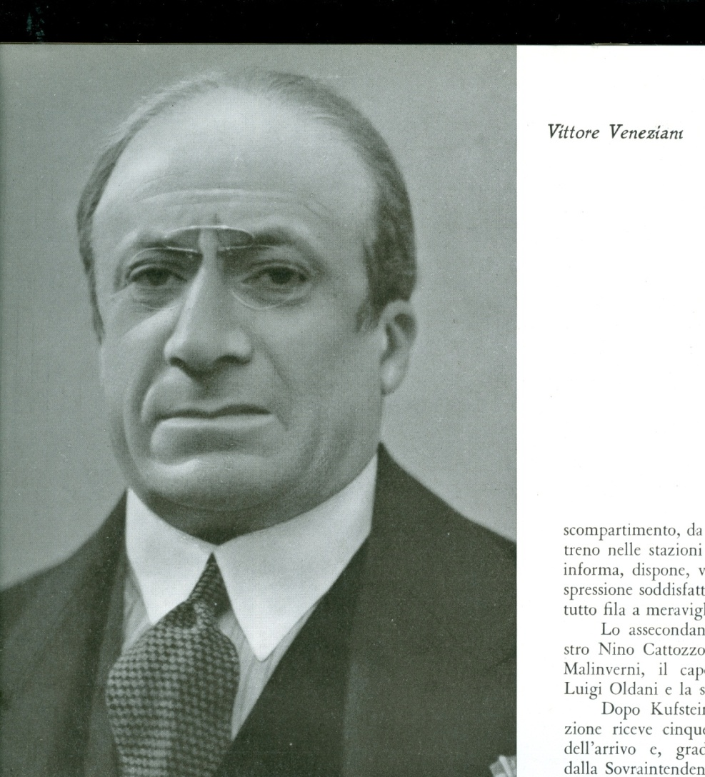
Notes:
Victor de Sabata Bn Trieste Mother Jewish. Too useful as counterweight to Tosc Vittore revered chorus master.

Slide 23
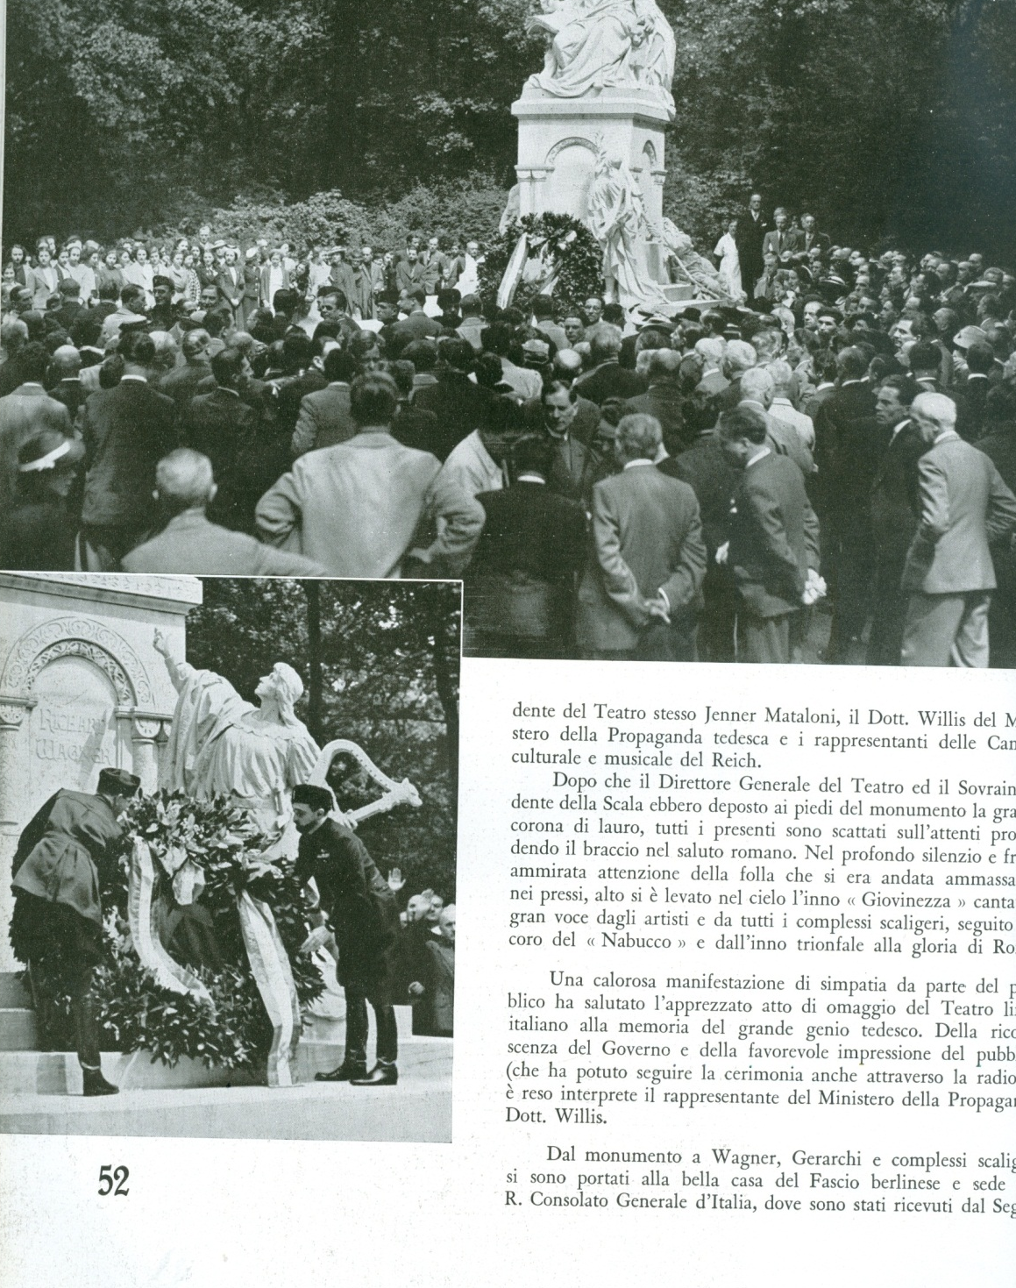
Notes:
Chorus o Hebrew slave Nabucco

Slide 24
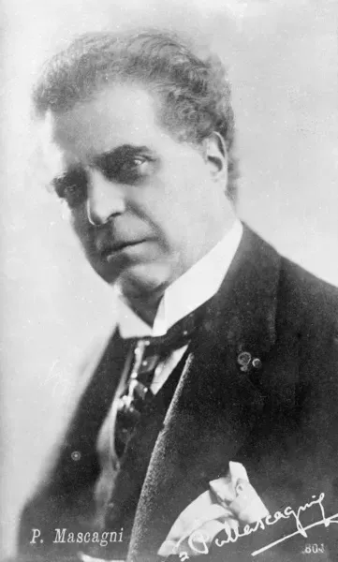
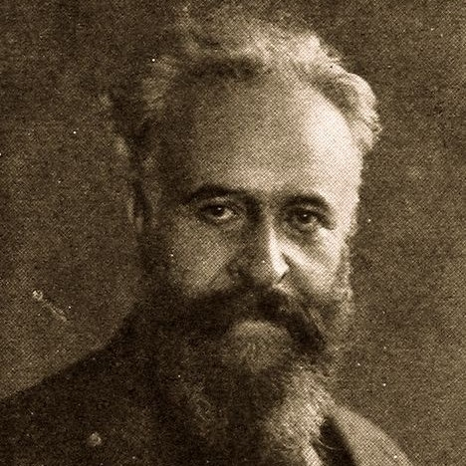
Notes:
Pietro Mascagni, Alberto Francchetti

Slide 25
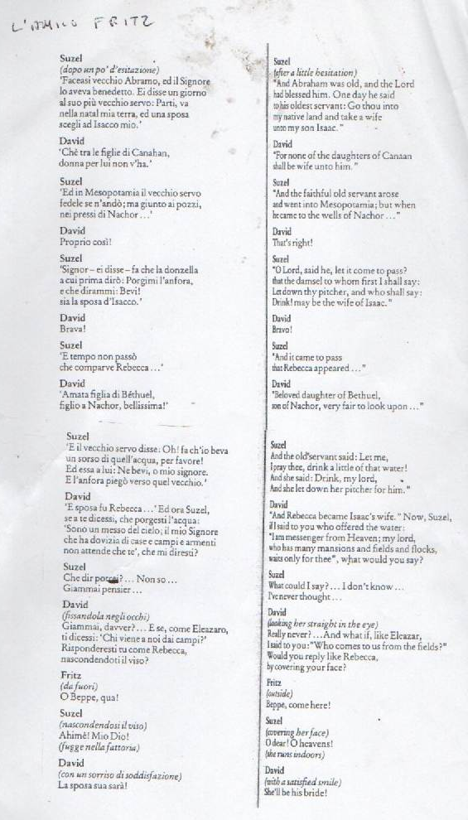
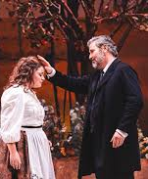
Notes:
Dottore for Rabbino. 1941

Slide 26
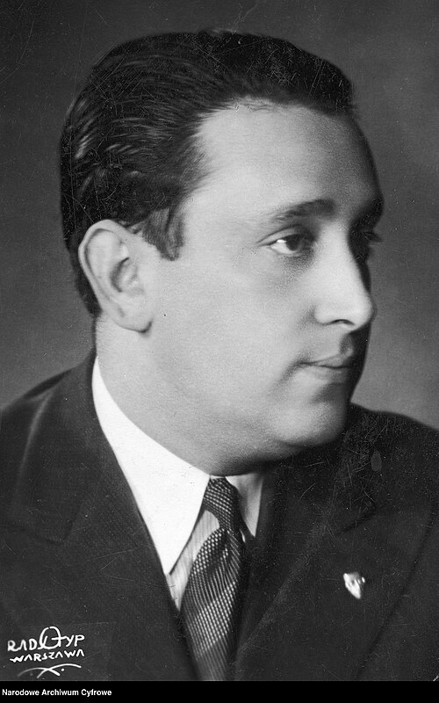
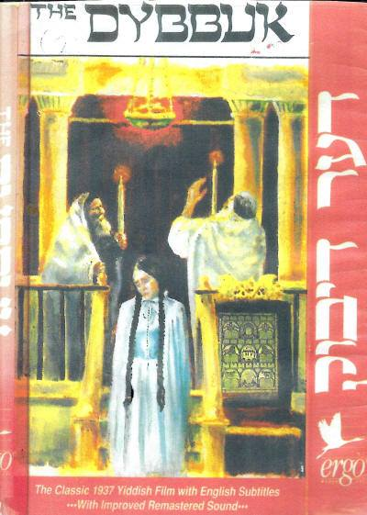
Notes:
Michal Waszynski, bn Mosze Waks

Slide 27
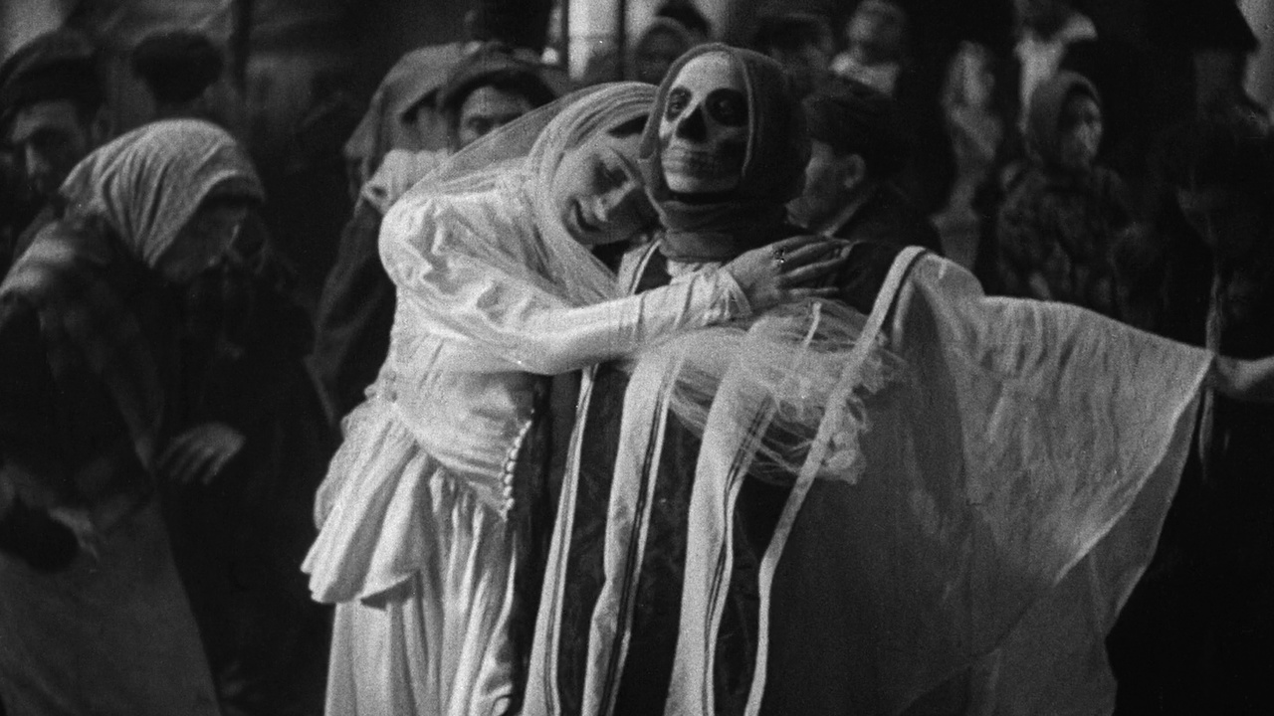

Slide 29
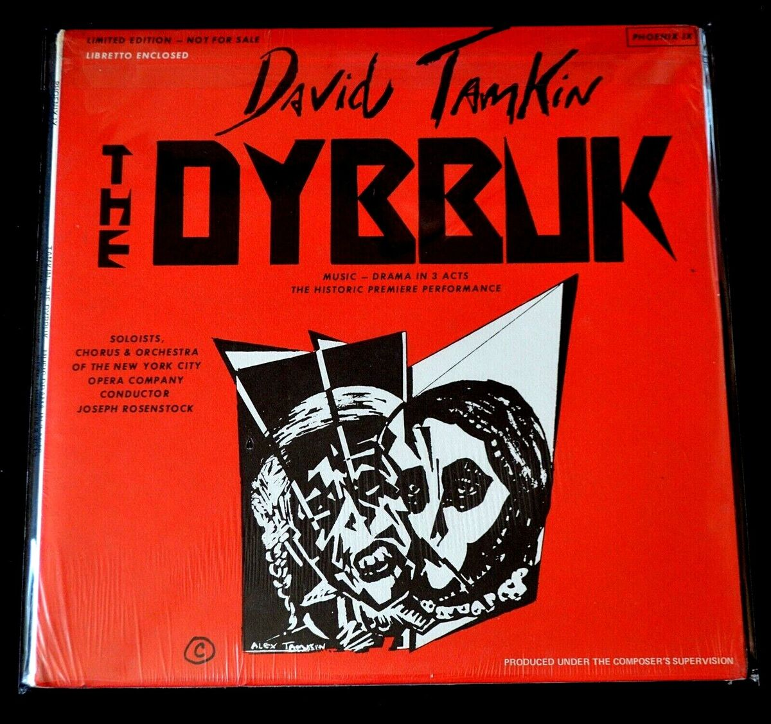

Slide 30
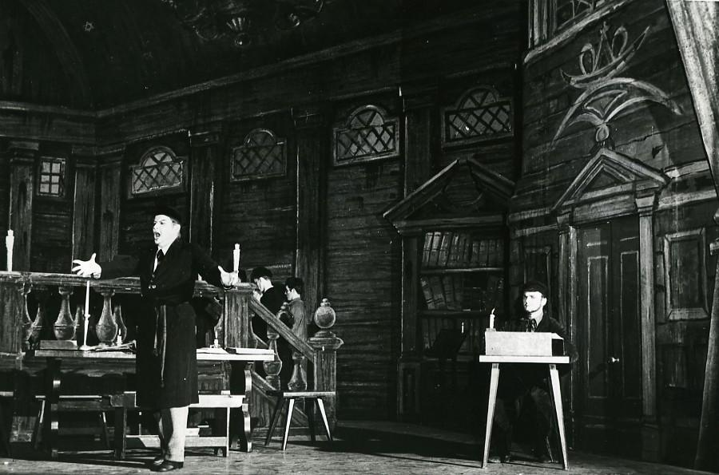

Slide 31
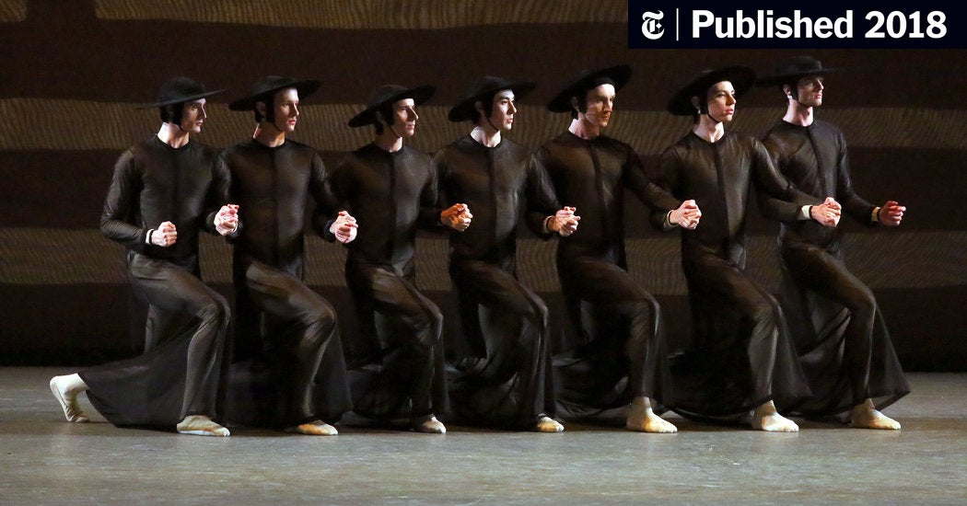

Slide 32
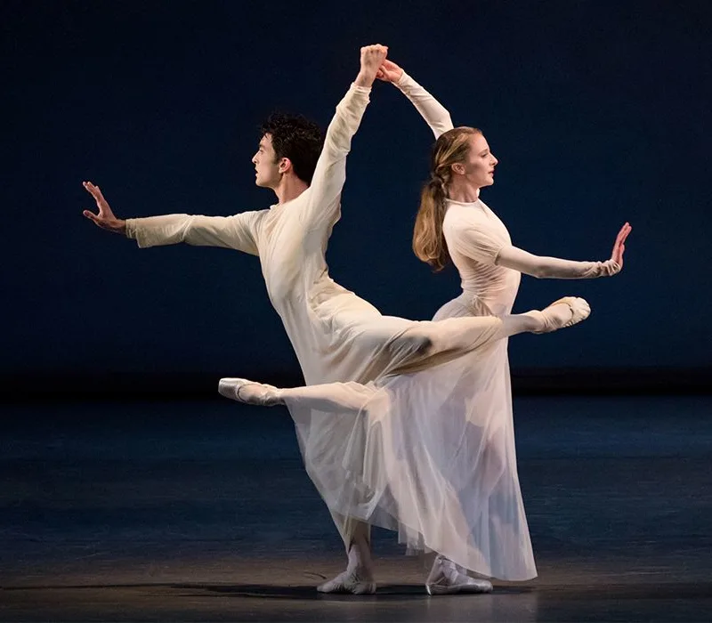

Slide 33
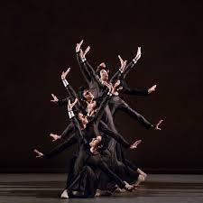

Slide 34
Notes:
1928 Th des Ch Elysees. Gaston Baty avant garde th director

Slide 39
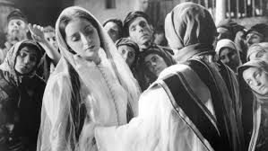
Notes:
Stars Lili Liliana and Leon Liebgold part of polishe theare group on tour 1939

Slide 40
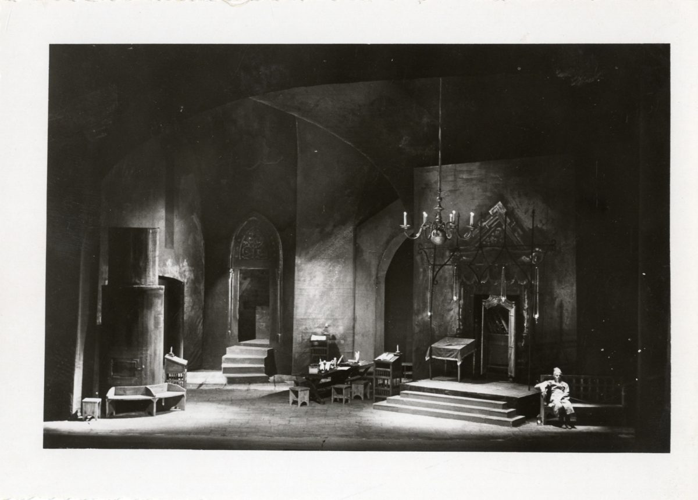

Slide 41
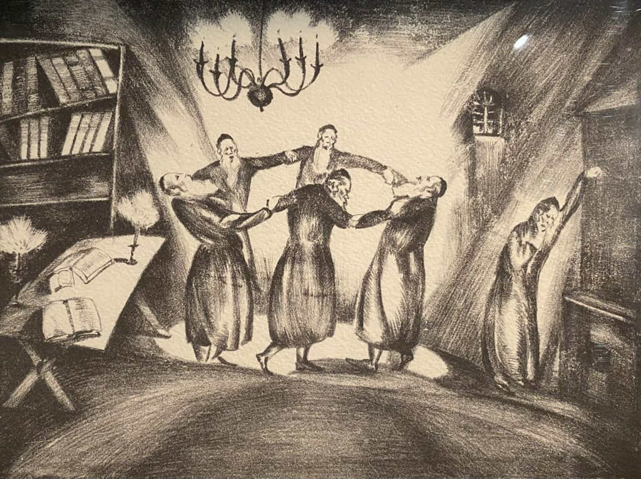

Slide 42
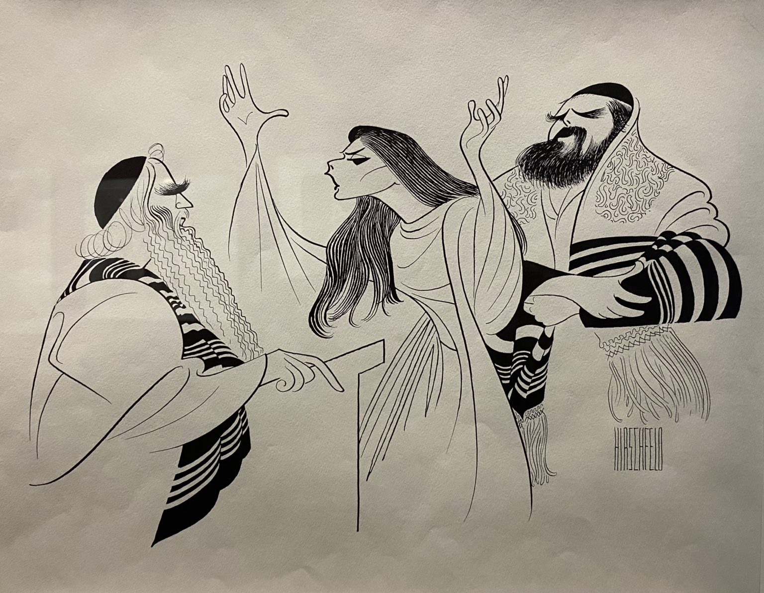
Notes:
Al Hirschfeld 1960

Slide 43
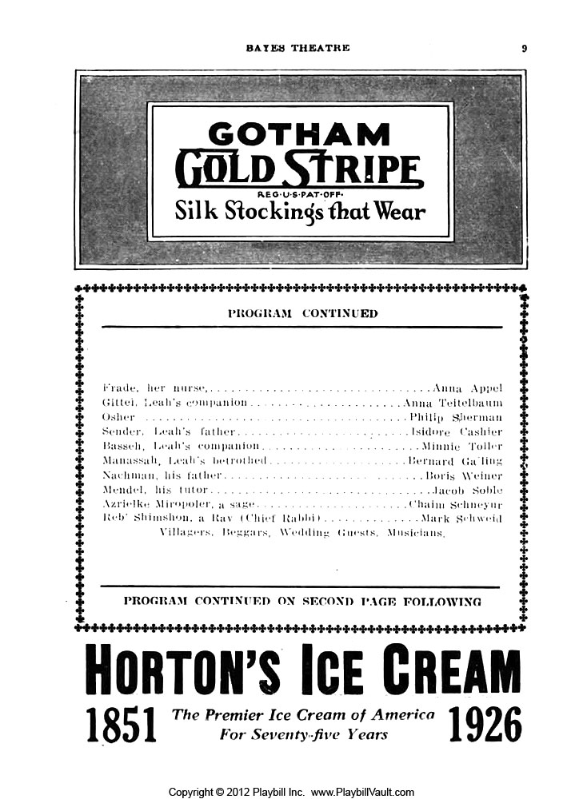

Slide 44
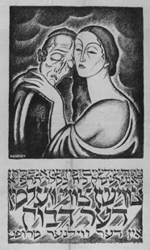

Slide 45
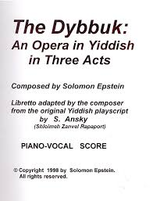

Slide 46


Slide 47
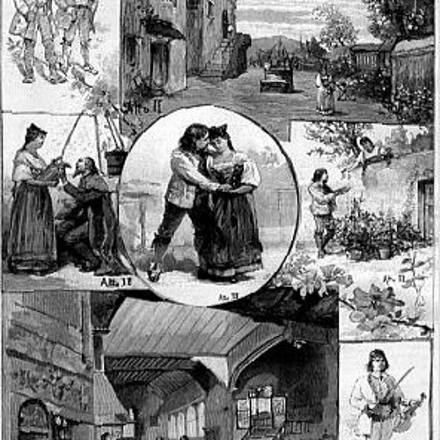

Slide 48
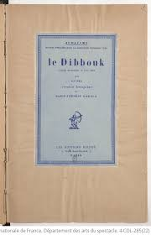

Slide 51
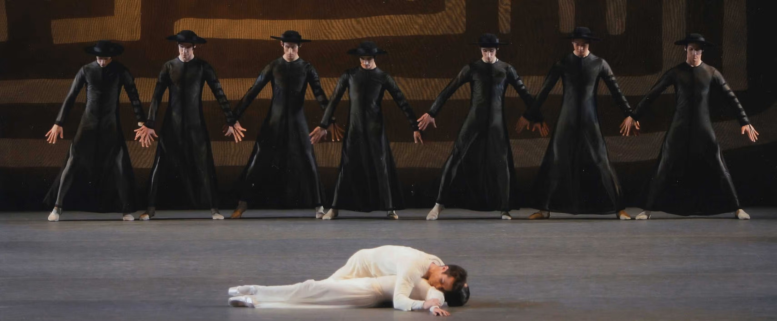

Slide 52


Slide 53


Slide 54


Slide 67
Notes:
Appointed director of Turin conserve 1940

Slide 75


Slide 94


Slide 96

Notes:
Bernstein Ballet

