Slide 1
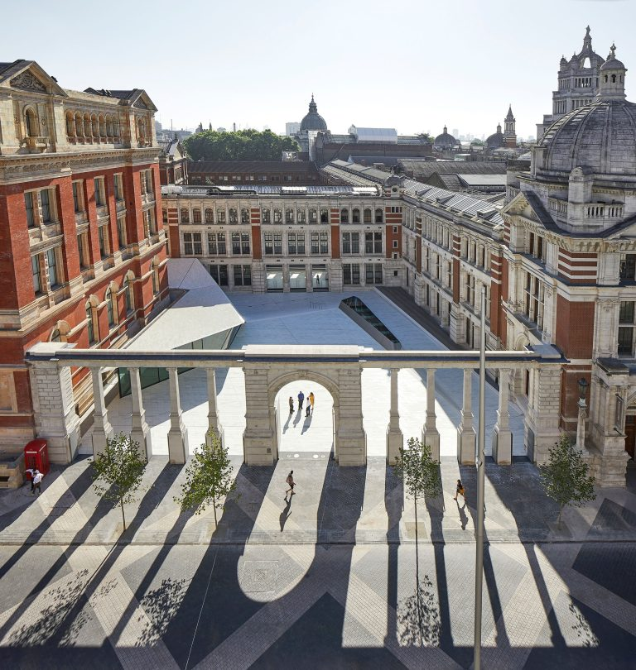
Notes:
Exhibition oldest and newest opened 2017
Rd

Slide 2
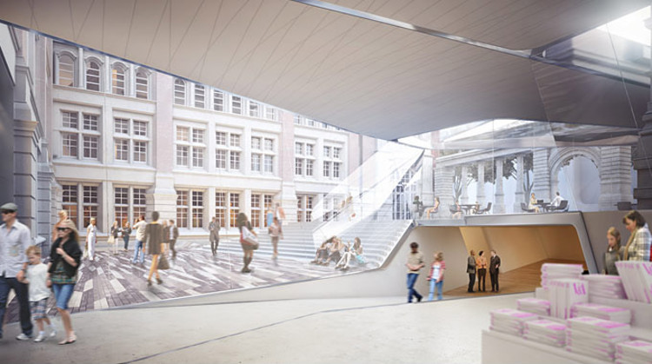

Slide 3
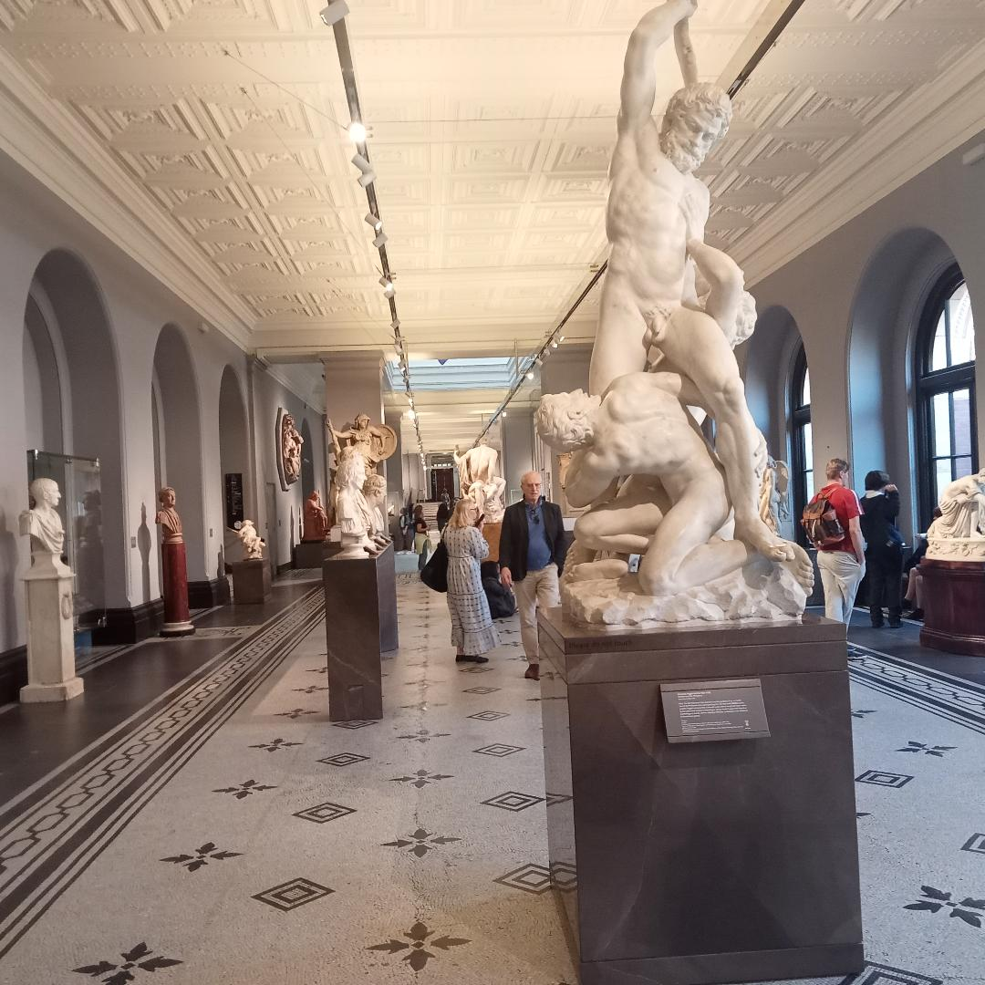

Slide 4
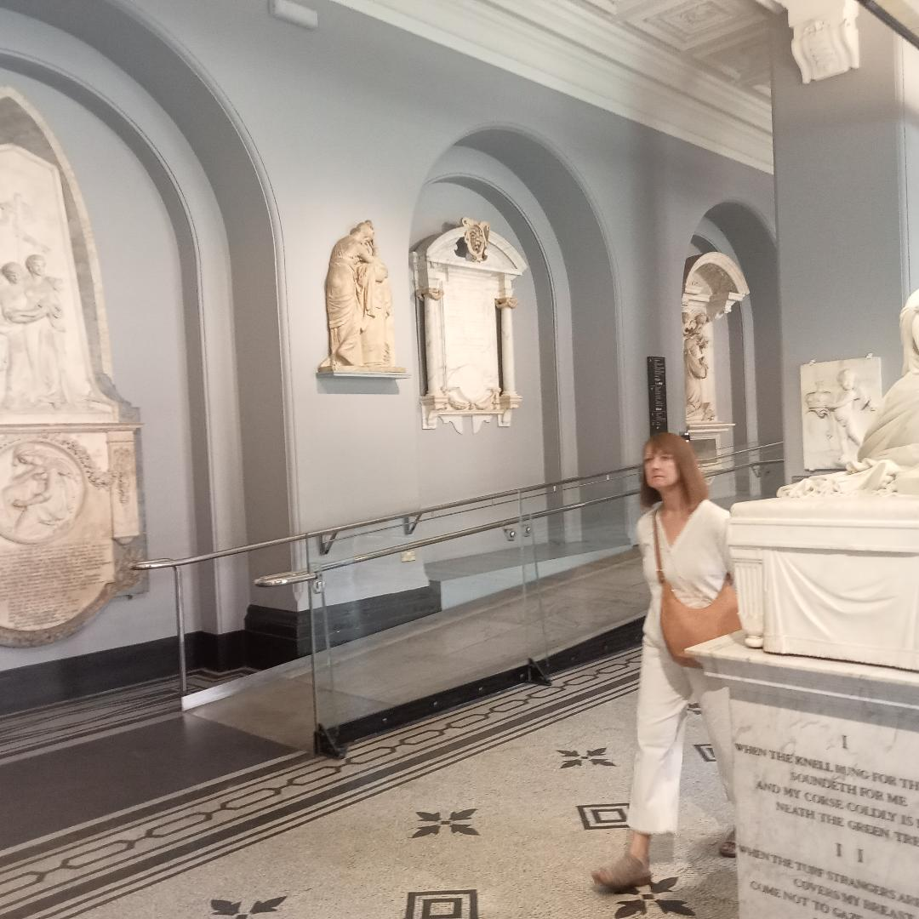

Slide 5
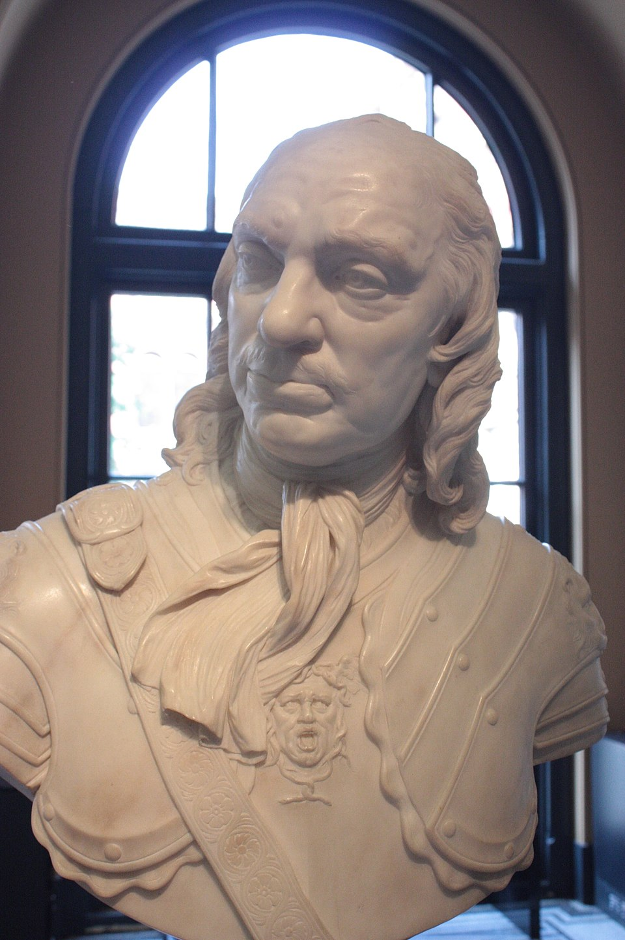

Slide 6
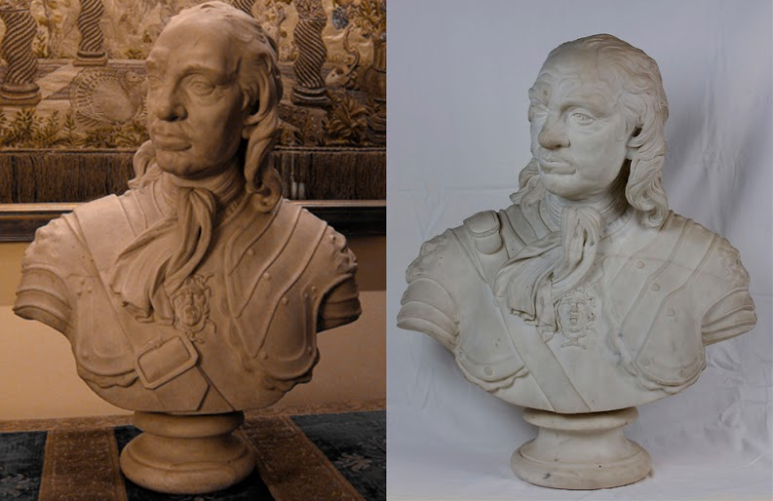
Notes:
Joseph Wilton 1762

Slide 7
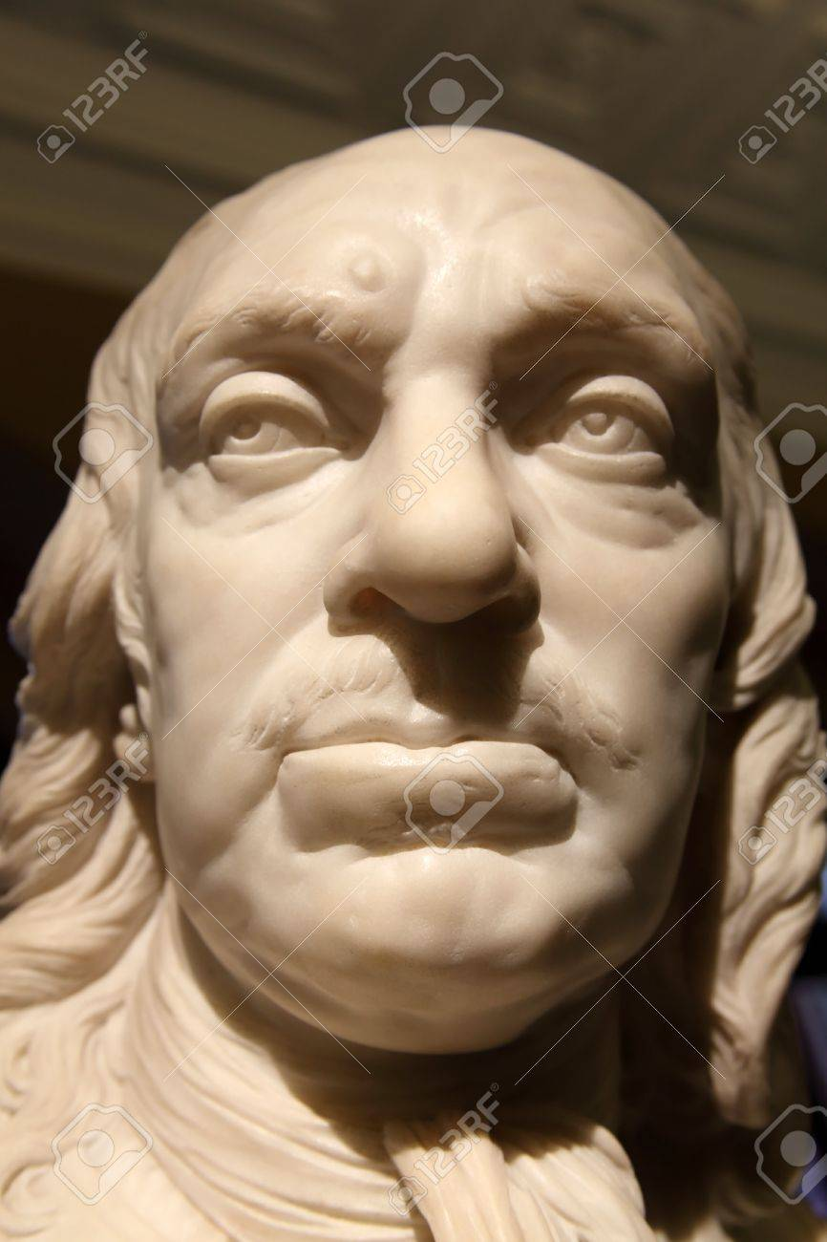
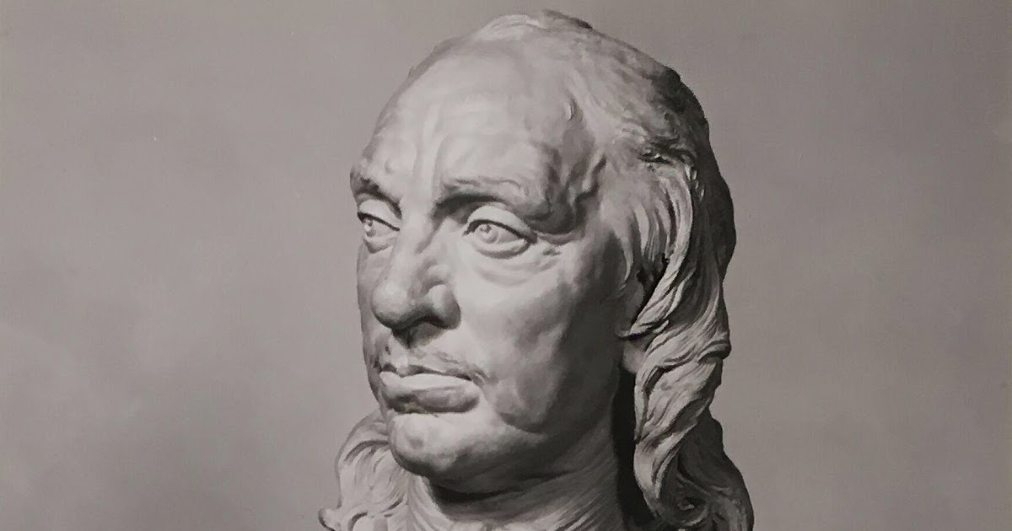
Notes:
Joseph Wilton 1762

Slide 8
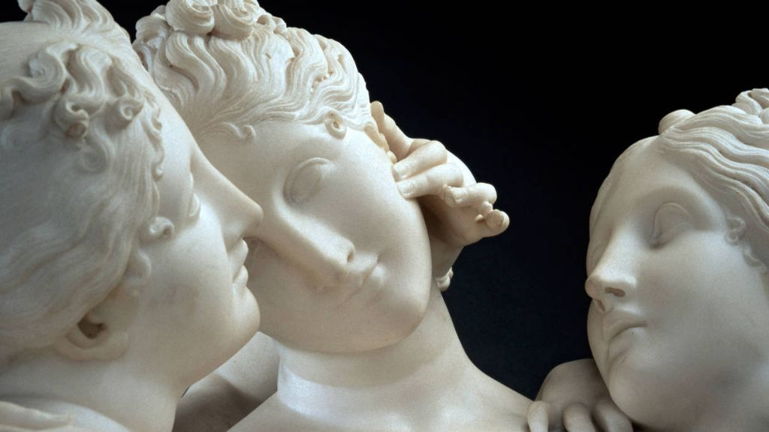
Notes:
Joseph Wilton 1762 canova 3 graces

Slide 9
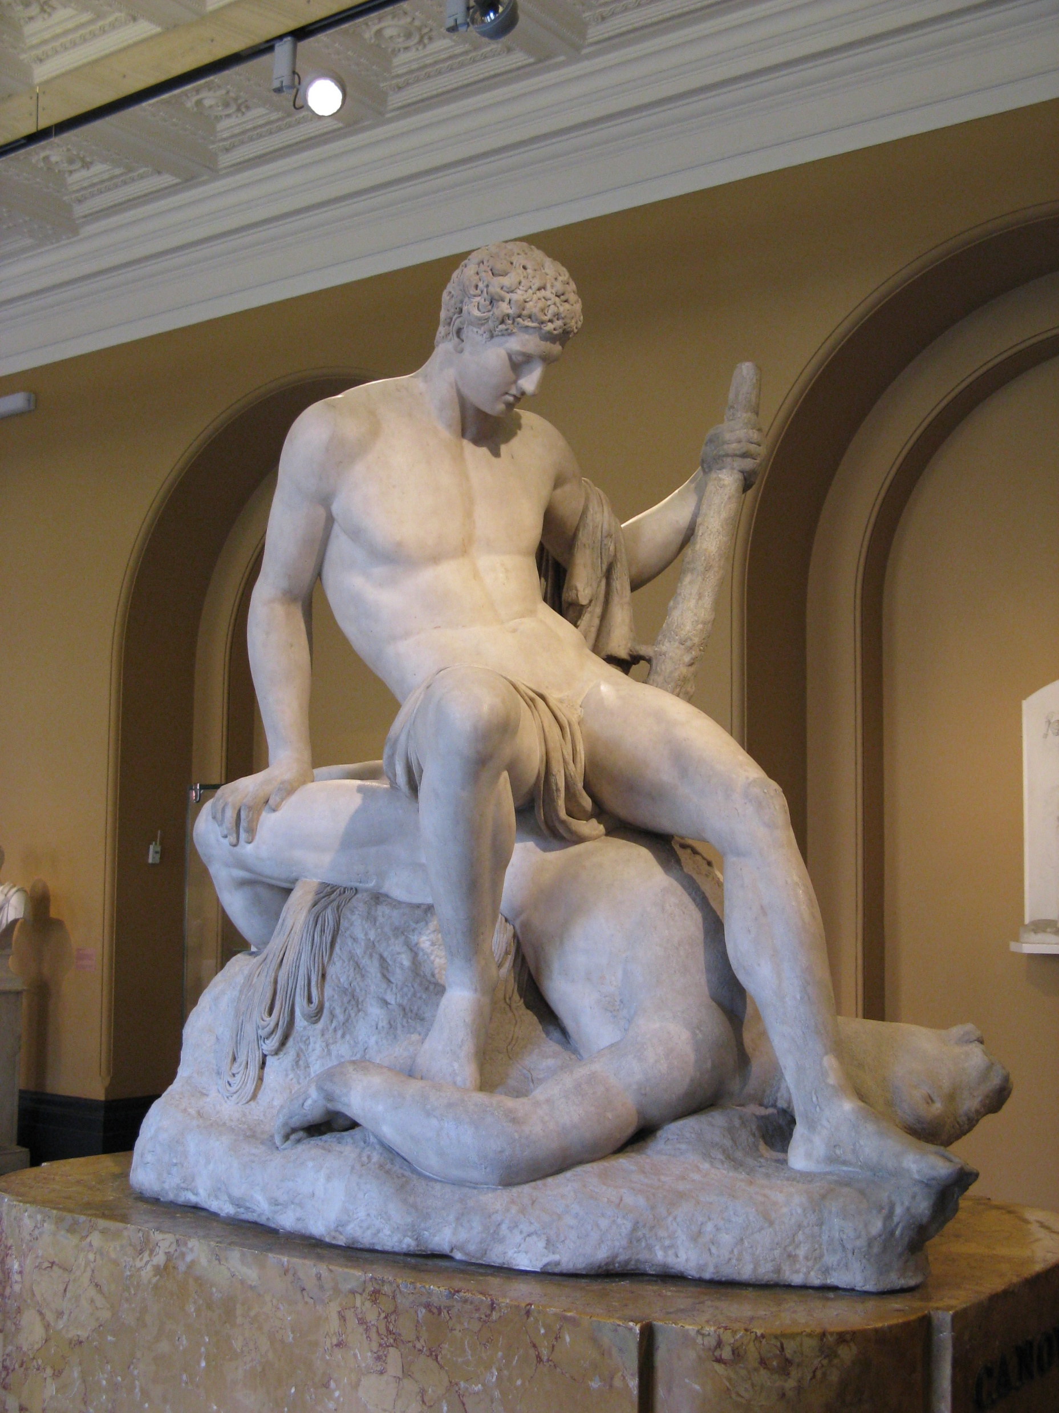

Slide 10
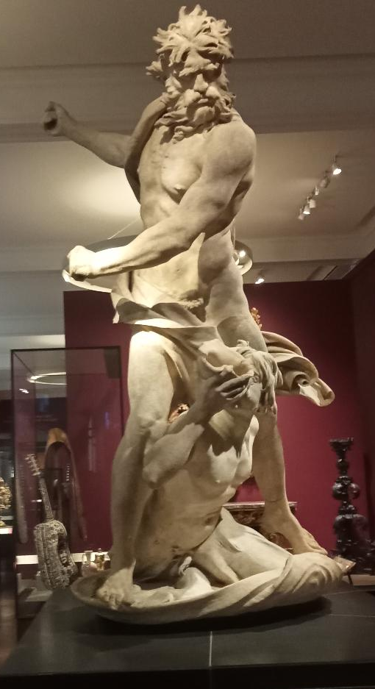
Notes:
Edle Einfalt und stille Grosse.Winckelmann

Slide 11
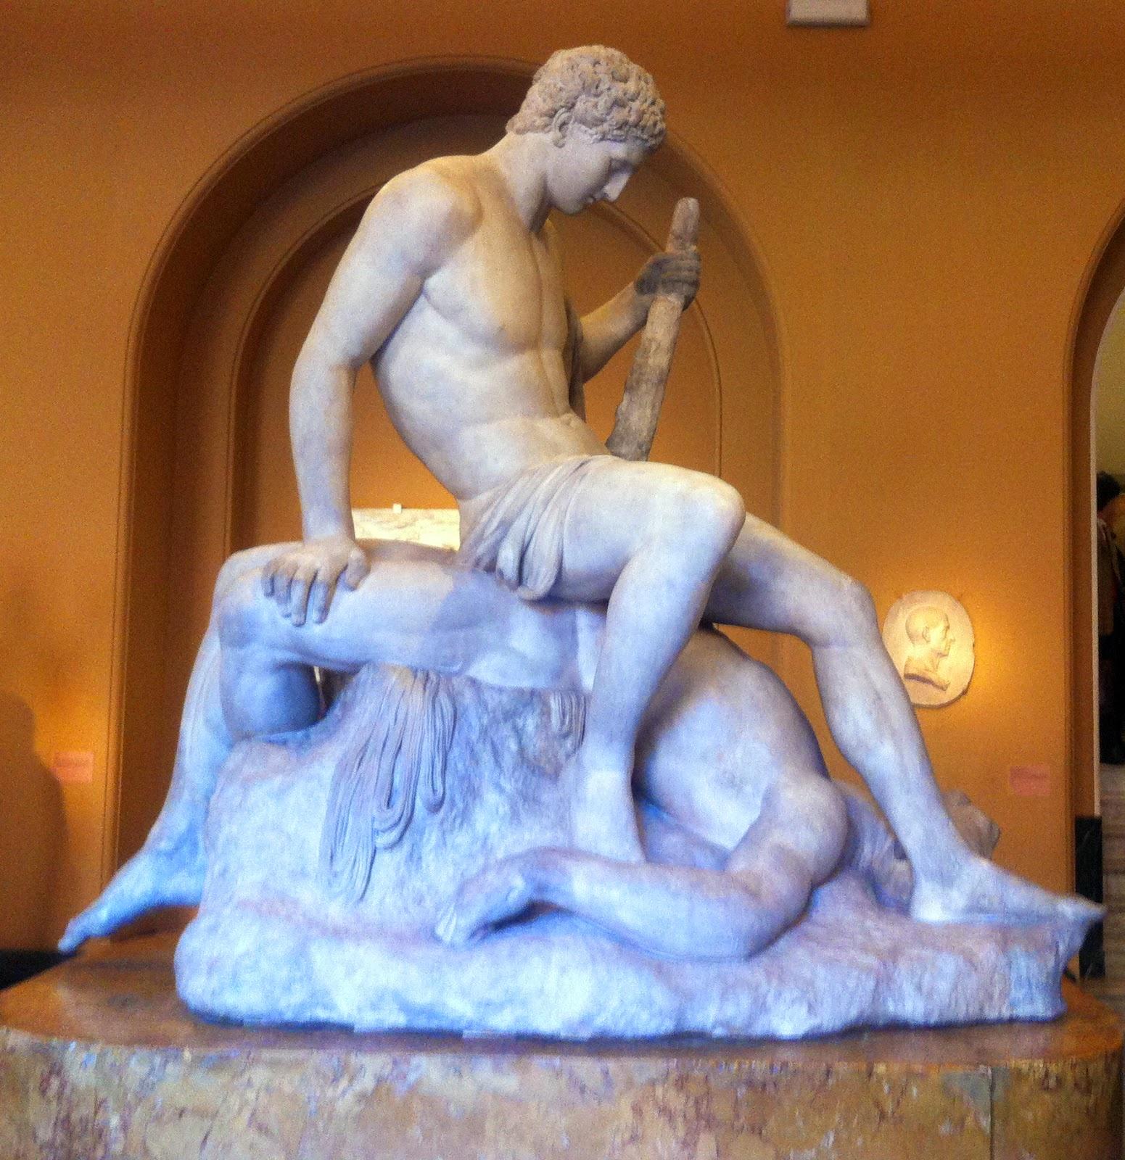

Slide 12
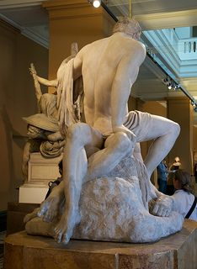

Slide 13
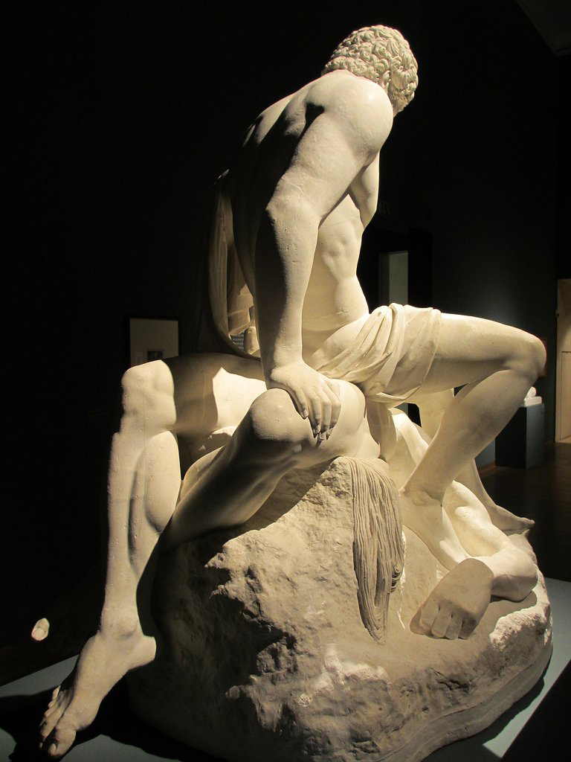

Slide 14
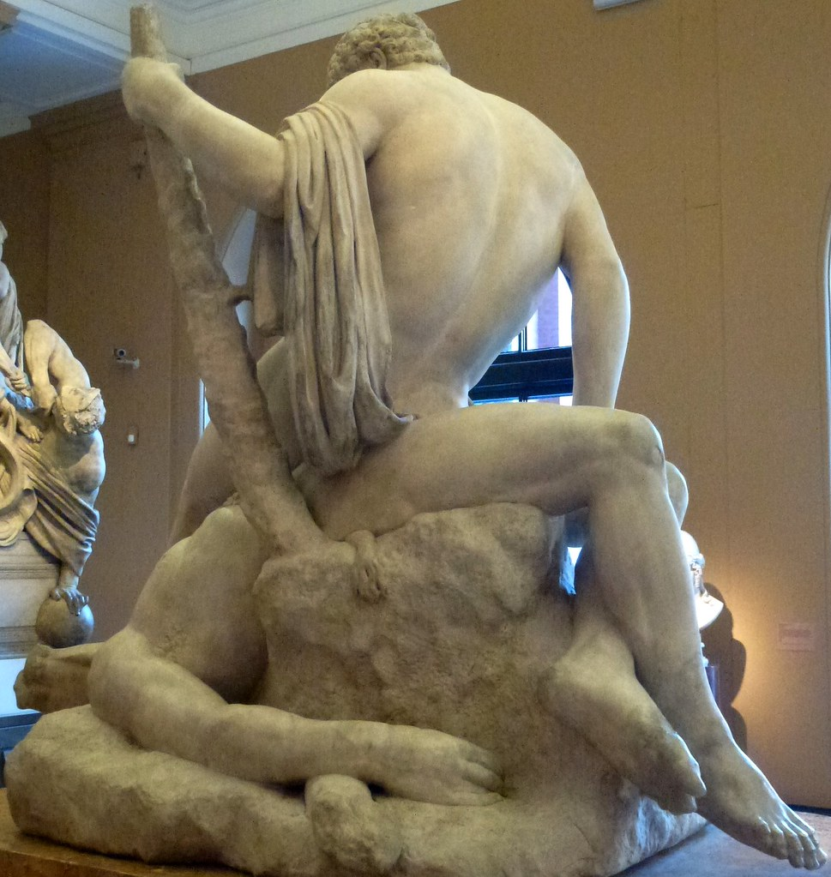

Slide 15
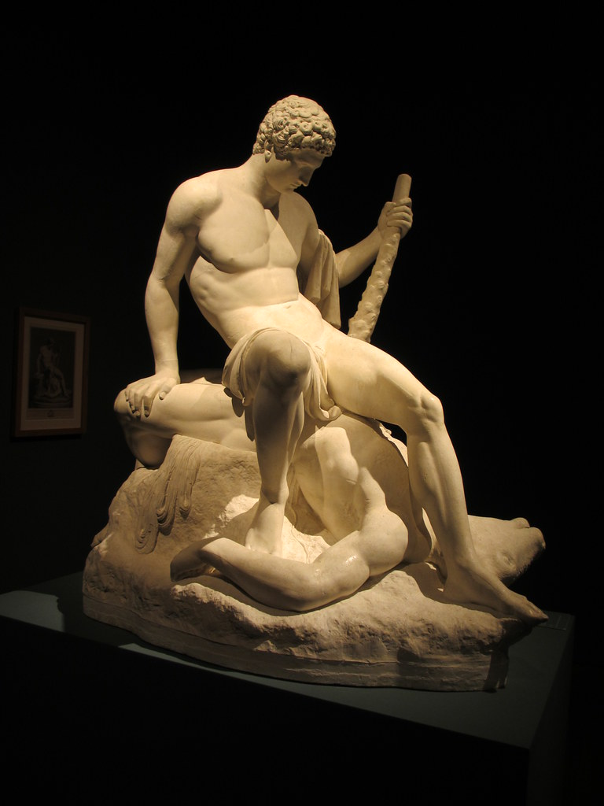

Slide 16
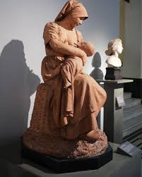
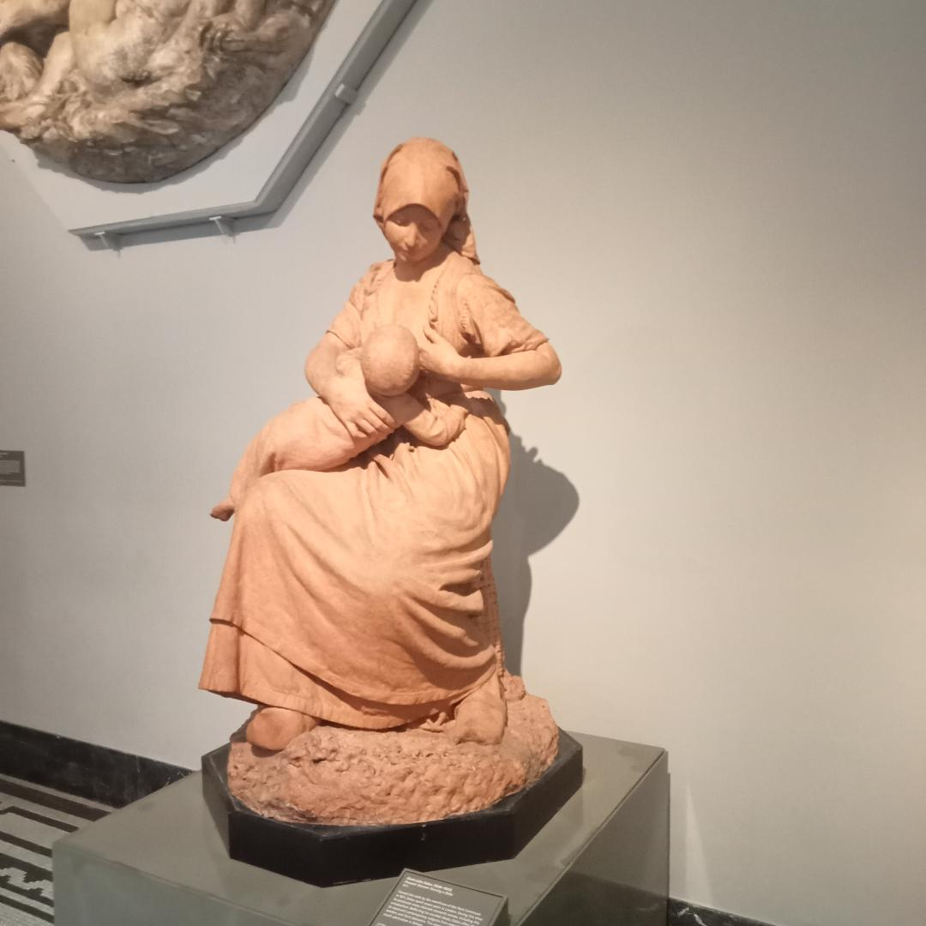
Notes:
Jules Dalou 1838-1902 pupil of Carpeaux. Commune. 8 yrs exile in GB. Galvanized British sculpt 1873

Slide 17
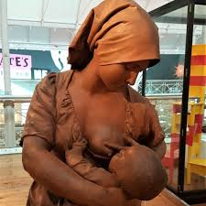
Notes:
Jules Dalou 1838-1902 pupil of Carpeaux. Commune. 8 yrs exile in GB. Galvanized British sculpt 1873

Slide 18
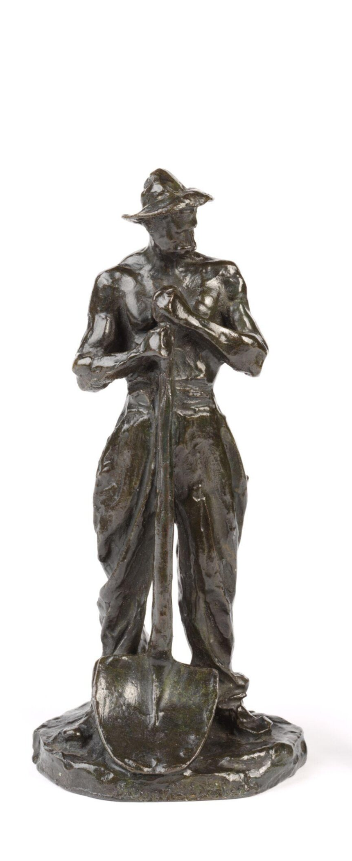
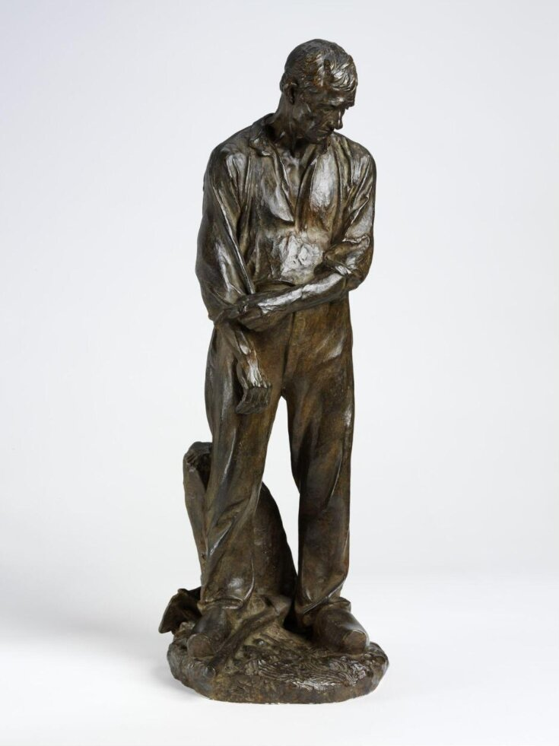

Slide 19
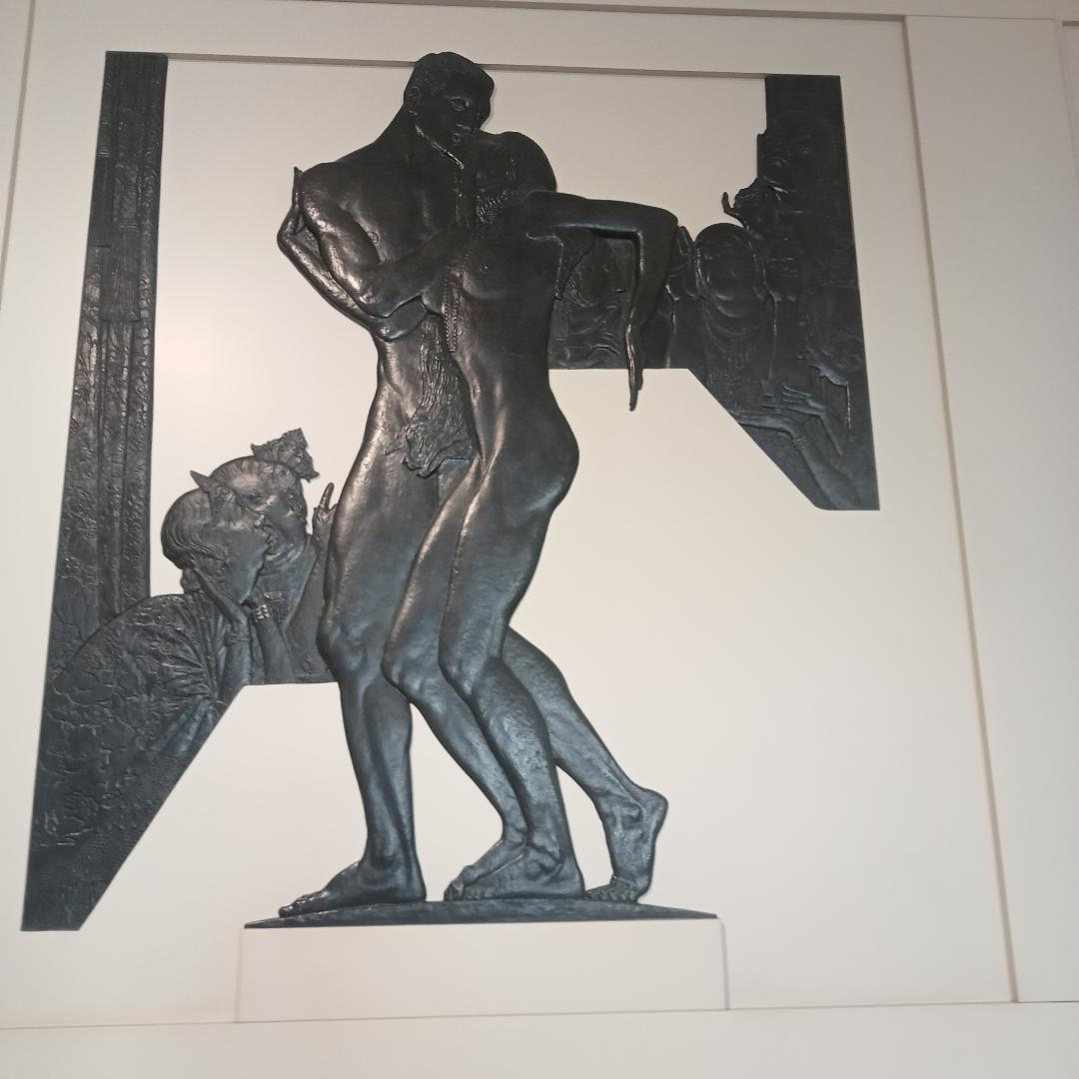
Notes:
Charles Sargeant Jagger Scandal 1930 Henry and Gwen Mond. Lord and Lady Melchett

Slide 20
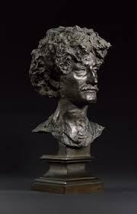
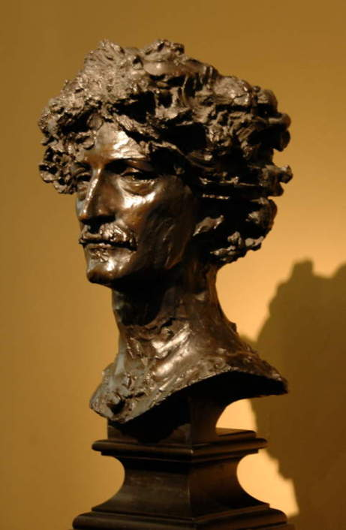
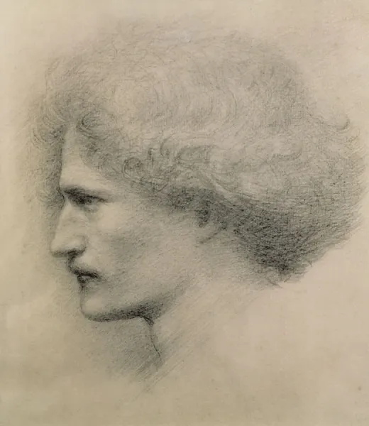
Notes:
Alfred Gilbert Paderewski. Not cast till after death suggests unfinished. 2 hrs

Slide 21
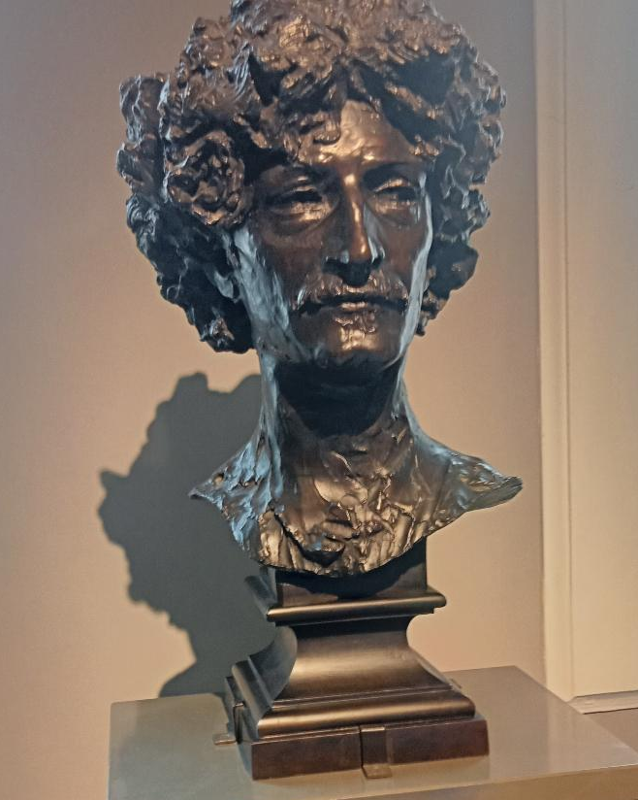

Slide 22
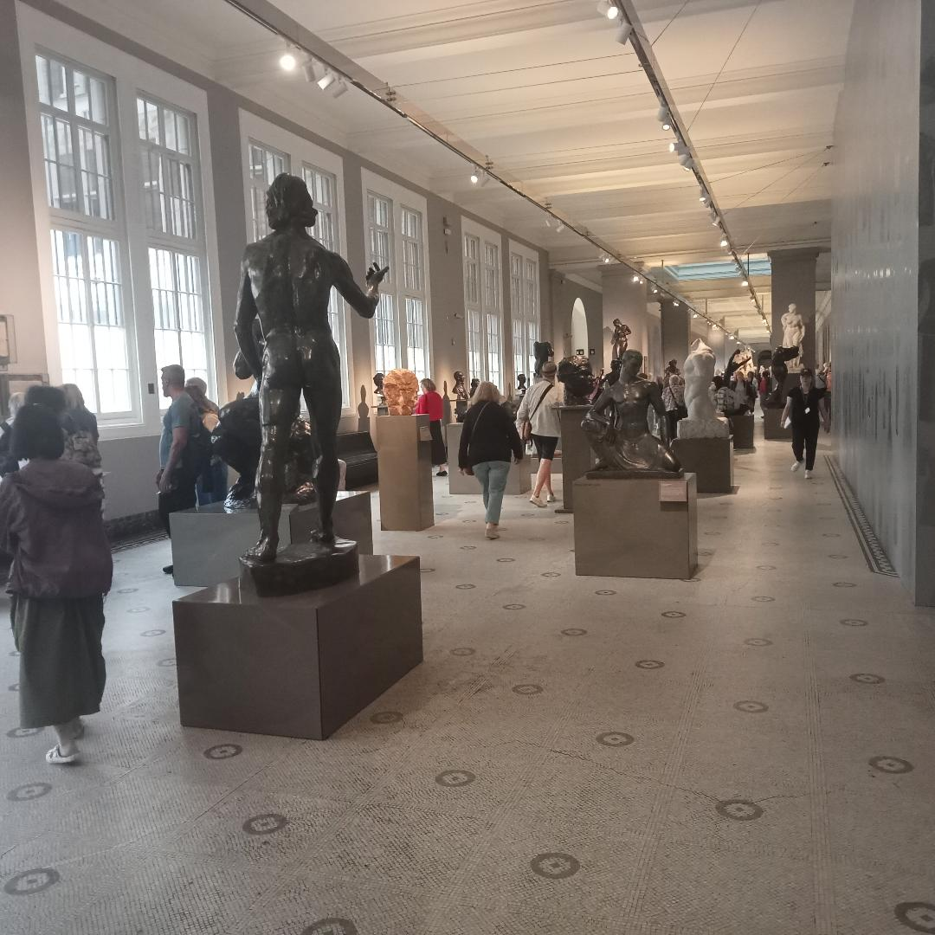

Slide 23
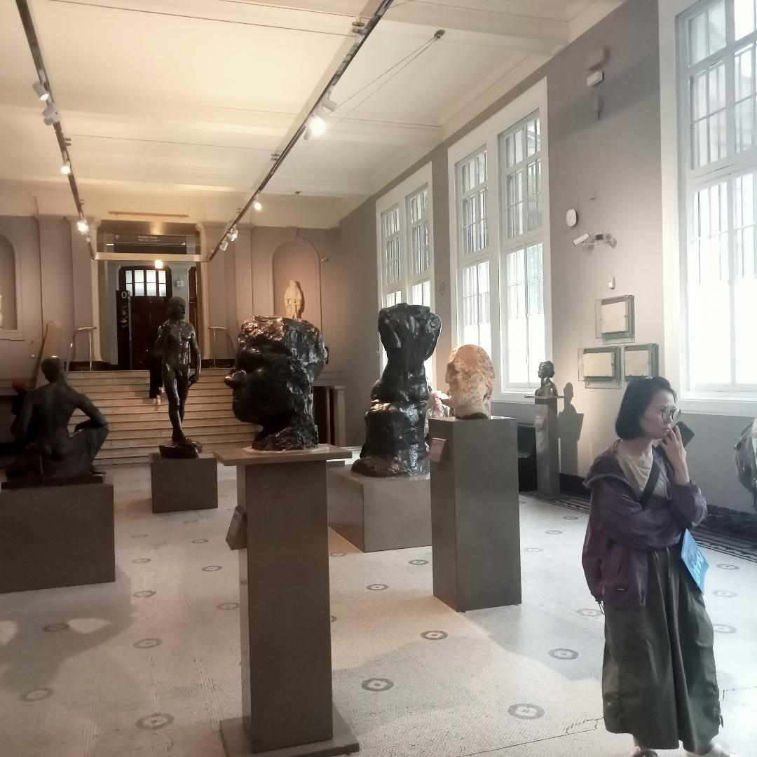

Slide 24
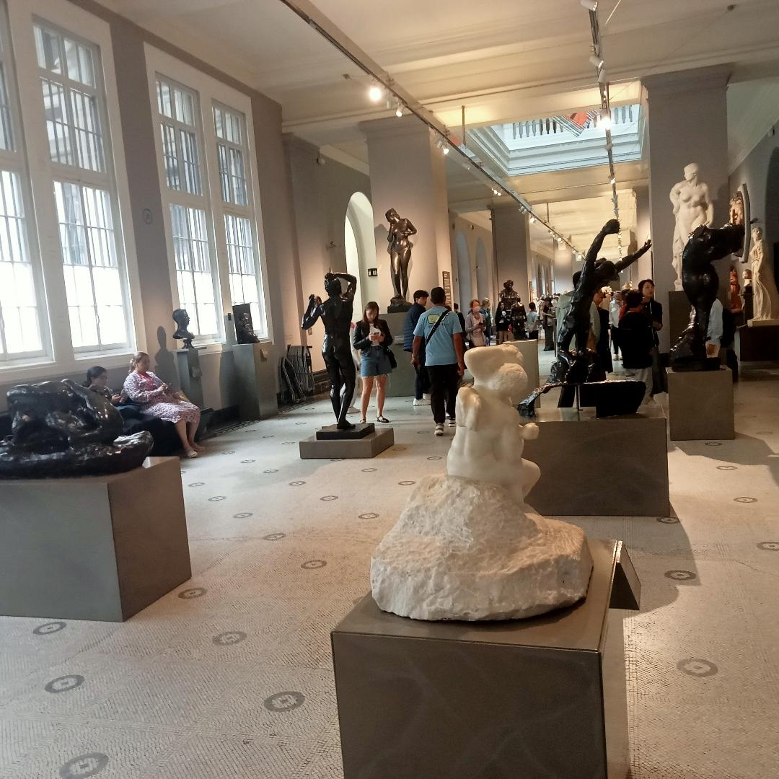

Slide 25
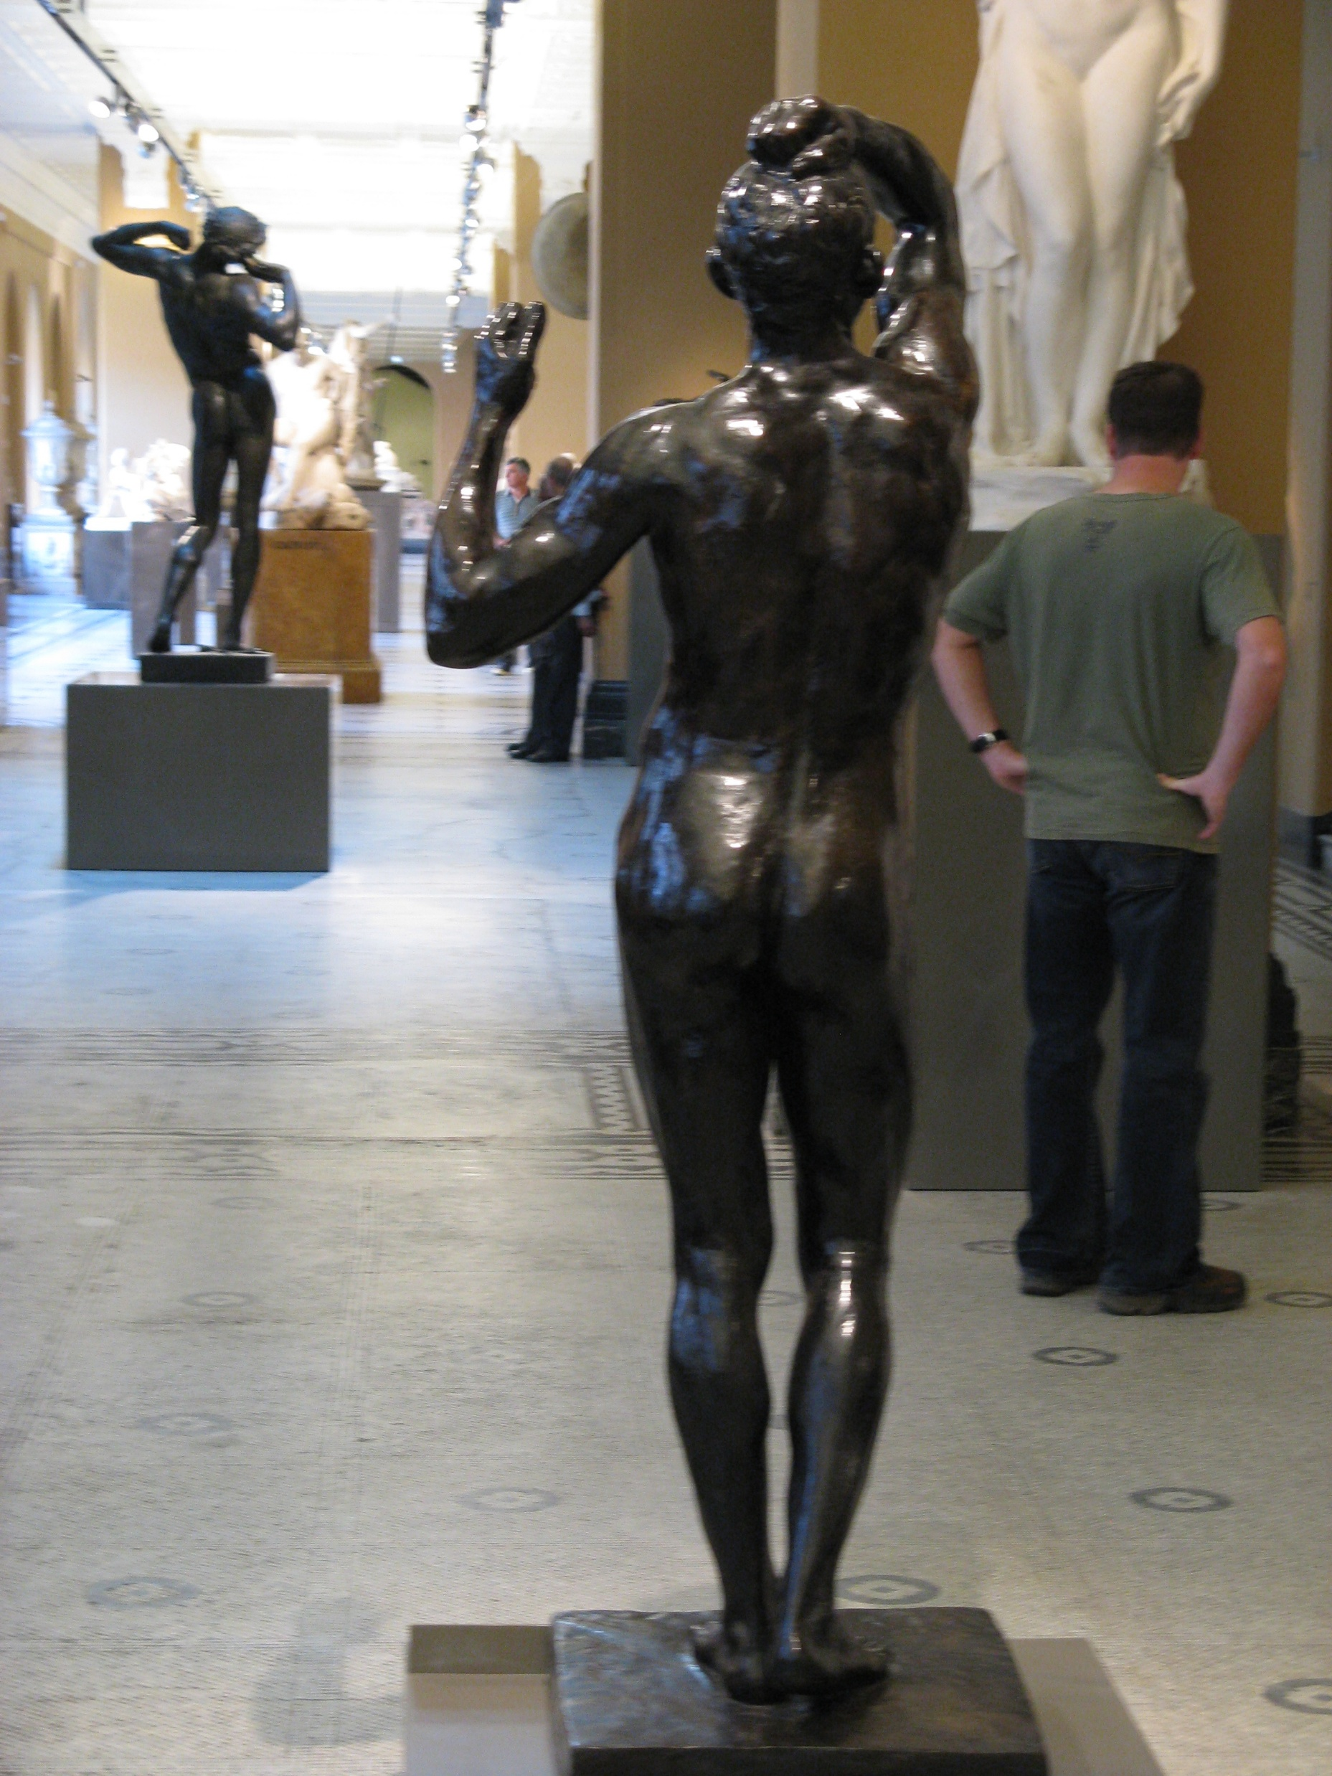
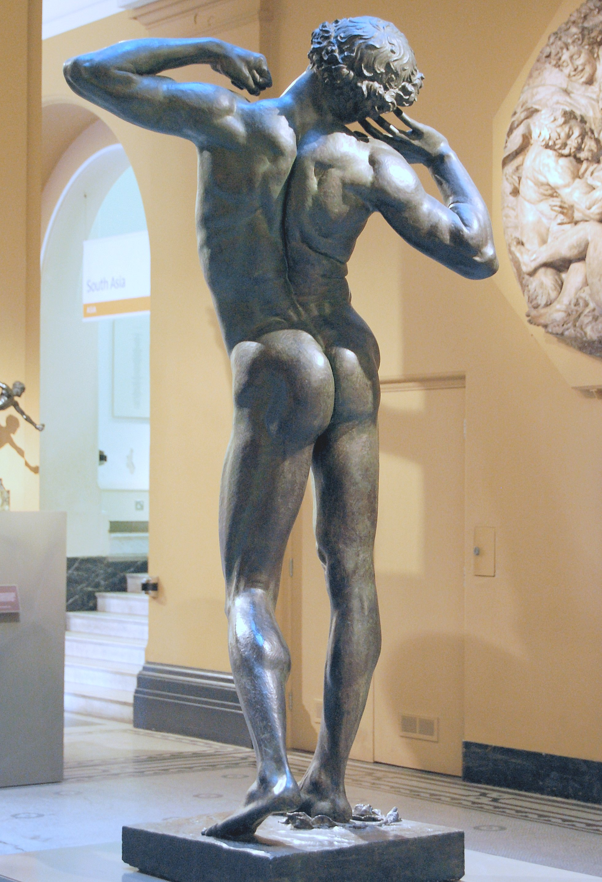

Slide 26
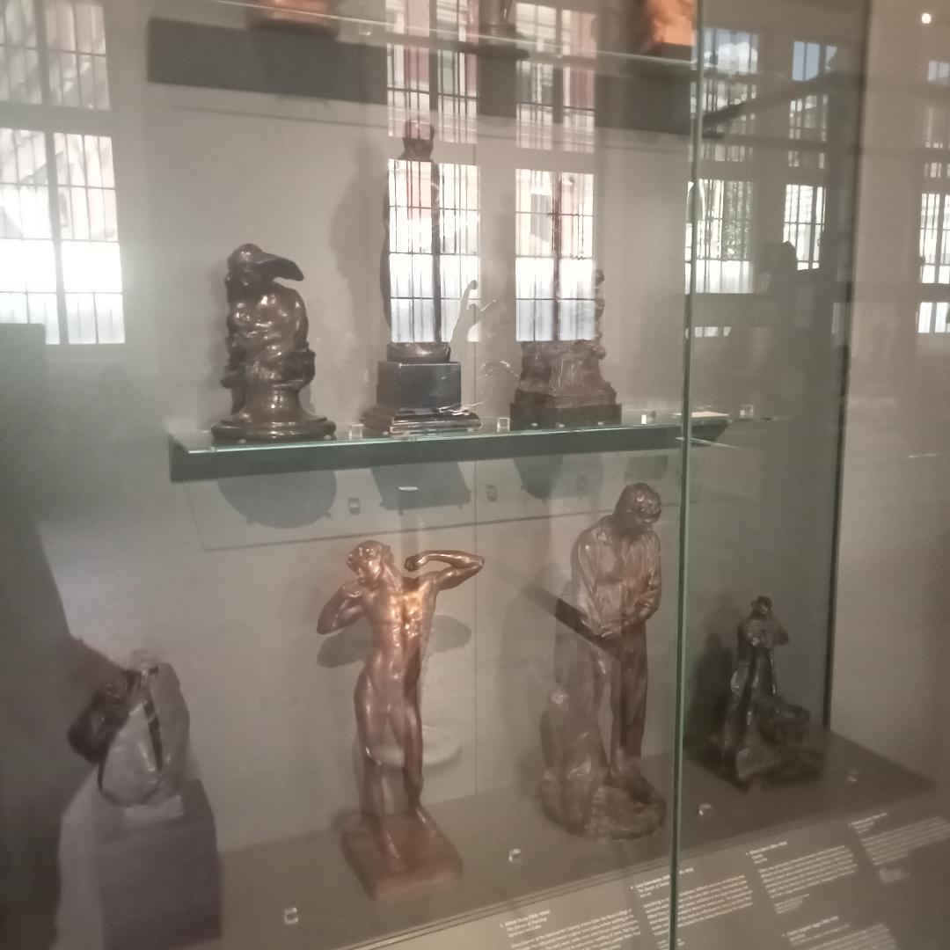

Slide 27
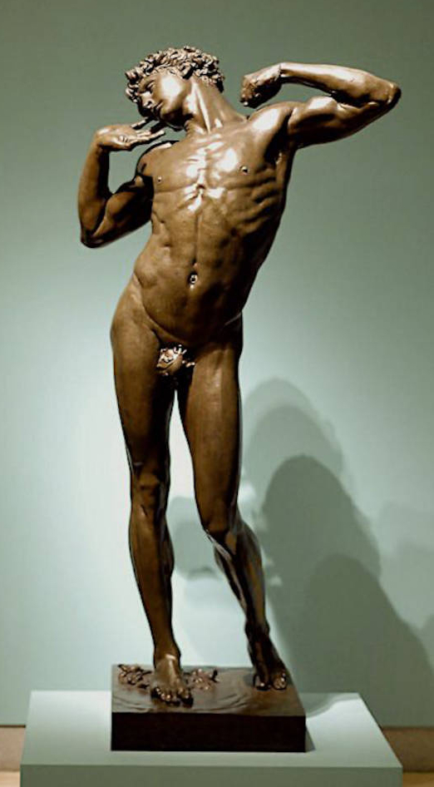

Slide 28
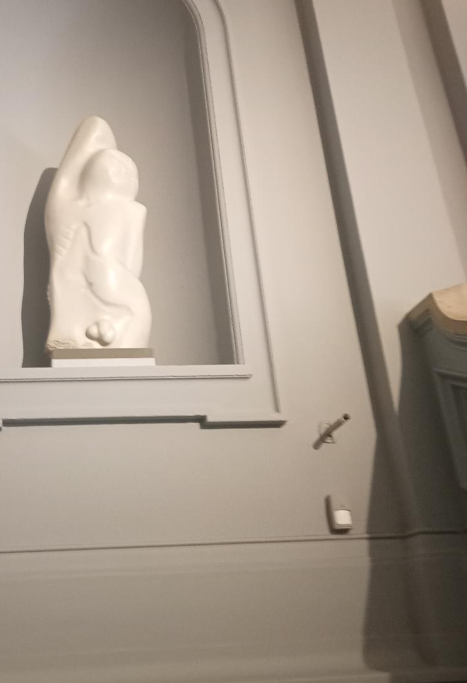
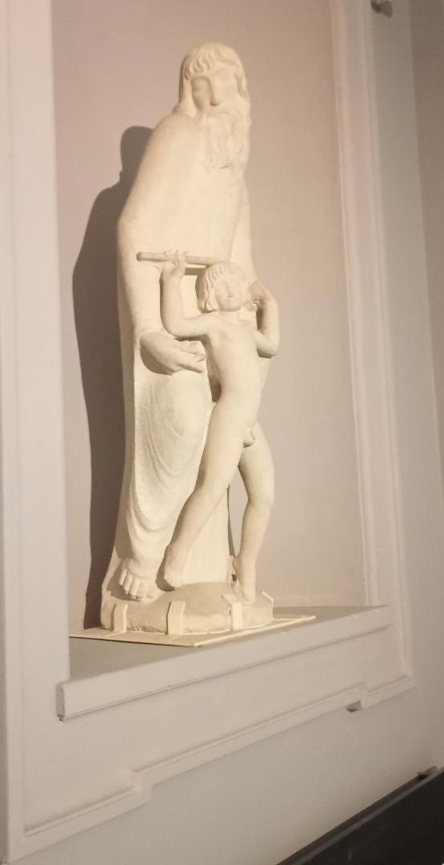

Slide 29
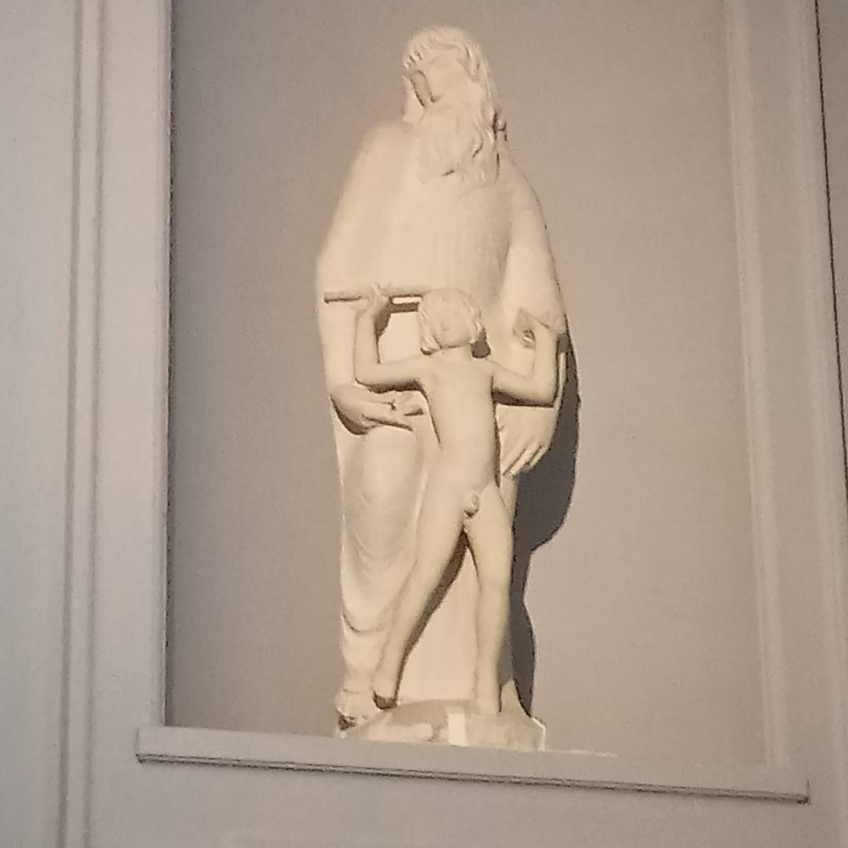

Slide 30
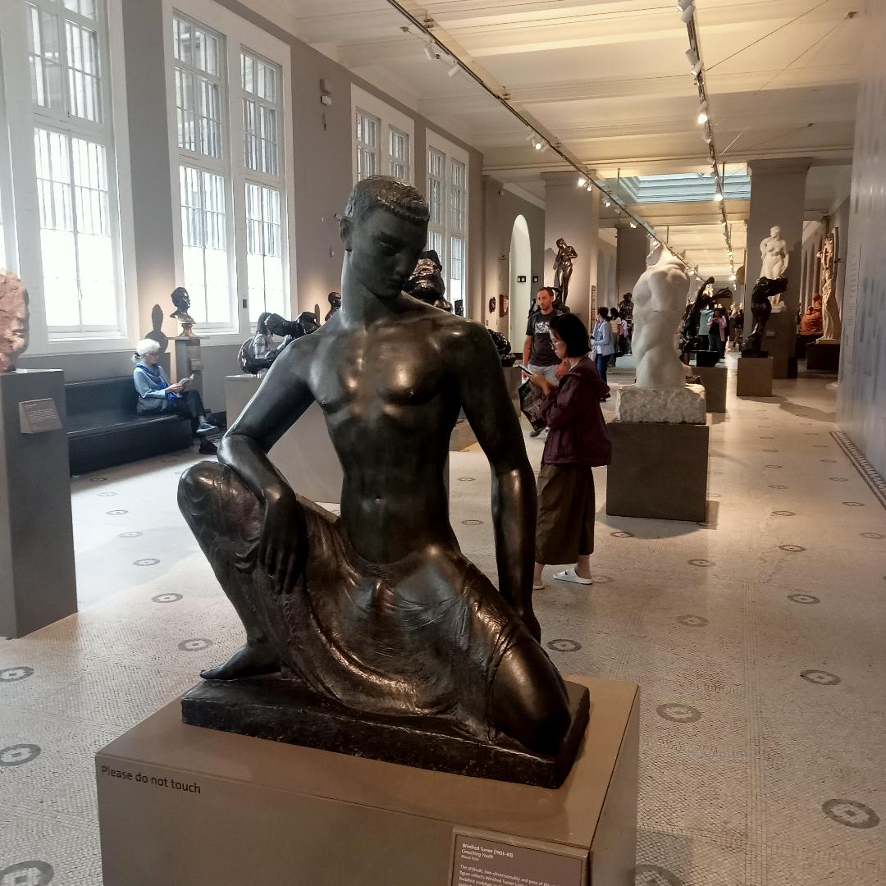
Notes:
Winifred Turner crouching youth c 1934

Slide 31
Notes:
Winifred Turner crouching youth c 1934

Slide 32
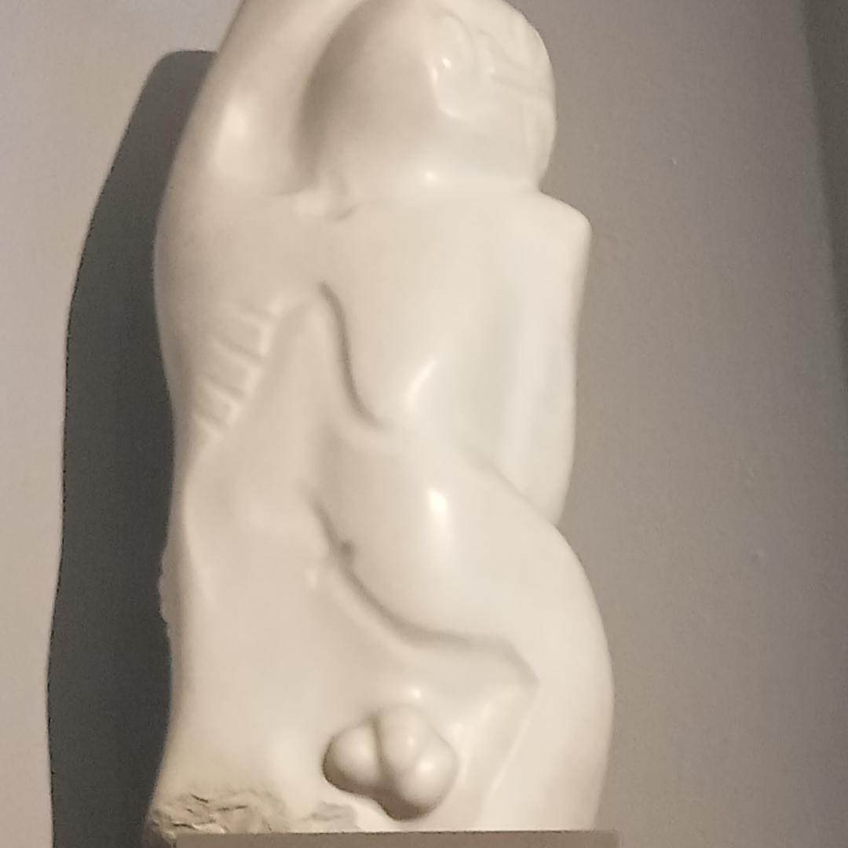

Slide 33
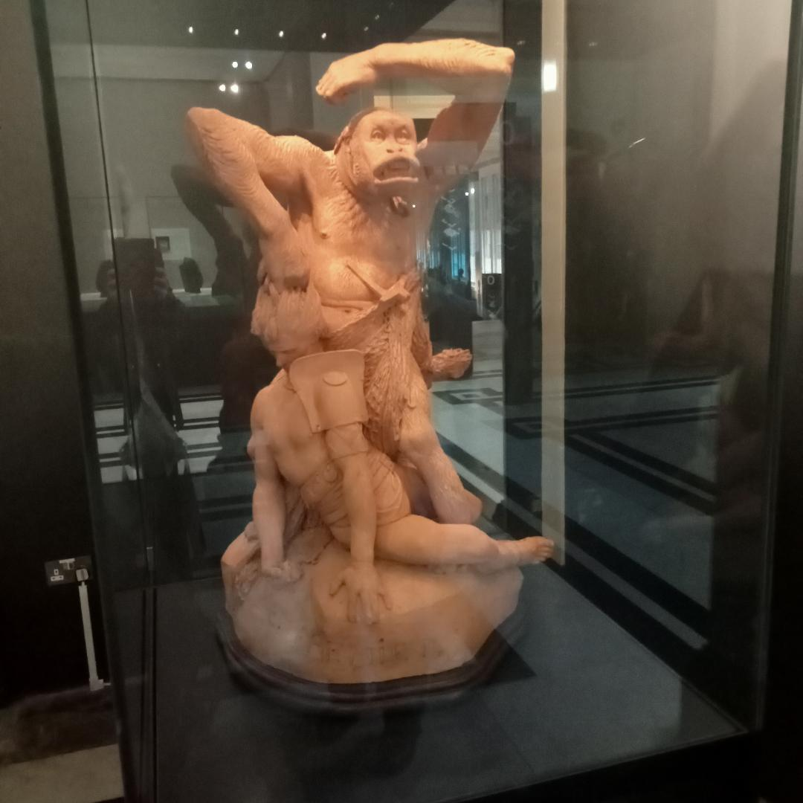
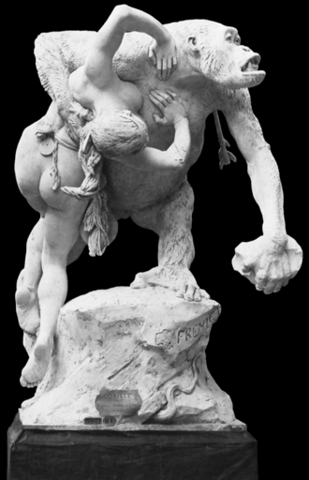

Slide 34
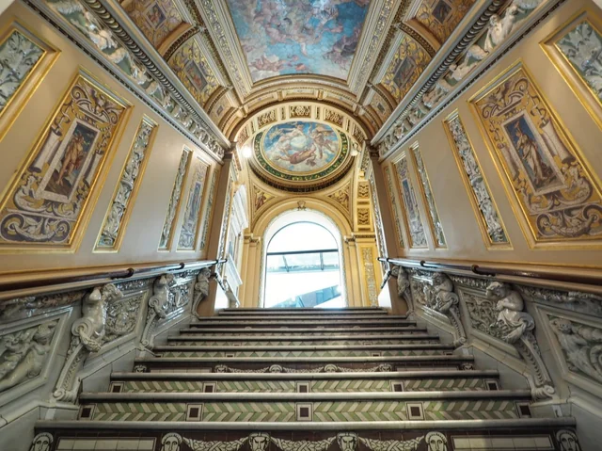
Notes:
Ceramic staircase project of Henry Cole Minton completed 1869

Slide 35
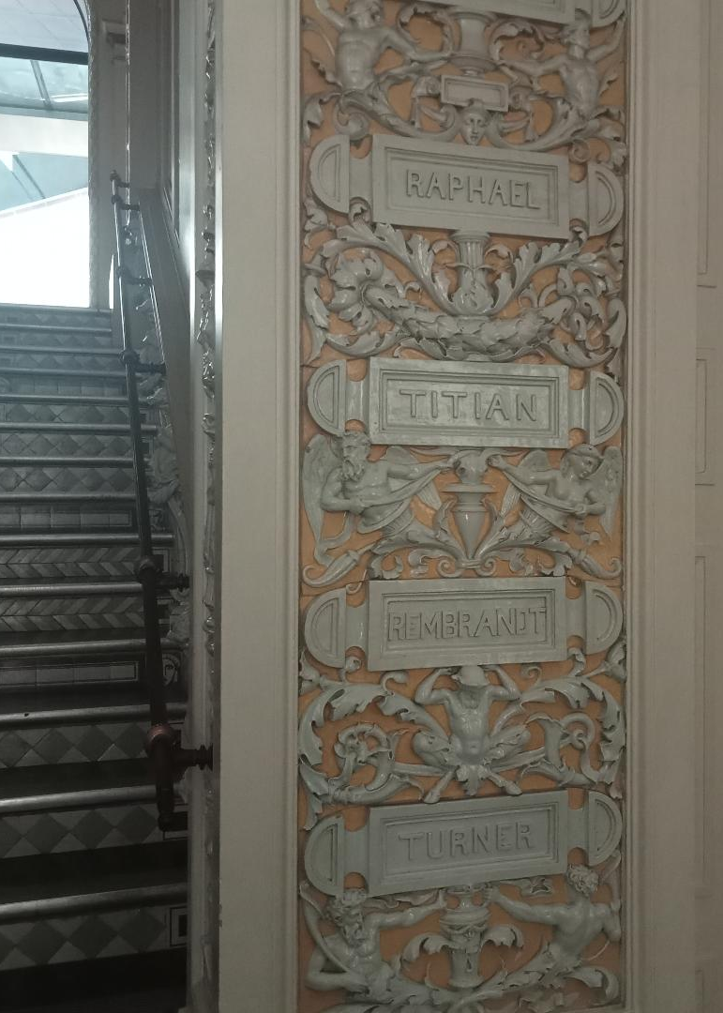
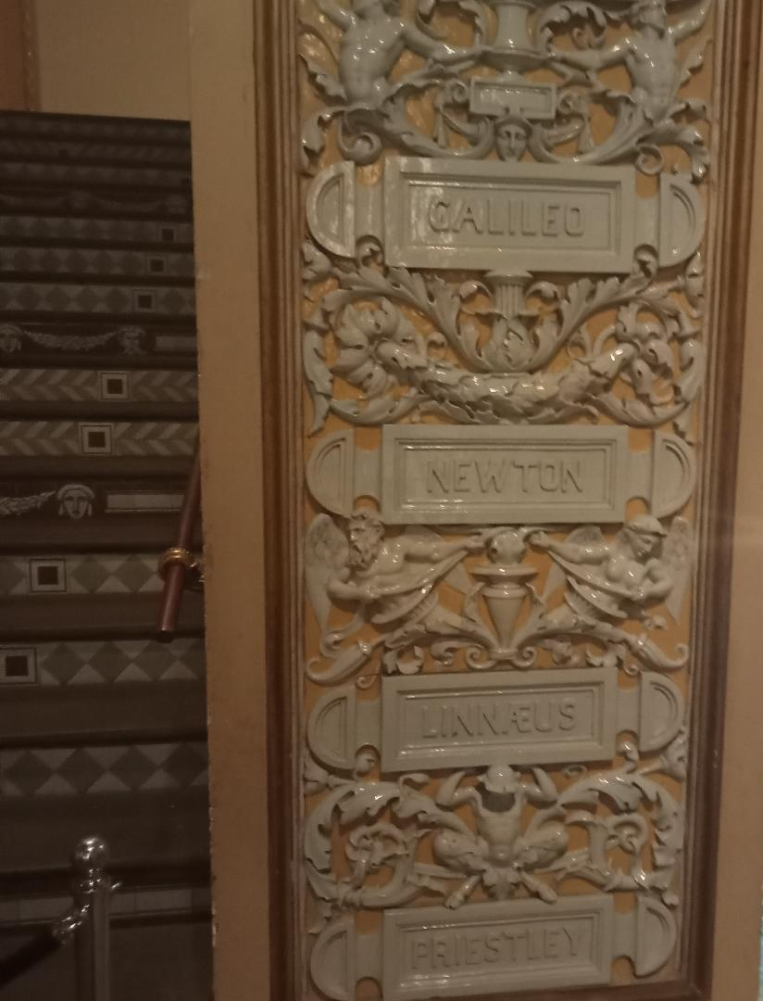

Slide 36
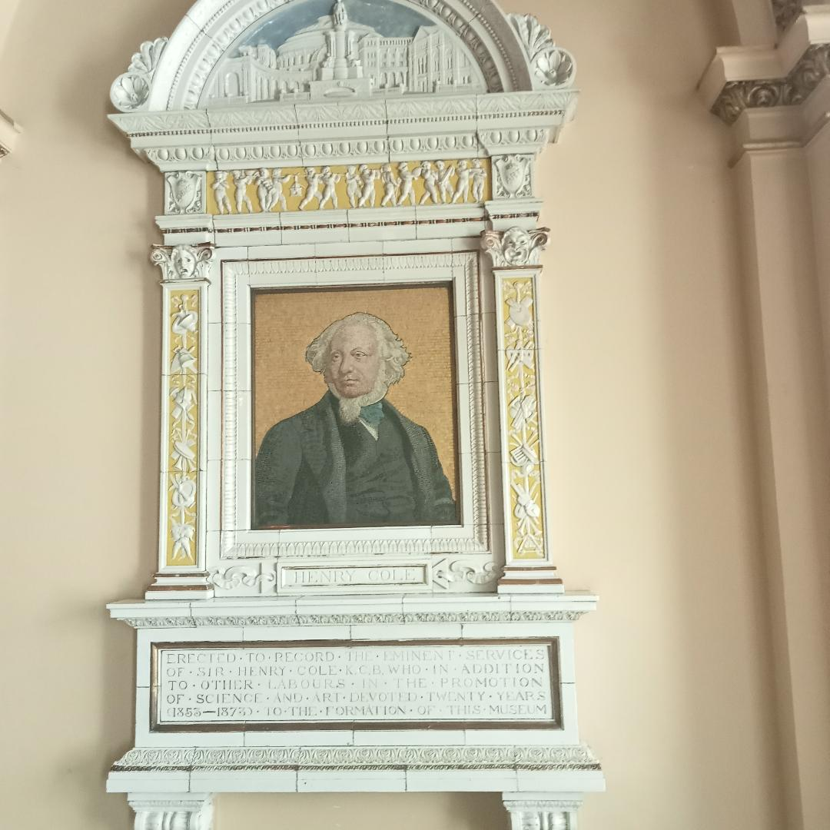
Notes:
Top albertopolis della Robbia 1878 Niece Florence Cole

Slide 37
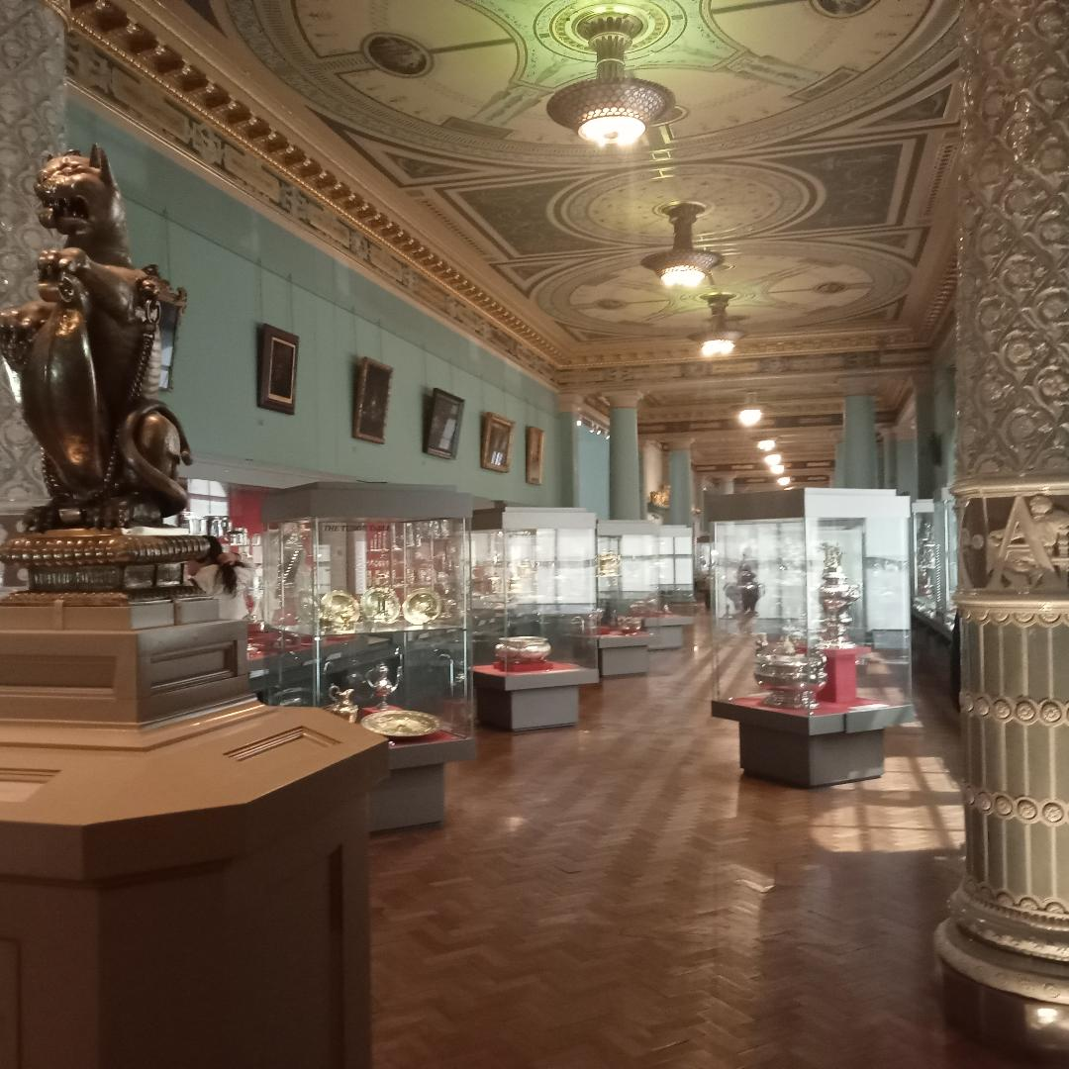

Slide 38
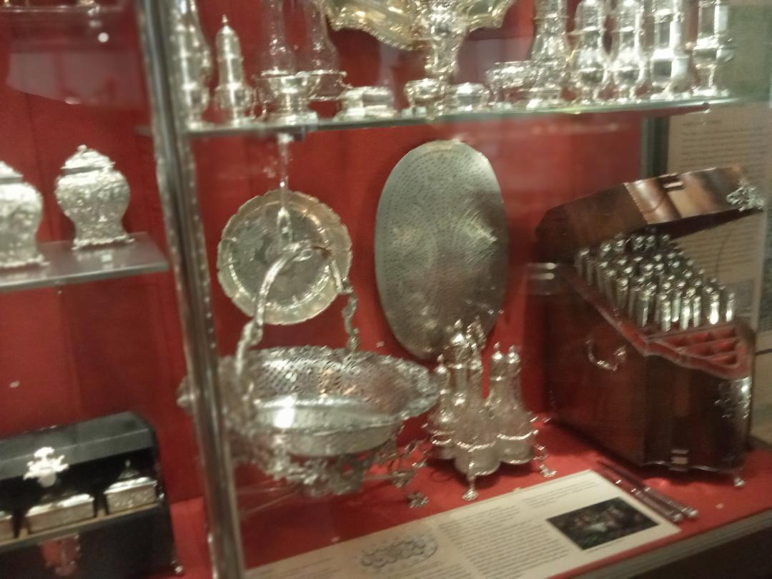

Slide 39
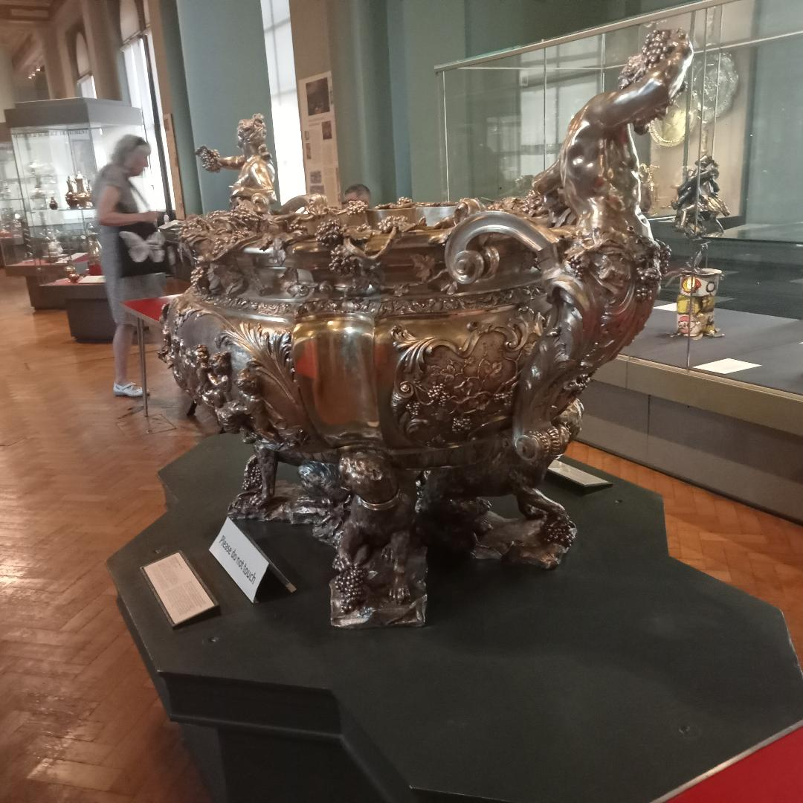

Slide 40
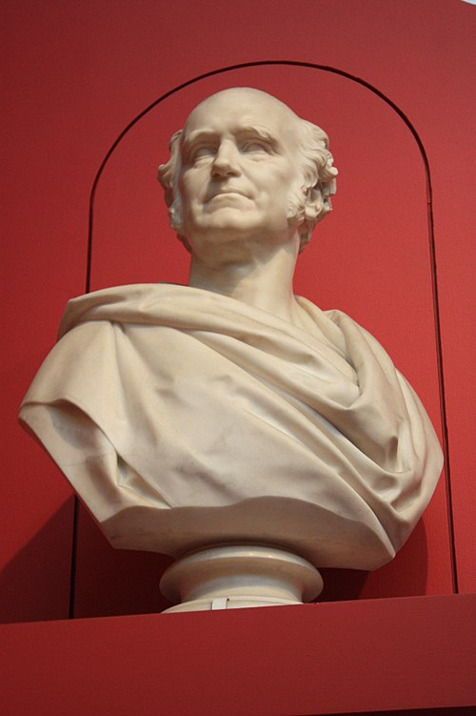
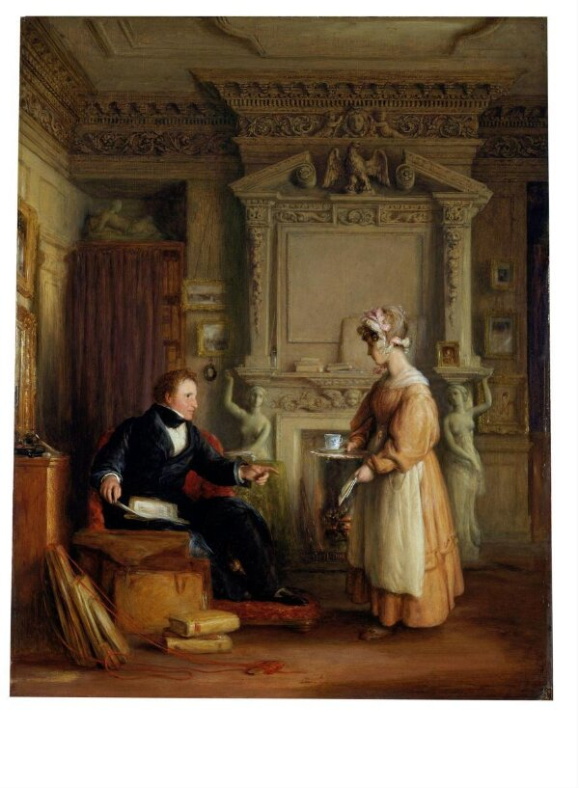
Notes:
Mulready John. Sheepshanks 1832-4 233 oil paintings given to V and A in 1857

Slide 41
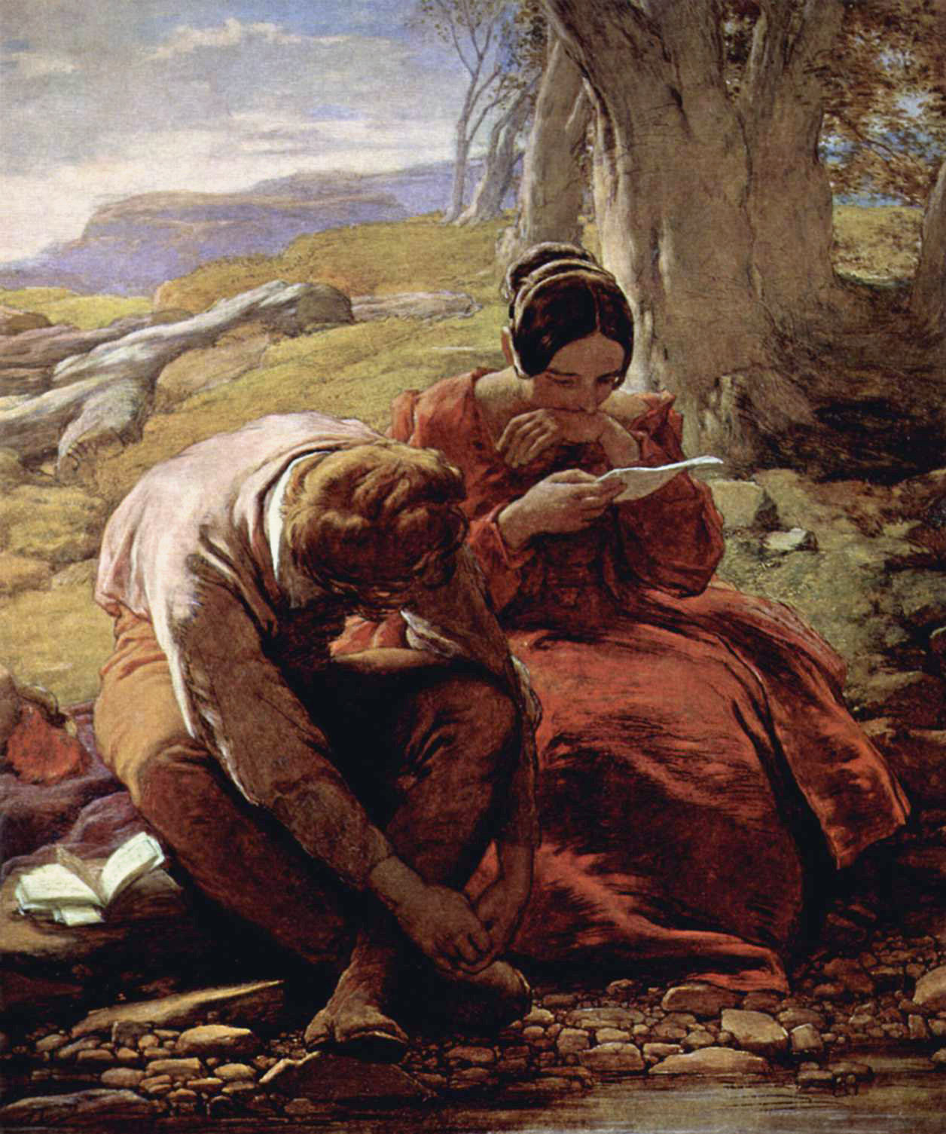
Notes:
William Mulready. The Sonnet 1839

Slide 42

Notes:
Palpitation Charles West Cope 1844

Slide 43

Notes:
William Mulready. The Toy seller

Slide 44

Notes:
Richard Redgrave. The Governess 1844

Slide 45

Notes:
Dignity and Impudence Landseer

Slide 46

Notes:
James Barry 1777. Bequeathed 1870. mean moody outsider

Slide 47


Slide 48


Slide 49

Notes:
William Etty the Deluge 1835-45

Slide 50


Slide 51

Notes:
Constantine Ionides. George Fred Watts

Slide 52


Slide 53

Notes:
Nardo di Cioni mid 14th C

Slide 54

Notes:
Beccafumi Charity suckling a child

Slide 55

Notes:
St Leo in Glory Dominico Tiepolo

Slide 56

Notes:
Abraham dismisses Hagar and Ishmael possibly by Ferdinand Bol 2nd book of Kings. Huge coll of etchings

Slide 57

Notes:
Gerard Terborth 1638 barrack rm 30 yrs war

Slide 58


Slide 59


Slide 60


Slide 62


Slide 63


Slide 64


Slide 65


Slide 66

Notes:
Courbet L’Immensite

Slide 67


Slide 68


Slide 69


Slide 70


Slide 71


Slide 72


Slide 73


Slide 74

Notes:
1883-5 commissioned by Alexander Ionides.

Slide 75

Notes:
1883-5 commissioned by Alexander Ionides.

Slide 76

Notes:
Venice from the Giudecca 1840 sheepshanks

Slide 77

Notes:
Line fishing off Hastings 1835

Slide 78

Notes:
Line fishing off Hastings 1835

Slide 79

Notes:
St Michael’s Mount sheepshanks

Slide 80


Slide 81

Notes:
Life-boat and Manby apparatus going off to a stranded vessel making signal (blue lights) of distress. 1831 sheepshanks

Slide 82
Notes:
Life-boat and Manby apparatus going off to a stranded vessel making signal (blue lights) of distress. 1831 sheepshanks

Slide 83


Slide 84


Slide 85


Slide 86


Slide 87


Slide 88


Slide 89


Slide 90


Slide 91


Slide 92


Slide 93


Slide 94


Slide 95


Slide 96


Slide 97


Slide 98


Slide 99


Slide 100


Slide 101


Slide 102


Slide 103


Slide 104


Slide 105

Notes:
Bear baiting

Slide 106


Slide 107


Slide 108



Slide 109


Slide 110


Slide 111


Slide 112


Slide 113



Slide 119


Slide 120


Slide 121


Slide 122


Slide 124


Slide 126



Slide 128


Slide 129


Slide 130


Slide 131


Slide 132


Slide 133


Slide 134


Slide 135


Slide 136


Slide 137


Slide 138


Slide 139


Slide 140


Slide 141


Slide 142


Slide 143


Slide 144


Slide 145


Slide 146


Slide 147


Slide 148


Slide 149


Slide 150


Slide 151


Slide 152


Slide 153


Slide 154

Notes:
Lawrence Alma Tadema 1868 Ionides

Slide 155

Notes:
Jules Dalou Helene Ionides 1879

Slide 156


Slide 157


Slide 158


Slide 159


Slide 160


Slide 162


