Slide 1
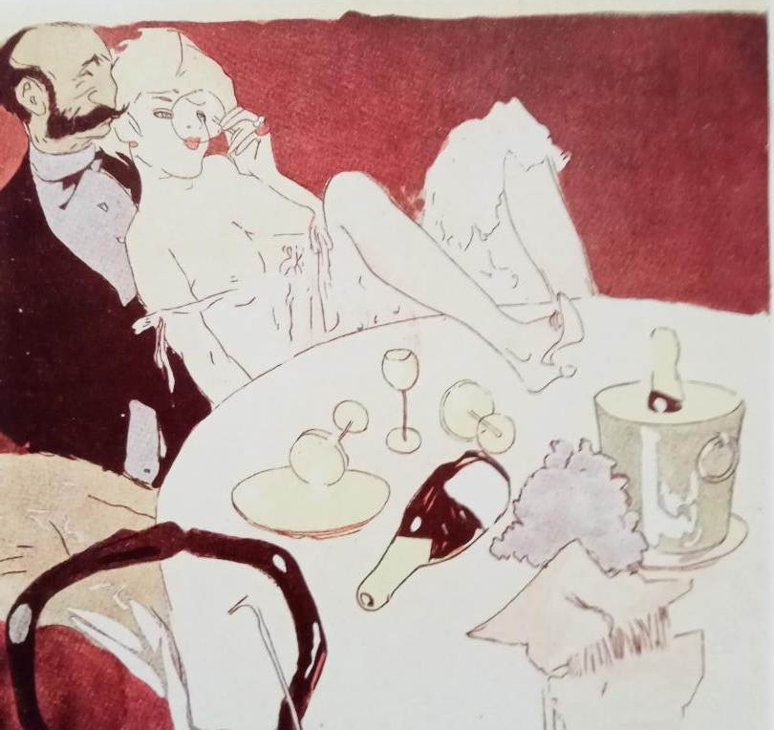

Slide 2
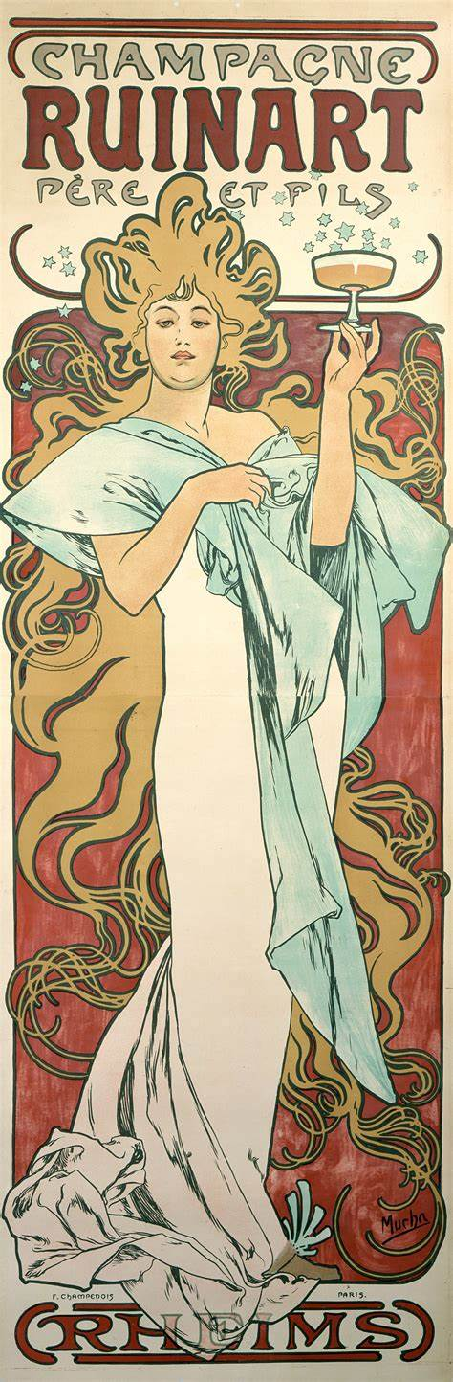
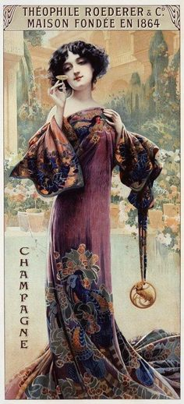
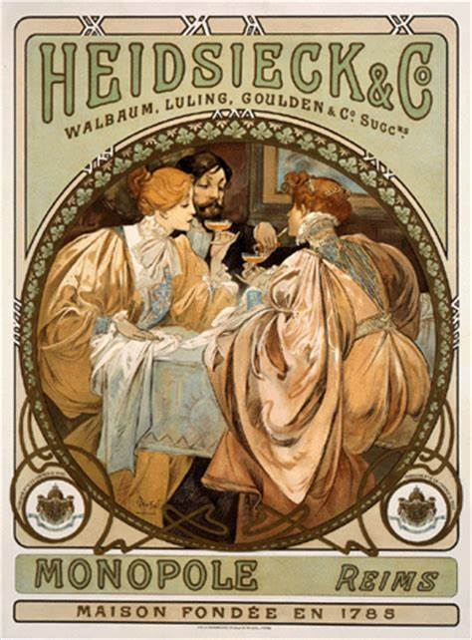
Notes:
BE quintessential drink of BE

Slide 3
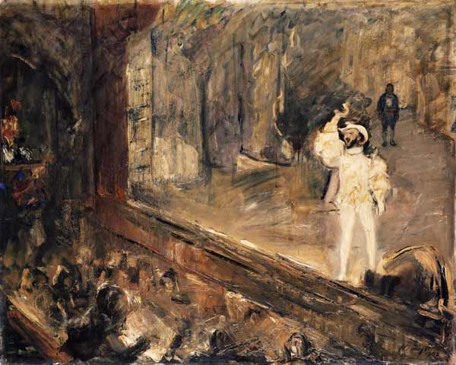
Notes:
Max Slevogt D’Andrade

Slide 4
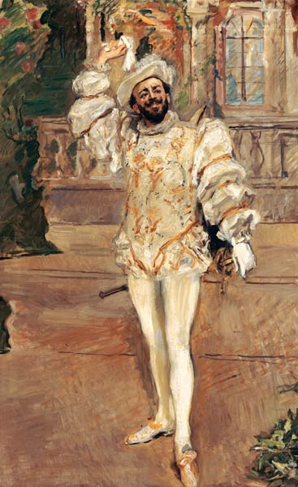

Slide 5
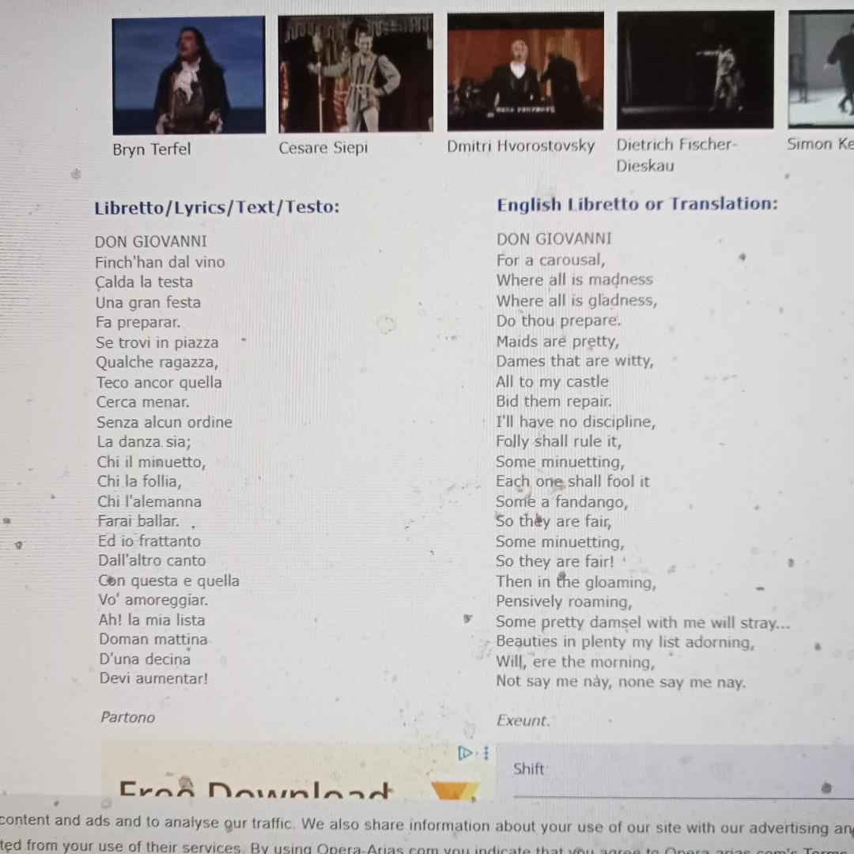


Slide 6
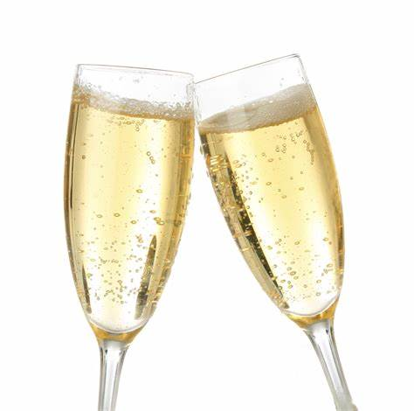
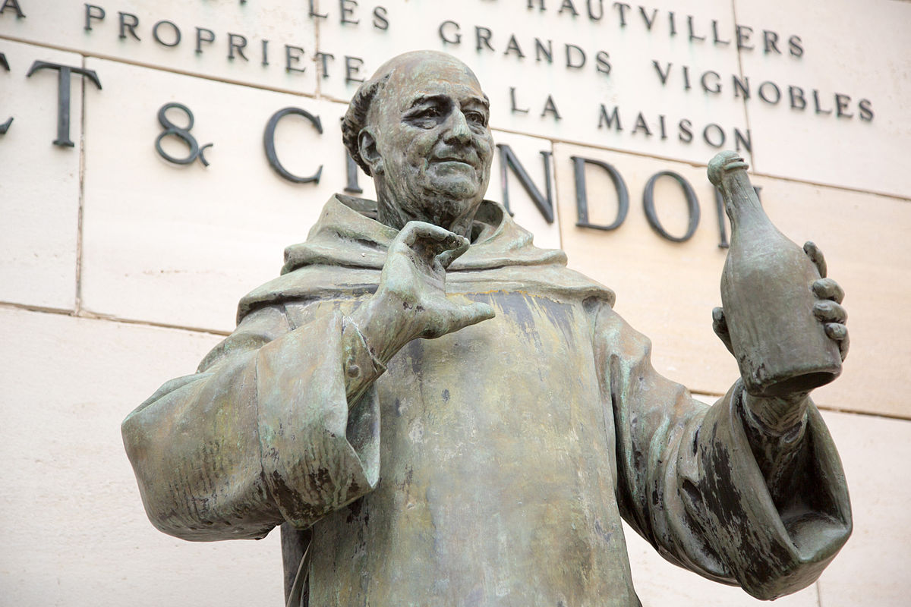
Notes:
Dom Perignon flute and coupe 17th C Benedictine monk credited

Slide 7
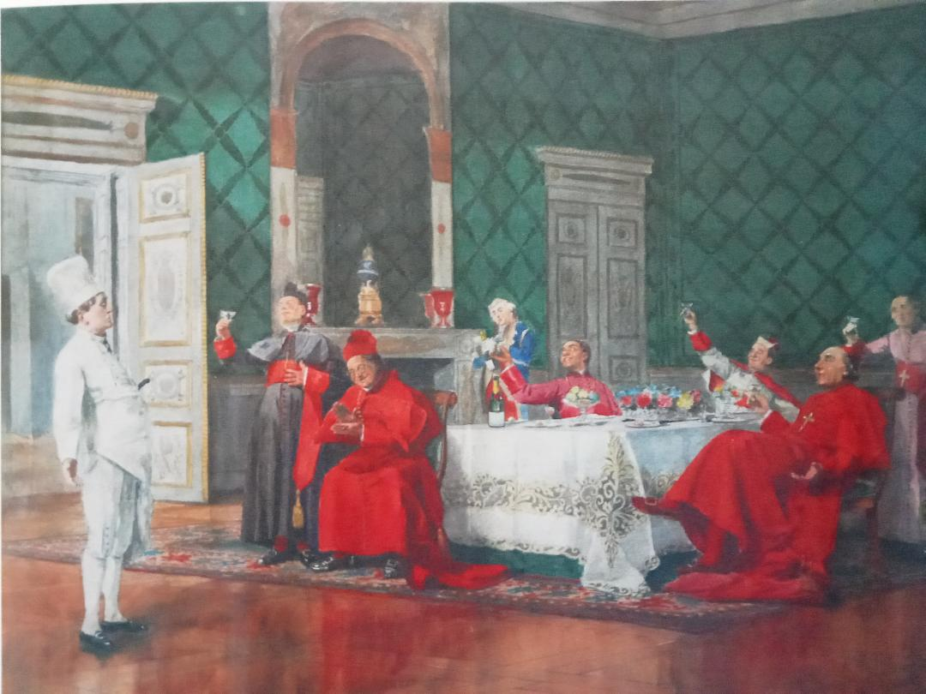
Notes:
Francois brunery. A la sante du chef

Slide 8
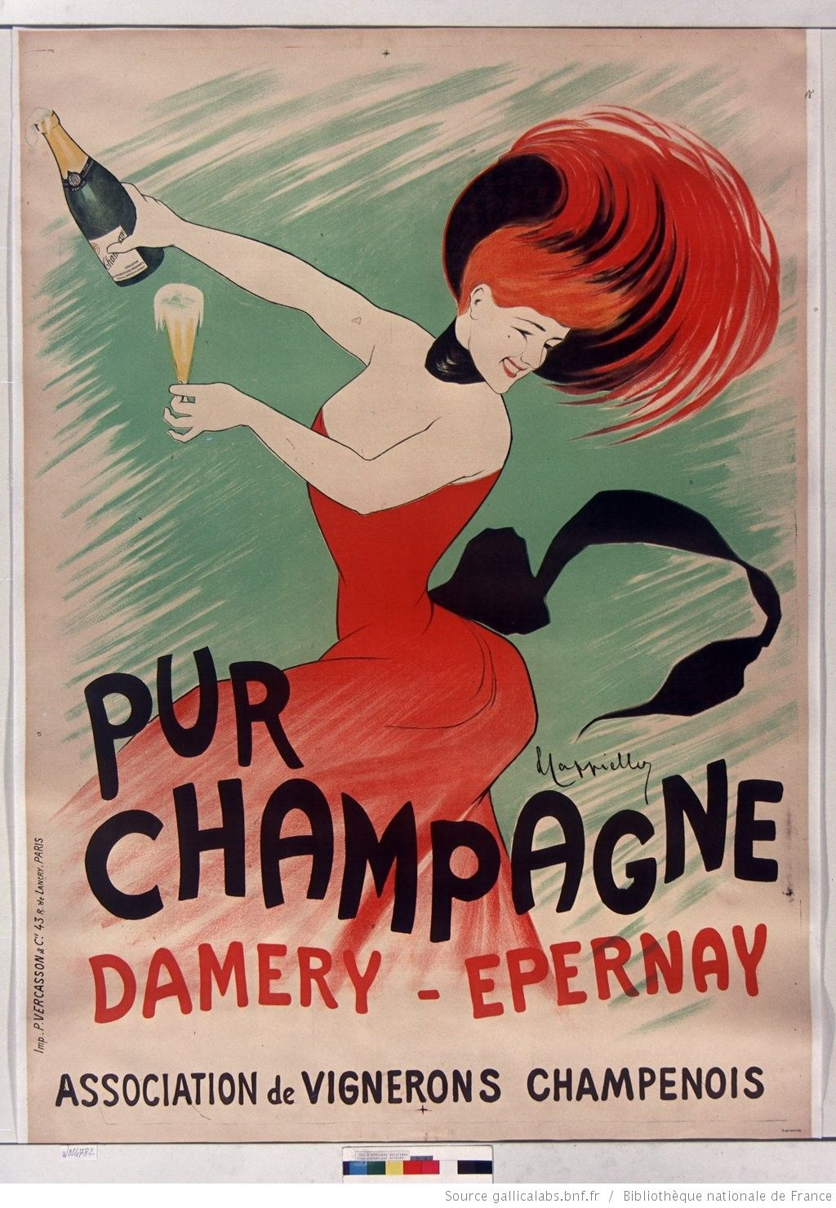
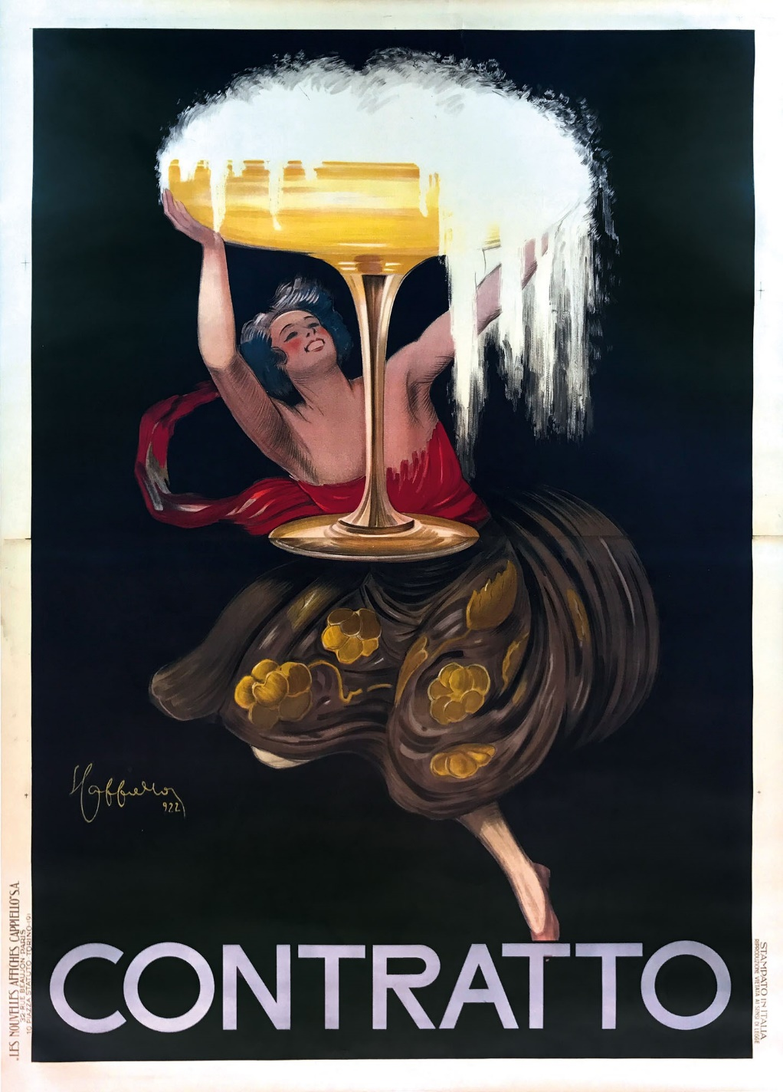
Notes:
Leonetto Cappiello

Slide 9
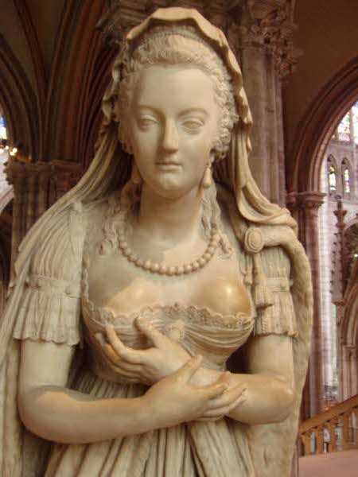
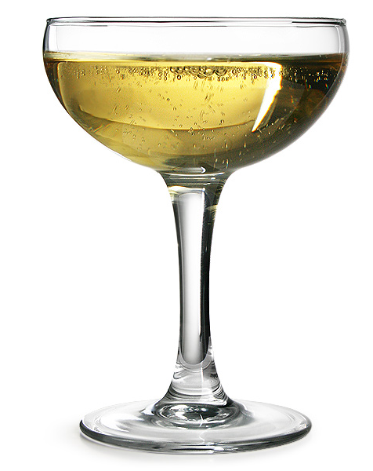
Notes:
Tobacco stained hands fondled generations st Denis

Slide 10
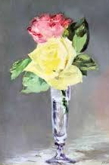
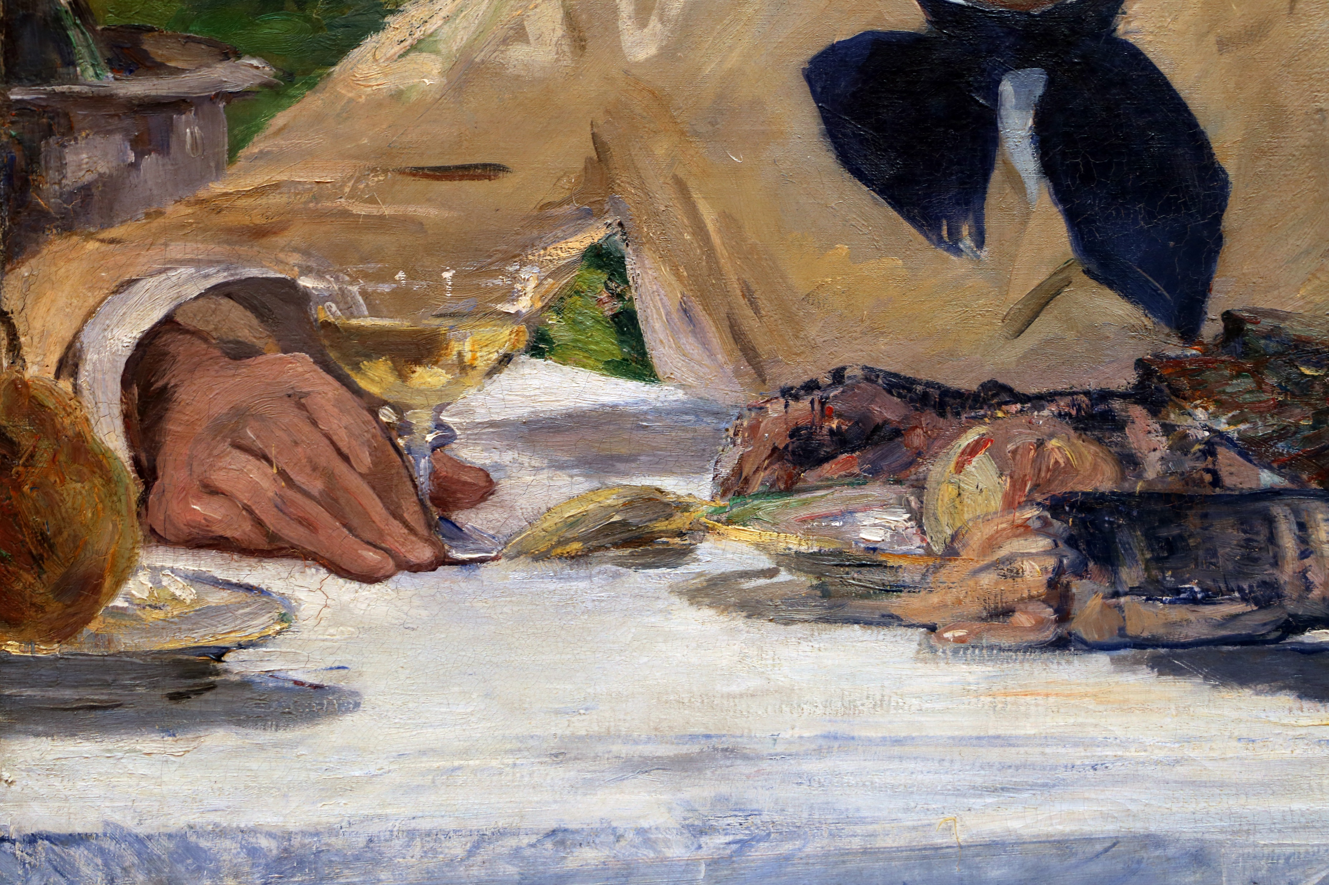

Slide 11
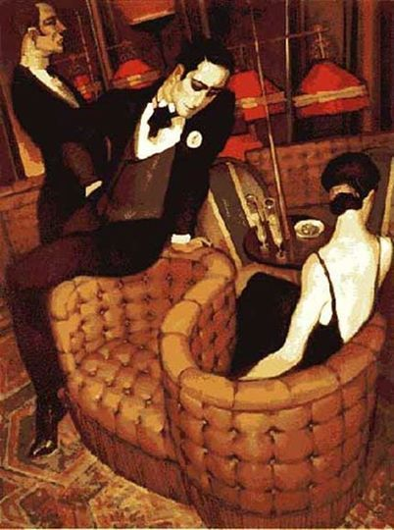
Notes:
Juarez Machado Brasilian. Decadent seductions

Slide 12
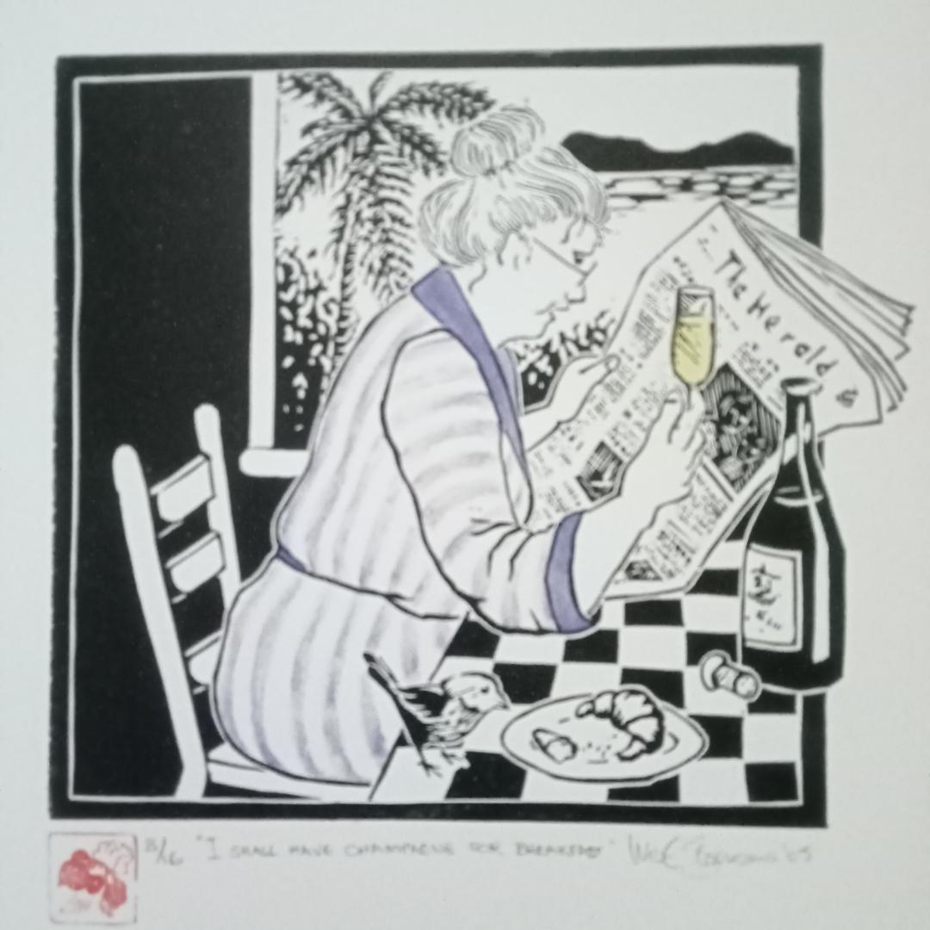
Notes:
Iris Steensma I have champagne for breakfast.

Slide 13
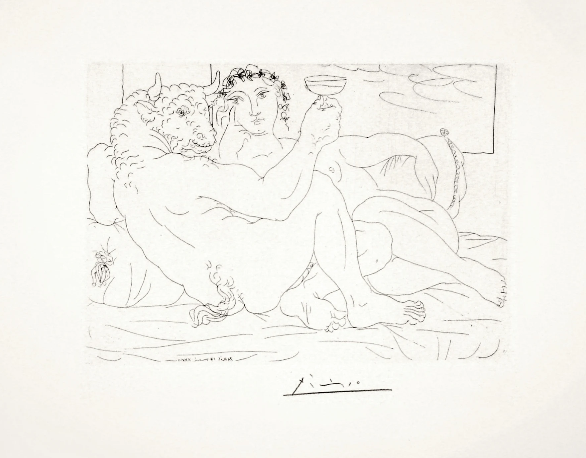

Slide 14
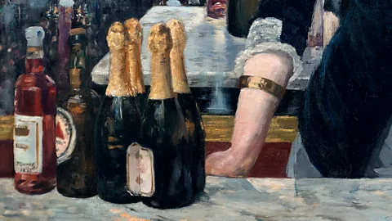

Slide 15
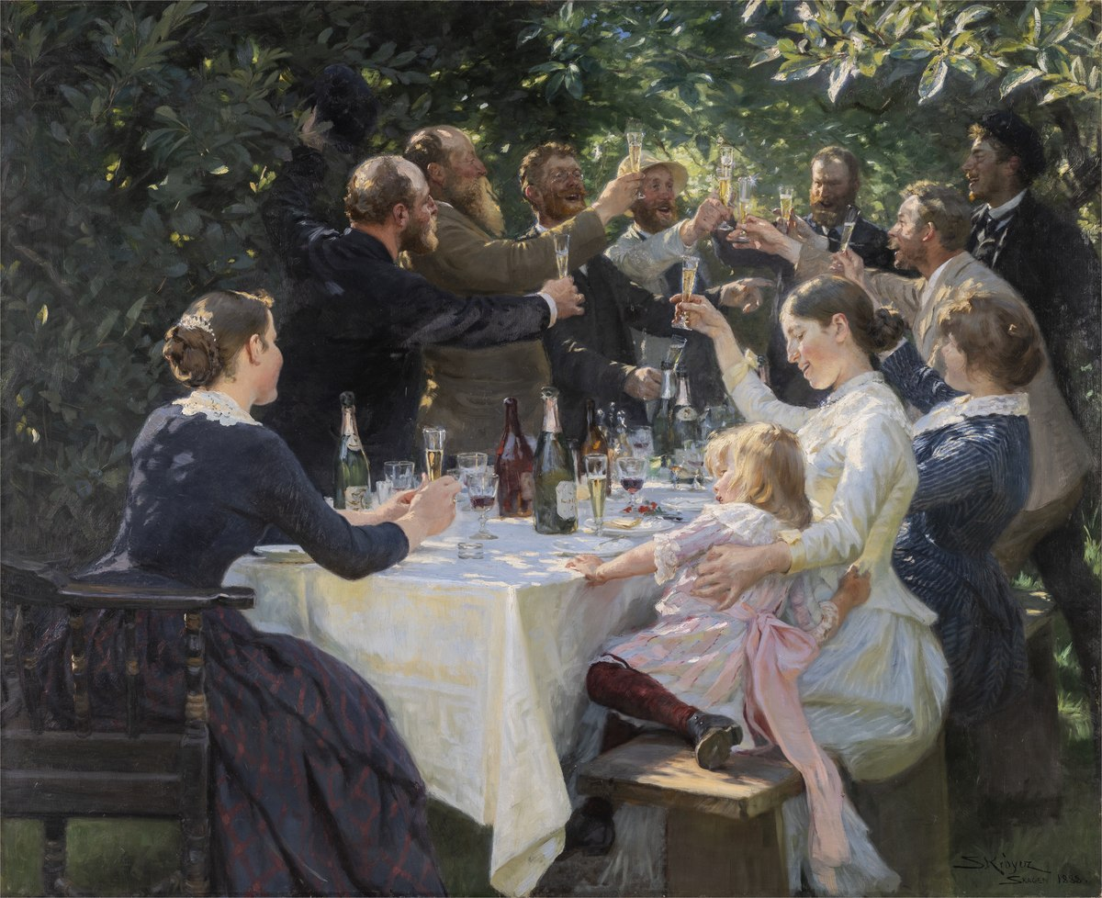
Notes:
Celebration Peder Kroyer. Toasting.

Slide 16
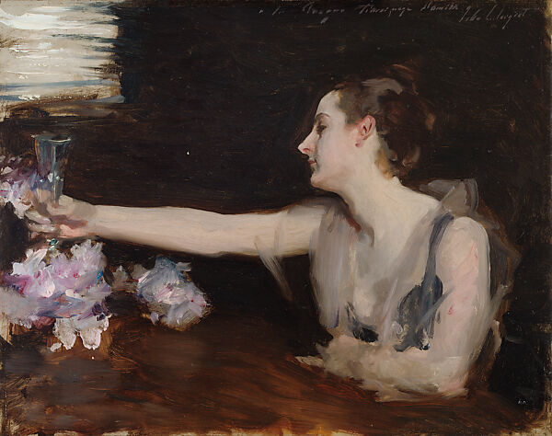

Slide 17
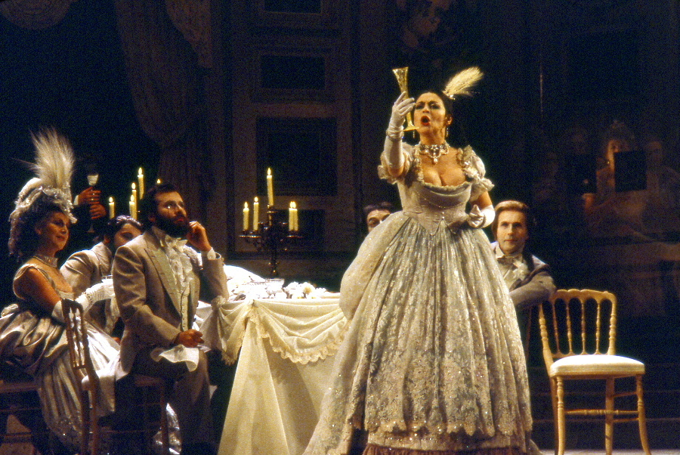
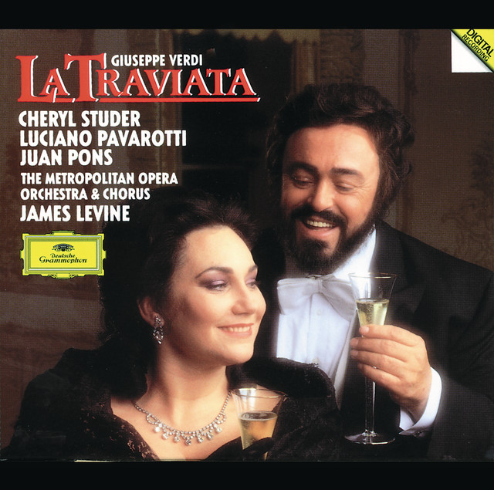

Slide 18
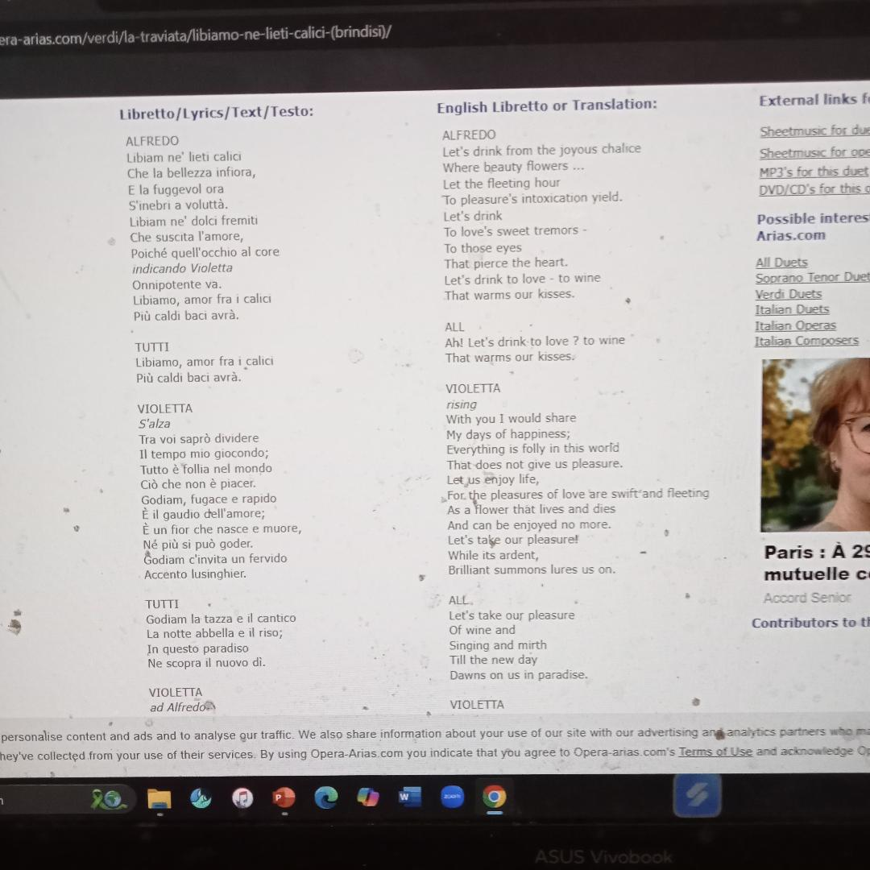
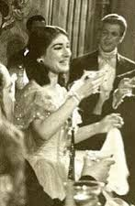

Slide 19
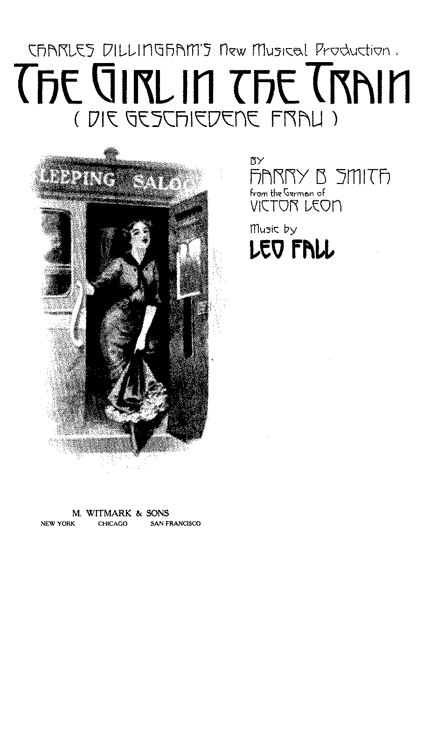
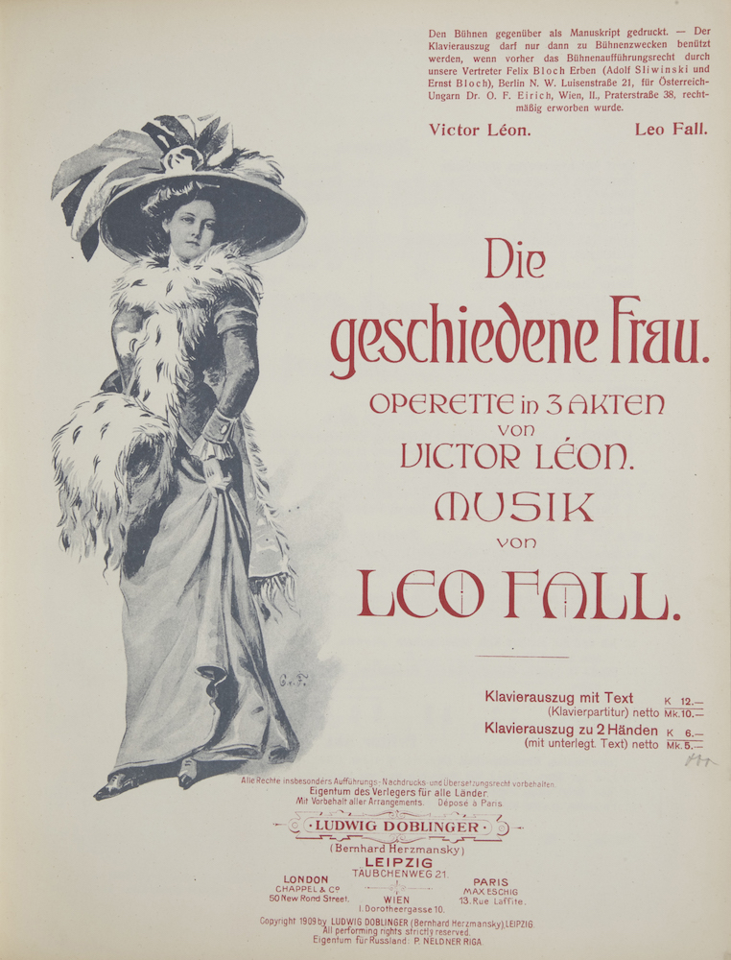
Notes:
1908 Vienna !911 Paris aphrodisiac properties

Slide 20
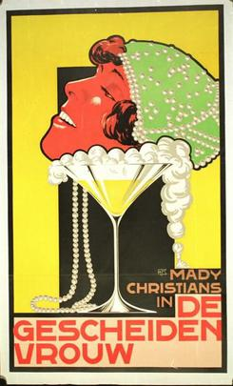
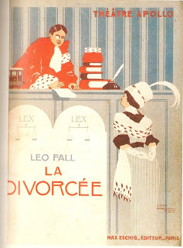
Notes:
Couchette from Vienna to Amsterdam with beautiful woman and bottle of Champagne. Red blooded man

Slide 21
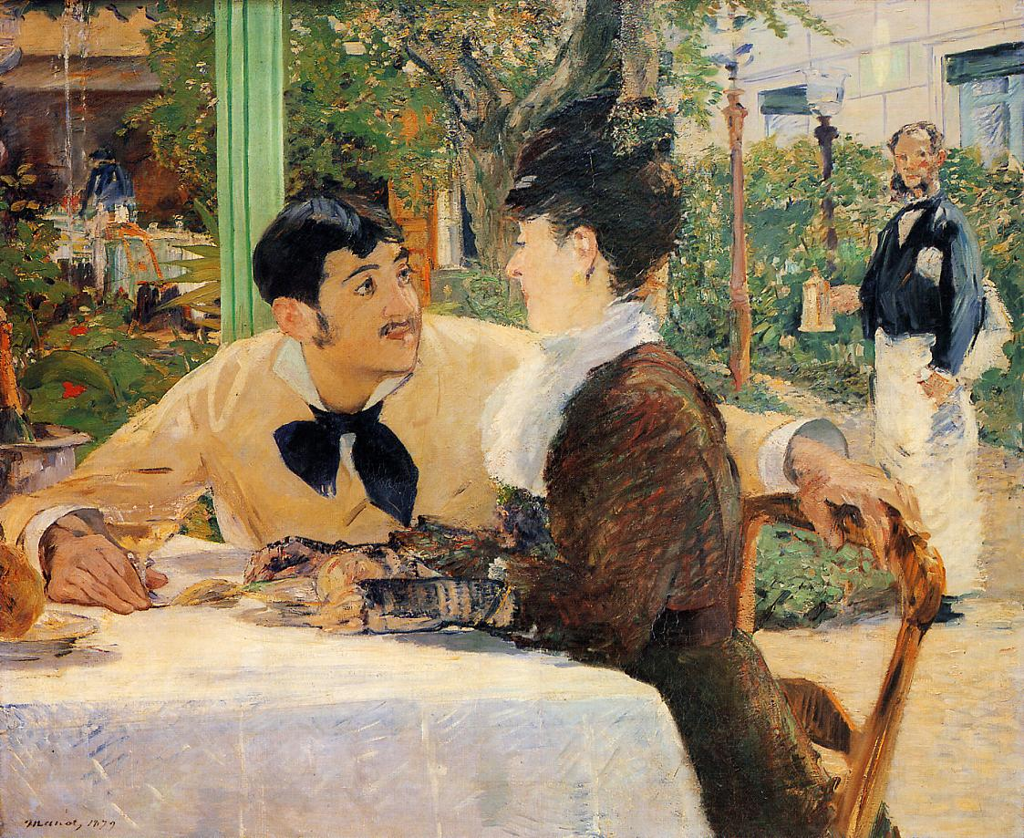

Slide 22
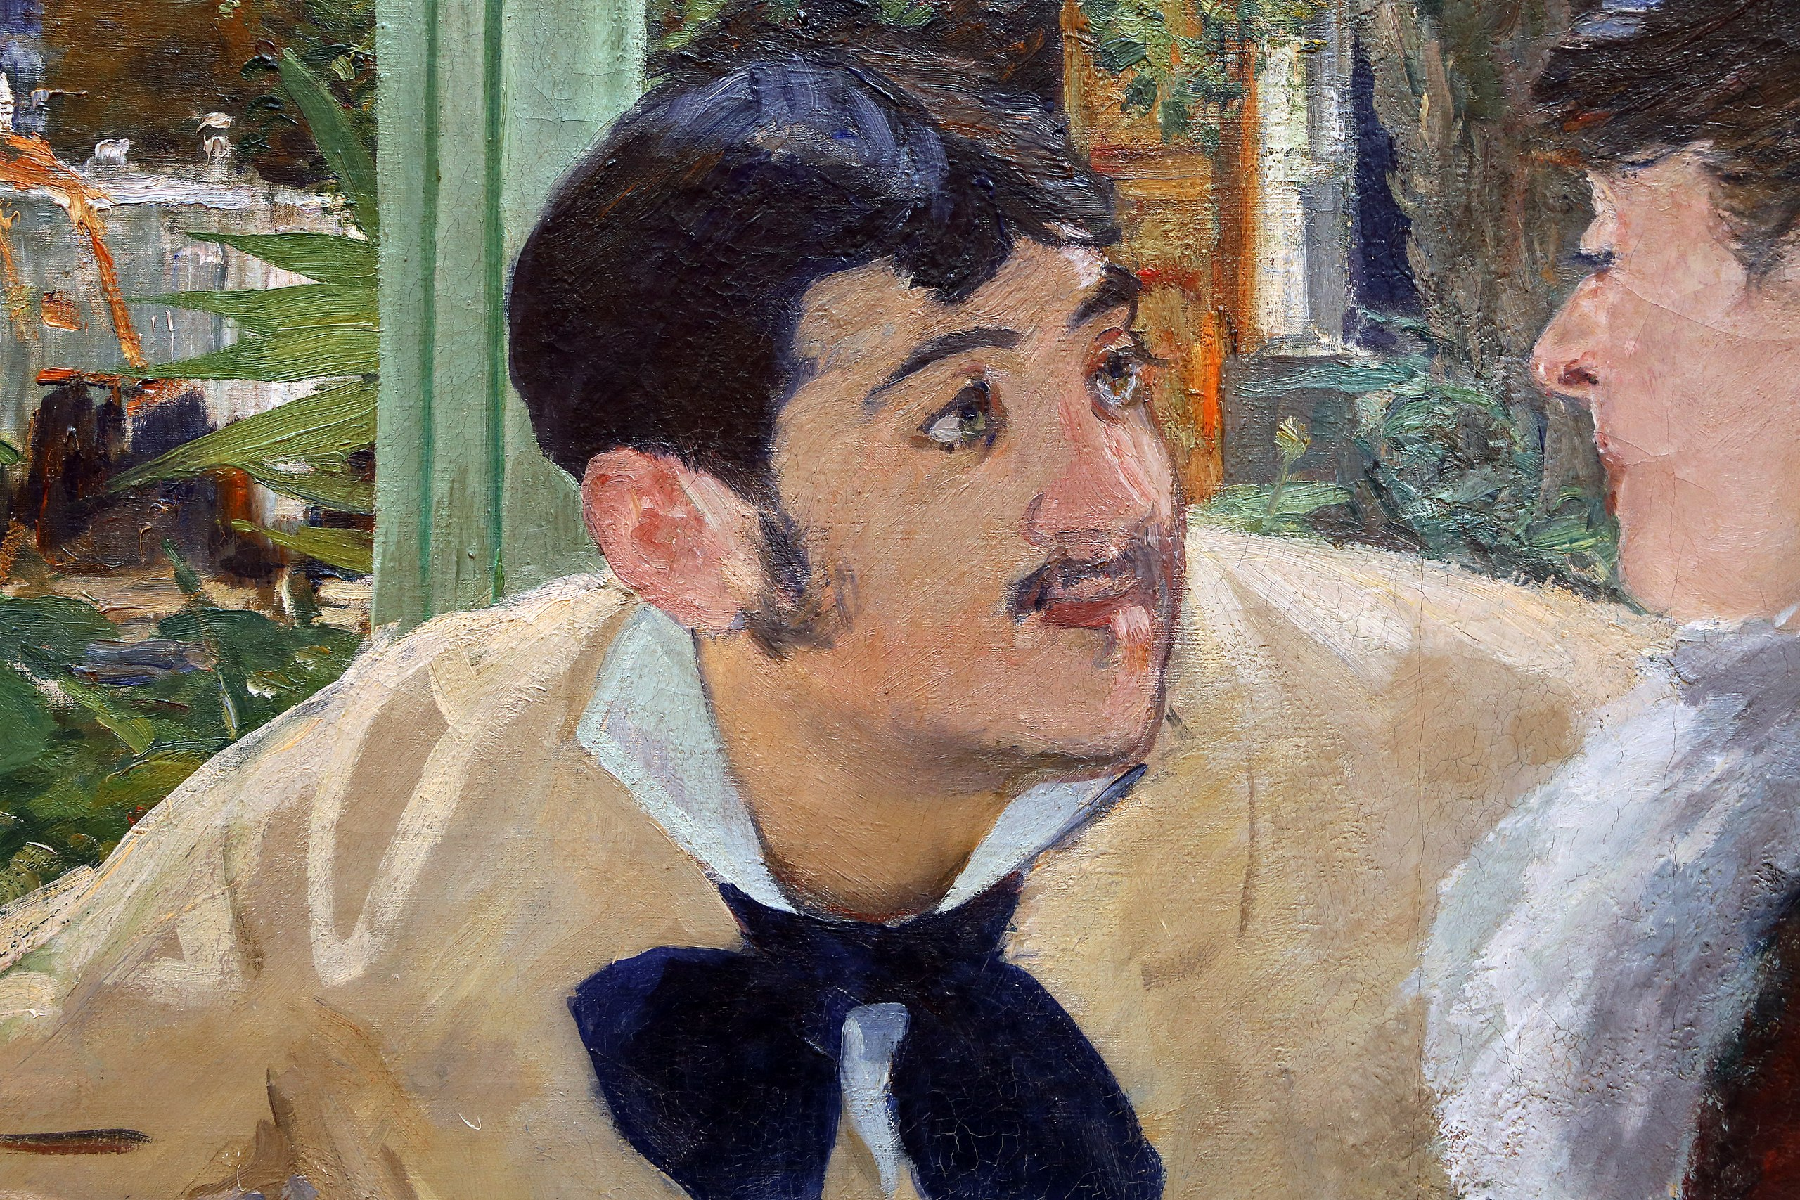

Slide 23
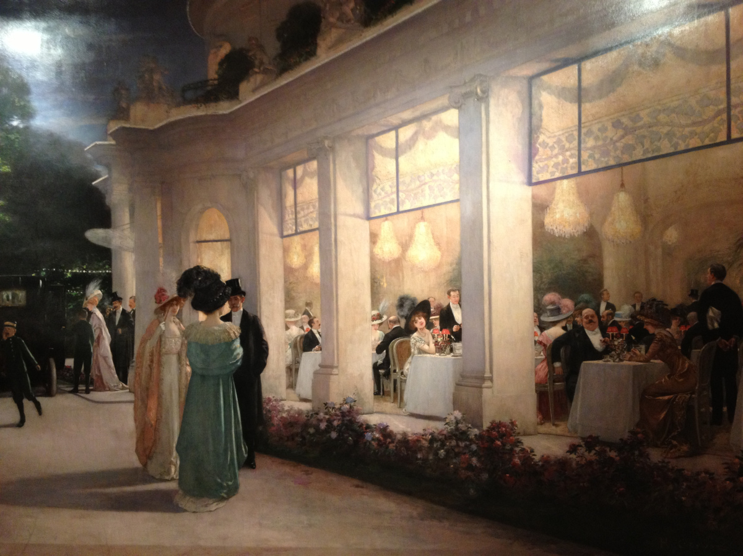
Notes:
BE 1890-1914

Slide 24
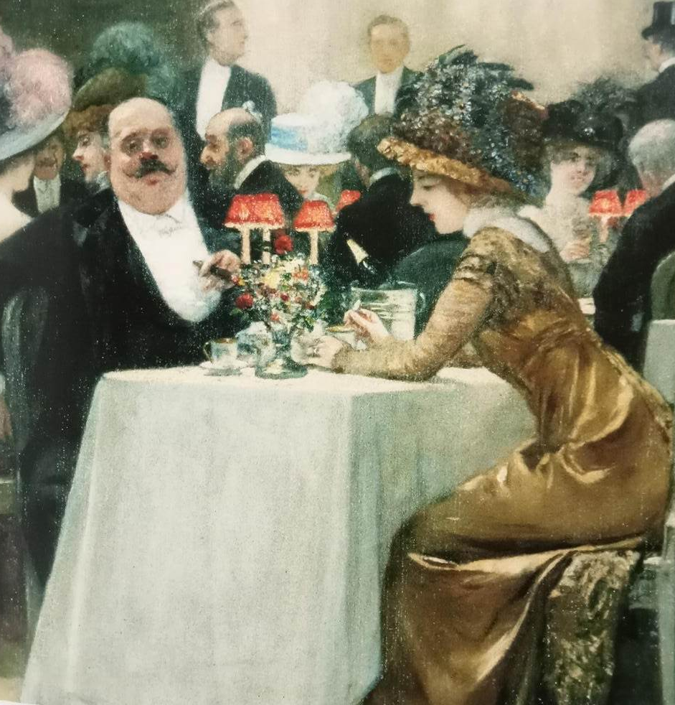
Notes:
Transactional love

Slide 25
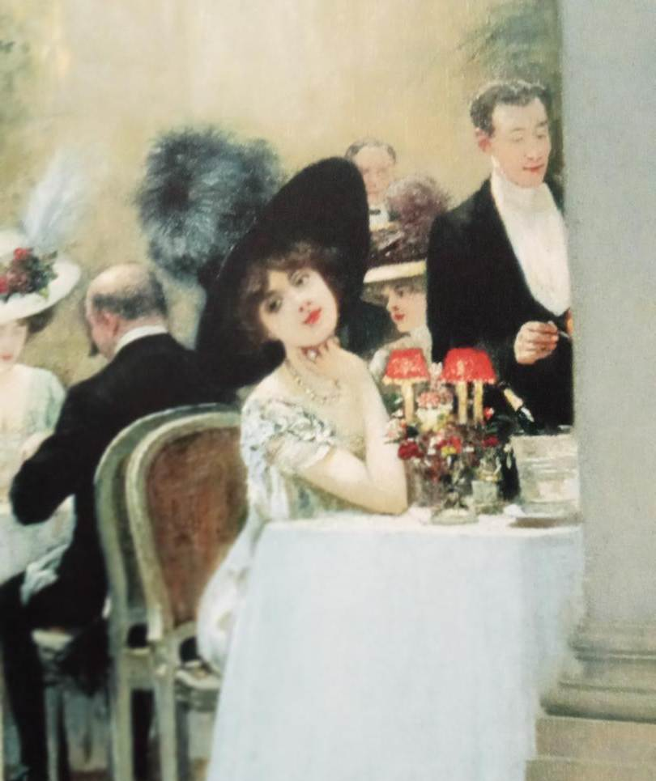
Notes:
Henri Gervex Une soiree au Pre Catalan

Slide 26
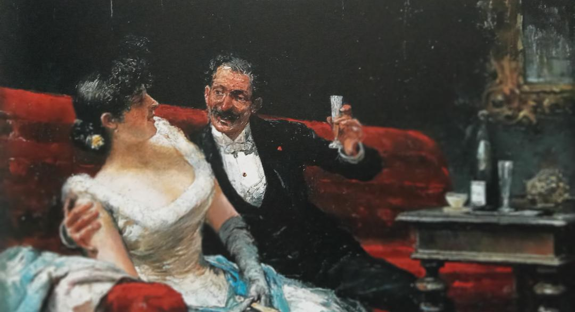
Notes:
Jose Llaneces La Flute de Champagne

Slide 27
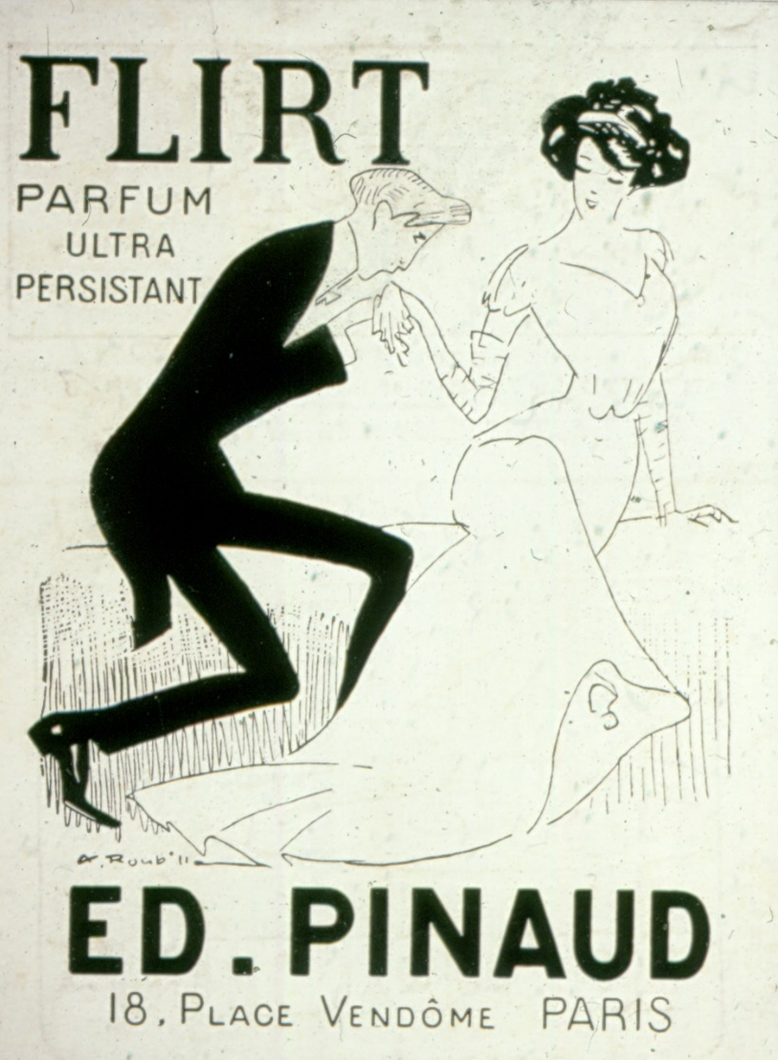
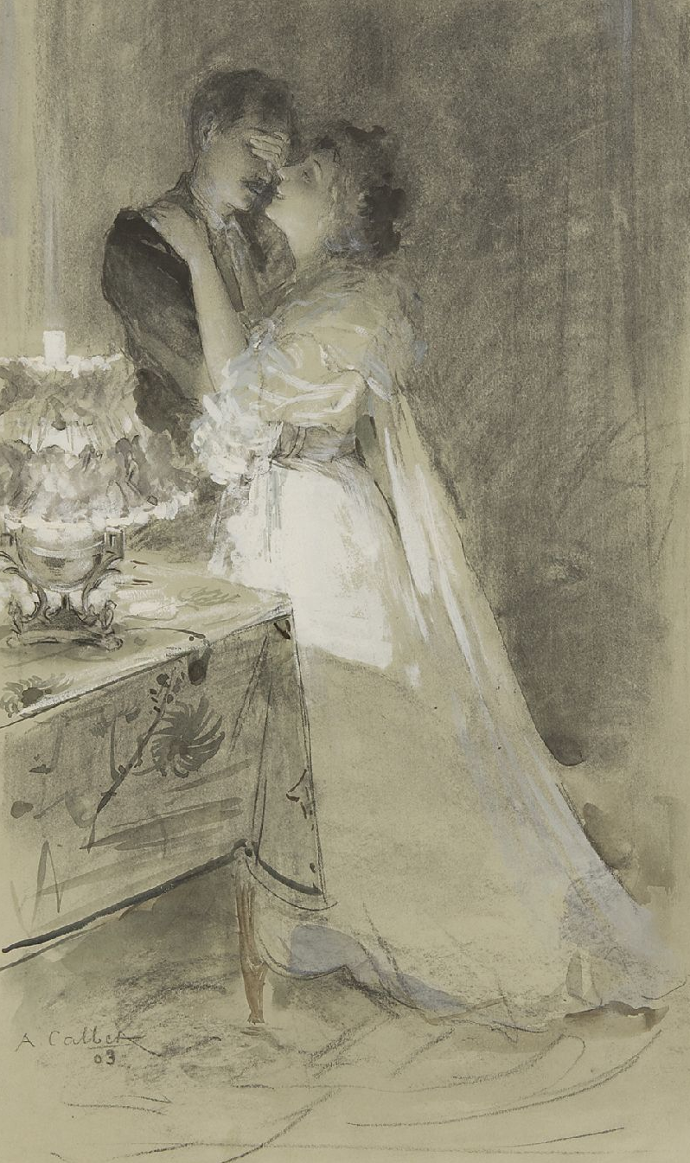
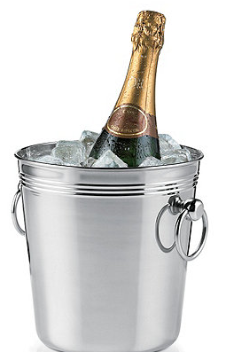
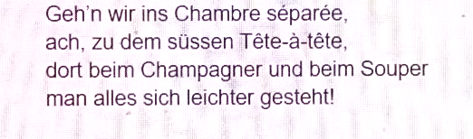
Notes:
Antoine Calbet. Seduction

Slide 28
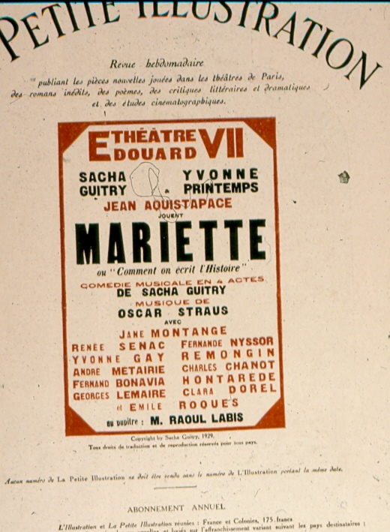
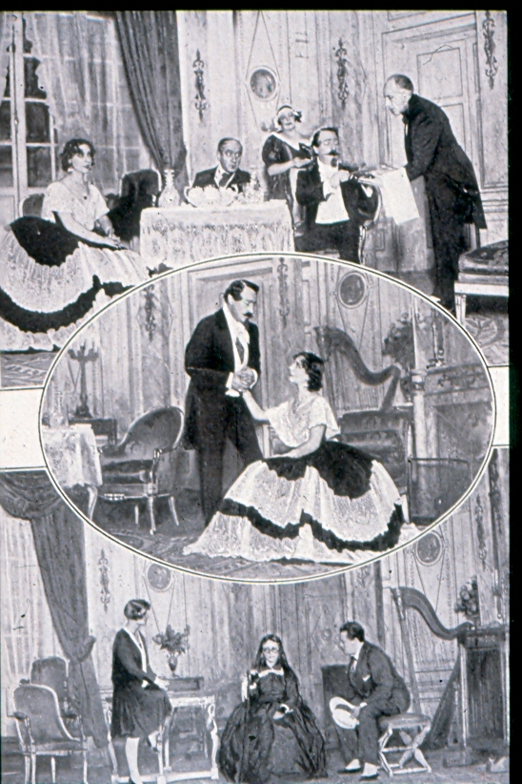
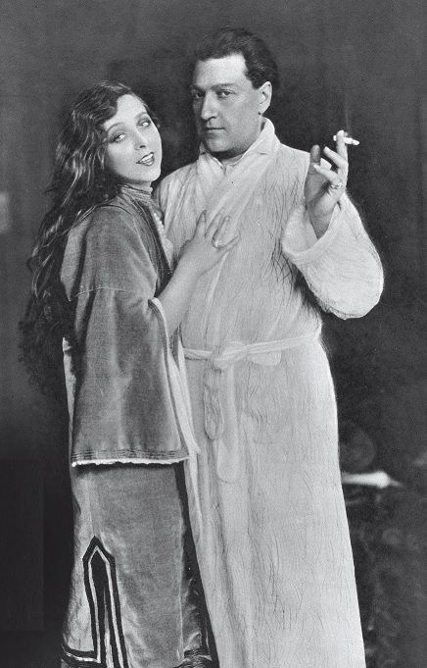
Notes:
Theatre ed 7 1928

Slide 29
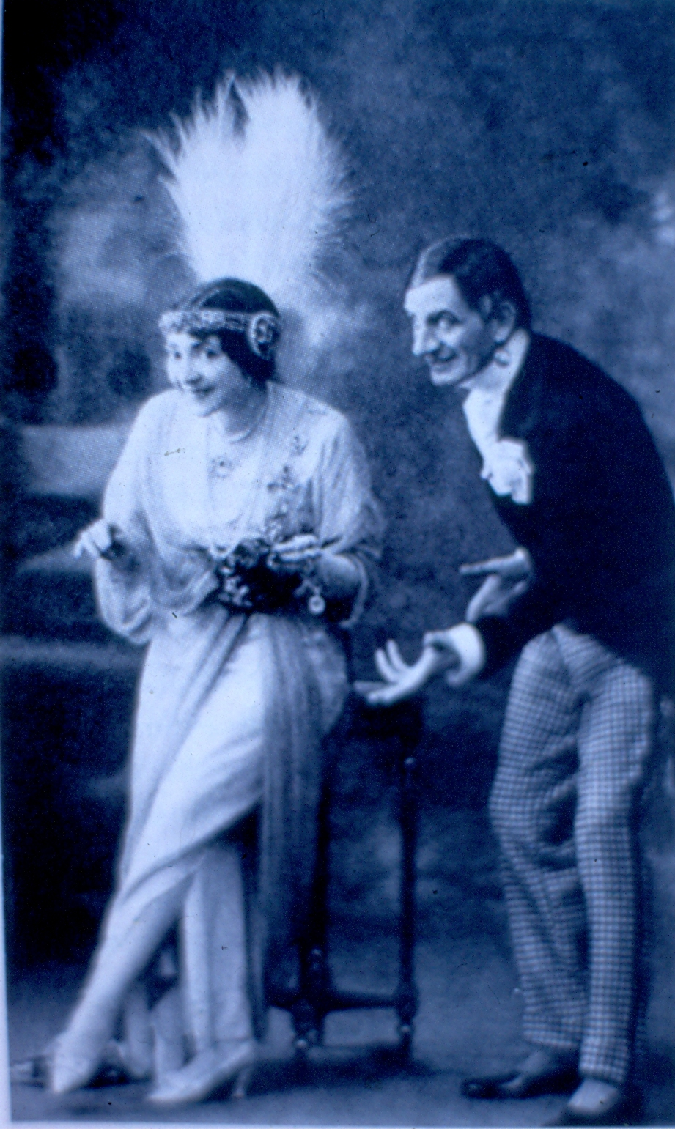
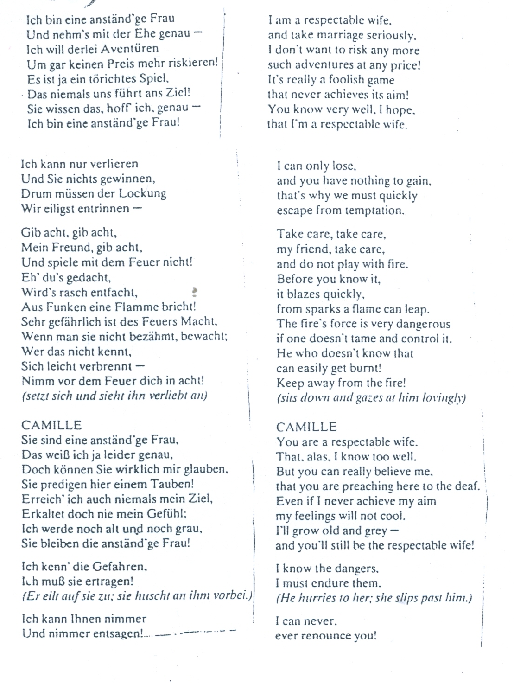

Slide 30
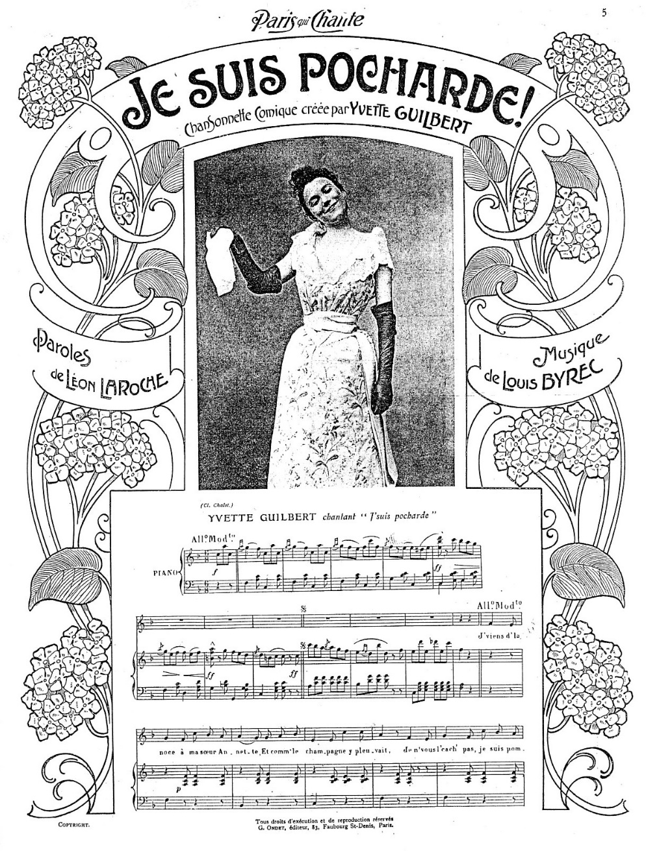
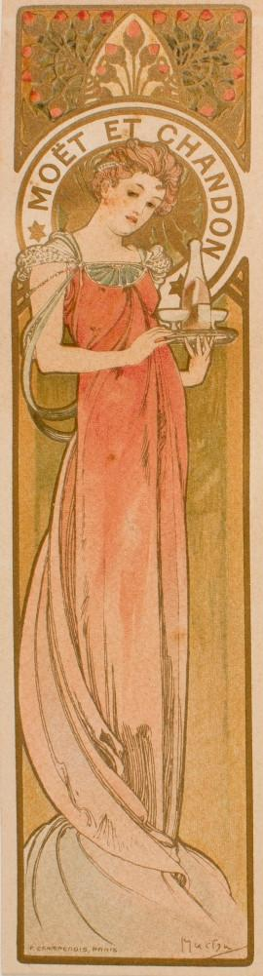
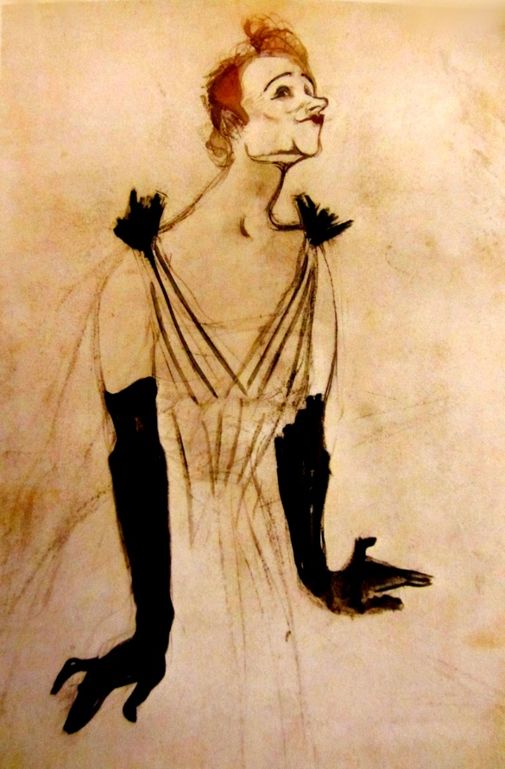
Notes:
Je suis prete a faire des cabrioles quand j’aibu Moet et Chandon

Slide 31
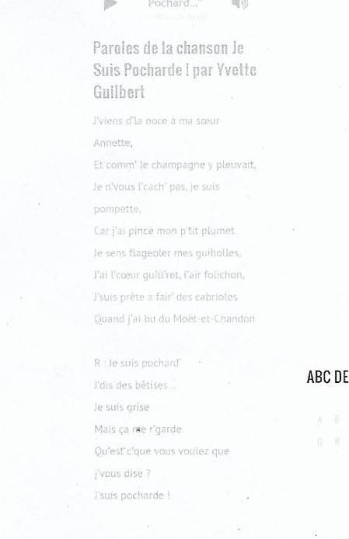
Notes:
Tipsy.

Slide 32
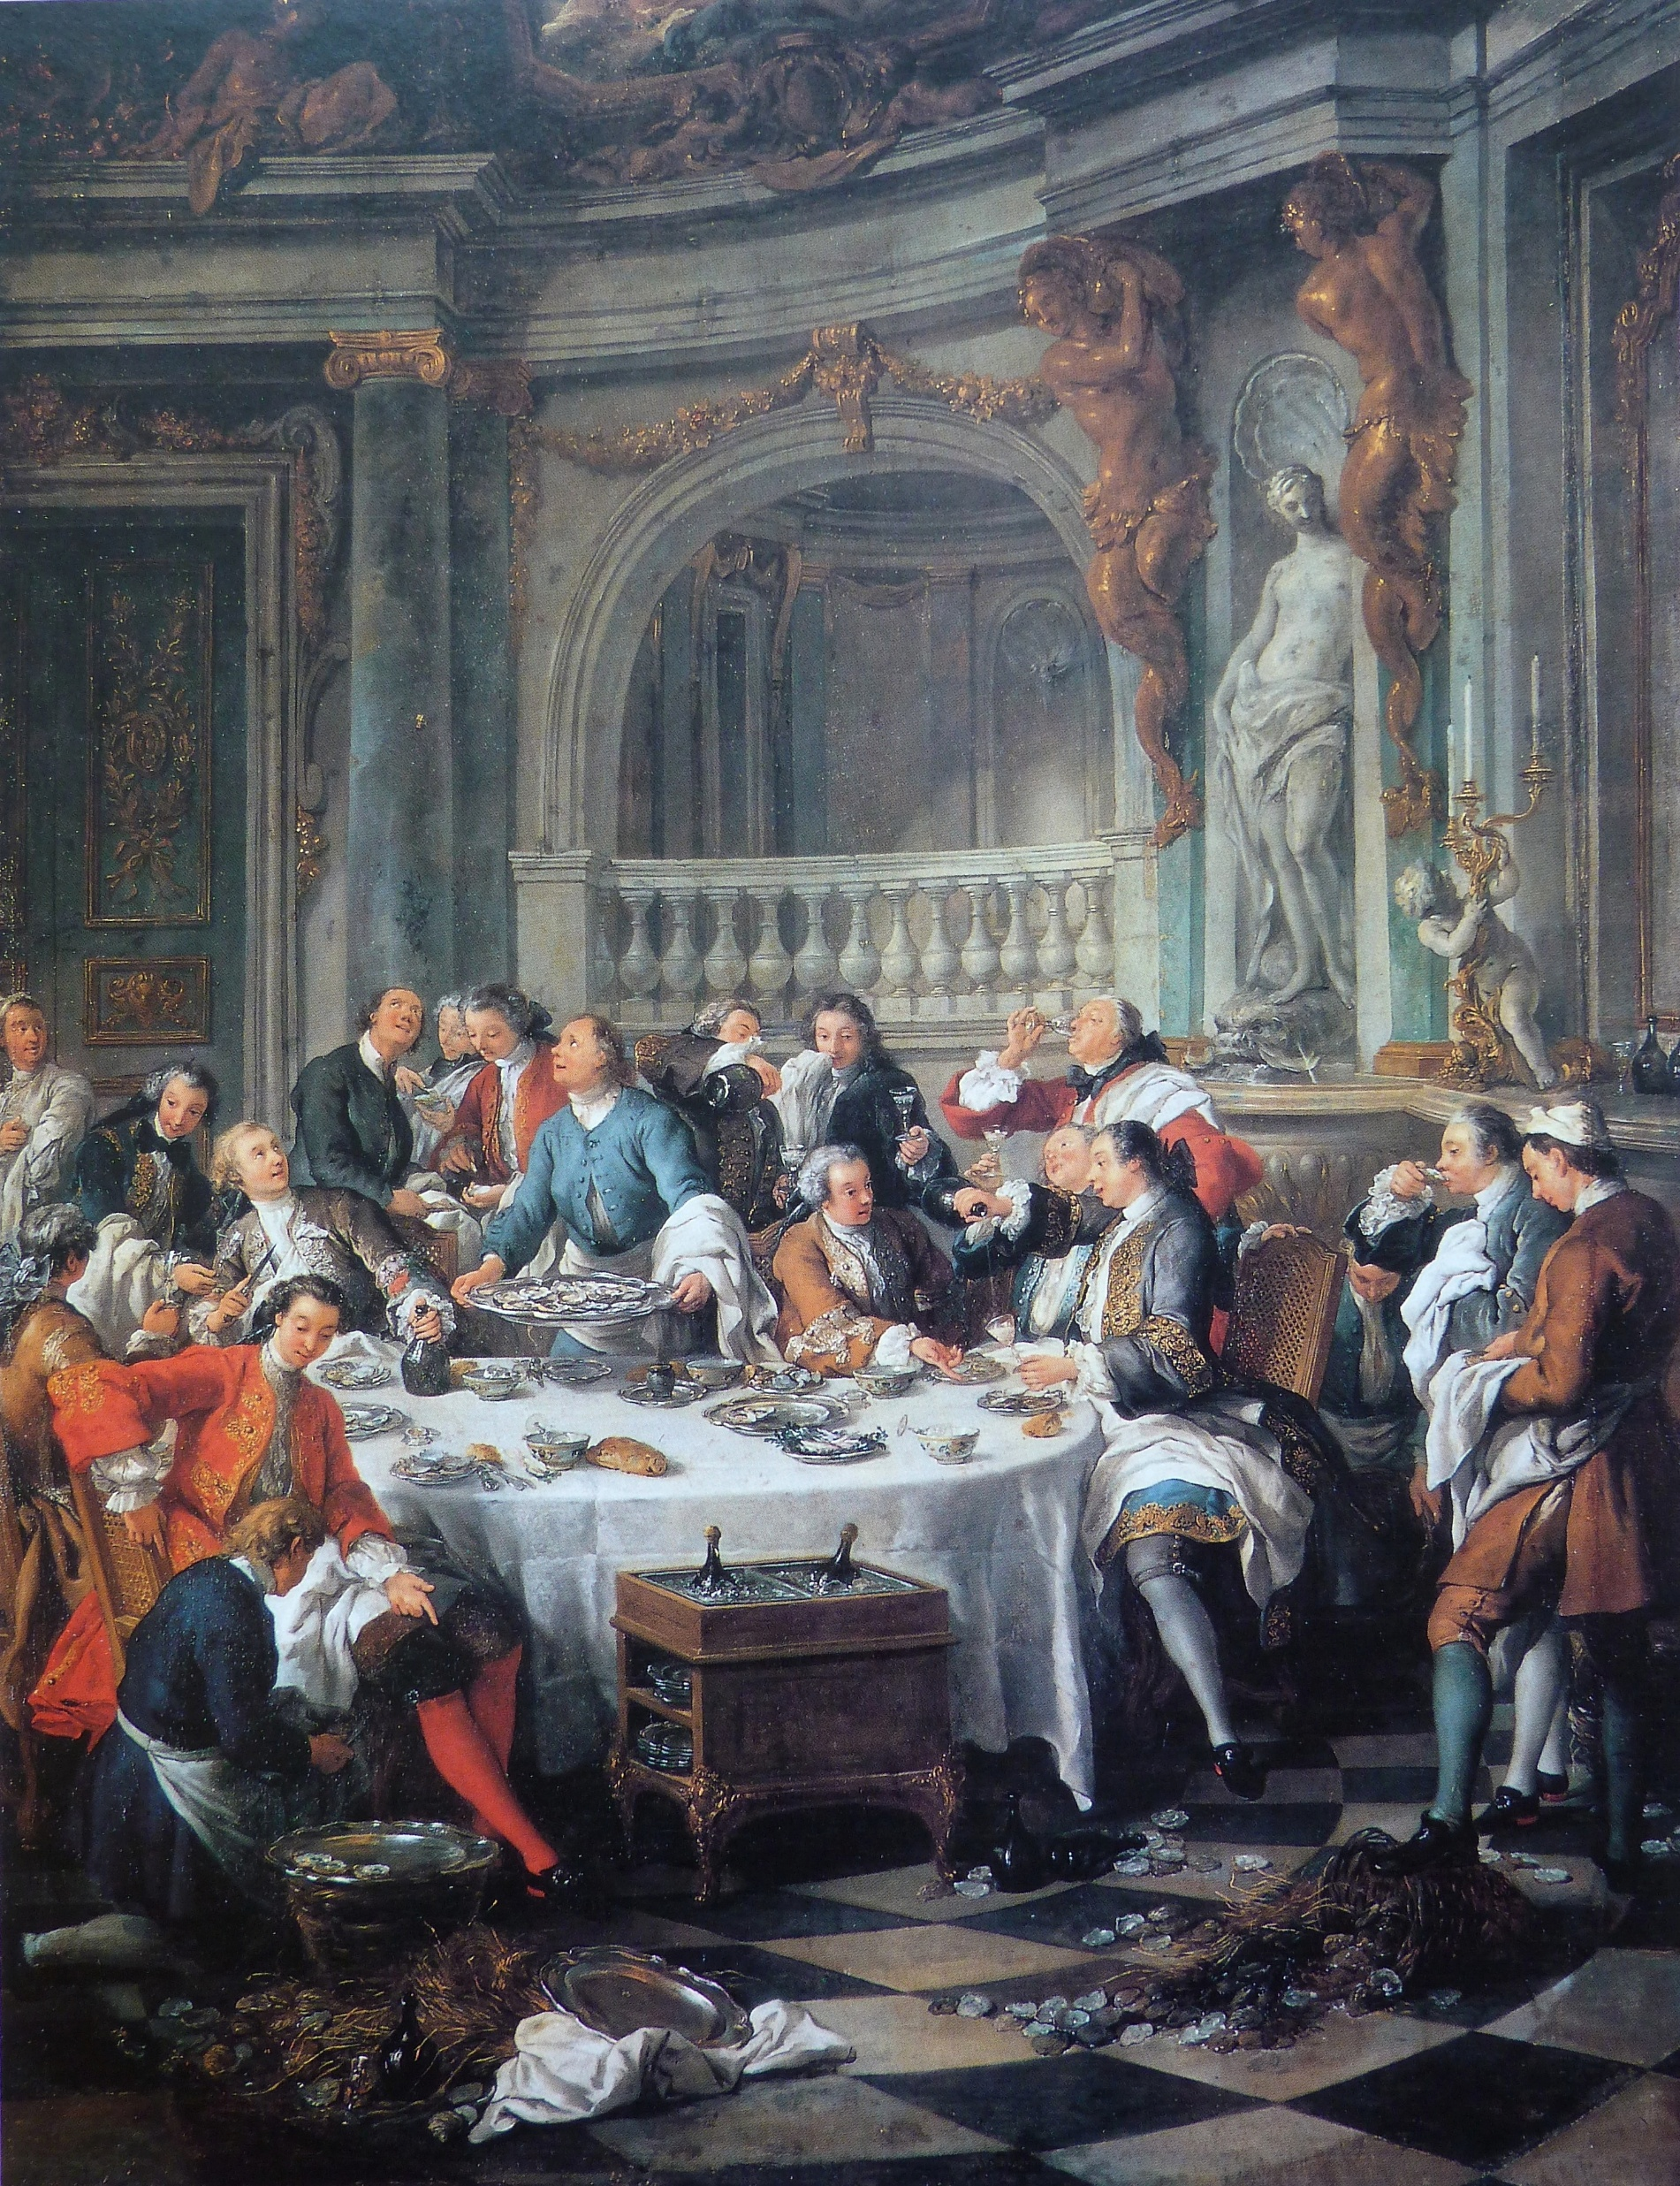
Notes:
Excess

Slide 34

Notes:
Francois Brunery

Slide 35

Notes:
Grosz

Slide 36


Slide 37


Notes:
Mythology of Champagne depravity garters

Slide 38


Slide 39


Notes:
Frehel Coco. Mixd with cocaine and Morphine

Slide 40

Notes:
Mixes morphine, cocaine and champagne. Oui j’etais grise j’ai fait une betise. J’ai tue mon gigolo

Slide 41




Slide 42
“slide 42 1.04 Strauss audio”

Slide 44


Slide 45


Slide 46


Slide 47


Slide 48


Slide 49


Slide 50


Slide 51


Slide 52


Slide 60


Slide 89

Notes:
Le Reveillon Georges Meunier

Slide 92
Notes:
Alphonse Mucha

Slide 104


Slide 106

Notes:
Roy Lichtenstein 1985

Slide 107


