Slide 1
Case Study #1: What’s Wrong With Nya?
This PowerPoint Case Study is brought to you by Ms. Goulet and Nya – Not Your Average Classroom’s Mascot

Slide 2
Not Your Average PowerPoint
This interactive PowerPoint
was created by Ms. Goulet.
More presentations and
activities can be found at her store:
Not Your Average Classroom
on TeachersPayTeachers.com

Slide 3
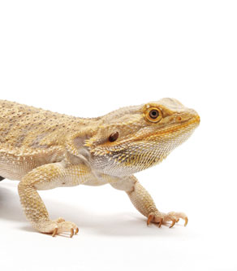
What’s Wrong with Nya?
Ms. Goulet has a class pet. She is a bearded dragon named Nya.
Every day, Ms. Goulet’s 1st period students are in charge of taking care of Nya. They turn on her lamps, fill her water dish, and put crickets in her tank for her to eat.

Slide 4
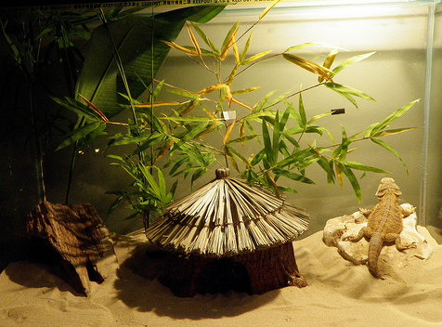
Bearded Dragon Care
Bearded Dragons come from Australian deserts. They need to be kept very warm with lamps. Their metabolism slows down if they get cold.

Slide 5
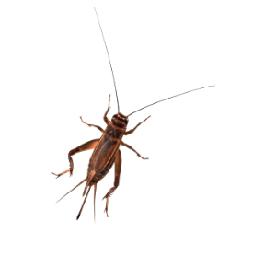
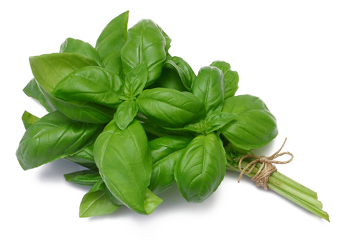
Bearded Dragon Care
Bearded Dragons eat mostly crickets and mealworms when they are young. As they get older they eat more leafy greens like basil, kale, collard greens, and dandelion leaves.
Fruits and veggies are great supplements, too.

Slide 6
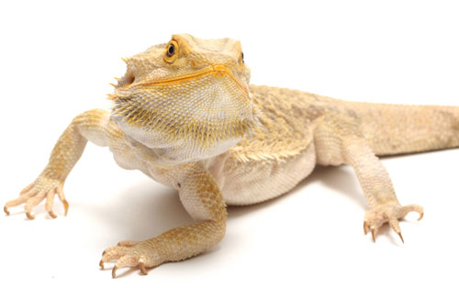
One Morning…
Everyone filtered into the classroom one December morning. A student turned on Nya’s heat lamp and her UV ray lamp.
Then, the student refilled the water and put 10 crickets in the tank.
Nya ignored each one!

Slide 7
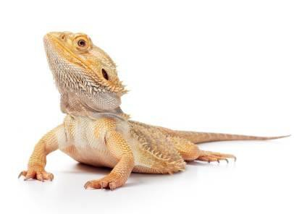
Nya Won’t Eat
At the end of the day there were still 10 crickets in the tank.
Why won’t Nya eat?

Slide 8
Let’s Brainstorm!
Let’s come up with all the reasons Nya might have stopped eating.
?

Slide 9
What did we come up with?
Nya is bored with crickets
Nya is getting older and wants more greens
Nya is too cold today
Nya is sick
All your ideas were great! Any of these could be true.

Slide 10
But how can we be sure?
What can we do to see if we are right…
If Nya is simply tired of eating the same thing everyday?
If she is getting too old to be eating crickets every day?
If she is too cold?
If she is sick?

Slide 11
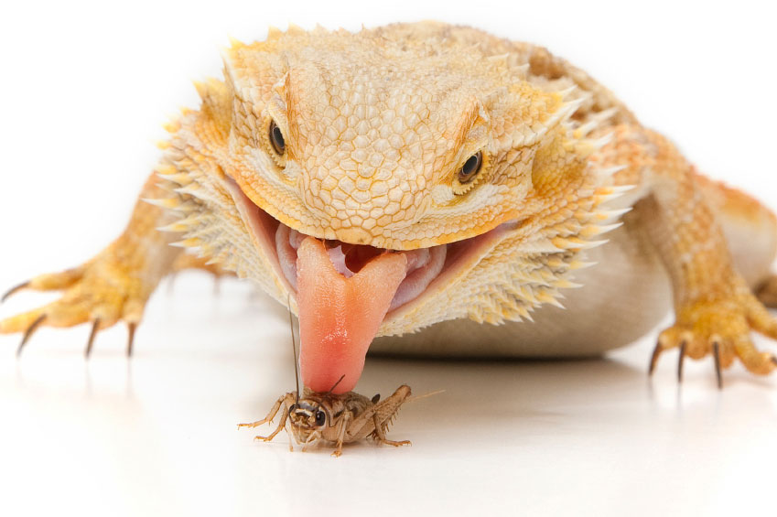
Good Job!
As it turns out, Nya was too cold. When a lizard is too cold, it’s whole body slows down and it doesn’t need to eat as much!

Slide 12
You used the Scientific Method!
observation
Nya stopped eating
question
Why isn’t she eating?
hypothesis
She is too cold to eat
prediction
If we warm her up, she will eat
test
Place the lamps closer
conclusion
She got warmer and started to eat

Slide 13
End of Scientific Method Case 1
Case 1: What’s Wrong With Nya?
Case 2: Bark of the Willow Tree
Case 3: Childbed Fever
Case 4: A Geographic Puzzle

Slide 14
Not Your Average PowerPoint
Thank you for your purchase! If you like the lesson, please let me
know by rating it on
TeachersPayTeachers.com!
Then “follow” my site so you don’t
miss any of my uploads
☺

