Slide 1
Monday August 18th, 2014
World Standard:RI.9-10.3. Analyze how the author unfolds an analysis or series of ideas or events, including the order in which the points are made, how they are introduced and developed, and the connections that are drawn between them.

Slide 2
Activator/Journal
Journal 7: When you hear or read the word, epic, what comes to mind? Why? Do you have any examples?
http://www.learner.org/courses/worldlit/gilgamesh/watch/

Slide 3
Hero’s Journey -What is it?
Stages in which almost every hero goes through (no matter what culture the hero is a part of). This can also be called the monomyth.

Slide 4
Heroes exist in a world is considered ordinary or uneventful by those who live there. Often the heroes are considered odd by those in the ordinary world and possess some ability or characteristic that makes them feel out-of-place.

Slide 5
Examples:
▪ The Wonderful Wizard of Oz: Dorothy in Kansas
▪ The Hobbit: Bilbo Baggins in Hobbiton
▪ Star Wars: Luke Skywalker on Tatooine
▪ The Lion King: Simba at Pride Rock

Slide 6
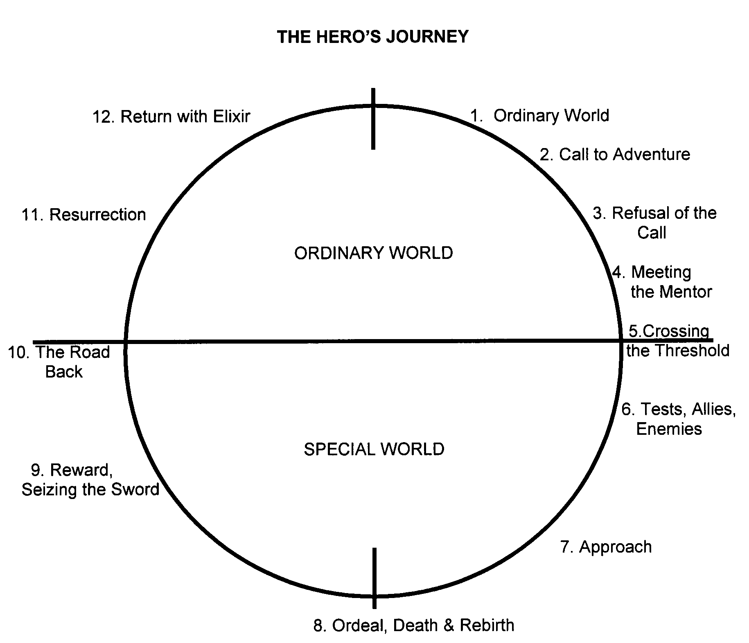

Slide 7
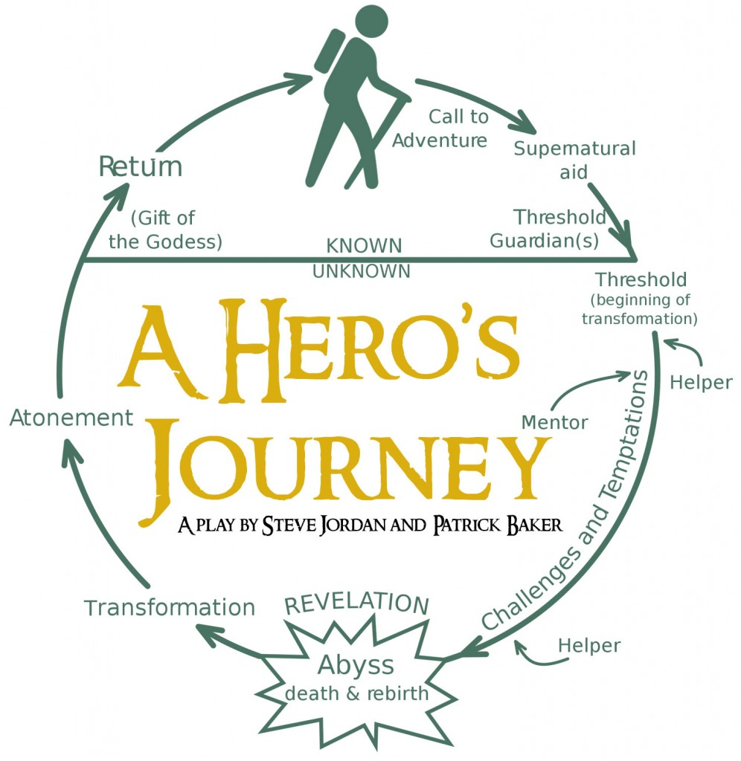

Slide 8
Still need more help?
http://ed.ted.com/lessons/what-makes-a-hero-matthew-winkler

Slide 9
What do we do now?
Write your own Hero’s Journey. Think about a TV show you just watched or maybe a book you just read. Who was the hero? What did he/she go through? Think about everything we just covered and write your own!
Add a sentence at the bottom describing what you just wrote/drew. This will be turned in for a grade!

