Slide 1
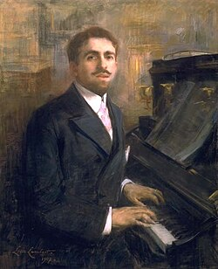
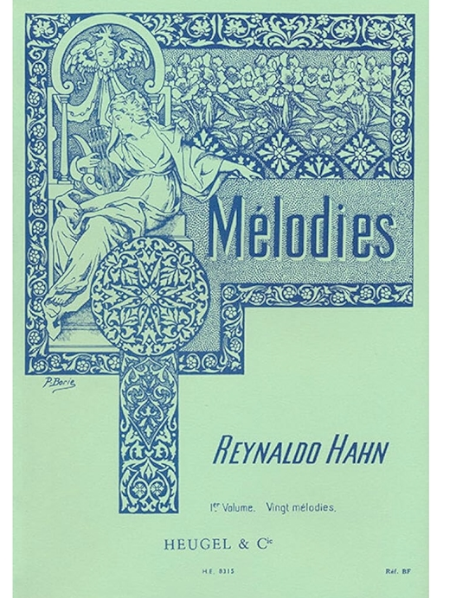
Notes:
Bn Caracas Sacha G To be Parisian, it is not necessary to be born there but to be reborn there” father grandson of Rabbi of Altona youngest son of12 children Paris age 3

Slide 2
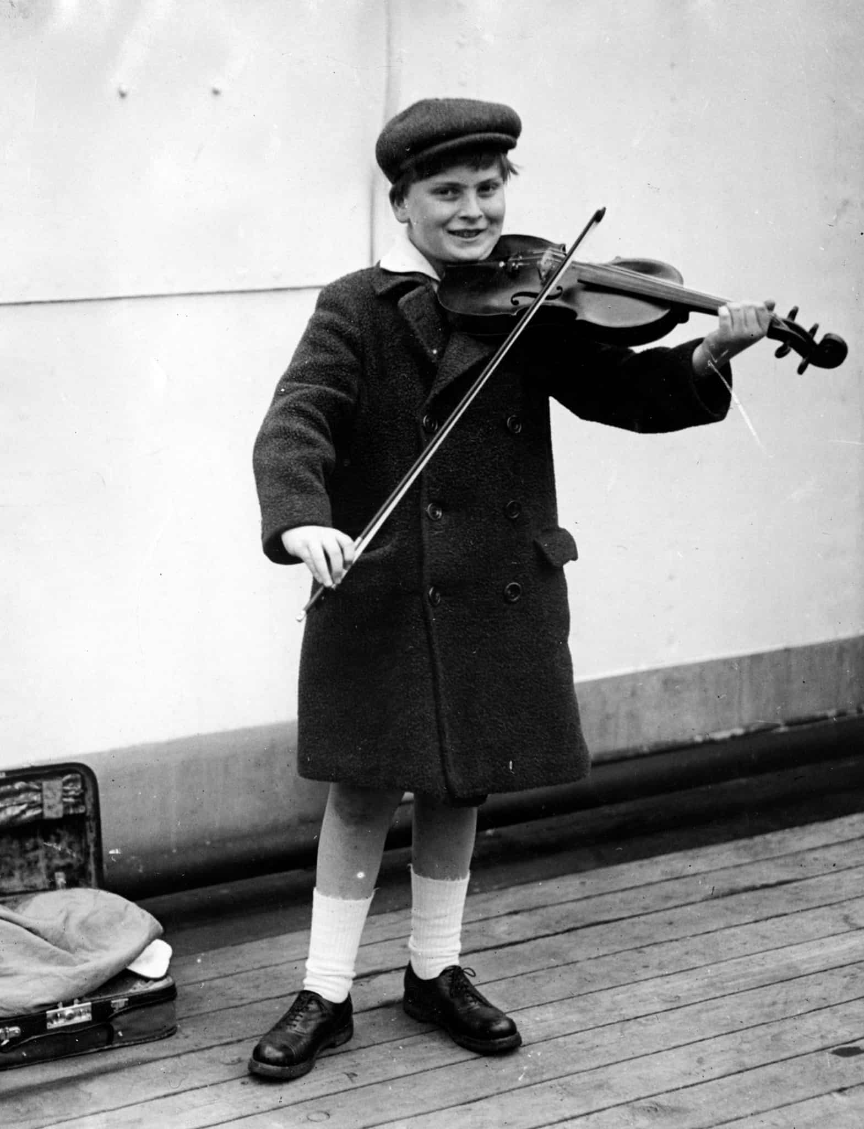
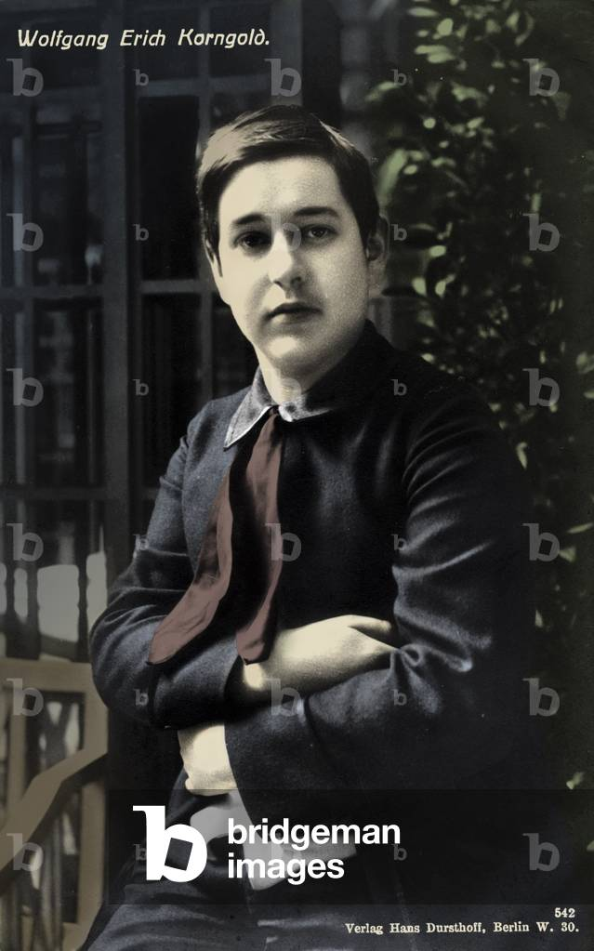
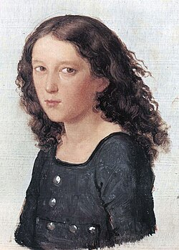
Notes:
Jewish boy composers and performers. Later expressed profound disgust for RC church, vague belief in God 9th aug 1874

Slide 3
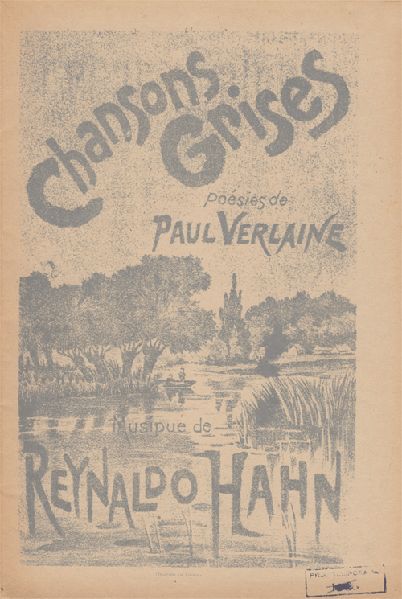
Notes:
1887-90 7 settings of Verlaine incl L’heure exquise

Slide 4
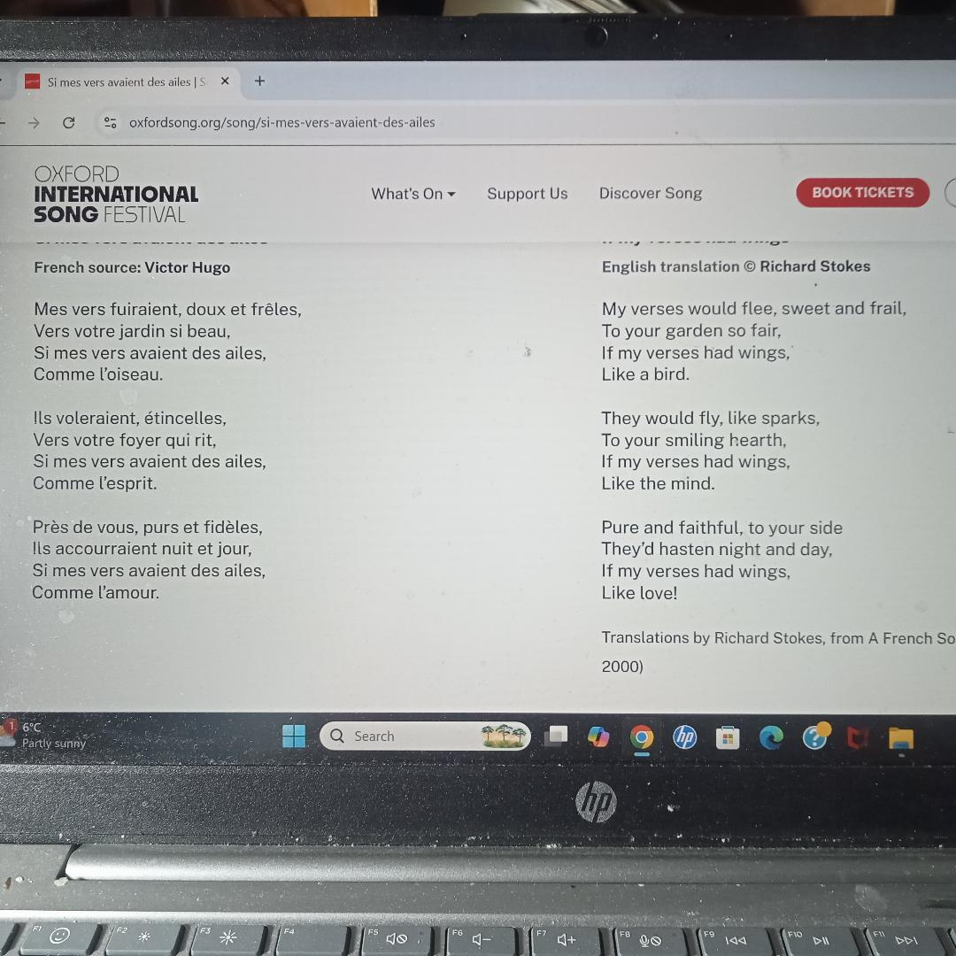
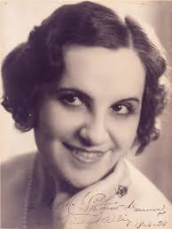

Notes:
1888 aged 13

Slide 5
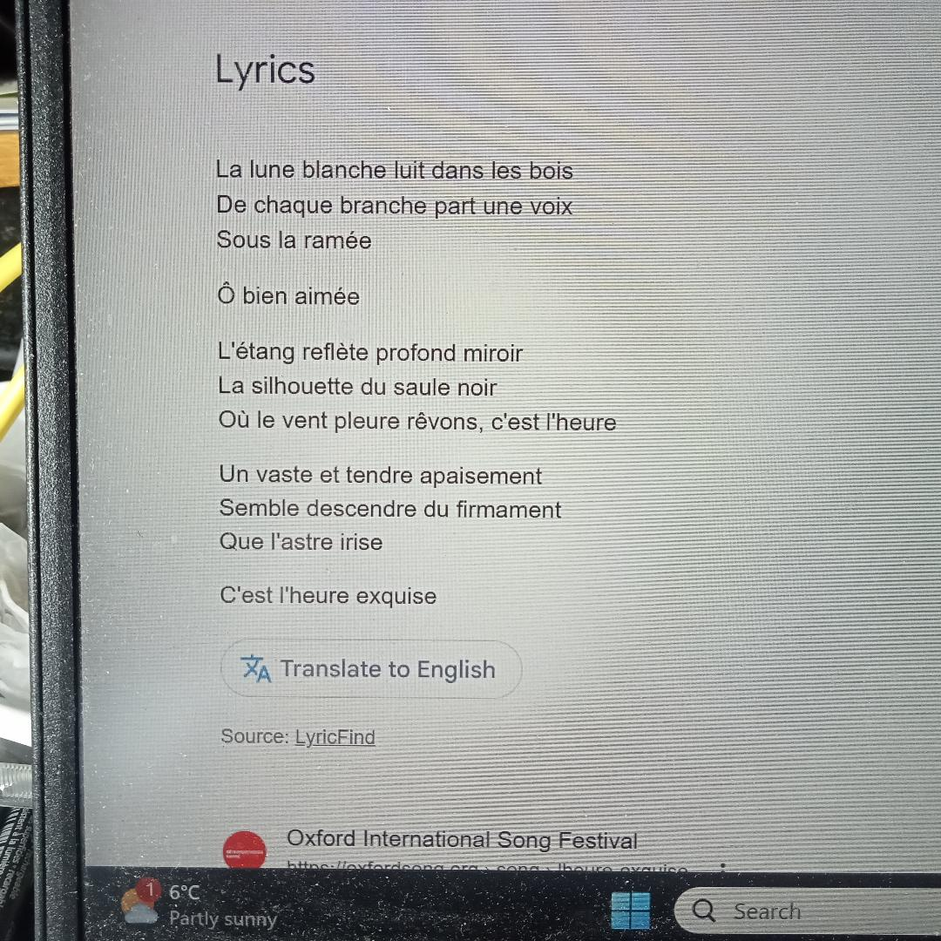
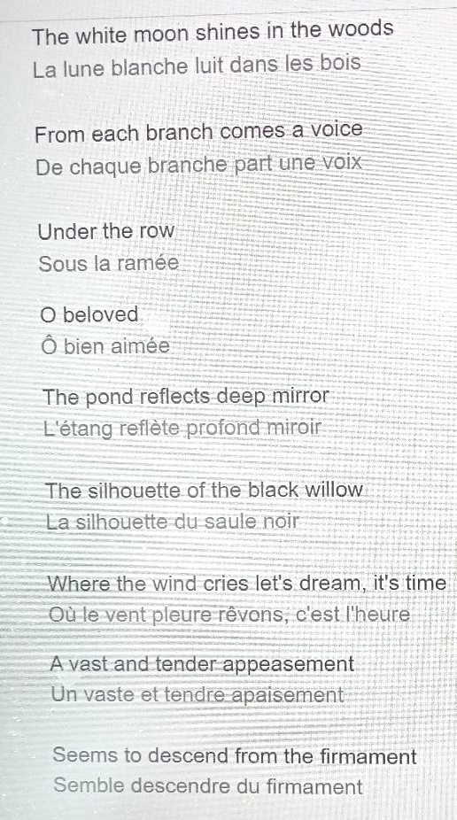
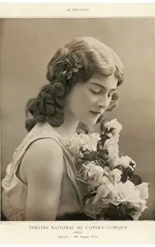
Notes:
Protogee. Debut 1905 Cherubino and Zerlina baton of while singing this song in salon of Madelaine Lemaire that H first met Proust
reynaldo

Slide 6
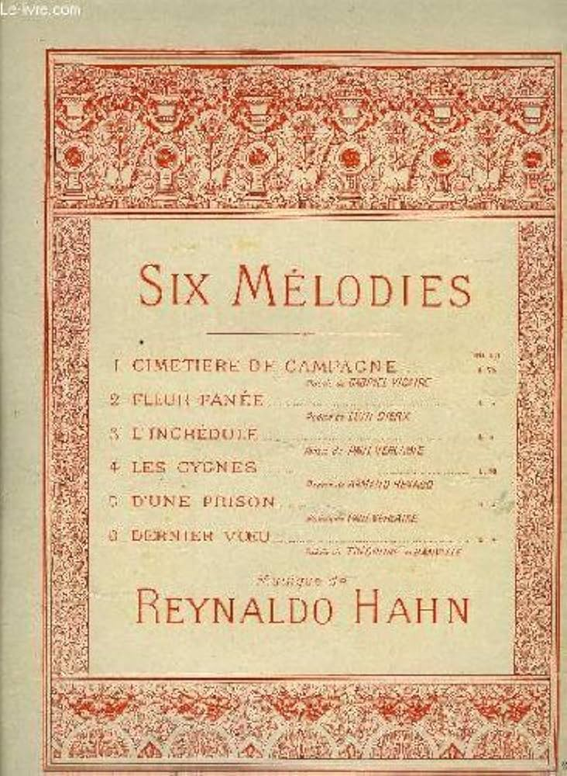
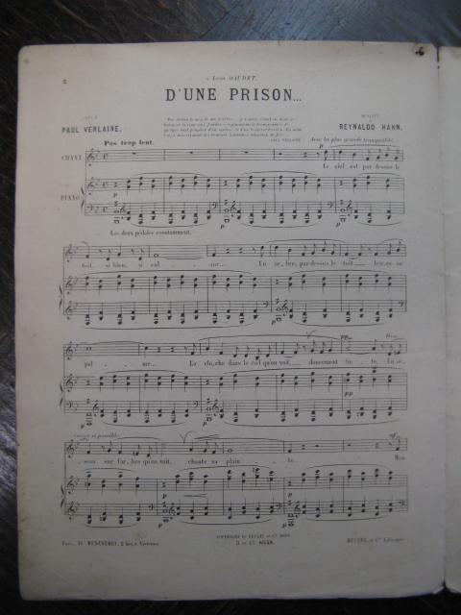
Notes:
D’une prison 1892

Slide 7
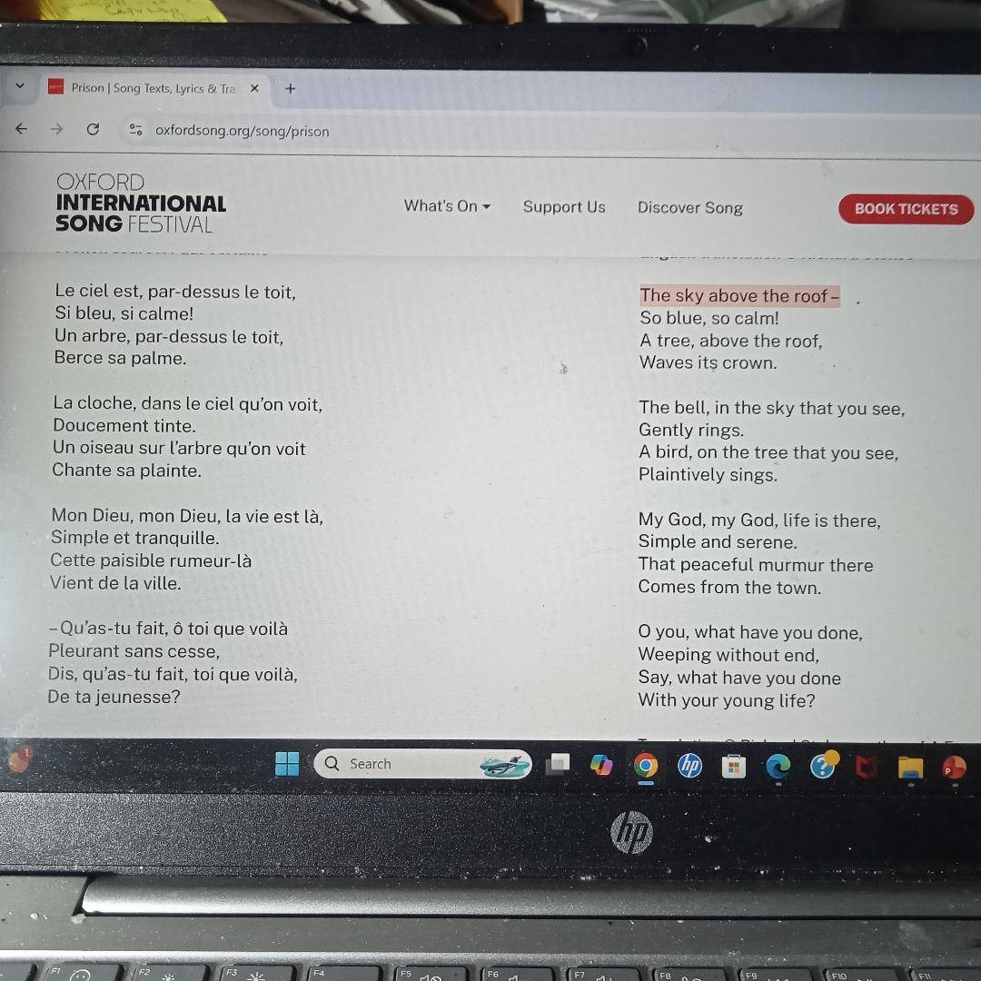
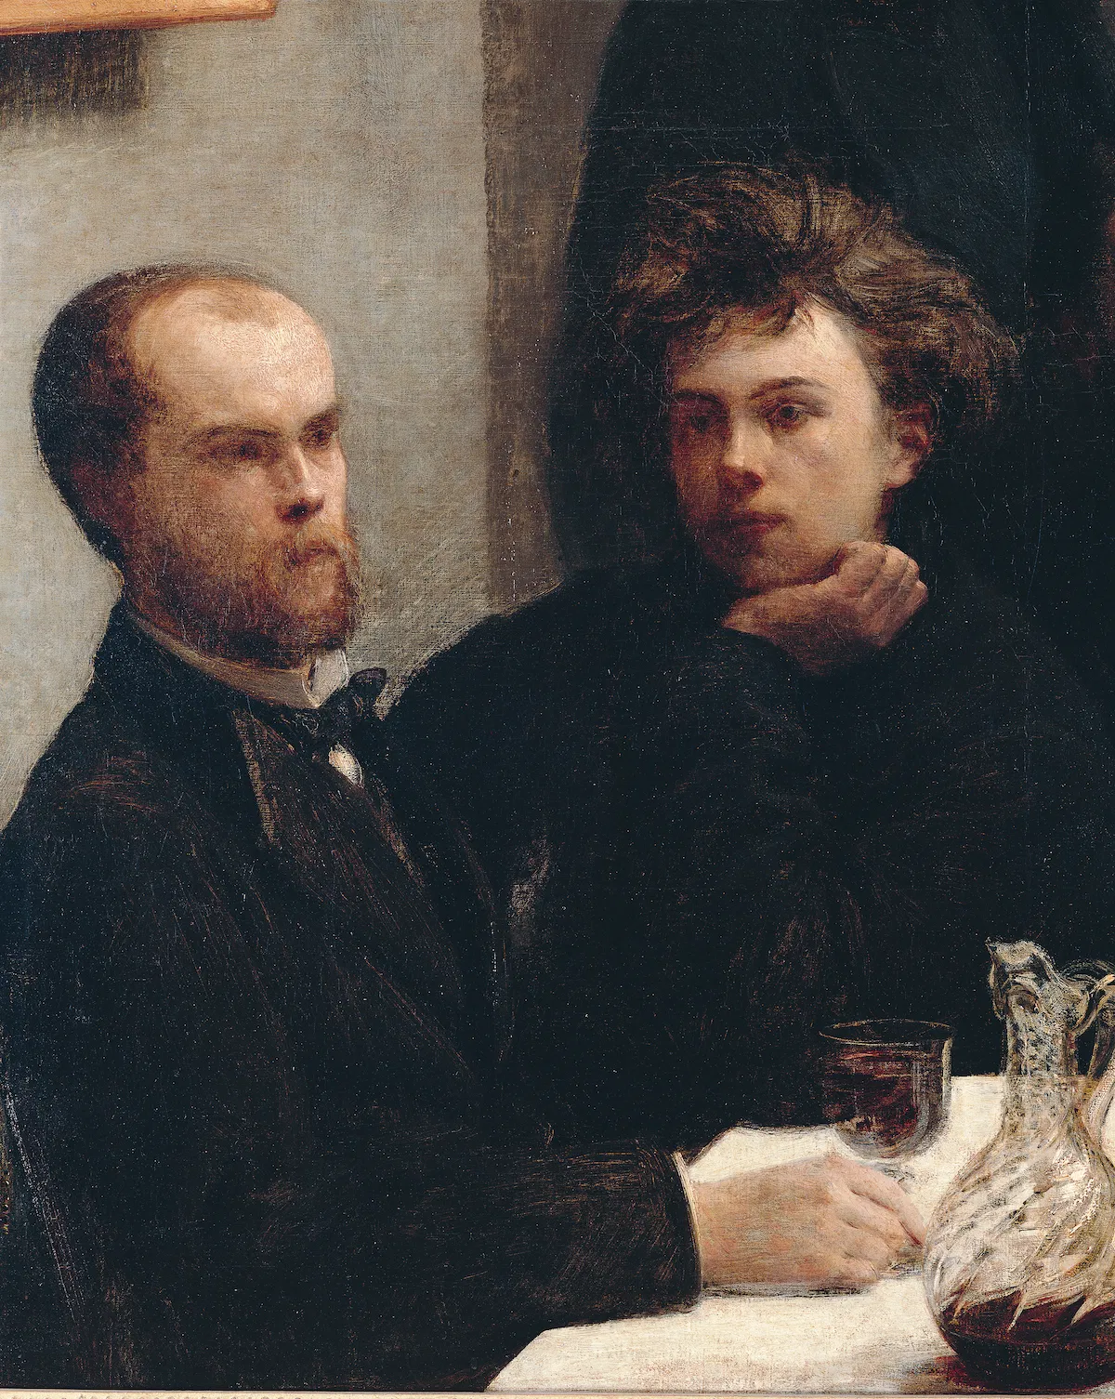

Slide 8
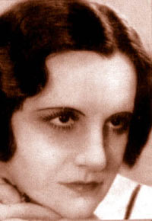
Notes:
Hypnotic. Restrained p

Slide 9
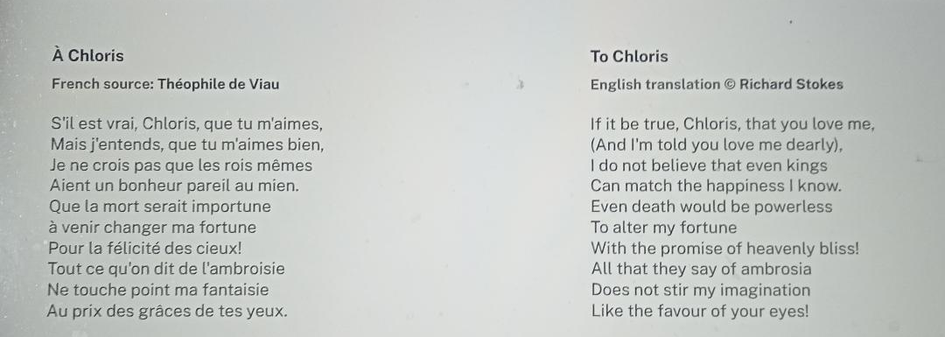
Notes:
1916 Pastiche. Piano based on Bach Air on the G string. Never recorded on 78rpm. Peter Hulsen.

Slide 10
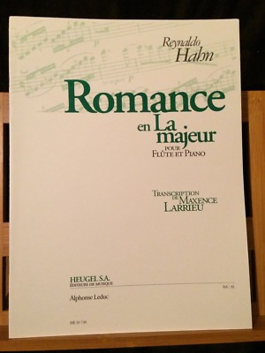

Slide 11
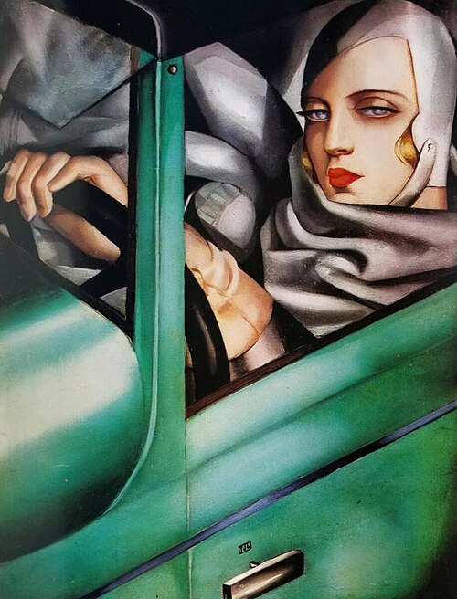
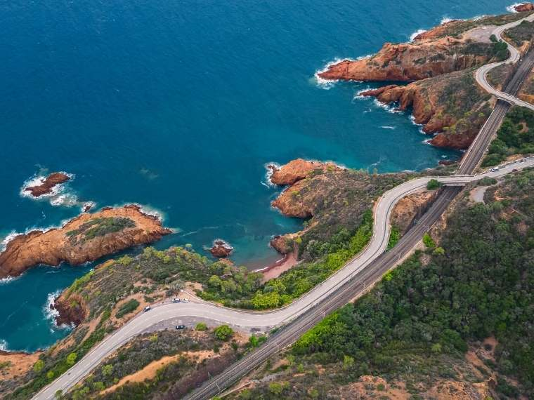

Slide 12
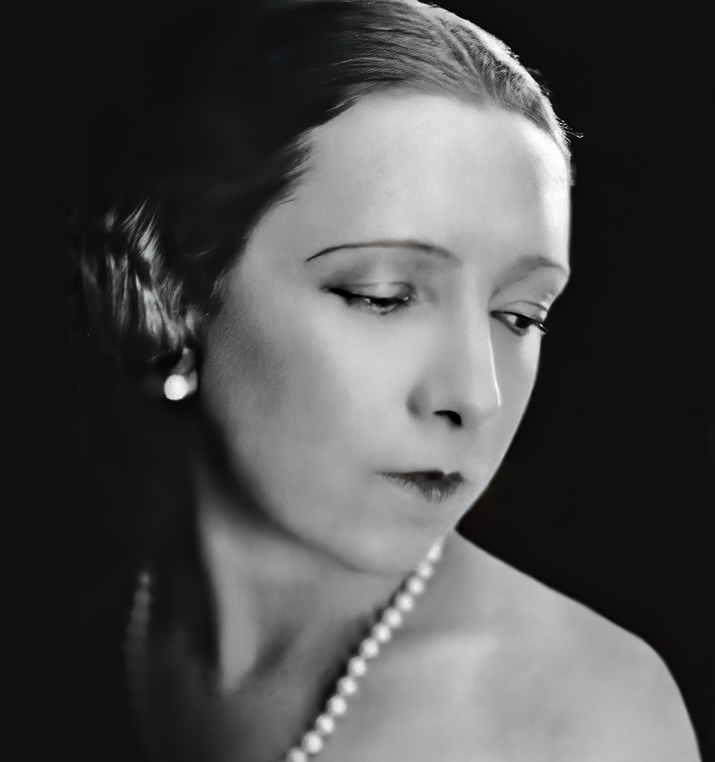
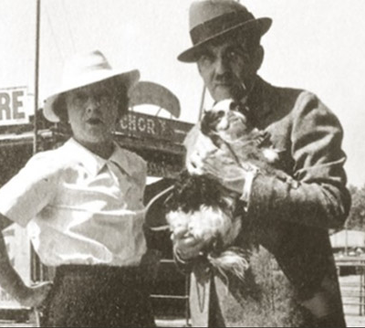
Notes:
Magda Tagliaferro 1930

Slide 13
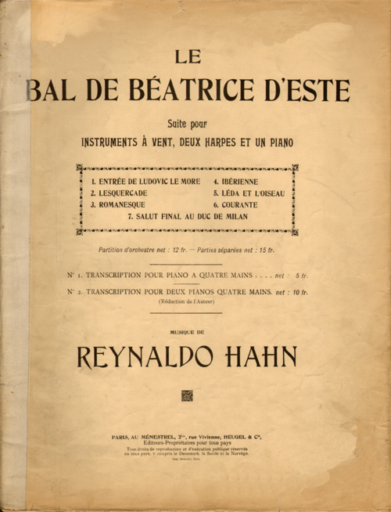
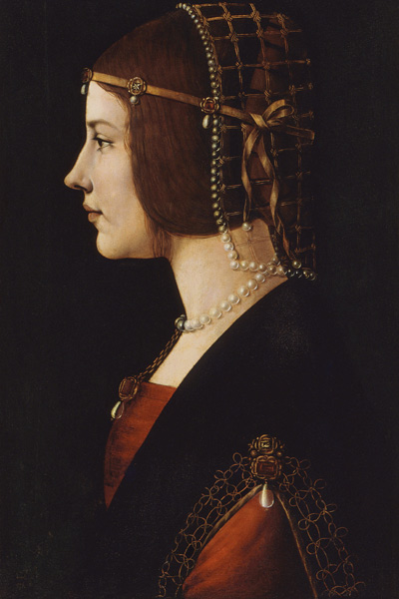
Notes:
It girl of 1490s

Slide 14
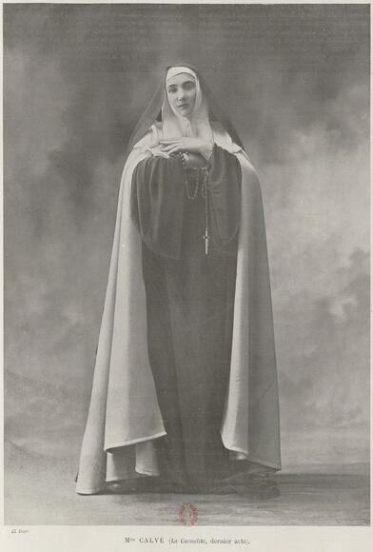
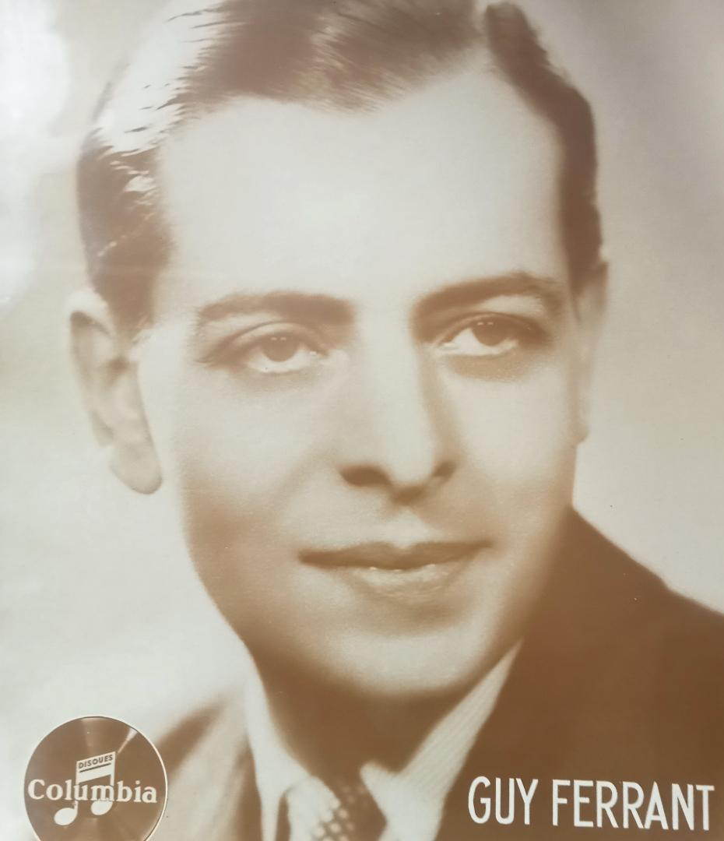
Notes:
Louise de La Valliere. Modest critical success. 27 perfs

Slide 15
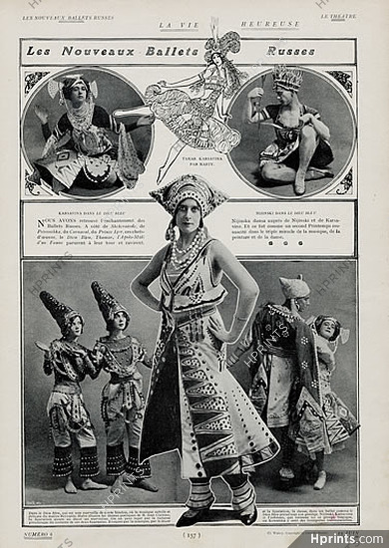
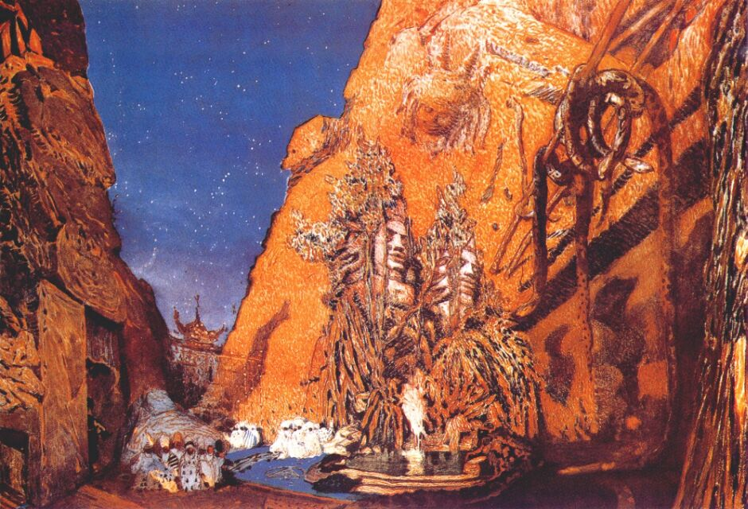
Notes:
1912 same season as Petrushka and Daphnis and Chloe

Slide 16
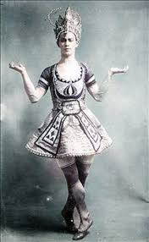
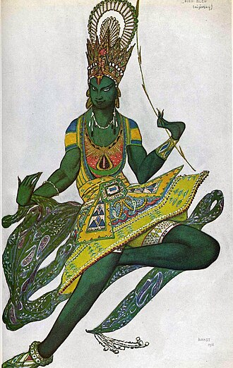

Slide 17
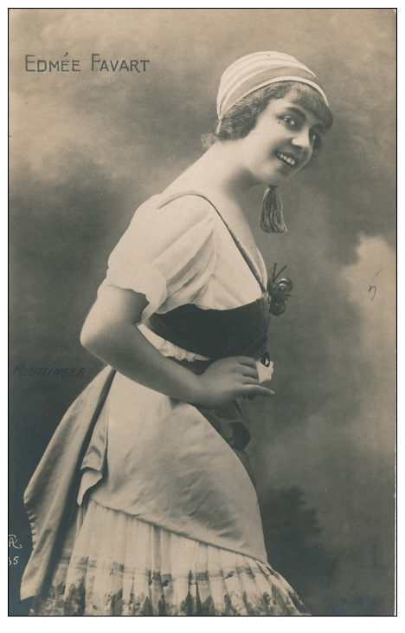
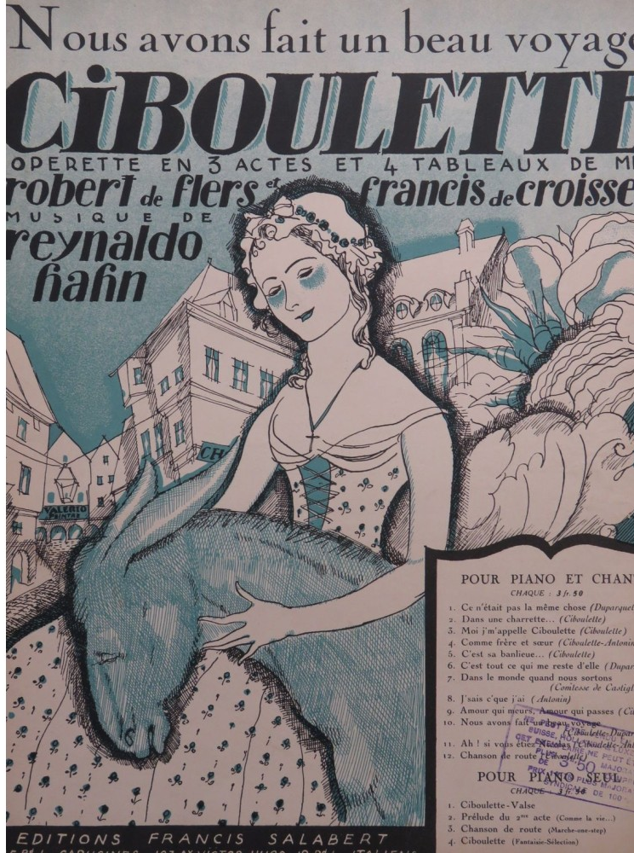

Slide 18
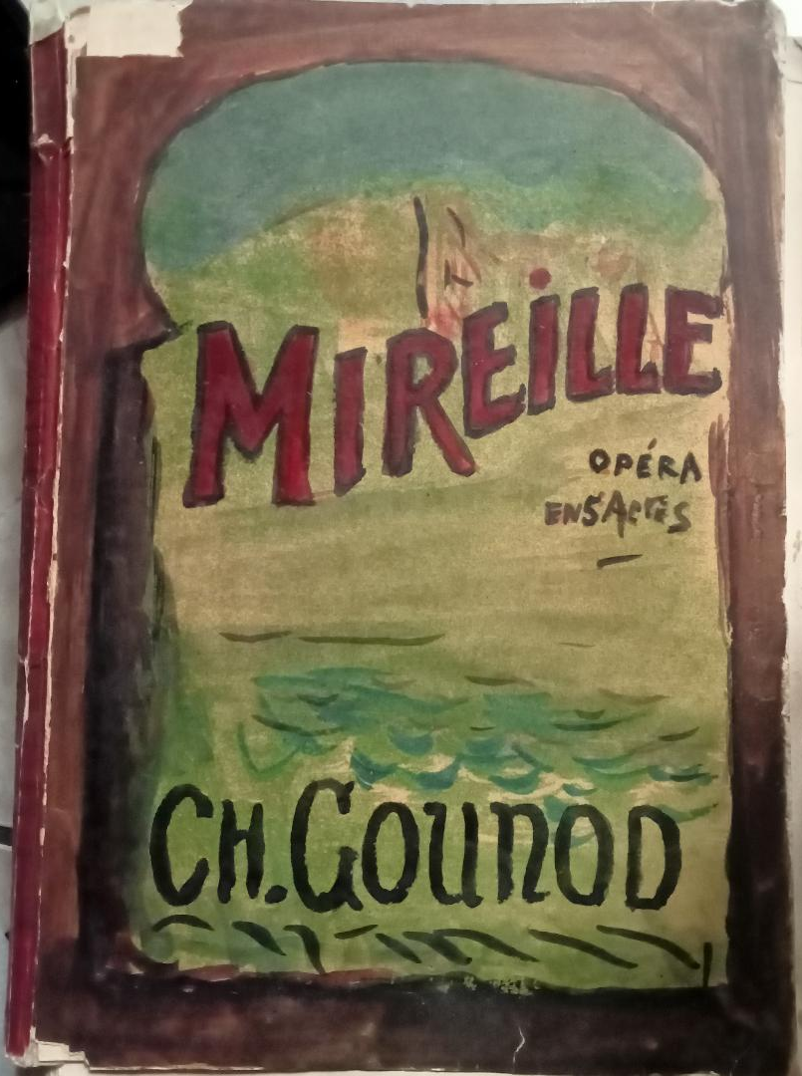
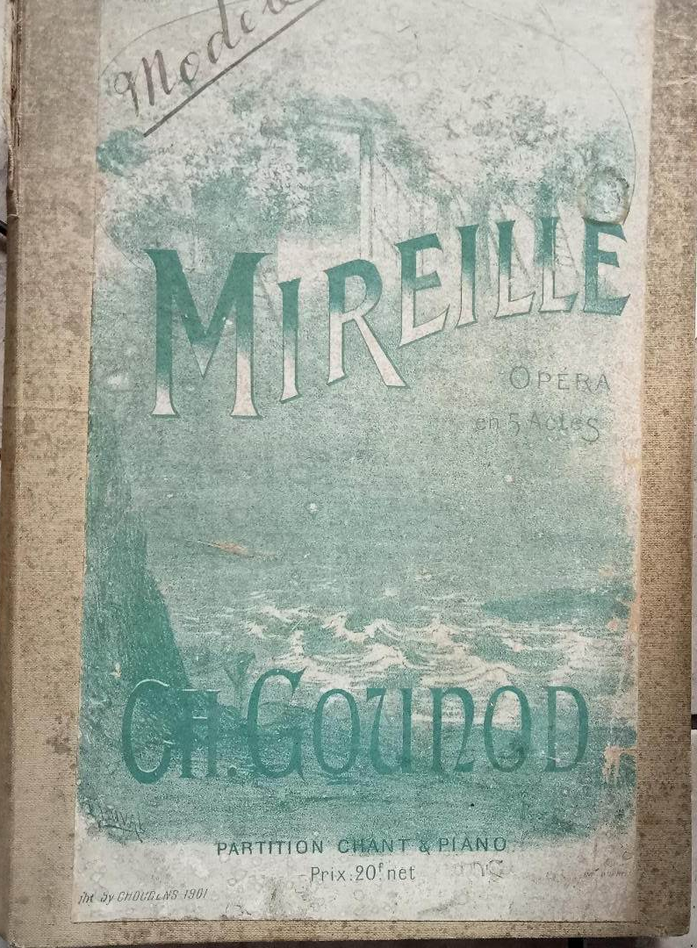
Notes:
28 June 1942 Arles

Slide 19
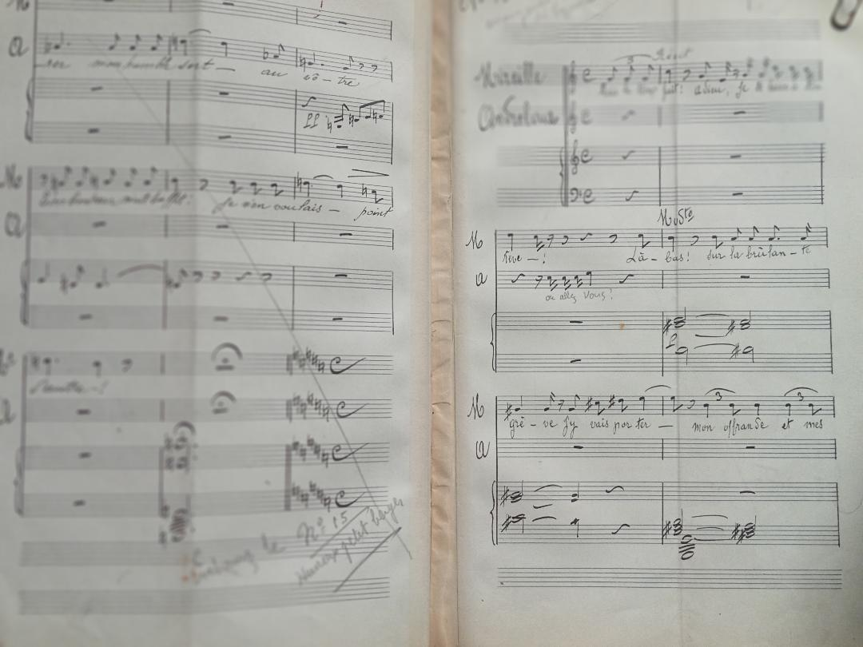

Slide 20
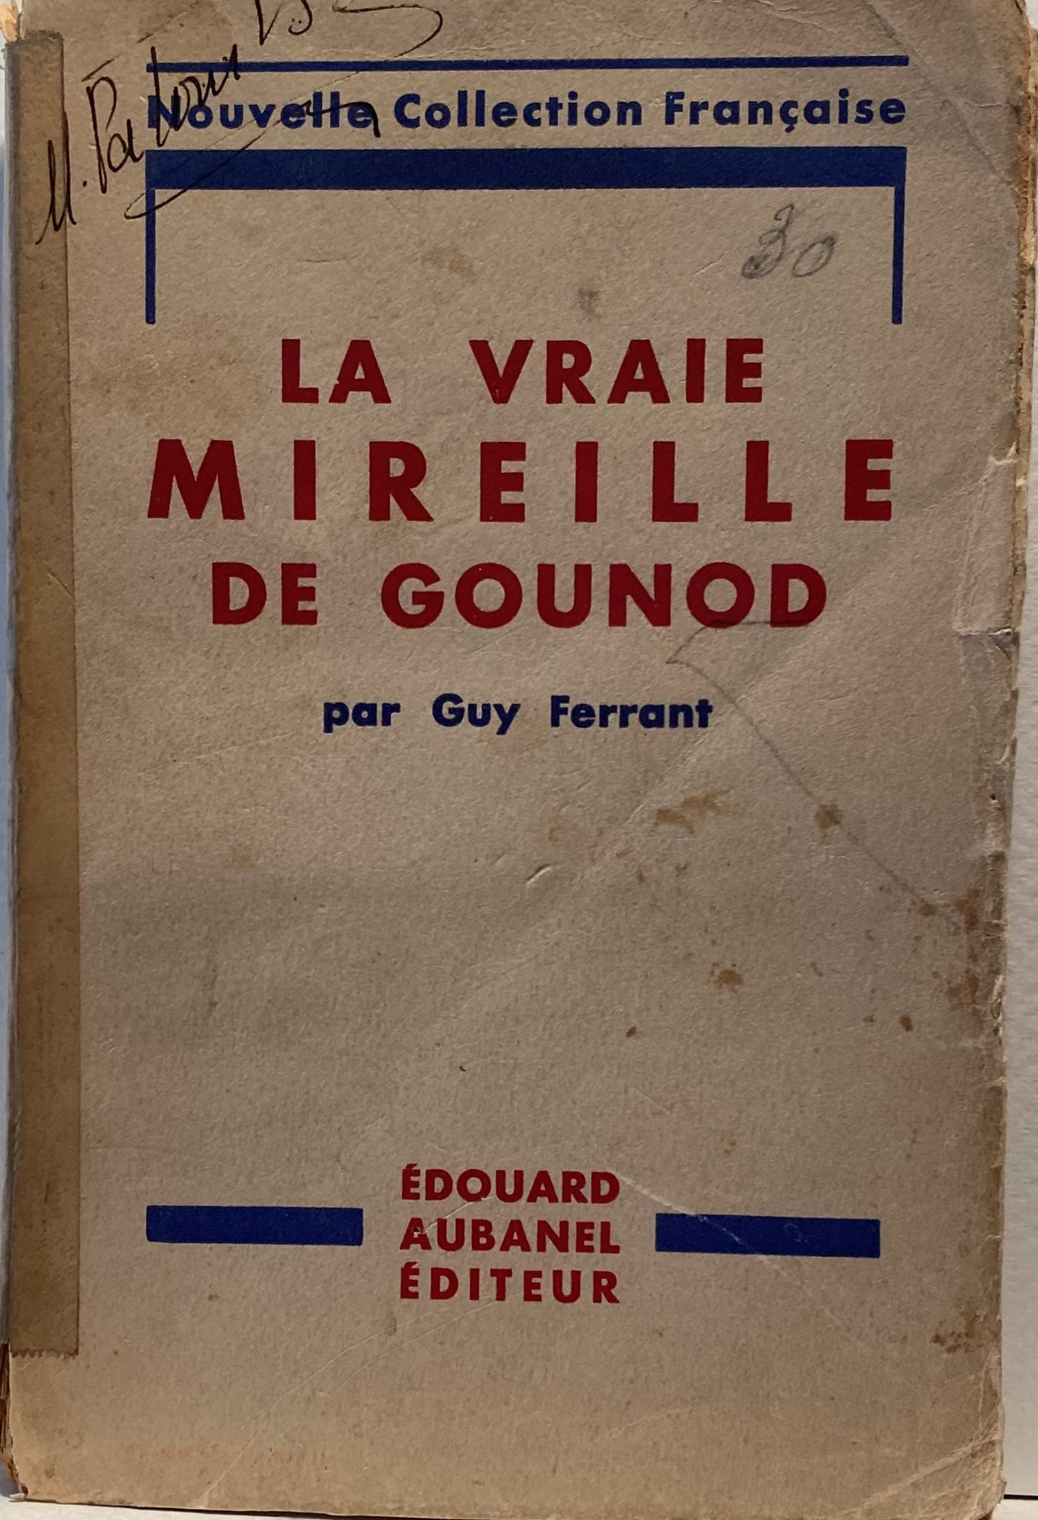
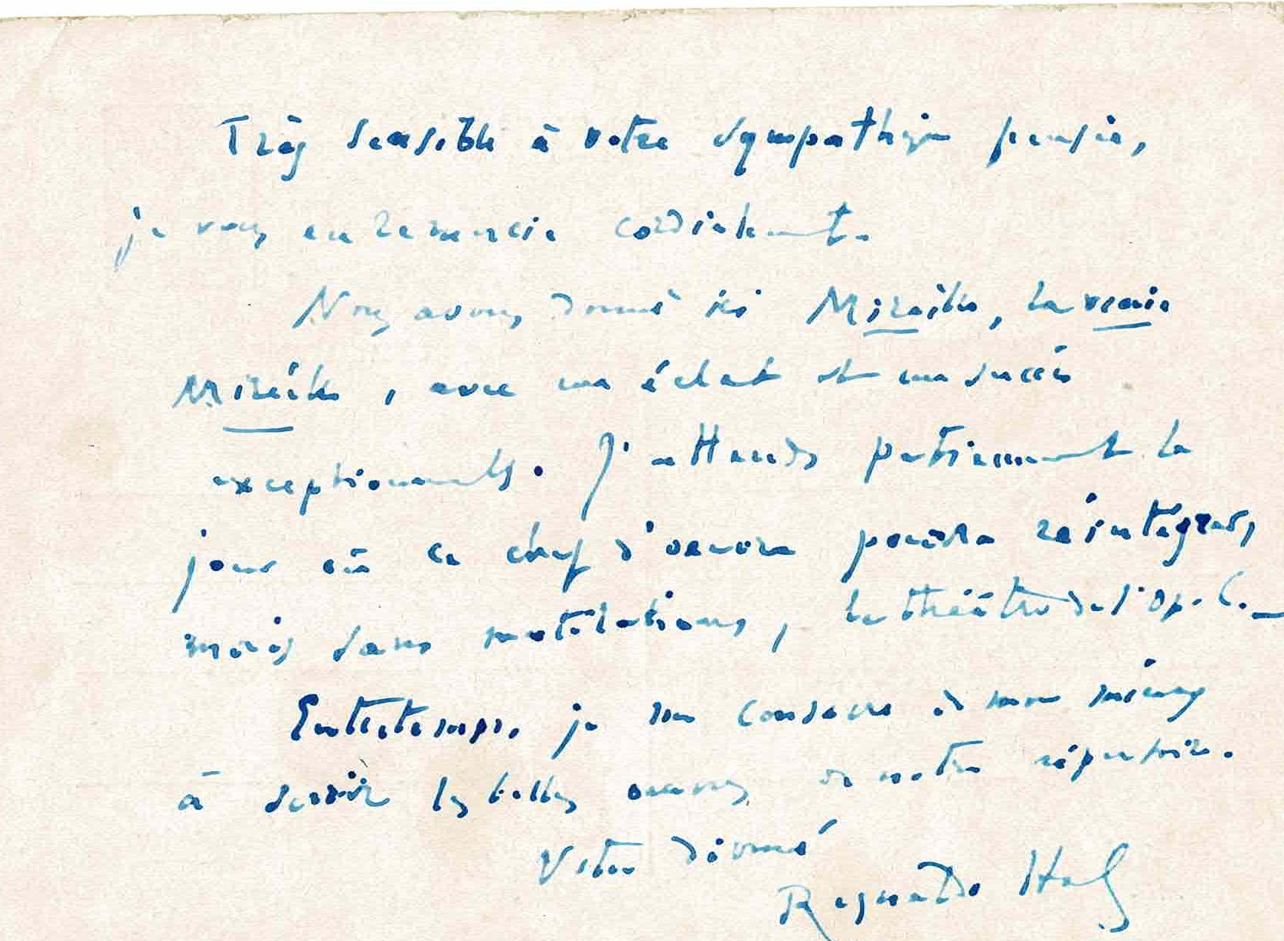
Notes:
Letter 24 nov 1942 2 weeks after Torch

Slide 21
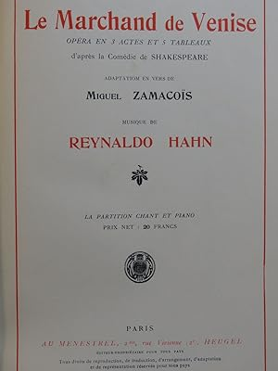
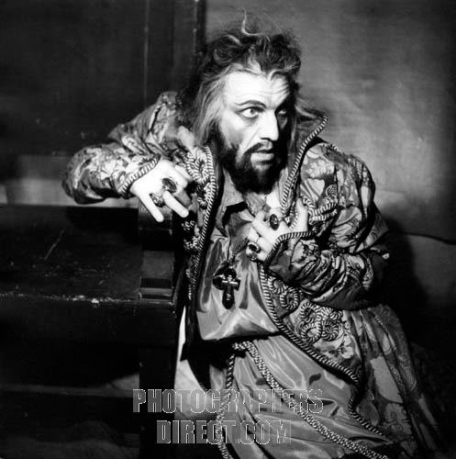
Notes:
Andre Pernet Garnier 1935

Slide 22
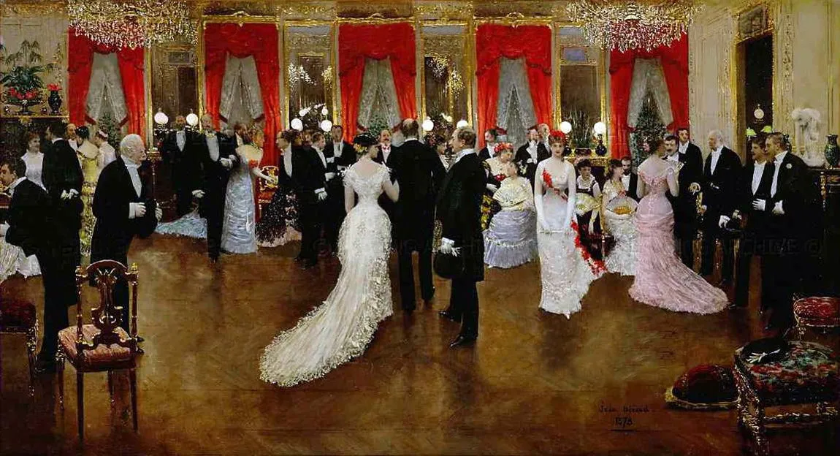

Slide 23
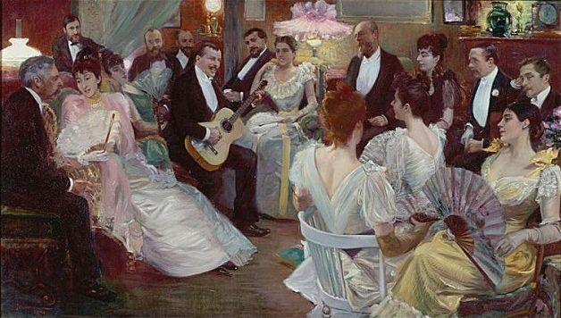
Notes:
Salon of Madeleine Lamaire

Slide 24
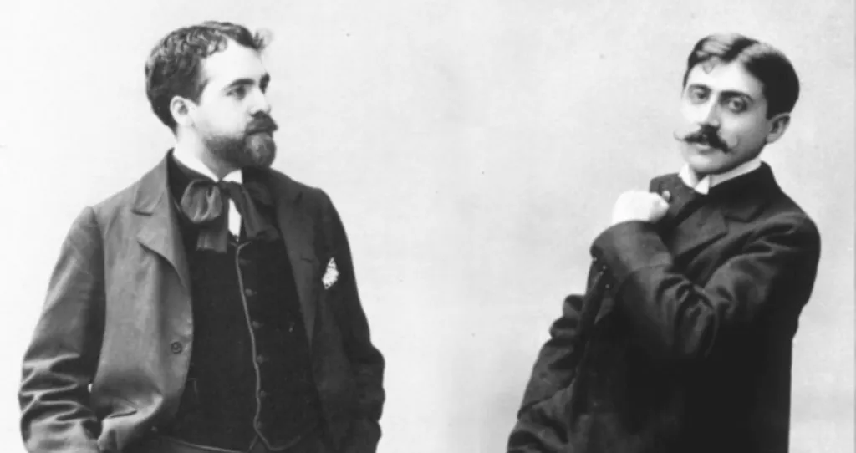
Notes:
H 18 P 22 2 yrs rel. Jean Santeuil “I mean you to be ever present in my novel like a god in disguise whom no mortel can recognise1898

Slide 25
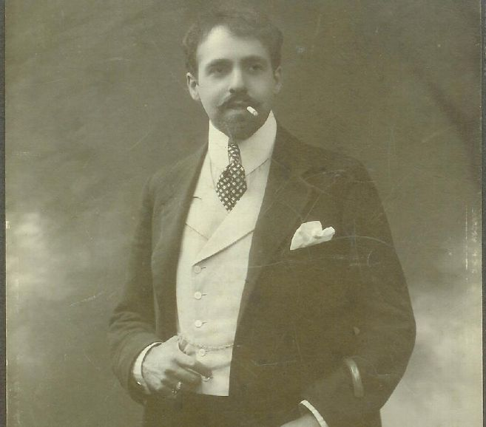

Slide 26
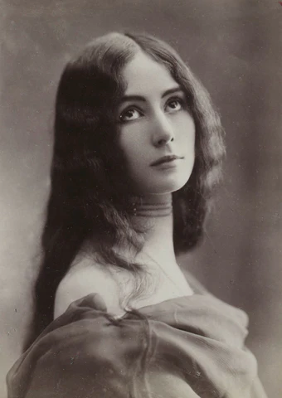
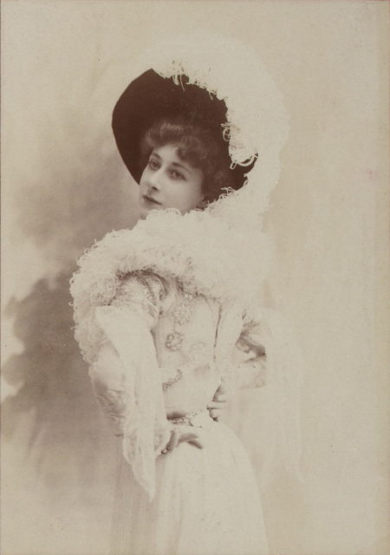
Notes:
Amitied amoureuse Close friendship. Dedicated song to her

Slide 27
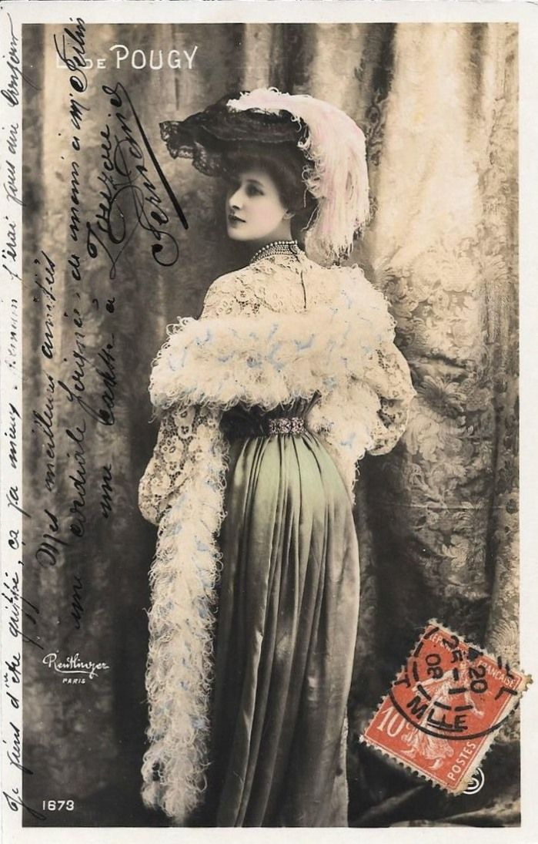
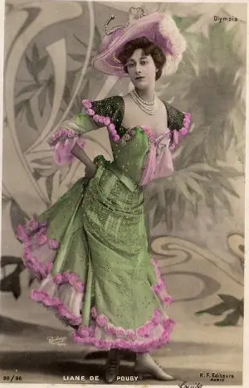

Slide 28
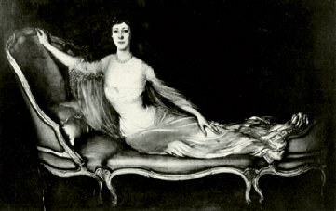
Notes:
Published Journal Yesterday after two hour passed at Liane de Pougy while she posed for La Gandara. Supernatural beauty of this woman, heavenly poetry that disturbs my skeptical calm

Slide 29
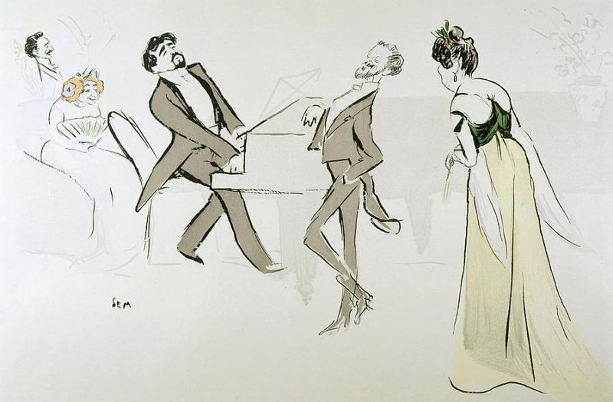
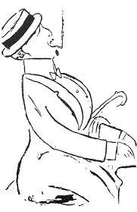
Notes:
Caricature by Cocteau

Slide 30



Slide 31



Slide 32



Slide 33


Slide 35


Slide 36


Slide 37


Slide 38


Slide 39


Slide 43


Slide 44


Slide 45


Slide 46


Slide 49

Notes:
Ciboulette

Slide 50

Notes:
Seduced and wrote “I love Reynaldo, my Reynaldo, you are well my lover, my true lover, my first lover, dear, dear pretty love of my dreams. Write to me that you will stay my lover, my sole lover”. Used for Odette de Crecy

Slide 51


Slide 82


Slide 98


Slide 99


Slide 100


Slide 102

Notes:
1902 27 perfs

