Slide 1
Flux Application Architecture in Delphi
Daniele Spinetti - Software Engineer
@spinettaro http://www.danielespinetti.it
www.embarcaderoacademy.com/p/coderage-2018

Slide 2
Who is talking?
Daniele Spinetti
Senior Software Engineer
Book author
OS Developer and active member
Contacts
skype: daniele.spinetti
email: spinettaro@gmail.com
Twitter: @spinettaro
Site: http://www.danielespinetti.it

Slide 3
Agenda
CodeRage
2018
Start with why
Introducing Flux Architecture
Understanding Flux core concepts
Flux Delphi Architecture
Network requests and asynchronous calls
Conclusions

Slide 4
Start with why
Finding a good application architecture is not easy, but defining an architecture for your application is important
Like it or not, every application is going to have an architecture
There is no such thing as the Best Architecture, but there is the Best Architecture for your current application
Flux is very simple to understand and there is almost no code for it
I believe Flux is very good for all of that

Slide 5
Flux Architecture
Flux is the application architecture that Facebook uses to structure client-side web applications
It’s a Clean Architecture
so it’s not intended only for web apps, but its features and simplicity will allow us to adapt it very well to other kind of projects
The application is divided into three main parts:
View, Dispatcher and Store
This three parts communicate through Events or Actions
Notes:
The data flow is always unidirectional
An unidirectional data flow is the core of the Flux architecture and is what makes it so easy to learn. It also provides great advantages when testing the application as discussed below.
The application is divided into three main parts:
View: Application interface. It create actions in response to user interactions.
Dispatcher: Central hub through which pass all actions and whose responsibility is to make them arrive to every Store.
Store: Maintain the state for a particular application domain. They respond to actions according to current state, execute business logic and emit a change event when they are done. This event is used by the view to update its interface.
This three parts communicate through Actions: Simple plain objects, identified by a type, containing the data related to that action.

Slide 6
Structure and Data Flow
https://github.com/facebook/flux/tree/master/examples/flux-concepts

Slide 7
Dispatcher
https://github.com/facebook/flux/tree/master/examples/flux-concepts

Slide 8
Dispatcher - Example
User types in title for a todo and hits enter
The view captures this event and dispatches an "add-todo" action containing the title of the todo
Every store will then receive this action
https://github.com/facebook/flux/tree/master/examples/flux-concepts

Slide 9
Stores
https://github.com/facebook/flux/tree/master/examples/flux-concepts

Slide 10
Stores - Example
Store receives an "add-todo" action
It decides it is relevant and adds the todo to the list of things that need to be done today
The store updates its data and then emits a "change" event
https://github.com/facebook/flux/tree/master/examples/flux-concepts

Slide 11
Actions
https://github.com/facebook/flux/tree/master/examples/flux-concepts

Slide 12
Actions - Example
Remember that all stores will receive the action and can know they need to clear the data or refresh credentials by handling the same "delete-user" action
When a user clicks "delete" on a completed todo a single "delete-todo" action is dispatched:
{
type: 'delete-todo',
todoID: '1234',
}
https://github.com/facebook/flux/tree/master/examples/flux-concepts

Slide 13
Views
https://github.com/facebook/flux/tree/master/examples/flux-concepts

Slide 14
Views - Example
https://github.com/facebook/flux/tree/master/examples/flux-concepts
The main view subscribes to the TodoStore
It accesses a list of the Todos and renders them in a readable format for the user to interact with
When a user types in the title of a new Todo and hits enter the view tells the Dispatcher to dispatch an action
All stores receive the dispatched action
The TodoStore handles the action and adds another Todo to its internal data structure, then emits a "change" event
The main view is listening for the "change" event. It gets the event, gets new data from the TodoStore, and then re-renders the list of Todos in the user interface

Slide 15
Flux data-flow
We can piece the parts of Flux above into a diagram describing how data flows through the system:
https://github.com/facebook/flux/tree/master/examples/flux-concepts

Slide 16
Flux Delphi Architecture

Slide 17
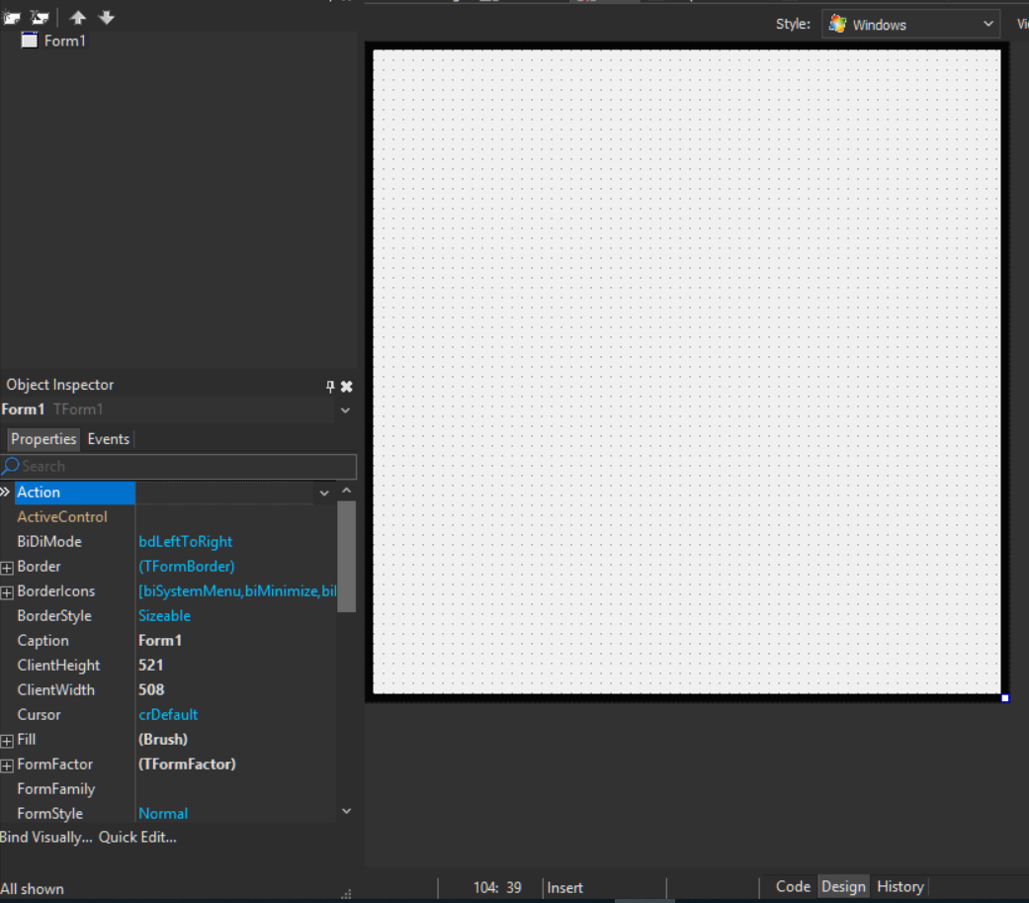
Flux Delphi Architecture - Views
First step is to map Flux elements with Delphi
First element is very easy to figure out and implement
View: Form

Slide 18
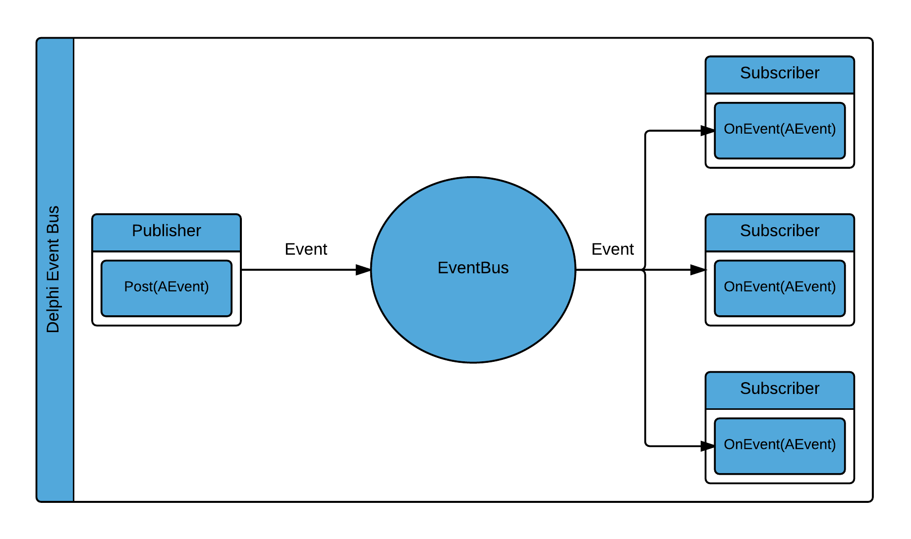
Flux Delphi Architecture - Dispatcher
Dispatcher: An event bus
DelphiEventBus is super easy to learn and use, is designed to decouple different parts/layers of your application
Event Driven and attributes based API
Support different delivery mode
https://github.com/spinettaro/delphi-event-bus

Slide 19
Flux Delphi Architecture - Actions
Actions are not complex either. They will be implemented as simple PODOs with two main attributes:
Type: a String identifying the type of event.
Data: a Map with the payload for this action.
For example, a typical action to show a list of particular resource will look like this:
TFluxAction.Create(ACTION_GET_WINES, LWines)

Slide 20
Flux Delphi Architecture - Stores
Stores contain the status of the application and its business logic
Stores react to Actions emitted by the Dispatcher, execute business logic and emit a change event as result
Finally, stores must expose an interface to obtain application Status. This way, view elements can query the Stores and update application UI in response

Slide 21
Ok… I understand Flux core concepts and the data-flow… but … how Flux application obtain data? For example by an external API?

Slide 22
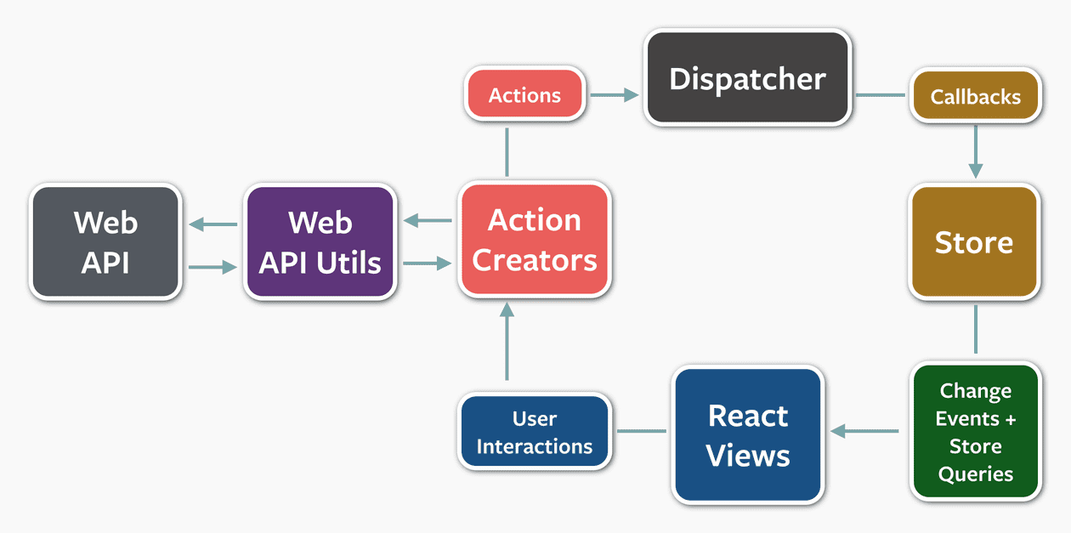
Network requests and asynchronous calls
https://github.com/facebook/flux/

Slide 23
Show me the code: Wine Cellar App

Slide 24
Conclusions
CodeRage
2018
Good and clean architecture
The reason is that Flux is very simple to understand and there is almost no code for it
it’s just a way to better structure your app
Delphi-Flux-Seed: https://github.com/spinettaro/delphi-flux-seed

Slide 25
Thank You!
Daniele Spinetti
Senior Software Developer
Book author
OS Developer and active member
Contacts
skype: daniele.spinetti
email: spinettaro@gmail.com
Twitter: @spinettaro
Site: http://www.danielespinetti.it

Slide 26
Resources and materials
https://facebook.github.io/flux/docs/in-depth-overview.html
https://reactjs.org/blog/2014/07/30/flux-actions-and-the-dispatcher.html
https://github.com/facebook/flux/

