Slide 1
DevOps for Everyone

Slide 2
Robert Warmack
Director of Technology
robert.warmack@idera.com
Background in Large Scale Systems Engineering and Cutting Edge DevOps Tech
Experience: Large Co’s, Start-ups, Google, last several years in cloud infrastructure and development
Plans for the Future: Simplify and improve the entire Idera developer experience from writing code to deploying it into production

Slide 3
What is DevOps?
Specialized Responsibilities
General Responsibilities
Market Trend
DevOps is applicable for EVERYONE.
Simple concept: Developers who also do operations work (and everything else technical) - “You build it, you run it.”
Why? Aligned incentives and better outcomes.
It’s a spectrum:
Average Large Organizational DevOps Adoption
Average SMB Organizational DevOps Adoption

Slide 4
Before DevOps
DBAs
Developers
QAs
SysAdmins
Dev Tools
DB Tools
Testing Tools
Ops Tools
Deployment

Slide 5
DevOps Today
DBAs
“Developers”
QAs
SysAdmins
Testing Tools
Dev Tools
DevOps Tools
Deployment

Slide 6
DevOps Mindset
Focus on traditional trouble-areas - “handoffs” and “integrations”
Automating everything and repeatable processes
Deployment and “publishing”
Democratization of the development process

Slide 7
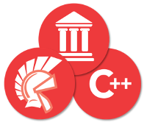
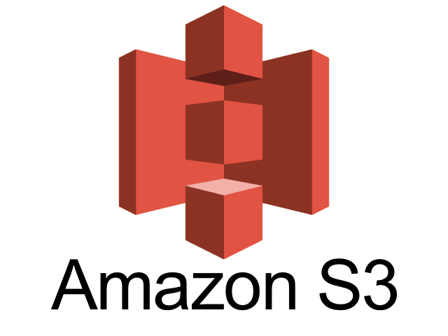
Sample DevOps Toolchain
Upgrade from:
Manual Scripts
Integrations
Push Code
Automate Builds
Cornerstone
Upgrade from:
FTP / Zips Local Storage
The usual suspects
Final asset/code delivery mechanisms

Slide 8
DevOps for the Masses!
Idera is all about DevOps
We’re passionate about DevOps here at Idera. If you’re interested in DevOps and improving your development toolchain, we’re here to help!
Please reach out to myself or any of your familiar SEs to discuss. robert.warmack@idera.com

Slide 9
Questions?
robert.warmack@idera.com

