Slide 1

Outline
Architecture overview
How the code is organized
Accounts and Auth
Running an app
Build, tests, and deployment
Monitoring, alerting, logging
VPN and SSH

Slide 2
The Reference Architecture includes two sample apps:
sample-app-frontend
sample-app-backend

Slide 3
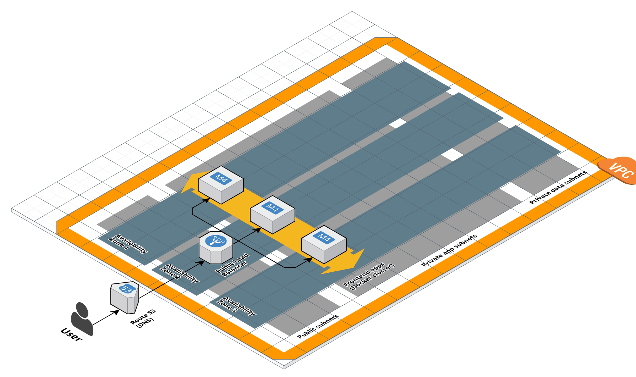
The frontend is an example of a user-facing app (e.g., returns HTML)

Slide 4
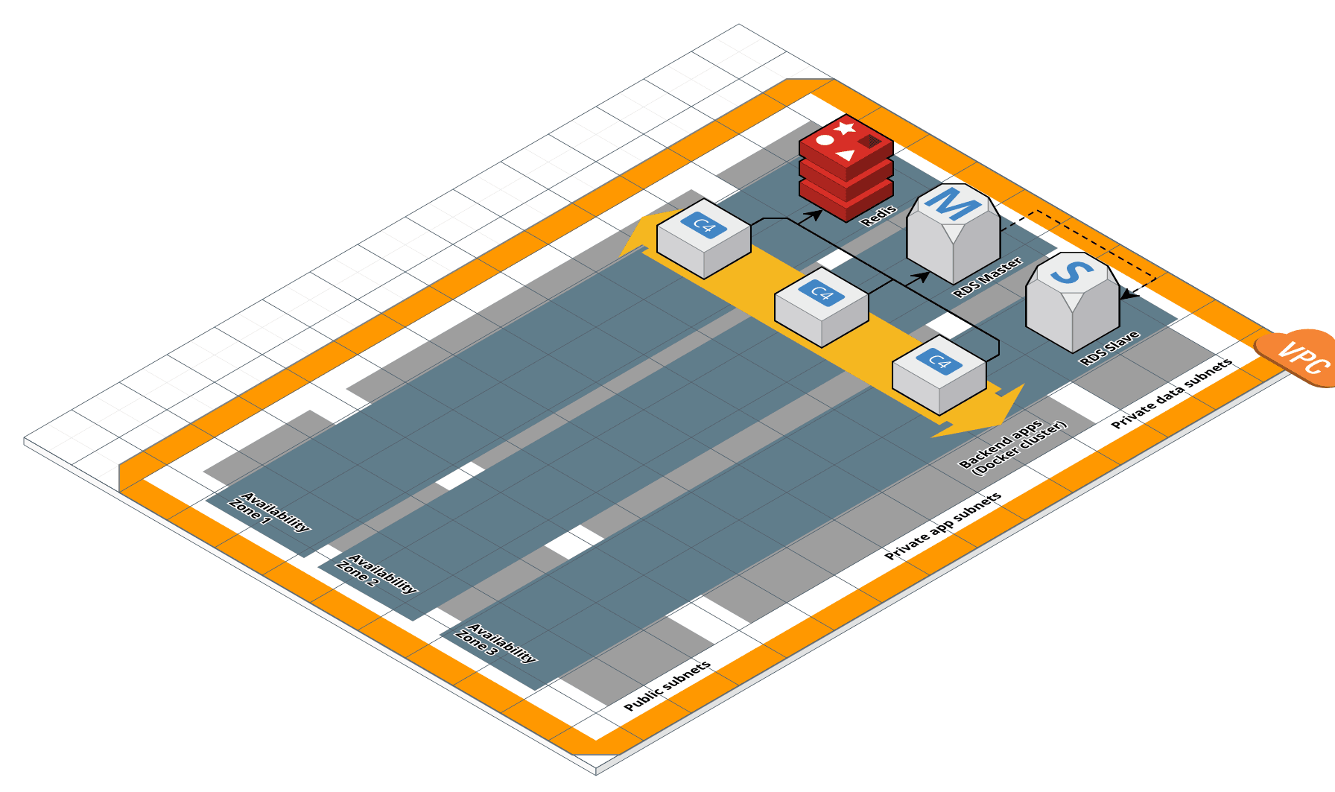
The backend is an example of an app that talks to the data stores

Slide 5
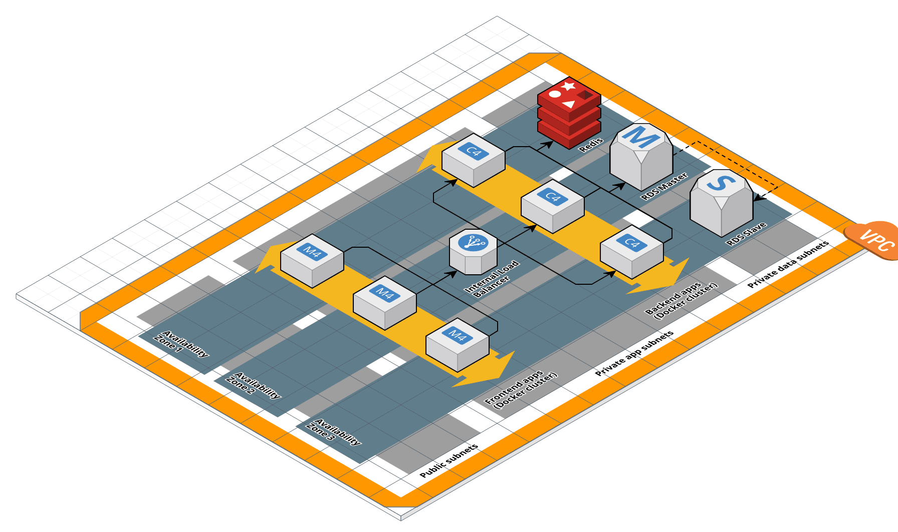
Reminder: the frontend can talk to the backend via an internal load balancer

Slide 6
The apps show patterns you may want to follow:

Slide 7
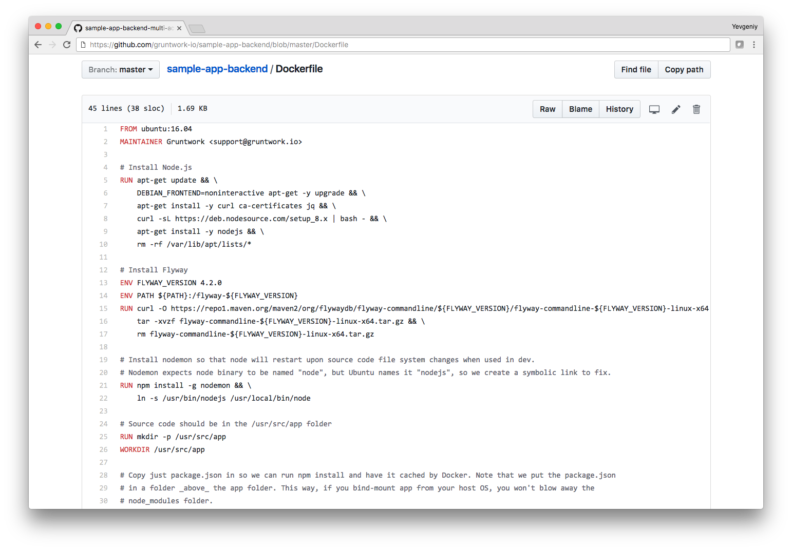
How to create a Dockerfile to package your app as a Docker container

Slide 8
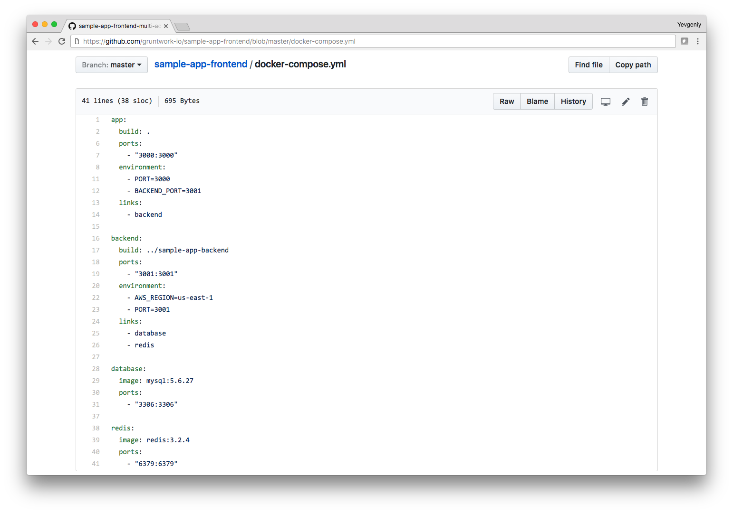
How to configure docker-compose.yml to run all apps and data stores with one command

Slide 9
Let’s run sample-app-frontend:

Slide 10
> git clone git@github.com:gruntwork-io/sample-app-frontend
First, git clone the repo (adjust Git URL to your own!)

Slide 11
> cd sample-app-frontend
> docker-compose up
Next, run docker-compose up to launch the whole stack

Slide 12
> cd sample-app-frontend
> docker-compose up
Building app
Step 1/14 : FROM ubuntu:16.04
---> dd6f76d9cc90
Step 2/14 : MAINTAINER Gruntwork <support@gruntwork.io>
---> Using cache
---> 9479e24c5b8c
[…]
Docker images will download/build as necessary

Slide 13
> cd sample-app-frontend
> docker-compose up
[…]
app_1 | [nodemon] starting `node /usr/src/app/app/server.js`
app_1 | Server running at http://0.0.0.0:3000
After a little while, server will be running

Slide 14
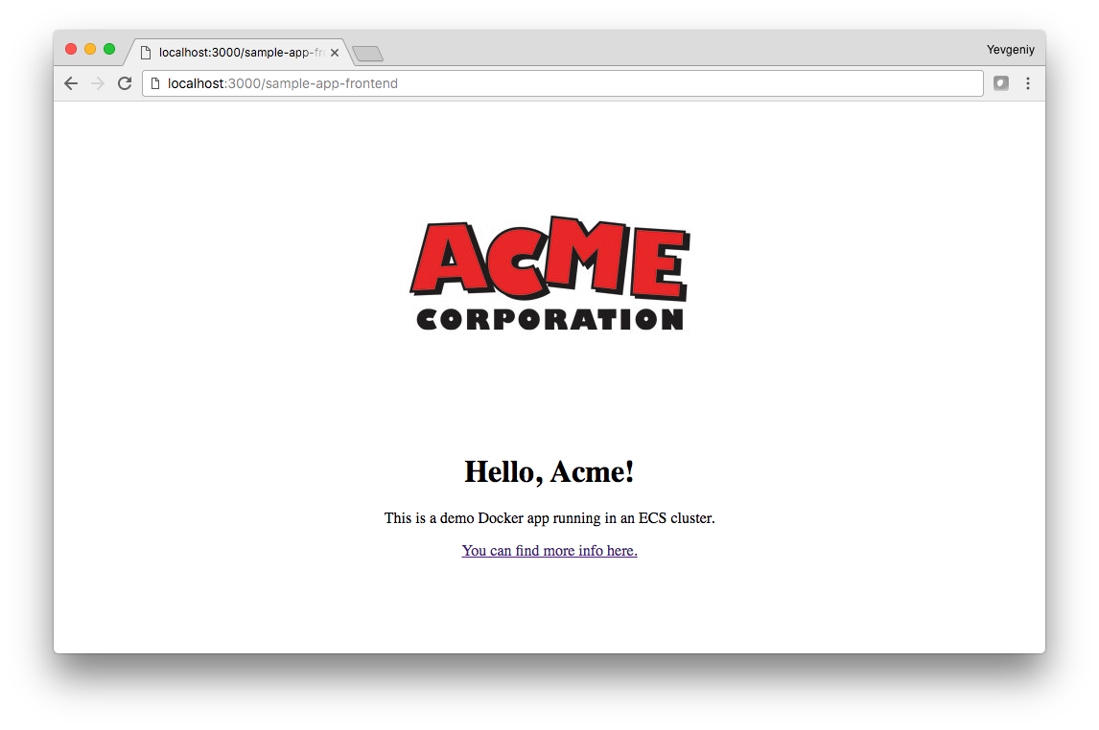
To test the frontend, open:
http://localhost:3000/sample-app-frontend

Slide 15
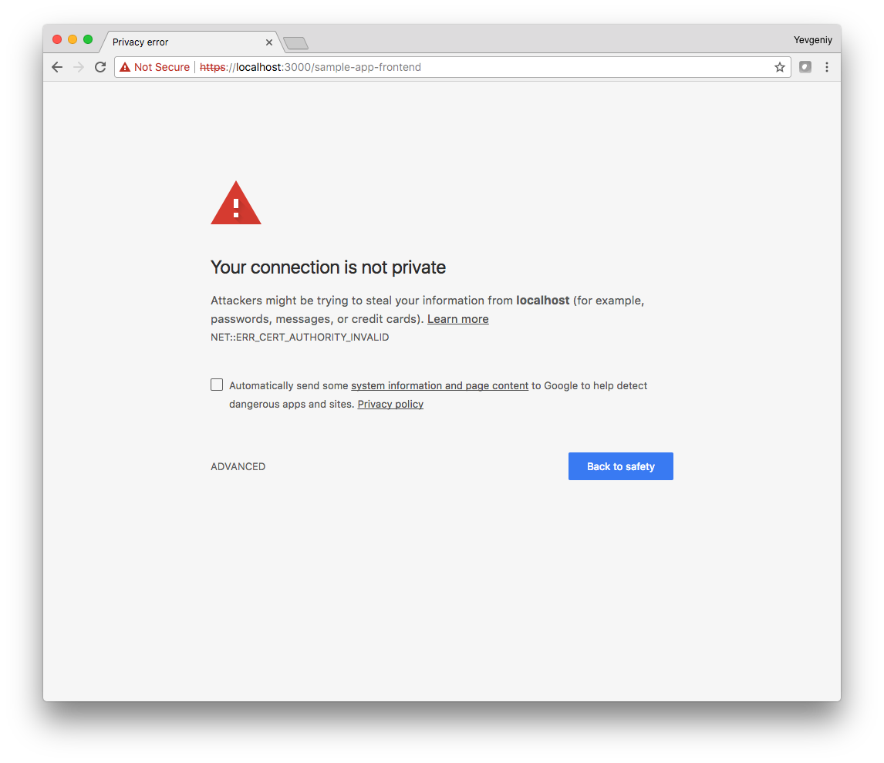
Note, if you are using end-to-end TLS, open:
https://localhost:3000/sample-app-frontend

Slide 16
Don’t panic! This is a normal warning for self-signed TLS certs. Click “Advanced.”

Slide 17
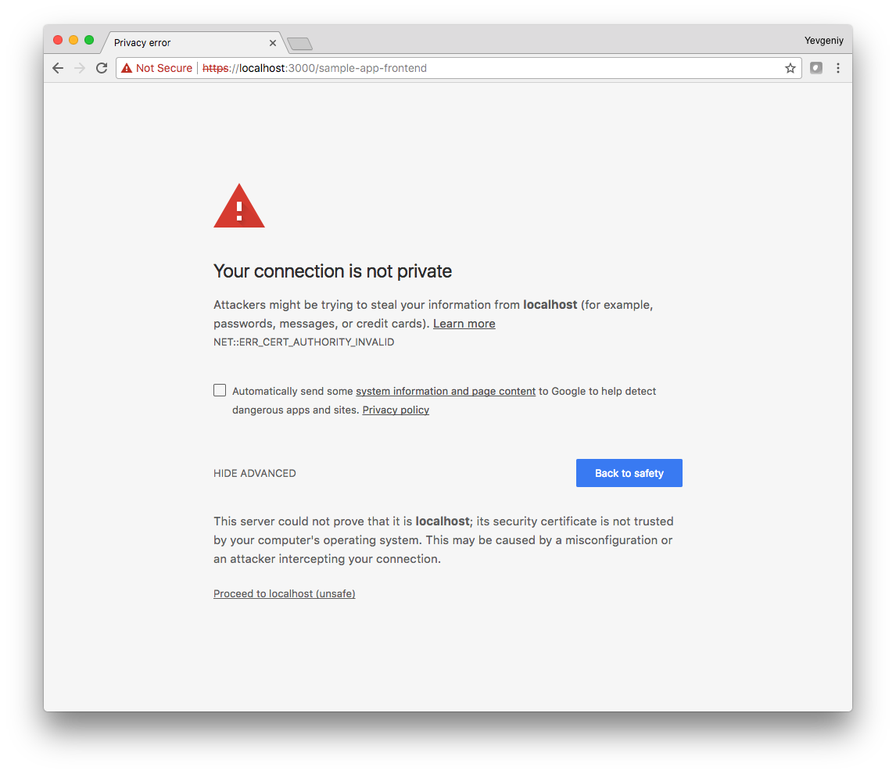
Click “Proceed to localhost (unsafe)”

Slide 18
Click “Proceed to localhost (unsafe)”

Slide 19
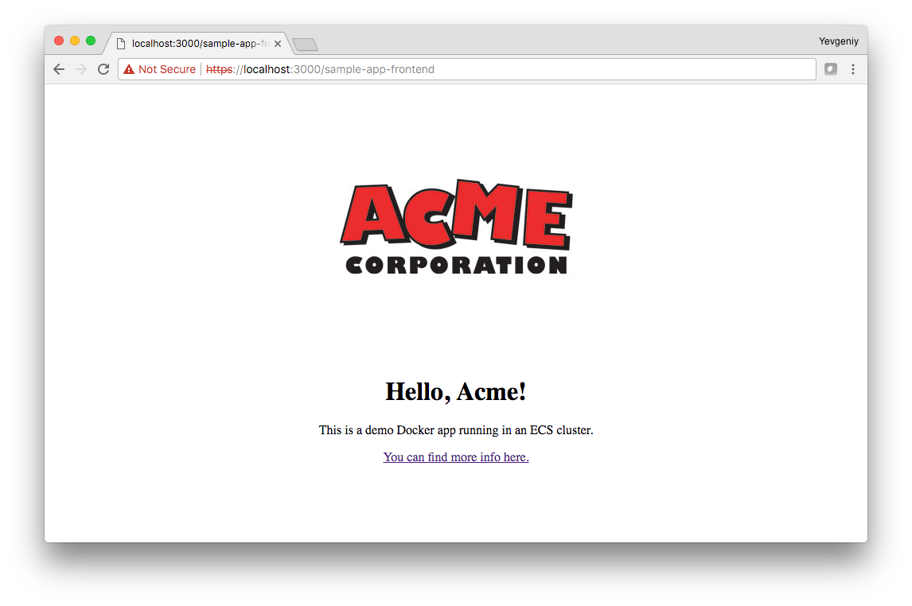
Now it’ll work normally

Slide 20
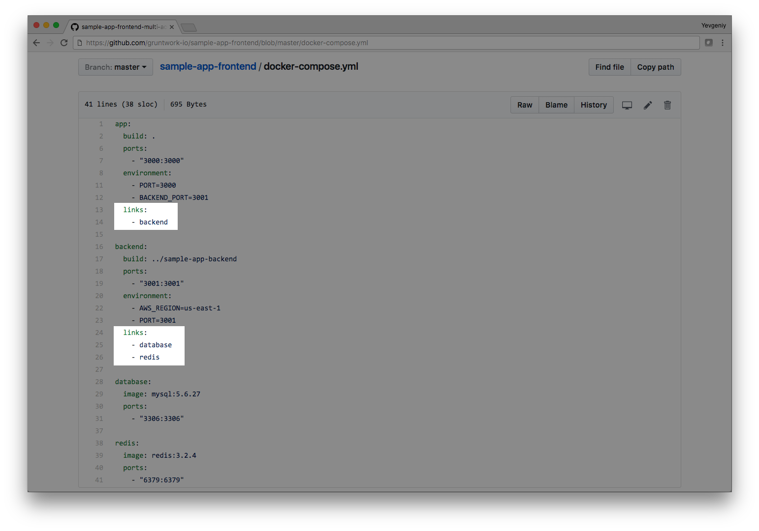
In docker-compose.yml, we use links to make the containers depend on each other

Slide 21
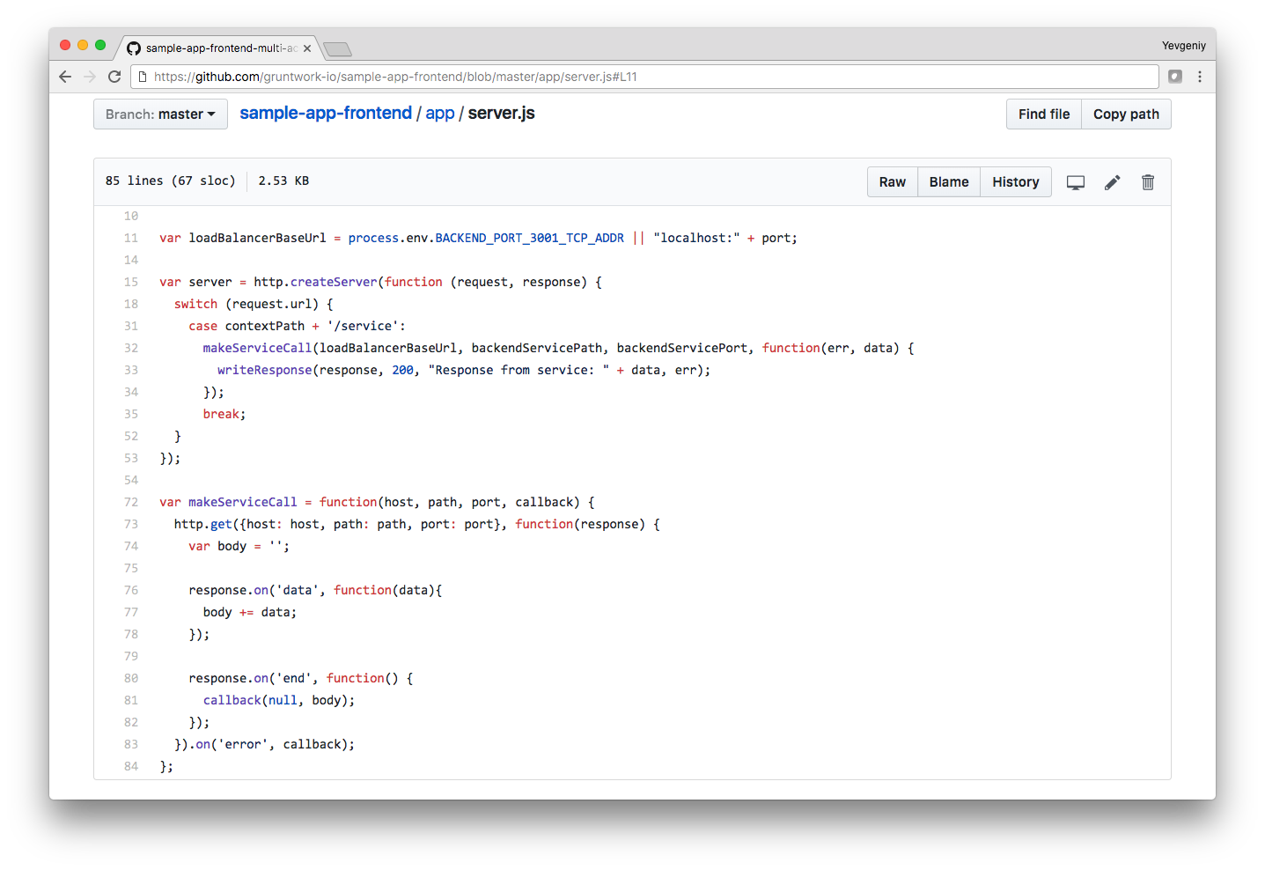
This allows the frontend to talk to the backend via a URL in an environment variable

Slide 22
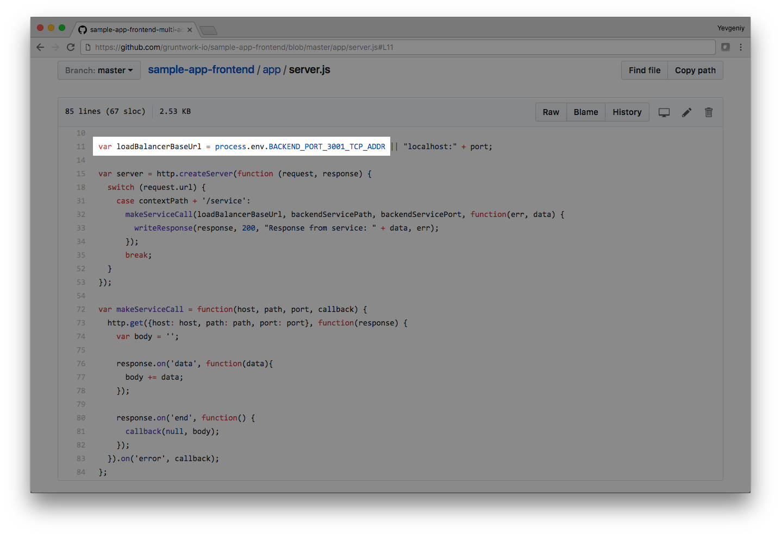
In dev, Docker Compose sets the environment variable. In prod, we set it using Terraform!

Slide 23
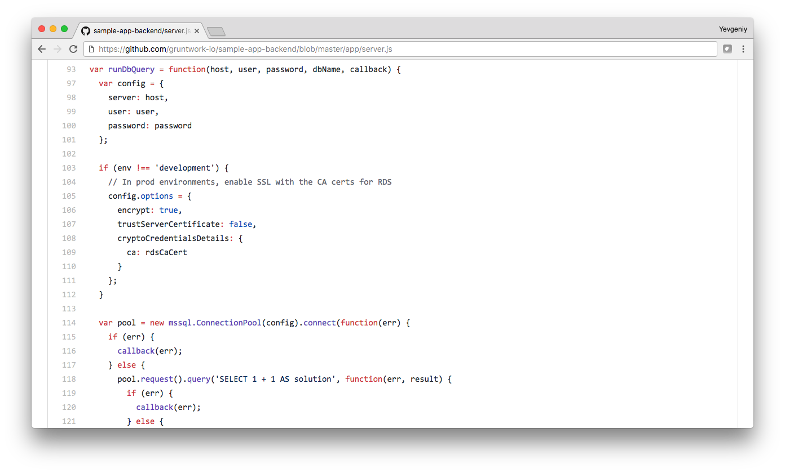
We use the same strategy to allow the backend to talk to the the DB, Redis, etc.

Slide 24
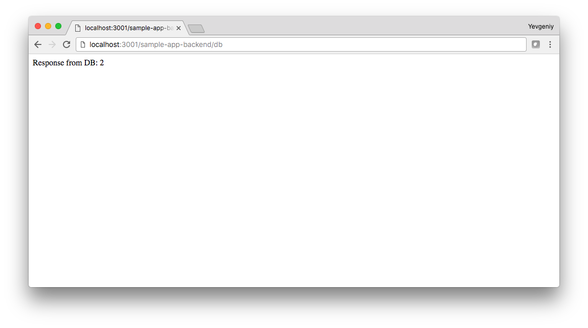
To test the backend + DB, open:
http://localhost:3001/sample-app-backend/db

Slide 25
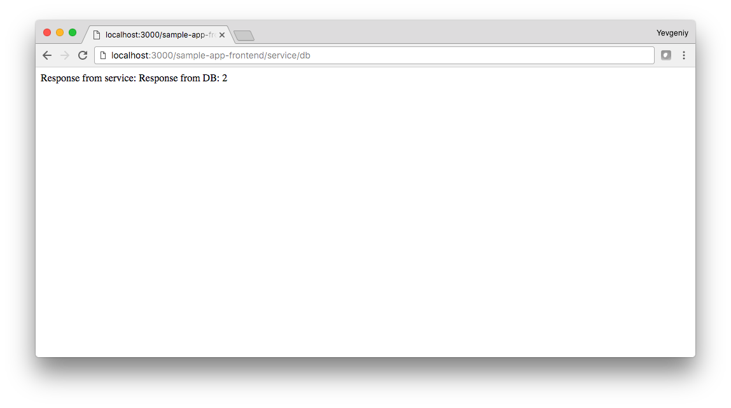
To test the frontend can talk to the backend:
http://localhost:3000/sample-app-frontend/service/db

Slide 26
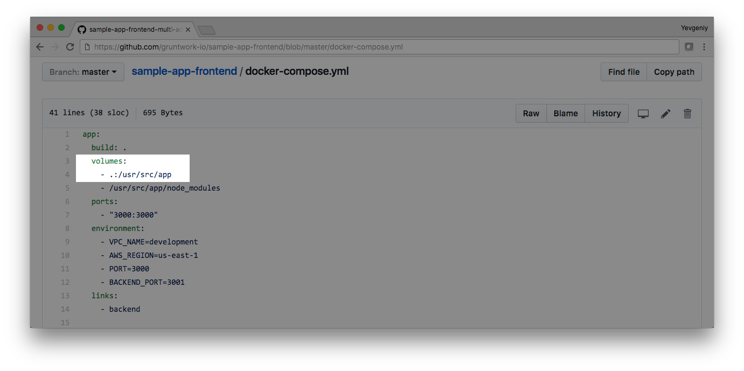
In docker-compose.yml, we also bind-mount your local folder so you can have hot reload!

Slide 27
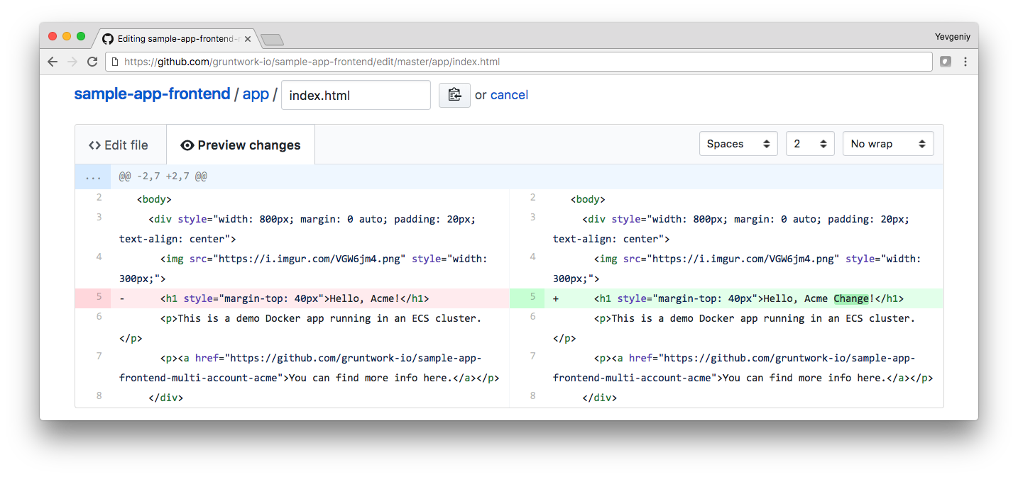
All you do is make a change to the code…

Slide 28
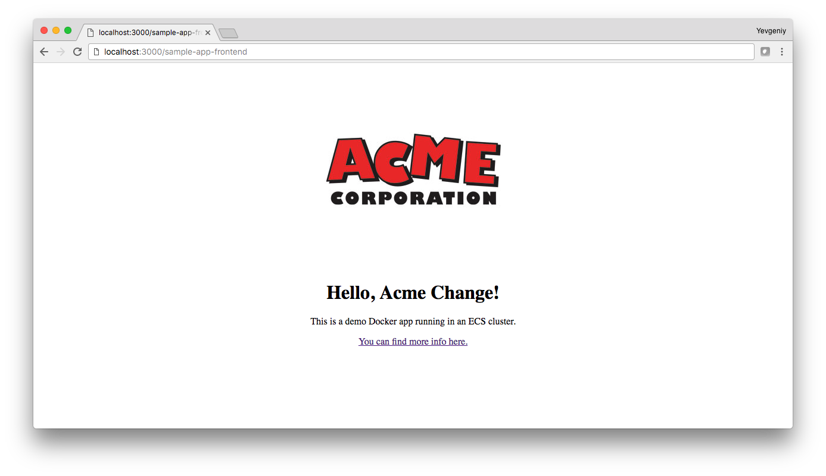
And when you refresh the page, the change will be immediately visible!

Slide 29
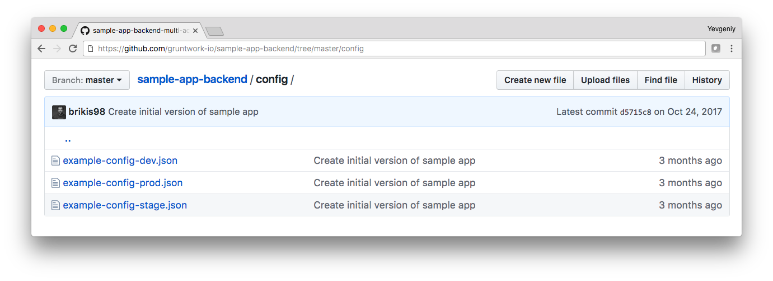
The sample apps show an example of how to handle configs in multiple environments

Slide 30
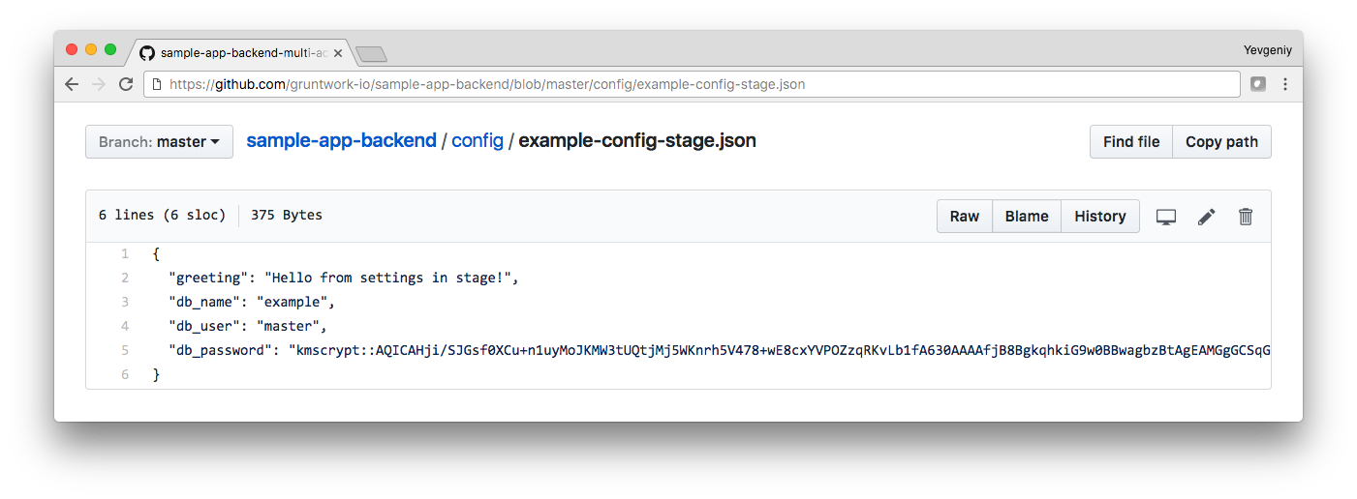
And how to securely store secrets (e.g., database passwords) in your config

Slide 31
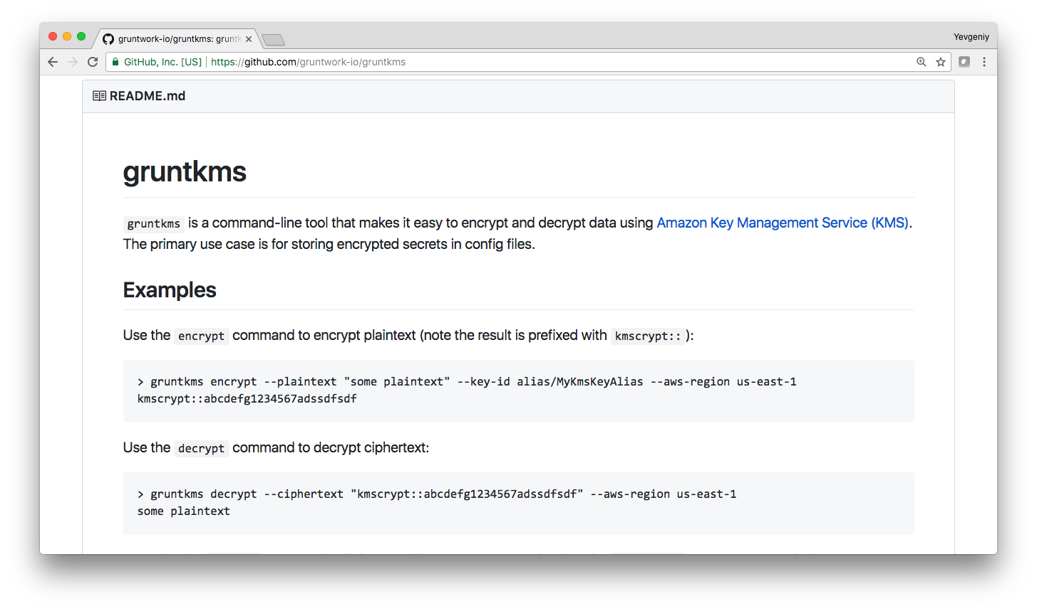
The easiest way to encrypt a new secret is to install gruntkms

Slide 32
> export AWS_ACCESS_KEY_ID=AKIAIOSFODNN7EXAMPLE
> export AWS_SECRET_ACCESS_KEY=wJalrXUtnFEMI/K7MDENG
> gruntkms encrypt \
--key-id alias/cmk-dev \
--aws-region us-west-2 \
--plaintext my-secret
kmscrypt::AQICAHji/SJGsf0XCu+n1uyMoJKMW3tUQtjMj5WKnrh5V478
To encrypt, authenticate to AWS and run gruntkms encrypt

Slide 33
> export AWS_ACCESS_KEY_ID=AKIAIOSFODNN7EXAMPLE
> export AWS_SECRET_ACCESS_KEY=wJalrXUtnFEMI/K7MDENG
> gruntkms encrypt \
--key-id alias/cmk-dev \
--aws-region us-west-2 \
--plaintext my-secret \
--role-arn arn:aws:iam::333333333:role/allow-full-access-from-other-accounts
With multi-account, you can assume a role using --role-arn

Slide 34
> export AWS_ACCESS_KEY_ID=AKIAIOSFODNN7EXAMPLE
> export AWS_SECRET_ACCESS_KEY=wJalrXUtnFEMI/K7MDENG
> gruntkms encrypt \
--key-id alias/cmk-dev \
--aws-region us-west-2 \
--plaintext my-secret \
--role-arn arn:aws:iam::333333333:role/allow-full-access-from-other-accounts
--key-id is the ID of a Customer Master Key (CMK) in KMS

Slide 35
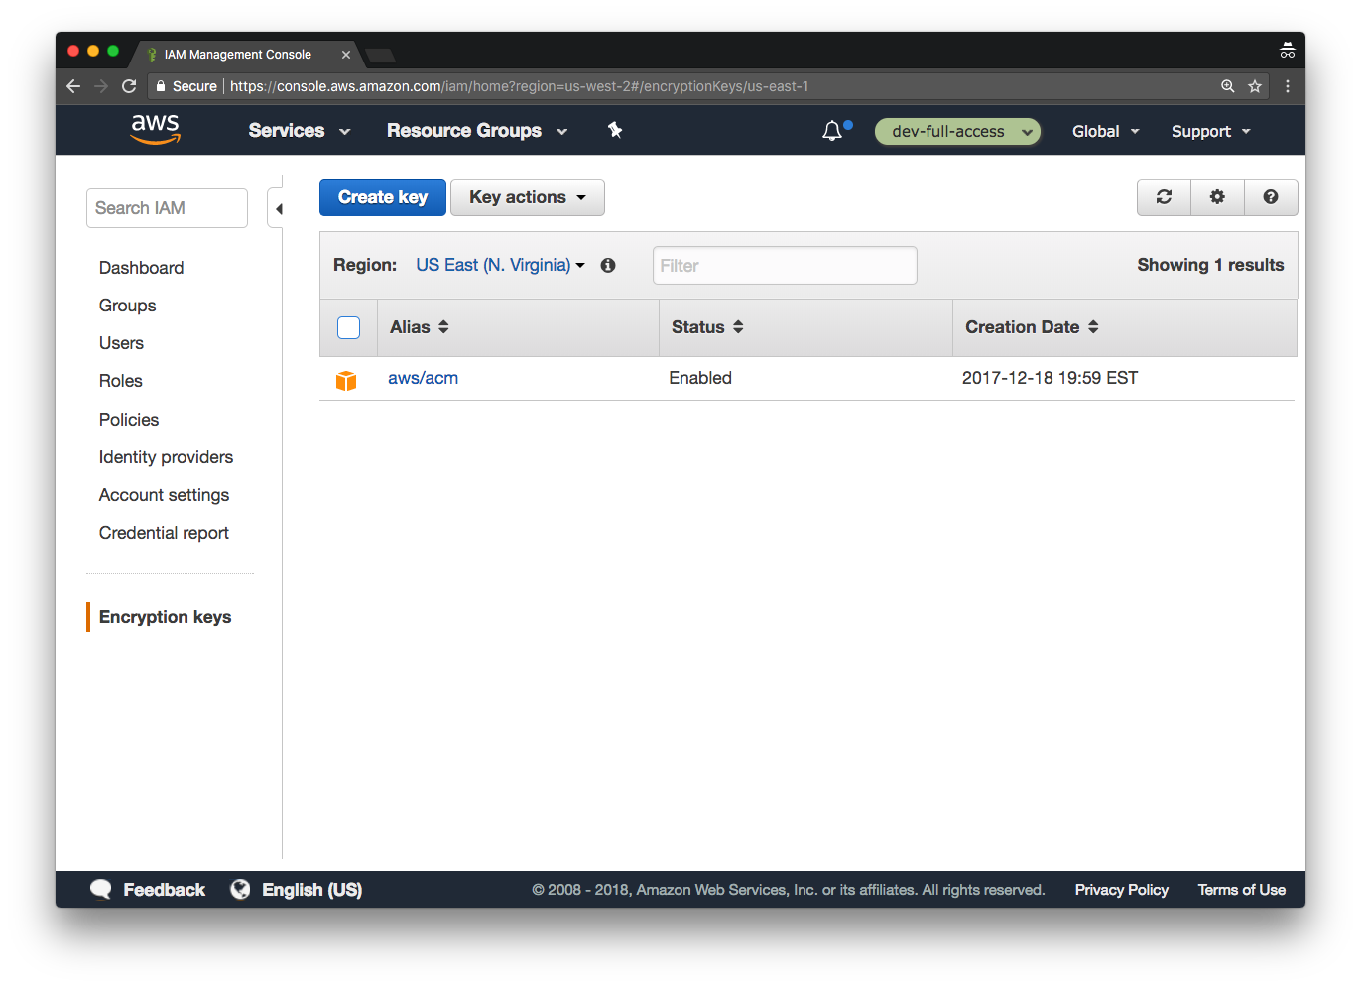
To find the available CMKs, head to the IAM console, and click “Encryption Keys”

Slide 36
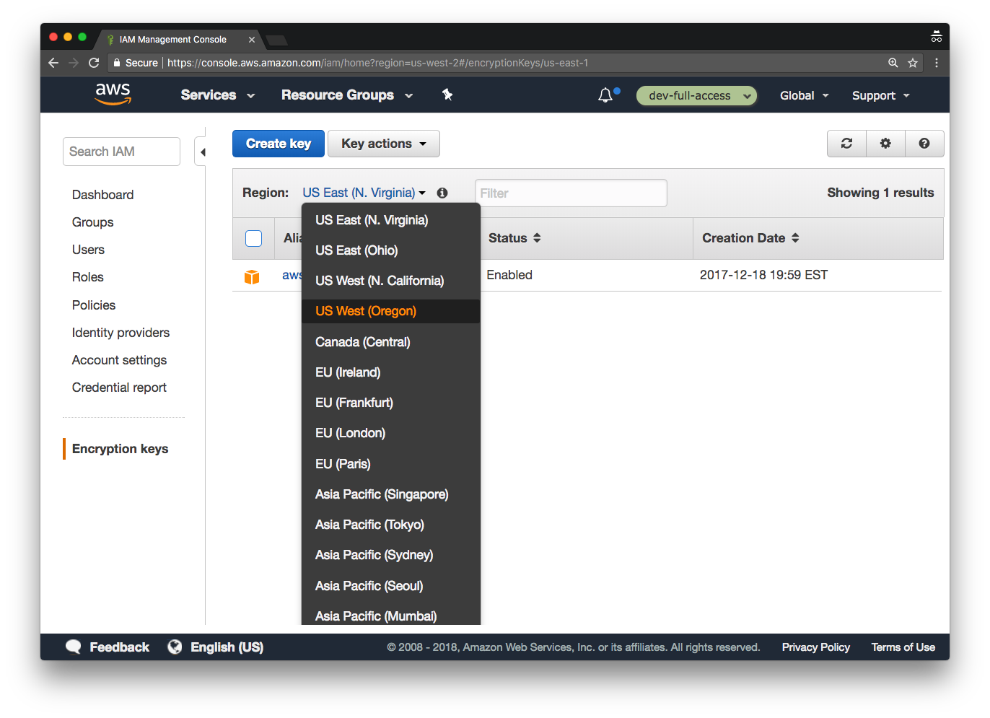
Pick the proper region (the region selector is not in the usual spot!)

Slide 37
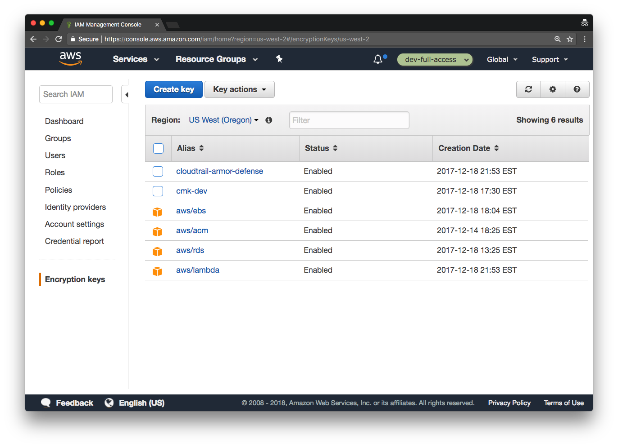
Now you can see all the available CMKs

Slide 38
An admin must give you access to a CMK (via IAM) for you to be able to use it.

Slide 39
You can use the “Alias” as the --key-id param with gruntkms (e.g., alias/cmk-dev).

Slide 40
> export AWS_ACCESS_KEY_ID=AKIAIOSFODNN7EXAMPLE
> export AWS_SECRET_ACCESS_KEY=wJalrXUtnFEMI/K7MDENG
> gruntkms encrypt \
--key-id alias/cmk-dev \
--aws-region us-west-2 \
--plaintext my-secret
kmscrypt::AQICAHji/SJGsf0XCu+n1uyMoJKMW3tUQtjMj5WKnrh5V478
You get back ciphertext that is safe to put into your config

Slide 41
> gruntkms decrypt \
--aws-region us-west-2 \
--ciphertext kmscrypt::AQICAHji/SJGsf0XCu+n1uyMoJKMW3tUQtjMj5WKnrh5V478
my-secret
You can also decrypt it with the decrypt command

Slide 42
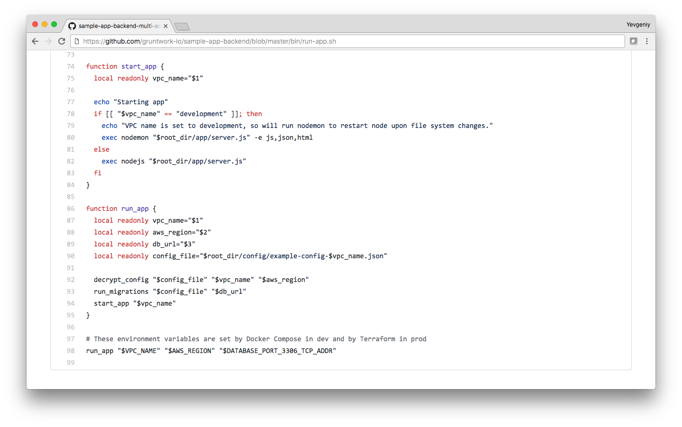
During boot, the sample apps execute the run-app.sh script

Slide 43
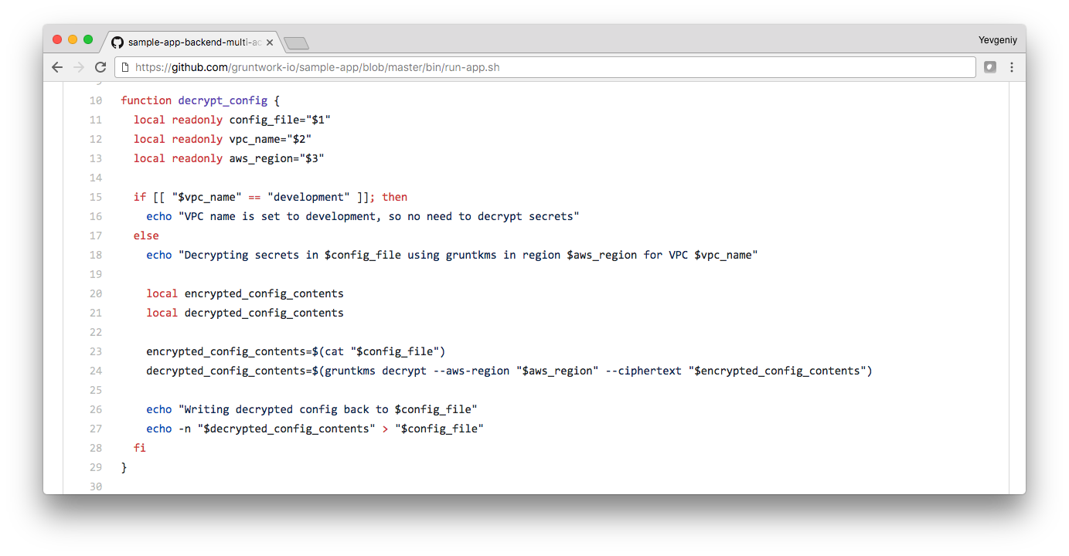
In prod, run-app.sh uses gruntkms to decrypt the configs before starting the app

Slide 44
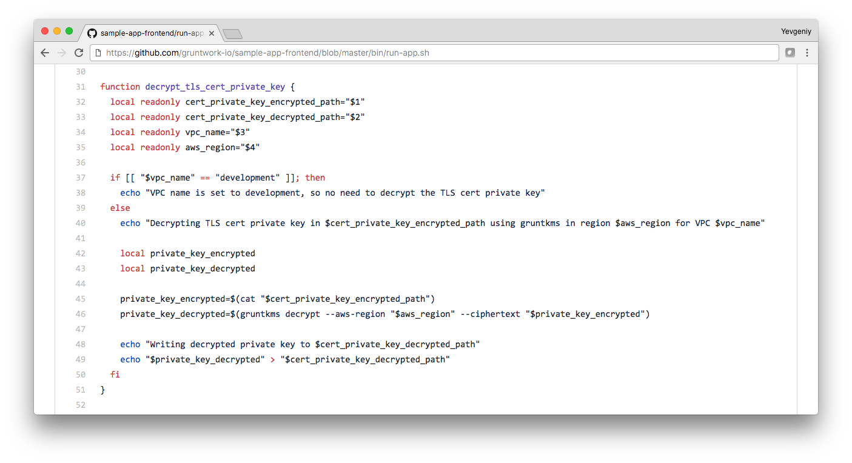
If you are using end-to-end encryption, it also decrypts the self-signed TLS certs

Slide 45
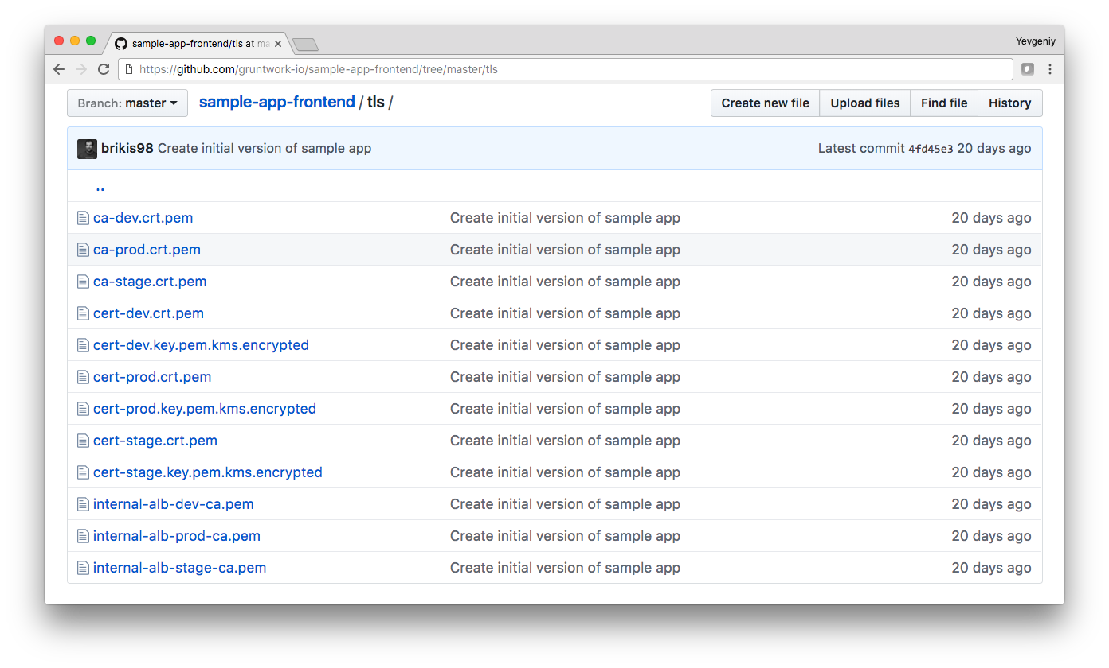
The certs themselves live in the tls folder

Slide 46
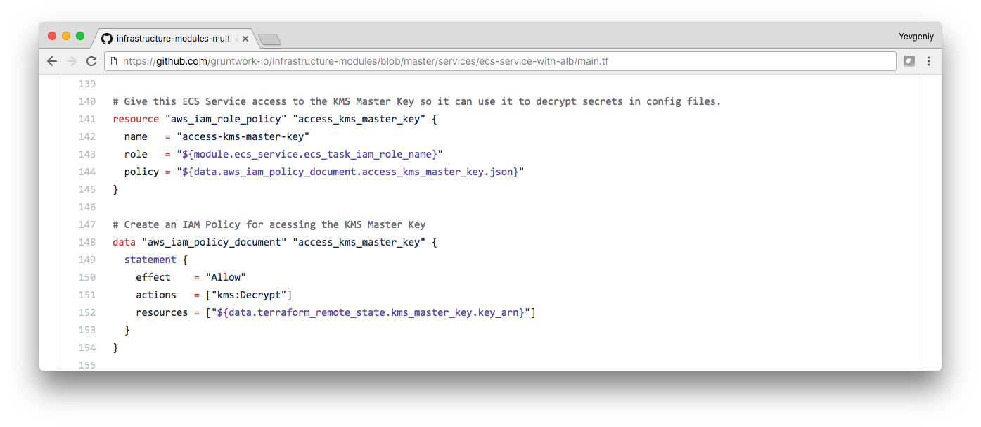
The app gets access to the CMK through an IAM role configured in Terraform

Slide 47
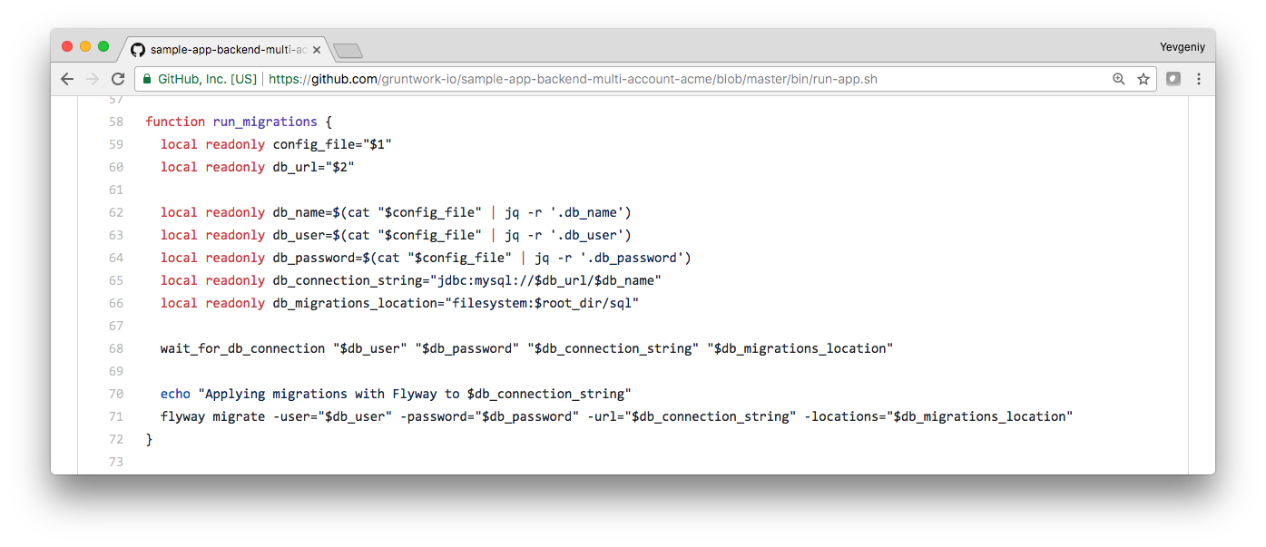
run-app.sh also uses flyway to apply schema migrations before starting the app

Slide 48
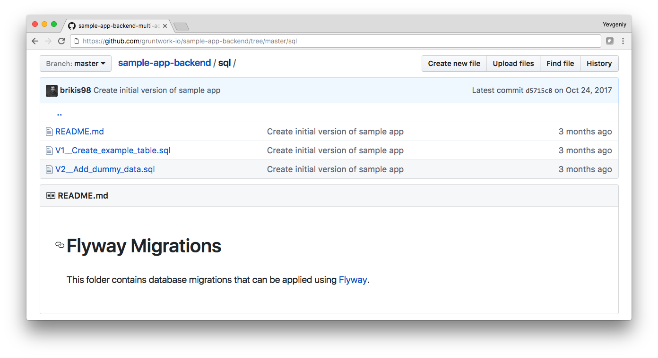
The schema migrations are in the sql folder

Slide 49
> git add app/index.html
> git commit -m "testing a simple text change"
> git push origin master
Now that you’ve made changes, commit them to kick off CI/CD!

